Slide 1
Oklahoma ABLE Commission PRO Brand Registration Renewal Process BrandRegistration@able.ok.gov Coordinator: Catherine Otey 405-522-3982

Slide 2
Annual Renewal Period Information
All Brand Registrations are effective July 1st through June 30th of each year.
All Brand Registrations must be renewed annually.
Annual Renewal Notifications with the renewal link and renewal dates will be sent via email to all manufacturer licensees annually in mid March.
https://ok.productregistrationonline.com/Renewals
This link is only active during the renewal period.
Annual Renewal Period begins April 15th through June 30th of each year.
Please note, if you register a new brand in the 4th Quarter, you will be charged a prorated state fee, if applicable, and the annual renewal fee.

Slide 3
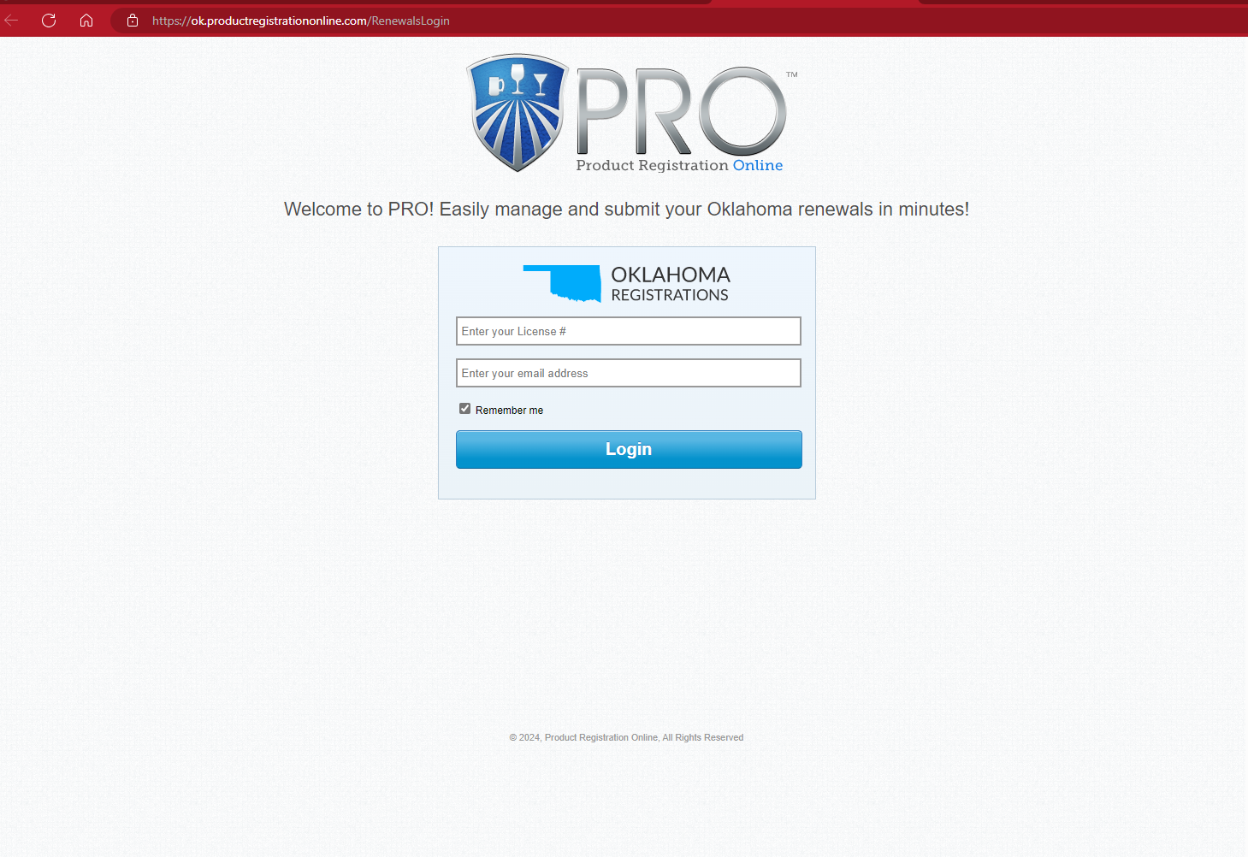
Product Registration Renewal Home Page
Step 1 – Enter ABLE License Number. (This is case sensitive. Also, there should be no spaces or dashes entered). Enter email address associated with your account.
Next Click on LOGIN.

Slide 4
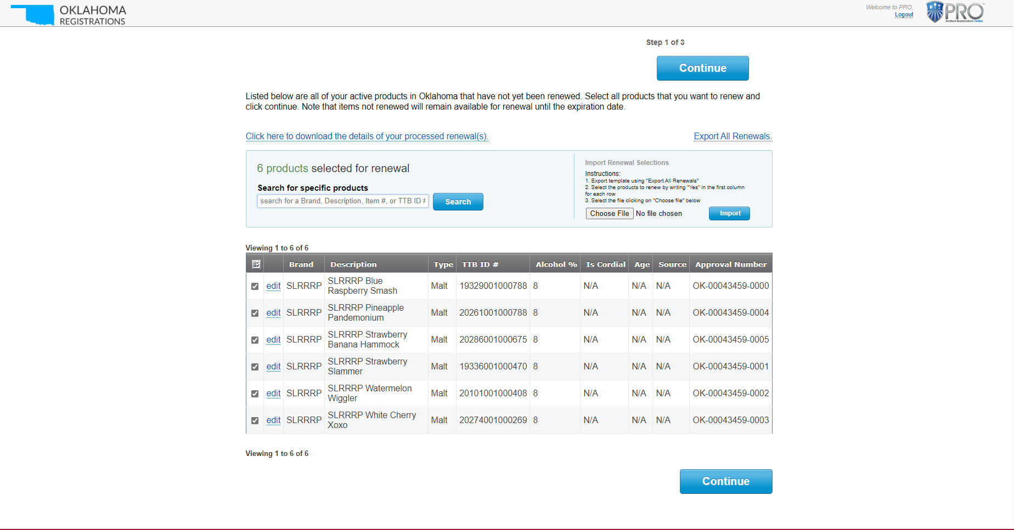
List of Registrations for Renewal
Step 2
A list of registrations eligible for renewal should appear. Please note, all registrations are already selected for renewal. If you do not want to renew a registration, you will need to unselect each to remove from renewal list.
You can also choose to download the details for your processed renewals by choosing the link at the top.
Click Continue

Slide 5
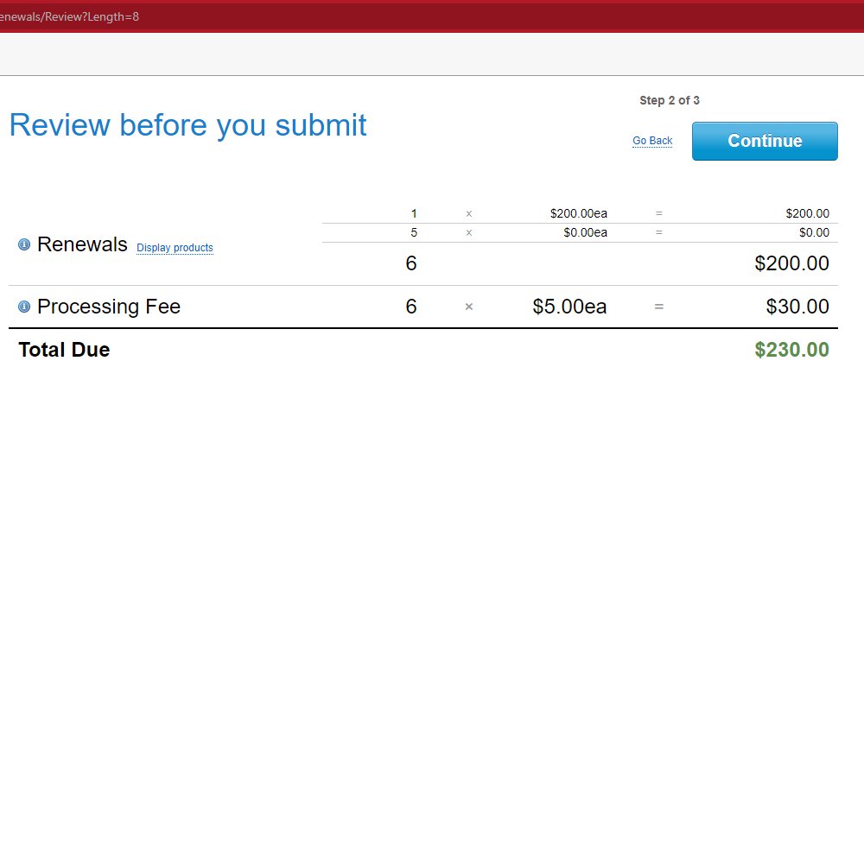
Review Renewal Fees
Step 2
Please review your renewal fees before your submit payment.
If you have any questions about the state fees, please contact the Brand Registration Coordinator.
Click Continue.

Slide 6
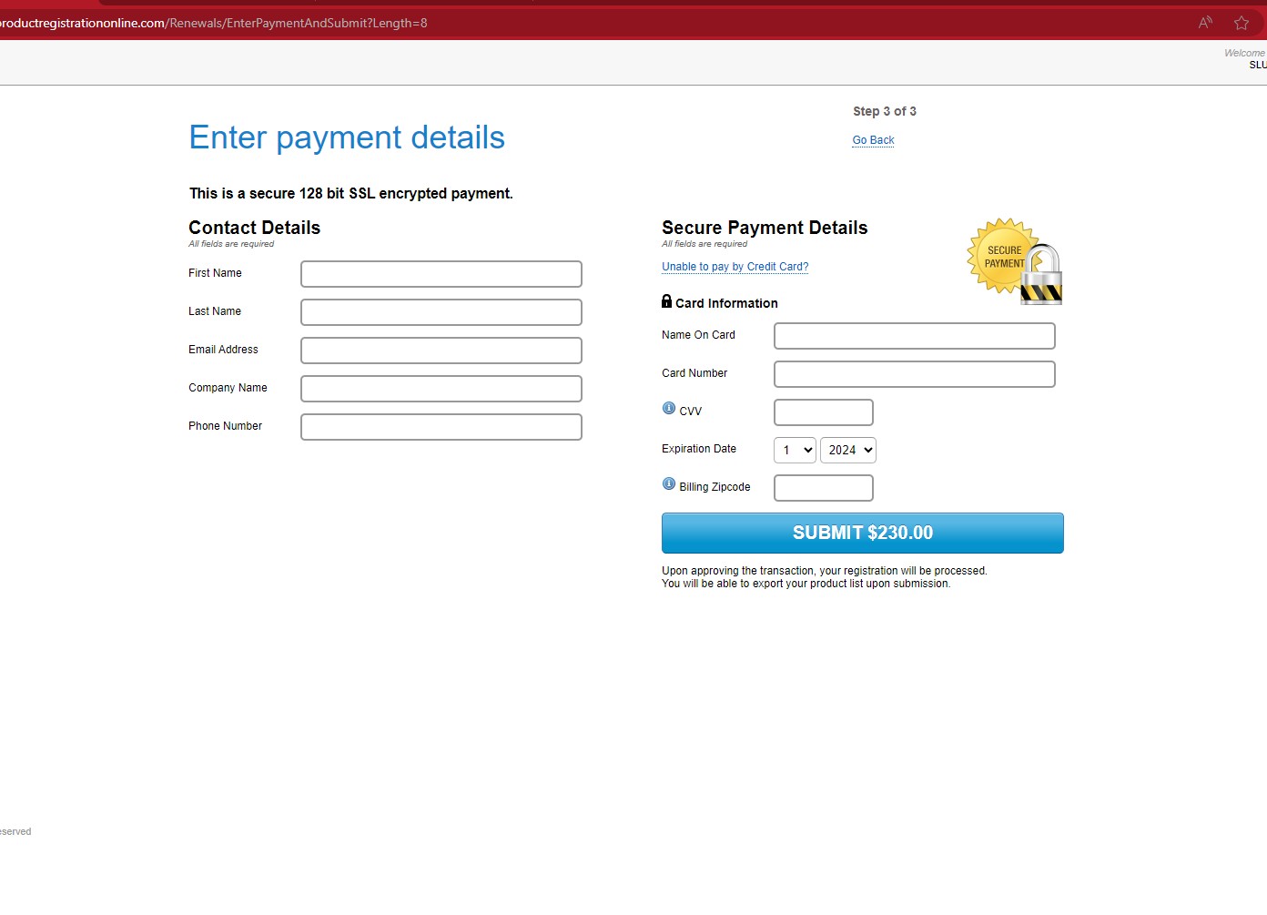
Enter Your Payment Details
Step 3 of 3
Enter your Contact Details.
Enter your Credit Card Details
Click Submit.
Be sure to keep a copy of your receipt along with a list of the registrations that you renewed for your records.
Unable to pay by Credit Card? Link applies to suppliers that have large amount of renewals that cannot be processed by Credit Card. Pro places a “hold” status on renewals until payment is received. Once the process the payment, PRO releases their renewals to the ABLE Commission.

