Slide 1
Oklahoma ABLE Commission PRO Brand Registration Catherine.Otey@able.ok.gov 405-522-3982
https://www.productregistrationonline.com

Slide 2
Which Product types to register?
Wine
Malt
Spirits
Combo/VP (Variety Pack)

Slide 3
Information you will need to include for each product you register.
Vintage
Bottle Size
Container Type
ABV
Bottle per selling unit
Selling units per case

Slide 4
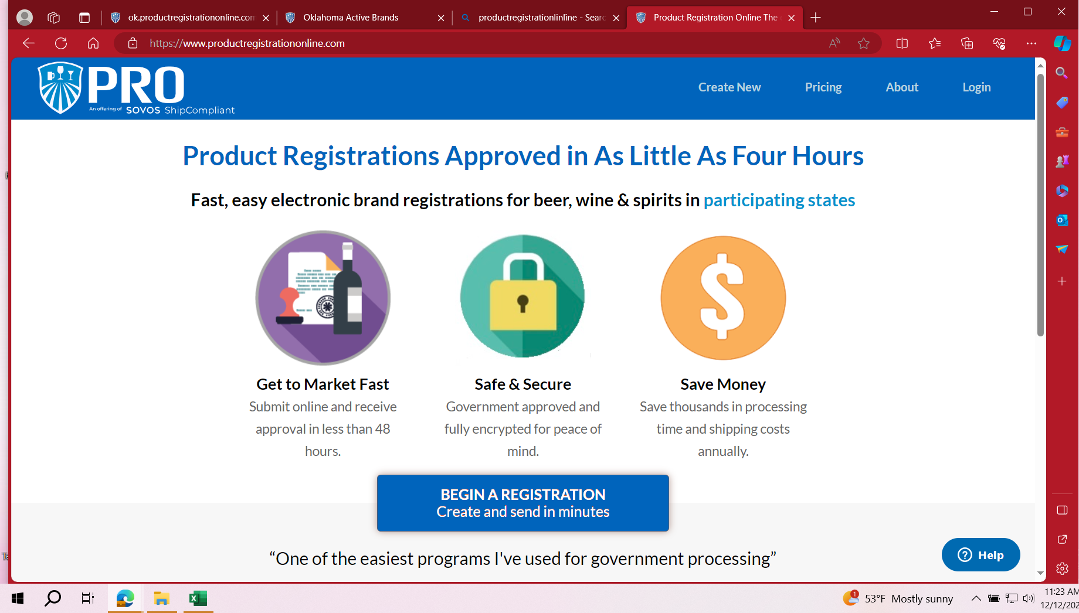
Product Registration Home Page
Step 1 – Click on blue BEGIN A REGISTRATION box.

Slide 5
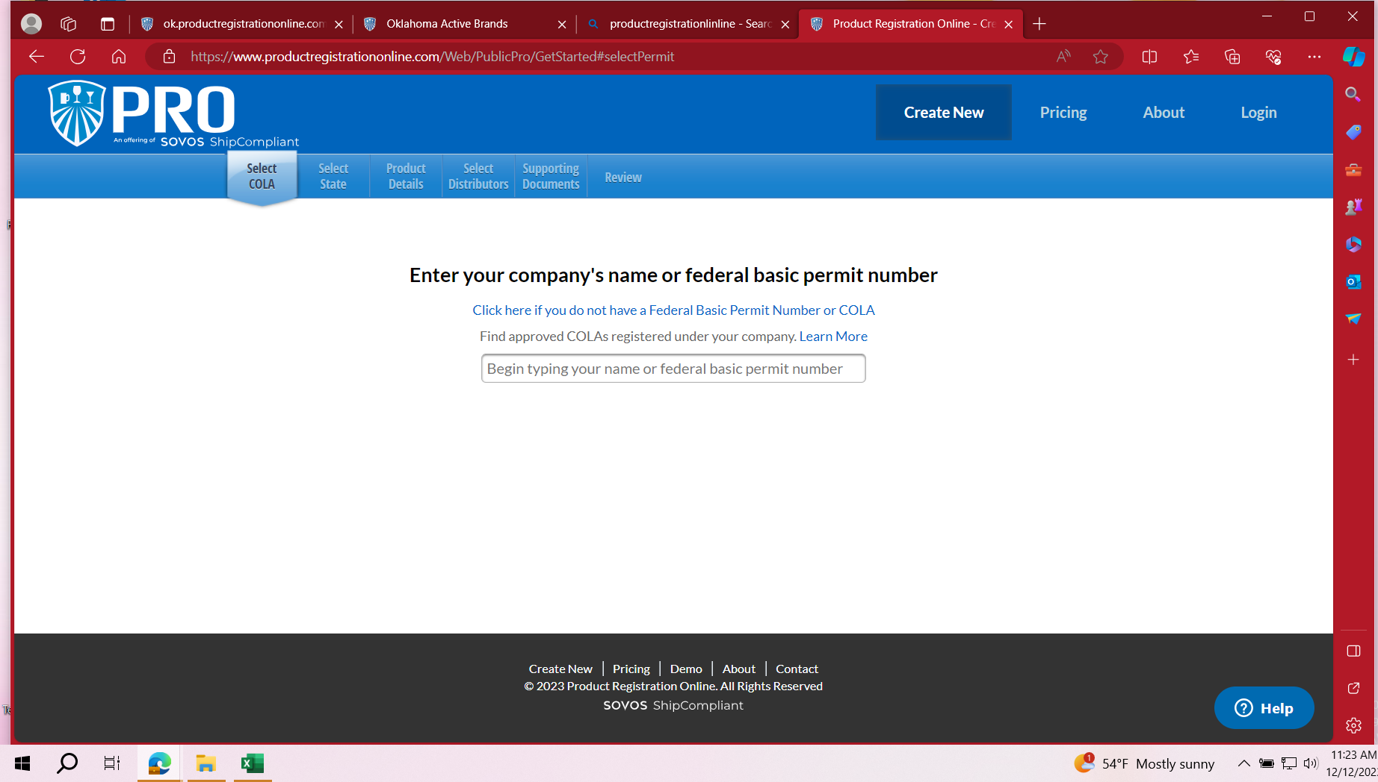
SELECT COLA PAGE
Step 2
If you are registering labels using a COLA (Certificate of Label Approval), you will enter your company’s name in the drop down and click on your Federal Basic Permit Number issued by the TTB.
If you are registering labels without a COLA, choose the Click here if you do not have a Federal Basic Permit Number or COLA. This includes COMBO/VP. Must register as NO COLA. All products within variety pack must be registered individually.

Slide 6
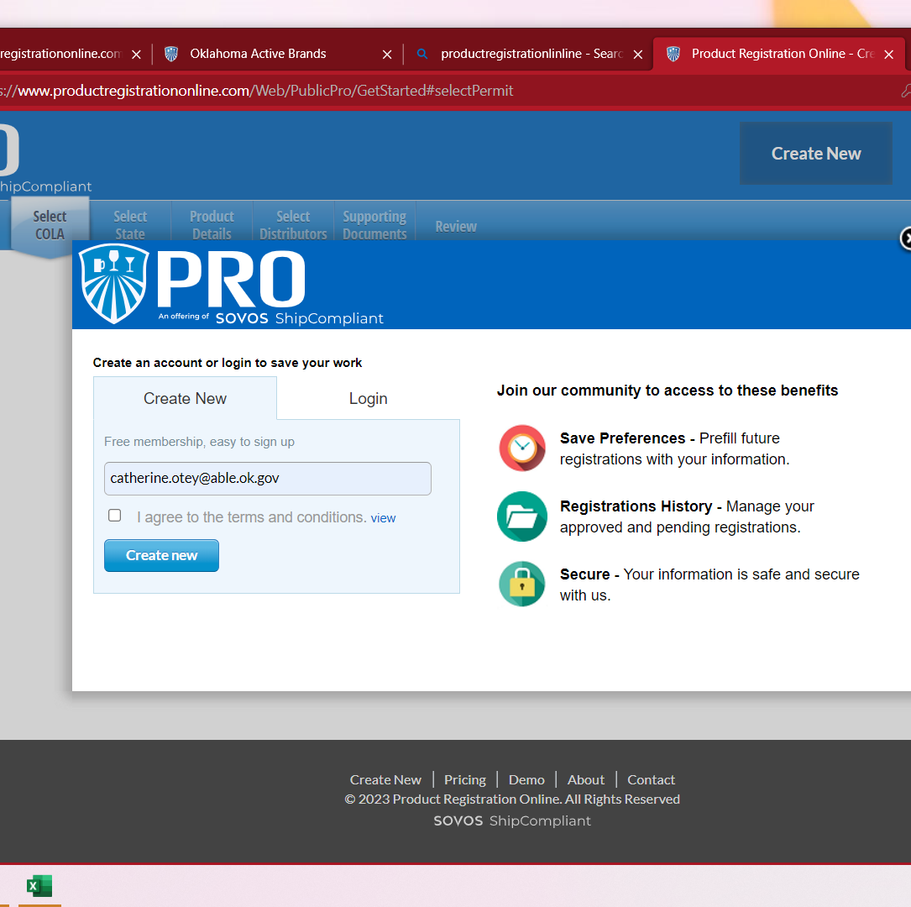
Create an Account or Login
Step 3
If your do not have an account, choose Create New tab.
If you have an account, choose Login and enter your credentials.
Please note, each member of your compliance team will need to set up an account.

Slide 7
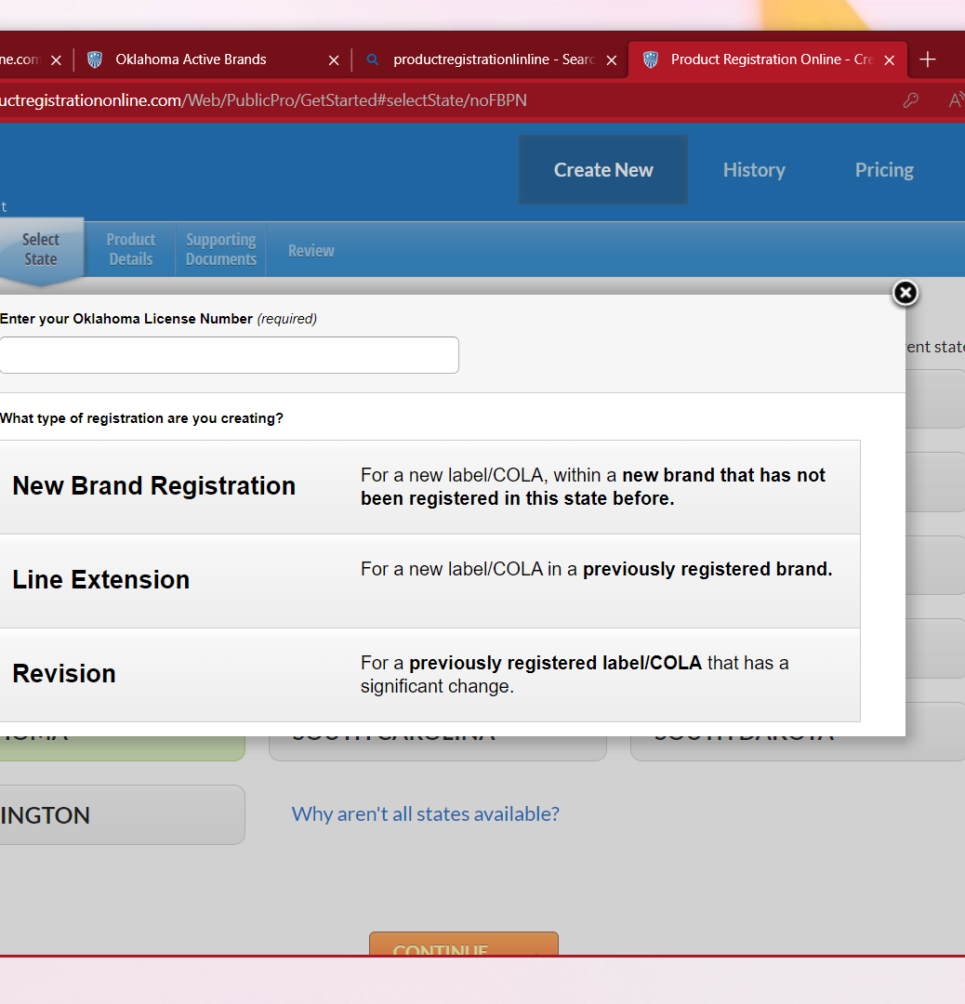
Enter Your Oklahoma License Number
Step 4
Enter your ABLE license number or your company name in the box.
Please be sure to choose your name/license number.
It is possible to register your labels under any license number. Make sure that your ABLE license number is being selected.
If you have an ABLE license number that includes alpha, year and 6 digits, please enter with no spaces or hyphens.

Slide 8
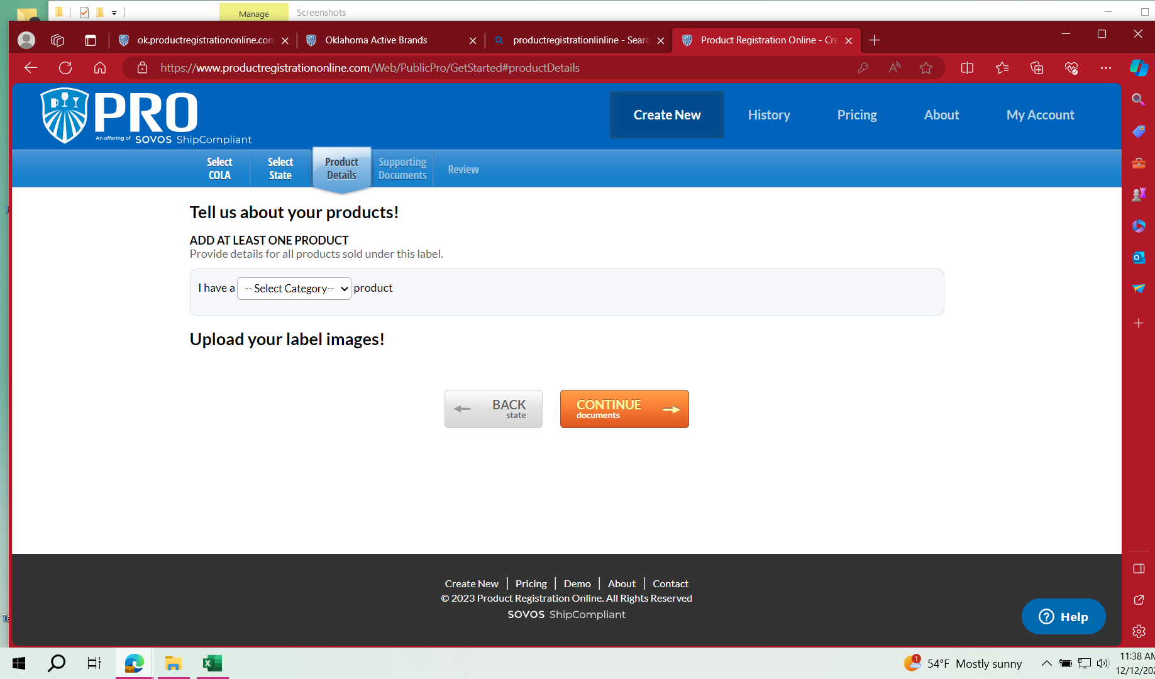
Registering with NO COLA
Step 5
Choose your product type
Enter Product details.
Click on Add another product if needed.
You will be prompted to upload images. Save Image before going to CONTINUE to Documents.
After clicking CONTIUE, you should be at Step 7 of the Registering with a COLA Instructions.

Slide 9
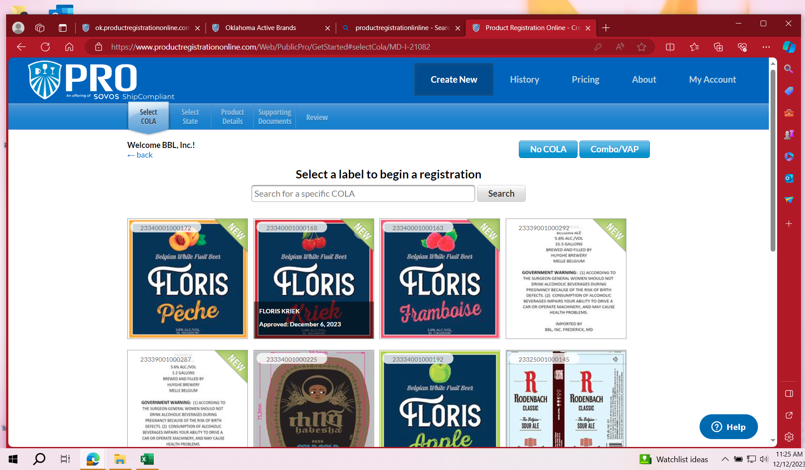
Registration with a COLA
Step 5
Select the COLA for the label you are registering.
All COLAs download directly from the TTB.
If you are registering without a COLA or a COMBO/VP (Variety Pack), choose NO COLA button.

Slide 10
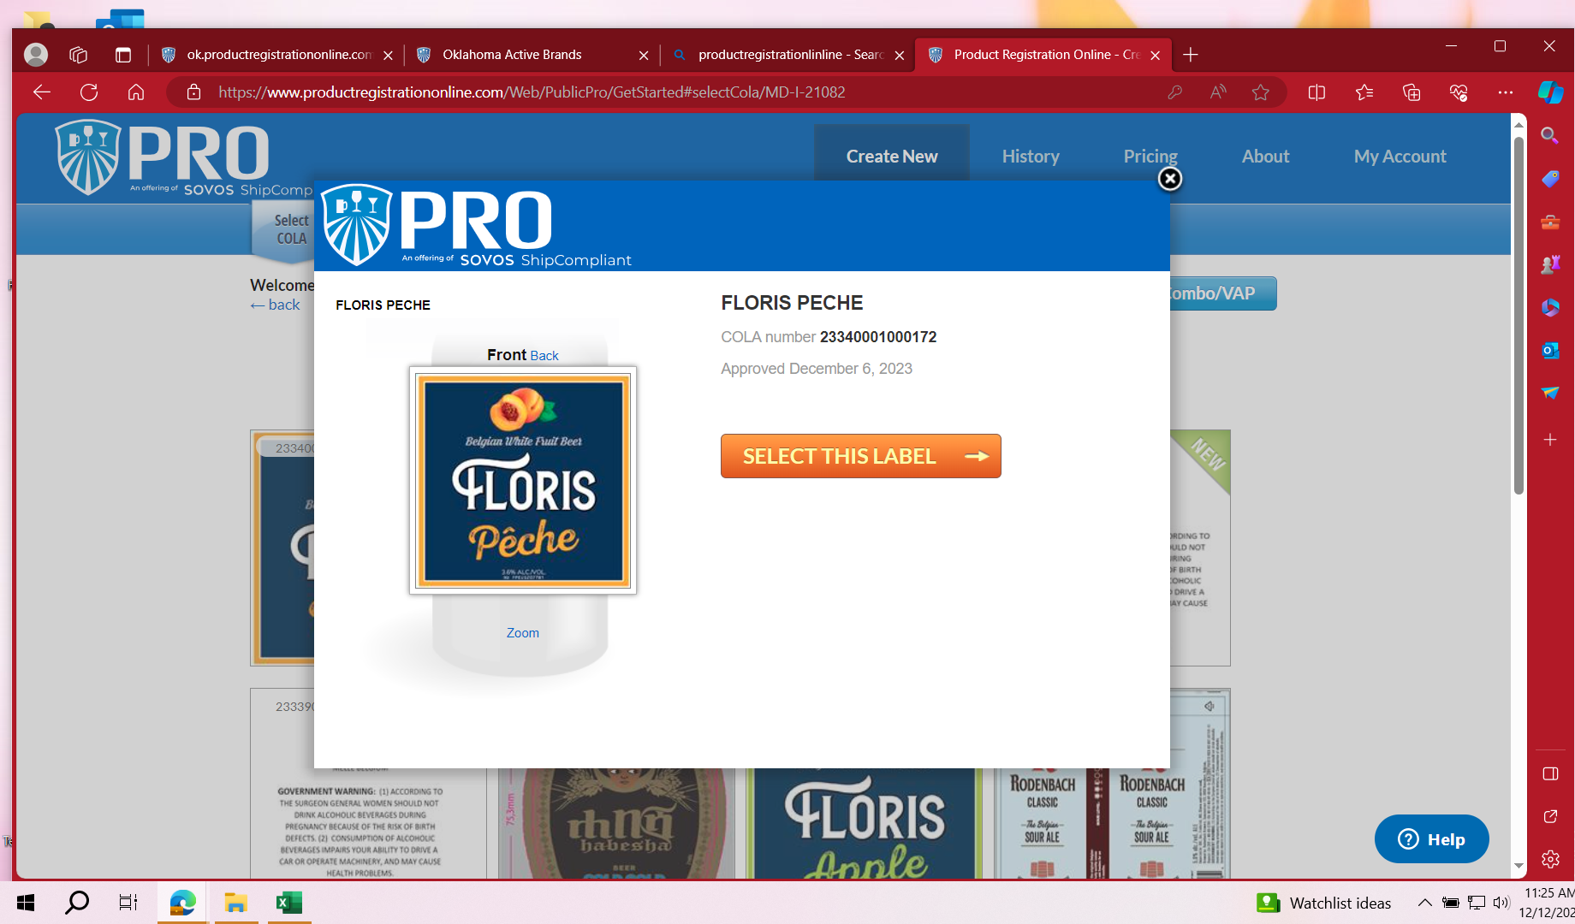
Step 6 – Select this label

Slide 11
Step 7 – Select OKLAHOMA

Slide 12
Types of Registrations
Step 8
Next you will be shown the 3 types of registrations. Each type has the criteria to help you choose the type you need.

Slide 13
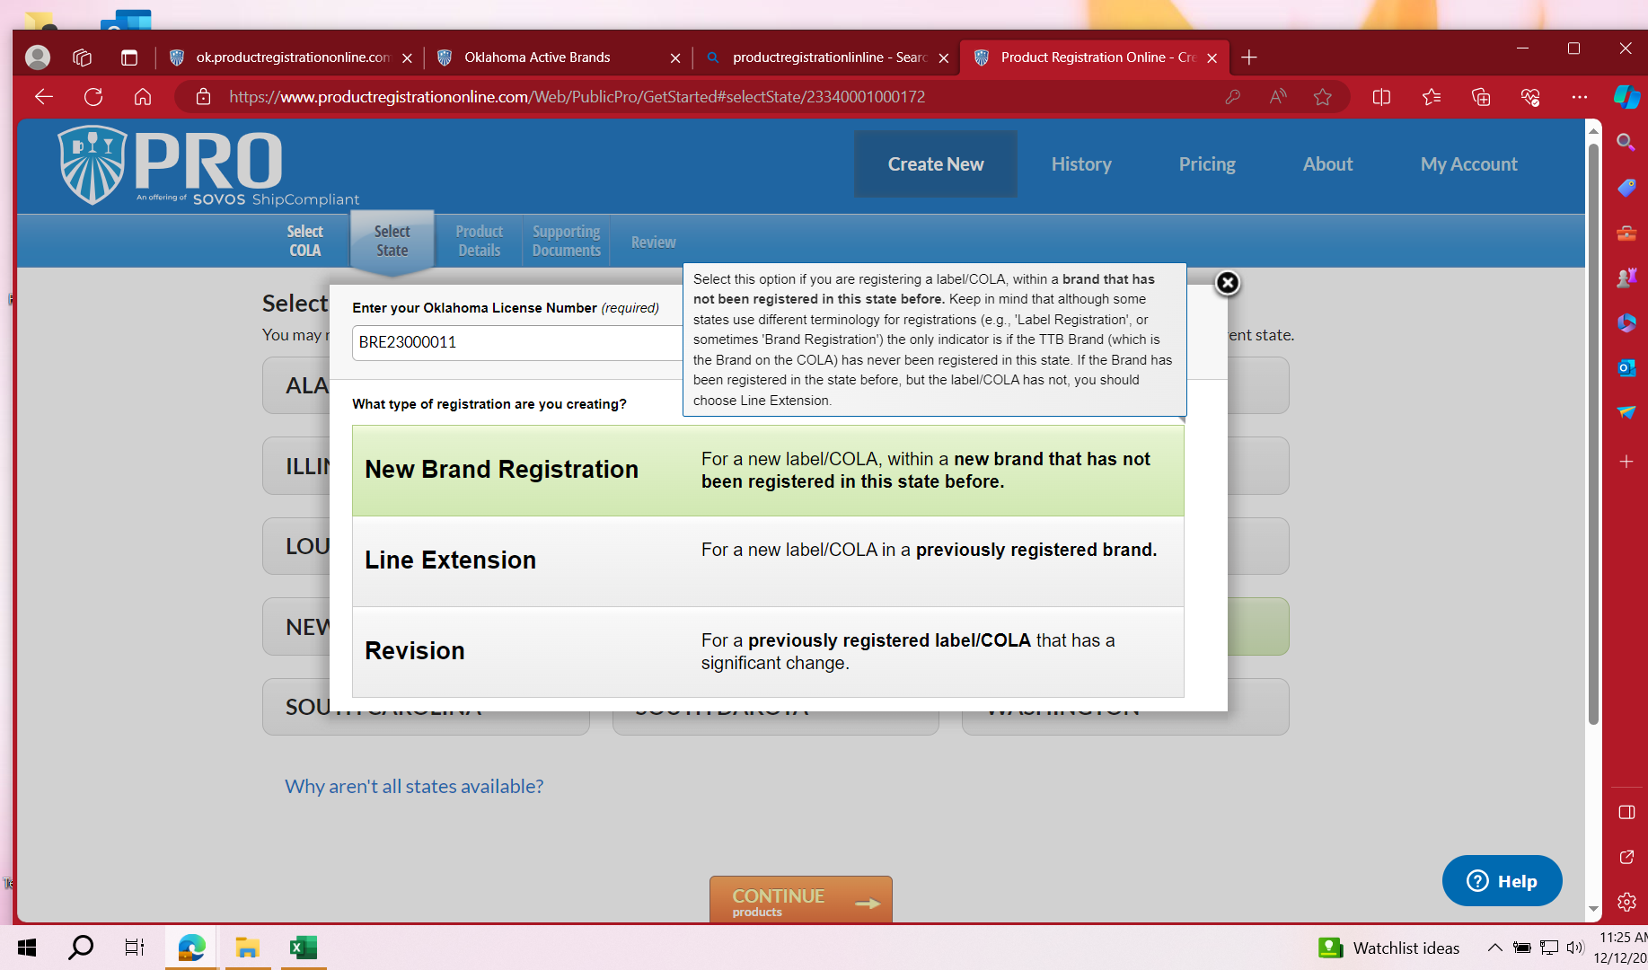
Types of Registrations – New Brand
Use this type if you are registering a label/COLA within a brand that has not been previously registered in the state during the current year.
Each brand registration is effective from 7/1 to 6/30 of each year.

Slide 14
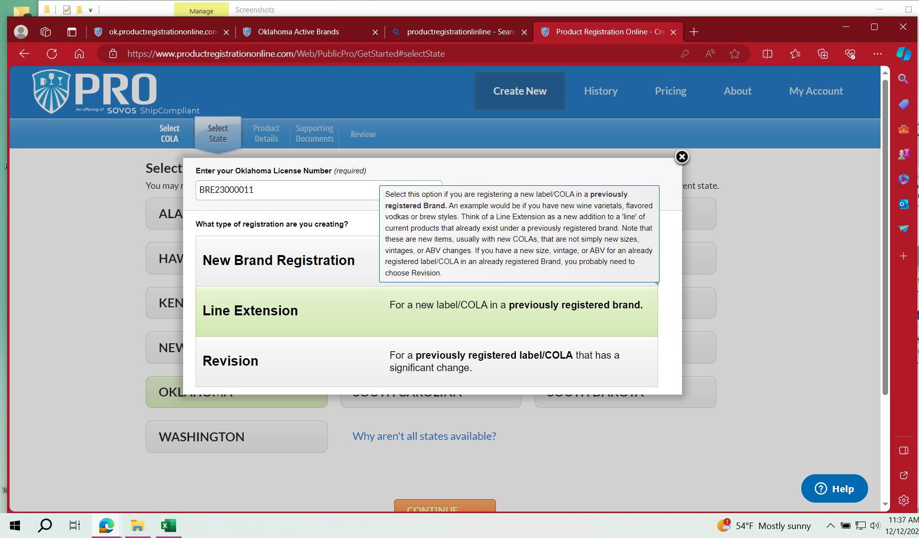
Types of Registrations – Line Extension
Use this type for a new label/COLA in a previously registered brand during the current year.

Slide 15
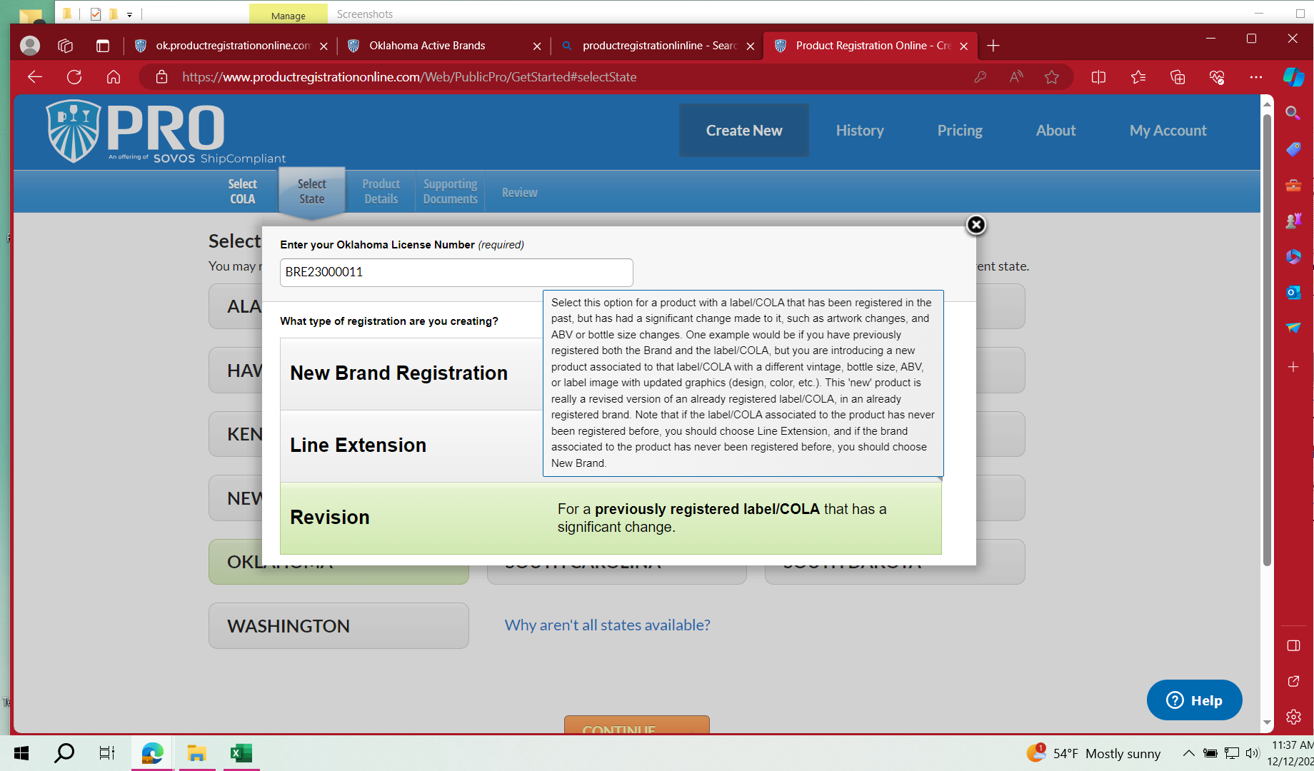
Types of Registrations - Revision
Use this type for a previously registered label/COLA that has significant change.
Examples of these changes are, new vintage or age, new ABV, content type, size or case configuration or graphics change on the label

Slide 16
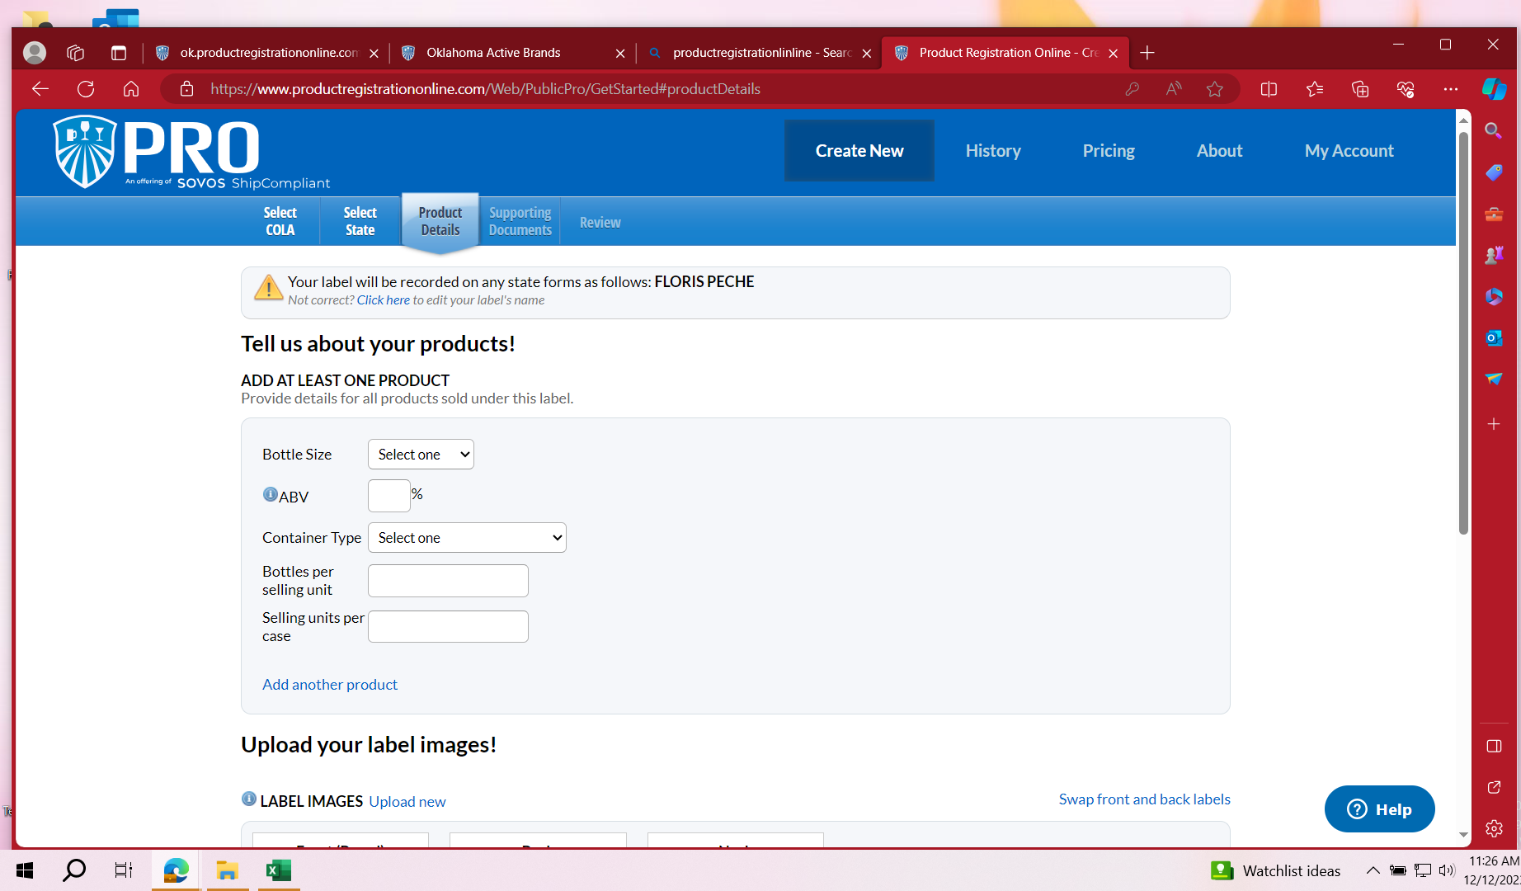
Product Details Tab
Step 9
You will see a yellow triangle at the top of the page.
Choose - Click here.
If registering with NO COLA, enter the Brand Name and the Fanciful Name. You can enter the Sub Brand and Style if you wish to do so. This is important because PRO charges the state fee according to each brand name that is registered.
If you are registering with a COLA, the brand name is
Add Product Details.

Slide 17
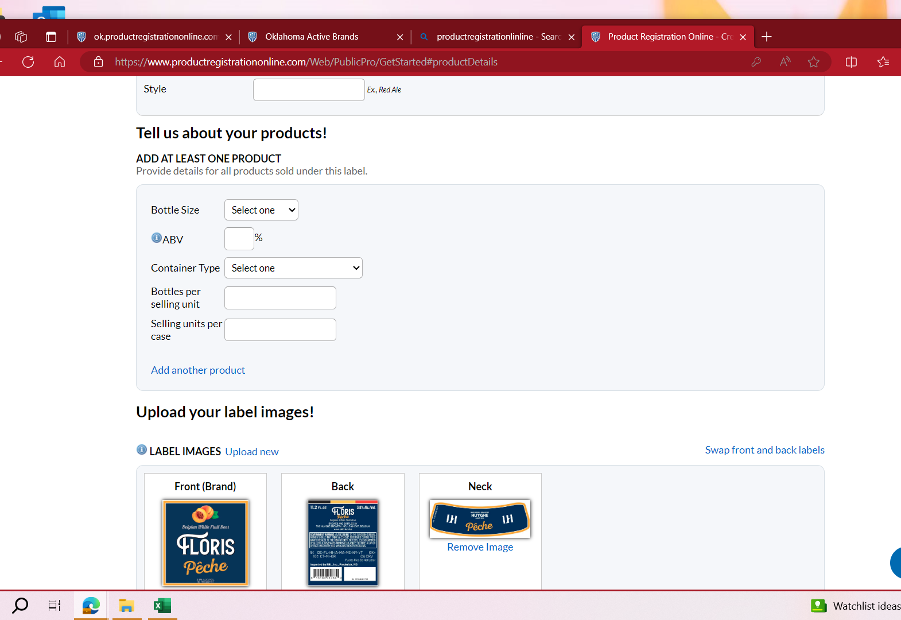
Adding Multiple Products to one registration
If you have more than one content size of the same product that has the same ABV, you can click on Add another Product.

Slide 18
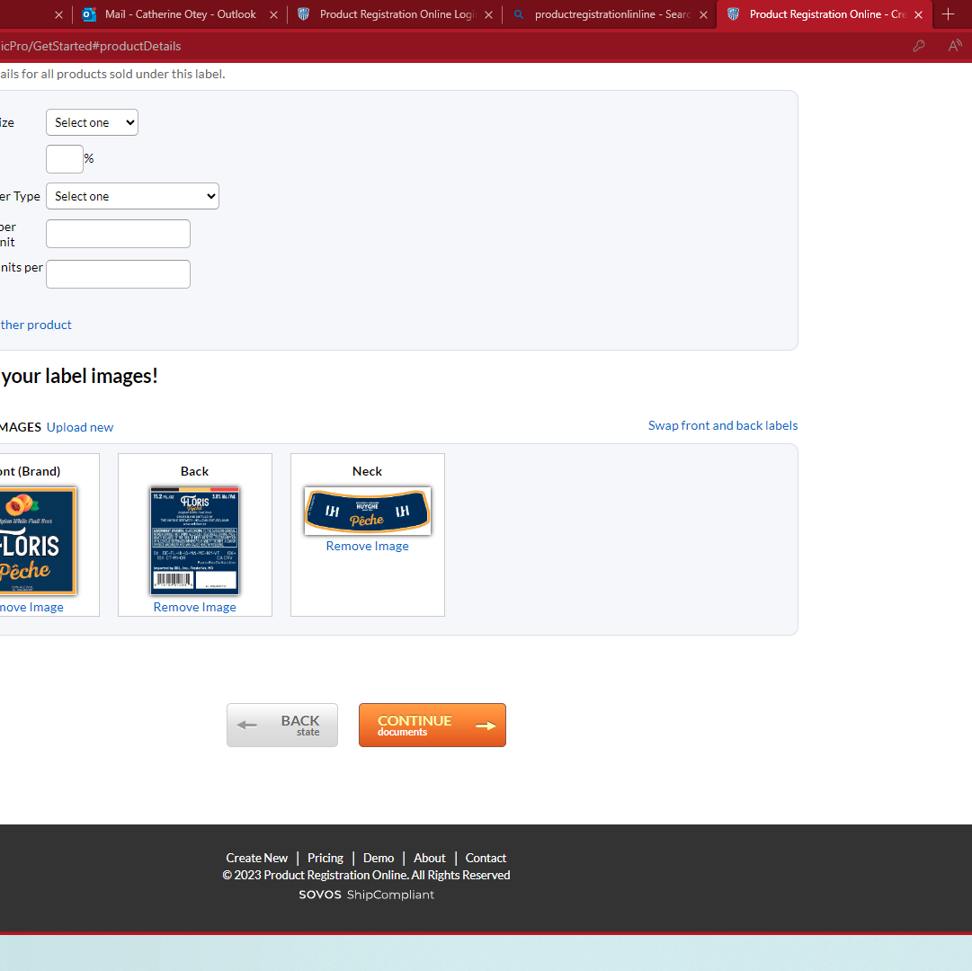
Upload your label images!
Step 10
After you have entered all your product details, click the CONTINUE to Documents box.
Your labels should already be uploaded.

Slide 19
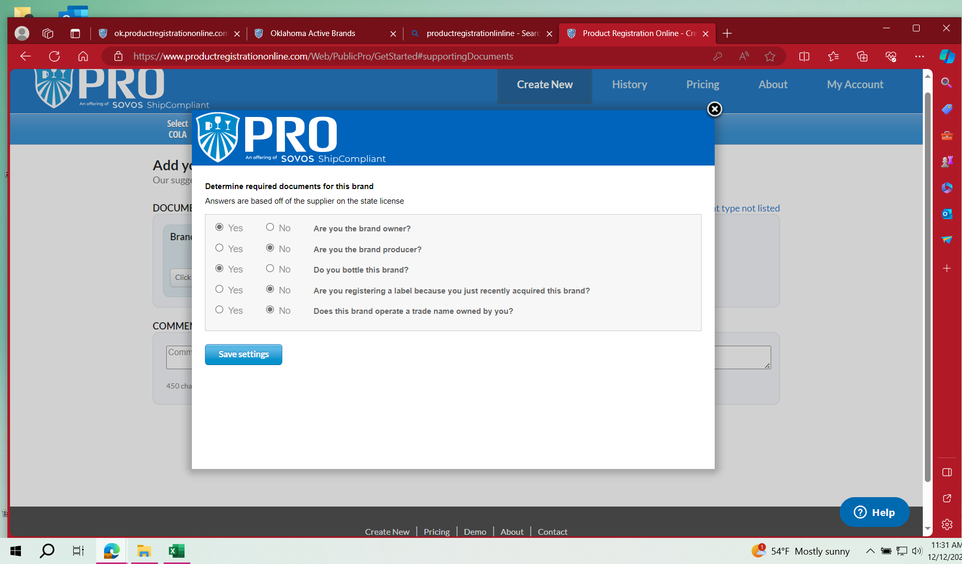
Determining Required Documents
Step 11
Answer each question
Save settings

Slide 20
Add your supporting Documents Step 12

Slide 21
Required Documents
Brand Acquistion Letter (if you answered yes to, Are you registering a label because your just recently acquired this brand?)
Trade Name Document (if you answered yes to, Does this brand operate a trade name owned by you?)
Bottling Letter (if you answered no to, Do you bottle this brand?)
Brand Owner Authorization Letter (if you answered no to, Are you the brand producer?)
After you unload the required documents, Click on CONTINUE TO REVIEW

Slide 22
Payment
After you review your registration and everything looks correct, you should be prompted to go to the payment page.
When you are adding a new registration, you must pay for each registration separately.
Depending on the type of registration you submitted, you may be charged a state fee.
In addition to any applicable state fees, there will be $5 technical fee that is charged by PRO for each registration. This is non-refundable by the ABLE Commission.
You can choose to start a new registration after your payment is submitted.

