Slide 1
Overview of Competency-Based Curriculum Essentials
Copyright © 2019 Resource Center for CareerTech Advancement

Slide 2
Competency-Based Curriculum Essentials
Clearly-stated learning objectives
Instruction aligned with learning objectives
Evaluation aligned to learning objectives and curriculum
Cognitive and affective skills practice
Psychomotor (“hands-on”) skill practice
Skill mastery documentation

Slide 3
Competency-Based Curriculum Essentials
What is a learning objective?
A specific, measurable task
Learners perform a skill or demonstrate knowledge
List in order the steps to…
Fill out a form…
Describe what the security guard should do when…
Often from national, state, or industry standards

Slide 4
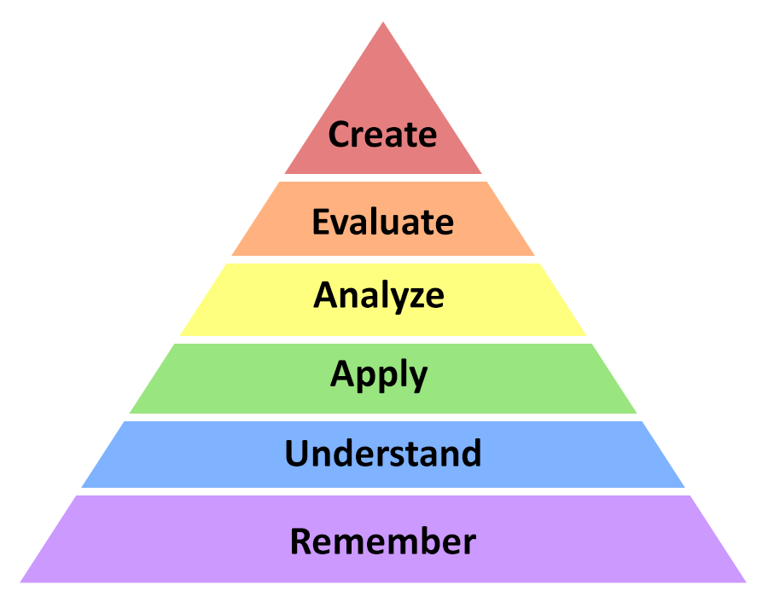
Competency-Based Curriculum Essentials
How does instruction align with learning objectives?
Objectives indicate which level of learning is appropriate

Slide 5
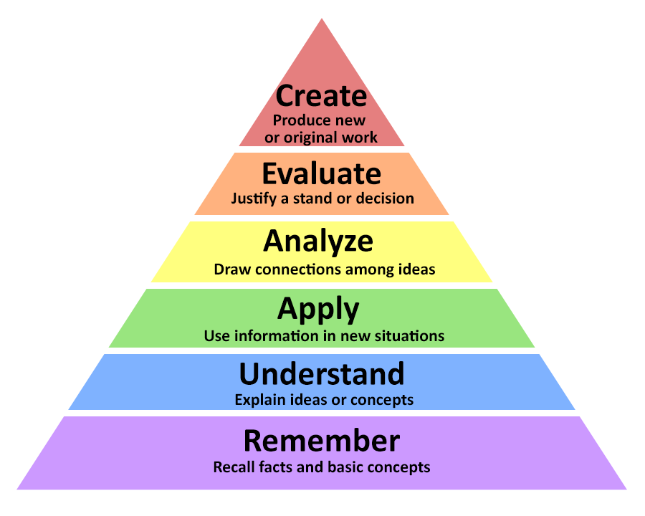

Slide 6
Competency-Based Curriculum Essentials
How is evaluation aligned to learning objectives and curriculum?
Objectives indicate how learning will be evaluated
Recall, arrange, differentiate, design, etc. (knowledge or psychomotor skills)
Formative assessment: done as you teach, to see if re-teaching is needed
Summative assessment: at the end of learning

Slide 7
Competency-Based Curriculum Essentials
How is evaluation aligned to learning objectives and curriculum?
Performance tests
Written/cognitive tests
Quizzes
Self-checks
Rubrics (project/activity)
Portfolios

Slide 8
Competency-Based Curriculum Essentials
Cognitive, affective, and psychomotor skills practice
Teach, evaluate, reteach as necessary
End-of-unit review
Step-by-step checklists for psychomotor skills
Pencil-and-paper activities (Assignment Sheets) with rubrics for cognitive and affective skills

Slide 9
Competency-Based Curriculum Essentials
Skill mastery documentation
Profile of Training Mastery (Competency Profile)
Checklist of all learning objectives
Instructor can mark each objective off as it is mastered by the learner

Slide 10
For More Information:
Craig Maile, Manager
craig.maile@careertech.ok.gov
405.743.5448
Tracy Boyington, Instructional Development Specialist
tracy.boyington@careertech.ok.gov
405.743.5516

Slide 11
All rights reserved; copyright © 2019 Resource Center for CareerTech Advancement For more information, email us at resourcecenter@careertech.ok.gov or visit our website at https://www.okcareertech.org/educators/resource-center

