Slide 1
Major Milestones of Career & Technology Education in Oklahoma
Notes:
PRESENTER’S NOTES

Slide 2
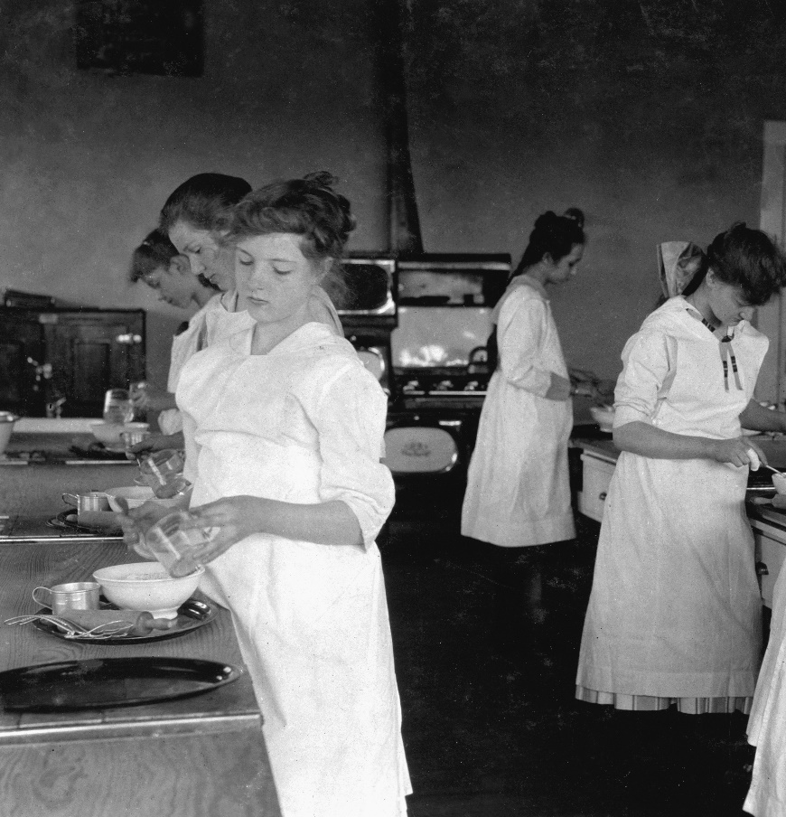
Passage of the Smith-Hughes Act (1917)
Signed by President Woodrow Wilson
Defined vocational education as the “preparation for employment in positions requiring less than a baccalaureate degree”
Oklahoma legislature agreed to accept the terms of the Act
Oklahoma’s plan was accepted in August
Notes:
PRESENTER’S NOTES
The purpose of vocational education as defined in the Smith-Hughes Act centered on promoting vocational education in general and agriculture and the trades and industries specifically. The Smith-Hughes Act also provided for the preparation of teachers of vocational subjects, appropriated money, and regulated its expenditures.
The earliest federal definition from the Smith-Hughes Act of 1917 defined vocational education as the “preparation for employment in positions requiring less than a baccalaureate degree.”
“Although the compliance with the Vocational Act of 1917 by the state legislature is frequently called the beginning of vocational education in Oklahoma, there had been determined efforts before that time to initiate a state-wide program. Indeed, Section 7, Article 13 of the Constitution of the state of Oklahoma demanded that ‘the legislature shall provide for the teaching of the elements of Agriculture, Horticulture, Stock Feeding and Domestic Science in the Common Schools of the State.’ In compliance with this provision the legislature provided that after July 1,1909, all teachers wishing to receive certificates in the state should pass an examination qualifying them to instruct ‘the elements of Agriculture and allied branches mentioned’ in the Constitution. Also, the various normal schools and other institutions of higher learning in the state were urged to offer training in the needed areas.”—Carl Tyson, The History of Vocational and Technical Education in Oklahoma, State Department of Vocational and Technical Education, circa 1975

Slide 3
Creation of the Division of Vocational Education within the State Department of Education (1929)
State statute dissolves the existing vocational education board, assigns its functions to a new agency—the State Board of Education
New board is designated Oklahoma’s official State Board for Vocational Education under the Smith-Hughes Act
Vocational education is assigned to its own division
Notes:
PRESENTER’S NOTES
What else was happening at this time?
Charles A. Lindbergh makes solo flight across the Atlantic (1927)
TV invented (1927)
Penicillin discovered (1928)
Stock market crashes (1929)
Sliced bread available (1930)
Great Depression begins (1930)
Air conditioning invented (1932)
“The period of1917 to 1927 was a formative era under the guidance of the federal government. It was a time of growth and experimentation, of many successes and few failures. It was a time of learning, and as the vocational education program of Oklahoma started its second decade of service, it was ready to assume new tasks and witness further growth.”—Carl Tyson, The History of Vocational and Technical Education in Oklahoma, State Department of Vocational and Technical Education, circa 1975

Slide 4
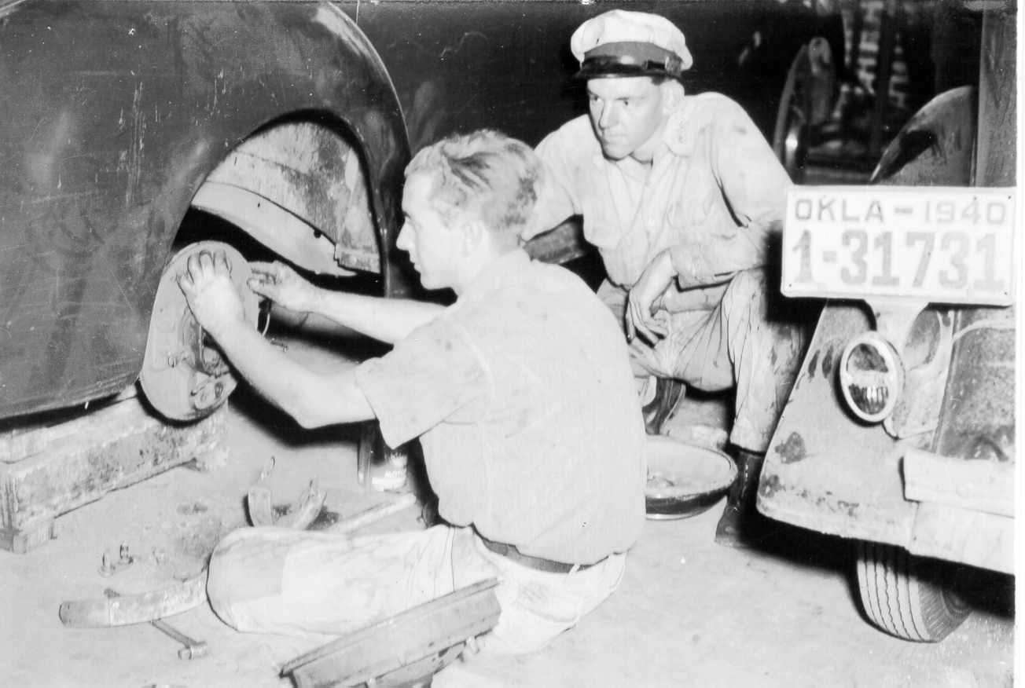
Federal Legislation in Support of Vocational Education (1929, 1935)
George-Reed Act (1929)
George-Ellzey Act (1935)
Increased federal support for vocational education
Gave home economics the status of an independent division and a more fair share of federal funding
Brought the federal supplement for vocational agriculture and home economics to $3 million each
Made federal funds available to train teachers and to supplement teachers’ salaries for distributive education
Notes:
PRESENTER’S NOTES
“Of all the branches of vocational education in Oklahoma, home economics received the biggest boost from the George-Reed Act of 1929 because that act allowed the states to spend larger percentages of the allotted funds for that area. In spite of the difficulties created by the depression home economics began the new decade with unprecedented growth. In 1930 there were less than sixty home economics programs in Oklahoma which were aided by federal matching funds, and there were less than 10,000 students, both adults and school girls, enrolled in classes. With the addition of the funds from the legislation, the number of schools offering home economics more than doubled in 1931 with more than 150 districts holding classes.”—Carl Tyson, The History of Vocational and Technical Education in Oklahoma, State Department of Vocational and Technical Education, circa 1975
With respect to the George-Deen Act (1936): “Oklahomans had already begun distributive education before the act was passed by the national legislature. In 1929 a course in "retail selling" had started in Tulsa, Oklahoma, and by 1936 such classes were held in six cities in the state—Bristow, Oklahoma City, Ponca City, Shawnee, Tonkawa, and of course, Tulsa. Although the number of these classes was small and the methods often crude, a foundation existed for further building. In 1937 the first federally funded distributive education classes were held in the state. Initially, two types of classes were offered, regular full-time classes for juniors and seniors in high schools and part-time evening classes for persons already engaged in some aspect of merchandise distribution. Additionally, Oklahoma A. & M. was designated as the teacher-training institution for distributive education.”—Carl Tyson, The History of Vocational and Technical Education in Oklahoma, State Department of Vocational and Technical Education, circa 1975

Slide 5
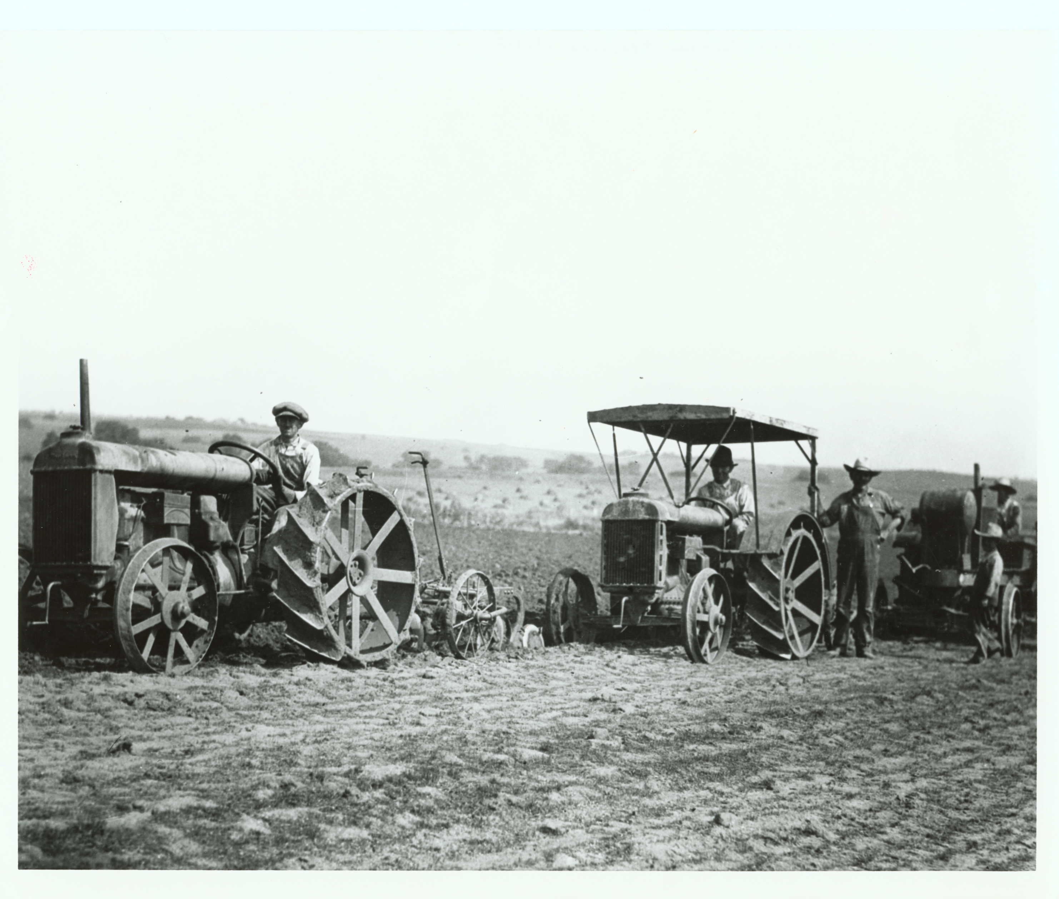
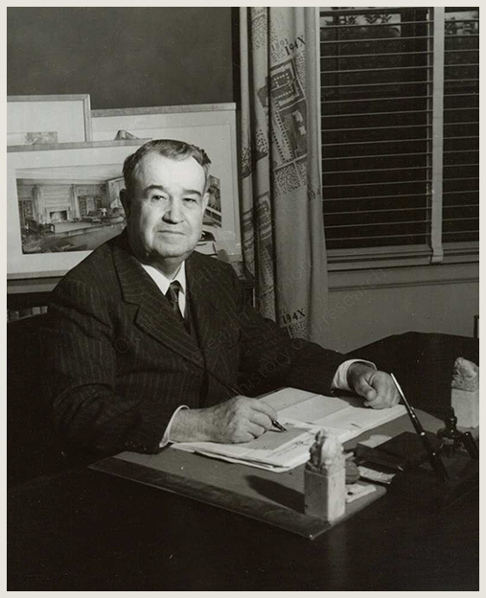
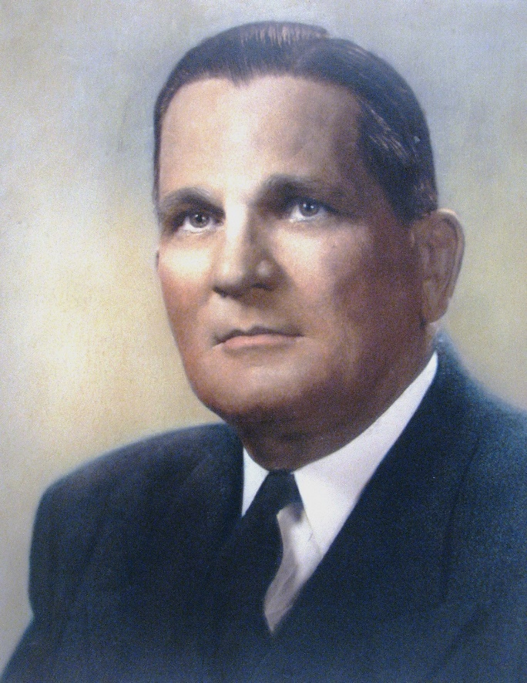
Relationship Between J.B. Perky and Henry G. Bennett (1931)
Henry G. Bennett
J.B. Perky
Notes:
PRESENTER’S NOTES
Henry G. Bennett became president of Oklahoma A&M College (OAMC) in Stillwater in 1929.
James B. Perky became supervisor for vocational agriculture in 1931.

Slide 6
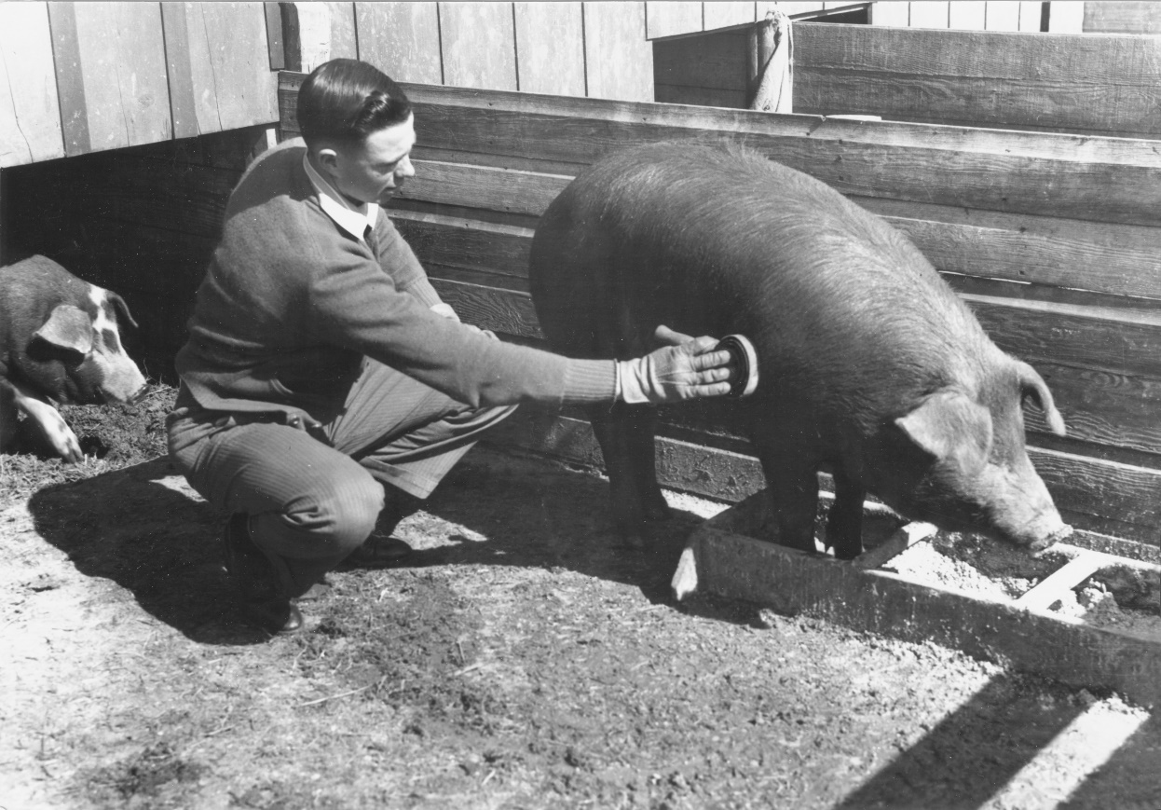
Relationship Between J.B. Perky and Henry G. Bennett (1931)
Natural allies:
  OAMC was the major supplier to the vocational system
  The vocational system was the major employer of OAMC graduates
  Representatives of both institutions had a statewide presence, often in the same communities
Notes:
PRESENTER’S NOTES
“In his new position Perky exhibited the traits that made him a good administrator. He was strong-willed but could compromise if necessary; he was decisive but understanding. And vocational agriculture needed a strong leader during the 1930s. While the entire nation was gripped by the depression, Oklahoma and several of its neighboring states were struck by an additional tormentor—the Dust Bowl.”—Carl Tyson, The History of Vocational and Technical Education in Oklahoma, State Department of Vocational and Technical Education, circa 1975
“One of the primary results of the Dust Bowl in Oklahoma was the depletion of the ranks of vocational agriculture teachers. When the federal government created the Civilian Conservation Corps and the Soil Conservation Service a great demand arose for persons schooled in techniques of modern farming and soil saving. Fortunately for the state many of the new positions could be filled with the vocational agriculture teachers of Oklahoma, but unfortunately for vocational agriculture this left many positions empty in the schools. However, stepped-up teacher training and pragmatic arrangements such as allowing teachers time off to handle government jobs overcame this problem.”—Carl Tyson, The History of Vocational and Technical Education in Oklahoma, State Department of Vocational and Technical Education, circa 1975

Slide 7
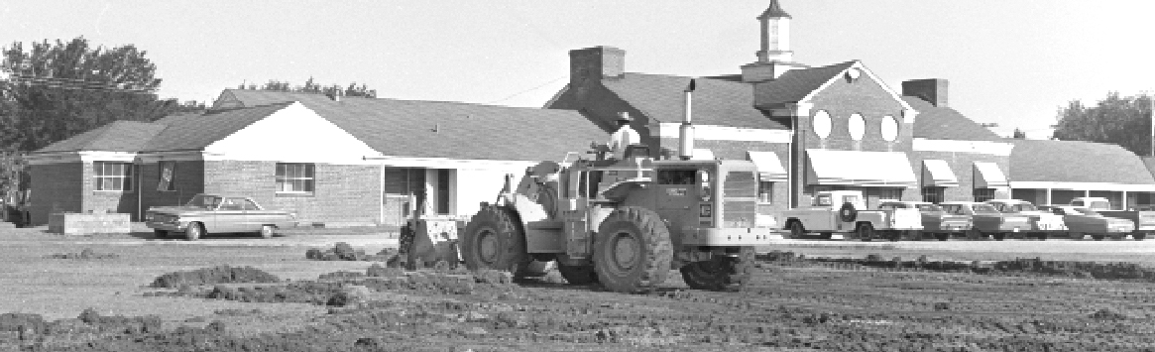
Relocation of the State Vocational Agency (1932)
Vocational education department operated from Oklahoma City since 1917
J.B. Perky moved the department to Stillwater and the OAMC campus
Current agency location was made available in 1958 by the renamed Oklahoma State University
Notes:
PRESENTER’S NOTES
“Despite the problems created by the Depression home economics survived, and toward the end of the decade—when the national economy appeared to revive and when the flow of people from Oklahoma slowed with the end of the Dust Bowl—enrollment in classes again rose radically. Like a barometer of the national economy, home economics was readying for renewed growth in the Forties.”—Carl Tyson, The History of Vocational and Technical Education in Oklahoma, State Department of Vocational and Technical Education, circa 1975
“Naturally, the third area of vocational education, trades and industry, was not free from the troubles of the thirties. Decreasing enrollments were apparent in each phase of the program, especially in the schools which were located in outlying or isolated districts. However, this problem did not become acute because many of the major trade schools and industrial centers were in larger urban regions, such as Oklahoma City, Tulsa, and Ponca City.”—Carl Tyson, The History of Vocational and Technical Education in Oklahoma, State Department of Vocational and Technical Education, circa 1975
“The addition of distributive education to the vocational education system of Oklahoma was indicative of the future. Vocational education had suffered through the Great Depression with the nation, and all those involved looked forward to the next decade with renewed optimism and dedication. Both of these factors were needed, for in 1940 the United States was facing the most determined threat to its existence in its history—World War II. Vocational education in Oklahoma and across the nation stood ready to help withstand the challenge of totalitarianism to the Republic.”—Carl Tyson, The History of Vocational and Technical Education in Oklahoma, State Department of Vocational and Technical Education, circa 1975

Slide 8

Appointment of J.B. Perky as State Director (1941)
A new state law reorganized the state department of education and required two new positions:
  Executive officer for the State Board for Vocational Education, and
  Director for vocational education
J.B. Perky assumed both roles and also remained state supervisor of vocational agriculture
Notes:
PRESENTER’S NOTES
What else was happening at this time?
The Fair Labor Standards Act sets minimum wage, maximum hours, equal pay and child labor standards (1938)
Japan attacks Pearl Harbor, the United States enters the Second World War (1941)
U.S. uses atomic bombs on Hiroshima and Nagasaki, Japan; the Second World War ends (1945)
Jackie Robinson breaks baseball’s color barrier by playing in the major leagues (1947)
Congress passes the Economic Cooperation Act, approving funding to rebuild Western Europe, also known as the “Marshall Plan” (1948)
The Bureau of Labor Statistics launches the Occupational Outlook Handbook, selling 40,000 copies of the first edition (1949)
Since 1929, the state superintendent of public instruction also assumed the duties of director of the state vocational system.
“Both as state supervisor of vocational agriculture and as director of vocational education, Perky was concerned about the teachers. Were they doing their jobs? Were the students receiving the type of education they deserved? Perky realized that the tax dollars that came to vocational education were repaid in one way: teaching. Moreover. he not only wanted his teachers to perform well during class periods. he expected them always to be ready to serve the needs of anyone in their area. If that meant knowing the price of wheat, the teacher should be ready to give the most recent quotation from the market. It was this attitude that helped make the vocational agriculture teachers of Oklahoma not only skilled instructors but also respected leaders of their communities.”—Carl Tyson, The History of Vocational and Technical Education in Oklahoma, State Department of Vocational and Technical Education, circa 1975

Slide 9

Oklahoma Vocational Education During the Second World War (1941-1945)
In 1940, the Congress passed the Defense Training Act, anticipating the needs of the nation should it become involved in the war. This act placed the responsibility of training defense workers in the Vocational Division of the United States Office of Education.
The various state boards of vocational education were charged with the task of training workers. In Oklahoma, J.B. Perky was given the job of administering the new program.
Each division affected—home economics, trades and industry, and vocational agriculture—had to submit plans and select staffs to provide vocational education courses and other necessary instruction deemed essential to the national defense. Therefore, Perky became director of the War Training Program and the supervisor of Food Production Training.
“The schools were mobilized for the war effort not only to provide the necessary orientation for the future members of the Armed Forces but also to furnish vocational training to meet the growing demand for manpower in industry and agriculture…Vocational schools were called upon to train not only high school students but also workers who were dislocated from nondefense industries and needed retraining to fit them for service in war-production industries. Classes were held at all hours of the day for all types of men and women. So far as high school students were concerned, the demand for admission to courses in vocational training was greater than the schools could accommodate. There was, in fact, a pronounced shift of interest from academic studies to vocational training.”
--I.L. Kandel, The Impact of the War Upon American Education, 1948
Notes:
PRESENTER’S NOTES
“After the sudden and shocking fall of France to Nazi armies, United States Commissioner of Education John Studebaker assembles a small panel consisting of the nation’s most esteemed vocational educators and asks that they plan to train 1.25 million defense workers in the next twelve months. J. B. Perky is one of the few summoned, and the recommendations that he and the rest offer become federal policy in precisely twenty-three days, when the Vocational Training for War Workers Program is created and assigned to each state’s Division of Trades and Industries. J. B. Perky thereupon becomes both Oklahoma’s director for war production training and state supervisor of food production training.’’—Danney Goble, Learning to Earn

Slide 10
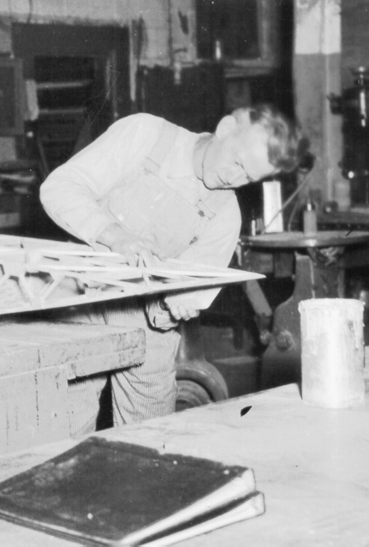
Oklahoma Vocational Education During the Second World War (1941-1945)
The other major war training branch of vocational education in Oklahoma was trade and industrial education. During the period from 1940 to 1945 more than 150,000 workers received training in this program. In 1944 alone more than 35,000 were instructed in more than fifteen specific occupations, ranging from aircraft mechanics to arc welding.
Home economics was involved with teaching food preservation techniques and the basics of first aid. Although not directly a part of the War Training Program, home economics made an important contribution via its emphasis in school and adult classes on nutrition.
Notes:
PRESENTER’S NOTES
“According to the Selective Service the largest numbers of rejections for military service were the result of poor nutrition. Home economics teachers not only taught good nutrition in their classes but also many volunteered to instruct Red Cross classes for interested adults.”—Carl Tyson, The History of Vocational and Technical Education in Oklahoma, State Department of Vocational and Technical Education, circa 1975

Slide 11
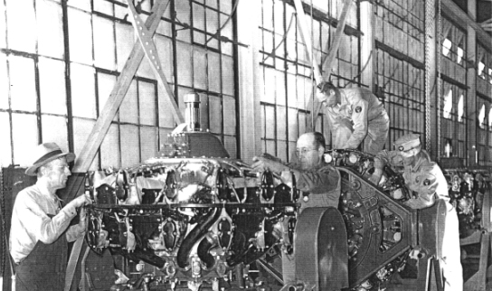
Oklahoma Vocational Education During the Second World War (1941-1945)
Tulsa opens a Douglas bomber plant in the city’s northeast corner (1942), where it will produce 3,138 B-24 Liberators; outfit another 4,000 military airplanes; and produce, pack, and ship 20,000 tons of aircraft parts.
Immediately east of Oklahoma City, Tinker Field and the manufacturing plants that surround it begin to build and outfit C-47s and other vital planes.
In each case, thousands of highly skilled aircraft workers will be needed, will be trained, and will be hired.

Slide 12
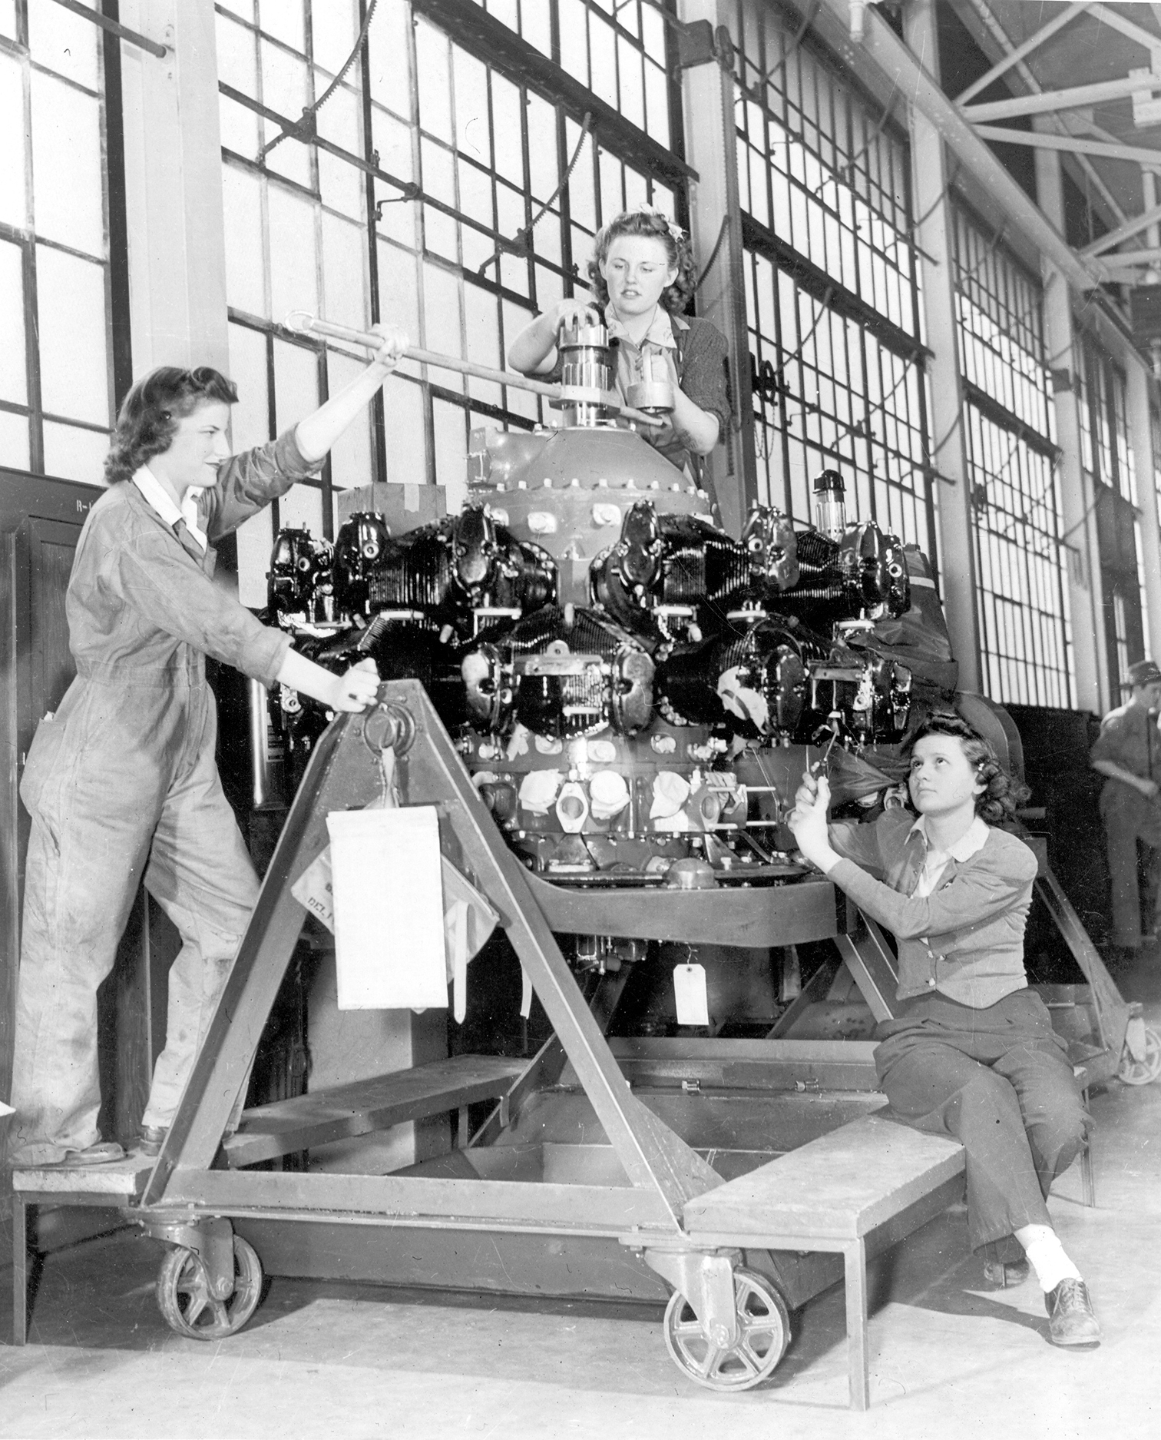
Oklahoma Vocational Education During the Second World War (1941-1945)
Under the direction of M. J. DeBenning, distributive education had become increasingly important. By 1945 it was no longer possible to properly administer it under the auspices of trades and industry.
DeBenning was appointed the first state supervisor of distributive education. That year (1945), more than 5,000 students were enrolled in the various types of distributive education classes which were offered.

Slide 13
Vocational Education At War’s End: The George-Barden Act (1946)
National and state leaders of vocational education realized that the task of assimilating the returning veterans and war production workers into the economy would require a massive increase in classes and instructors.
Teacher training in Oklahoma had been accelerated. However, help was needed from the federal government to adequately prepare for the influx of students.
The Vocational Education Act of 1946 was known as the George-Barden Act. It provided for a sizable increase in the amount of federal aid to vocational education and allowed for greater flexibility in the use of funds:
  more than doubled the annual federal appropriations for all forms of vocational education
  changed the formula for distributing the funds away from equal distribution
Notes:
PRESENTER’S NOTES
Congress had previously divided $12 million annually among agriculture, home economics, and trade and industries equally. From the larger appropriations approved by the new Act, vocational agriculture would receive $10 million per year, home economics and trade and industries $8 million each, and distributive education $2.5 million.
Distributive Education Clubs of America (DECA) is formed at a convention of state organizations held in Memphis. Oklahoma becomes a charter member.

Slide 14
Expansion of the Mission of Vocational Education through Federal Legislation (1956-1963)
Health Amendment to the George-Barden Act (1956)
National Defense Education Act (1958)
Congress added the preparation of practical nurses to the mission of state vocational education programs
Provided an additional $60 million for states’ vocational training over four years—almost double what had been available
Required that the extra funds be used exclusively for the training of “highly skilled technicians in recognized occupations requiring scientific knowledge in fields necessary for the national defense”
Notes:
PRESENTER’S NOTES
What else was happening at this time?
Segregation ruled illegal in Brown v. Board of Education of Topeka (1954)
Federal-Aid Highway Act paves the way for the interstate highway system (1956)
Soviet Union launches the Sputnik satellite (1957)
Cuban missile crisis; John Glenn becomes first U.S. astronaut to orbit Earth (1962)
President John F. Kennedy assassinated; Dr. Martin Luther King, Jr., gives “I Have A Dream” speech (1963)
“In what is commonly referred to as the Brown decision, the United States Supreme Court unanimously holds that legally imposed segregation of the public schools violates Constitutional guarantees under the Fourteenth Amendment. Although other states resist, all stubbornly, Oklahoma begins dismantling its separate-but-equal school system immediately. The beginning comes quickly for Oklahomans, but the end will come slowly for everyone.”—Danney Goble, Learning to Earn
Initially assigned to trades and industries, practical nursing education later broke off to become an independent division.
“The Second World War had put change in motion, and the momentum carried over into the fifties and beyond. Few then could have sensed it—only the perspective of time made it evident—but the 1950s may have been the hinge upon which the state’s entire history turned.”—Danney Goble, Learning to Earn

Slide 15
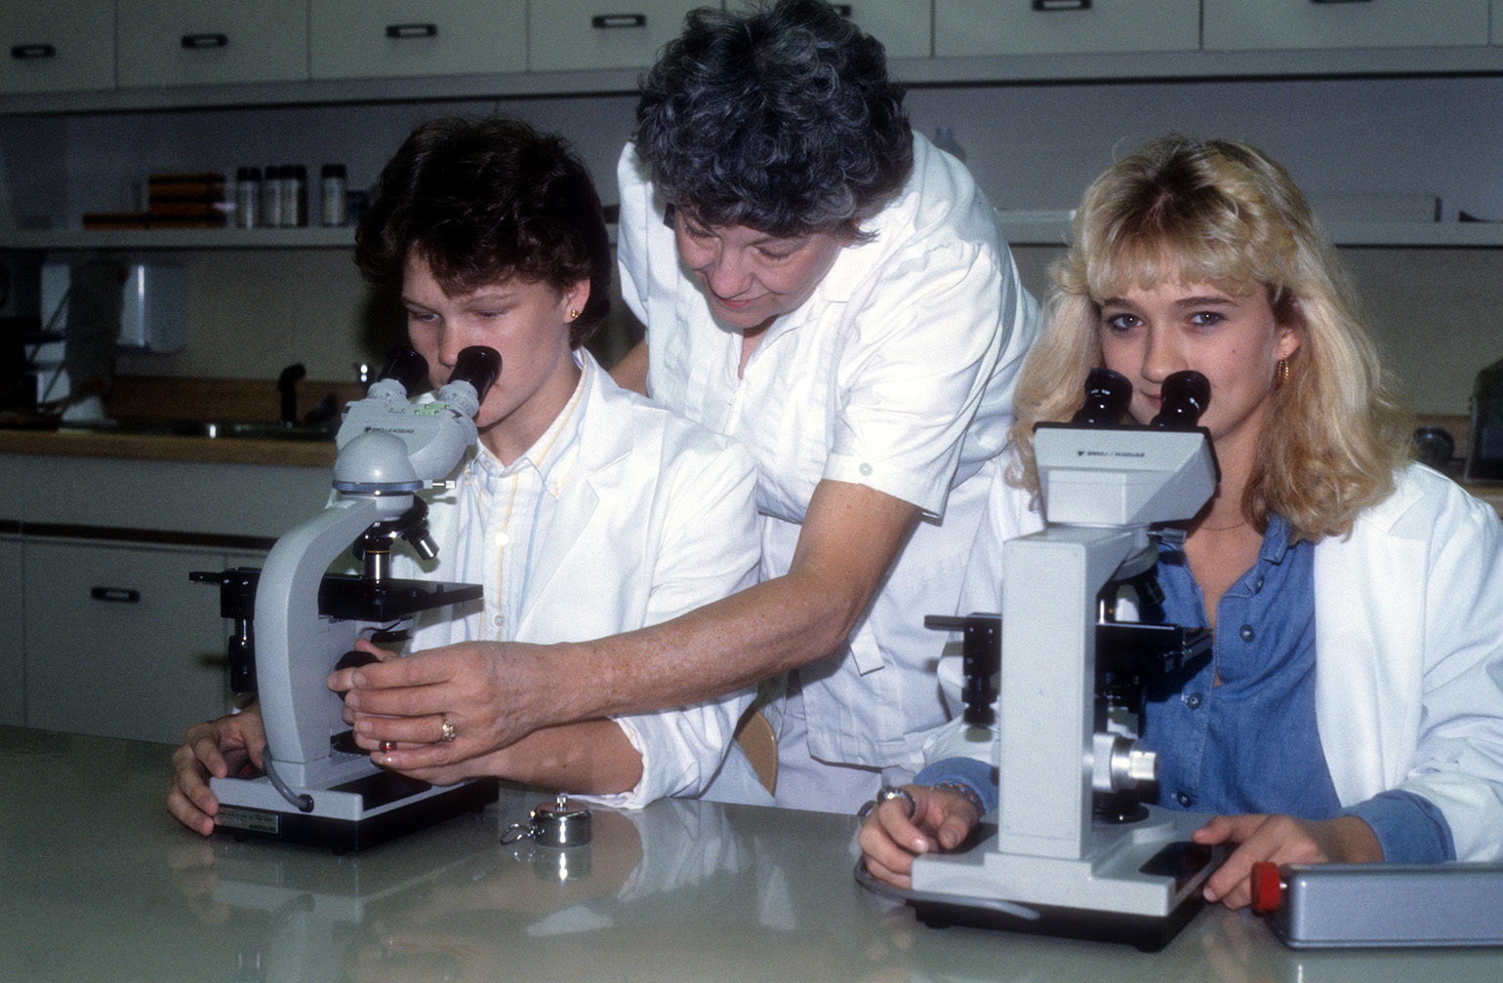
Expansion of the Mission of Vocational Education through Federal Legislation (1956-1963)
Manpower Development and Training Act (1962)
Provided for advanced technical training to the unemployed and to victims of automation
Notes:
PRESENTER’S NOTES
“After two years of study and deliberation, a panel of experts charged by the United States Department of Health, Education, and Welfare to evaluate the state of vocational education in America issues a blistering report: Education for a Changing World of Work. It is extremely critical of traditional programming, in particular its focus upon occupational divisions, especially when so many of the occupations seem hopelessly outdated. Instead, it recommends that vocational education target not professions but people, especially those heretofore systematically slighted, if not ignored altogether.”—Danney Goble, Learning to Earn
“The idea of vocational education programs designed to serve an area of a State rather than a single community found expression…in the National Defense Education Act [of 1958]. The purpose then was to train highly skilled technicians for fields necessary for the national defense; but the Vocational Education Act of 1963 specifies area schools with a larger purpose—to provide vocational education in the broad sense in which the act defines it. What the new act does is to provide funds for the construction of area schools—something that NDEA did not do.”—The Vocational Education Act of 1963 (Report Number OE-80034), U.S. Department of Health, Education, and Welfare, 1965

Slide 16
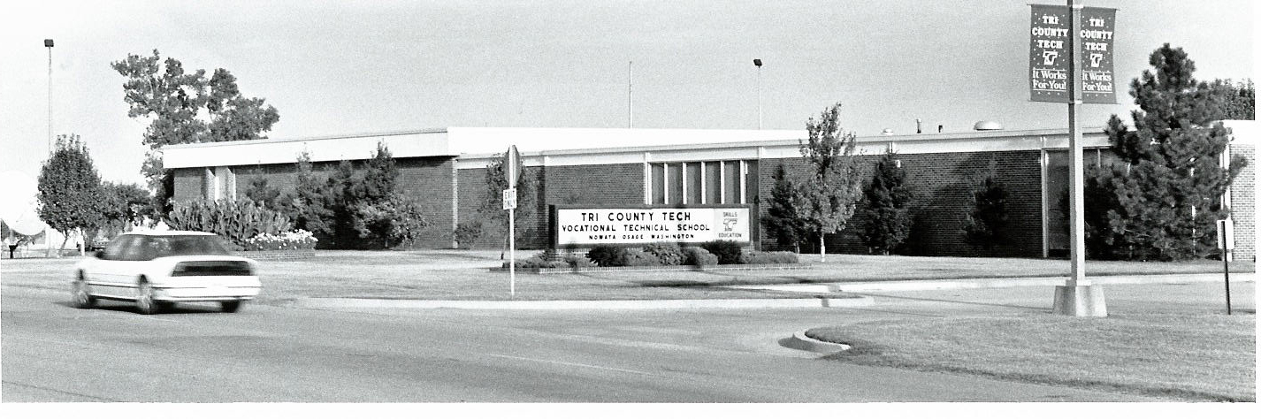
Expansion of the Mission of Vocational Education through Federal Legislation (1956-1963)
Vocational Education Act (1963)
Modified formulas to divide funding according to a state’s population in the ages most to gain from vocational training
Curriculum development, strategic planning, program evaluation, demonstration and experimental projects became an obligation
Required that one-third of each state’s money had to be reserved for postsecondary education for adults and for area vocational schools for secondary students

Slide 17
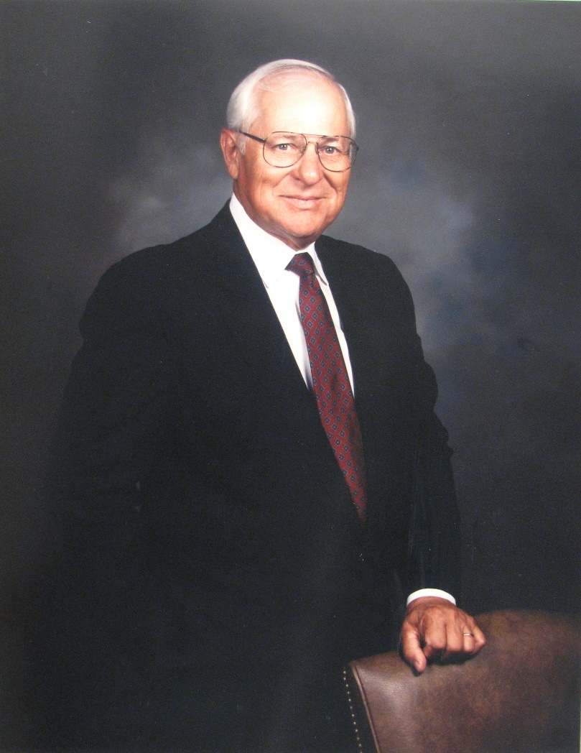
Hiring of Francis Tuttle as State Coordinator of the New Area Schools Division (1964)
Francis Tuttle—then superintendent of Muskogee Public Schools—accepted an offer from Oliver Hodge—state superintendent of public instruction—and from J.B. Perky to head the new area schools division.
Notes:
PRESENTER’S NOTES
J.B. Perky had the vision that vocational education was something that Oklahoma could become the best at; Francis Tuttle was a long-time friend of Perky and would design a state system so innovative that it would require an amendment to the state constitution.

Slide 18
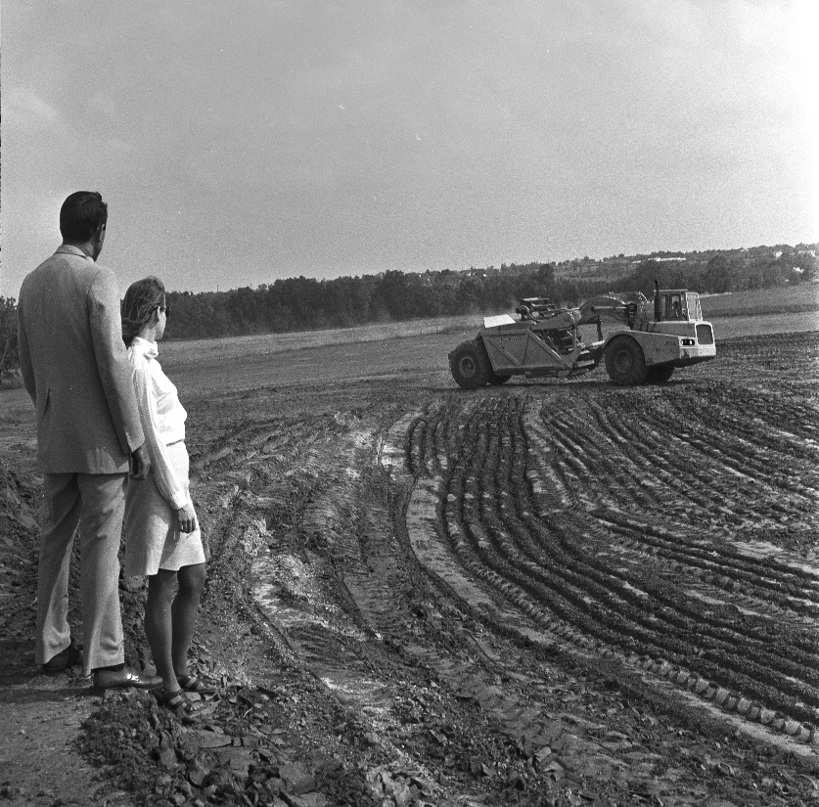
Approval of State Question 434 (1966)
Allowed one or more school districts to form a single vocational district with its own elected vocational board and expected to build and maintain area vocational-technical schools
Combined property rolls from the districts
Allowed districts to levy up to 5 mills for capital construction and ten mills more for operating expenses, subject to district voter approval
Notes:
PRESENTER’S NOTES
“In November [1966], Dewey Bartlett is elected governor. Between his election and his inauguration in January 1967, Bartlett commits himself to becoming Oklahoma’s “job-gettingest” governor ever and resolves to make the state’s vocational education system a major force in his crusade for economic expansion.”—Danney Goble, Learning to Earn
Before the passage of SQ 434 in 1966, five area vocational-technical schools were formed that were a part of their public school districts: Tulsa Tech, Foster Estes (which would eventually become Metro Tech), Red River in Duncan, Southern Oklahoma in Ardmore and O.T. Autry in Enid. While it is recognized that Tulsa was the first entity to form an area school district, all five of these schools “stuck their necks out” to test the new concept of the “area vo-tech school.”
District voters approved Tri-County Tech in Bartlesville as the state’s first area vocational-technical school in 1967.

Slide 19
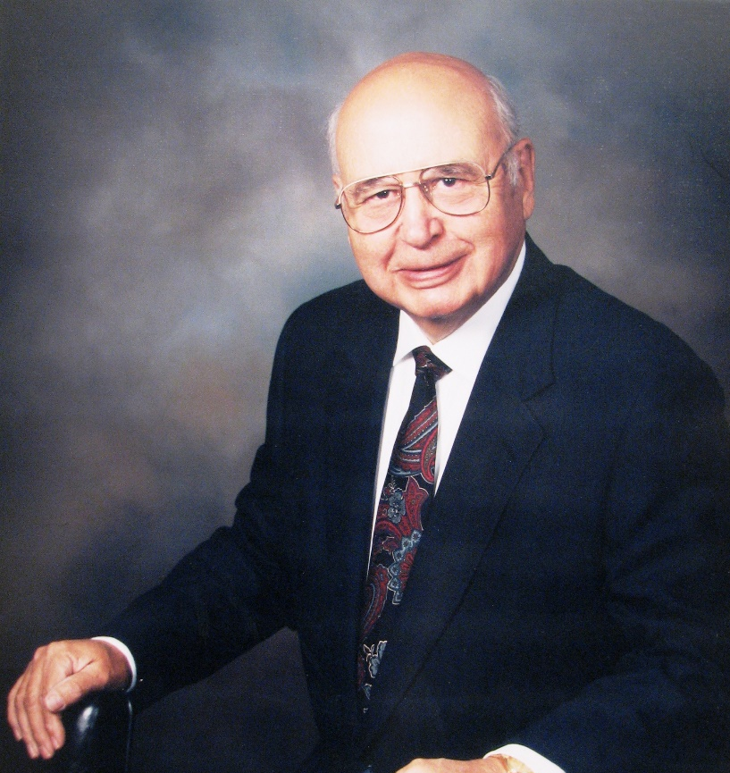
Appointment of Francis Tuttle as State Director of Vocational and Technical Education (1967)
Hired Arch Alexander as assistant state director, later deputy state director (1972)
Established a participatory, team approach
Set a single salary scale for women and men for every position across every division
Notes:
PRESENTER’S NOTES
Francis Tuttle replaced J.B. Perky as State Director.
Francis Tuttle’s first act upon taking over—and five years before any federal law required it—was to set a single salary scale and apply it to every position across every division.

Slide 20
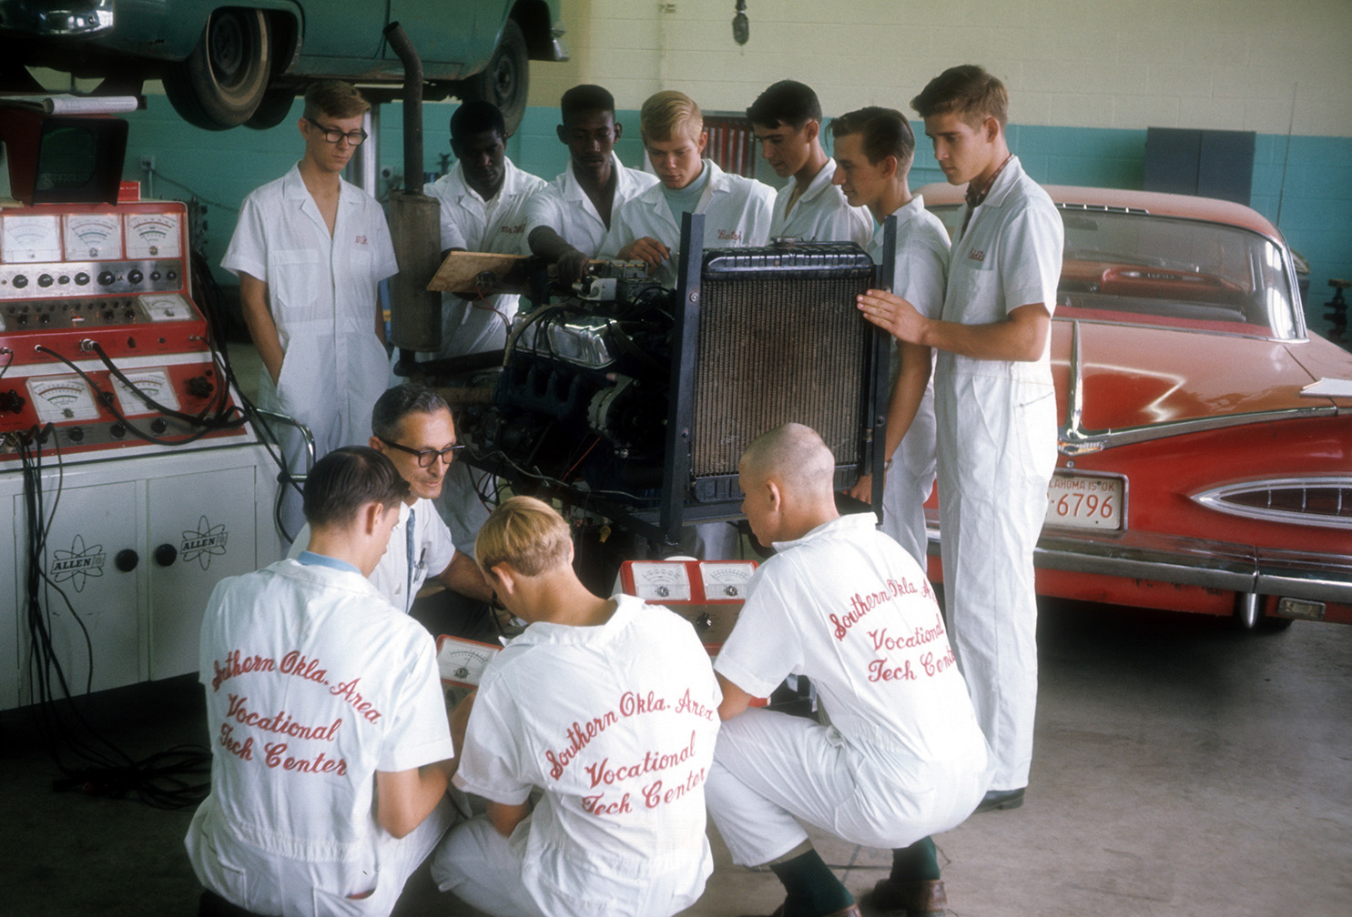
New Thrust, Single Purpose, New Model (1968)
The federal Vocational Education Amendments of 1968 reversed the thrust of vocational education away from vocations and toward education. One outcome of the 1968 law was the creation of five new divisions:
  Business and finance
  Manpower training
  Research, planning, and evaluation
  Educational services
  Special services
As of July 1, 1968, Oklahoma made the oversight of vocational education the single purpose of a newly defined, distinct official board—the State Board of Vocational and Technical Education.
Origin of Oklahoma’s Model for Vocational Education: Francis Tuttle sent Arch Alexander to South Carolina to observe and learn; Oklahoma later improved upon the South Carolina model of having special schools assigned to their own division at the state level.
Notes:
PRESENTER’S NOTES
Both Georgia and North Carolina also had solid reputations for their state programs, but South Carolina stood out from the rest. Vocational education in South Carolina meant industrial development for South Carolina. That was its principal purpose.
Oklahoma offered the nation’s first quick-start occupational training programs for new and expanding businesses; was the first state to maintain a division dedicated to short-term adult education; was first to establish a division promoting business productivity; and was first to dedicate an entire division to developing human resources. In addition, while South Carolina’s area schools were purely postsecondary, those in Oklahoma were intended for both adults and secondary students.

Slide 21
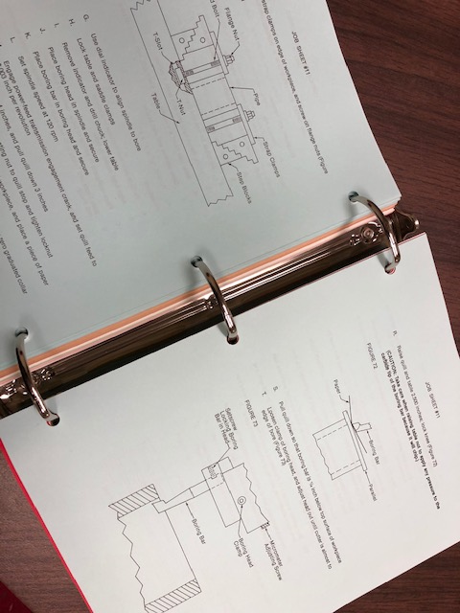
Oklahoma Becomes a National Leader in Vocational Education Curriculum (1968, 1975)
In 1968, Oklahoma established the Curriculum and Instructional Materials Center to design, develop and disseminate instructional materials for vocational programs statewide. The hallmark of CIMC curriculum was its competency-based structure and its color-coded components. The CIMC would operate for 50 years as an example of Oklahoma’s investment in quality instructional materials to support its vocational—later career and technology—education system.
Encouraged by the U.S. Office of Education, Oklahoma took the lead in organizing the Mid-America Vocational Curriculum Consortium, a multi-state project to coordinate, develop, and distribute curriculum materials. Ann Benson, who joined the state staff as a curriculum specialist in 1973, directed the project during its first 10 years. MAVCC remained a prominent source of curriculum for career and technology education nationwide for 40 years.
Notes:
PRESENTER’S NOTES
“Not even ten years after...the CIMC opened its doors, Oklahoma already had established its primacy as a national resource for curriculum and instructional materials. That meant a lot — and a lot more than just prestige. It made Oklahoma a major player in a billion-dollar-a-year business and a major influence where occupational training was presented anywhere by anybody.”
--Danney Goble, Learning to Earn: A History of Career and Technology Education in Oklahoma
“It is very evident to the members of the Third-Party Evaluation team that the main thrust of implementation of career education instructional materials in Oklahoma has been due to the efforts of the staff of the State Department of Vocational and Technical Education Curriculum and Instructional Materials Center. The most commendable aspect of the total project has been the involvement of classroom teachers, teacher educators, administrators, and state department personnel in assessing needs, development of instructional materials, field testing of career education materials, and in evaluation.”
--The Oklahoma State Department of Vocational and Technical Education Curriculum Laboratory Grant, Research Project in Vocational Education, Final Report, 1975

Slide 22
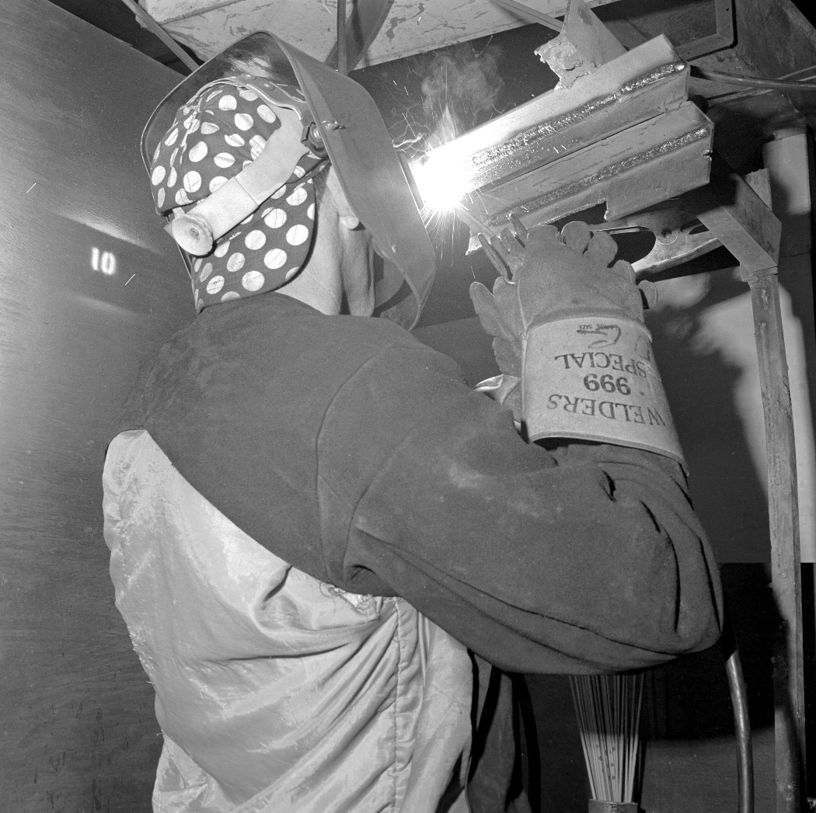
First Delivery of Vocational Training to Inmates at a Skills Center (1971)
Under the jurisdiction of the state Department of Corrections, the first vocational training classes were provided to inmates at the Ouachita facility, near Hodgen in eastern Oklahoma.
The Skills Centers Division has grown to encompass multiple programs in public and private correctional facilities statewide, including juvenile facilities. It has evolved into a virtual statewide school system within prison walls.
Notes:
PRESENTER’S NOTES
“Tensions surface [1973] between the State Department of Vocational-Technical Education and the State Regents for Higher Education. At issue is control over the vocational programs that are offered through the state colleges and universities. The parties agree to compromise their differences beginning this year by entering into formal contracts whereby the SDVTE [State Department of Vocational and Technical Education] agrees to hand over to the regents the federal funds that it receives to support vocational education that is offered at the postsecondary level. Such compromises will only delay final resolution, until the two parties can take their differences to the state supreme court. The court will decide the issue in favor of the SDVTE.”—Danney Goble, Learning to Earn

Slide 23
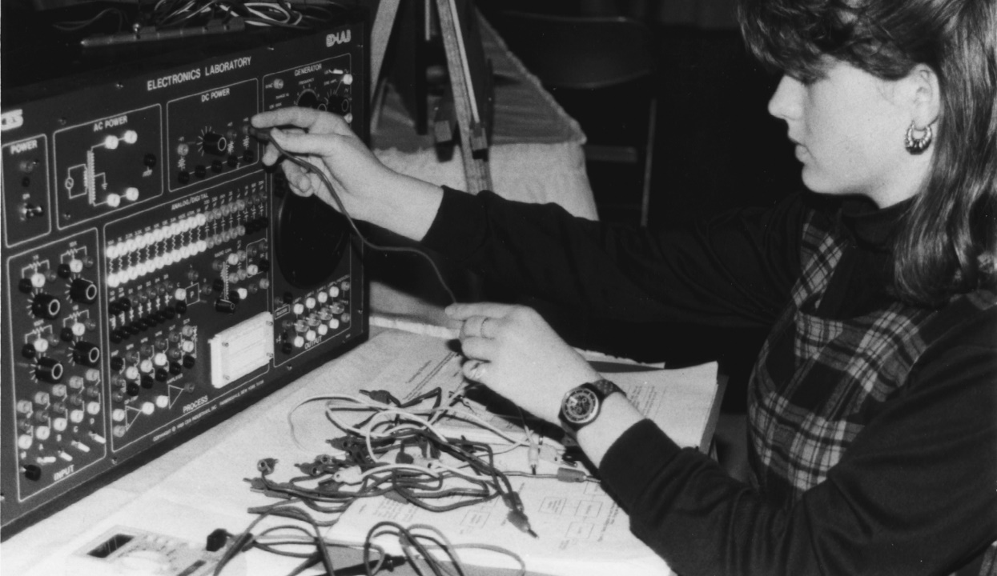
Enactment of the Displaced Homemaker Act by the Oklahoma State Legislature (1976)
The federal Vocational Education Amendments of 1976 prohibited gender discrimination in vocational education’s programming.
Oklahoma enacted the Displaced Homemaker Act.
Required the State Board of Vocational and Technical Education to develop job training counseling, money management and placement programs for displaced homemakers through multi-purpose centers within the area vocational-technical schools.
Notes:
PRESENTER’S NOTES
In 1974, the Oklahoma Health Occupations Student Organization is formed. Health Occupations Students of America—or HOSA—was officially organized in 1976 with Oklahoma as a charter state.
In 1978, the American Industrial Arts Student Association was established with Oklahoma as one of the first state associations. It later became Technology Student Association, or TSA.

Slide 24
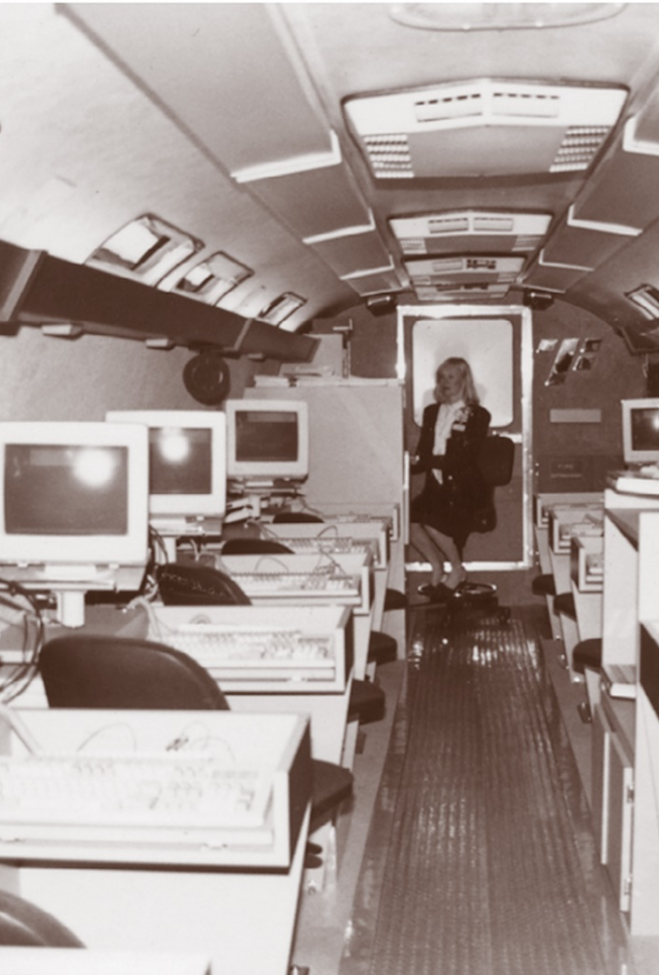
Training for Industry (1976)
As a measure of vocational education’s contributions to bringing new investments and jobs to Oklahoma, its various programs — the Training for Industry (TIP) projects in particular — are credited with being major factors in the year’s increase of $58,471,000 in capital investments in Oklahoma and the addition of 2,672 new jobs for its people.

Slide 25
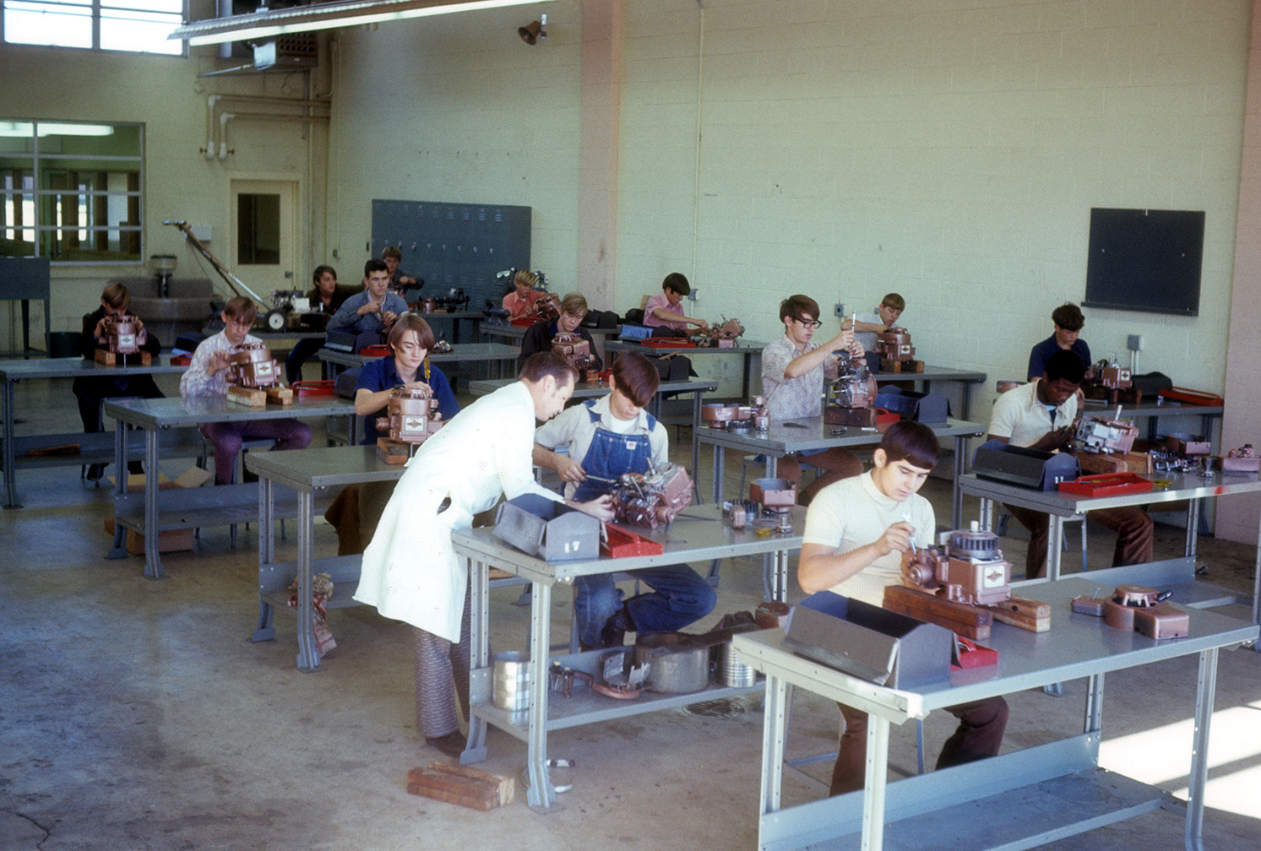
Legislation Enhancing Vocational Programs and Expanding Student Populations (1984-1998)
Carl D. Perkins Vocational Education Act (1984)—authorized funding to improve vocational programs and serve special student populations
Carl D. Perkins Vocational and Applied Technology Education Act (1990)—increased federal funding for vocational education, including Tech Prep
Oklahoma Youth Apprenticeship Program (1993)—established by the state legislature, to be administered and supervised by the State Board of Vocational and Technical Education
Dropout Recovery Programs (1998)—established by the state legislature within technology center districts
Notes:
PRESENTER’S NOTES
“As a measure of the value that Oklahoma employers attach to SDVTE [State Department of Vocational and Technical Education] training, an estimated two-thirds of the state’s largest and most competitive firms have made vo-tech certification a minimum requirement for hiring.”—Danney Goble, Learning to Earn
The 1990 Act placed a great deal of emphasis on the integration of vocational and academic instruction. Congress believed that for vocational education to remain relevant and to be able to prepare students for the increasingly technological and complex jobs of the future, it would have to teach broader skills and incorporate basic academic concepts into its curriculum.
The 1990 Act further strengthened the provisions related to the provision of educational services to disadvantaged, disabled and other special population students.
Both Tech Prep and the integration of academic and vocational instruction were intended to position the Perkins Act as a tool for educational reform by linking vocational education more closely with academics and with instruction at the postsecondary level.

Slide 26
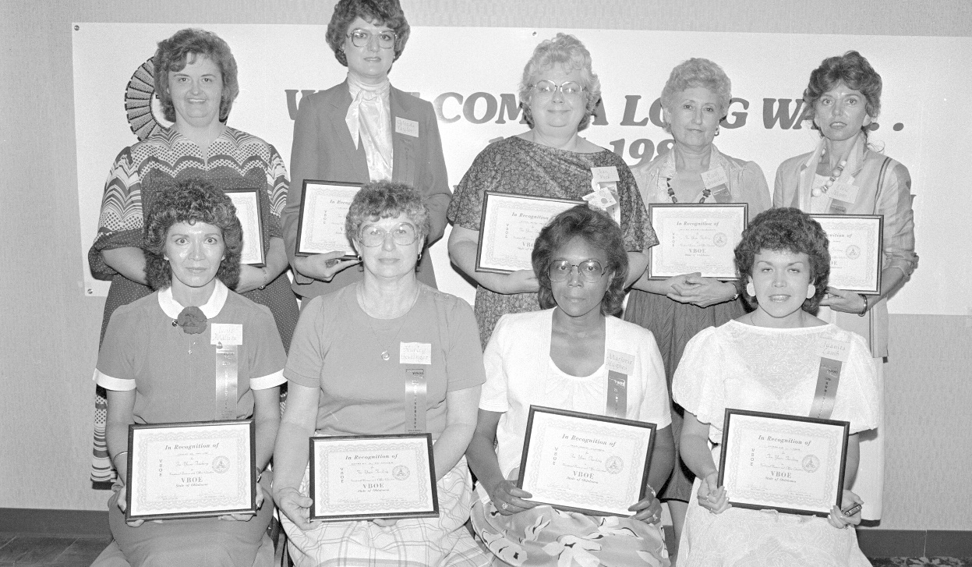
Over 200,000 Vocational Enrollments (1985)
Francis Tuttle retired after 18 years as state director in 1985.
Vocational enrollments reached over 200,000.
The system grew to a network of 25 districts with 41 sites statewide.

Slide 27

State Agency Launches “Skills to Rebuild” Effort (1999)
After a series of tornadoes struck across the state on the evening of May 3, the state agency prepared and presented a comprehensive “Skills to Rebuild” curriculum through 13 of the area vocational-technical schools. The classes were intended to equip people with the skills they needed to repair their own homes and businesses.

Slide 28
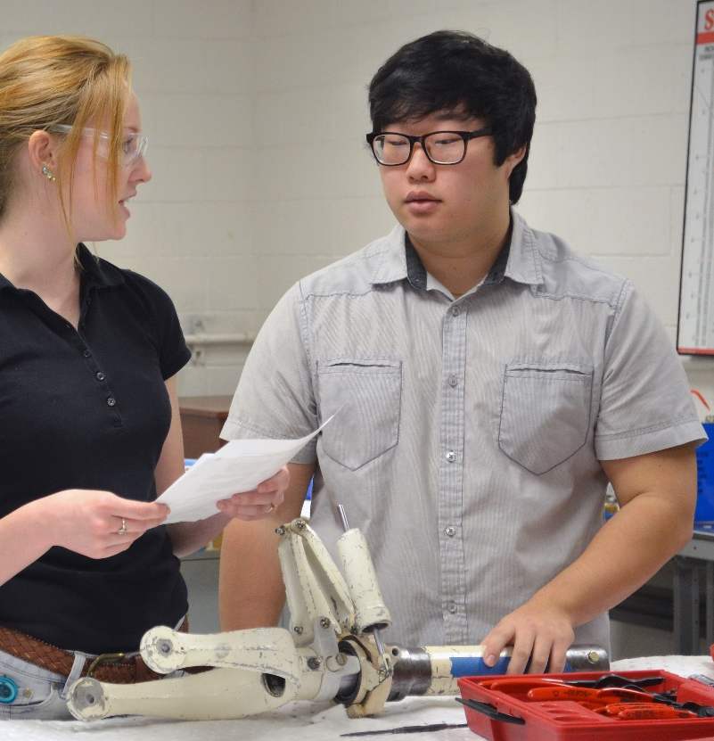
Agency Name Change (2000)
Oklahoma House Bill 2128
Changed the name of the state agency to the Oklahoma Department of Career and Technology Education
Changed the name of the state board to the State Board of Career and Technology Education
Notes:
PRESENTER’S NOTES
This change paralleled a national trend; the American Vocational Association had already become the Association for Career and Technical Education, and thirty other states had replaced “vocational” in the names of agencies and governing boards with “career,” “technology,” and other variations.
In Oklahoma, the area vocational-technical schools became technology centers.

Slide 29
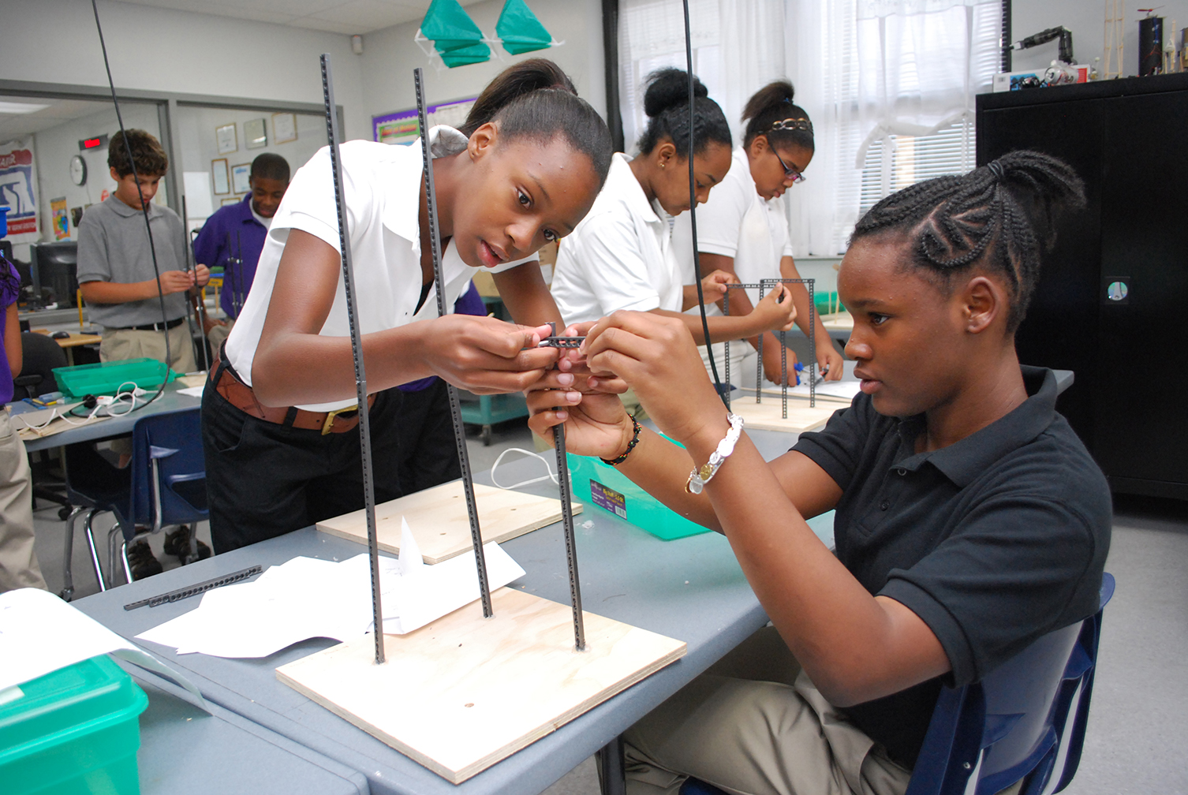
Passage of State Bill 1271 (2004)
The Oklahoma legislature passed State Bill 1271, which authorized technology centers to hire certified instructors to teach math and science (including calculus and physics) for pre-engineering, biomedical science, and biotechnology students.
In addition, CareerTech partnered with the Oklahoma State Regents for Higher Education to launch the Cooperative Alliance Program, which allowed high school students to earn college credit toward science degrees by completing courses at technology centers or colleges.

Slide 30

Perkins Act Includes CTSO Activities as Allowable Use of Funds (2006)
The 2006 Perkins Act, an updated version of earlier Perkins laws passed in 1998, 1990, and 1984, provided resources to secondary and postsecondary career and technical education programs to support innovation and program improvement. The Perkins Act specifically includes career and technology student organization activities as an allowable use of funds at the state and local level.
Local uses of funds for supporting career and technical student organizations can include “student preparation for and participation in technical skills competitions aligned with career and technical education program standards and curricula” (Carl D. Perkins Career and Technical Education Act of 2006, as amended through P.L. 116-6, enacted February 15, 2019).

Slide 31

Reaching 500,000 Total Enrollments (2004)
State legislature authorized technology centers to hire certified instructors to teach math and science (including calculus and physics) for pre-engineering, biomedical science, and biotechnology students.
The state CareerTech system partnered with the State Regents for Higher Education to launch the Cooperative Alliance Program—allowed high school students to earn college credit toward science degrees by completing courses at technology centers or colleges.
Oklahoma voters approve Oklahoma Lottery Trust Fund to help support education.
Notes:
PRESENTER’S NOTES
As of 2018, the lottery raised nearly $900 million for Oklahoma’s educational system.

Slide 32

Partnership with Oklahoma Military Connection (2012)
Oklahoma Military Connection places civilian employers in contact with Oklahoma Transitioning military, veterans, service members, and their families.
A cooperative effort among:
  Oklahoma Employment Security Commission
  Office of Workforce Development
  Oklahoma Department of Career and Technology Education (CareerTech for Vets)
  Oklahoma Military Department (Employment Coordination Program)
  Citizen Soldier For Life
Notes:
PRESENTER’S NOTES
Sponsors online resources, hiring events, and career services.

Slide 33
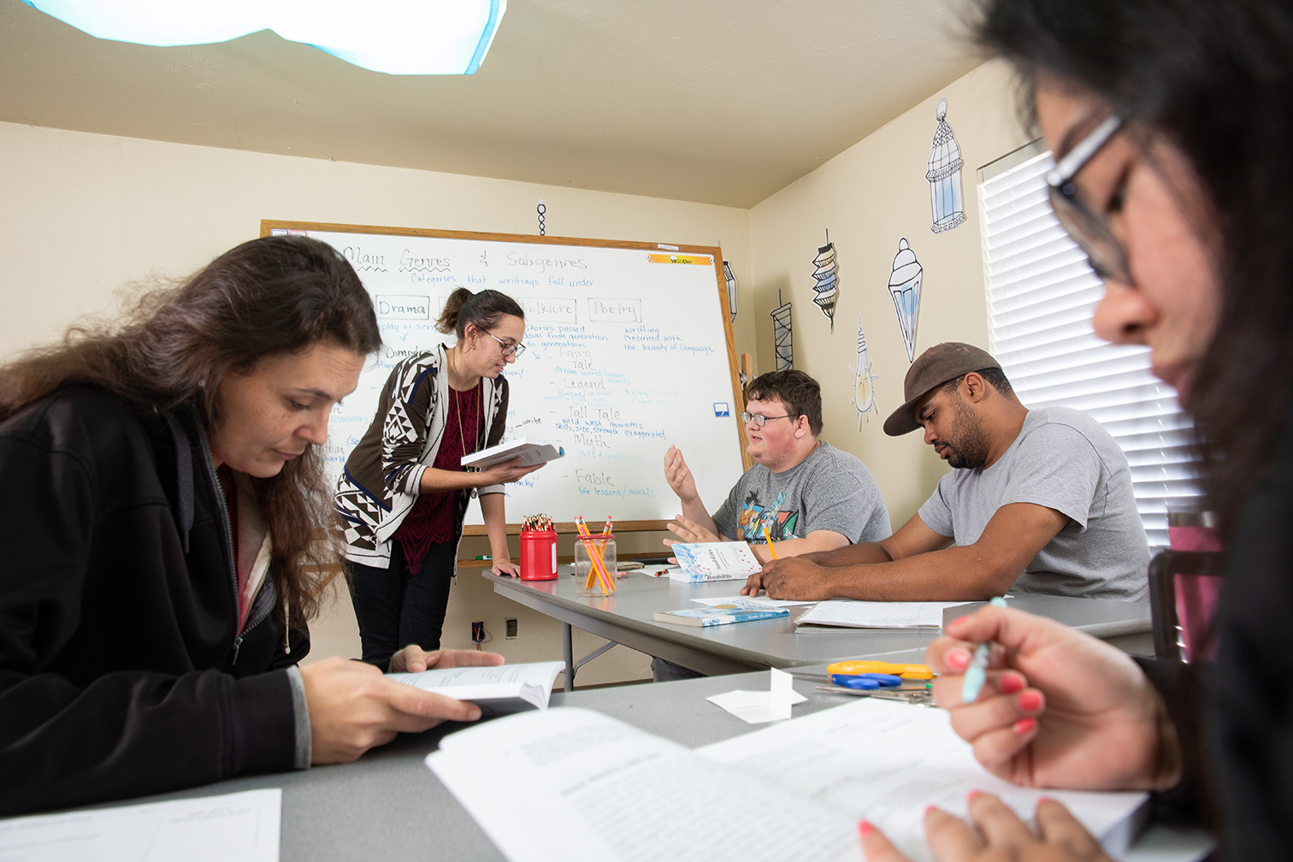
Addition of Adult Basic Education (2014)
The state legislature moved the Adult Education-Lifelong Learning grant to the Oklahoma Department of Career and Technology Education.
The federal Workforce Innovation and Opportunity Act, Title II: Adult Education and Family Literacy Act provides supplemental funds to help adults become employable, productive citizens through:
  Adult basic education (ABE)
  High school-level courses for GED students
  English as a Second Language (ESL)
  U.S. citizenship classes
  English language literacy
  Civics education

Slide 34
Launch of OKCareerGuide.org Website (2015)
Partnership among the Oklahoma Department of Career and Technology Education, CareerTech for VETS, Oklahoma Works and Kuder Connect 2 Business.
Website includes self-assessments, training information, and resource links.
OKCareerGuide.org offers:
  Education and planning resources and guidance for middle school, high school, postsecondary, and adult students
  Career transition information for veterans
  Resources for parents, teachers, and school counselors
  Opportunities to target businesses and other potential employers

Slide 35
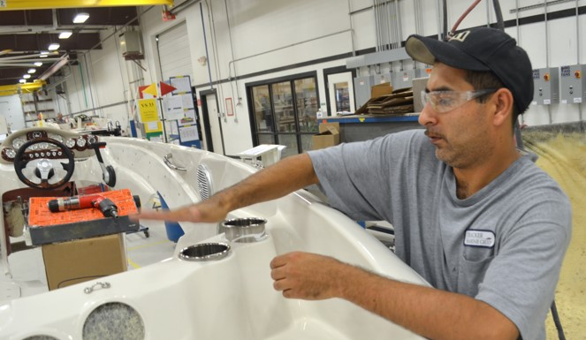
Oklahoma CareerTech By the Numbers (FY21)
394 PK-12 school districts
29 technology center districts with 59 campuses
14 Skills Centers sites
31 adult basic education providers at 116 sites
426,125 total enrollments
20,606 technology center enrollments
893 skills centers enrollments
5,670 companies served
Notes:
PRESENTER’S NOTES
*Cost-Benefit Analysis of CareerTech Career Majors - Lifetime Income Gains and the Impact on the Oklahoma Economy. A study prepared by: Mark C. Snead, Ph.D., March 2013.
“CareerTech in Your Community” resources: https://www.okcareertech.org/about/careertech-system/careertech-in-your-community

Slide 36

“Oklahoma had outdone the professionals’ expectations and even its own ambitions. It also had outdone its original model: South Carolina. In fact, it had left South Carolina far behind not only in its special schools but in the area schools as well.
“There was a reason. Right from the start, everyone from Governor Bartlett and Francis Tuttle on down had insisted that Oklahoma must build area schools open to both secondary students and adults.”
—Danney Goble, Learning to Earn: A History of Career and Technology Education in Oklahoma

Slide 37
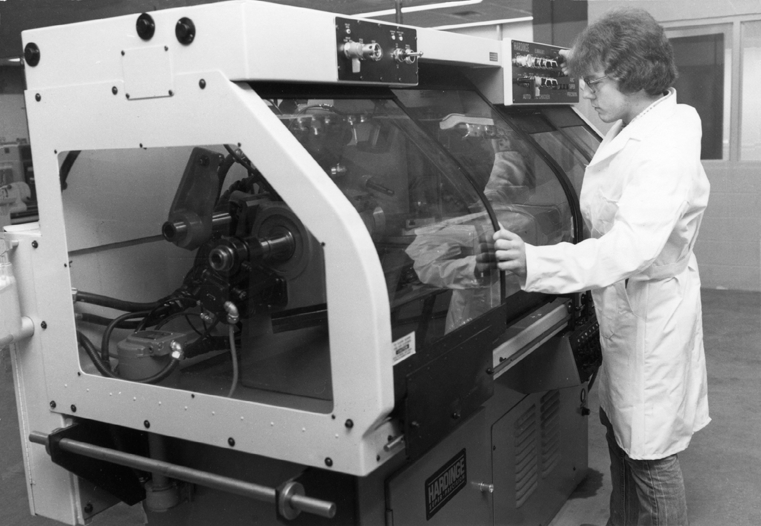
Acknowledgments
Content: Danney Goble, Learning to Earn: A History of Career and Technology Education in Oklahoma; Carl Tyson, The History of Vocational and Technical Education in Oklahoma; Oklahoma Department of Career and Technology Education
Images: Oklahoma Department of Career and Technology Education
Compilation (2022): Resource Center for CareerTech Advancement
Special Thanks: Dr. Tom Friedemann, Superintendent, Francis Tuttle Technology Center (2009-2019)

