Slide 1


Did You Know?
When carrots arrived in England and France, the lacy green tops were prized as an adornment for women’s hats and hair.
Notes:
Source: USDA/ERS, Agricultural Outlook, November 1997
Photo: © PhotoDisc, Inc., Agriculture

Slide 2
Did You Know?
Henry J. Heinz skillfully combined new advances in canning with sprightly advertising to make famous not just his pickles but his other “57 Brands,” a figure he picked out of thin air.

Slide 3
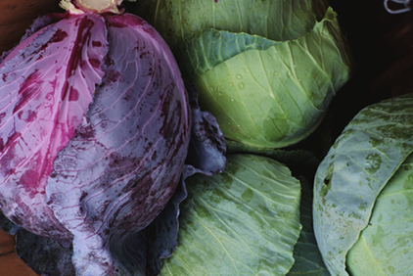
Did You Know?
It was the French who inspired the English word “cabbage,” believed to be derived from caboche, a slang term meaning “head.”
Notes:
Source: USDA/ERS, Agricultural Outlook, September 2002
Photo: © PhotoDisc, Inc., Agriculture

Slide 4
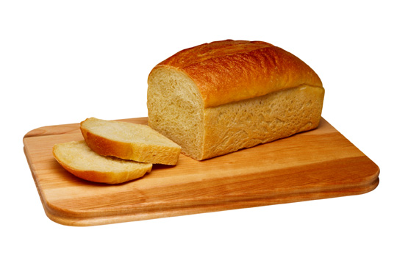
Did You Know?
Carbohydrates constitute only about 1% of body weight, but supply most of the energy needs of the body.
Notes:
Source: National Institute for Occupational Safety and Health, the Industrial Environment—its Evaluation & Control, 1973
Photo: © PhotoDisc, Inc., Market Fresh

Slide 5
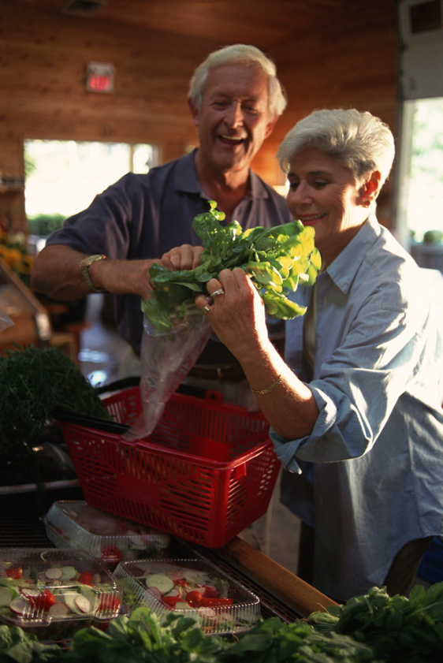
Did You Know?
Taste buds are particularly subject to wear and tear, and may be replaced every 2 weeks. The total number of buds diminishes over time, but there appears to be considerable reserve capacity, so there is normally little loss in the sense of taste as we age.
Notes:
Source: U.S. Department of Health and Human Services, Oral Health in America: A Report of the Surgeon General, 2000
Photo: © Creatas, Farm to Table

Slide 6

Did You Know?
If you had 10 billion $1 notes and spent one every second of every day, it would take 317 years for you to go broke.
Notes:
Source: U.S. Department of the Treasury, Bureau of Engraving and Printing
Photo: © PhotoDisc, Inc., Shopping List

Slide 7
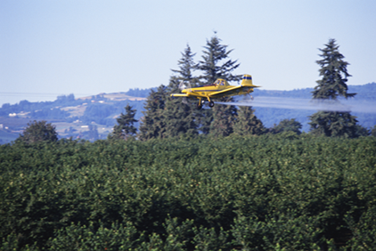
Did You Know?
Silent Spring by Rachel Carson and other books during the 1960s heightened consumer awareness of the presence of pesticides and other residues in food.
Notes:
Source: USDA/ERS, Managing for Safer Food (Agricultural Economic Report No. 817), April 2003
Photo: © PhotoDisc, Inc., Agriculture

Slide 8

Did You Know?
Fats are the major source of energy storage, help to hold body organs and nerves in position, protect against injury and shock, insulate and maintain body temperature, and act in the transportation and absorption of fat-soluble vitamins.
Notes:
Source: USDA/ERS, FoodReview, September-December 2001
Photo: © PhotoDisc, Inc., People and Lifestyles

Slide 9

Did You Know?
The age-old Camellia sinensis plant is the source of all nonherbal teas. Manufacturers process the leaves three different ways to produce green, black, and oolong—the three major classes of teas.
Notes:
Source: USDA, Agricultural Research, September 2003
Photo: © PhotoDisc, Inc., TechnoCulture and Urban Life

Slide 10

Did You Know?
Potato starch is used in baked goods, such as specialty breads, rolls, and crackers, instant pudding mixes, and molding confections, such as gum drops, jelly beans, and chewing gum.
Notes:
Source: USDA, FoodReview, Volume 24, Issue 1
Photo: © PhotoDisc, Inc., Backgrounds and Objects

Slide 11

Did You Know?
Pumpkins are native to the Americas and are members of the Cucurbit (gourd) family, which includes watermelon, cucumbers, and zucchini squash. The ornamental jack-o-lantern remains the most popular use of pumpkins in the U. S.
Notes:
Source: USDA/ERS, Vegetables and Melons Outlook (VGS-286), October 2001
Photo: © Dynamic Graphics, Active Families

Slide 12
Did You Know?
As World War II loomed in Europe, some critics…began to complain about the vitamin deficiencies of processed food. They linked such food to the dismal health status of many new military recruits.
In 1940 and 1941, physicians at Mayo Clinic found that teenagers placed on a diet low in thiamine (vitamin B1) became surly and uncooperative. As a result, the Federal Government had millers restore thiamine (dubbed the “morale vitamin”) into bread flour.
Notes:
Source: USDA/ERS, FoodReview, Volume 23, Issue 1

Slide 13

Did You Know?
Like white asparagus, white (blanched) celery is preferred in some European countries. In fact, during the early 1900’s, white celery was in vogue in the U.S., and not until the 1940’s did green celery become the industry standard.
Notes:
Source: USDA/ERS, Agricultural Outlook, November 2000
Photo: © PhotoDisc, Inc., Market Fresh

Slide 14
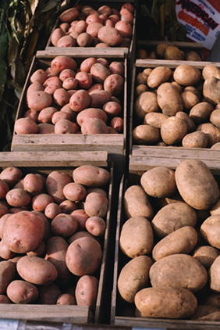
Did You Know?
Sweet potatoes are not yams. The yam is a starchy tropical root crop of Asian or African origin, unrelated to the sweet potato family. The word “yam” came from the African word “nyami.” What is marketed in the U.S. as a “yam” is really a type of sweet potato.
Notes:
Source: USDA/ERS, Agricultural Outlook, November 2002
Photo: © PhotoDisc, Inc., Agriculture

Slide 15
“He who opens a school door, closes a prison.”
--Victor Hugo
Notes:
Source: USDA/ERS, Fruit and Tree Nuts Outlook (FTS-296), January 2002
World War II (1939-1945)

Slide 16
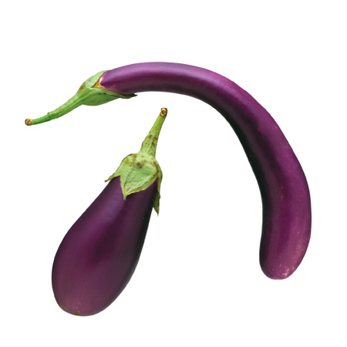
Did You Know?
Eggplant goes back about 2,000 years in the recorded history of India, and there are actually more than 30 Sanskrit names for the fruit in ancient Indian literature. Thomas Jefferson is credited with bringing the fruit to the United States.
Notes:
Source: USDA, Agricultural Research, January 2004
Photo: © PhotoDisc, Inc., Market Fresh

Slide 17
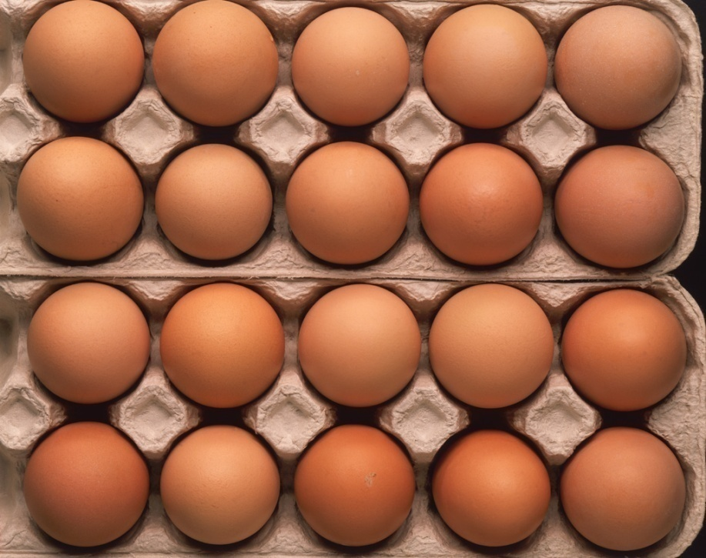
Did You Know?
Most eggs sold today are infertile because there are no roosters housed with the laying hens. Fertile eggs are often found at roadside stands or health foods stores. There are no nutritional differences between fertile and infertile eggs. If fertile eggs are not incubated there will be no development of the embryo and no way to distinguish them from infertile eggs.
Notes:
Source: The University of Maine, Cooperative Extension, Facts About Eggs (Bulletin #2257), June 2002
Photo: © Creatas, Farm to Table

Slide 18
Did You Know?
During the 1940s, researchers created frozen concentrated orange juice as a way of providing fruit to soldiers during World War II.
After the war, the juice became popular in U.S. households as consumers found it more convenient than squeezing the fruit themselves.
Notes:
Source: USDA/ERS, Fruit and Tree Nuts Outlook (FTS-296), January 2002
World War II (1939-1945)

Slide 19

Did You Know?
The term “snap beans” refers to the crackling sound made when fresh beans are broken in two. Once widely known as string beans because of their stringy pods, over the past century the tough pod strings have been bred out of most of today’s popular varieties.
Notes:
Source: USDA/ERS, Agricultural Outlook, March 2002
Photo: © PhotoDisc, Inc., Market Fresh

Slide 20
Did You Know?
The most renowned food companies today were founded in the late 1800s and early 1900s, an era noted for the Industrial Revolution and rising household incomes. As many households could no longer afford the time to process farm products, entrepreneurs capitalized by launching new food companies.
Notes:
Source: USDA/ERS, New Directions in Global Food Markets (Agriculture Information Bulletin Number 794), February 2005

Slide 21

Did You Know?
Each day an average heart “beats” (expands and contracts) 100,000 times and pumps about 2,000 gallons of blood. In a 70-year lifetime, an average human heart beats more than 2.5 billion times.
Notes:
Source: American Heart Association, Heart and Stroke Facts, 2003
Photo: © Brand X Pictures, Sporting Challenge

Slide 22

Did You Know?
In ancient China as early as 3000 to 1000 B.C., the classic Yellow Emperor’s Book of Internal Medicine first described the principle that human harmony with the world was the key to prevention and that prevention was the key to long life.
Notes:
Source: U.S. Department of Health and Human Services, Physical Activity and Health: A Report of the Surgeon General, 1996
Photo: © Corel Corporation, China

Slide 23

Did You Know?
A person blinks once every 5 seconds—a total of almost 30 minutes while you are awake each day.
Notes:
Source: National Institutes of Health, National Eye Institute
Photo: © PhotoDisc, Beauty and Health

Slide 24
Did You Know?
French hatters of the 17th century discovered that mercuric nitrate aided greatly in the felting of fur. Such use led to chronic mercury poisoning so widespread among members of that trade that the expression “mad as a hatter” entered our folk language.
Notes:
Source: National Institute for Occupational Safety and Health, the Industrial Environment—its Evaluation & Control, 1973

Slide 25
“If you can dream it, you can do it.”
--Walt Disney
Notes:
Source: USDA/ERS, Fruit and Tree Nuts Outlook (FTS-296), January 2002
World War II (1939-1945)

