Slide 1

Financial Literacy Skills
Part 1
Developed by Resource Center for CareerTech Advancement, a division of Oklahoma CareerTech

Slide 2

Managing Money
To manage money with sense, you need to learn to apply basic money management skills. These skills include finding a career that can support the lifestyle you choose and making wise decisions about how you spend and save.

Slide 3

Managing Money
Trends in Career Opportunities
Slower growth in labor force
More diverse labor force
  Growth for women increases
  Growth for men slower
Older labor force
Largest growth in service-producing industries
  Slower growth for construction
  Higher growth for agriculture and forestry

Slide 4

Managing Money
Trends in Career Opportunities - continued
Replacement needs account for 3/5 of job openings
Service and professional specialty occupations account for 2 in 5 jobs.
  Computer-related occupations=15%
  Replacement needs in agriculture, forestry, fishing
  Office automation slows increase, causes decrease
  Precision production, craft, repair occupations, fabricators, and laborers grow slower than average.

Slide 5

Managing Money
Trends in Career Opportunities - continued
Fastest-growing occupations – computer technology and health care services
Job growth varies by education and training requirements. Education essential in getting high-paying jobs.

Slide 6

Managing Money
Sources for Career Information
Career consultants
Counselors
Educational institutions
Employers
Internet networks and resources
Personal contacts
Professional societies and journals
Libraries, career centers, and guidance offices
Trade associations and magazines

Slide 7

Managing Money
Guidelines for Pricing a Job Offer
Set personal priorities.
Compare the dollar value of the job offer to your current job or to other offers.
Be realistic about negotiating.
Calculate your value and your contribution to the organization in advance.

Slide 8

Managing Money
Ways to Earn and Save Money
“Live below your means.”
Create a realistic spending plan and stick to it.
Stop impulsive buying.
Reconsider any purchase over a certain amount.
Purchase medical and auto insurance.
Charge items only if you can afford to pay for them now.
Put away your credit cards for a week or so a month and live without them.

Slide 9
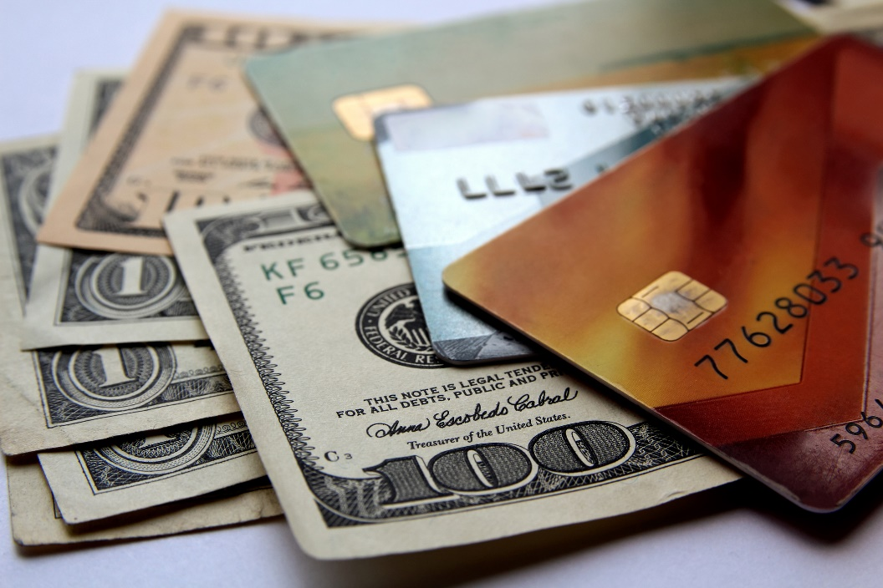
Managing Money
Ways to Earn and Save Money - continued
Never co-sign or guarantee a loan for someone or assume joint debt with someone who has a shaky financial history.
Do not make high-risk investments.
Let your savings work for you.
Shop for the smartest investments, like interest-bearing accounts.
Diversify.
Find alternatives to spending.

Slide 10

Managing Money
Ways to Earn and Save Money - continued
Earn money whenever you can.
Use your own time, ability, and talent to do tasks around the house and such.
Keep in mind that it is smarter to earn interest than to pay interest.

Slide 11

Managing Money
Fixed and Variable Expenses
Fixed expenses – set amount of money due on a set date
  Rent or mortgage
  Taxes
  Loans
  Leases
  Insurance
  Regular payments to others
  Regular contributions
  Dues
  Regular savings

Slide 12

Managing Money
Fixed and Variable Expenses - continued
Variable expenses – expense that changes is amount and frequency
  Utilities
  Charge accounts/credit cards
  Medical and dental bills
  Transportation
  Food
  Non-regular savings
  Other items such as clothing, vacations, education, entertainment, toiletries, gifts, that don’t come up on a regular basis

Slide 13
Managing Money
Basic Steps in a Financial Plan
Establish your financial goals.
  Decide what you want your money to do for you.
  Determine what style of living you want.
  List savings objectives.
Estimate and total your income.
  Determine how much money you get from all sources for the plan period. Examples: earnings, gifts, bonuses, interest earned, etc.

Slide 14

Managing Money
Basic Steps in a Financial Plan - continued
Estimate and total your expenses.
  List all your expenses, separating them into fixed and variable expenses.
  Total expenses so you know how much you spend.
Analyze your current income and spending.
  Carefully examine what you estimated for income and expenses. Overestimating income and underestimating expenses is easy to do and causes problems.

Slide 15

Managing Money
Basic Steps in a Financial Plan - continued
  Subtract expenses from income for the plan period. If you come out even or need money, consider ways to increase income or cut expenses. If you have extra money, decide how to apply it to your savings goal.
Prepare a trial financial plan.
  Should be written and list goals, income, and expenses.
  Revisit and revise your plan and update regularly.
  Put your plan into action and keep organized records.

Slide 16

Managing Money
Basic Steps in a Financial Plan - continued
Evaluate your financial plan periodically.
  Whenever your income, expenses, or goals change significantly, review your plan to see if you need to make changes.
  Significant events all have an impact on your plan. These may include graduating, going to college, starting a new job, moving, getting married, having children, changing jobs, getting divorced or death.

Slide 17

Managing Money
Factors That Influence Spending
Advertising
Availability of credit, goods, services
Environmental impacts
Needs
Wants
People
Prices
State of the economy and economic predictions

Slide 18

Managing Money
Factors That Influence Spending - continued
Technology
Traditions
Values

Slide 19

Managing Money
Methods of Managing Personal Finances
Prevention
  Develop good savings habits.
  Practice sound money management.
  Use credit wisely.
  Purchase enough insurance protection.
  Use reasonable caution in financial matters.

Slide 20

Managing Money
Methods of Managing Personal Finances - continued
Preparation
  Get a good education to be better able to find a job.
  Learn marketable job skills to advance on the job.
  Stay current in you field to earn promotions and raises.
  Establish an emergency fund equal to at least six months’ pay.
  Regulate your lifestyle to live below your income level in case of unexpected expenses or lower income.

Slide 21

Managing Money
Methods of Managing Personal Finances - continued
Coping with financial challenges
  Accept that your financial crisis is real and won’t go away on its own.
  If you’re in debt, contact creditors immediately to arrange payment plans – don’t wait until you miss payments.
  Avoid making any new credit purchases.
  Find free or inexpensive financial counseling.
  Adjust your spending habits and cut expenses.

Slide 22

Managing Money
Methods of Managing Personal Finances - continued
  Encourage additional family members to look for employment.
  Look into sources of assistance from employers, insurance, government programs, and community or charitable organizations.
  Consider selling items such as real estate, jewelry, investments, cars, and other valuable possessions. Even books and clothes can be sold.

Slide 23

Managing Money
State Guidelines for Using a Budget
Determine your goals.
Estimate your income.
Estimate your expenses – include savings.
Earmark money available for expenses.
Spend money according to the budget.
Regularly compare estimates to actual amounts of spending and income.
Evaluate your budget and revise as needed.

Slide 24
Managing Money
Items Deducted by Law from a Paycheck
Social Security (FICA)
Unemployment insurance (state and federal)
Workers’ Compensation
Federal income tax
State and city income tax

Slide 25

Managing Money
Items Deducted by Request from a Paycheck
Union dues
Group insurance plan premiums
Savings account deposits
Flexible spending account funds
Investments
Retirement plans

Slide 26

Managing Money
Benefits Reflected in a Paycheck
Health insurance
Life insurance
Tax-sheltered investments
Sick leave
Annual leave, vacation time, or personal time
Holiday leave or pay
Workers’ compensation
Retirement/pension plans
Profit-sharing and stock purchase programs

Slide 27

Managing Money
How Games of Chance Work
Outcome depends on random event.
Unlike games of skill.
Nothing player can do to increase odds of winning.
Lotteries and modern slot machines are games of chance.
Odds are against the player.
In the long run, the casino or lottery always wins.

Slide 28

Managing Money
Costs and Benefits of Gambling
Costs
  Can become an addiction.
  You can spend more than you can afford to lose.
  Gambling increases crime.
Benefits
  Jobs in the industry
  Income can be used to benefit society.
  Entertainment

Slide 29

Managing Money
Types of Charitable Giving
Monetary donations
Volunteer service
Gifts-in-kind

Slide 30

Managing Money
Impact of Charitable Giving
Tax benefits
Personal satisfaction
Creation of jobs
Reducing waste
Benefit to the community

Slide 31

Understanding Banking
“Reckless Lifestyle Leads to Financial Loss.” This headline is fictitious, but it accurately describes the lives of real people who manage their money poorly. People who do not understand money matters, pay little attention to banking regulations, and fail to use their money in productive ways, may not only ruin their credit but also waste thousands of dollars during their working years. Using financial services wisely is one way to help avoid wasting money.

Slide 32

Understanding Banking
Functions of a Full-Service Bank
Receive deposits
Provide checking and savings accounts
Transfer money to/from accounts
Electronic funds transfers (EFT)
Pre-authorized bill payment
Make loans
Advise customers on services

Slide 33

Understanding Banking
Functions of a Full-Service Bank – continued
Make account information and transactions available online
Provide insurance on deposits (FDIC)
Provide special services (often for a fee)
  Cashier’s checks
  Certified checks
  Money orders
  Safe-deposit boxes
  Traveler’s checks and more

Slide 34

Understanding Banking
Types of Financial Institutions
Brokerage firm
Commercial bank
Savings and loan association
Credit union
Mortgage company
Mutual savings bank

Slide 35

Understanding Banking
Types of Financial Institutions - continued
Life insurance companies
Investment companies
Finance or loan companies
Financial supermarket

Slide 36

Understanding Banking
Reasons Why Financial Institutions Pay and Charge Interest
Why they pay interest:
  To encourage depositors to use their institution
Why they charge interest:
  To earn money
  Institutions pay less interest to depositors than they charge borrowers, so they make a profit.

Slide 37

Understanding Banking
Types of Interest
Simple interest – calculated on a yearly percentage rate based on original loan.
Compound interest – calculated on the amount of the account at regular time periods; interest added into balance so balance grows each time it is added.
Compound interest is better for savers.
It is a disadvantage for borrowers.

Slide 38

Understanding Banking
Functions of Bank Accounts
Provide a convenient way to buy goods and services and pay bills.
Provide legal proof of payment; check serves as receipt.
Protect money from theft or loss.
Eliminate need to carry lots of cash.
Provide a record of money spent.
Allow access to other banking services.

Slide 39

Understanding Banking
Functions of Bank Accounts - continued
Provide a record of transactions.
Serves as a credit reference.

Slide 40

Understanding Banking
Steps in Opening a Bank Account
Receive bank documents.
Provide personal identification.
Fill out the signature card.
Sign the signature card.
Deposit money using deposit slip.
Order personalized checks, if desired.
Apply for ATM or debit cards.

Slide 41

Understanding Banking
Types of Checking Accounts
Regular checking; minimum balance is usually required to avoid service charge.
Special accounts; also known as limited activity accounts; for those with low balances and/or few transactions; low flat fees or per transaction fee.
Interest-bearing; pays interest on account but requires higher balance.

Slide 42

Understanding Banking
Types of Checking Accounts - continued
Share accounts; checking account at a credit union; similar to regular checking account at a bank

Slide 43

Understanding Banking
Types of Savings Accounts
Regular Savings - can add money or withdraw money at any time; pays lowest interest rate.
Certificates of Deposit (CD) – certain amount is deposited for a specific length of time; the longer the time, the higher the interest; penalty for early withdrawal.
Money Market – pays interest based on U.S. Treasury rates; usually require a minimum balance.

Slide 44
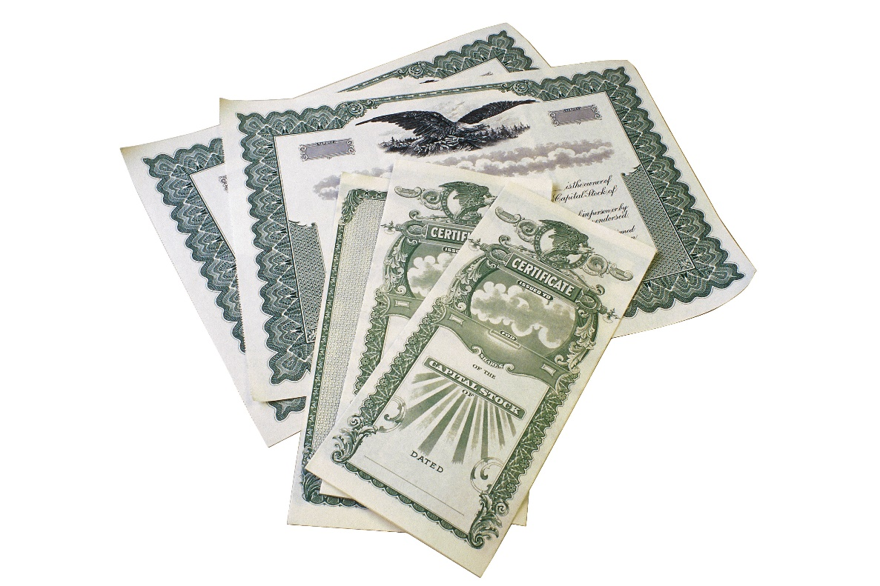
Understanding Banking
Types of Savings Accounts - continued
Savings Bond – non-transferrable debt certificates issued by the U.S. Treasury; held to maturity (usually 30 years) with fixed interest rate paid every six months; exempt from state and local tax.

Slide 45
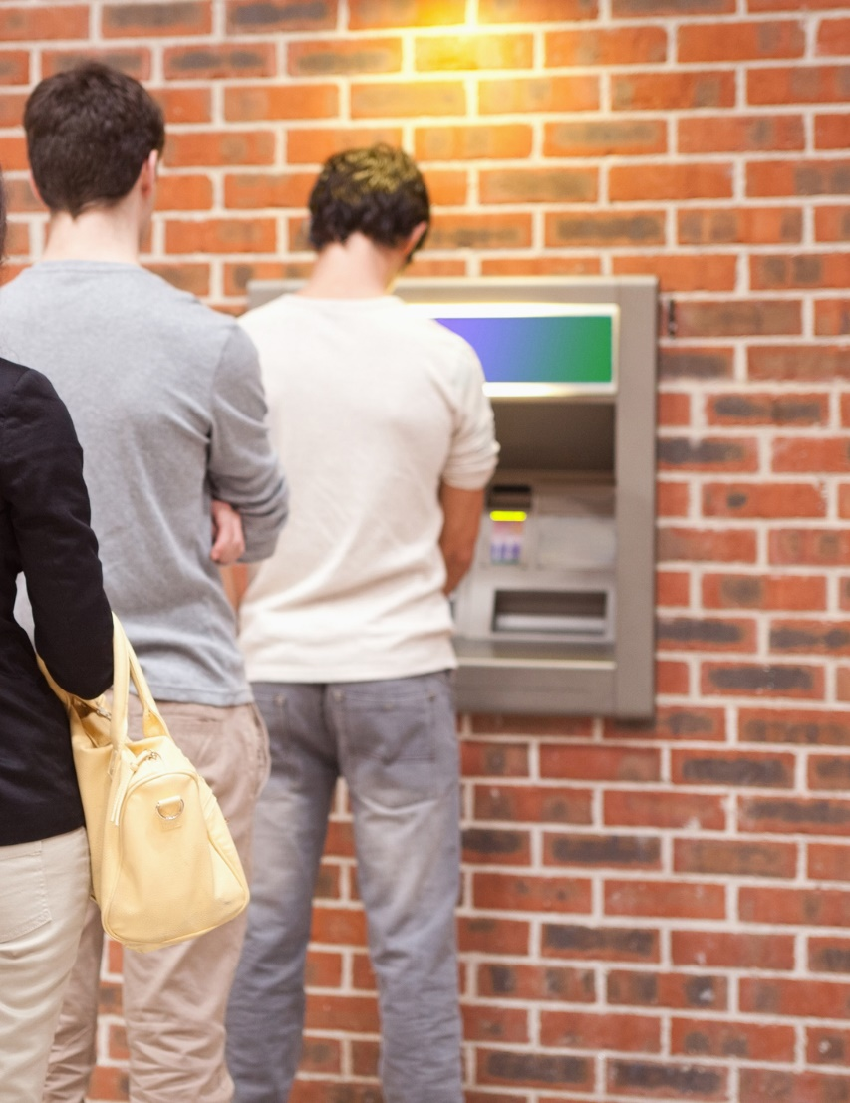
Understanding Banking
Types of Electronic Banking Services
ATM (automated teller machine) – cash station located in convenient places; available 24/7 year-round.
Automatic savings – at customer’s request, institution withdraws money from checking and deposits into savings on a regular basis.
Automatic loan payments – at customer’s request, loan payment is deducted from checking and goes toward loan balance.

Slide 46
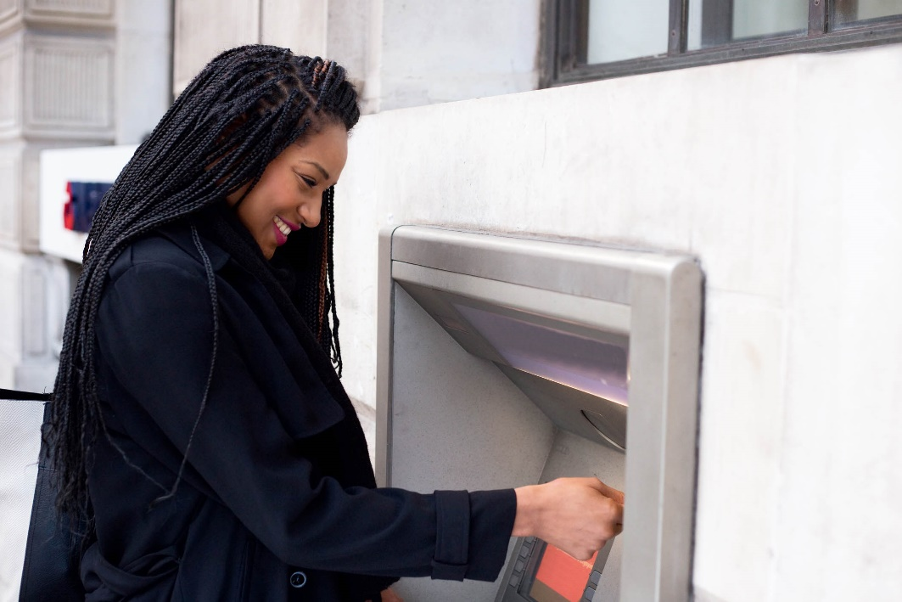
Understanding Banking
Types of Electronic Banking Services
ATM (automated teller machine) – cash station located in convenient places; available 24/7 year-round.
Automatic savings – at customer’s request, institution withdraws money from checking and deposits into savings on a regular basis.
Automatic loan payments – at customer’s request, loan payment is deducted from checking and goes toward loan balance.

Slide 47
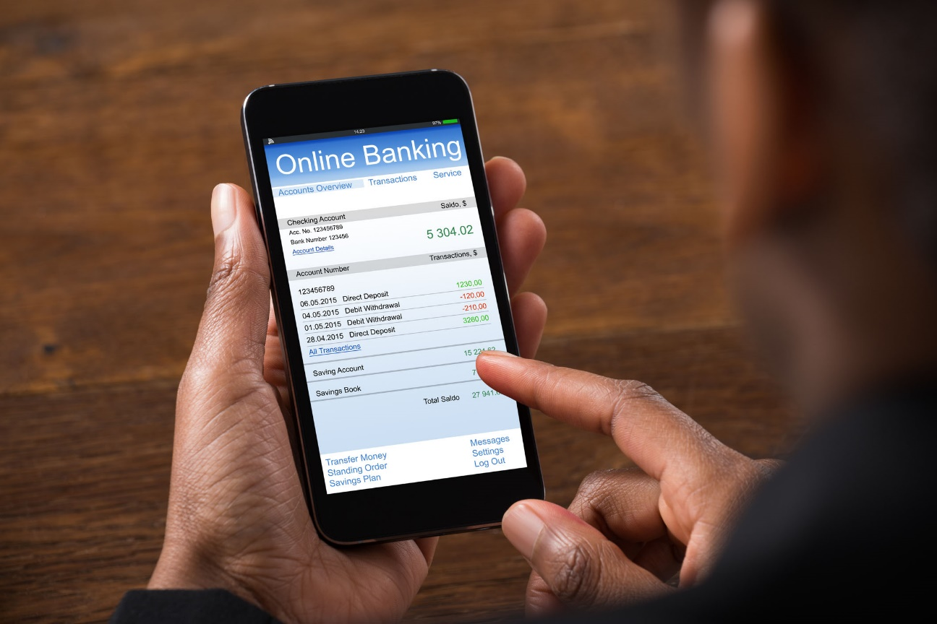
Understanding Banking
Types of Electronic Banking Services - continued
Direct deposit/automatic deposit
Bank credit card
Bank debit card
Electronic bill paying
Online banking
Pay-by-phone systems
Electronic check conversion

Slide 48

Understanding Banking
Types of Check Endorsements
Blank endorsement – simply signing your name
Restrictive endorsement – adding “for deposit only”
Special endorsement – also full endorsement; signing over to a third party
Two party check – check to two people
Business check – made to a business

Slide 49
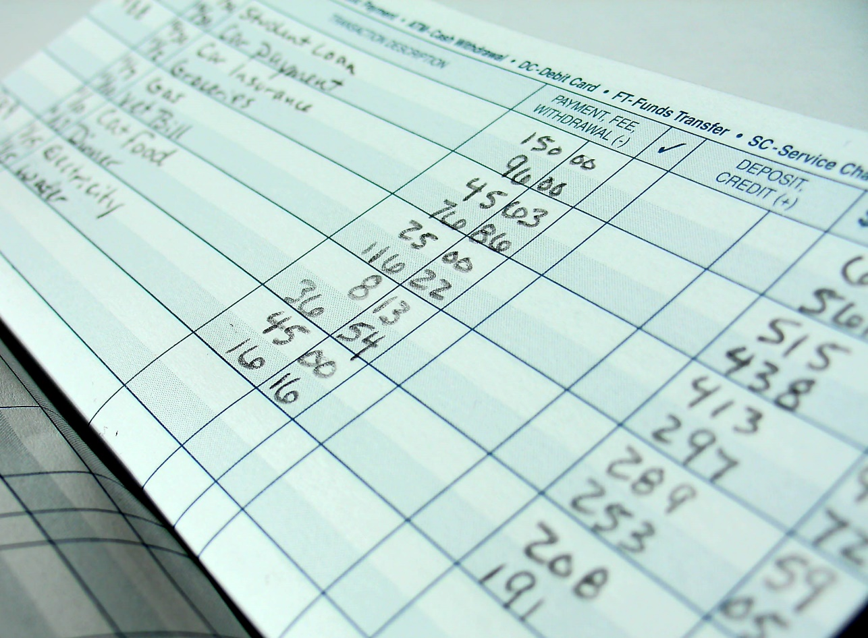
Understanding Banking
Reasons for Reconciling Financial Records
To catch mistakes
To prevent overdrafts
To know exactly how much is in your account
To be in control of your finances

Slide 50
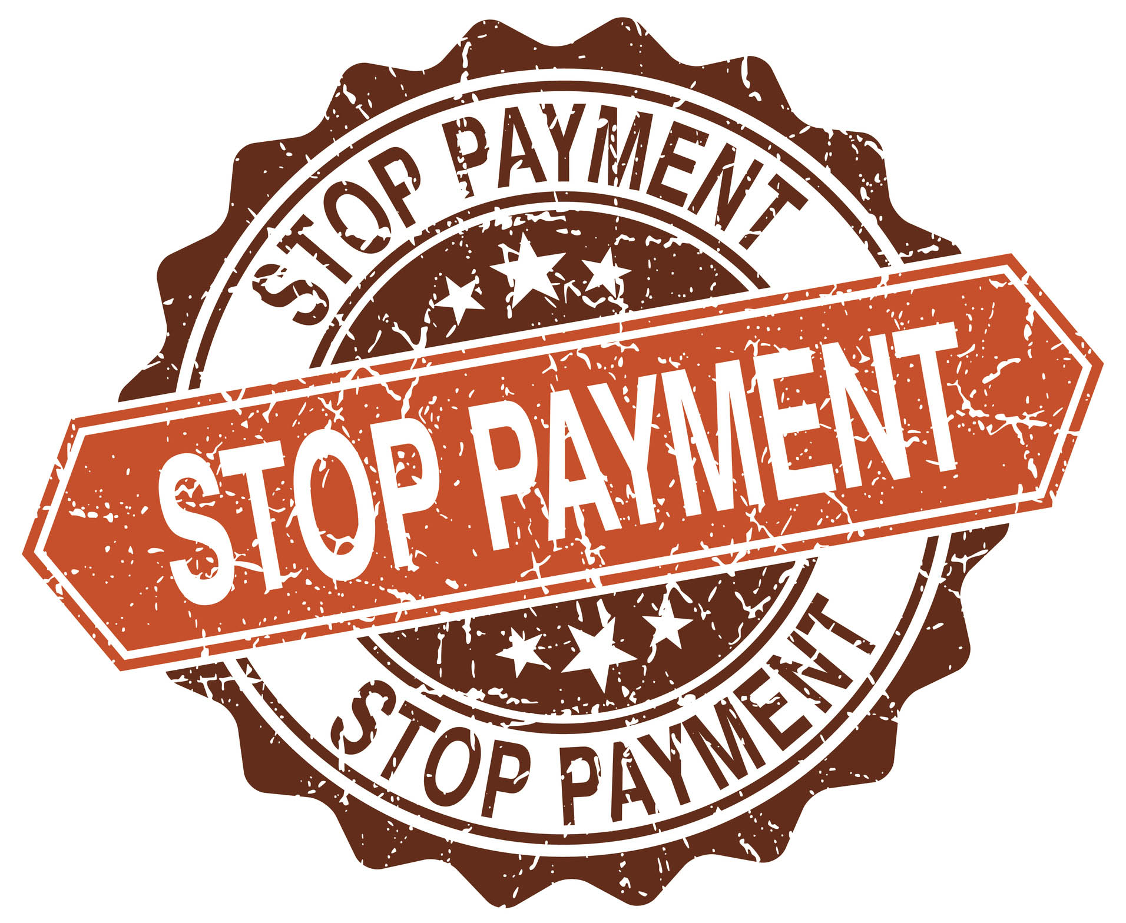
Understanding Banking
Steps in Stopping Payment on a Check
In writing – form or formal letter; method determined by bank.
By phone, followed by written request – to make binding, must be followed by a written request.

Slide 51
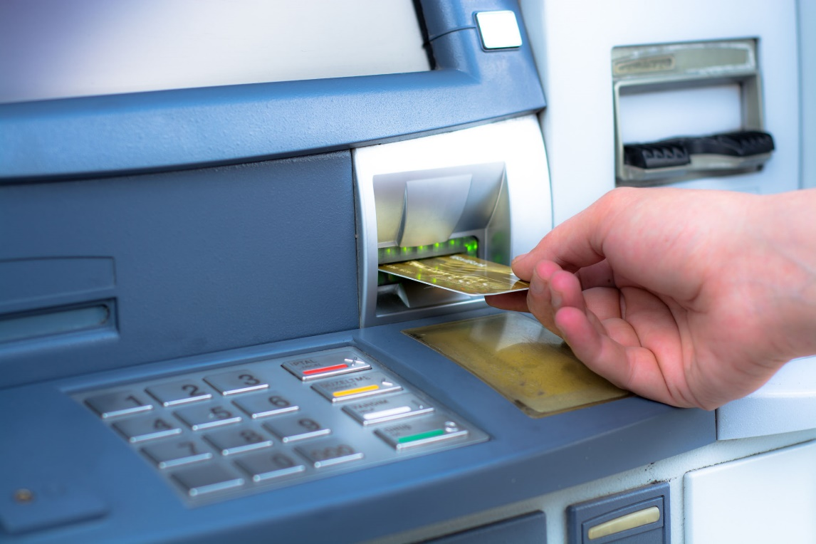
Understanding Banking
ATM and Debit Cards
ATM cards require a PIN (personal identification number) to use; used with ATM machines; may be a fee for using an ATM outside your network.
Debit Cards have a VISA or Mastercard logo and can be used where VISA or Mastercards are accepted; often double as an ATM card; may include fees for out-of-network ATM machine.
Both ATM and debit cards are linked to your bank account.

Slide 52
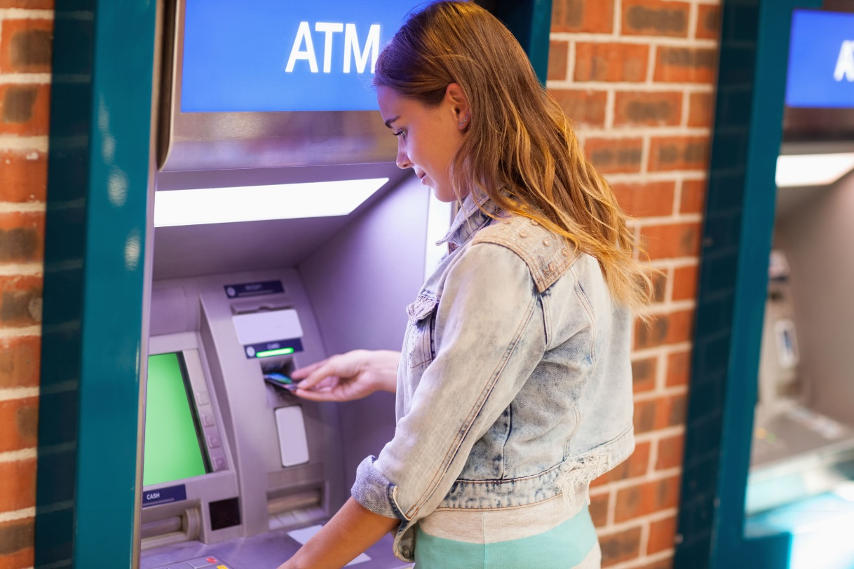
Understanding Banking
ATM and Debit Cards - continued
Can use both to withdraw money.
Can use both to check balances at ATM machines.
Can use both to make deposits at ATM machines.
Both cards automatically deducts money from your bank account immediately.

Slide 53

Understanding Banking
Hidden Costs of Banking
Overdraft charges
Surcharges for using ATM card
Teller fees
Per transaction fees for some debit cards
Inactivity fees

Slide 54

Understanding Banking
Ways to Protect Your Accounts
Report lost cards immediately.
Keep records in a secure place.
Shred documents with account numbers.
Memorize your PIN.
Be mindful of who is watching you.
Keep receipts to compare with statements.
Use your bank’s ATM.

Slide 55
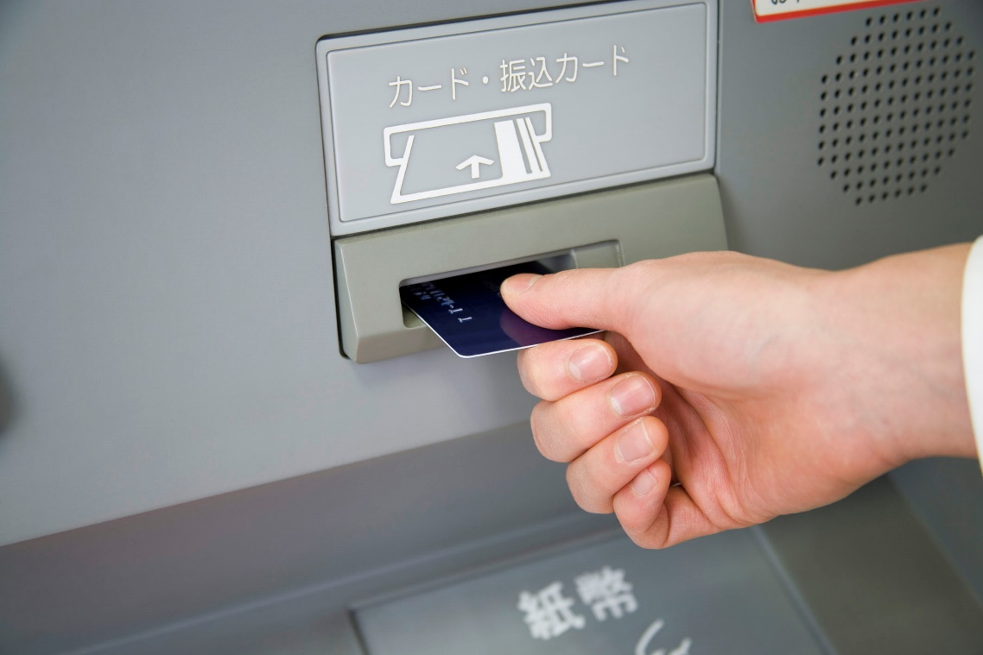
Understanding Banking
Ways to Protect Your Accounts - continued
Avoid third-party ATMs at places like rest stops, nightclubs, etc.
Check debit card withdrawals carefully.
Keep accurate records.
Report any unauthorized use or signature; the same applies to errors.
Don’t tell anyone your account number or password.

Slide 56

Using Credit Wisely
Even though businesses and governments have used credit for hundreds of years, consumer credit has been commonly used only in the last 60 years. Consumers who use credit have discovered that it has two major impacts on their lives. Credit allows people to buy and enjoy goods and services now, instead of having to wait until money is saved for purchases. But, it also means having to plan ahead so that the debt can be paid when it is due.

Slide 57

Using Credit Wisely
Types of Sales Credit
Installment credit – charge an item and pay it off gradually with a set schedule and amount.
Regular credit – making full payment after a certain period of time; often used for services; also called non-installment credit.
Open-end credit – choice of paying full amount or paying over time; interest charged when not paid in full; also called revolving credit.

Slide 58

Using Credit Wisely
Sources of Credit
Commercial banks
Credit unions
Finance companies
Life insurance policy
Online lender
Payday loan companies
Pawnbroker

Slide 59

Using Credit Wisely
Sources of Credit - continued
Private lender
Retail store
Savings and loan associations
Credit card companies

Slide 60

Using Credit Wisely
Differences in Credit and Charge Cards
Credit cards
  Issued by a company such as a bank, oil company or store.
  Has a set limit.
  May offer additional benefits.
  Receive monthly statements with a minimum amount due.
  Interest is charge if not paid in full.
  May have an annual fee.

Slide 61

Using Credit Wisely
Differences in Credit and Charge Cards - continued
Charge cards
  Issued by a few companies, such as American Express
  You pay an annual fee.
  You are charged interest on unpaid balances.
  No limits.
  Usually required to pay entire balance.
  More benefits than credit cards.
  Many retails will not accept charge cards.

Slide 62

Using Credit Wisely
Disadvantages and Advantages of Using Credit
Disadvantages
  Encourages you to spend more than you can afford.
  May encourage impulse buying.
  Ties up future income to pay debt.
  Contracts and terms can be difficult to understand.
  Maintaining a balance increases the cost of items.
  Low intro rates are temporary.

Slide 63

Using Credit Wisely
Disadvantages and Advantages of Using Credit - continued
  Encourages the need for “instant gratification.”
  Inability to pay credit card bills contributes to poor credit rating.
  Items can be repossessed if you don’t make payments.
  Relying on credit may encourage limited shopping options.
  Improper use of credit can increase stress and conflict.

Slide 64
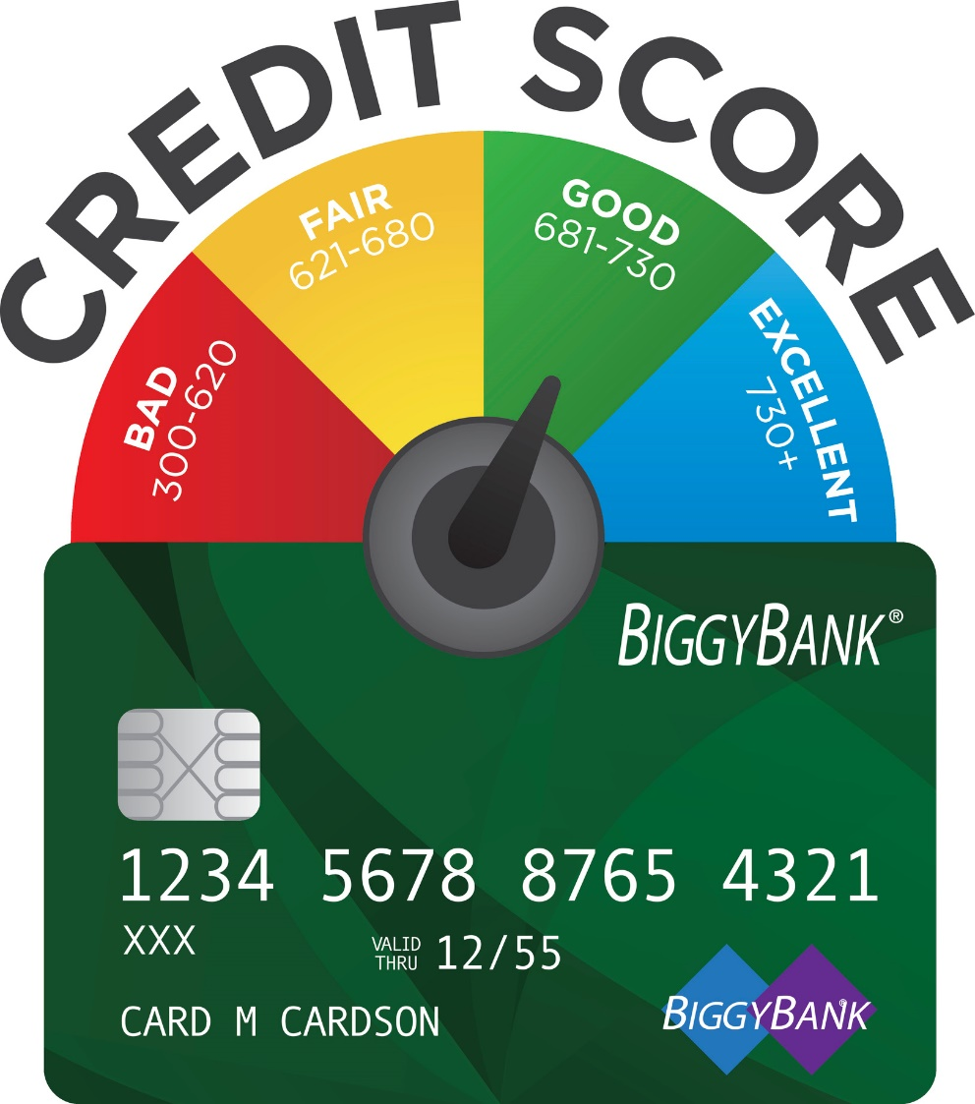
Using Credit Wisely
Disadvantages and Advantages of Using Credit - continued
Advantages
  Allows you to take advantage of bargains.
  Allows you to use items while paying for them
  Can be a source of emergency funds.
  Can allow you to raise your standard of living until you save enough cash (such as a home).
  Helps you make purchases that are part of long range plans (education, a car, etc.).
  Used responsibly, credit helps establish your credit rating.

Slide 65

Using Credit Wisely
Disadvantages and Advantages of Using Credit - continued
  Helps simplify record keeping.
  Makes returns more convenient.
  Eliminates the need to carry large amounts of cash.
  Credit card companies can help negotiate if there are problems after the sale of an item or service.

Slide 66

Using Credit Wisely
Factors that Affect Interest Rates
Ability to repay
Collateral offered
Current rate of interest
Economic conditions
Length of time to repay
Source of credit
Total amount borrowed
Type of credit selected

Slide 67

Using Credit Wisely
Wise Credit Practices
Limit the total amount borrowed to 20% or less of yearly take-home pay.
Limit the total of monthly payments to 10% or less of monthly take-home pay.
Buy items that will outlast the payment period.
Make the largest down payment possible.
Understand how much credit costs.
Use credit to buy items that increase in value.

Slide 68
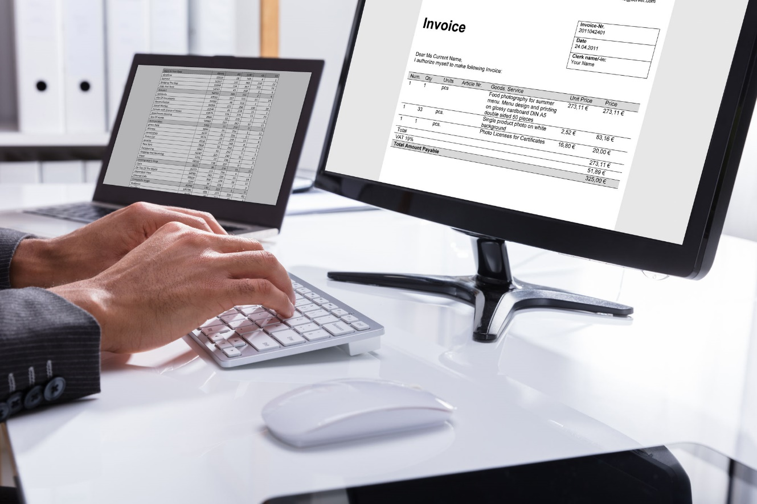
Using Credit Wisely
Wise Credit Practices - continued
Pay double or a few dollars more on each payment.
Shop for credit.
Keep a good credit reputation.

Slide 69

Using Credit Wisely
Ways to Establish a Good Credit Record
If you have no credit, start with a department store card.
Show responsibility by using your credit and paying it off.
Pay bills when due.
Use credit only if your income is steady and reliable.

Slide 70

Using Credit Wisely
Ways to Establish a Good Credit Record - continued
Understand and follow the terms of every credit contract.
Do not borrow up to your credit limits.
Review your credit report regularly.

Slide 71

Using Credit Wisely
Options for Credit Card Payments
Pay balance in full every month.
Pay the full balance more often than once a month.
Pay more than the minimum but less that the balance each month.
Pay the minimum payment every month.

Slide 72

Using Credit Wisely
Factors that Determine Credit Risk
Payment record
Employment record
Certain personal factors (type of bank accounts, reason for wanting credit, occupation, type of residence, location)

Slide 73

Using Credit Wisely
Consequences of Bankruptcy
Petition for bankruptcy stays on your credit record whether granted or not.
Property and possessions (within reason) are seized and sold.
Monies received are applied to financial obligations.
Cannot file again for seven to ten years.
Difficulty obtaining credit after bankruptcy.

Slide 74
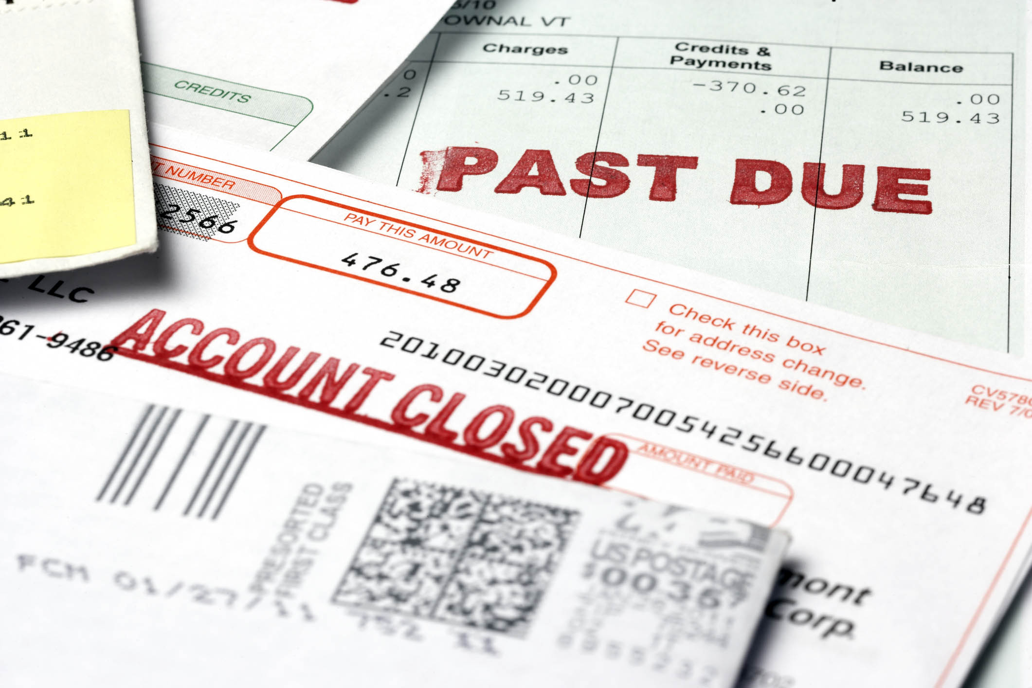
Using Credit Wisely
Credit Warning Signs
Putting off one creditor to pay another
Receiving past-due notices
Paying only minimum payments
Charging more that you can pay each month
Using one charge account to pay another
Having a monthly payment mentally rather than knowing amount owed.

Slide 75

Using Credit Wisely
Credit Warning Signs - continued
Ignoring the high cost of interest
Using cash advances for monthly living expenses
Obtaining higher limits or additional cards to juggle payments
Routinely running out of money before payday
Failing to save some money each month

Slide 76

Using Credit Wisely
Advantages and Disadvantages of Debt Consolidation
Advantages
  One creditor to work with
  One debt amount and one monthly payment
  Possibility of a lower interest rate if loan is from a bank or credit union and is used to pay off high-interest credit cards.
  Interest may be tax-deductible if money from a home equity loan is used.

Slide 77
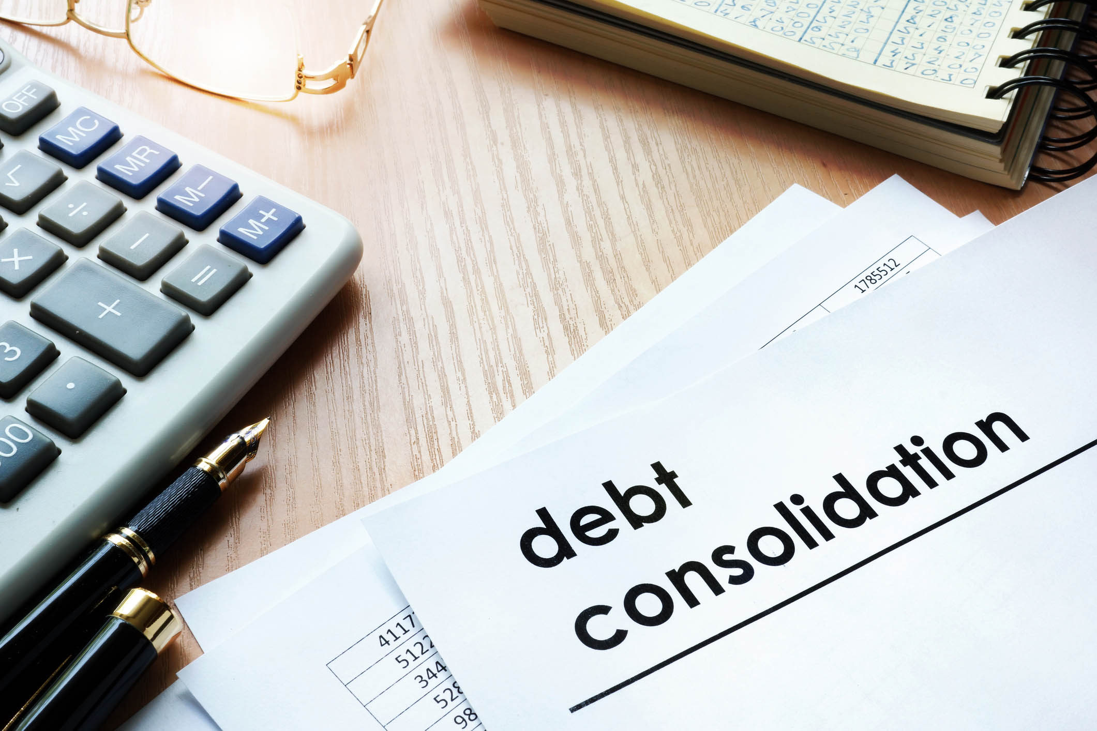
Using Credit Wisely
Advantages and Disadvantages of Debt Consolidation - continued
  Disadvantages
    Debt period may be extended and more interest paid.
    Interest rate may be higher if money comes from a finance company.
    Your home may be at risk if you use a home equity loan.
    Consumers may continue to use credit cards and find themselves deeper in debt.

Slide 78

Using Credit Wisely
Services That Offer Counseling and Advice to Consumers with Credit Problems
The National Foundation for Consumer Credit
“Mom-and-Pop” counseling services
Psychologists specializing in counseling debtors
Financial institutions

Slide 79
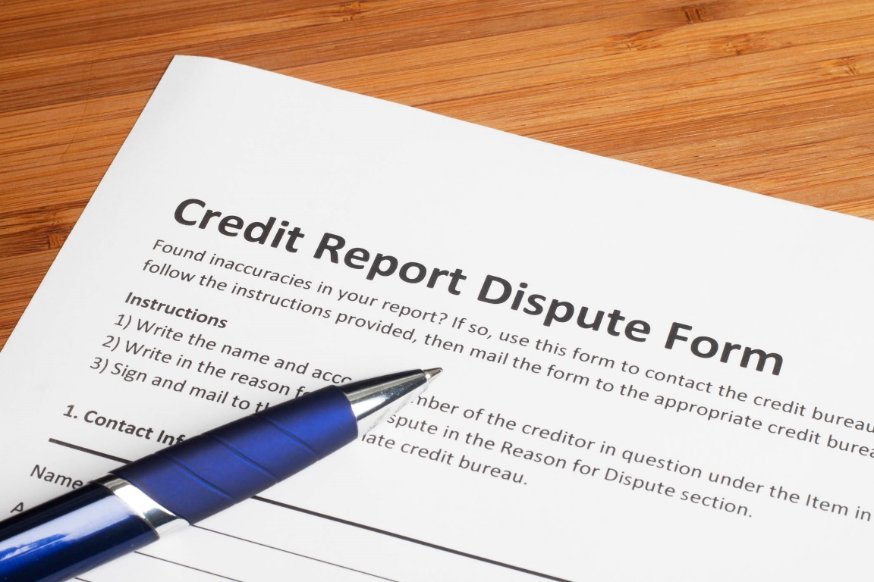
Using Credit Wisely
Steps in Challenging an Inaccurate Credit Report
Request a summary of your credit report.
Ask credit bureau to recheck inaccurate information.
If their information is incorrect, they must change it.
If they find information is correct, you have a right to be heard. File a brief statement of your version of the story.

Slide 80

Using Credit Wisely
Legal Means of Debt Collection
Arrangement – creditor allows more time to pay
Bankruptcy – federal court distributes assets, income, property
Garnishment – money is withheld from debtor’s paycheck to pay debt
Repossession – collateral attached to loan is taken back; borrower can be responsible for amount remaining

Slide 81
Using Credit Wisely
Garnishment
Used to collect debt after regular procedures fail.
No more than 25% of net weekly pay can be taken or 30 times the minimum wage, whichever is less.
Creditor receives a court order to garnish.
Employer gets a copy of the court order and must withhold a percentage each pay period.

Slide 82
Using Credit Wisely
Garnishment - continued
Employee cannot be fired because of garnishment.
Money is sent to court clerk’s office.
When all debt and legal fees have been collected, employer is notified to end collection.
Department of Labor rules protect debtor is wages are garnished: https://www.dol.gov/general/topic/wages/garnishments

Slide 83

All rights reserved; copyright © 2019 Resource Center for CareerTech Advancement
For more information, email us at
resourcecenter@careertech.ok.gov

