Slide 1
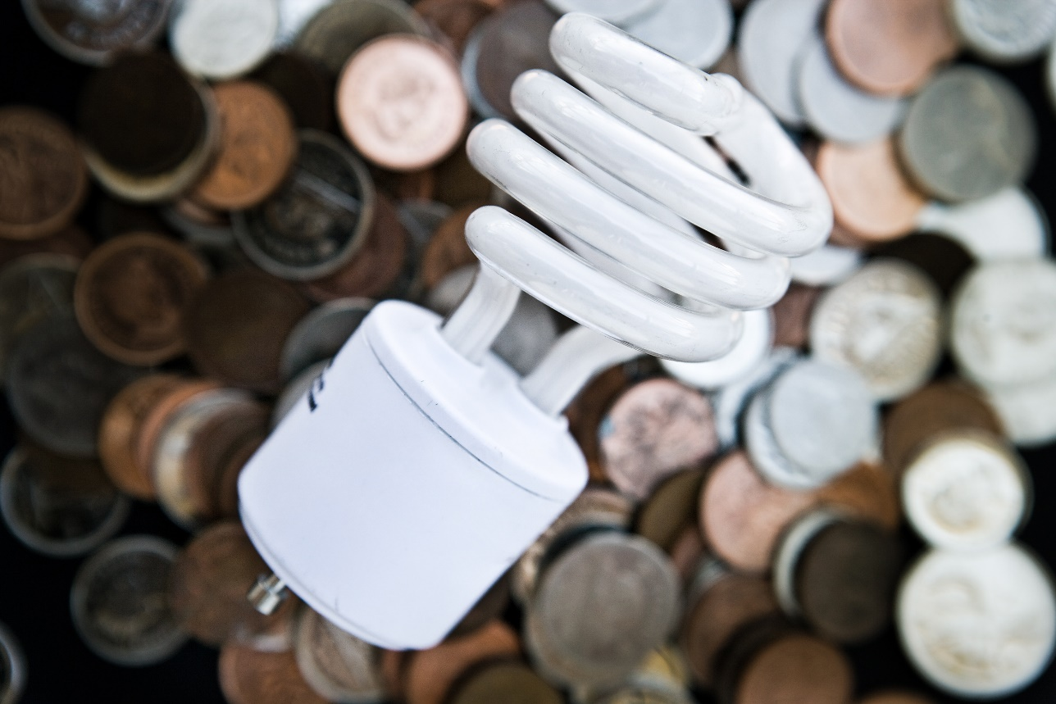
Green Living Skills
Developed by Resource Center for CareerTech Advancement,
a division of Oklahoma CareerTech

Slide 2
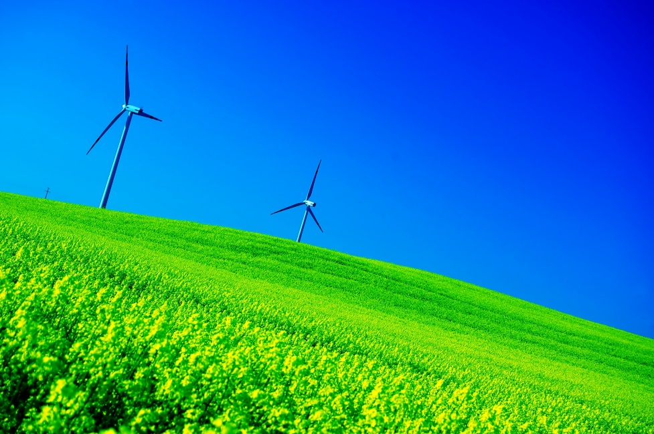
Defining Green Principles
Green is more than a color.
People are adopting green as a way of living and a way of doing business.
“Green” involves more than just the way people interact with each other — it is also about the environment and the world in which we live.
By learning about issues and concepts relating to sustainable living, you can make better buying decisions and lifestyle changes that help to protect the environment.

Slide 3
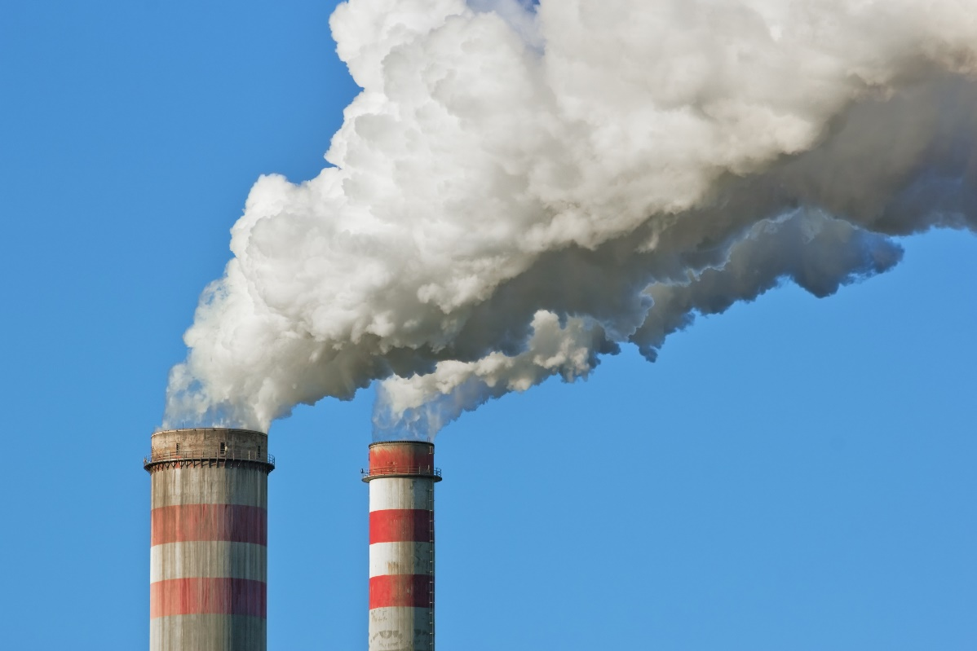
Defining Green Principles
Topics covered:
Principles of Green Living
Chemicals in the Environment
Greenhouse Gases
Climate Change/Global Warming
Fossil Fuels
The Importance of Rainforests
The Importance of Species Biodiversity
The Hydrologic Cycle

Slide 4
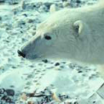
Principles of Green Living
Words to Know:
Consumption – the act or process
Deplete – to reduce significantly
Habitat – the place where a plant or animal lives and grows
Sustainable – using a resource in a way so that it is not depleted or permanently damaged

Slide 5
Principles of Green Living
The green movement began in the 19th Century when writers like Henry David Thoreau began writing about nature.
Ralph Waldo Emerson believed that nature itself has value and should be protected.
Sustainability is a large part of the green lifestyle.
Sustainability involves the idea of creating and maintaining conditions in which people live in harmony with nature — by meeting the needs of the present without compromising the availability of resources for future generations

Slide 6
Principles of Green Living
Adopting a green lifestyle means thinking about your impact on the world around you.
Your actions can affect the well-being of those who earn their living from nature.
You can also affect wildlife, their habitats, and even the global climate.
Green living is also an attempt to reduce consumption of natural resources.
This involves reducing our carbon and ecological footprints — the amount of energy and other resources we consume and the impact we leave behind.

Slide 7
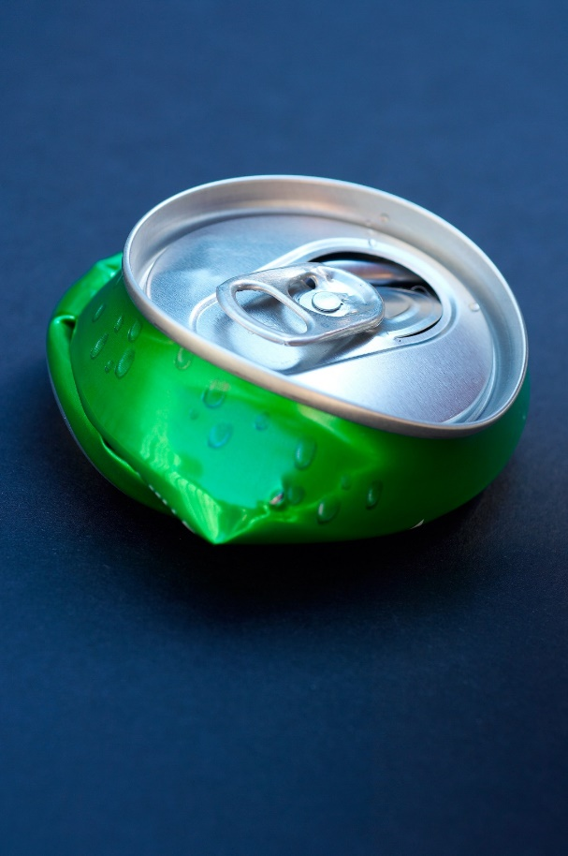
Principles of Green Living
Ways of reducing your ecological footprint could include:
Recycling, reusing, and repurposing items
Using environmentally safe cleaning products
Using alternative means of transportation
Conserving electricity
Changing personal practices (shopping, gardening, etc.)
Reducing water usage

Slide 8
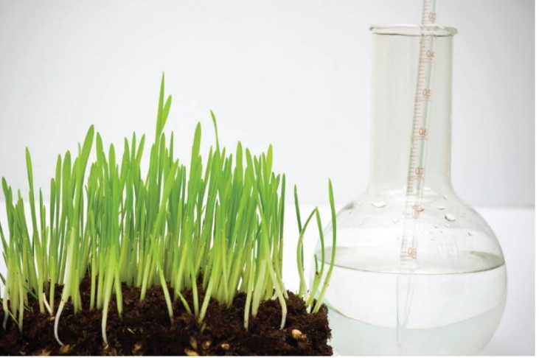
Principles of Green Living
Agricultural production has seen many advances in technology and mechanization over the last 75 years.
The increased use of chemicals, as well as government policies that maximize production, have also dramatically improved the efficiency of agricultural production.
One result is that fewer farmers can produce more food and fiber. However, other results include soil depletion, surface and groundwater pollution, higher machinery costs, the loss of family-owned farms, and shrinking rural economies.
In the late 20th Century, agriculture specialists began encouraging socially and environmentally responsible production methods.
Not only does sustainable agriculture address these concerns, but it also benefits those in the entire food system, including the consumer.

Slide 9
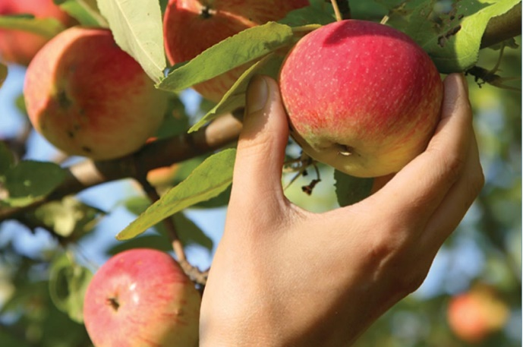
Principles of Green Living
Some principles of sustainable agriculture include:
Conserving natural resources so that natural systems are continually replenished.
Wisely using renewable and recyclable resources.
Preserving soil, water, and air quality and avoiding substances that can cause pollution.
Respecting biodiversity.
Using minimal amounts of pesticides, herbicides, fertilizers, and fuel.
Allowing livestock room to roam, graze, root, and socialize as they would in a natural environment.
Strengthening the economy of rural communities.
To be successful, sustainable agriculture must also be profitable and provide a good quality of life.

Slide 10
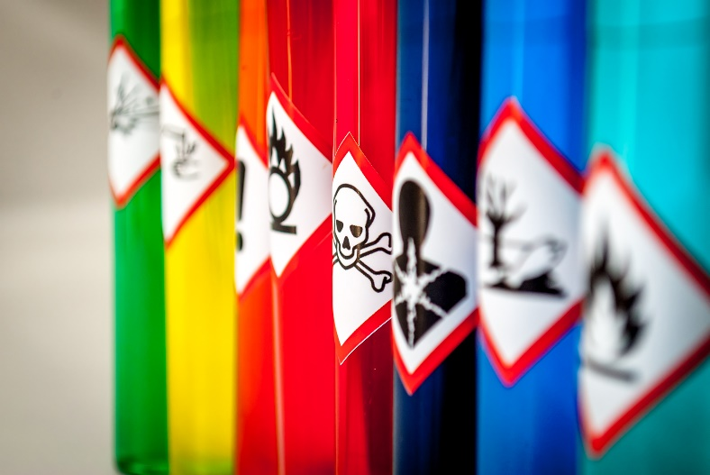
Chemicals in the Environment
A chemical is a substance with a defined molecular composition.
Chemicals make up everything in the environment.
They can be synthetic (manmade) or naturally occurring, safe or toxic.
Words to Know:
Periodic Table - the scientific arrangement of chemical elements based on their atomic numbers (the number of protons in the nucleus of an atom of the element)
Toxic - poisonous

Slide 11
Chemicals in the Environment
Matter makes up just about anything that takes up space and has mass, which includes everything in the universe.
Matter can be made of pure substances or mixtures of substances, but all forms of matter are made of chemicals. These chemical elements make up all matter.
All forms of matter are made of one or more elements in many different molecular combinations.
So far, scientists have identified over 100 elements, but there may be more that have yet to be discovered. The known elements are listed on the periodic table.

Slide 12
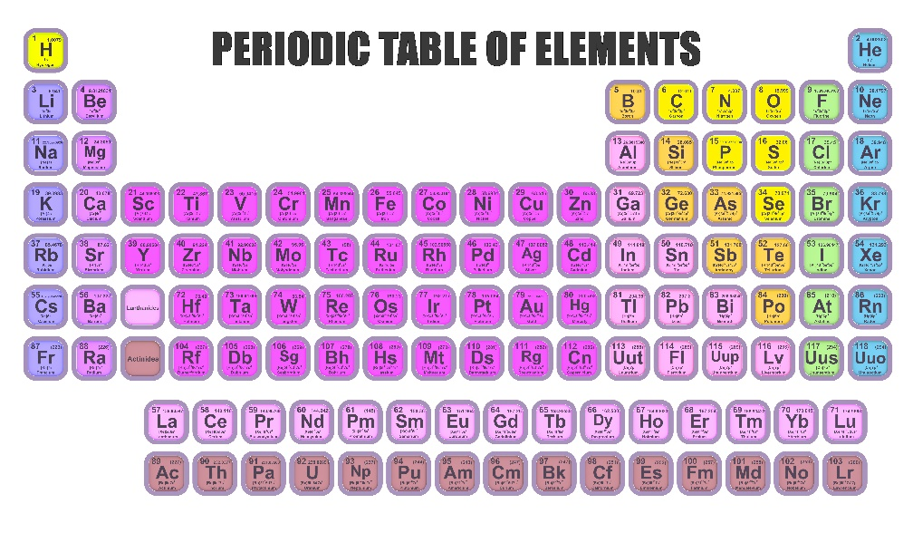
Chemicals in the Environment
Periodic Table

Slide 13
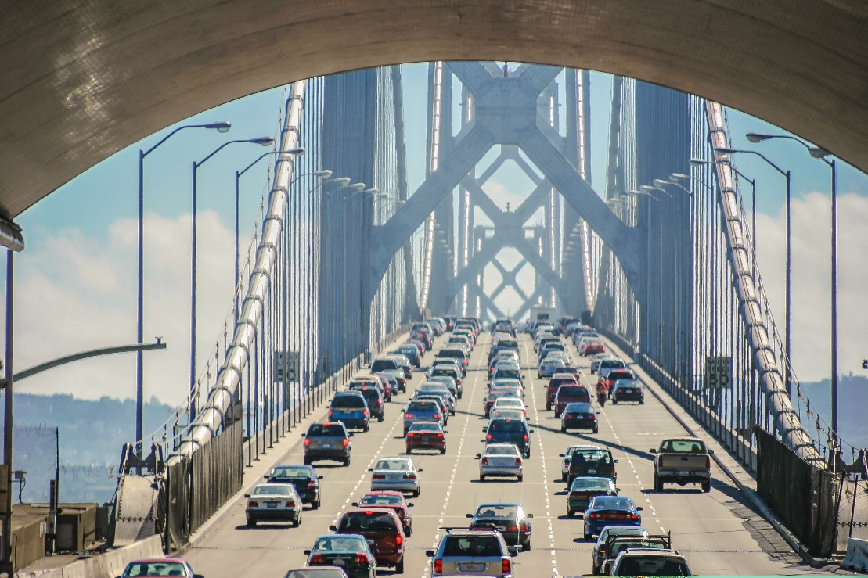
Chemicals in the Environment
We change the matter in the environment as we perform daily activities. How:
Driving cars
Taking showers
Using cleaning products
Perform countless activities that involve complex chemical reactions

Slide 14
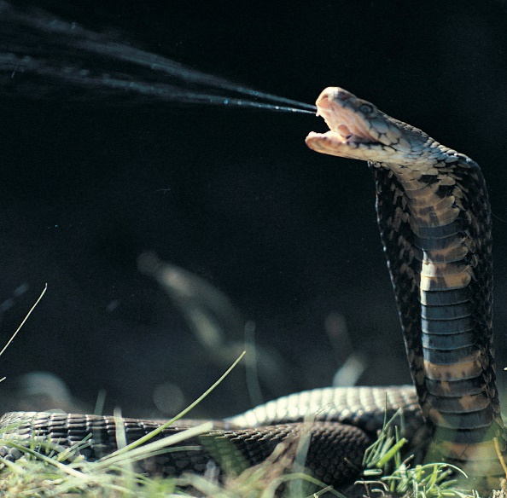
Chemicals in the Environment
Some naturally occurring chemicals are safe when we’re exposed to them in low amounts, but they can be toxic in high concentrations. (Salt is one example.)
For hundreds of years, people have known that some chemicals in nature are poisonous.
Poisons that occur naturally are called toxins and can be produced by certain plants, animals, and fungi.
Chemical substances are also manufactured. Many of these synthetic chemicals are safe and benefit us greatly. But some can have a toxic effect on life and the environment.

Slide 15
Chemicals in the Environment
Elements and compounds can change from one physical state to another without their chemical state changing.
A chemical reaction occurs when molecules interact, causing a compound to start out as one thing and turn into something else.
No chemical reaction occurs when a refrigerator, freezer, or air conditioner cools the air. However, the chemicals that cause the air to cool, such as chlorofluorocarbons (CFCs) along with other pollutants, can react with sunlight, heat, and oxygen (O2) in the air to create ozone (O3).
High above the Earth, the ozone layer works to protect life from the sun’s harmful UV rays. This protective layer becomes weaker when certain destructive gases destroy the ozone molecules. Closer to the Earth’s surface, ozone can become a harmful air pollutant that attacks living tissues. In the late 1970s, most countries banned CFCs.

Slide 16
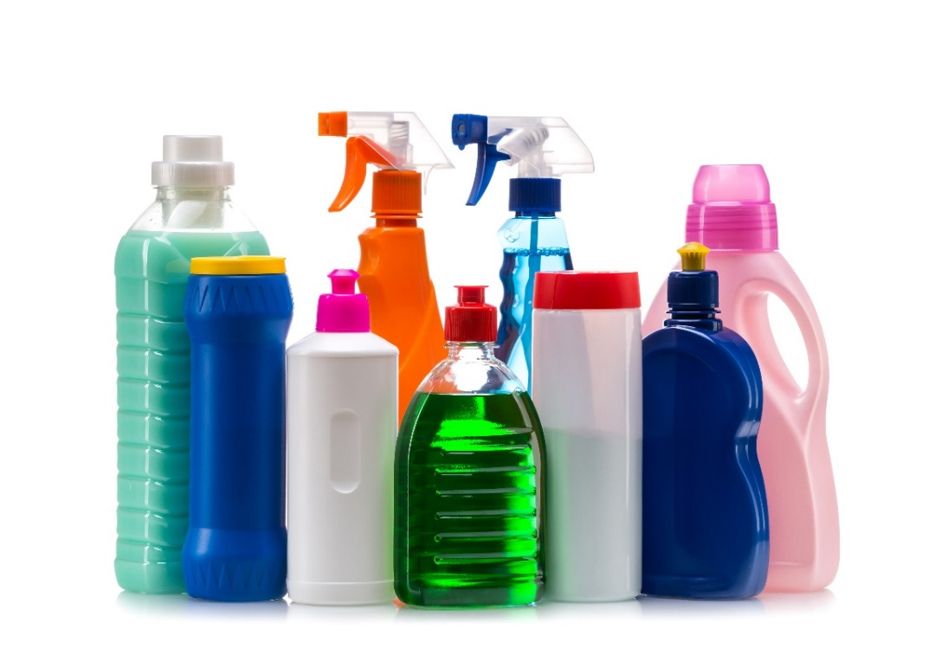
Chemicals in the Environment
We come into contact with chemicals every day.
Some of this chemical exposure is obvious, such as the use of household cleaners and lawn care products.
Other chemicals are hidden in products where you might not expect to find them.

Slide 17
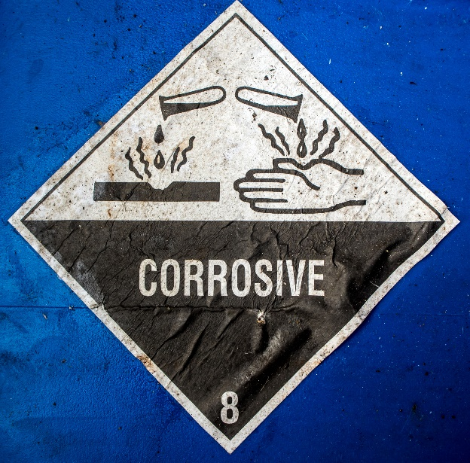
Chemicals in the Environment
Many products we use display warning labels to alert users of dangerous fumes or hazards when a product is absorbed through the skin.
Certain chemicals released from products such as furniture, clothing, and cookware can be dangerous as well.
Not only are we exposed to chemicals as we use certain products, but chemicals can be released when products are manufactured.
In addition, sometimes products can break down into dangerous substances once they reach the end of their useful life.

Slide 18
Chemicals in the Environment
Electronic waste, or e-waste, comes from machines and appliances, such as refrigerators, microwave ovens, fluorescent light bulbs, computers, cell phones, and televisions.
As newer models of electronics enter the market, the older products become obsolete, leading to e-waste. E-waste contains hazardous substances, such as heavy metals, organic pollutants, and flame retardants.

Slide 19
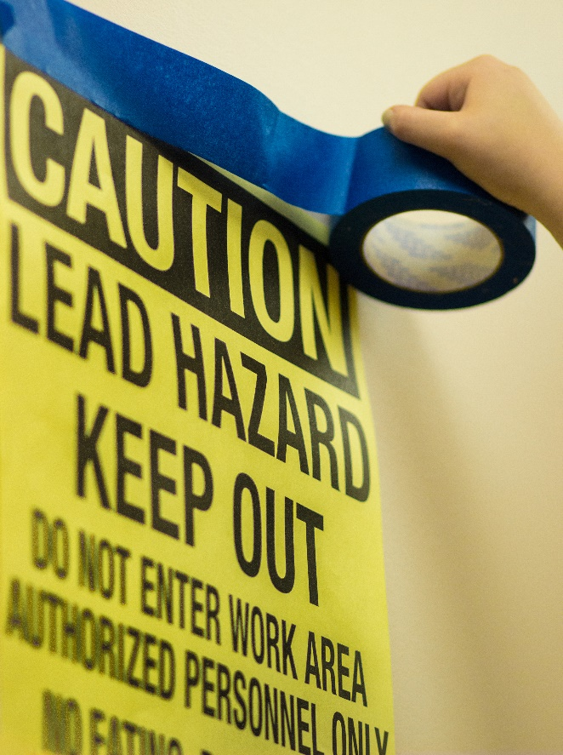
Chemicals in the Environment
Lead is considered particularly dangerous because no level of exposure to lead is considered safe.
The use of unleaded gasoline and standards limiting the use of lead in products has reduced lead exposure in the United States.
Lead-containing products are still widely made and sold around the world. Lead in paint poses one of the greatest risks of exposure.

Slide 20
Greenhouse Gases
The greenhouse effect is the overall rise in the Earth’s temperature caused by certain gases in the atmosphere.
Some of the sun’s energy is allowed to pass back into space, but carbon dioxide, nitrous oxide, methane, and other gases trap energy from the sun.
Without these gases, the sun’s energy would bounce back into space, making the Earth’s temperature much cooler.
These gases are called greenhouse gases (GHGs) because they work much like a greenhouse.
The greenhouse effect is important to keep the Earth warm enough to sustain life. But as more and more greenhouse gases are being released into the atmosphere, the world is heating up a little too much — a phenomenon called climate change.

Slide 21
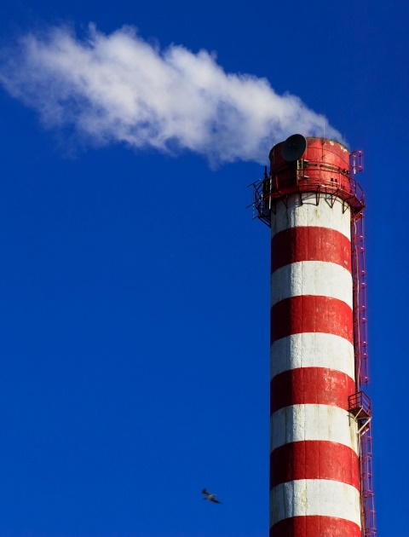
Greenhouse Gases
Many greenhouse gases are naturally occurring, including water vapor, carbon dioxide, methane, nitrous oxide, and ozone. Others result exclusively from human industrial processes. The main greenhouse gases include the following:
Carbon dioxide (CO2) - is released into the atmosphere when fossil fuels, solid waste, and wood products are burned. It also results from certain chemical reactions such as the making of cement. In nature, anything that breathes gives off carbon dioxide when it exhales. Carbon dioxide can also be removed from the environment by plants.
Methane (CH4) - emissions result from the decay of organic waste in landfills and from livestock. Methane is also released during the mining, production, and transportation of fossil fuels.

Slide 22
Greenhouse Gases
Nitrous oxide (N2O) - is produced naturally by micro-organisms in the soil and water, particularly in tropical rainforests. Human-related sources include synthetic nitrogen fertilizers used in crop production, animal manure, sewage treatment, and the burning of fossil fuels and solid waste.
Note: Nitrous oxide is used in car racing fuels to increase the power of engines. It is also the same gas that is administered by dentists and surgeons as an anesthetic and is sometimes called “laughing gas.”
Freon (chlorofluorocarbon or CFC) - has been used as a coolant in air conditioners, in some fire suppression systems, and as an ingredient in aerosol sprays. Freon was originally invented as a less toxic alternative to other chemicals previously used as refrigerants.
Hydrochlorofluorocarbons (HCFCs) have been used to replace CFCs. HCFCs contain chlorine and can cause less ozone depletion than CFCs.
Note: Freon is the best-known agent that causes ozone depletion. Because of this, its use is now restricted.

Slide 23
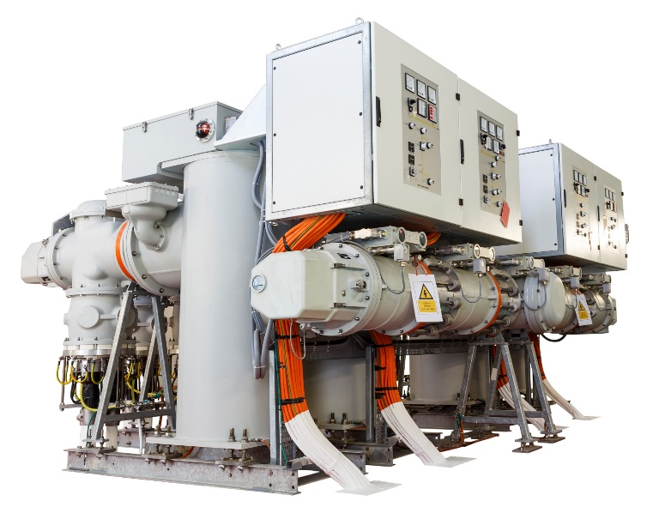
Greenhouse Gases
Sulfur hexafluoride (SF6) - is a greenhouse gas that has a potency of 22,000 times greater than carbon dioxide. It is used as a gaseous insulator for high-voltage circuit breakers, switchgear, and other electrical equipment.
Fluorinated gases - are synthetic greenhouse gases given off by industrial processes. These gases are sometimes used as substitutes for CFCs and HCFCs. Although these gases are not usually released in large quantities, they are very potent; use of these types of gases could cause global warming to increase significantly.

Slide 24
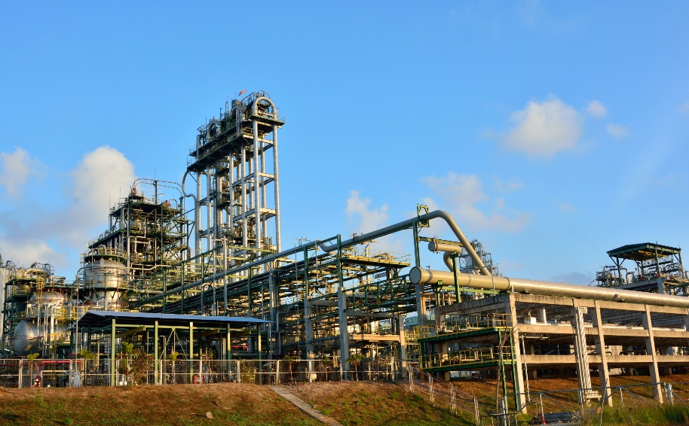
Greenhouse Gases
Fluorinated gases – continued
Nitrogen trifluoride (NF3) is a gas that is used to create LCD televisions, computer microcircuits, and solar panels. It is also 17,000 times more effective at trapping heat in the atmosphere than carbon dioxide, and it survives five times longer in the atmosphere. Fortunately, manufacturers have options for controlling and trapping emissions, and other less harmful production options are available.
Hydrofluorocarbons (HFCs) and perfluorocarbons (PFCs) are not believed to affect the ozone layer, but they play a role in global warming because they are up to 12,500 times as potent as carbon dioxide.

Slide 25
Climate Change/Global Warming
The Earth’s climate has experienced drastic changes. These changes usually took place over thousands of years.
However, during the Industrial Revolution, factories, transportation, and farming practices began changing the environment at a faster pace. During this time, people developed the first machines that burned fossil fuels.
Advancements in agriculture also meant that more land could be farmed, which required forests to be cleared for crop production.
Today’s cars and coal-burning power plants release more and more greenhouse gases into the atmosphere.
Methane from livestock, landfills and coal mining also adds greenhouse gases.

Slide 26
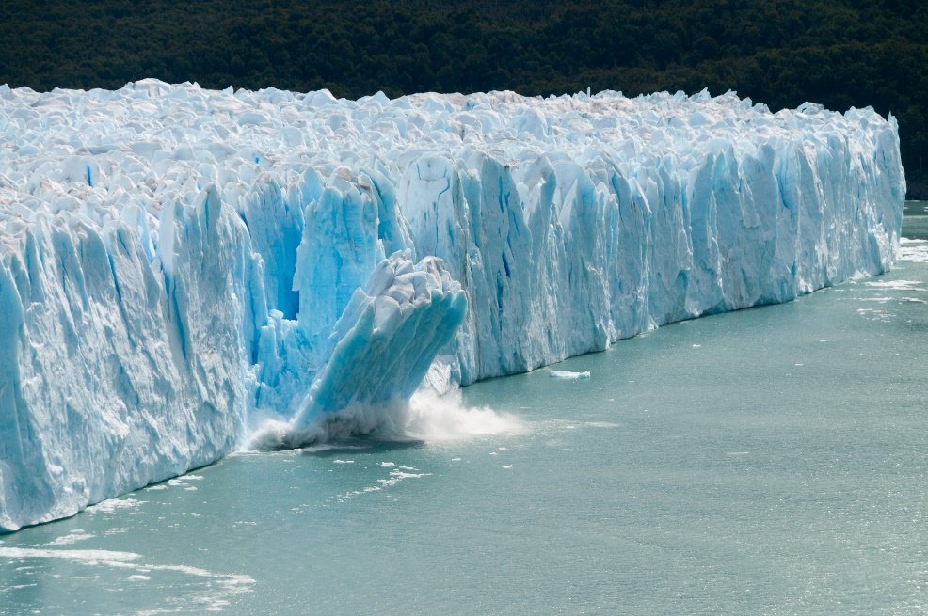
Climate Change/Global Warming
Words to Know:
emissions trading - a system that allows countries to buy and sell allowances or quotas of greenhouse gas emissions; high polluters can buy unused “credits” from countries that pollute less, and countries can earn credits for planting trees, practicing certain soil conservation techniques, and performing activities that increase carbon absorption
emit - to give off, such as light or heat
glacier - large sheets of ice that move very slowly

Slide 27
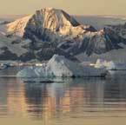
Climate Change/Global Warming
Many scientists believe that the activities of people — and the greenhouse gases people produce — are changing the environment.
In the process, the Earth is becoming warmer.
Glaciers are one indicator of this warming trend.
Glaciers around the world are melting more quickly than before.
Sea levels are also rising, producing high tide levels that are higher than they’ve been before. These higher sea levels could be related to the melting glaciers.

Slide 28
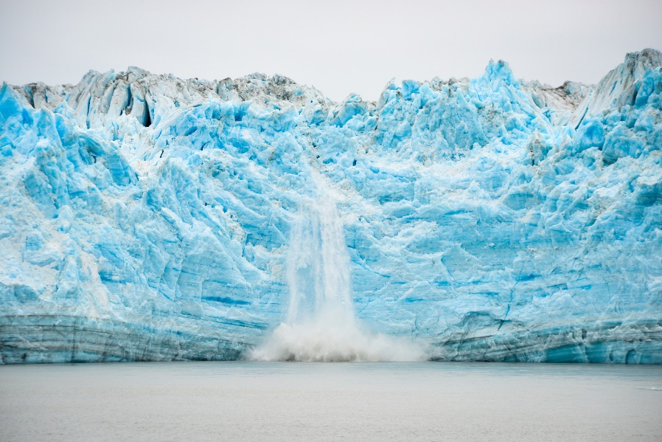
Climate Change/Global Warming
Over the past 100 years, the average global temperature has increased by one degree.
Over the next hundred years, the average temperature could increase by six degrees. This may sound small, but it is enough to drastically change the climate.
Scientists don’t know for sure what will happen, but higher temperatures could lead to more heat stress, more violent weather, more frequent droughts, increased coastal flooding, changes in food and water supplies, destruction of habitats and ecosystems, and increased air pollution.

Slide 29
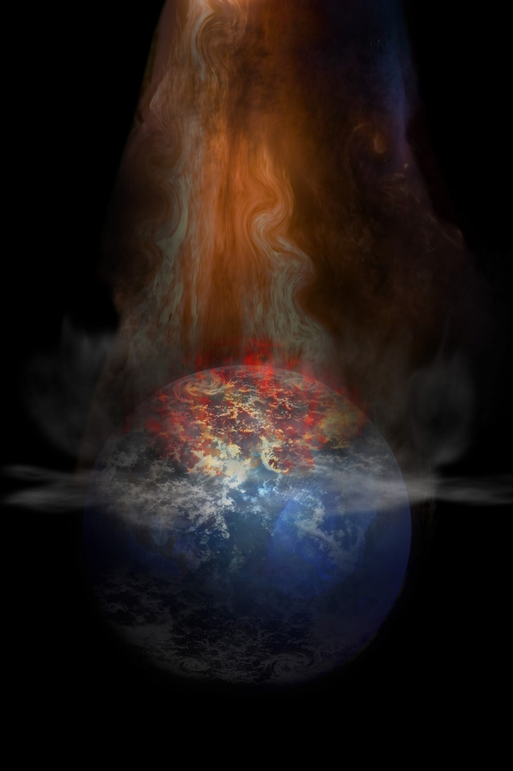
Climate Change/Global Warming
Most sources of greenhouse gas emissions are expected to increase.
However, this growth may be reduced through the use of cleaner technologies and by consumers choosing to reduce the amount of greenhouse gases being emitted.
Another potential solution is the idea of emissions trading.

Slide 30
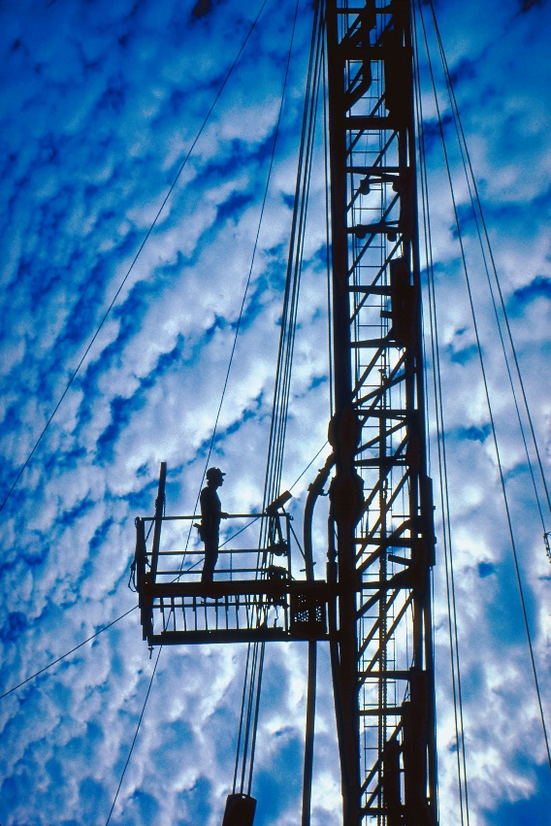
Fossil Fuels
Fossil fuels include coal, petroleum (oil), and natural gas.
They are called fossil fuels because they began forming hundreds of millions of years ago in the Carboniferous Period — before the age of dinosaurs.
The basis of fossil fuels is carbon.
These fuels are found in areas once covered with swamps and oceans, large trees, and broad leafy plants.
As the ancient trees and plants died, they sank to the bottom of the swamps and formed peat and were gradually covered by sediments.
Over millions of years, the sediment layers turned into rock. The peat was compressed and turned into fossil fuel.

Slide 31
Fossil Fuels
Coal is composed of carbon, hydrogen, oxygen, nitrogen, and sulfur. It has been used as a fuel for thousands of years.
Coal is found in many areas of the continental United States and throughout the world.
It is mined through deep underground shafts or strip-mined from the Earth’s surface.
Most of the coal is shipped on trains to power plants across the U.S.
Petroleum was used thousands of years ago in Ancient Egypt and the Middle East. In North America, Native Americans skimmed petroleum oil off the surface of lakes and streams and used it to waterproof their canoes and for medicine.
Later, North American settlers eventually began using petroleum to replace whale oil in lamps when whale oil became too expensive.
In 1859, oil was discovered in a water well in Pennsylvania. From this discovery, entrepreneurs figured out how to pump the oil to the surface and put it into barrels.

Slide 32
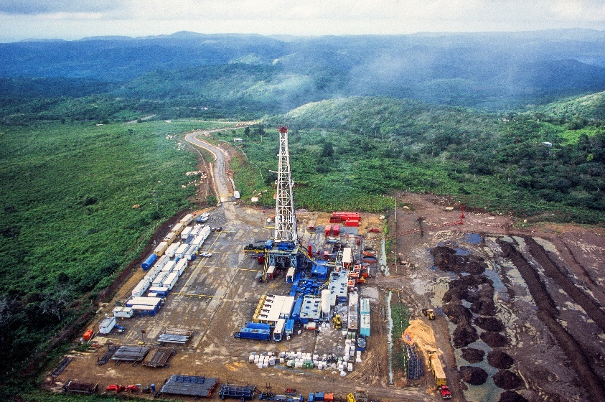
Fossil Fuels
Words to Know:
Porous - allowing liquid or gas to pass through
Sediment - material deposited by water, wind, or glaciers; the material that settles to the bottom of a liquid
Today, companies drill through the Earth’s surface to the deposits below to find oil and natural gas.
The oil and natural gas are then pumped out of the ground and transported by pipelines to holding tanks.
Oil is refined and used to make many different products — fuel (gasoline, diesel fuel, jet fuel, home heating oil, oil for ships, and oil to burn in power plants to make electricity), lubricants, fertilizers, fabrics, and plastics.

Slide 33
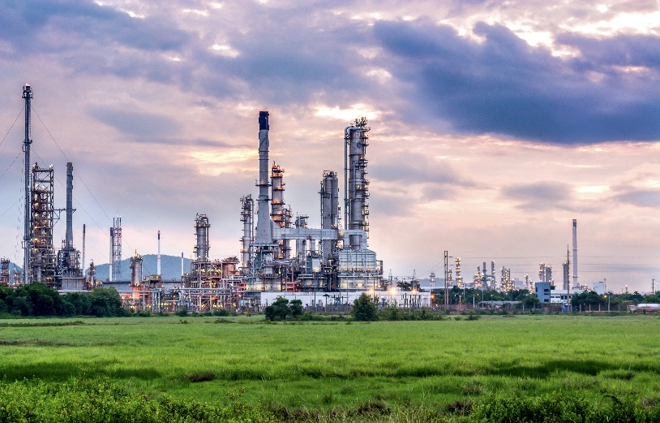
Fossil Fuels
Natural gas is usually found near petroleum underground in porous rock. Natural gas is made up of methane (CH4), which is a compound of carbon and hydrogen.
It was first used thousands of years ago in the Middle East. Natural gas is usually odorless.
Before it is transported through pipelines, it is mixed with a chemical that makes it smell like rotten eggs.
Natural gas is highly flammable and without the odor, you couldn’t tell if there was a leak.
Natural gas is the basis for many of the alternatives to petroleum fuel.
The United States is a major producer of natural gas.

Slide 34
The Importance of Rainforests
Consumption of natural resources has risen at a cost to the world’s ecosystems. Tropical rainforests are particularly at risk.
A rainforest is an intricate and fragile system — the destruction of one part can lead to damage or even to the destruction of the whole.

Slide 35
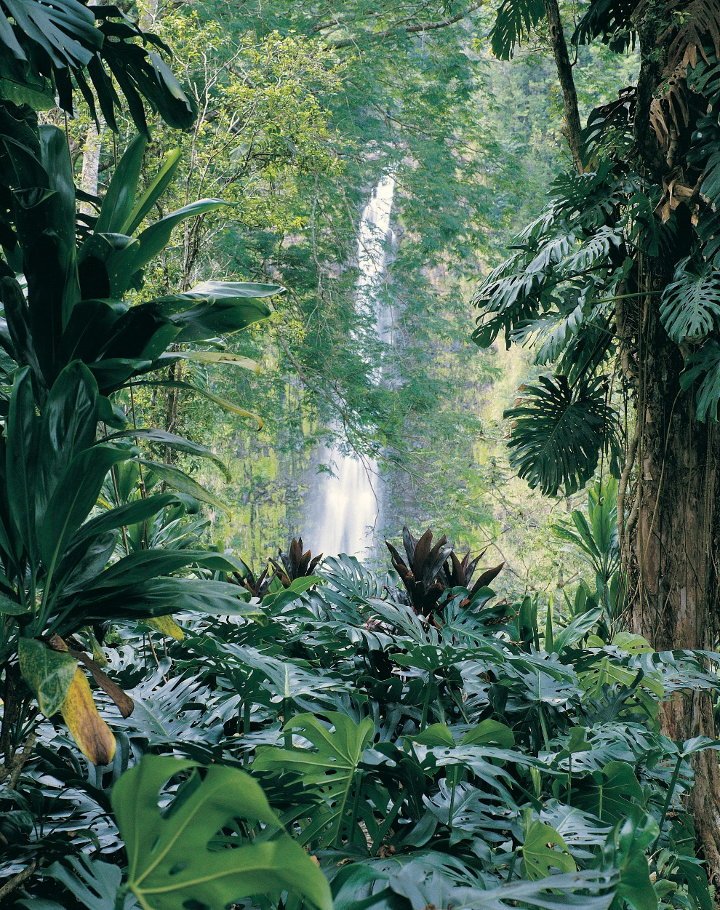
The Importance of Rainforests
Tropical rainforests are sources of great riches. The plants and animals of the rainforest provide food, lumber, and jobs.
Forested land can also be cleared to make room for crop and livestock production.
Rainforests once covered 15-20 percent of the Earth’s land surface; they now cover only about five percent.

Slide 36
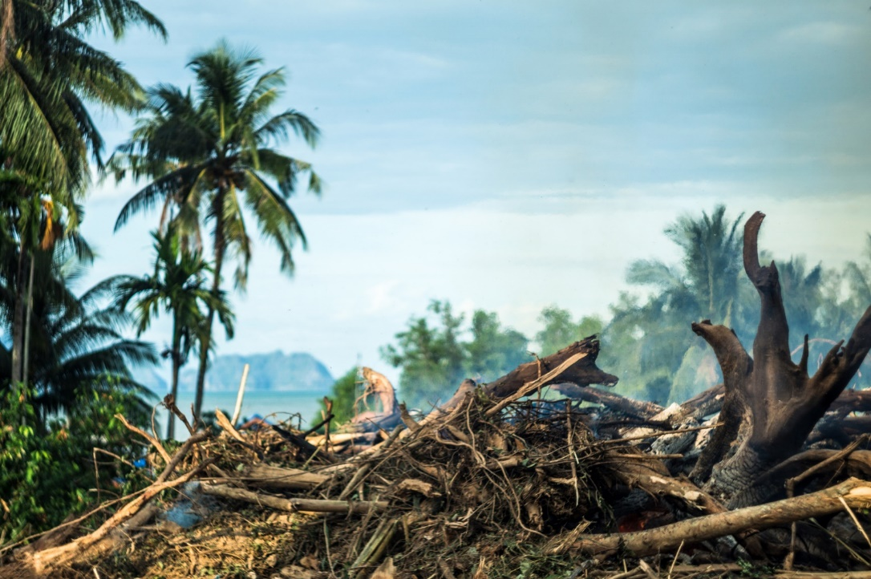
The Importance of Rainforests
As important as lumber and jobs are, the greatest value of tropical rainforests is that they help regulate the global climate.
In addition, tropical rainforests are more biologically diverse than any other ecosystem, and the loss of these different plant and animal species has a profound impact on the world.

Slide 37
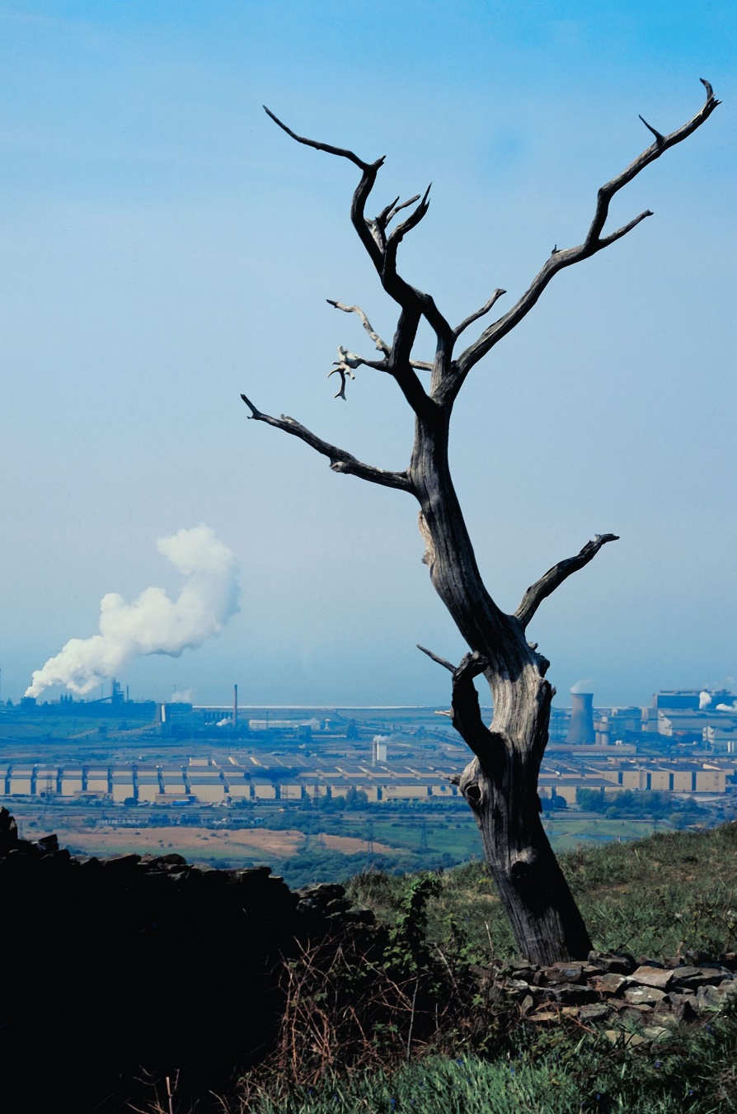
The Importance of Rainforests
The following is a short list of ways that rainforests are important to the Earth.
Regulating the climate — Forest plants convert carbon dioxide into clean air through photosynthesis, which helps slow the greenhouse effect. When a mature forest is healthy, the storage and release of carbon dioxide is kept in check. However, when forests are burned or cleared and the debris left to decay, carbon dioxide is released into the atmosphere.

Slide 38
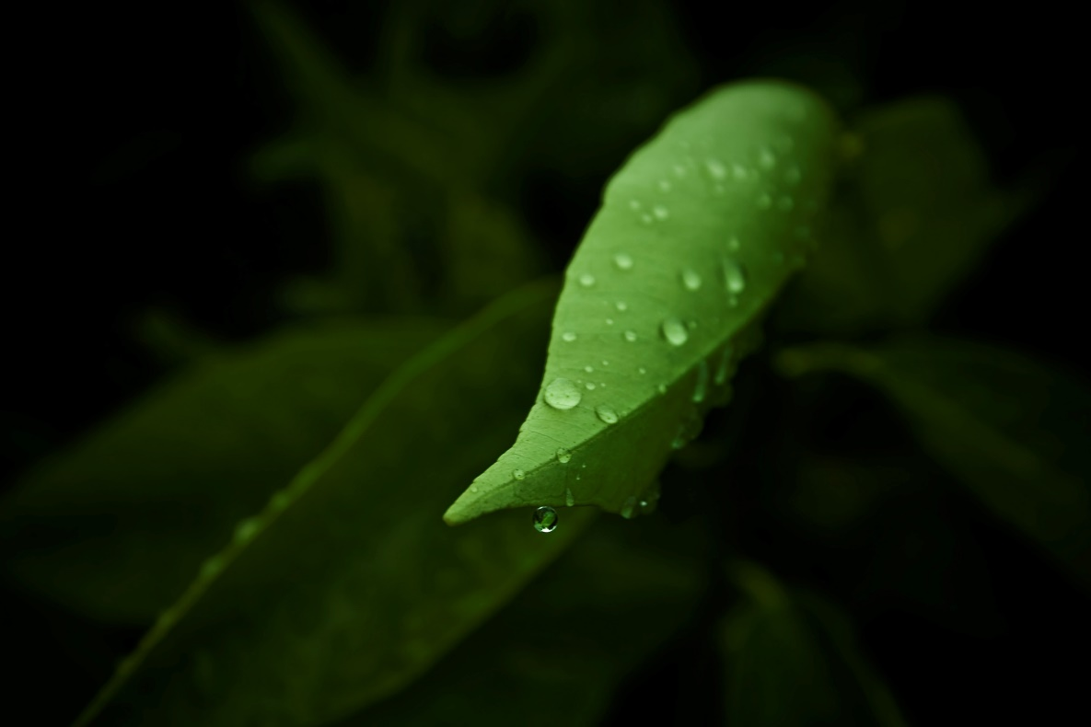
The Importance of Rainforests
Rainforests, especially those in the tropics, also regulate global climate by releasing moisture into the atmosphere. This moisture cycles back to the ground as precipitation. The cycle is disrupted when forests are cleared. As a result, droughts become more common and temperatures increase.

Slide 39
The Importance of Rainforests
The Amazon rainforest plays a role in the world’s overall climate. The Amazon cools the global temperature by 3-4°F and balances the humidity and rain. The Amazon forest holds the world’s largest stock of carbon in the form of plant material.

Slide 40
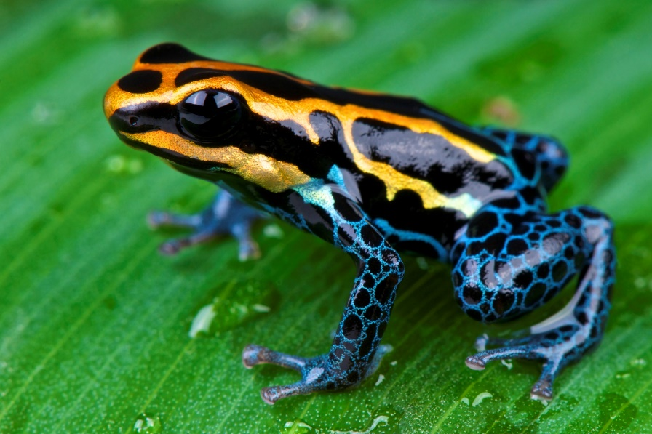
The Importance of Rainforests
Maintaining diversity — Tropical rain forests are home to over 50 percent of plant and animal species. Rainforests also offer a bounty of foods. At least 80 percent of the developed world’s diet originated in tropical rainforest areas. Foods we routinely use that originated in rainforests include coffee, cocoa, many fruits and nuts, squash and yams, spices, sugar cane, and vanilla. Without rainforests, this source is lost, along with the chance to develop new foods. Global food production could also become vulnerable.

Slide 41
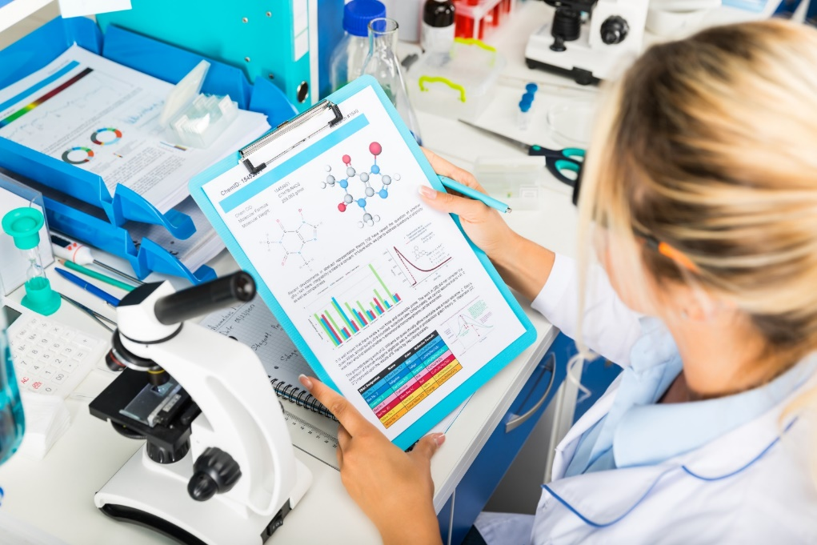
The Importance of Rainforests
Developing pharmaceuticals — Rainforests are the source of one-fourth of the medicines used today. They may also provide the key to curing a number of diseases. Many of the discoveries of modern drugs are made possible with the knowledge of the native peoples living in rainforest areas. However, as the rainforests are cleared, these people are moving out and dying off. Their culture and knowledge of the forest’s plant life are disappearing, along with the area’s unique plant and animal species and their potential uses.

Slide 42
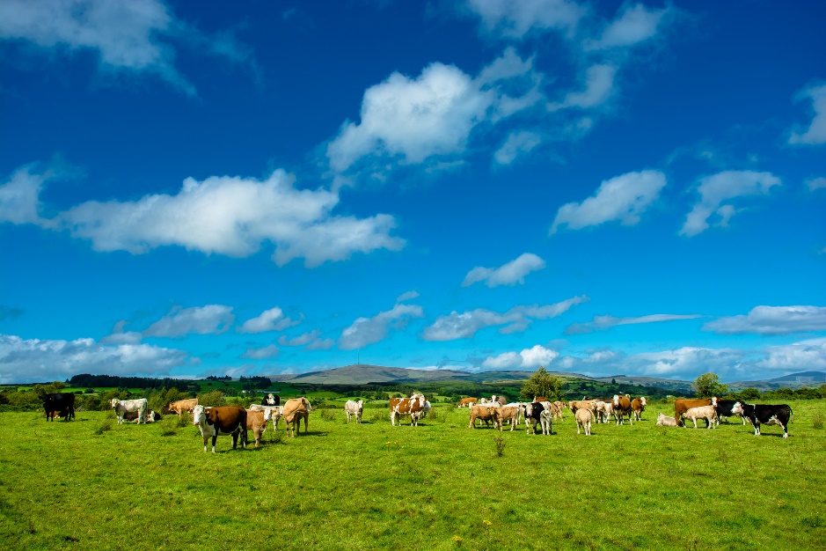
The Importance of Rainforests
Protecting soil — Rainforests help regulate the flow of surface water by absorbing moisture and releasing it slowly. When the forests are cleared, heavy rainfall often causes soil erosion and siltation. Many tropical rainforest areas are being cleared for lumber production and other uses. However, the soils found in forests are
nutrient-deprived. The trees rely on the nutrients released from newly decayed plants. If this nutrient recycling system is interrupted, the land can only support activities such as cattle ranching for a short time.

Slide 43
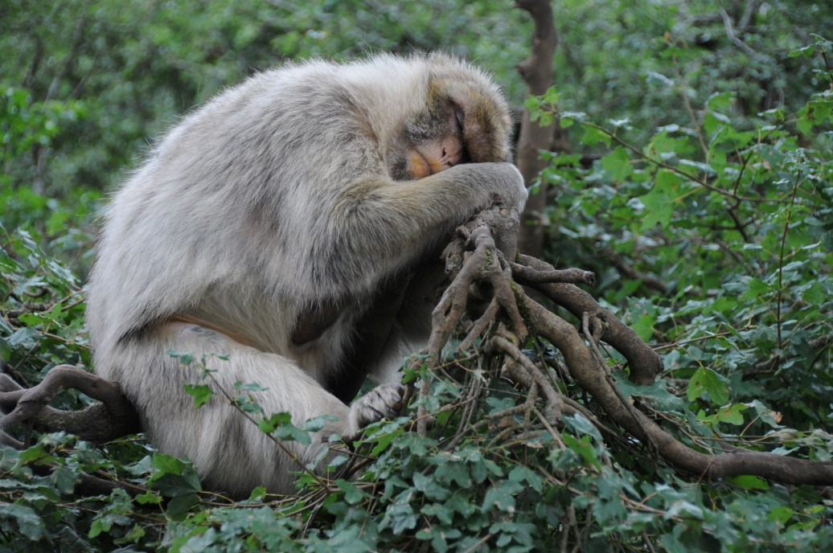
The Importance of Species Biodiversity
Endangered species are plants and animals that are declining so quickly and so few exist that they are on the verge of extinction. Species that are in less danger are classified as being rare or threatened.
Species are becoming endangered on every continent and in every habitat. Species biodiversity — the number of plant and animal species in an environment — is also being lost.
In general, the cause of this decline is human activity.

Slide 44
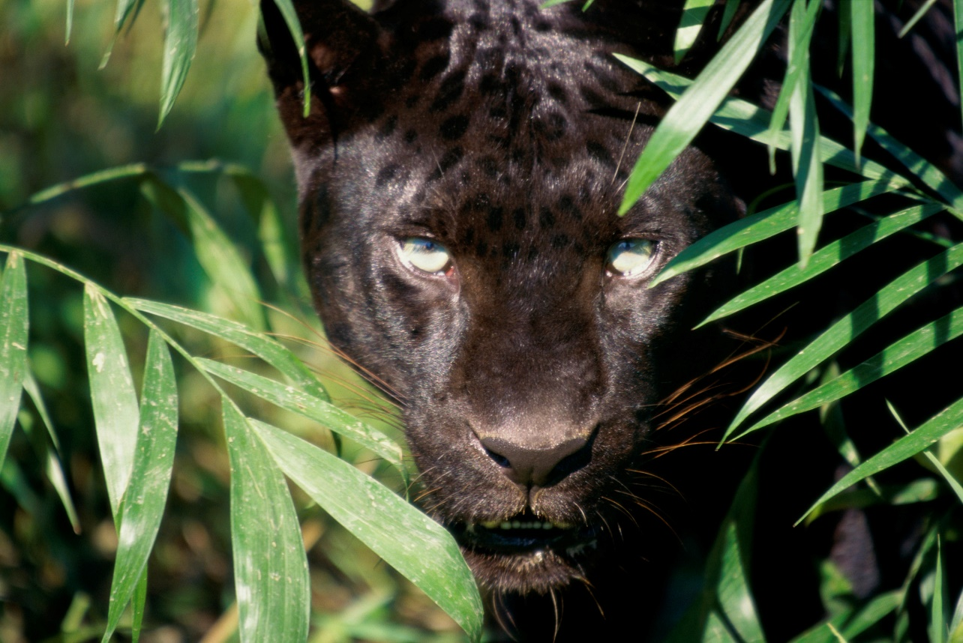
The Importance of Species Biodiversity
Extinction of a species could potentially mean the loss of a cure for diseases or of crops that are naturally resistant to insects and diseases. The value of most plants and animals has yet to be discovered.
When a plant or animal becomes extinct, it is lost forever. Not only is that particular species lost, but all of its genetic potential is also lost.

Slide 45
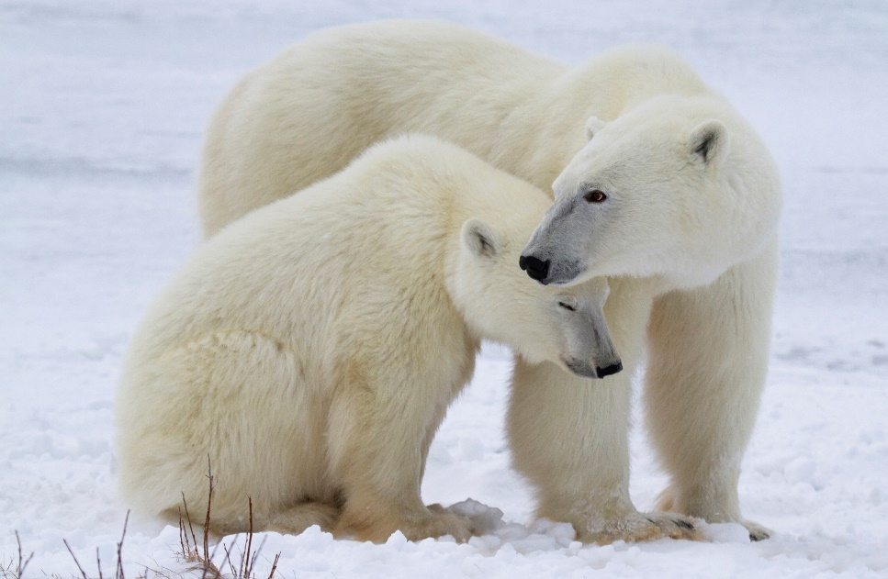
The Importance of Species Biodiversity
Scientists estimate there may be as many as 15 million species of plants, animals, and micro-organisms existing on Earth today and that tens of thousands of species may be lost each year.
All species have value and the loss of one species can have an impact on the whole environment. Extinction also leads to an imbalance in the food chain. This in turn may cause extinction of other species or a population explosion in others. When this happens, animals could begin competing for food that other animals and humans depend upon.

Slide 46
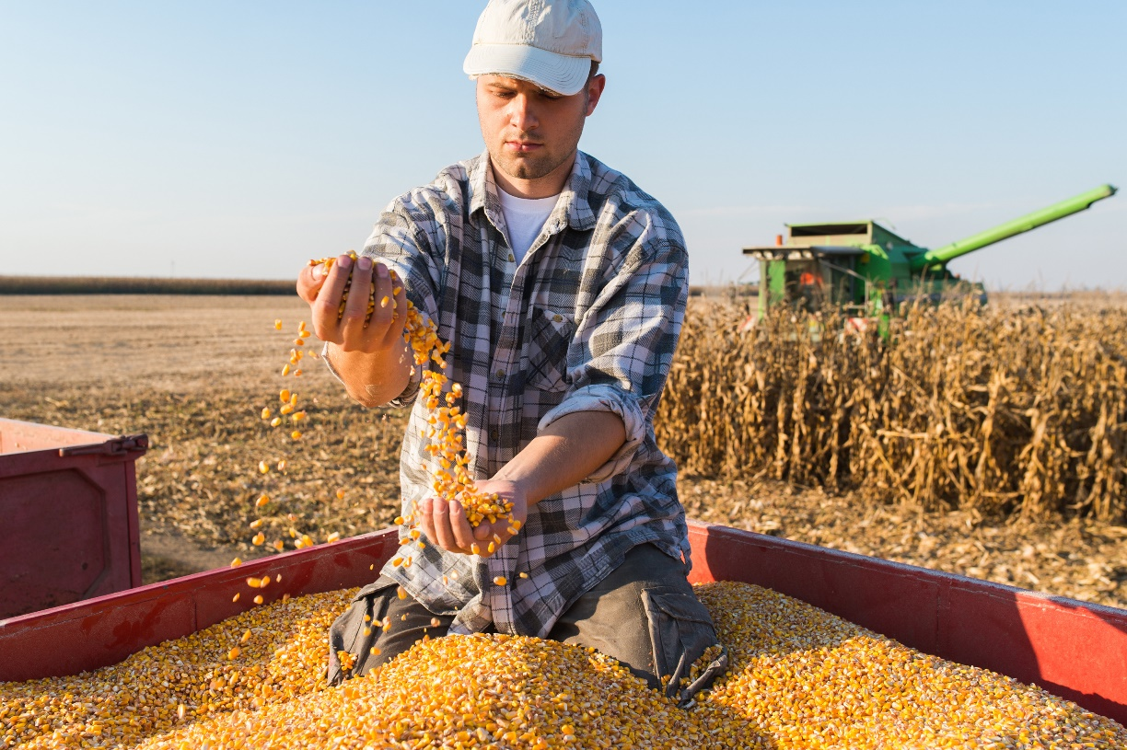
The Importance of Species Biodiversity
Extinction of a species could potentially mean the loss of a cure for diseases or of crops that are naturally resistant to insects and diseases. The value of most plants and animals has yet to be discovered. When a plant or animal becomes extinct, it is lost forever. Not only is that particular species lost, but all of its genetic potential is also lost.

Slide 47
The Importance of Species Biodiversity
Plants and animals are facing extinction for a variety of reasons:
Habitat loss — The native home of a plant or animal is its habitat. Some plants and animals require specific types of living conditions. These types of species are much more likely to become endangered through habitat loss than those that are more widely adapted. This does not mean that the entire habitat is wiped out. For example, sometimes habitat loss can mean the removal of dead trees in a forest that certain birds use for nesting. Habitats can be lost for a variety of reasons:
Clear cutting — Forest depletion is by far the number one cause of extinction.

Slide 48
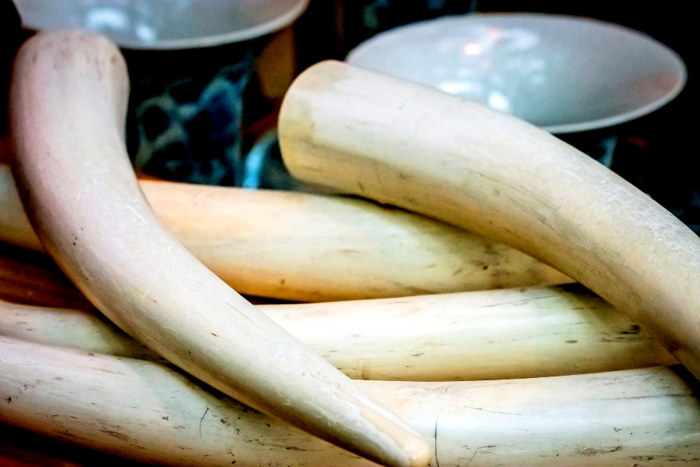
The Importance of Species Biodiversity
Urban development — The boundaries of cities are expanding to accommodate more and more people. Plant and animal habitats are lost as undeveloped land is developed for homes and businesses. Rivers and wetland areas are often changed or damaged as flood control structures are built or as the areas are developed for recreation.
Invasive species — Non-native plants and animals can take over an area and crowd out desirable native species.
Unsustainable consumption — In some areas, natural resources are being depleted without being replenished.
Exploitation — Some animals are hunted or poached for exotic food, herbal medicines, fur, or ivory.

Slide 49
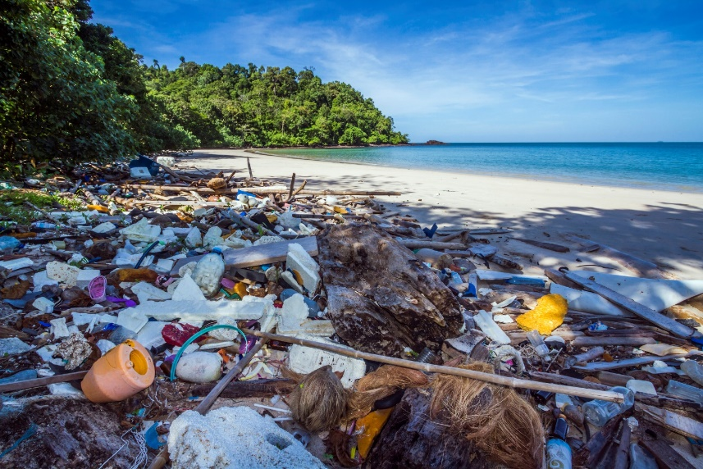
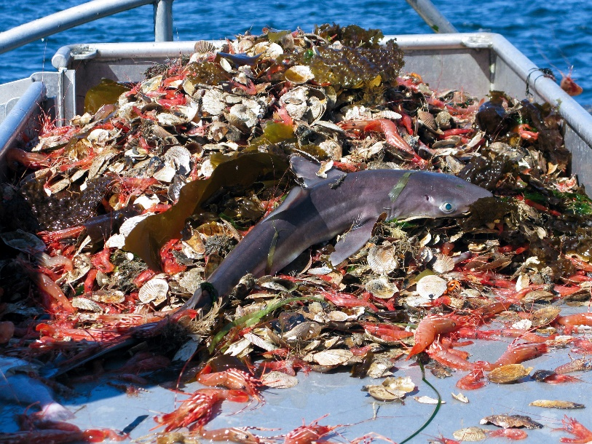
The Importance of Species Biodiversity
Disturbance — The presence of humans, vehicles, and machinery may cause some animals to abandon their habitat, even if the habitat itself is undisturbed.
Pollution — Pollution from industrial and vehicle exhaust, industrial accidents, and illegal dumping can all lead to extinction. The overuse of chemicals such as pesticides and fertilizers can also contaminate habitat areas and poison animals.
Bycatch — Plants and animals are sometimes unintentionally killed in the process of harvesting other species. For example, dolphins may become caught in fishing nets and drown.

Slide 50
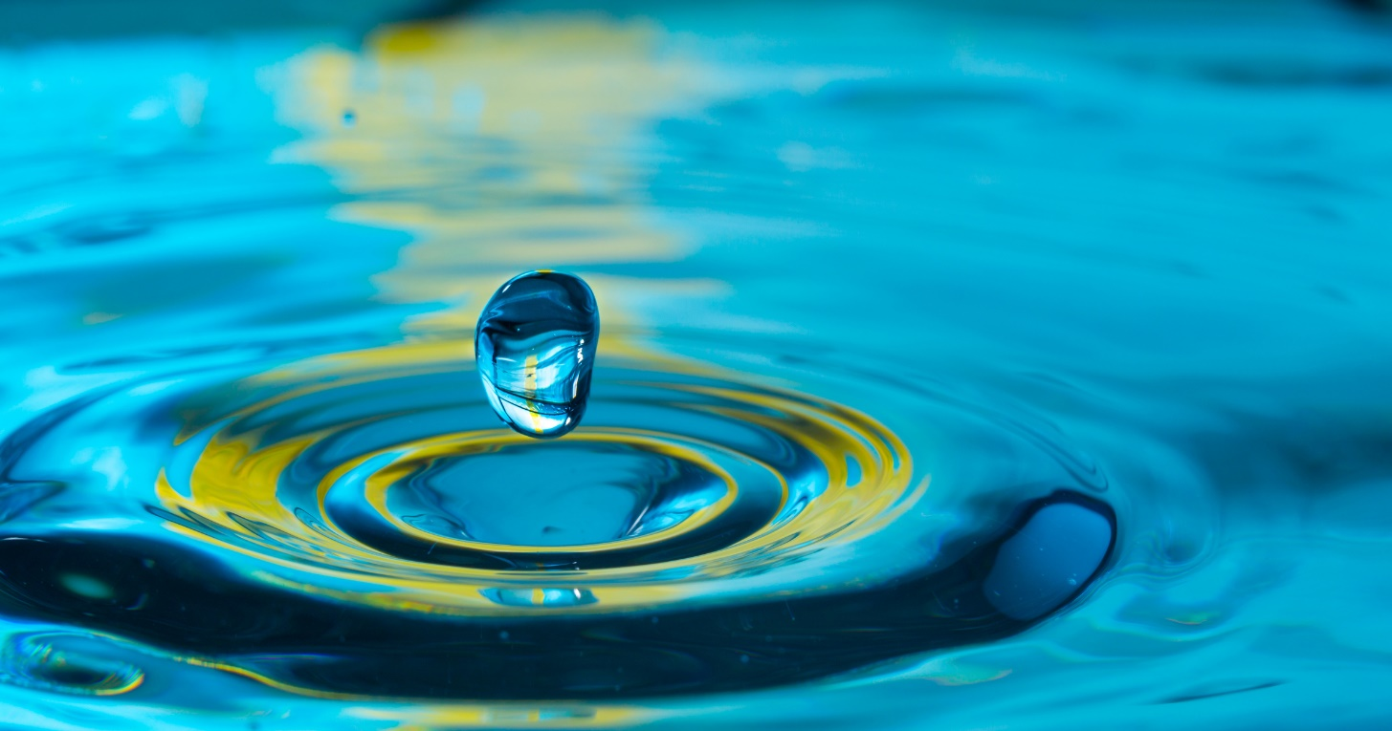
The Hydrologic Cycle
Water — all life on Earth depends on it. Human bodies are made up of more than 80 percent water. Water is also used every day for cooking, showering, swimming, boating, farming, manufacturing, and other activities.

Slide 51
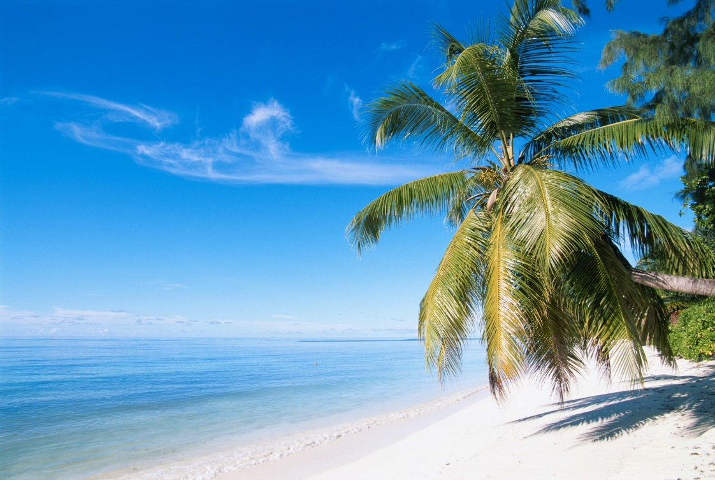
The Hydrologic Cycle
Water affects global climate. Water warms up more quickly and cools down more slowly than land surfaces. Because of their large mass and the thermal properties of water, the oceans are able to store tremendous amounts of heat and regulate temperature.
About three percent of the Earth’s surface is covered in ice, such as on mountain glaciers and at the North and South Pole. Ice reflects a lot of the sun’s energy. It also plays an important role in regulating climate because of its insulating properties.

Slide 52
The Hydrologic Cycle
Although nearly three-fourths of the Earth’s surface is covered with water, most of this water is not fit to drink.
Considering the small amount of water that is fit for consumption, have you ever wondered why we haven’t run out?
The hydrologic cycle continually moves water and replenishes our supply of fresh water.

Slide 53
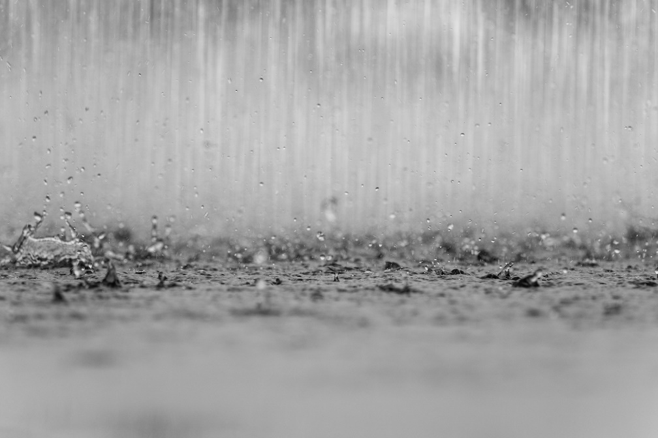
The Hydrologic Cycle
An important characteristic of water is that it can be found in three forms — as a solid, a liquid, and a gas (or vapor). These forms also play an important part in the hydrologic cycle. The hydrologic cycle moves water through the hydrosphere — the region containing all of the water in the atmosphere and on the surface of the Earth. Five phases make up the hydrologic cycle:
Evaporation
Condensation
Precipitation
Infiltration
Runoff

Slide 54
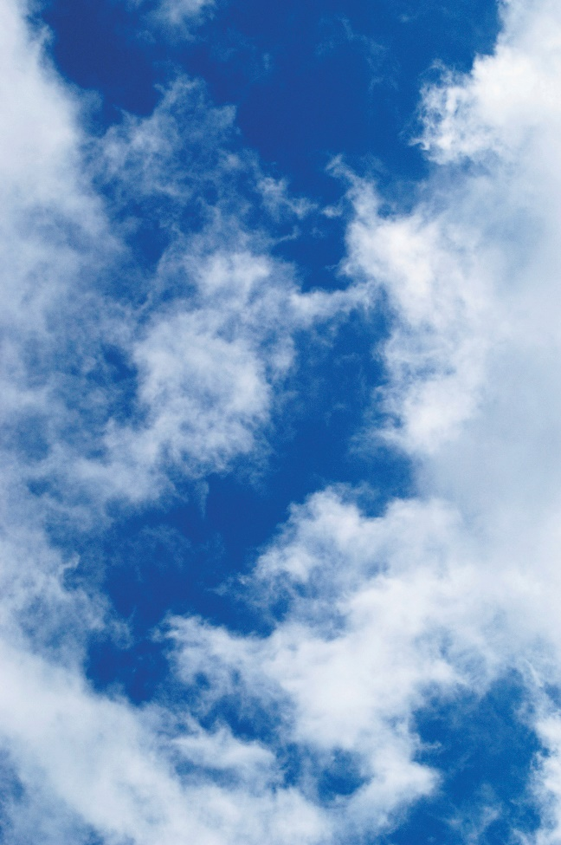
The Hydrologic Cycle
The process begins with the evaporation of water from the oceans.
The sun’s heat helps evaporate water and move it from the Earth’s surface into the air.
Evaporation is the changing of a liquid into a vapor. Sunlight further contributes to this process by raising the water temperature of oceans and other bodies of water. The warm, moist air is lifted up into the atmosphere.
As the air rises, it cools, condenses, and forms clouds. (Condensation can also happen at ground level, which is why dew often forms on plants in the morning.)

Slide 55
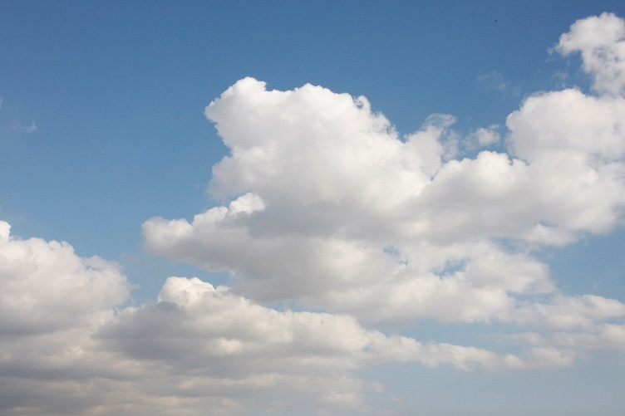
The Hydrologic Cycle
As clouds form, the winds and the jet streams move them until the moisture is released as precipitation.
Once rain, hail, or snow has fallen to the ground, most of it evaporates back into the atmosphere or is transpired by plants.
Some of the precipitation infiltrates the surface, seeps down, and becomes groundwater.
If precipitation falls faster than it can soak into the ground, it becomes runoff. The runoff stays on the ground’s surface and flows into streams and eventually collects in large bodies of water, such as lakes or oceans. Similarly, groundwater also seeps into streams and makes its way back to the ocean, where the cycle begins again.

Slide 56
All rights reserved; copyright © 2018 Resource Center for CareerTech Advancement
For more information, email us at
resourcecenter@careertech.ok.gov
Visit our website at https://www.okcareertech.org/educators/resource-center

