Slide 1

Exploring Energy Alternatives
Green Living Skills – Part 2
Developed by Resource Center for CareerTech Advancement,
a division of Oklahoma CareerTech

Slide 2

Exploring Energy Alternatives
Energy is a fundamental part of nature.
The food we eat is made possible because of the energy of the sun.
When we’re active, we burn energy as calories.
Even our electric lights, vehicles, and other types of machinery require energy in order to work.
Today, consumers have more choices when it comes to sources of energy. Many of these options provide green alternatives to more traditional sources!

Slide 3
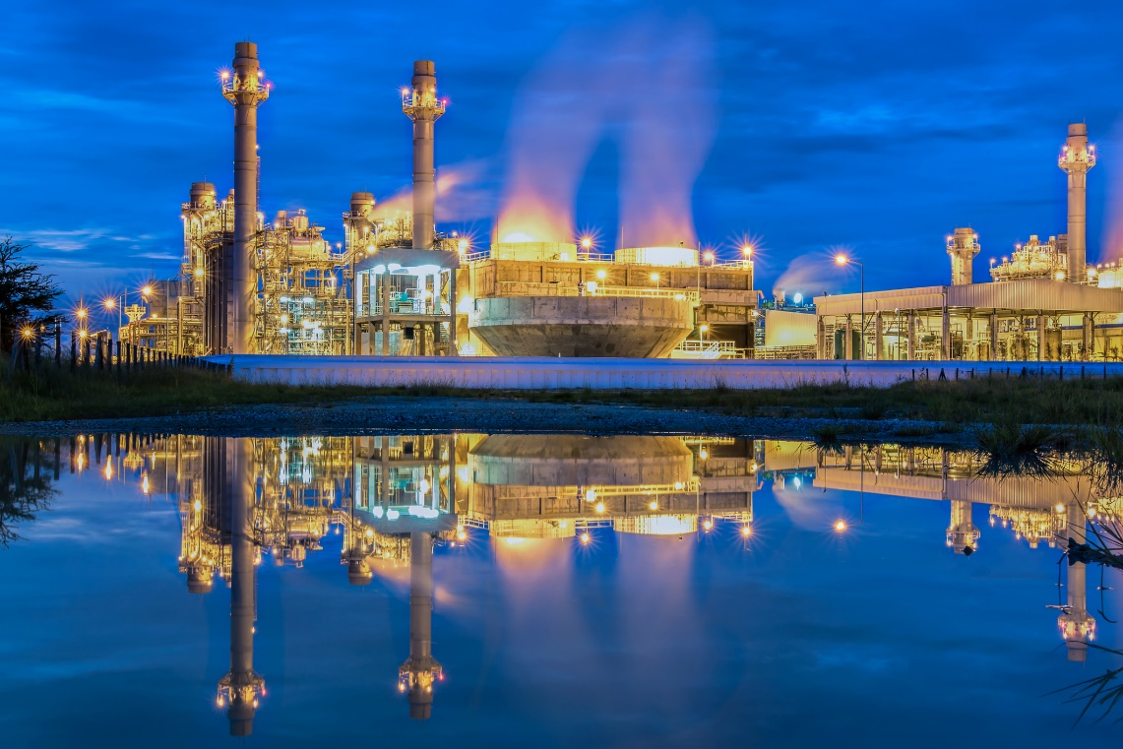
Exploring Energy Alternatives
Topics covered:
Renewable Energy
Energy Measurement and Transformation
Energy Sources
How Electricity is Transmitted
Wood as a Fuel Source
Alternative Fuels
Biofuels
Flexible Fuel, Hybrid and Electric Vehicles

Slide 4
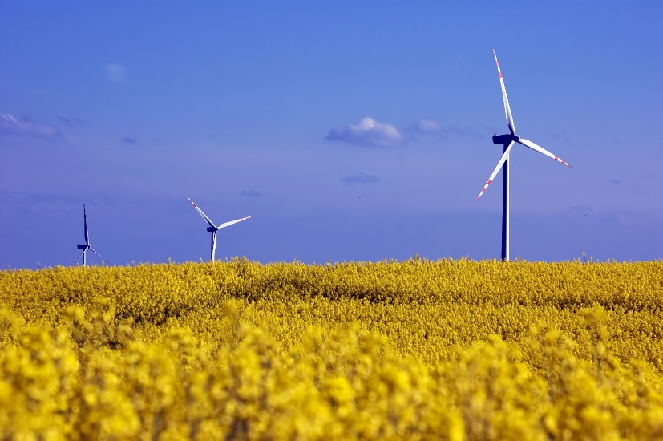
Renewable Energy
Energy to power the modern world can come from a variety of sources, including:
  Fossil fuels (from oil, coal and natural gas)
  Biomass energy (from plants)
  Geothermal energy (from the Earth)
  Hydropower (from moving water) and ocean energy
  Nuclear energy (from the energy trapped inside an atom)
  Solar energy (radiant energy from the sun)
  Wind energy

Slide 5
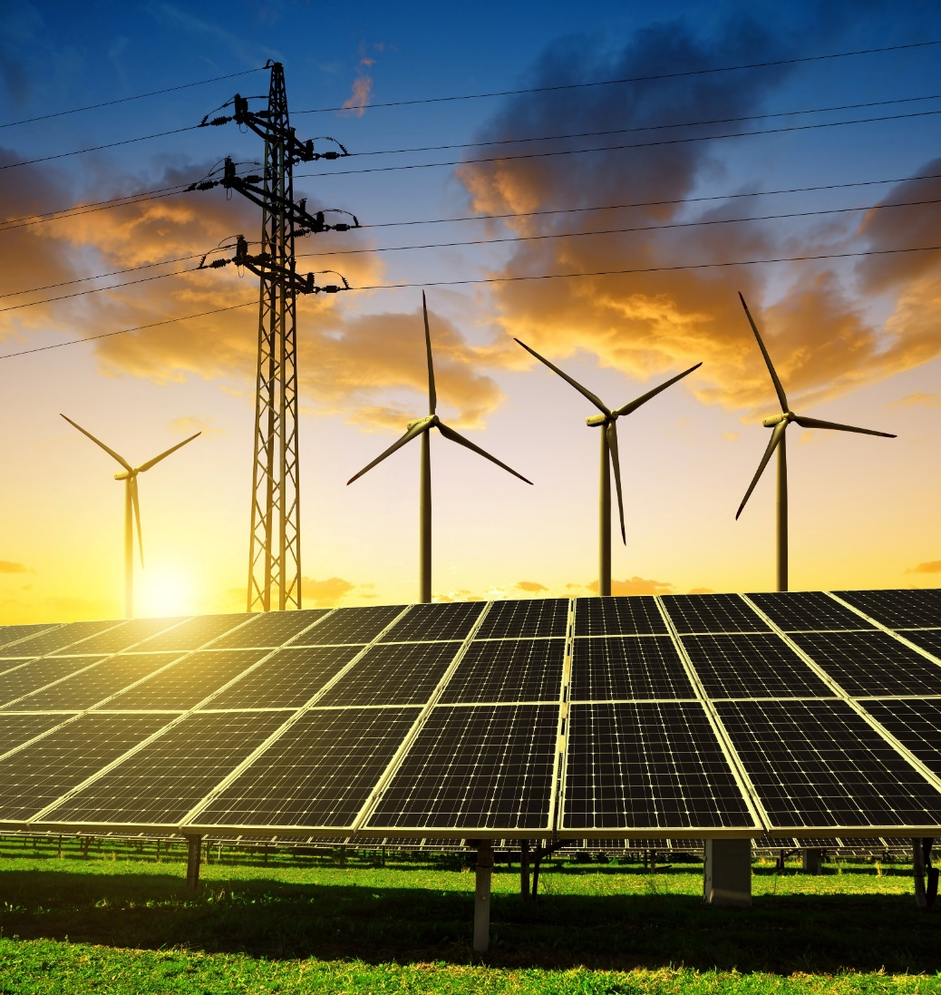
Renewable Energy
Renewable energy sources include:
  wind
  solar
  geothermal hydropower and
  biomass energy
  Fossil fuels such as coal and natural gas are not renewable; it takes millions of years for nature to create fossil fuels, so these sources will eventually run out.

Slide 6
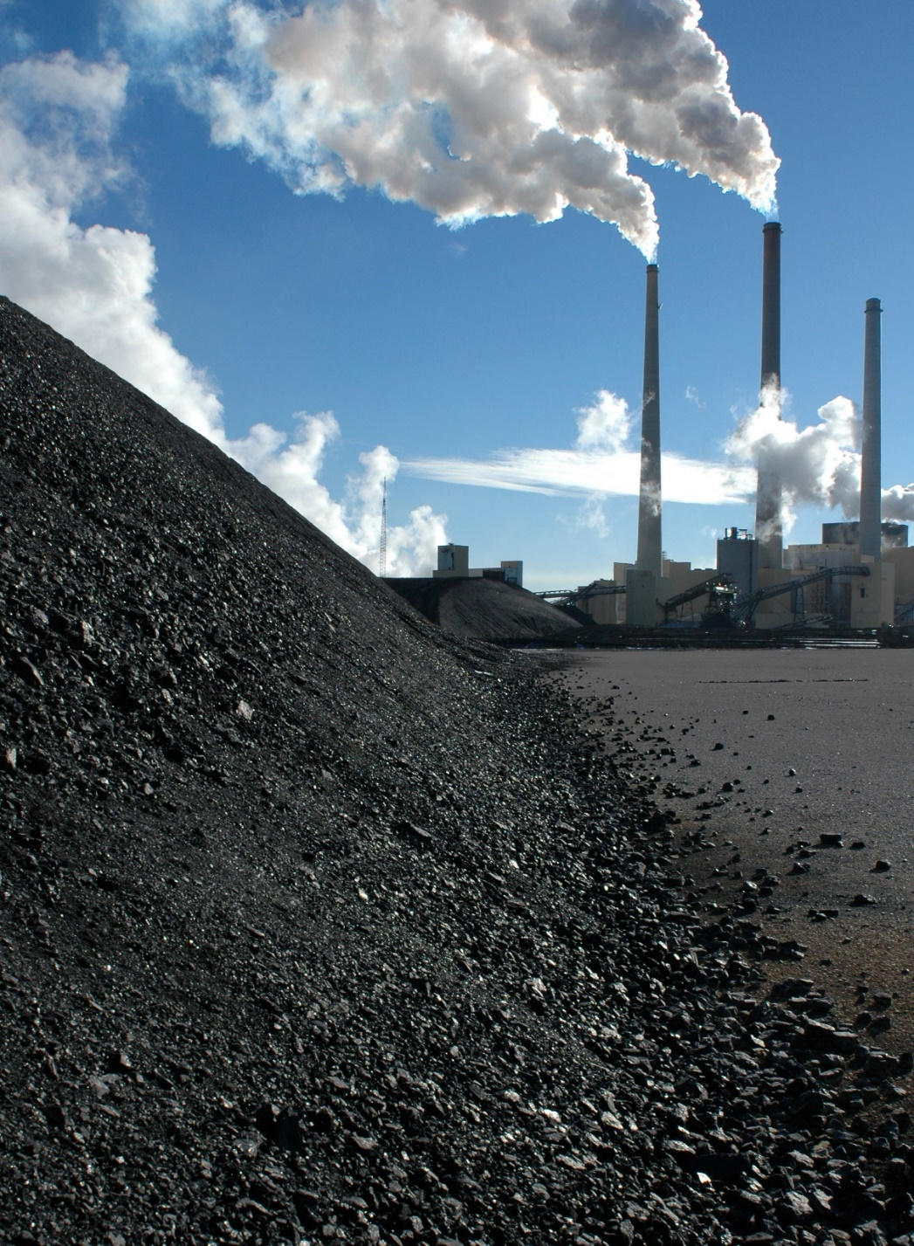
Renewable Energy
Most electricity used in the United States comes from power plants that use coal, nuclear, and other types of non-renewable energy that produce waste.
Because of this, the generation of electricity is the top cause of industrial pollution.

Slide 7
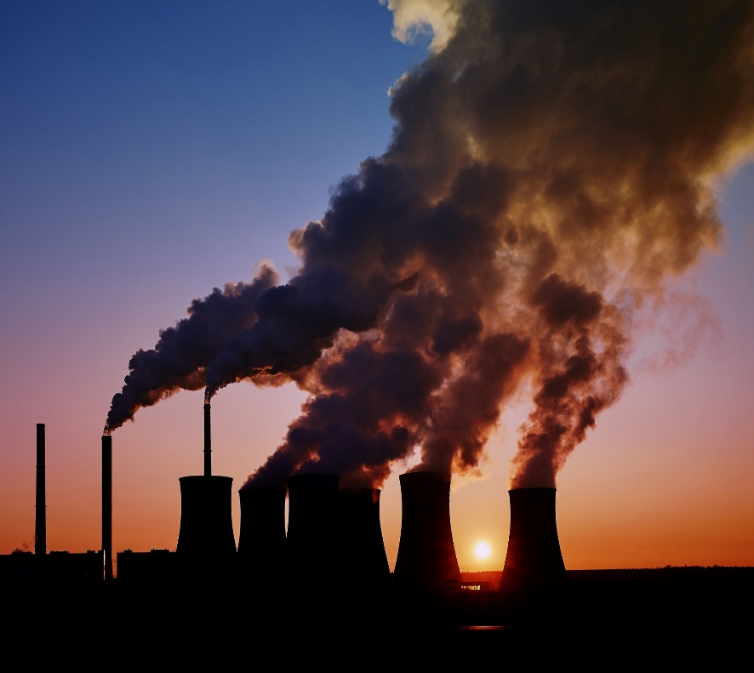
Renewable Energy
Traditional power generation gives off a number of byproducts that negatively affect humans and the environment, including:
  Sulfur dioxide (SO2), which causes acid rain and can increase respiratory illnesses.
  Nitrogen oxides (NOx), which reacts with sunlight to create ground level ozone and smog.
  Ozone (O3) in the lower atmosphere, which causes smog.
  Particulate matter (soot), which is harmful to people with lung disease.

Slide 8
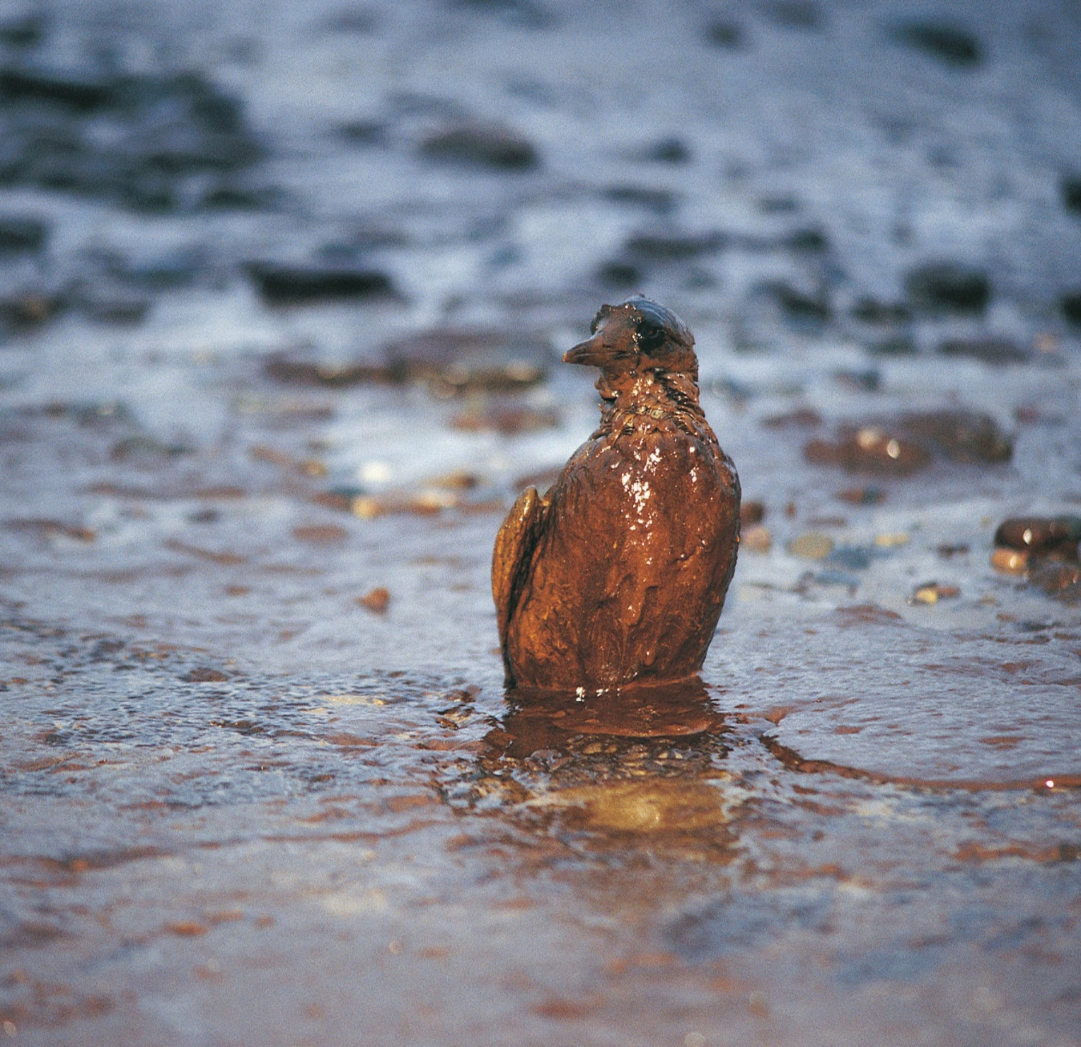
Renewable Energy
  dioxide (CO2), which contributes to global warming.
  Radioactive waste from nuclear energy, which poses a potential threat.
  Mercury, which accumulates in fish and other animals that humans consume.
  Crude oil spills, which can cause an environmental disaster.

Slide 9
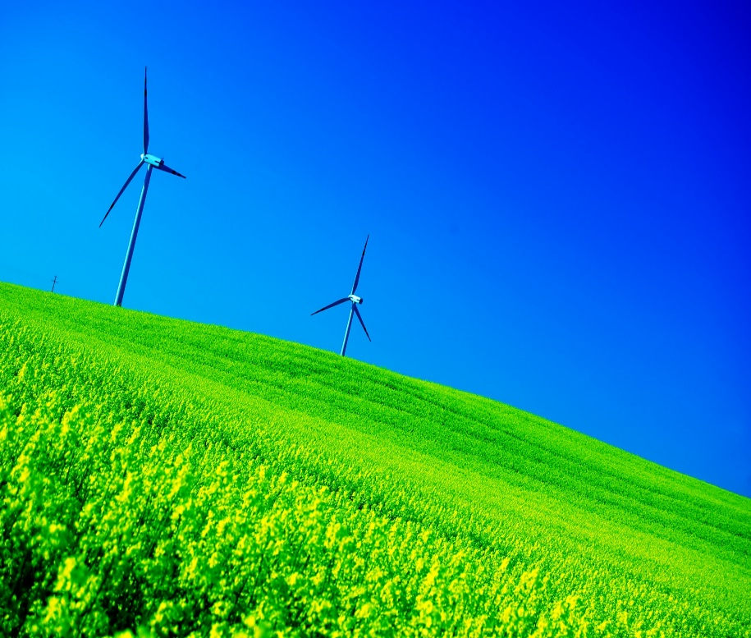
Renewable Energy
Renewable energy produces less pollution and waste, so there is less risk to the environment. There are many other benefits. Renewable energy can:
  Create jobs and opportunities for economic development.
  Provide energy security by increasing the diversity of power sources.
  Help stabilize the cost of energy, since renewable energy production does not involve fuel costs.
  Keep energy dollars in the U.S. instead of paying foreign entities for oil.
  Help conserve natural resources.

Slide 10
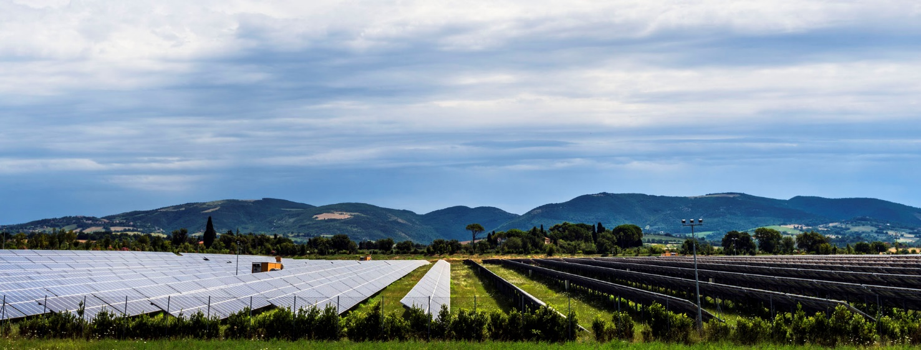
Renewable Energy
Even renewable energy development has some drawbacks.
  Solar and wind farms require large tracts of land.
  The process of making solar cells and batteries produces chemical waste.
  Currently, renewable energy can provide only a part of our energy needs.
  Although the price is dropping, renewable energy is more expensive than power from fuel-burning power plants.
  Birds are killed when they hit wind turbines. In addition, some wildlife are frightened away from their natural habitats if wind turbines are in place.

Slide 11
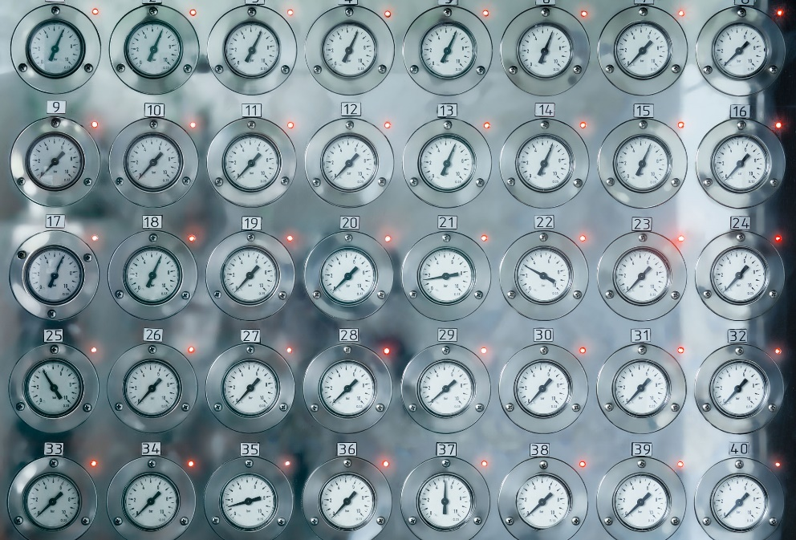
Energy Measurement and Transformation
Words to Know
  BTU - British Thermal Unit, the amount of heat energy required to raise the temperature of one pound of water by one degree Fahrenheit at sea level
  Joule - one joule is the amount of energy needed to lift an object weighing one pound to a height of nine inches
  kinetic energy - the energy associated with an object in motion
  potential energy - energy stored within a physical system
  radiation - rays of energy

Slide 12
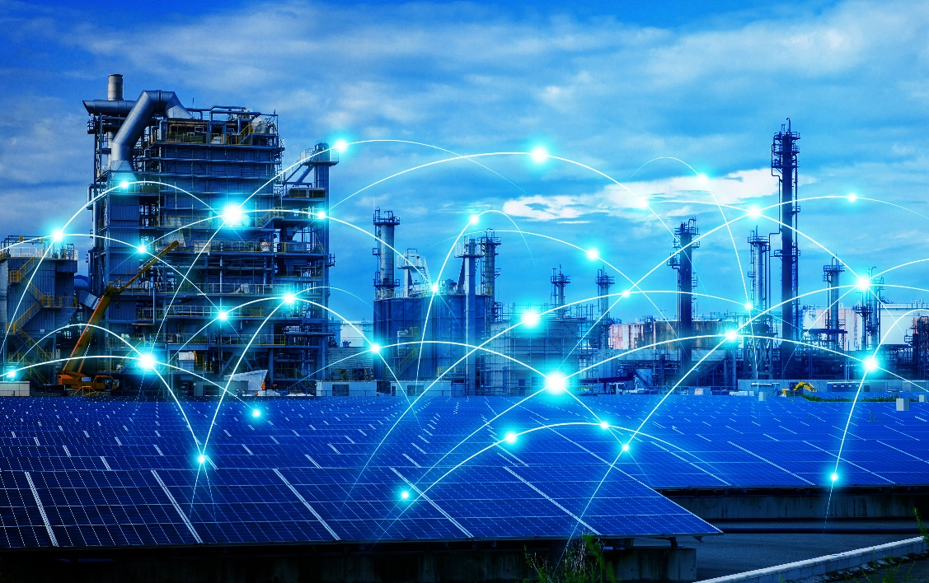
Energy Measurement and Transformation
A British thermal unit (BTU) is a way of measuring energy.
Energy is also measured in joules. A thousand joules is equal to a British thermal unit.
Around the world, most scientists use joules to measure energy, much like most use the metric system instead of the English measurements of feet and pounds.

Slide 13
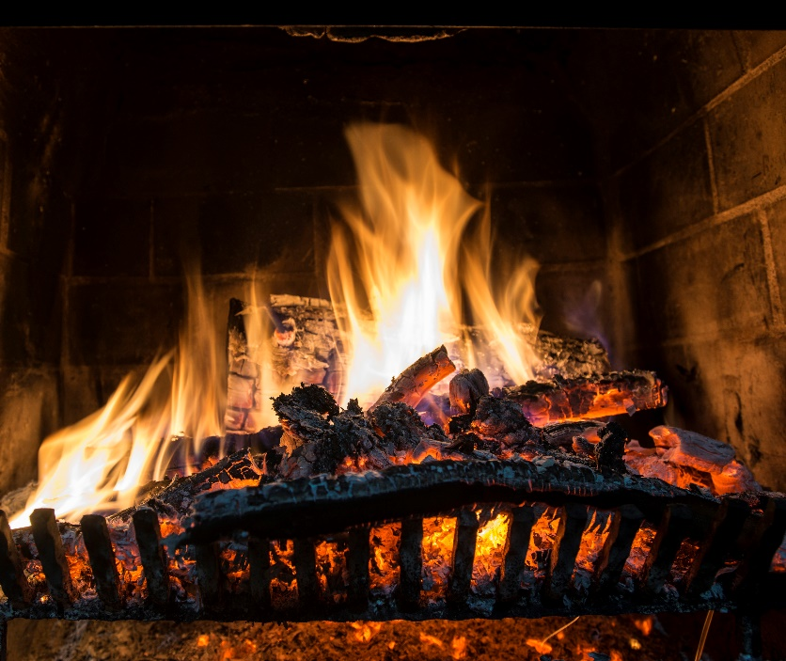
Energy Measurement and Transformation
Albert Einstein’s Theory of Relativity tells us that energy can be transformed into other types of energy, but it cannot be created or destroyed. We experience the transformation of energy every day.
  When you use a flashlight, the energy from a battery is transformed into light energy.
  When you burn wood in a fireplace, sunlight stored as potential energy in the wood provides the energy for the fire.
  Fuel is stored in your vehicle’s gas tank as chemical energy. As you drive the car, kinetic energy powers the car.

Slide 14
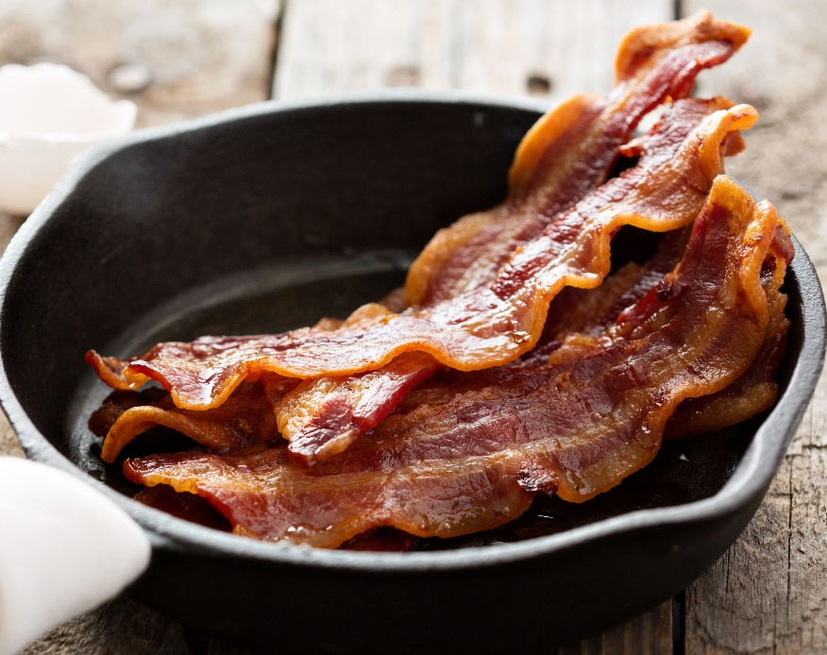
Energy Measurement and Transformation
Heat is another form of energy and it moves by way of conduction, convection, and radiation.
  Heat conduction occurs when energy is passed directly from one object to another. When you cook bacon in a skillet on the stove, the pan is made of metal — a good conductor.
  Convection is the movement of heat energy. Warm air is lighter than cold air, so it rises.
  Radiation is electromagnetic waves that transport energy through space. Radiation can be absorbed or reflected. Darker surfaces absorb more radiation, while lighter surfaces tend to reflect radiation. Shiny surfaces also reflect more heat than dull or matte surfaces.

Slide 15
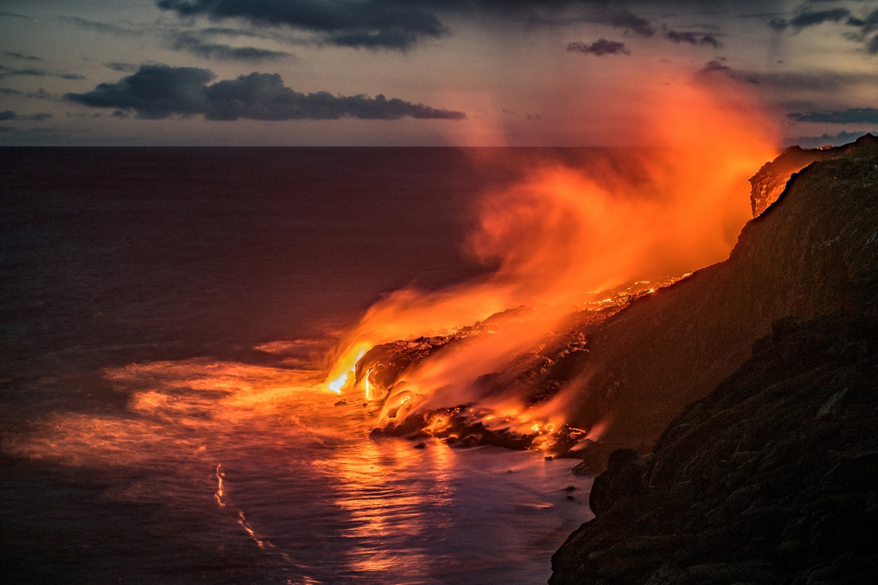
Energy Sources
Words to Know
  emit - to give off, such as light or heat
  geothermal - from the Greek words geo (Earth) and thermal (heat)
  magma - molten rock

Slide 16
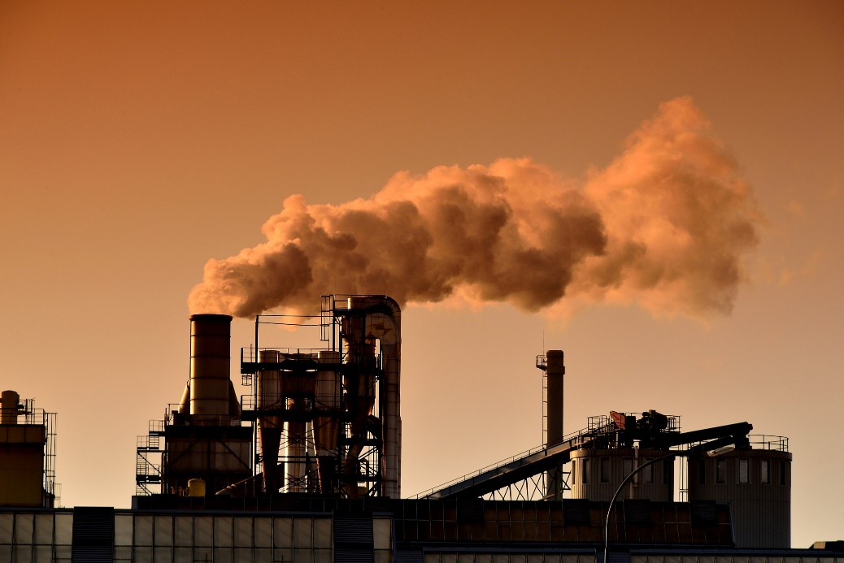
Energy Sources - Coal
Clean coal is a term used to describe improved coal mining techniques, new coal-generated power plants that are safer for the environment, and processes that make coal burn more cleanly and efficiently.
Coal is a plentiful and relatively inexpensive form of energy, which makes coal good for consumers.
However, the burning of coal sends large amounts of carbon dioxide and sulfur dioxide into the atmosphere and contributes significantly to global warming and acid rain.

Slide 17
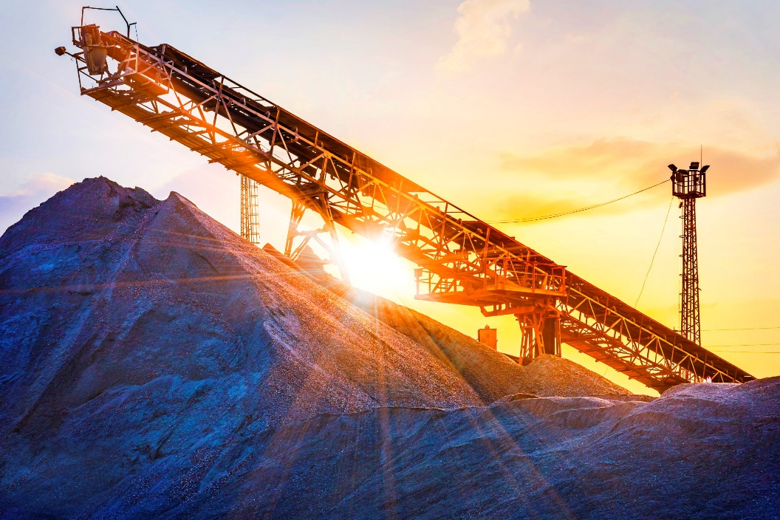
Energy Sources - Coal
Since most coal is burned in power plants to generate electricity, making power plants cleaner and more efficient is an important part of clean coal technology.
Most coal-burning power plants in the United States are outdated. Most were built during a time when there was much less concern for the environment.
Since coal is plentiful and cheap, it was not cost effective to design power plants to be highly efficient. Today, it would be unacceptable to build new coal plants based on old technology.

Slide 18
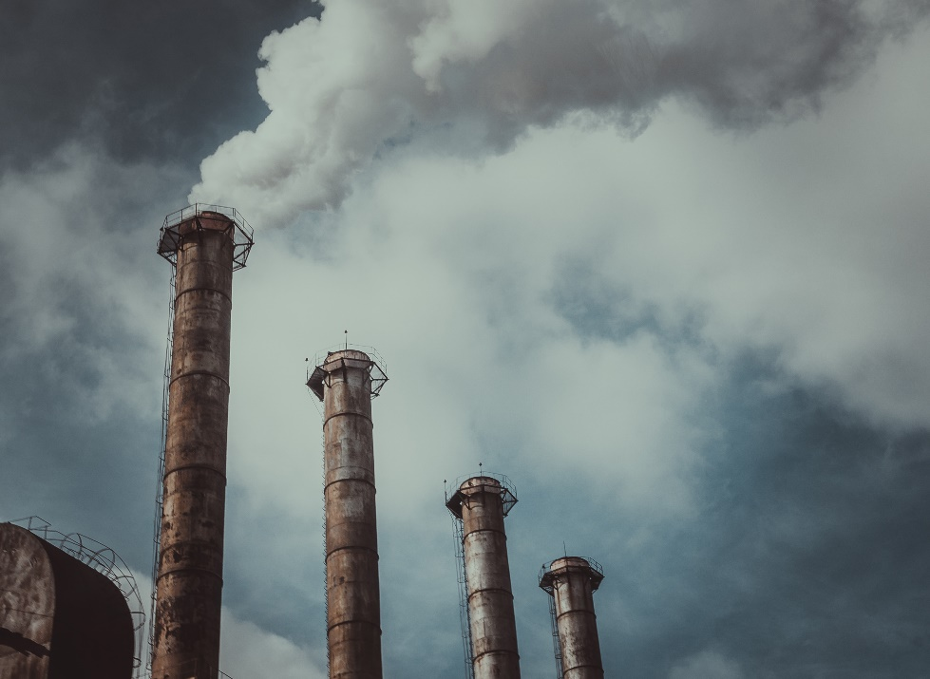
Energy Sources - Coal
Coal mining itself has never been a clean process.
Coal mining and processing can pollute the air, lead to the destruction of trees and other vegetation, destroy the land, and pollute waterways.
Some people argue that, since coal is a fossil fuel, cleaner coal technology is not as sound an investment as renewable energy — the world’s coal reserves could eventually be used up.
However, since it will take time to develop other forms of power generation, clean coal technology is a better approach than the older, dirtier coal technology.

Slide 19
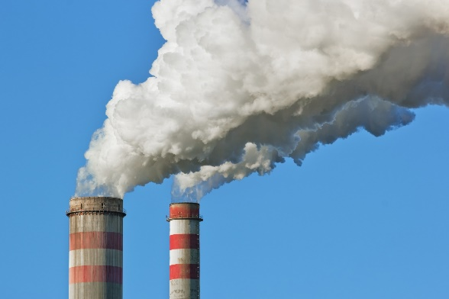
Energy Sources - Coal
Ways to make coal cleaner could include:
  Improving mining processes to make mining more environmentally friendly.
  Using wet scrubbers to remove sulfur dioxide from the exhaust of power plants.
  Filtering power plant exhaust to remove particulates that cause respiratory problems.
  Chemically washing coal to remove impurities to ensure that fewer pollutants are released into the atmosphere (although the washing process creates waste).
  Burning better quality coal to reduce pollution.
  Using nitrogen oxide burners to reduce some of the causes of ground-level ozone.
  Capturing and storing the carbon dioxide released by burning coal in power plants.
  Investing in research to discover new, cleaner coal-burning technologies.

Slide 20
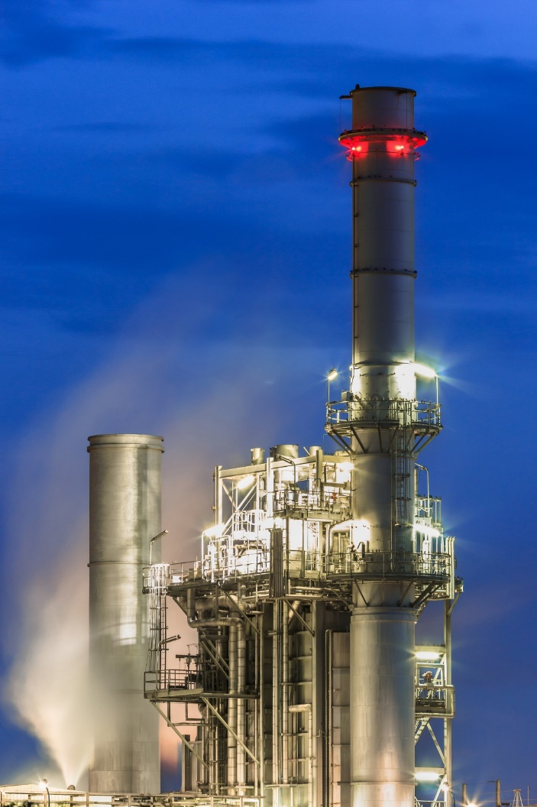
Energy Sources – Gasified Coal
Gasified coal is a relatively clean fossil fuel product that really isn’t coal.
During the production process, hydrogen and methane are separated out of the coal. Most of the carbon dioxide captured during production is usually disposed of by injecting it into the ground.
The product that results is called syngas — a gas that burns cleaner than other coal-based energy.
The gasification process also provides for the cogeneration of steam power.
Using an advanced form of this technology, a power plant could theoretically eliminate nearly all of its emissions.

Slide 21
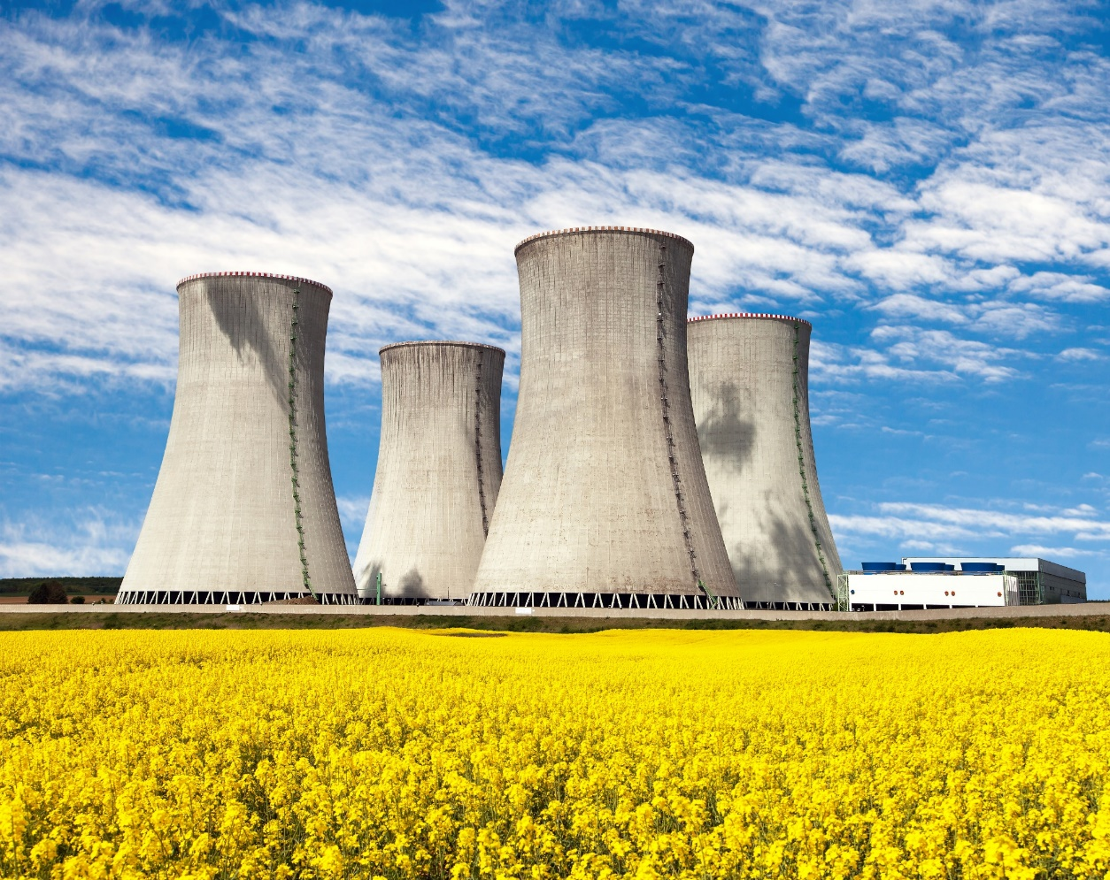
Energy Sources - Nuclear
Nuclear power uses the energy trapped inside the atom.
Albert Einstein realized that matter can be converted to energy. He created the mathematical formula E=mc² to explain this universal law. In Einstein’s equation, E stands for energy, m stands for mass, and c is the speed of light.
Scientists used this equation to help develop atomic energy.

Slide 22
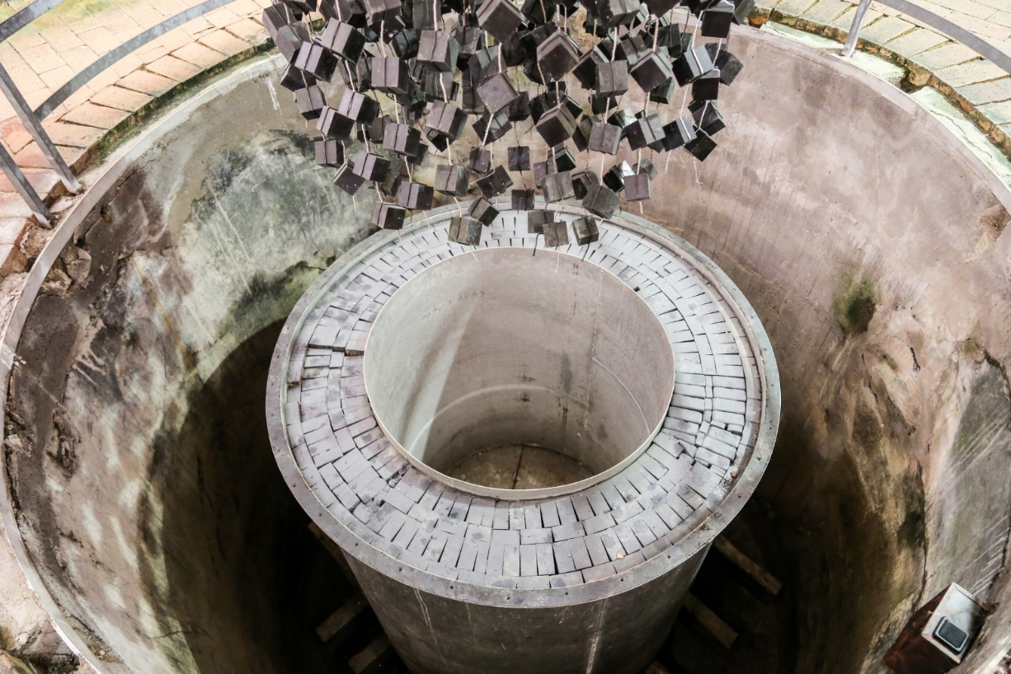
Energy Sources - Nuclear
Nuclear power can result from fission and fusion:
  Fission means to split apart.
  As small as atoms are, they can still be split.
  When this happens, both heat and light are released.
  When this energy is released slowly in a controlled way, it can be used to generate electricity.
  When it is released all at once, it causes an explosion.

Slide 23
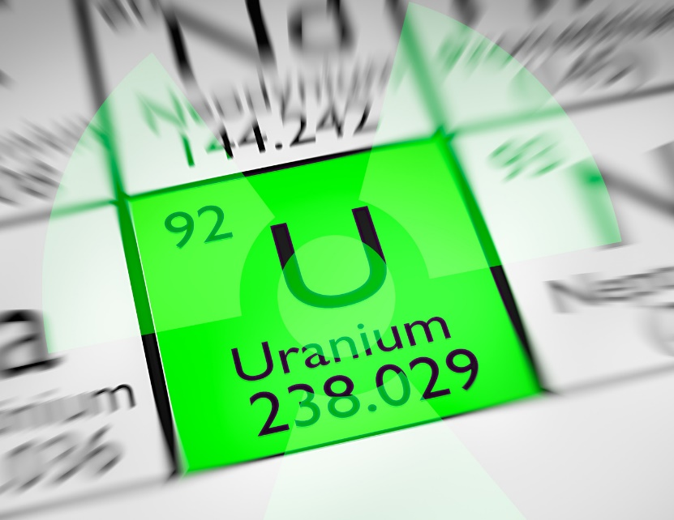
Energy Sources - Nuclear
  Nuclear power plants are fueled by uranium.
  Uranium is a common element that is mined from many places around the world.
  Uranium is processed into pellets that are loaded into long rods placed into a nuclear reactor. Inside a power plant’s atomic reactor, uranium atoms are split apart in a controlled chain reaction.
  The chain reaction also gives off heat energy.
  This heat is used to boil water to make steam, and the steam turns a turbine to generate electricity.
  So, instead of burning a fuel, nuclear power plants rely on the energy inside of atoms. The reaction also creates radioactive waste. This material has the potential to harm people and the environment if not contained.

Slide 24
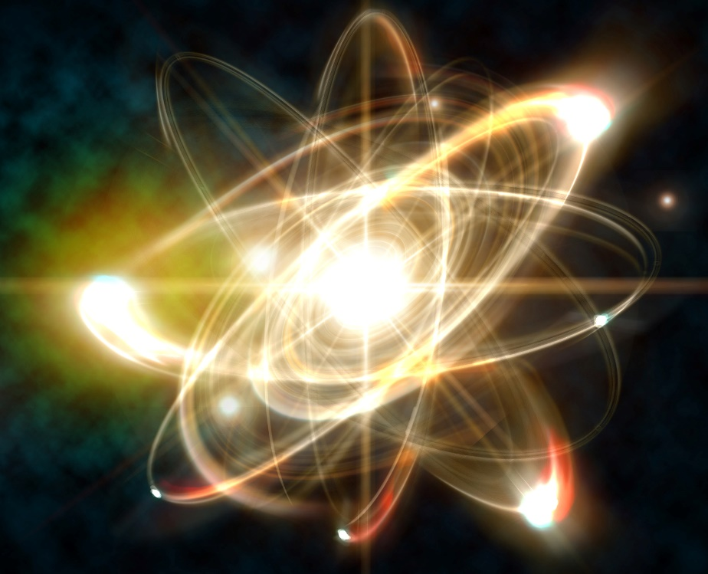
Energy Sources - Nuclear
  Fusion is the joining of smaller nuclei to make a larger nucleus. For example, the sun produces nuclear fusion of hydrogen atoms into helium atoms, which gives off heat and light and other radiation.
  Researchers have been trying to find a way to control nuclear fusion to make a fusion reactor to produce electricity. But they have not figured out how to control the reaction in a contained space.
  Nuclear fusion creates less radioactive waste than fission, and its supply of fuel can last almost indefinitely.

Slide 25
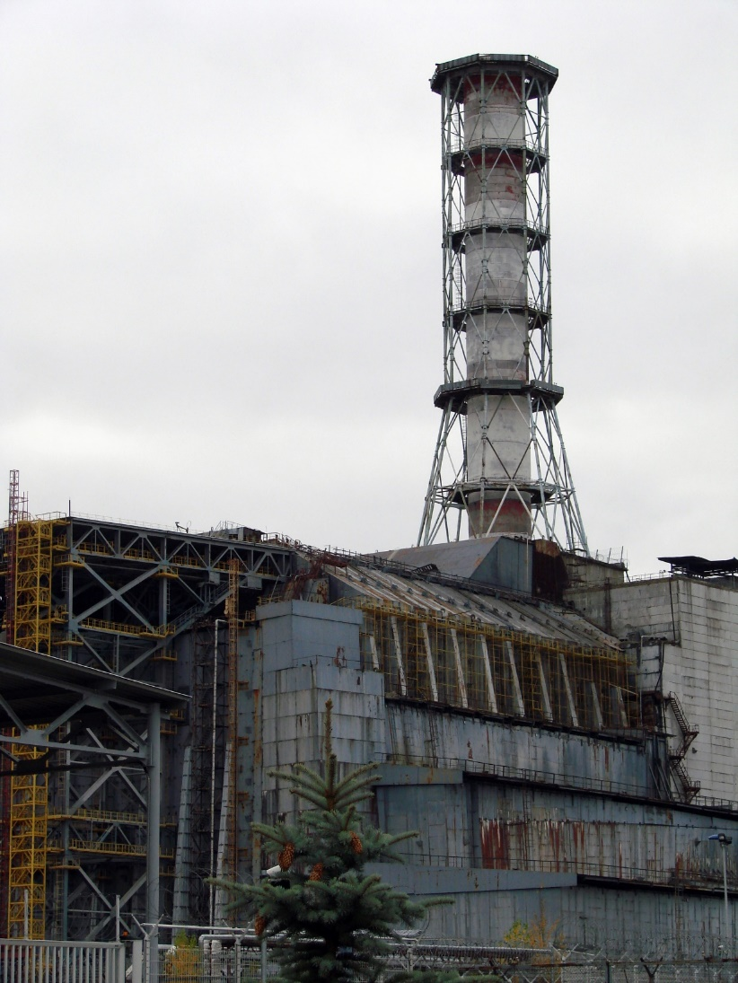
Energy Sources - Nuclear
  Some people view nuclear power as a low-cost, low-emission alternative to fossil fuels.
  Others fear the negative impact of nuclear waste and accidents such as Three Mile Island (in the United States) and Chernobyl (in the former Soviet Union).
  The way nuclear power plants generate electricity isn’t very different than a typical coal-burning power plant — both create steam to drive a turbine generator.
  However, because nuclear energy can emit harmful levels of radiation, extra precautions, containers, and protective shielding are required to prevent the escape of radiation and radioactive steam.

Slide 26
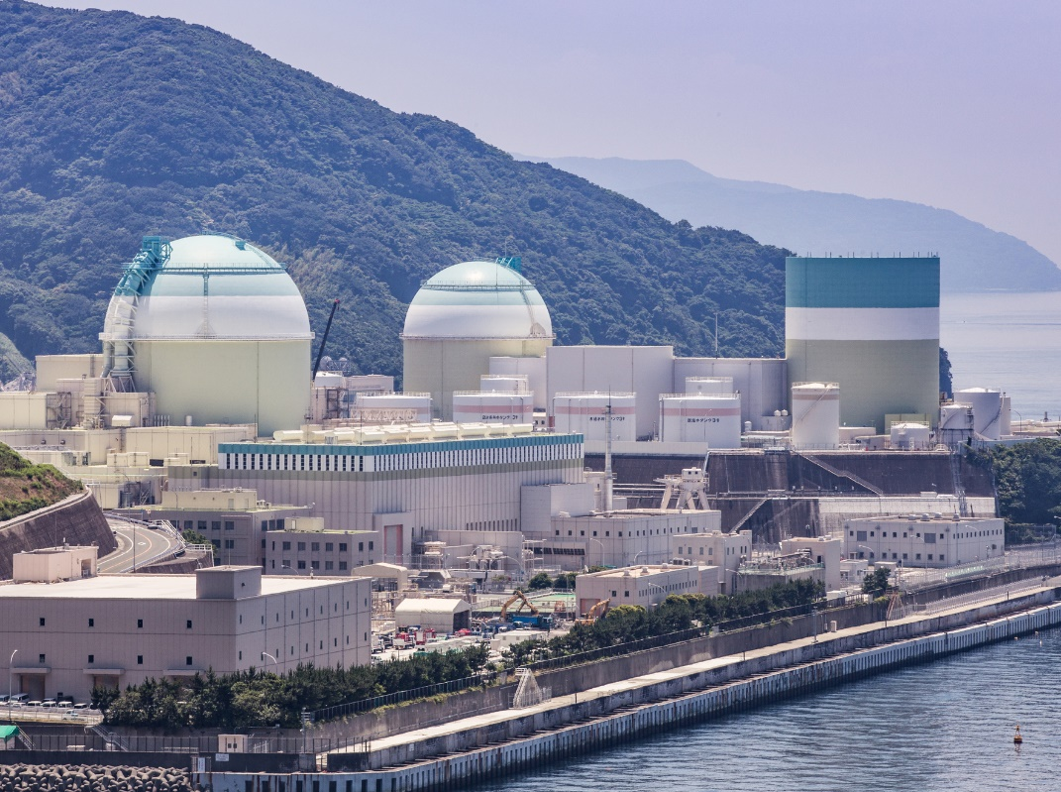
Energy Sources - Nuclear
  Nuclear power has advantages and disadvantages.
    Its greatest benefit is that it doesn’t depend on fossil fuels.
    Coal and natural gas power plants release tremendous amounts of carbon dioxide into the atmosphere, which contributes to climate change.
    Carbon dioxide emissions are minimal with nuclear power plants, so there’s very little impact on global warming.
    The cost of nuclear power also isn’t affected by rising oil and gas prices.
    A single nuclear power plant can produce a large amount of energy.

Slide 27
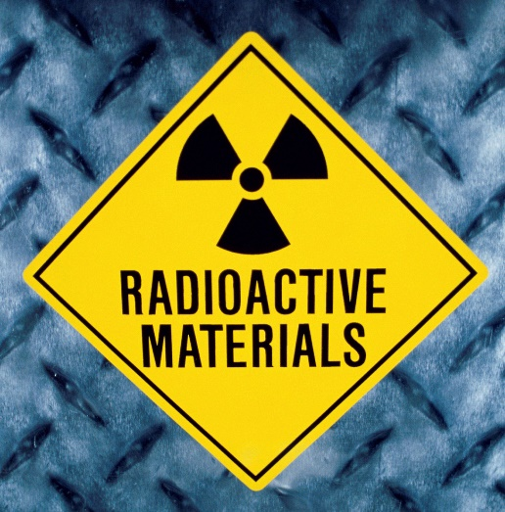
Energy Sources - Nuclear
  However, the process of mining and purifying uranium is not environmentally friendly.
    Transporting nuclear fuel to power plants poses a risk of contamination.
    In addition, the spent (used) fuel is radioactive and potentially deadly.
    Nuclear waste emits radiation and heat, which means that it has the potential to corrode any container.
    Nuclear waste will eventually decay to safe radioactive levels, but the decay process takes thousands of years.
    Currently, waste is cooled for several years before it is mixed with glass and stored in concrete structures.
    It can also take decades to propose, plan, and construct a nuclear power plant.
    Finally, the world’s supply of uranium will eventually be used up.

Slide 28

Energy Sources - Wind
Since ancient times, people have harnessed the wind to perform work.
  Early civilizations used sails to move a boat through the water.
  The wind was also used to turn large millstones to grind grain into flour or cornmeal and to pump water.
Today, the kinetic energy of the wind generates electricity. Small wind turbines can be used to power a home or a business.

Slide 29
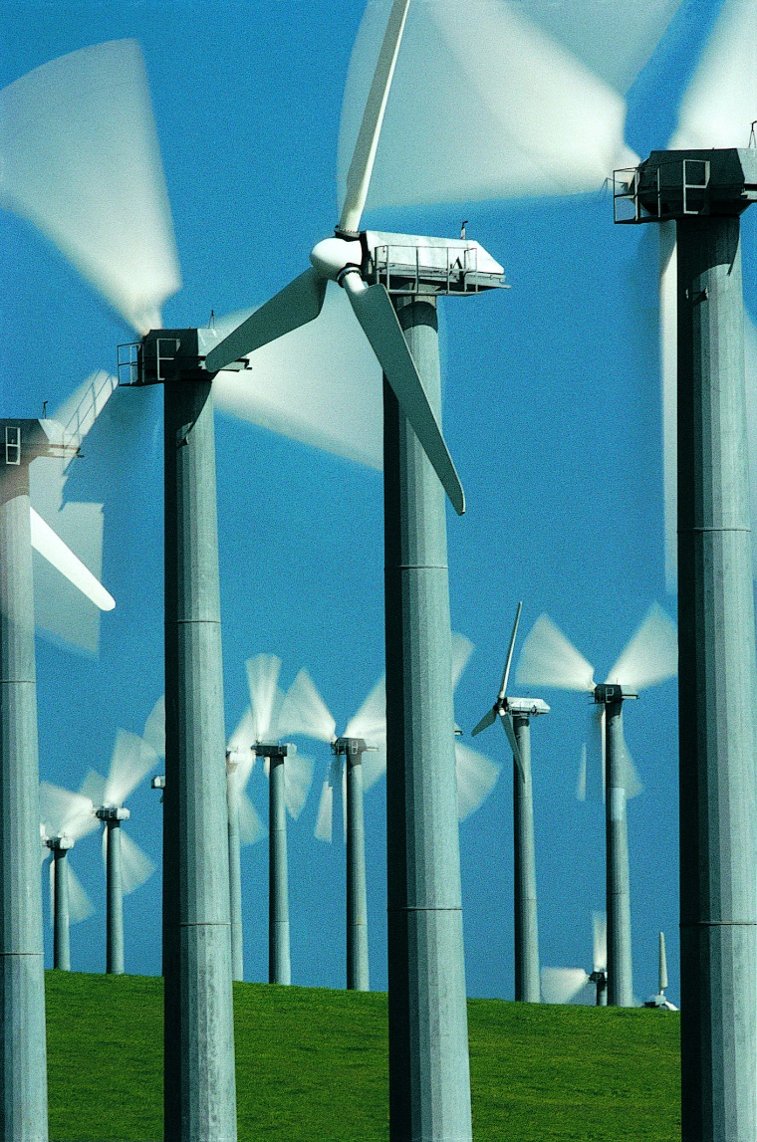
Energy Sources - Wind
Wind “farms” of dozens of giant turbines can supply power to entire cities. They are becoming more and more common and are being built in areas that are generally windy.
The wind turns the blades on a wind turbine. The blades are attached to a hub mounted on a turning shaft, which turns a generator to make electricity. Each turbine can produce about 50 to 300 kilowatts of electricity.
Electricity generated from the entire wind farm is sent through a transformer and the voltage is increased so that it can be sent over high-power lines.

Slide 30
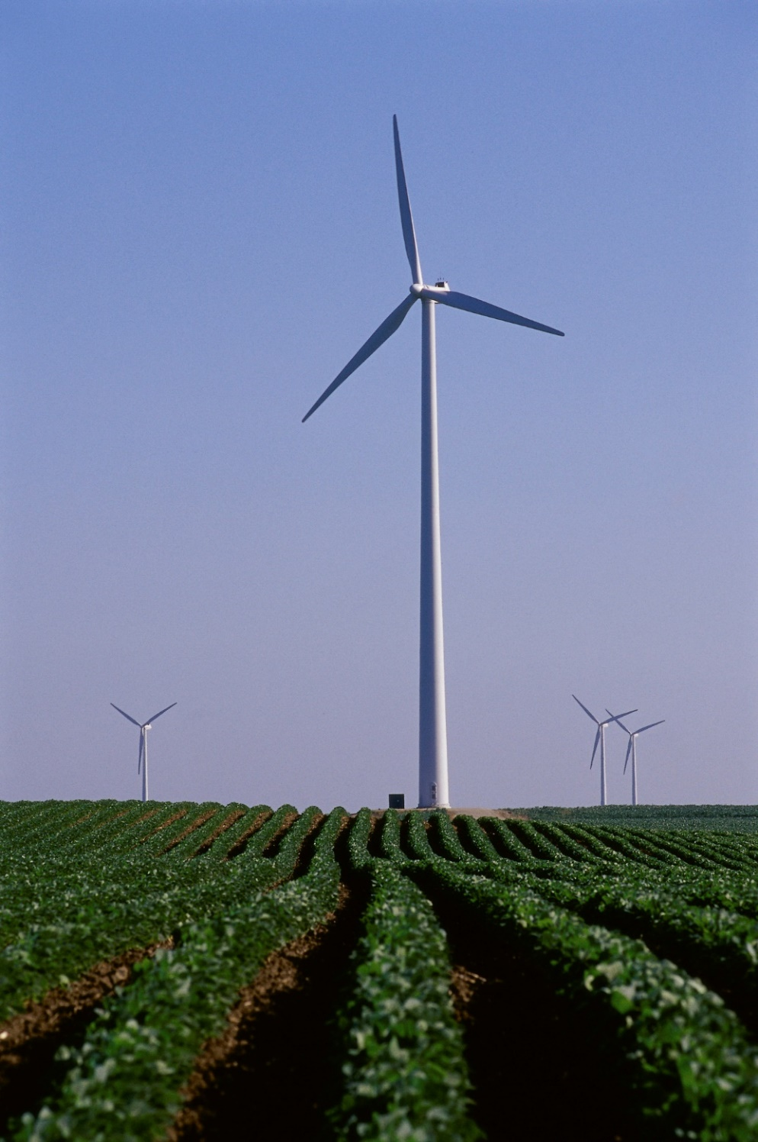
Energy Sources - Wind
Wind energy is very clean; there are no emissions and no harmful waste.
It is also renewable and plentiful.
Wind power is the cheapest form of alternative power. Wind farms can be constructed relatively quickly, so they can be up and running much sooner than a traditional power plant.
They also provide income to landowners who lease the land for the wind farms.
Unlike other forms of power generation, wind power also does not consume water.

Slide 31
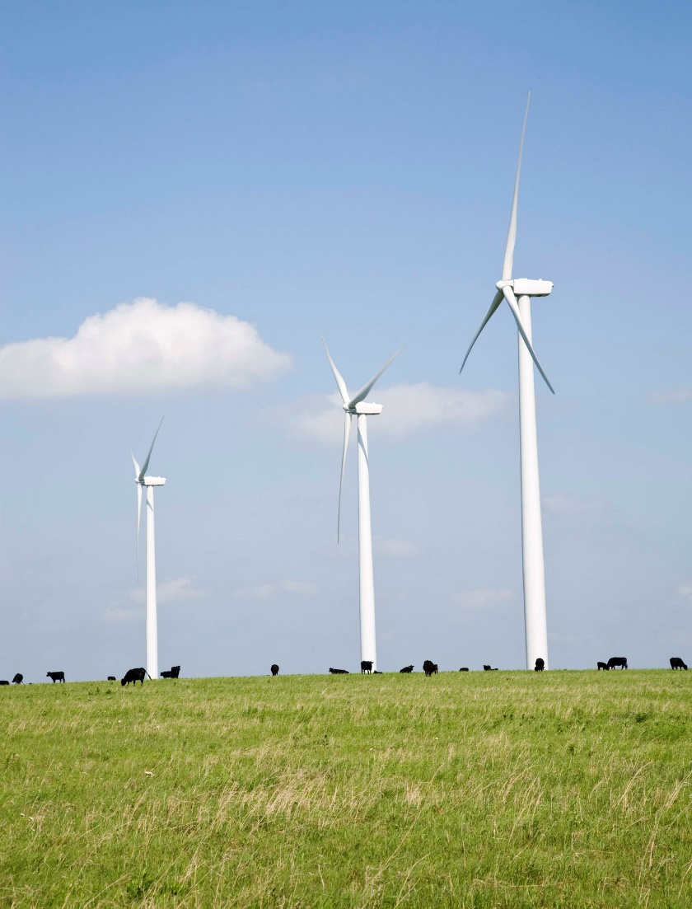
Energy Sources - Wind
A drawback with wind energy is that it is not windy all of the time.
On calm days, wind turbines cannot generate electricity. They require wind speeds of at least 12 to 14 miles per hour to function properly. This means that wind turbines do not produce the same amount of electricity all of the time.
Wind farms are also usually located in rural areas far from the locations where the electricity is needed. This means that the electricity usually must be carried over long distances to reach urban customers.

Slide 32

Energy Sources – Solar
Solar energy can be used to make electricity. Most solar power plants use mirrors to focus the sunlight to create heat. This heat boils water to make steam. The steam turns a turbine to generate electricity. Solar thermal power plants use sunlight during the day and usually burn natural gas at night to boil water to make electricity. This system of indirectly generating power using concentrated sunlight is called CSP, or concentrated solar power.

Slide 33
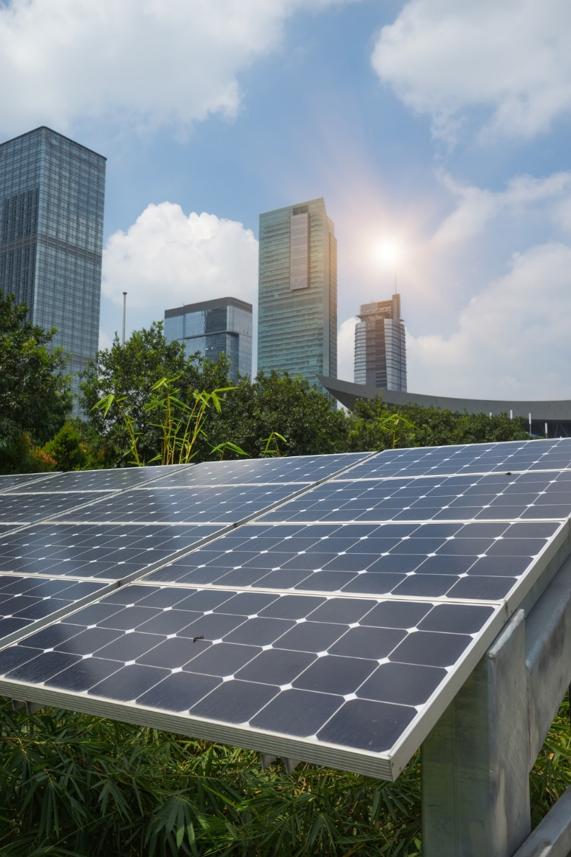
Energy Sources – Solar
Sunlight can also be converted directly to electricity using solar cells (also called photovoltaic cells or PV cells). Photo means “solar” and voltaic means “voltage.”
Developed in the 1950s, solar cells are commonly used to power such devices as calculators, lights, electric fence chargers, and even appliances on spacecraft and satellites.
Solar cells are usually made of silicon (or some other semiconductor material).

Slide 34

Energy Sources – Solar
When light strikes the solar cell, a certain portion of the light is absorbed by the silicon material.
This energy causes electrons to flow, causing a current.
When metal contacts are placed on the front and back surfaces, a current of electricity can be drawn.
At a solar power plant that uses PV cells, individual solar cells are arranged in a module and the modules are grouped together in an array. These arrays can be set to track the sun during the day.
The electrical energy generated by the solar cells can then be used directly or it can be stored in batteries.

Slide 35
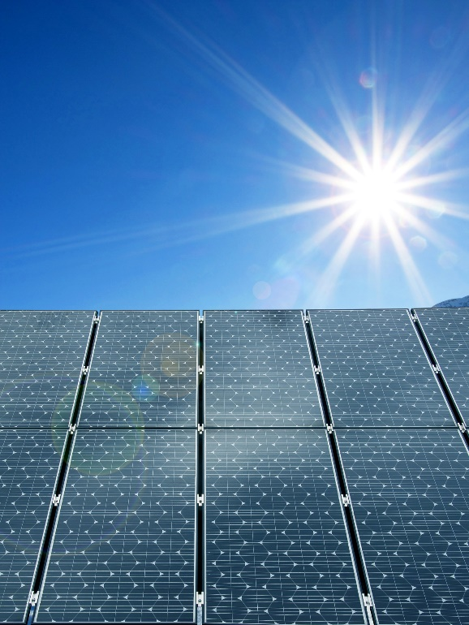
Energy Sources – Solar
Solar power generation gives off no pollution and can reduce dependence on fossil fuels.
It can also be used as a source for electricity in remote areas where electricity is otherwise unavailable.
There are also no moving mechanical parts, so there is minimal equipment breakdown.
Once the solar power system is installed, it provides free electricity.
The cost of installing solar panels is less expensive than the cost of running power lines. However, the initial cost can be expensive.
A major drawback with solar power generation is that it only works well when the sun is shining. A minimal amount of power can be generated on cloudy days and none at night. In addition, solar cells can be affected by the weather and by pollution in the atmosphere.

Slide 36
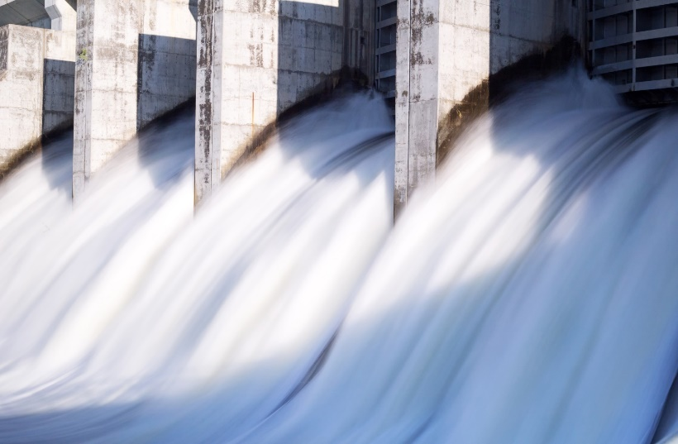
Energy Sources – Hydropower
Hydropower is energy generated by the movement of water. It is one of the oldest energy sources. Hydropower is based on the idea that the more quickly or steeply the water moves, the more power can be generated. The flow of water is powerful as it flows over a waterfall. Likewise, the water’s energy increases when a narrow canyon creates a bottleneck.
Hydroelectric power generators can be located in naturally occurring sites such as a narrow river canyon or near a large waterfall. For example, Niagara Falls, New York is the location of a hydroelectric power station.

Slide 37
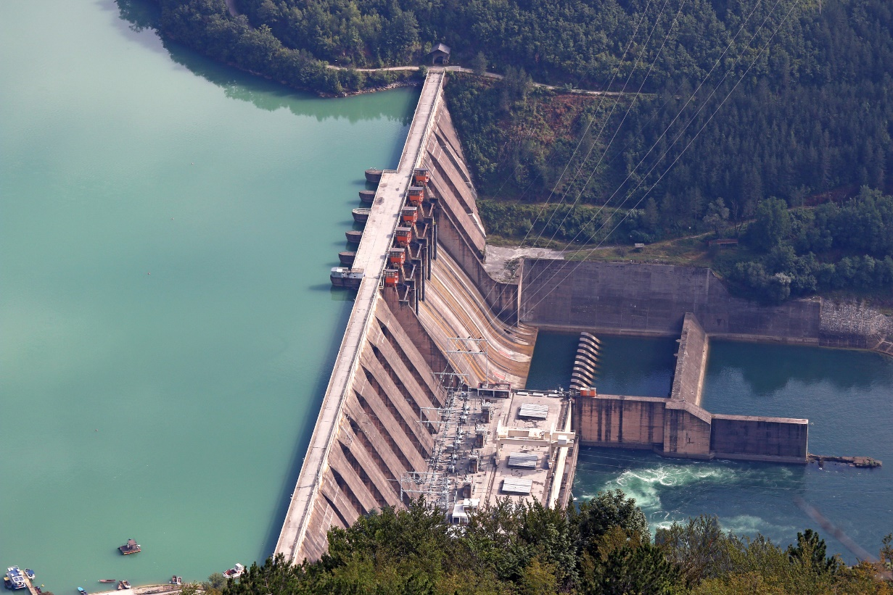
Energy Sources – Hydropower
Manmade dams also provide a source for energy by controlling the movement of water.
The water in the reservoir is stored energy. When the dam gates are open, the moving water becomes kinetic energy.
  The Grand Coulee Dam in the state of Washington is the nation’s largest hydrofacility.
  Another famous hydroelectric power station is the Hoover Dam on Lake Mead along the Colorado River.

Slide 38
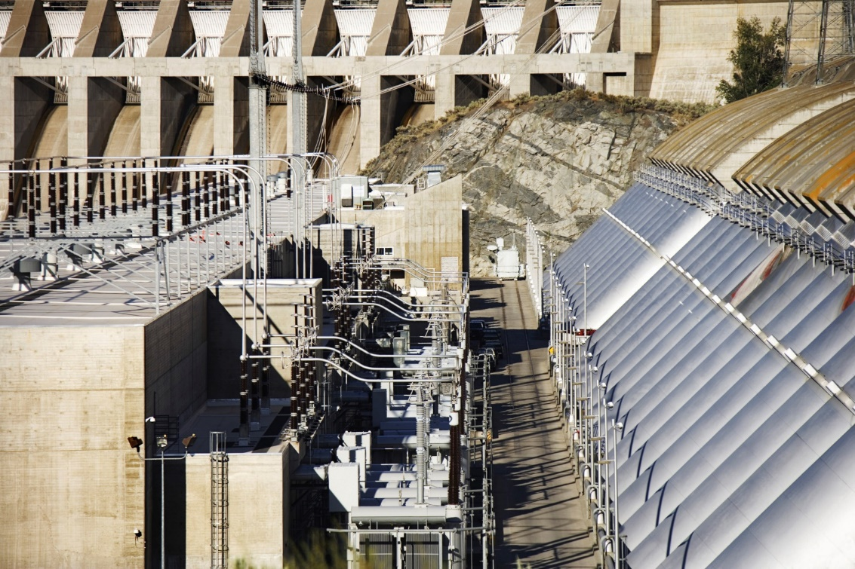
Energy Sources – Hydropower
The way most hydroelectric power plants work is relatively simple.
  Fast-moving water is directed through a pipe called a penstock, which then forces the water against turbine blades, causing the turbine to spin and generate electricity by rotating a series of magnets inside coils of wire.
  Once passing through the turbine, the water re-enters the river or stream, and the electricity is carried away from the power station over power lines.

Slide 39
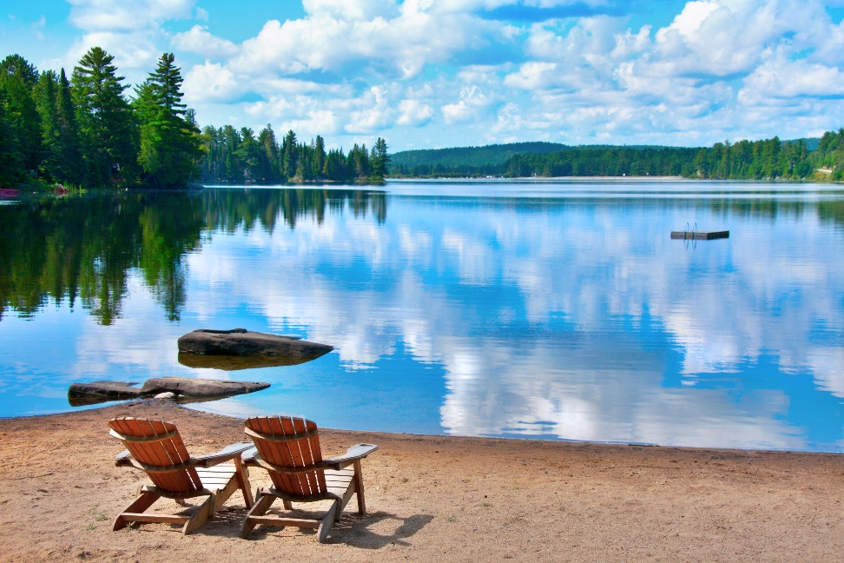
Energy Sources – Hydropower
  Hydropower is a low-cost, renewable resource.
  There are no waste products and it is pollution free. Reservoirs constructed near hydroelectric dams provide recreation and promote tourism, and they often provide a source of drinking water.
  However, the construction of dams can harm the natural habitats and migration patterns of wildlife.

Slide 40
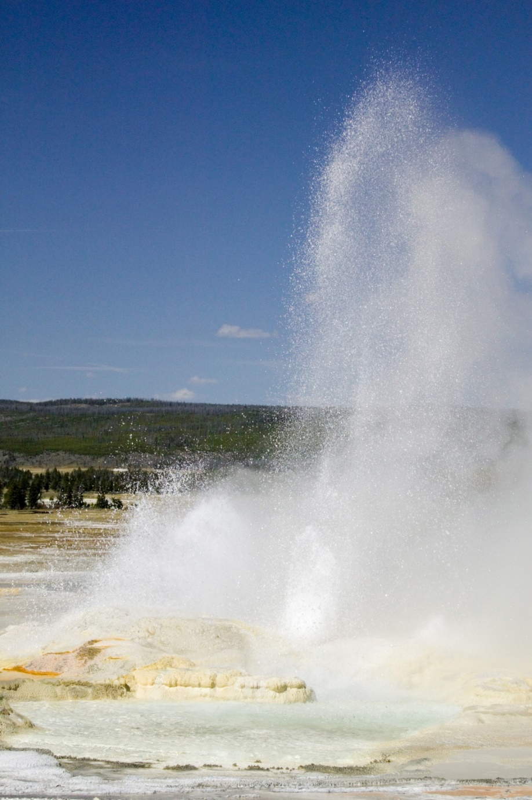
Energy Sources – Geothermal
The Earth contains a tremendous amount of heat energy, which can be used to generate electricity.
Areas in the United States suited for geothermal power plants include regions of volcanic activity, such as the West Coast, places with hot springs and geysers, and other sites where steam and hot water are naturally released.
Hot springs have been used as sources for geothermal energy since ancient times, but it was not used to generate electricity until the 20th Century.

Slide 41
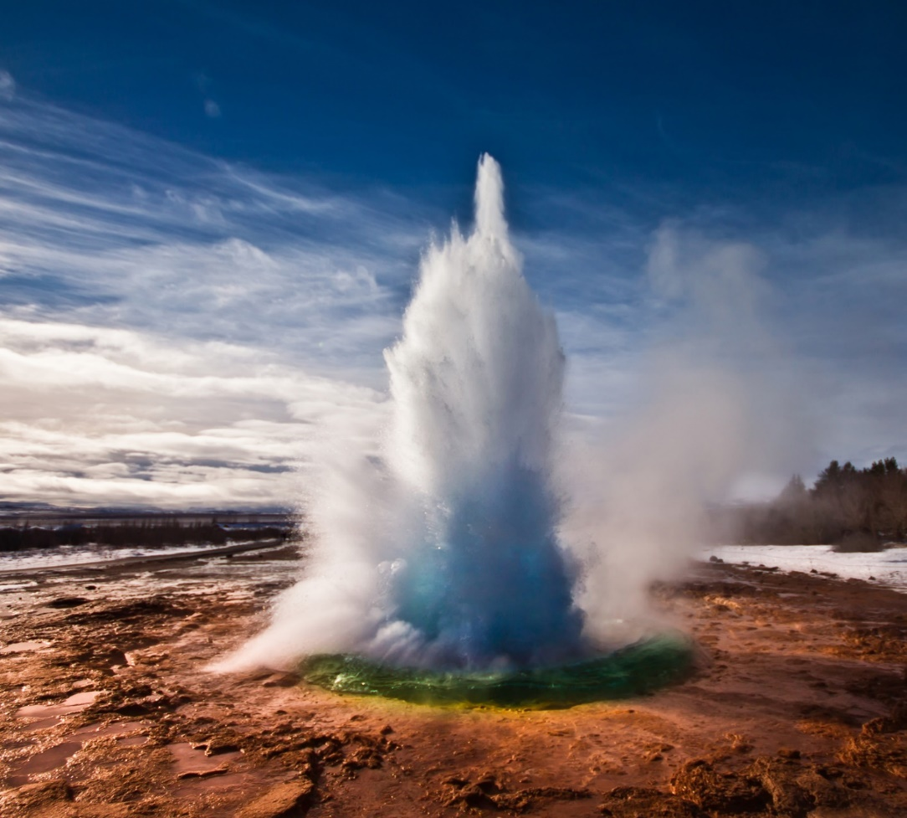
Energy Sources – Geothermal
The Earth’s crust floats on top of a layer of magma on the Earth’s mantle. The temperature of the rock layers below the Earth’s surface increases the deeper you go below ground.
At a depth of about 10,000 feet, the temperature of the rock would be hot enough to boil water.
Magma sometimes breaks through the surface of the Earth in a volcano and flows as lava.
Water sometimes makes its way close to the hot rock, which creates a hot spring or geyser.

Slide 42
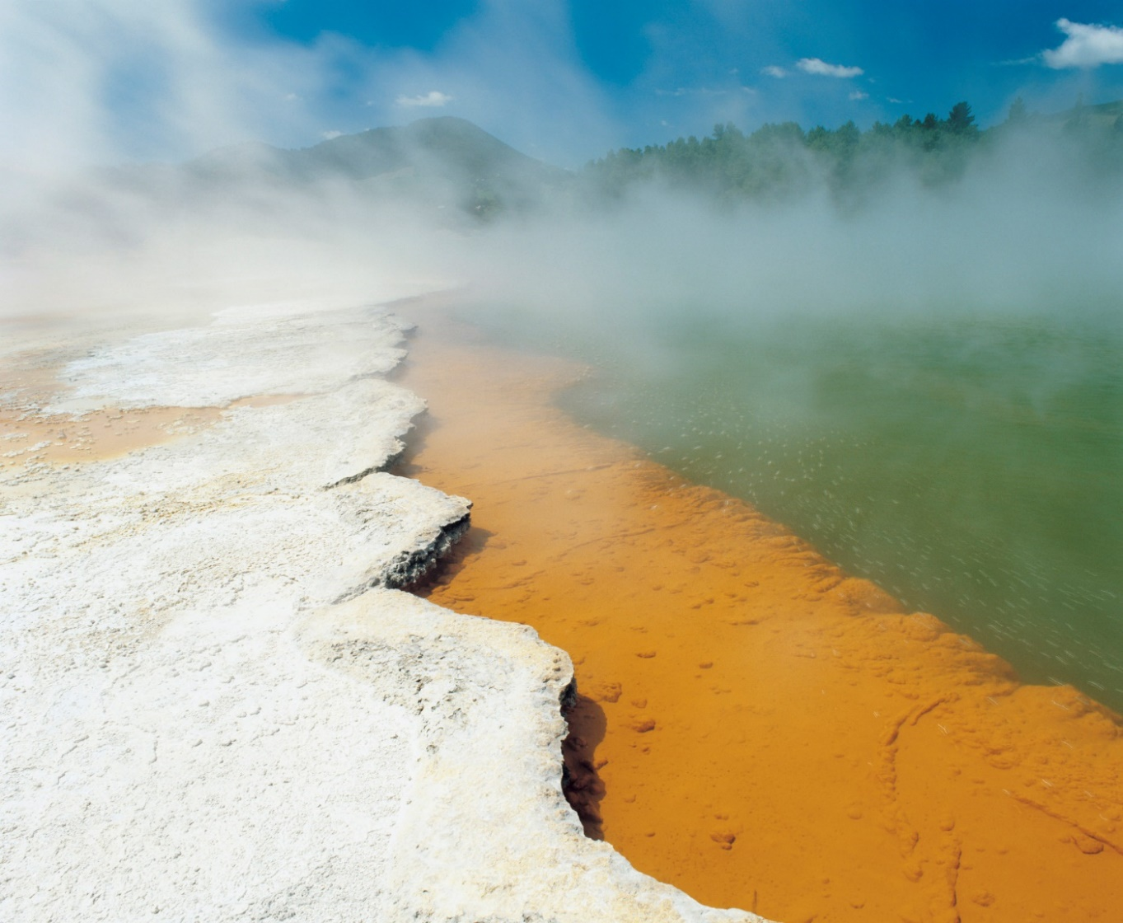
Energy Sources – Geothermal
At a geothermal power plant, water is heated by the Earth, so no fuel is burned to heat water to create steam.
To generate electricity, hot water or steam comes up through pipes that have been drilled deep into the ground.
The steam is then used to turn a turbine, which powers the generator that makes electricity.
The water is cooled and pumped back into the ground so that it can be reheated by the Earth.

Slide 43
Energy Sources – Geothermal
Geothermal power plants are very efficient, but only a few places in the world are capable of producing enough electricity from geothermal energy sources. Because of this, less than one percent of the world’s electricity comes from geothermal sources.
The nearly constant temperature of the first few feet of the Earth can be used to heat and cool your home.
Geothermal ground source heat pump systems take advantage of this fact.
In a ground source heat pump system, water is usually pumped through one end of a lengthy piping system that is buried a few feet down. When the water reaches the other end, it is a significantly warmer temperature than it was at the start.

Slide 44

Energy Sources – Geothermal
Ground source heat pumps can be used in almost any climate, even in areas that receive a lot of snow.
They can also be an economical way to heat water when used with a backup boiler.
The use of one of these systems can greatly reduce heating and cooling costs and energy consumption.
However, these systems are somewhat expensive and it can take several years to recover the initial costs of design and installation.
In addition, the piping system must be installed over a relatively large area, which means they are not suitable for small developments.

Slide 45
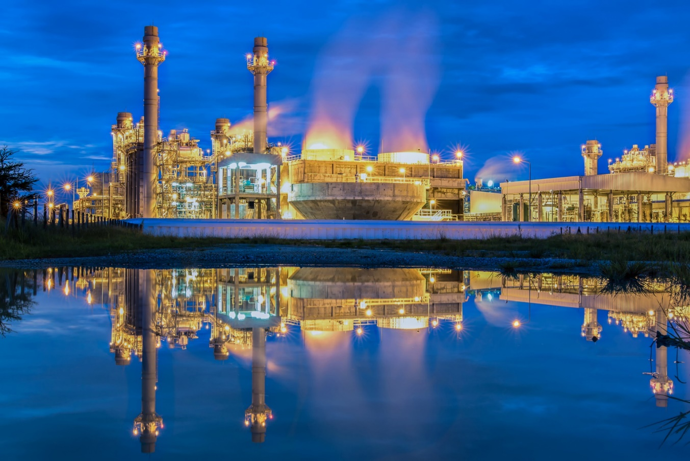
How Electricity is Transmitted
Electricity is generated at power plants, but it must be carried from the power plant and transformed before people can use it.
Electrical power travels from the power plant to schools, offices, and homes through the power distribution grid — an open network of public power lines.
The force of electricity is measured in volts.

Slide 46
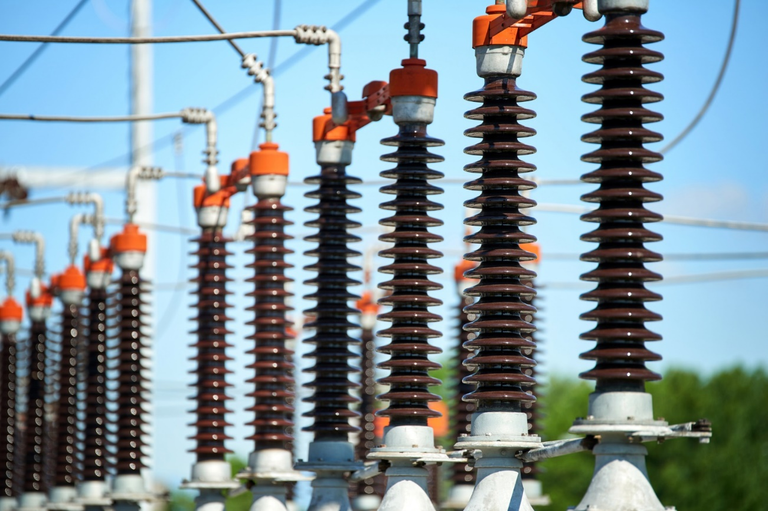
How Electricity is Transmitted
Generators at power plants produce electricity with a voltage of about 25,000 volts.
At the power plant, the electricity’s voltage is boosted to 400,000 volts. This allows the electricity to travel long distances on high-voltage transmission lines made of copper or aluminum.
Although copper and aluminum have a low resistance, some of the electrical energy is lost as heat energy.

Slide 47
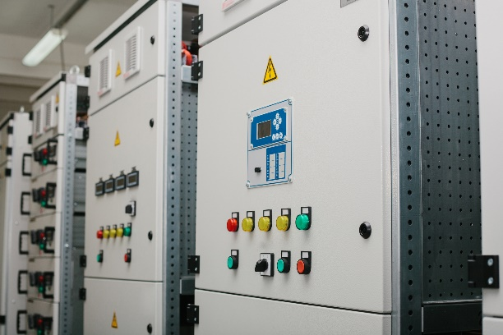
How Electricity is Transmitted
The transmission lines carry electricity to a power substation, where the high-voltage electricity is transformed back into lower-voltage electricity.
A substation often has switches so that it can be taken out of the power grid and the electricity can be rerouted when necessary. From the substation, the electricity travels into neighborhoods and to smaller transformers mounted on poles, so that it can be used by consumers.
Sometimes the electricity also goes through a converter box. Eventually, the electricity’s voltage is reduced to 220 volts for large appliances like electric stoves and hot tubs and 110 volts for lights and small appliances.

Slide 48
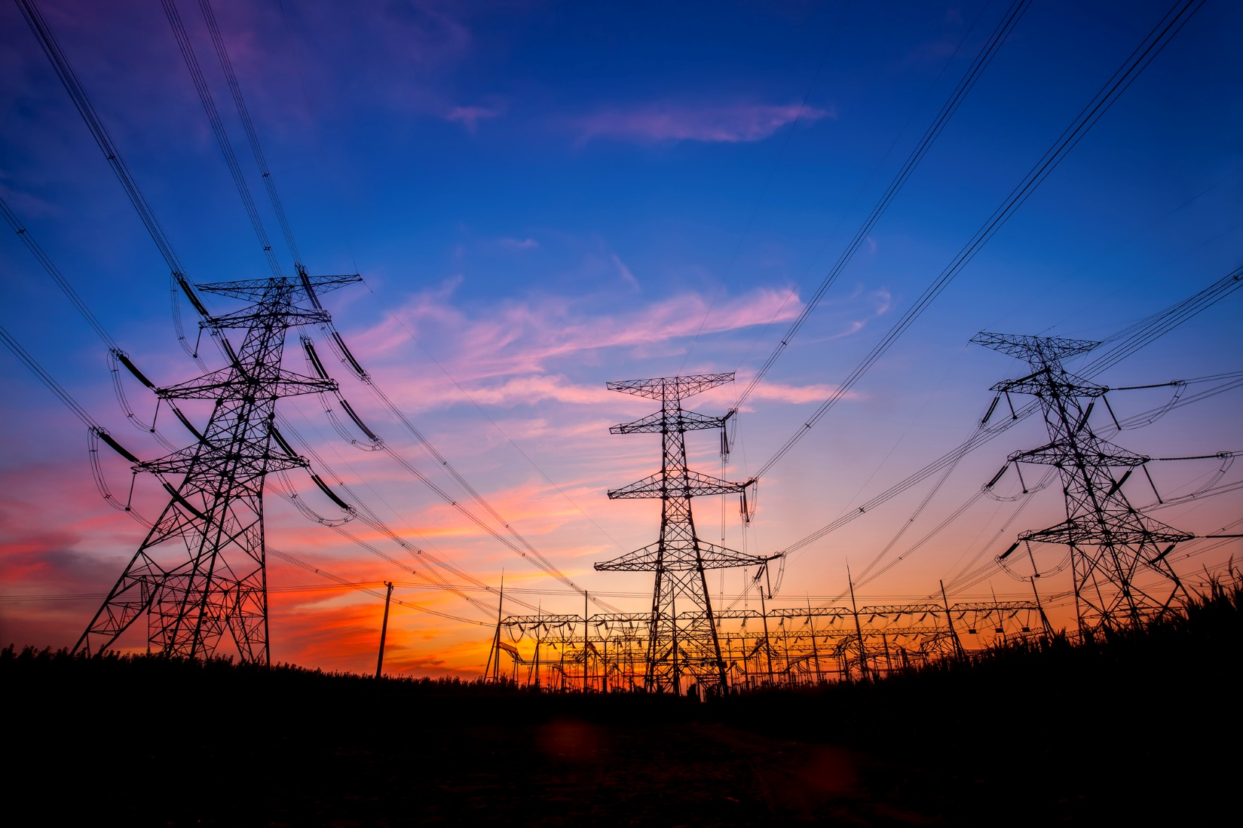
How Electricity is Transmitted
Electricity passes through a meter before it enters a home or business. The meter keeps track of how much electricity is used. The electricity enters a home or business through a fuse box, which provides a safeguard if electrical problems occur.

Slide 49
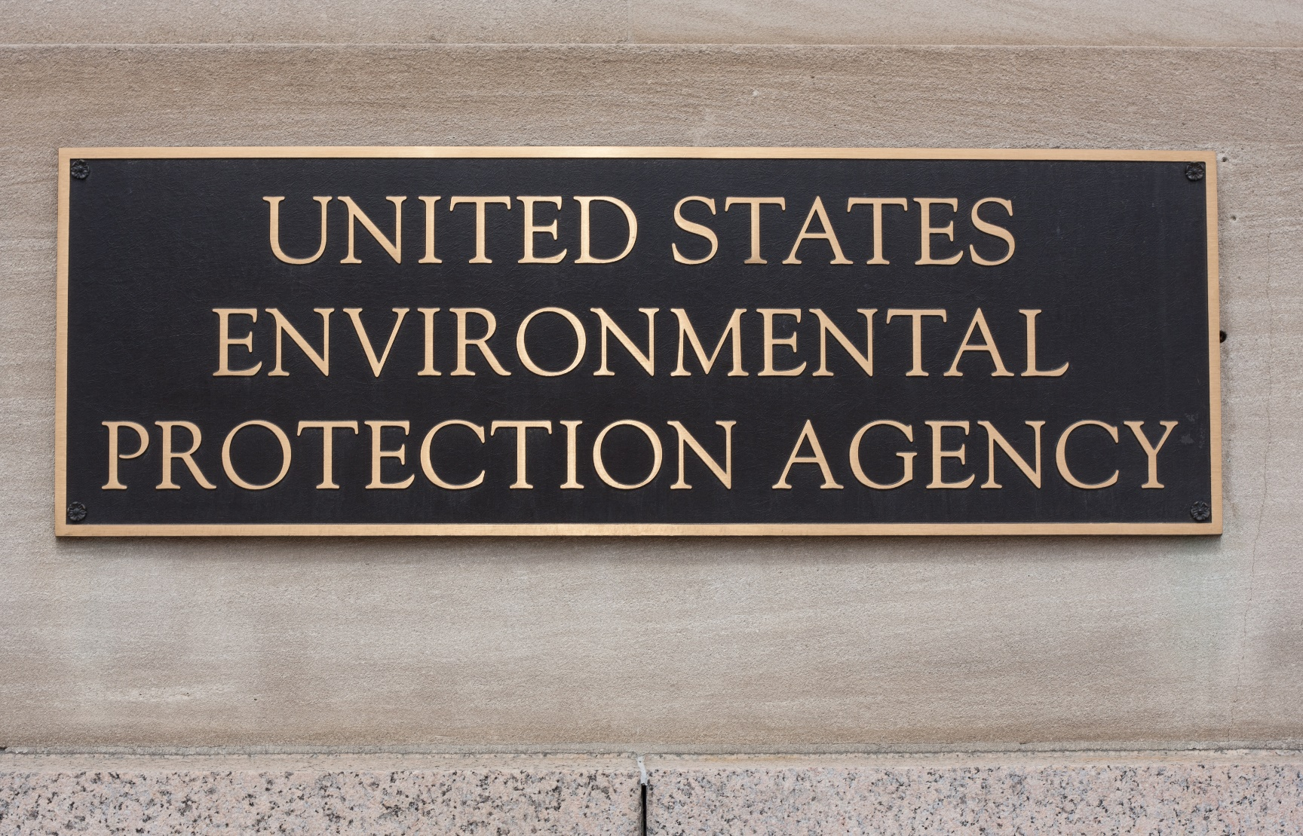
Wood as a Fuel Source
Words to Know
  Creosote - the buildup of carbon materials in chimneys
  EPA - the U.S. Environmental Protection Agency, created in 1970

Slide 50
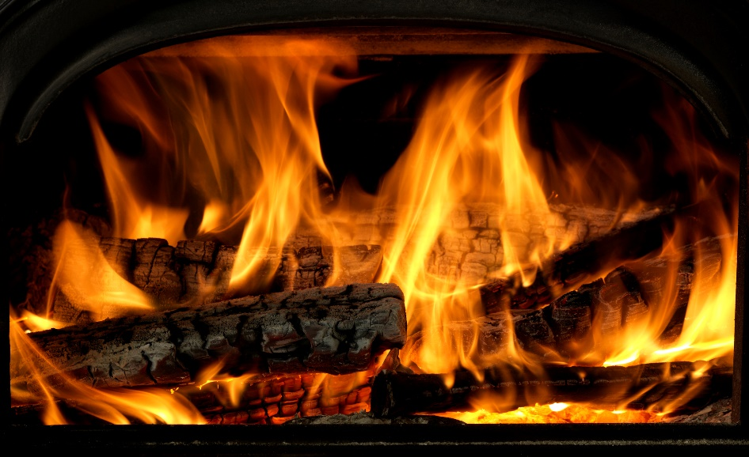
Wood as a Fuel Source
Wood heating provides a low-cost, renewable source of alternative energy that can be used just about anywhere.
However, wood fuel can have negative impacts.
  When anything is burned (including wood), pollutants are released into the environment.
  However, when done correctly, heating a house by burning wood can have a lower environmental impact than burning some types of fossil fuels.
  Wood smoke is also unhealthy to breathe in high concentrations. Even breathing small amounts can be harmful to those who sometimes experience difficulty breathing because of lung diseases or allergies.

Slide 51

Wood as a Fuel Source
Wood smoke pollution can be a neighborhood nuisance, it can cause localized air pollution when many households make too much smoke in a confined area (such as a valley), and it can create indoor air pollution when smoke is released into the house.
To be environmentally friendly, wood fuel needs to be harvested in a sustainable manner, it must be burned cleanly, and the heat must be used efficiently. A lot of wood used to heat homes comes from clearing weed trees, pruning, or removing trees that have fallen or become damaged or diseased that would need to be cleared anyway.

Slide 52

Wood as a Fuel Source
Newer wood stoves, fireplaces, inserts, and furnaces can cut wood smoke by up to 90 percent compared to older so-called ‘airtight’ wood-burning appliances, and they also tend not to spill smoke into the indoor air.
When operated correctly with good quality wood fuel, EPA-certified appliances burn much less wood and may produce fires with no visible smoke.
Woodstoves are space heaters that heat a space directly. Most homeowners rely at least partially on electricity for heat. Even if a home is heated with gas or heating oil, electricity is needed to run the fans to circulate the heat throughout the house.
When a storm interrupts the electrical supply, wood stoves or fireplaces can keep homes warm and habitable.

Slide 53
Wood as a Fuel Source
Wood is an energy source that you can gather and store yourself. Wood is also a way to “buy local” and keep your money in your community.
Even newer, efficient wood burning appliances have disadvantages:
  Certain parts of the country that experience high air-pollution levels sometimes do not allow wood-burning heat appliances.
  Wood stoves and fireplaces get very hot and can present a danger to young children and pets.
  Using wood heat must be monitored and watched, unlike a thermostat that you can set and forget.
  If not properly cleaned and maintained, creosote can build up in the chimney. Creosote is flammable and can cause a dangerous chimney fire. (The fire danger can be virtually eliminated by performing reasonable maintenance.)

Slide 54
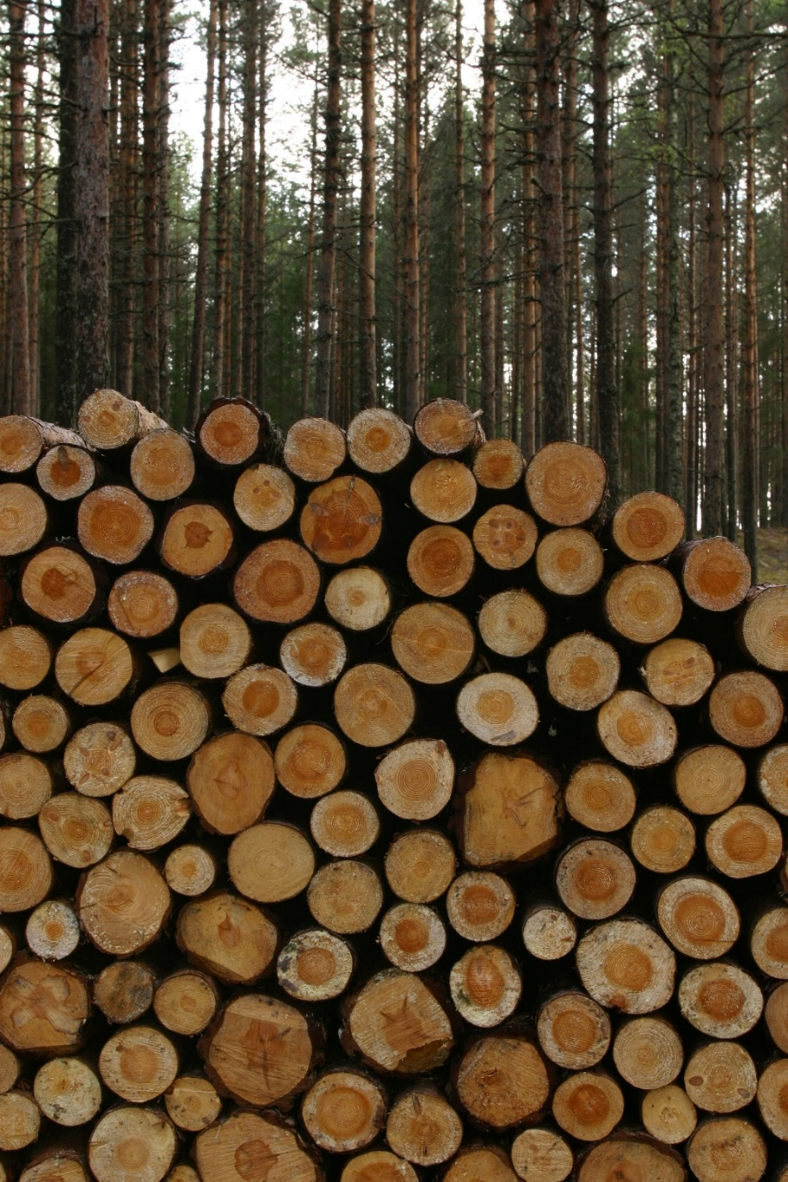
Wood as a Fuel Source
  Some insurance companies view woodstoves as too great a fire risk and won’t insure homes that have a woodstove, even if the woodstove has been installed correctly and otherwise meets the required safety standards.
  Wood heat is sometimes not seen as being efficient, since most of the heat is lost straight up the chimney.
  High-end wood stoves and inserts can be expensive.

Slide 55
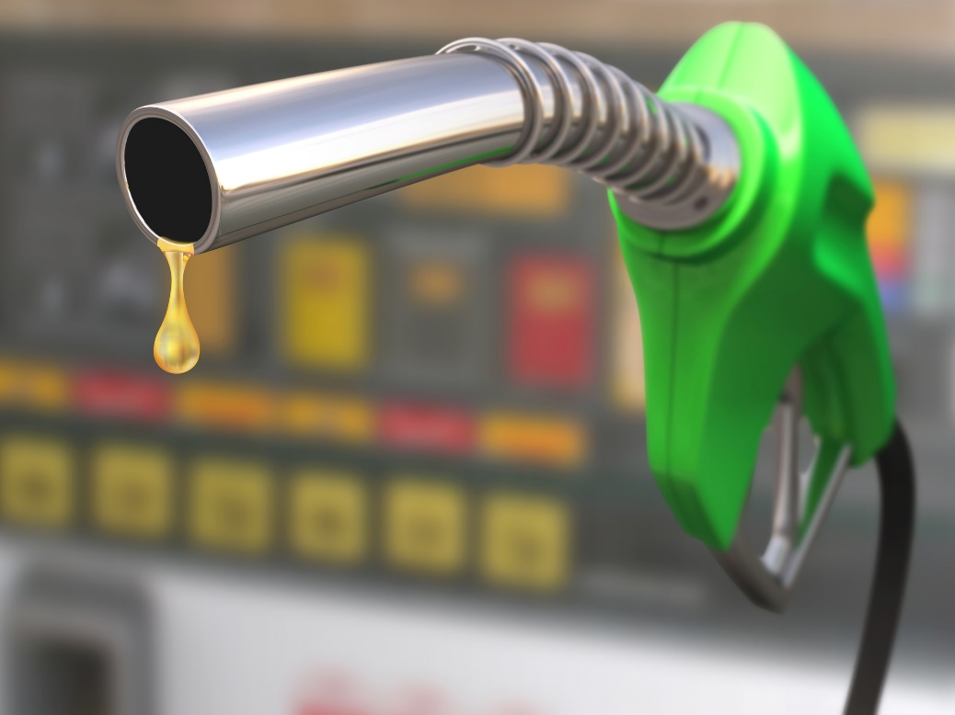
Alternative Fuels
“Alternative fuels” are fuels for cars, trucks, and other vehicles that are made from something other than petroleum. Alternative fuels provide consumers a greener fuel option than gasoline, broaden the energy supply, and have less impact on the environment. Vehicles can burn many types of fuel, including:
  Alcohol
  Natural gas
  Electricity
  Hydrogen
  Liquids made from coal
  Biodiesel

Slide 56
Alternative Fuels
Alcohol is a relatively common alternative fuel. Two types of alcohol fuels are ethanol and methanol.
Ethanol, or grain alcohol, is usually made from corn, although it can also be made from biomass such as crops, agricultural waste, and cellulose.
Grain alcohol is similar to the alcohol in alcoholic beverages. However, ethanol fuel is denatured, which means it is poisonous.
Methanol, or wood alcohol, can be made from biomass as well as coal (most is made from natural gas). Methanol is also very poisonous. Methanol-powered cars have been required at many race tracks since the 1960s. Methanol burns cooler than gasoline, so it is safer in case of fire. Methanol is a lower energy fuel than gasoline, which means it provides fewer miles per gallon.

Slide 57
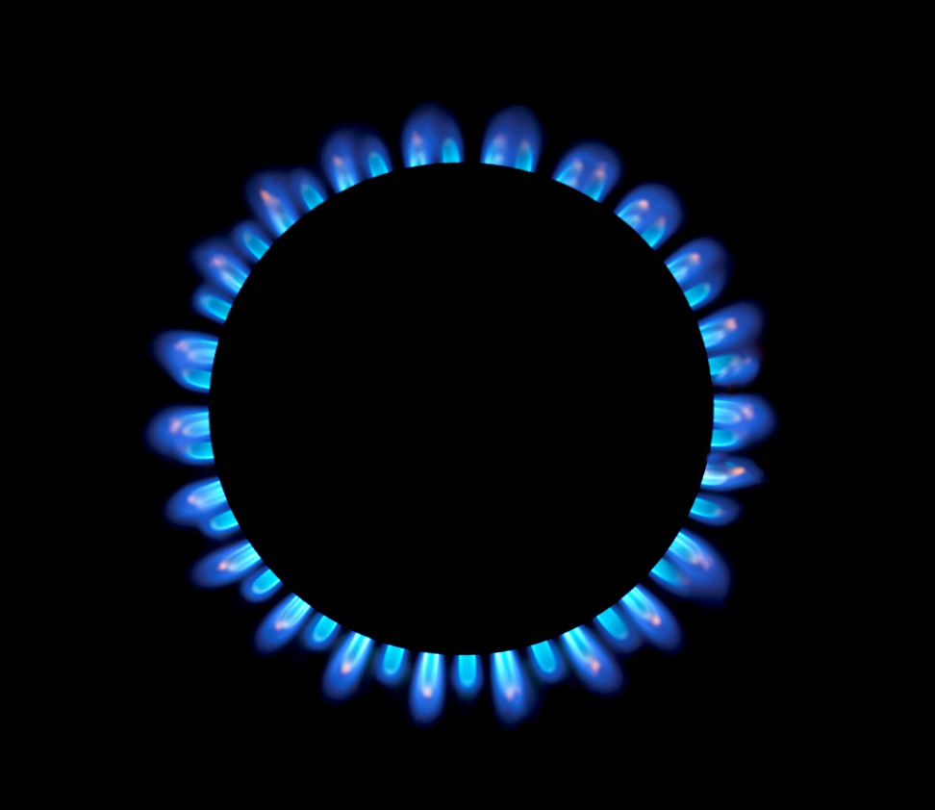
Alternative Fuels
Natural gas is a versatile fuel — it can generate heat, cook, and even power vehicles.
Like other fossil fuels, natural gas comes from the ground. However, instead of being in a solid form (like coal) or a petroleum-based liquid, it is a gas.
Natural gas does not come from petroleum. Instead, it is mostly made up of methane along with water vapor and traces of other gases, such as butane, propane, and ethane.
It is also more environmentally friendly than oil or coal.

Slide 58
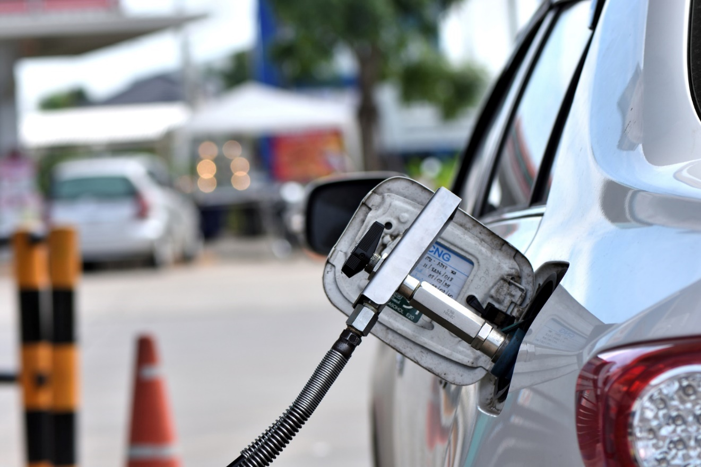
Alternative Fuels
Natural gas can be used in one of three forms:
  A low-pressure gas for cooking and cleaning, which is piped from the local gas company.
  Compressed natural gas (CNG), which is used to power vehicles and is purchased at CNG fuel stations.
  Liquefied natural gas (LNG), which is made by cooling natural gas to condense it into a liquid for use in heavy-duty engines.

Slide 59
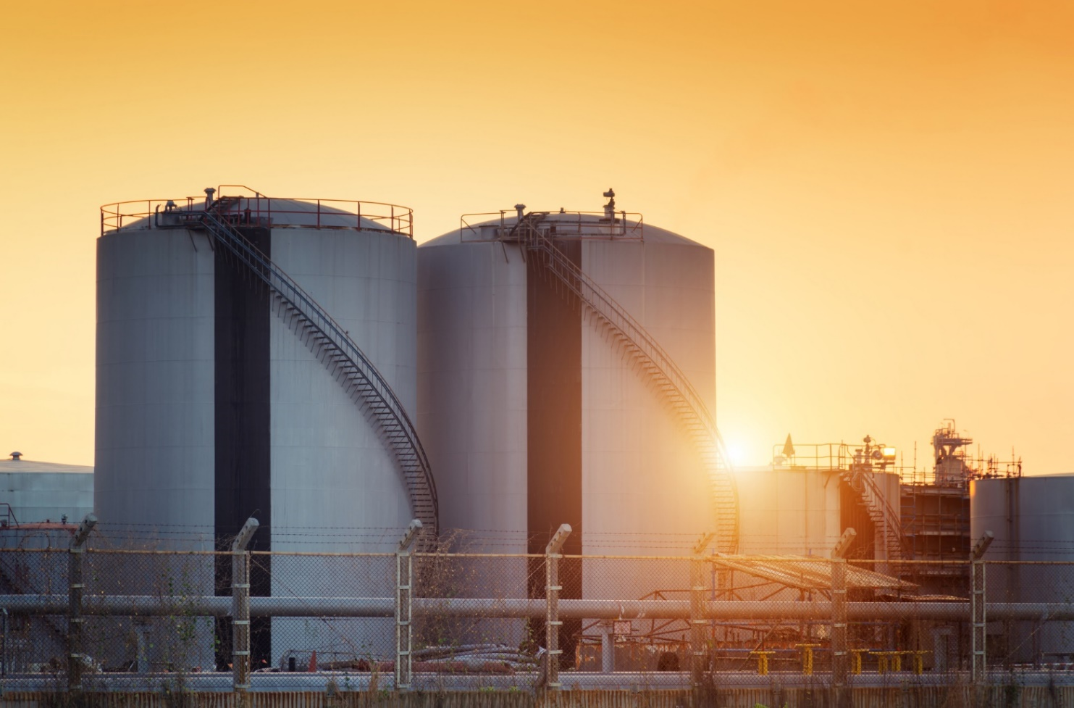
Alternative Fuels
  CNG is a relatively clean burning alternative fuel.
  In order for natural gas to be burned in vehicles, it must be compressed and stored in high-pressure cylinders.
  LNG is made by cooling natural gas to minus 260°F to condense it into a liquid — a process called liquefaction.
  LNG is much denser than natural gas or CNG, so it provides more energy for the volume of space it occupies.

Slide 60
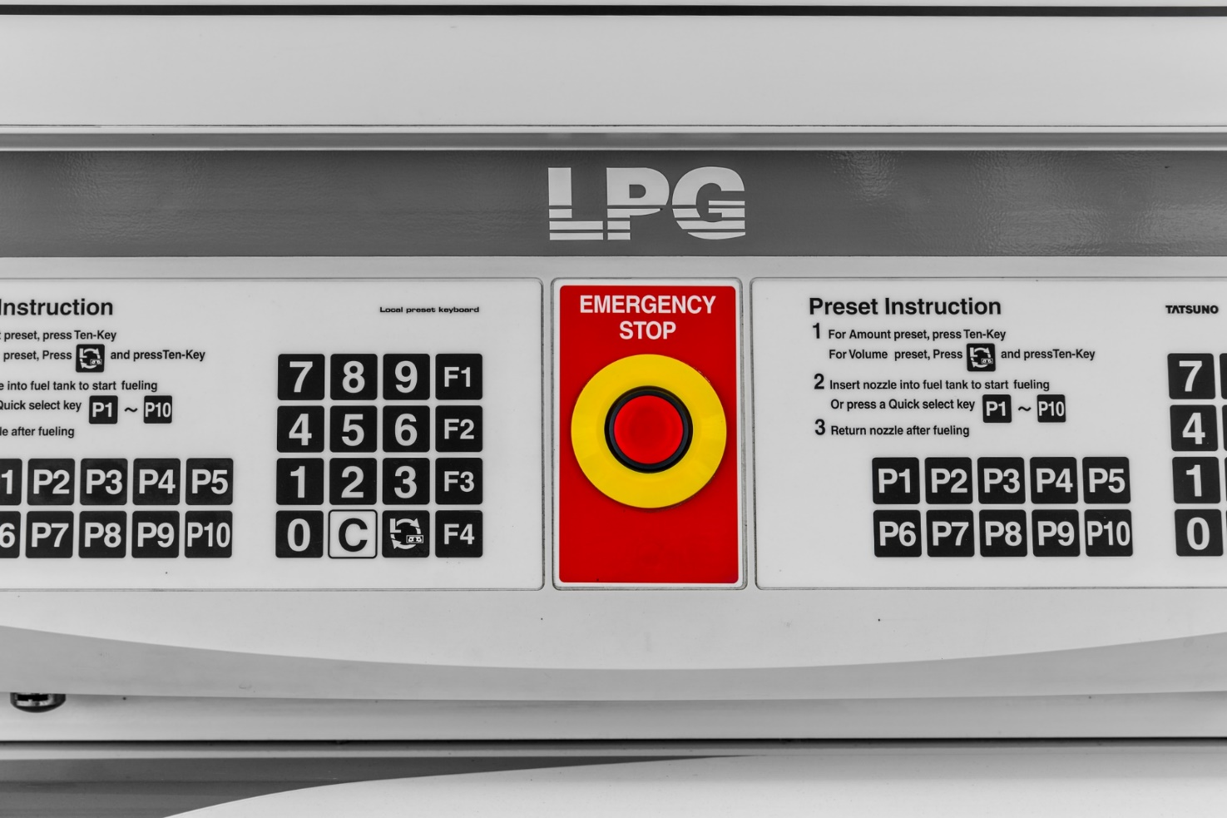
Alternative Fuels
  CNG is a relatively clean burning alternative fuel.
  In order for natural gas to be burned in vehicles, it must be compressed and stored in high-pressure cylinders.
  LNG is made by cooling natural gas to minus 260°F to condense it into a liquid — a process called liquefaction.
  LNG is much denser than natural gas or CNG, so it provides more energy for the volume of space it occupies.

Slide 61

Alternative Fuels
Liquefied Petroleum Gas (LPG) is made up of mostly propane. (In fact, most people call LPG “propane,” although it is also made up of a mixture of hydrocarbon gases.) To keep it in a liquid state, LPG is stored in tanks under pressure.
LPG can be used in vehicles. LPG-powered vehicles give off less pollution than gas- or diesel-powered engines. LPG is also used in homes for heating, cooking, and hot water, especially in rural areas where there is no access to natural gas pipelines.

Slide 62
Alternative Fuels
Hydrogen is a unique type of gas because it is a clean fuel that burns almost pollution-free.
When hydrogen is burned, it gives off water vapor. When burned in an internal combustion engine, traces of other gases are also released, but the exhaust is free of carbon dioxide.
Hydrogen may one day be a commonly used fuel for transportation.
However, scientists have yet to figure out a way to store enough hydrogen on a vehicle to drive a practical distance.
Also, hydrogen is expensive.

Slide 63

Biofuels
Biofuels - fuels made from recently living biological material, organic byproducts, and micro-organisms
Biofuels can be burned in their existing state, or they can be converted to other fuels such as ethanol, methanol, methane, and hydrogen.
To be a true biofuel, the fuel must be made from at least 80 percent renewable materials.

Slide 64
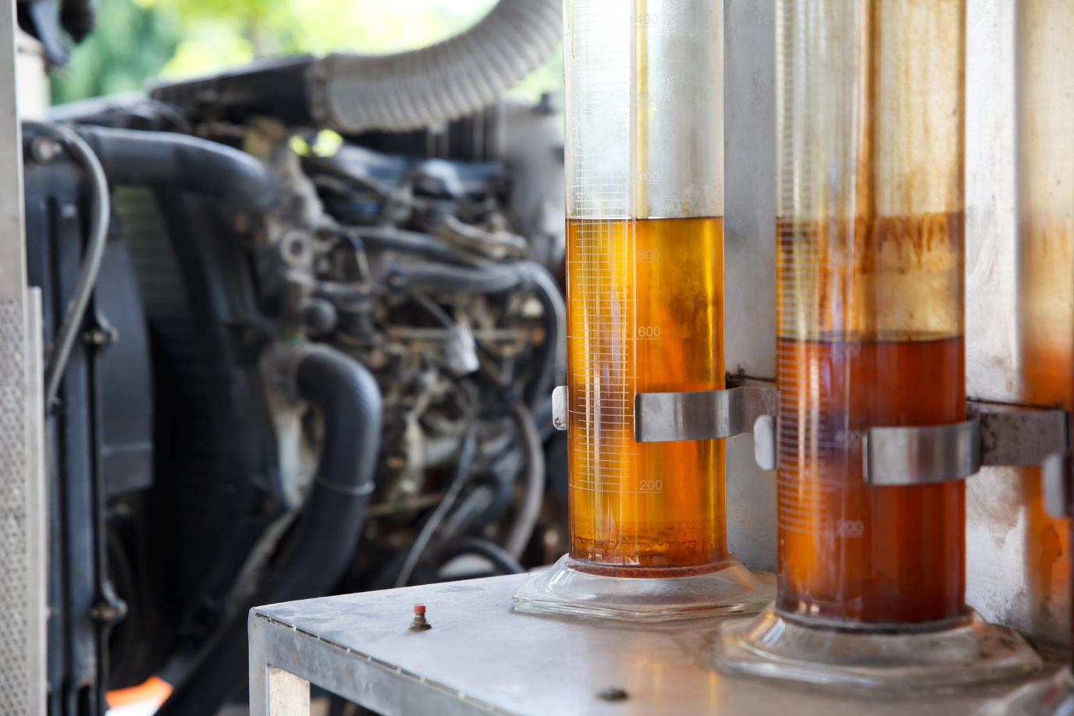
Biofuels
Biofuels can be made from food crops such as corn and sugarcane, recycled vegetable oil, and non-food items such as switchgrass, algae, woodchips, and animal waste — an almost endless list. Ethanol is made primarily from corn and is most often used as an additive for petroleum-based fuels.
Biodiesel is a similar fuel made from soybean oil.

Slide 65

Biofuels
Biofuels have many benefits:
  Biomass fuels are renewable, meaning that it is available in unlimited quantities.
  Biofuels can reduce oil consumption and, as a result, help the environment.
  Biofuels are cleaner than traditional fossil fuels.
  Biofuel production sometimes offers a co-product benefit. For example, when converting corn to ethanol, the material that remains can be used as a high-protein animal feed.
  Non-food crops such as switchgrass require very little fertilizer and can be grown just about anywhere.
  Some biomass fuels are generated by waste. Plant waste is naturally clean. Therefore, biomass can help keep the surroundings clean.
  Biofuel production makes agricultural markets more competitive and creates jobs.

Slide 66

Biofuels
While biofuels offer many benefits, they do have some drawbacks:
  Depending on the crop and where it is grown, biofuel production may require large amounts of water.
  Food crops used to produce biofuels use resources that otherwise could go toward food production.
  Fertilizer and other runoff that occurs in agricultural production can pollute ground and surface water.
  Although they are often described as “clean burning” compared to gasoline or other fossil fuels, a biofuel can still give off significant amounts of carbon dioxide and other pollutants.
  Agricultural production requires fuel. Therefore, traveling a mile using a fuel such as ethanol consumes more energy than going the same distance using gasoline.

Slide 67

Flexible Fuel, Hybrid and Electric Vehicles
Flexible fuel vehicles (FFVs) are designed to operate on gasoline, alcohol or a gas/alcohol combination.
The engine of an FFV is designed to withstand the corrosive nature of the alcohol fuel.
Alcohol fuels are commonly a blend of about 85 percent alcohol and 15 percent gasoline. Since the energy content of alcohol fuels is lower, drivers can expect to get fewer miles per gallon than when using gasoline.

Slide 68
Flexible Fuel, Hybrid and Electric Vehicles
A hybrid vehicle is one that relies on two types of power in order to move. A gasoline engine is usually the primary source of power, but it is used in combination with an electric motor.
Hybrid vehicles also have batteries. Sometimes these batteries are recharged from energy generated by the movement of the vehicle. Other types of hybrids can be plugged into an electrical outlet for recharging.
Hybrid vehicles usually have better fuel economy and lower emissions than conventional vehicles. This means that they burn less oil and pollute less.
However, hybrid vehicles are more expensive, their engines are complicated, and developing reliable, compact and lightweight batteries that are also affordable remains a challenge.

Slide 69
Flexible Fuel, Hybrid and Electric Vehicles
Electric vehicles (EVs) have been in use since the early 1900s.
At that time, gasoline was expensive. Plus, the early gas-powered cars had to be hand-cranked to get them started, they were noisy, and they created a lot of exhaust, so electric vehicles were much more popular.
The oil boom of the early 1900s led to many changes. New refining techniques caused a substantial drop in the price of gas, the electric key starter was invented, and gasoline engines were much improved.
As a result, gasoline-powered cars became the preferred method of transportation. Over the years, cars were designed for better fuel economy and fewer emissions, and they continue to improve. Even cars built today are much more efficient than vehicles built only 10 years ago. Still, the idea of using electricity to power cars is gaining in popularity.

Slide 70

Flexible Fuel, Hybrid and Electric Vehicles
Over the years, cars were designed for better fuel economy and fewer emissions, and they continue to improve.
Even cars built today are much more efficient than vehicles built only 10 years ago. The idea of using electricity to power cars is gaining in popularity.
Unlike hybrids, electric vehicles do not burn gasoline. Instead, they use electricity stored in batteries.

Slide 71

Flexible Fuel, Hybrid and Electric Vehicles
To charge the vehicle’s batteries, the car is usually plugged into an electrical outlet. This is the same electricity that is used to power lights and appliances in homes and businesses. Because of this, electric vehicles are only truly green if they are recharged using electricity generated by renewable energy.
EVs include more than just cars.
Some cities and National Parks use electric-powered subway trains, trams, buses, and trolleys. Electric-powered bikes, all-terrain vehicles, and golf carts are common.

Slide 72
All rights reserved; copyright © Copyright © 2018 Resource Center for CareerTech Advancement
For more information, email us at
resourcecenter@careertech.ok.gov
Visit our website at
https://www.okcareertech.org/educators/resource-center

