Slide 1

Vehicle Ownership Skills
Developed by Resource Center for CareerTech Advancement,
a division of Oklahoma CareerTech

Slide 2

Vehicle Ownership Skills
Topics covered:
Purchasing and Insuring an Automobile
Maintaining an Automobile
Driving Safely
Planning a Trip

Slide 3

Purchasing and Insuring an Automobile
Buying an automobile is a major investment. It usually involves requesting a bank loan or other financing, and can require several years of payments.
It is also required by law to purchase automobile insurance, and often the type of vehicle you drive determines the amount of insurance you pay.
Therefore, it is important to select a vehicle that not only meets your transportation needs, but also meets your financial requirements.

Slide 4
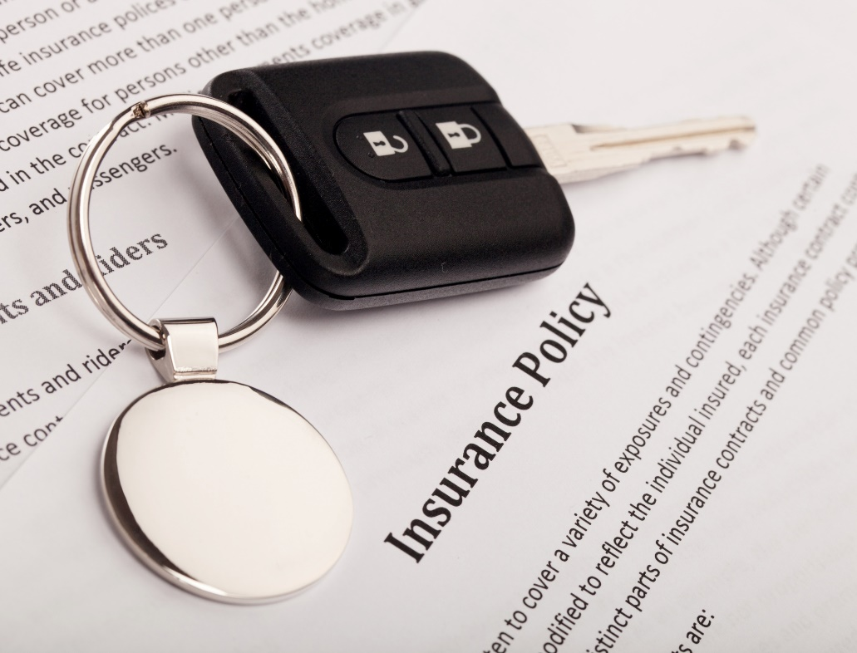
Purchasing and Insuring an Automobile
It is equally important to protect your investment by purchasing adequate insurance. A combination of liability and collision coverage will offer financial security in an accident.

Slide 5

Purchasing and Insuring an Automobile
Things to Consider When Buying a Vehicle
Price
Type of automobile
Examples: Compact car, sedan minivan, mid-size pickup truck, full-size pickup truck with extended cab, SUV
New or used
Automatic or manual transmission
Intended use
Examples: To haul cargo, to provide transportation to school or work, to impress friends

Slide 6

Purchasing and Insuring an Automobile
Things to Consider – continued
Safety
Examples: Air bags, maneuverability, performance in braking and crash tests
Economy
Examples: Gas mileage, availability and cost of service and parts, sticker price
Desired options
Examples: Four-wheel drive, leather interior
Size

Slide 7

Purchasing and Insuring an Automobile
Things to Consider – continued
Appearance and styling
Examples: Exterior color, roll bars, running boards
Performance and handling
Comfort
Warranty coverage
American-made (domestic) or foreign-made (imported)

Slide 8

Purchasing and Insuring an Automobile
Advantages and Disadvantages of Ownership Types
Advantages of buying new:
  Satisfaction of owning a new automobile
  Most repairs covered by a warranty
  Availability of options
  ✔ Note: If the customer cannot find a new vehicle with the desired options, the consumer can order an automobile with the options desired.
  Lower interest rates
  More time allowed for repaying the loan
  Lower risk of breakdowns

Slide 9

Purchasing and Insuring an Automobile
Disadvantages of buying new:
  Larger initial depreciation
  Possible manufacturer’s defects
  Higher initial cost
  Examples: purchase price, down payment, taxes
  Higher monthly payments
  Higher insurance rates

Slide 10

Purchasing and Insuring an Automobile
Advantages of buying used
  Lower monthly payments
  Few “new” problems
  Example: most recall issues have been repaired/replaced
  Lower insurance costs
  Smaller initial depreciation

Slide 11
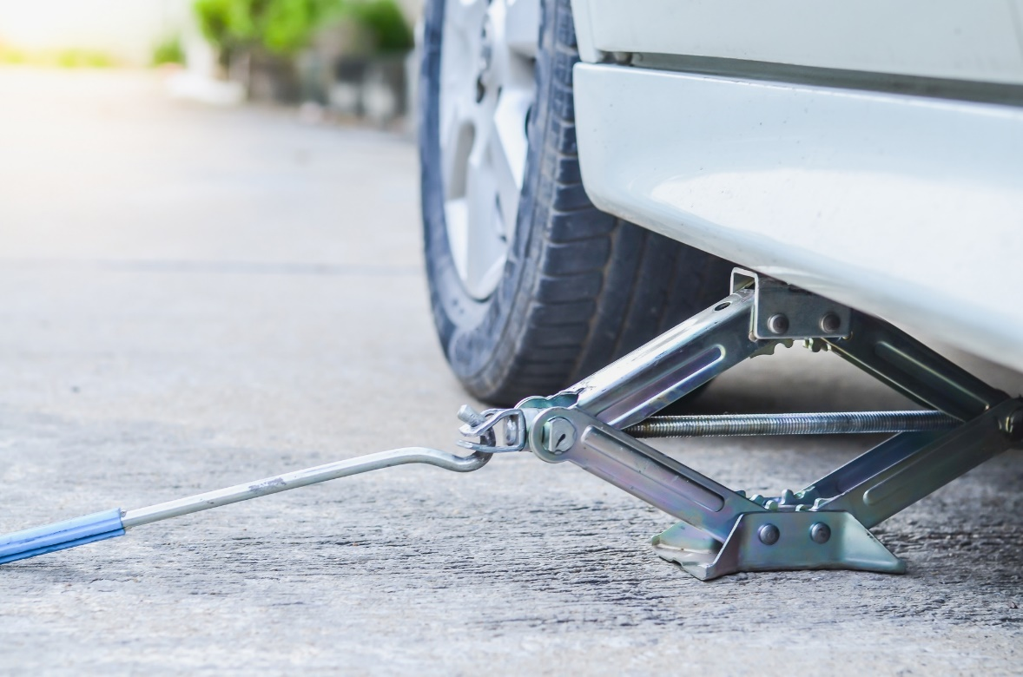
Purchasing and Insuring an Automobile
Disadvantages of buying used
  Little warranty protection
  Lower resale value
  Possible wear and maintenance problems
  Higher interest rates
  No choice of desired options
  Possibility of missing accessories
  Example: Jack, spare tire, radio

Slide 12

Purchasing and Insuring an Automobile
Advantages of leasing
  Driving a nicer vehicle
  Most repairs covered by warranty
  Lower monthly payments
  New car every 2 – 3 years
  Lower risk of breakdowns

Slide 13

Purchasing and Insuring an Automobile
Disadvantages of leasing
  No ownership at the end of contract
  You make payments like a new car but don’t own it at the end
  Hidden charges can apply
  Large down payment
  Heavy penalties for driving more miles than allowed on contract
  Heavy penalties to terminate lease
  No end to monthly payments
  Higher insurance rates

Slide 14

Purchasing and Insuring an Automobile
Guidelines for Purchasing a New Car Include:
Research your options.
Determine the dealer’s cost.
Investigate rebates.
Compare prices.
Avoid unnecessary extras.

Slide 15

Purchasing and Insuring an Automobile
Guidelines for Purchasing a New Car - continued
Compare prices.
Test drive the vehicle.
Request maintenance records.
Research the car’s history.
Research the car’s title history.
Have the car inspected by an outside mechanic.
Verify the odometer disclosure statement.
Understand the return policy.

Slide 16
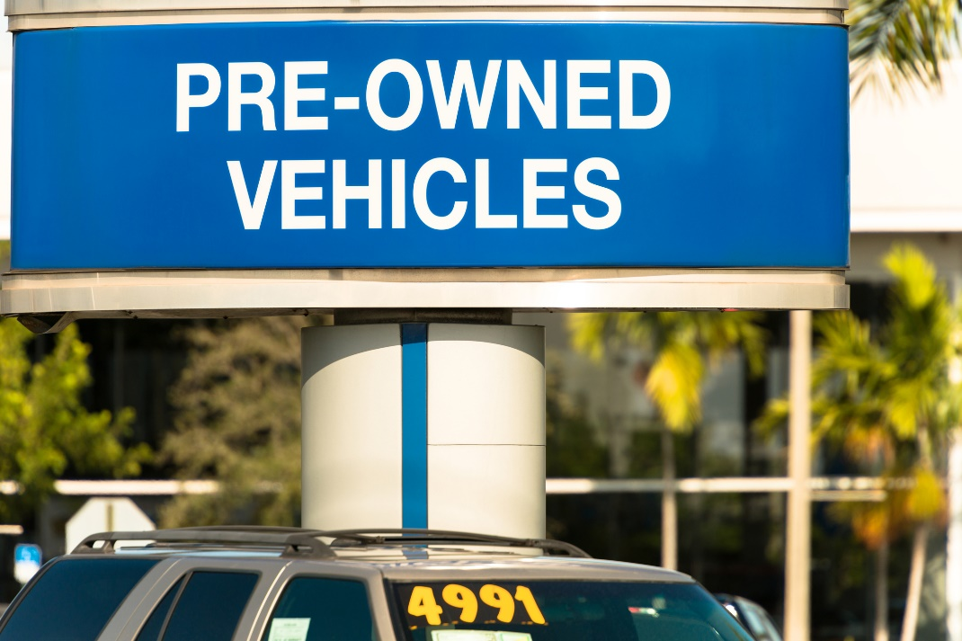
Purchasing and Insuring an Automobile
Guidelines for Purchasing a Used Car Include:
Verify warranty information.
Understand all documents.
Determine necessary paperwork.
Know your rights as a purchaser.

Slide 17

Purchasing and Insuring an Automobile
Guidelines for Leasing a Car Include:
Shop around.
Negotiate.
Clarify the meaning of “normal wear and tear.”
Calculate total mileage allowed.
Read the manufacturer’s warranty.
Calculate penalties.
Clarify responsibility for unexpected damage.
Get all terms in writing.

Slide 18

Purchasing and Insuring an Automobile
Types of Warranties Include:
As-Is
  No warranty is available.
  You, not the dealer, are responsible for any repairs after you leave the lot.
Extended warranty
  Additional time or mileage coverage you can purchase from the dealer.
  Extends the coverage of the original warranty.

Slide 19

Purchasing and Insuring an Automobile
Types of Warranties - continued
Full warranty
  Generally provides for free repair or replacement of defective parts during the warranty period.
  Typically requires the work be done at a factory-authorized service center.
  Period of coverage is usually for a stated time and mileage period.
  Normally available only on new cars.
  Does not usually cover optional items such as the stereo system or parts and repairs considered part of the normal routine maintenance of the automobile such as light bulbs, hoses, and belts.

Slide 20

Purchasing and Insuring an Automobile
Types of Warranties - continued
Implied warranty
  Nearly every purchase you make has an implied warranty under most state laws, unless the merchant tells you differently in writing such as with the "As Is" sticker types. Conditions of implied warranties vary from state to state.
  Limited warranty
  Period of coverage is usually for a stated time and mileage period.
  Normally available on used cars purchased from a dealership.
  May provide free parts and repairs but not cover the labor to make the repair or replace the parts.

Slide 21

Purchasing and Insuring an Automobile
What to Expect During the Bargaining Process
Offers and counter-offers
Note: These are made until a compromise on price is reached.
Mechanical inspection
Note: Used cares are normally checked by an outside mechanic.
Additional salespeople
Note: Dealers often bring in salespeople or managers.

Slide 22

Purchasing and Insuring an Automobile
Characteristics of Loan Agencies
Auto dealer
  Convenient
  Can be good for a first loan.
  Can charge high interest rates.
  Note: Dealers usually sell loans to a bank or finance company.
  Bank
    Reasonable interest rates
    Can require large down payment.
  Note: Shop around for the best bank rate. Some banks offer better rates for auto-debits.

Slide 23

Purchasing and Insuring an Automobile
  Characteristics of Loan Agencies - continued
  Credit union
    You must be a member of the credit union.
    Can offer the most reasonable interest rates.
    Can offer credit life insurance for no extra charge.
  Finance company
    Can offer loans to borrowers who aren’t eligible for a bank or credit union loan.
    Can have higher interest rates than banks and credit unions.
    Can charge for additional services.

Slide 24
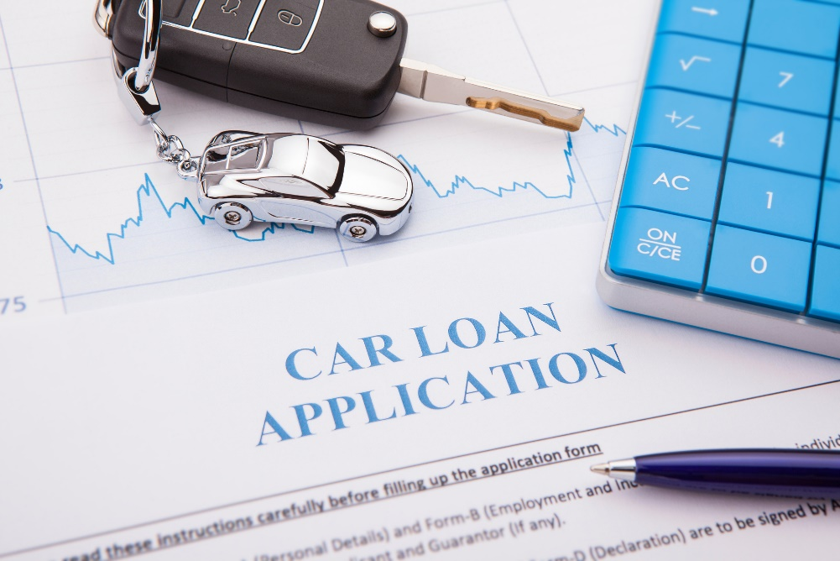
Purchasing and Insuring an Automobile
  Factors to Consider When Financing a Car
  Evaluate your financial situation.
  Check your credit report/record.
  Determine pricing.
  Consider repossessed vehicles.
  Consider transferring loan payments.
  Calculate taxes and transfer costs.
  Understand the trade-in allowance.
  Calculate operating expenses.
  Calculate total purchase costs.

Slide 25

Purchasing and Insuring an Automobile
  Items that Must be Included in a Credit Contract Include:
Total price of the purchase
Total finance charge in dollars
Amount of each payment
Number of payments to be made
When the payments are due
Address of the seller
Collateral used – usually the vehicle purchased

Slide 26

Purchasing and Insuring an Automobile
Items Included in a Credit Contract - continued
Full description of item bought
Actual price of the automobile
Amount of the down payment
Any trade-in allowance
Penalties for late payment, default (failure to pay), or prepayment
Seller's promise about service, replacement, or repair

Slide 27

Purchasing and Insuring an Automobile
Actions to Take Before Signing a Purchase Agreement
Recheck the vehicle.
Read the agreement carefully.
Ask questions.
Fully complete each form.
Feel satisfied.
Get a receipt.

Slide 28

Purchasing and Insuring an Automobile
Reasons for Buying Auto Insurance
Note: Most states require a minimum amount of insurance coverage.
Personal injury protection – can help cover medical costs resulting from a car accident.
Property protection – can help cover repairs for property damage from an auto accident.

Slide 29
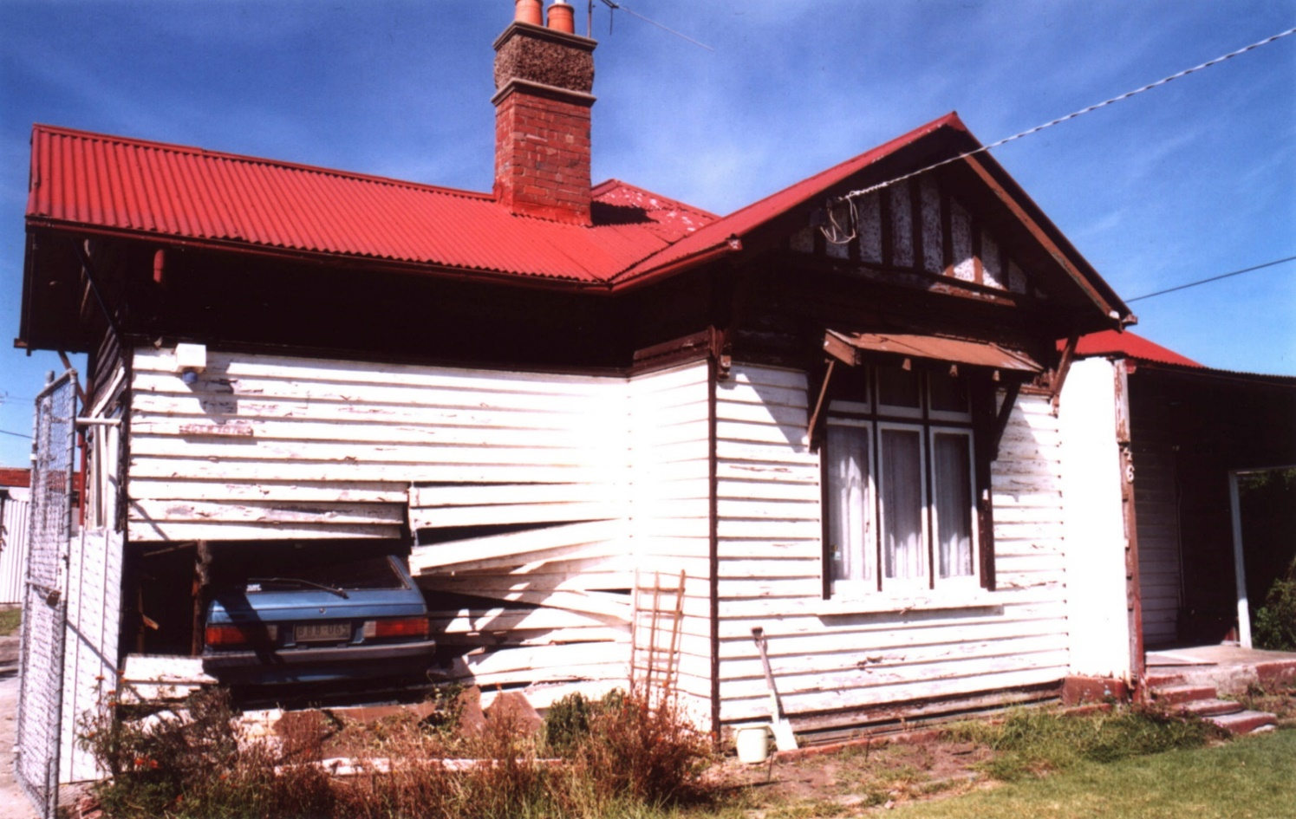
Purchasing and Insuring an Automobile
Types of Auto Insurance
Note: Types vary by state.
Bodily injury liability
Collision
Comparative negligence
Comprehensive physical damage
Medical payments
No-fault

Slide 30
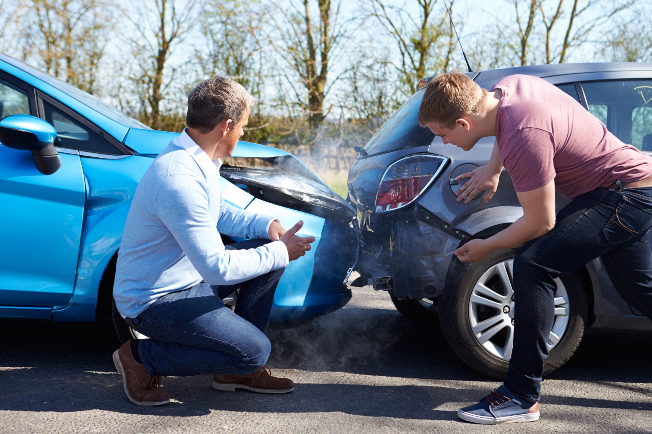
Purchasing and Insuring an Automobile
Types of Auto Insurance - continued
Personal injury protection (PIP)
Property damage liability
Uninsured motorist

Slide 31
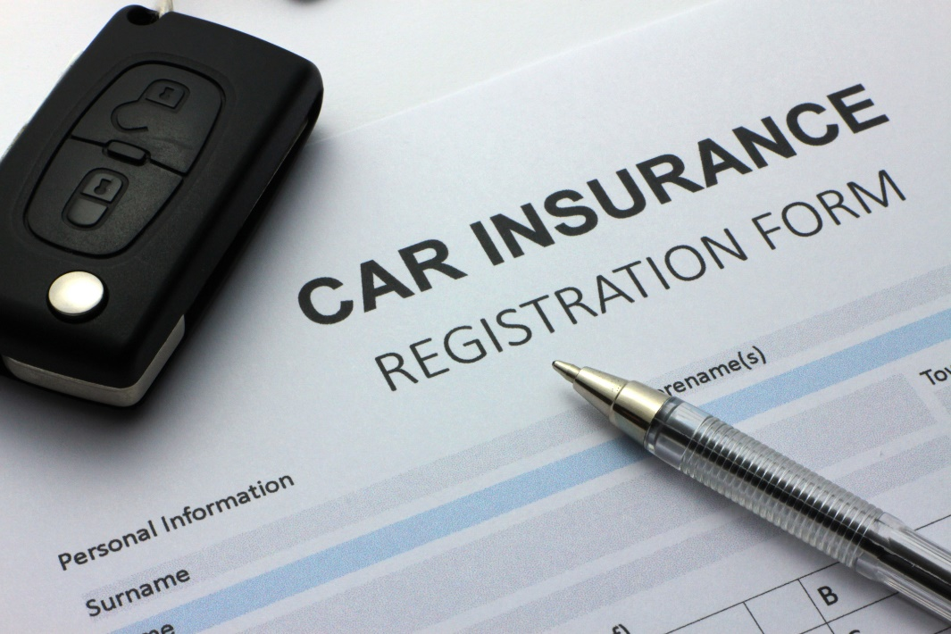
Purchasing and Insuring an Automobile
Guidelines for Purchasing Car Insurance
Know your state laws.
Determine the amount and types of coverage you need.
Comparison shop.
Consider options that lower premiums.
Consider special types of coverage or raising your policy limits.

Slide 32

Purchasing and Insuring an Automobile
Factors Affecting Car Insurance Rates
Driver’s classification (age, gender, marital status, driving record, etc.)
Geographic area
Eligibility for premium discounts
Year, make, and model of the car
Amount of deductible
Amount of coverage
Insurance company

Slide 33

Purchasing and Insuring an Automobile
Factors Affecting Rates - continued
Vehicle use
Number of drivers
Credit history
Number of policies

Slide 34

Purchasing and Insuring an Automobile
Steps for Filing an Insurance Claim
Phone your insurance company
Submit required documentation
Maintain detailed expense reports and support documentation

Slide 35

Maintaining a Vehicle
A properly maintained vehicle uses less fuel, requires fewer costly repairs, provides more trouble free driving, and requires replacement parts less frequently.
It’s important to understand the preventative measures you can take and to recognize problems.

Slide 36
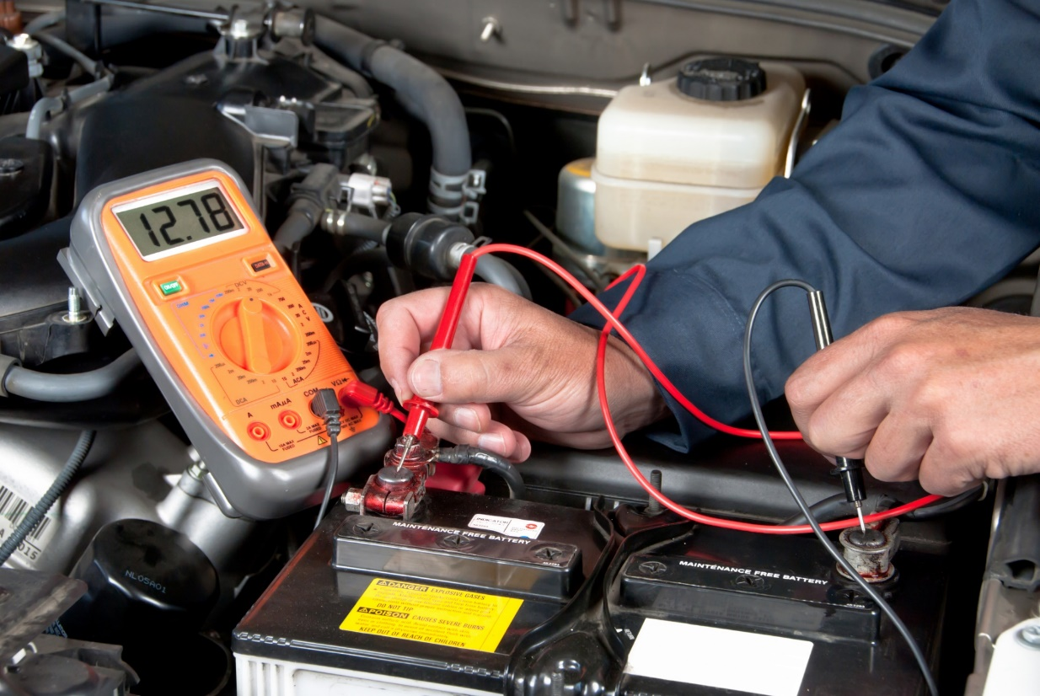
Maintaining a Vehicle
Parts of a Vehicle that Require Preventative Maintenance You Can Do
Fluid levels – transmission, brake, power steering, oil, and radiator fluids
Engine oil/oil change
Air filter
Belts
Battery
Tires
Exterior
Interior

Slide 37

Maintaining a Vehicle
Parts of a Vehicle that Require Periodic Maintenance by a Service Professional
Engine tune-up
Brake adjustment
Chassis, transmission, drive axle, front wheel bearings, and drive shaft
Fuel filter
Wheel alignment
Tire rotation

Slide 38

Maintaining a Vehicle
Parts Requiring Periodic Maintenance by a Service Professional - continued
Power steering lines and hoses
Exhaust system
Air conditioning
Carburetor adjustment
Headlights/lamps
Shock absorbers
Oil change

Slide 39
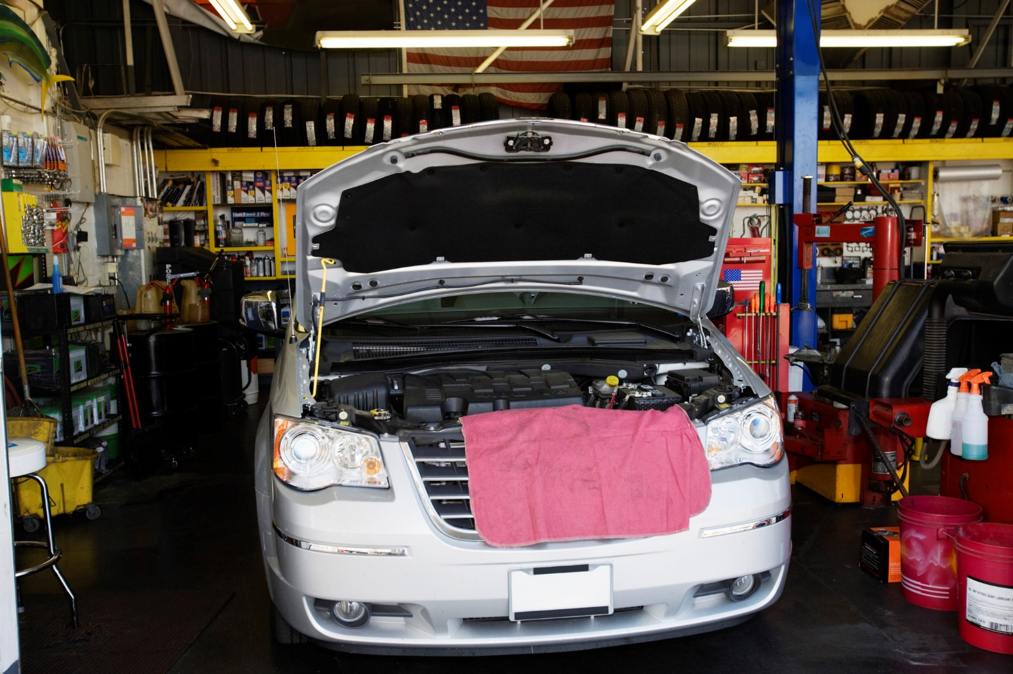
Maintaining a Vehicle
Types of Vehicle Repair Facilities
Car dealers
Specialty shops
Independent services

Slide 40
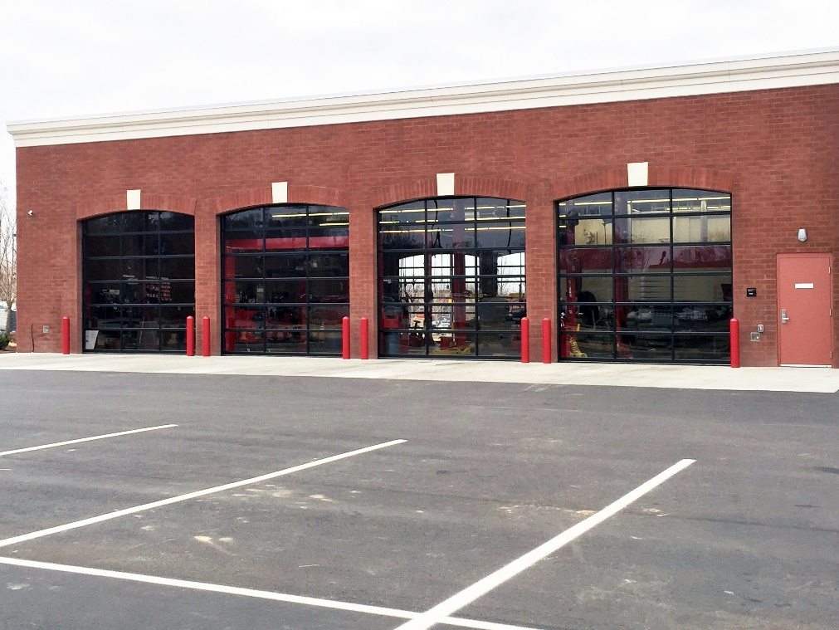
Maintaining a Vehicle
Factors to Consider When Choosing an Vehicle Repair Facility
Reputation
  Industry and organization membership
  Ask others about experiences
  Ask for recommendations
Competence
  Signs of certification for mechanic and facility
  Licensing
  Experience of technician working on your make and model

Slide 41

Maintaining a Vehicle
Factors When Choosing a Repair Facility - continued
Convenience
  Easy access from work or home
  Open hours
  Is transportation provided?
  Estimate of time required
Cost
  Comparison shop.
  Ask pricing before having work done.
  Ask if there is a diagnostic charge.
  Ask for a written estimate.
  Determine which warranties the shop honors.

Slide 42

Maintaining a Vehicle
Investigate Symptoms that Can Indicate Problems with Your Vehicle
Drips or stains – wet spots and puddles may indicate problems
Odors
Noises
Steering problems
Riding or handling poorly
Braking problems

Slide 43

Maintaining a Vehicle
Symptoms that Can Indicate Problems - continued
Engine troubles
  Difficulty starting engine
  “Check engine” light on
  Rough idling or stalling
  Poor acceleration
  Poor fuel economy
  Excessive oil use
  Engine continues running after the key is removed

Slide 44

Maintaining a Vehicle
Symptoms that Can Indicate Problems - continued
Transmission
  Abrupt or hard shifts between gears
  Delayed or no response when shifting from neutral to drive or reverse
  Failure to shift during normal acceleration
  Slippage during acceleration (such as engine speeding up with no vehicle response)

Slide 45

Maintaining a Vehicle
Methods for Troubleshooting Possible Vehicle Problems with Your Technician
Alternator – loose wiring can make it appear defective; check loose connections; perform output test.
Battery – corroded or loose terminals problem; clean terminals and test battery function.
Starter – check all connections and test battery before replacing starter.
Muffler – loud rumbling can indicate need for a new muffler or exhaust pipe.

Slide 46

Maintaining a Vehicle
Different Types of Replacement Parts
New parts – not always necessary; usually cost more.
Remanufactured, rebuilt, and reconditioned parts – generally made to manufacturer’s specs; price and quality can vary; cost less generally.
Salvaged parts - parts taken from another vehicle; can be only source for some items; reliability seldom guaranteed.

Slide 47

Maintaining a Vehicle
Warranties, Service Contracts, and Resolving Disputes
Warranties
  No standard warranty for repairs.
  Get warranty requirements in writing.
  Subject to limitations like time, mileage, deductibles, and facilities used.
  Contact the Federal Trade Commission or state/local consumer protection agencies for warranty rights.

Slide 48

Maintaining a Vehicle
Service Contracts
  Many dealers sell service contracts.
  Not all service contracts are the same; prices vary and are usually negotiable.
  Before buying, consider price, types of repairs covered; where repairs are make; claims information; paid upfront or reimbursement; and reputation of service contract company.
  Contact state Attorney General or local protection agency for information on the company’s reputation.

Slide 49

Maintaining a Vehicle
Resolving disputes
  Document all transactions and experiences; include dates, times, expenses and names.
  Talk to shop owner or manager first; if this doesn’t work, contact Attorney General or consumer protection agency.

Slide 50
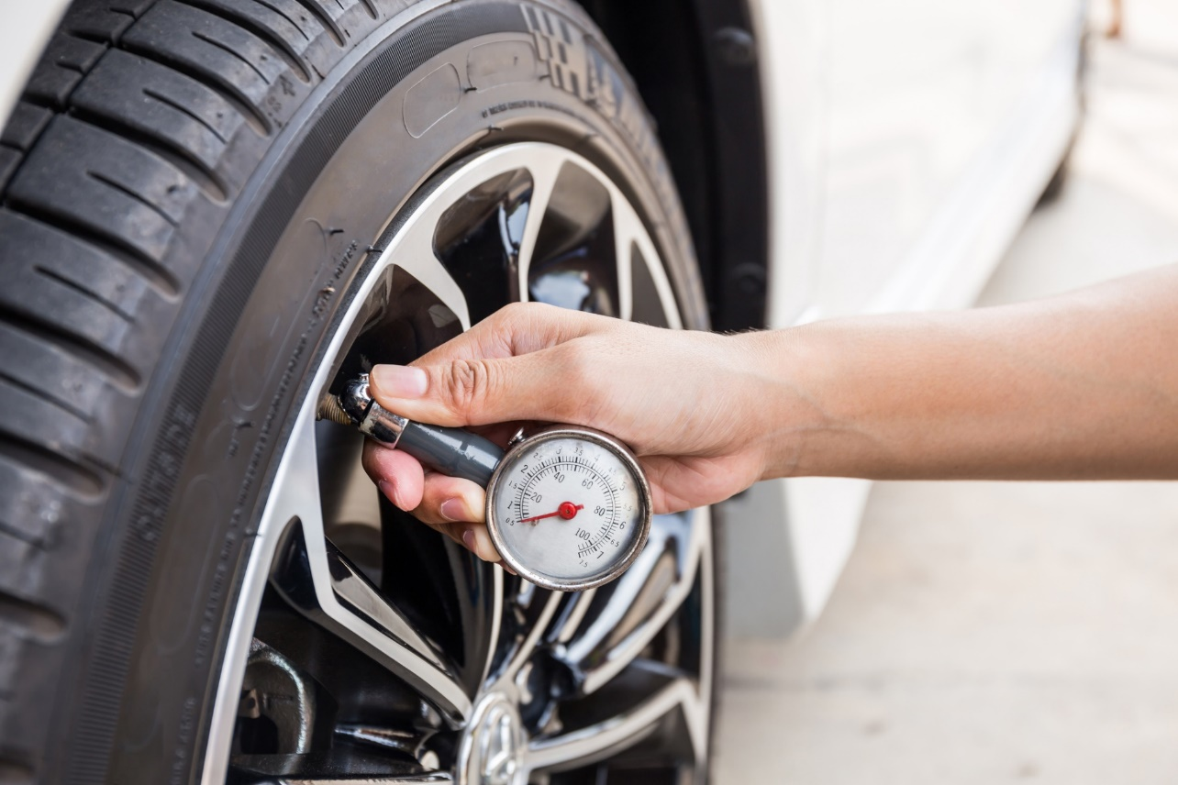
Maintaining a Vehicle
Tire Maintenance and Inspection
Recommended pressure is on tire and/or owner’s manual.
Check tire pressure monthly.
Rotate tires every 5,000 miles.
Watch for signs of tread wear or damage.
Check tire pressure when tires are cold (before running a mile).

Slide 51

Maintaining a Vehicle
Methods for Saving Fuel
Limit engine warm-up time.
Accelerate slowly.
Drive at a steady pace.
Observe the speed limit.
Anticipate traffic lights to avoid sudden stops.
Avoid overfilling the fuel tank.

Slide 52
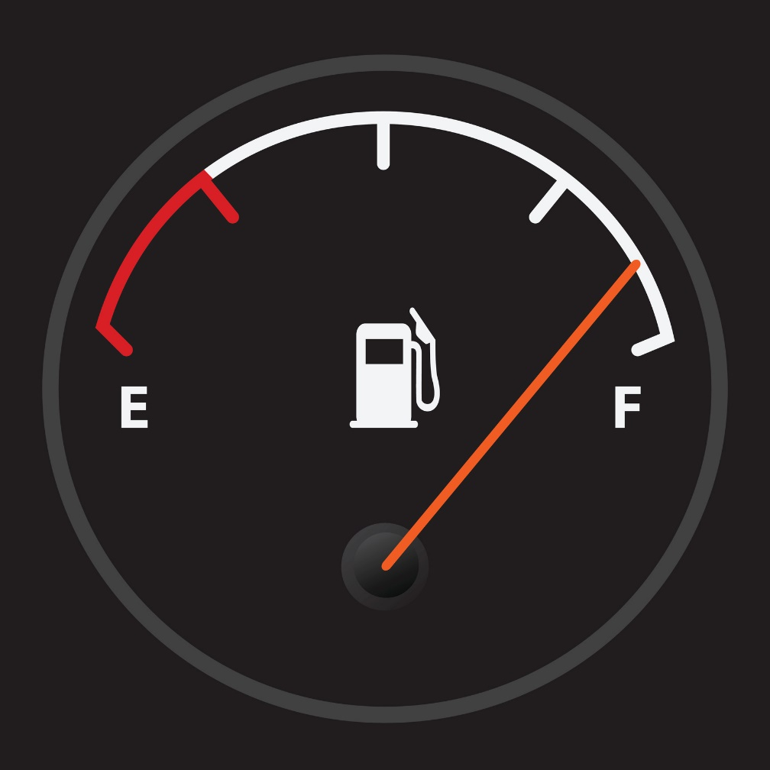
Maintaining a Vehicle
Methods for Saving Fuel - continued
Keep fuel tank at least half full
Avoid carrying unnecessary weight.
Keep tires properly inflated.
Keep engine properly tuned.
Use a manual transmission.

Slide 53

Driving Safely
Driving is both a privilege and a responsibility. It requires knowledge, thinking, planning, and concentration in order to be a safe driver.
Vehicles move at very fast speeds, and it only takes a second of lapsed concentration to lose control. Therefore, it is important to understand the steps you can take to ensure that you are driving safely at all times.

Slide 54

Driving Safely
Have The Right Attitude for Safe Driving:
Always pay full attention to your driving.
Know the driving laws and obey them.
Remember you are sharing the road with other drivers.
Use the Golden Rule.
Remain alert to possible collisions.
Control your emotions; prevent them from interfering with your driving.
Don’t text and drive!

Slide 55

Driving Safely
Factors that Encourage Safe Driving
Wear a seat belt.
Use good driving posture.
Drive defensively.
Avoid driving when emotionally upset.
Obey the speed limit.
Use signals when changing lanes.
Use the passing lane only for passing.
Be polite even if other drivers are not.

Slide 56

Driving Safely
Factors that Encourage Safe Driving - continued
Keep the radio volume at a reasonable level.
Keep your car doors locked.
Avoid distractions.
Be aware of your surroundings.
Pay attention to road signs.
Keep an emergency kit in your vehicle.
Do not drink alcohol before driving.
Read medication labels before driving.

Slide 57

Driving Safely
Standard Colors and Shapes of Road Signs
Sign colors
  Red – stop or “not allowed”
  Green – directions
  Yellow – general warning
  Black & white – regulations and instructions
  Orange – warning of construction or maintenance
  Blue – service and facilities
  Brown – recreation and scenic guides

Slide 58

Driving Safely
Standard Colors and Shapes of Road Signs - continued
Sign shapes
  Round – railroad ahead; warning signs
  Octagon – stop signs
  Crossbuck – railroad crossing signs
  Pentagon – school zone signs
  Diamond – warning signs
  Rectangle – regulatory signs
  Trapezoid – recreational area guide signs
  Triangle – yield signs
  Pennant – no passing zone sign
  Miscellaneous shapes – route, highway, and interstate signs

Slide 59

Driving Safely
Traffic Signals
Solid traffic lights – usually located at intersections and have three colors; red on top, green on bottom so color-blind people know what to do by position.
  Red – stop completely before entering intersection of do not continue until light is green.
  Yellow – the light is about to turn red; stop if you can; do not speed up, this causes accidents often.
  Green – you can cross the intersection or turn; make sure it is clear before entering the intersection.

Slide 60

Driving Safely
Traffic Signals - continued
  Flashing lights – some intersection only have one light that flashes yellow or red.
    Flashing red – you must come to a complete stop; when traffic is clear, you can continue.
    Flashing yellow – slow down and look both ways before moving on.
    Arrows
      Red – do not move forward until green.
      Yellow – the arrow is about to turn red; use caution and stop if you can,
      Green – you can move in the direction the arrow indicates.

Slide 61

Driving Safely
Ways to Deal with Car Trouble on the Road
  Pull over to the side of the road.
  Make your vehicle visible.
  Determine the problem.
  Wait inside the vehicle for help to arrive.
    Lock your doors and use cellphone to call for help.
    Do not walk along an interstate.
    Do not attempt to cross the roadway.

Slide 62

Driving Safely
Safety Measures for Winter Driving
  Schedule a tune-up before driving in winter.
  Use snow tires.
  Carry winter equipment in the car.
  Check the weather before driving.
  Notify others of your plans.
  Plan your trip.

Slide 63

Driving Safely
Winter Driving Techniques
  Hazardous conditions – drive slowly, turn on lights, keep windshields clear, test brakes often, and never tailgate.
  Stopping on ice or snow – always be prepared to stop and leave plenty of room between cars; never pump brake with ABS brakes.
  Controlled skidding – if you begin to skid, do not brake; remove foot from accelerator; turn when gently in direction you want to go; if you can’t gain control, try to steer into a snow bank.

Slide 64
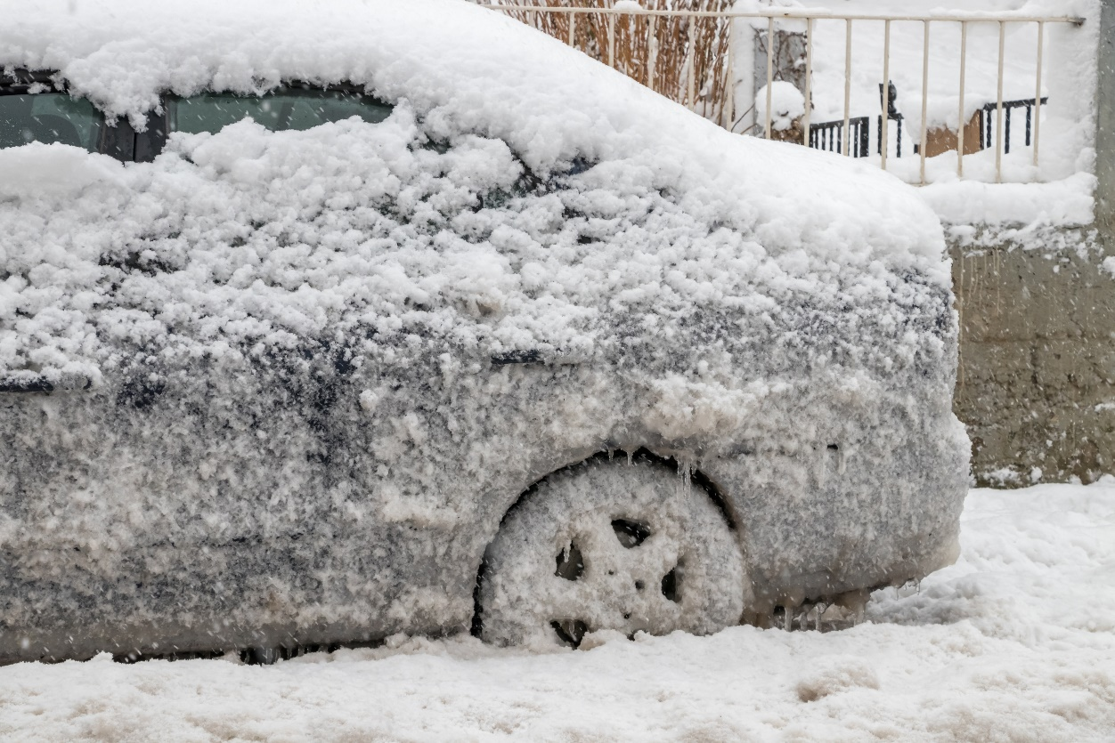
Driving Safely
Winter Driving Techniques - continued
  Getting vehicle unstuck – don’t continue spinning your wheels; shovel snow away from wheels and under car to clear a pathway; pour sand, salt, or gravel around the wheels to help with traction.

Slide 65

Driving Safely
Causes of Drowsy-Driving
  Drowsy drivers react slower, pay less attention, process information slower and this can lead to accidents.
  Sleep loss
  Driving patterns
  Using sedatives
  Consuming alcohol
  Untreated sleep disorders

Slide 66

Driving Safely
Characteristics of Crashes Caused by Drowsy-Driving
  Problem occurs later at night, early morning, or mid-afternoon.
  Crash likely to be serious.
  Single vehicle usually leaves the highway.
  Crash occurs on a high-speed road.
  Driver doesn’t attempt to avoid crash.
  Driver is alone in the vehicle.

Slide 67

Driving Safely
Ways to Avoid Drowsy-Driving
  Get enough sleep.
  Avoid drinking any alcohol when feeling drowsy.
  Avoid driving between midnight and 6:00 am.
  Stop driving as soon as you start feeling sleepy.
  Detect and manage sleep disorders.

Slide 68

Planning a Trip
Tips for Traveling Safely and Comfortably
  Research your destination.
  Make hotel reservations in advance.
  Verify reservations.
  Make arrangements for your pets.
  Notify family or friends of your plans.
  Update vaccinations.
  Acquire all necessary documentation.
  Budget for your trip.
  Plan activities.
  Know the people you are traveling with.
  Pack appropriate clothing.

Slide 69

Planning a Trip
Guidelines for Packing for a Trip
  Know your travel plans.
  Make a two-tone plan.
  Include accessories.
  Consider the type of fabric.
  Plan for alternate weather conditions.

Slide 70

Planning a Trip
Items to Include When Packing
  Clothing
    Swimwear
    Undergarments
    Sleepwear
    Formalwear
    Shirts
    Sweater
    Pants and slacks
    Shorts
    Socks
    Shoes
    Hat
    Workout clothes
    Accessories such as jewelry, scarves, belts, etc.

Slide 71
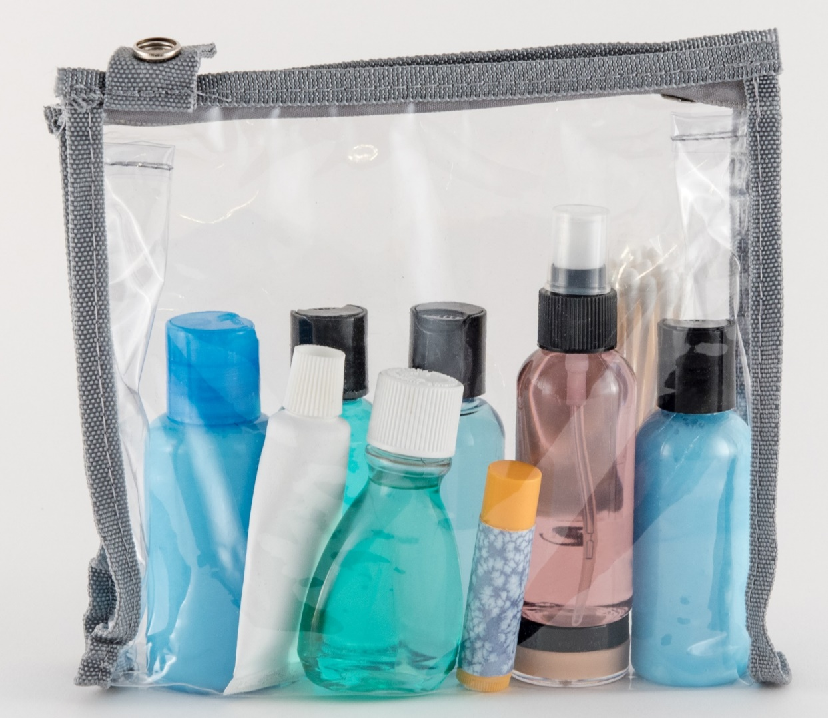
Planning a Trip
Items to Include When Packing - continued
  Toiletries
    Cosmetics
    Moisturizer
    Shaving kit
    Comb/brush
    Deodorant
    Toothbrush and toothpaste
    Curling iron
    Tweezers

Slide 72

Planning a Trip
Items to Include When Packing - continued
  Travel accessories
  Note: Remember to pack extra batteries and chargers for electronic equipment.
    Cellphone
    Camera
    Journal/notebook and pen
    Foreign-language dictionary
    Maps and directions
    Travel guides
    Entertainment
    Sports gear
Sewing kit
Luggage locks
Umbrella
Sunglasses
Travel iron or steamer

Slide 73

Planning a Trip
Items to Include When Packing - continued
  Healthcare items
    Skin creams
    Anti-bacterial wipes/get
    Band-Aids
    Bug repellent
    Sunscreen
    Extra pair of glasses
    Pain reliever
    Prescription medicines

Slide 74

Planning a Trip
Items to Include When Packing - continued
  Money
    Cash
    Credit cards
    Travelers checks and receipt

Slide 75

Planning a Trip
Items to Include When Packing - continued
  Documents
    Tickets
    Passports and visas
    Photo ID/Driver’s license
    Itinerary
    Insurance cards
    Emergency numbers/Embassy info
    Vaccination certificates, if required
    Frequent flier/frequent guest cards
    Addresses to send postcards
    Copy of medical history, if needed
    Prescriptions for medications
    Vouchers and coupons
    Business cards
    Vacation packing list

Slide 76

Planning a Trip
How to Pack
  Make a list of what you need before packing.
  Carry valuables and medications with you.
  Avoid wrinkling clothes.
  Put individual shoes in plastic bags.
  Pack according to the luggage you are using.

Slide 77

Planning a Trip
Tasks Before Leaving on Vacation
  Have mail picked up or held.
  Stop newspaper delivery.
  Secure valuables in safe deposit box.
  Turn down heat or air conditioning.
  Arrange to have lawn mowed.
  Use an automatic timer for lights.
  Securely lock all windows and doors.
  Give your travel information to a family member or friend.

Slide 78

Planning a Trip
Guidelines for Air Travel
  Purchase tickets early.
  Travel during off-peak times.
  Pack with security in mind.
  Attach ID tags to your luggage.
  Arrive at airport early.
  Dress appropriately to navigate security.
  Remember your photo ID.
  Stay close to your departure gate during boarding.
  Keep liquids under three ounces and in a clear quart bag.

Slide 79

Planning a Trip
Guidelines for Using Public Transportation
  Get a copy of the bus/subway schedule.
  Determine which stop is closest to you.
  Arrive at least five minutes early.
  Have your fare ready.
  Verify you are on the right bus/train.
  Notify the bus driver when you want to get off the bus.

Slide 80
All rights reserved; copyright © 2018 Resource Center for CareerTech Advancement
For more information, email us at
resourcecenter@careertech.ok.gov
Visit our website at
https://www.okcareertech.org/educators/resource-center

