Slide 1

Title IX: SURVIVING THE NEW TITLE IX REGULATIONS
HOW TO DEVELOP NEW POLICIES AND NAVIGATE THE CROSS-EXAMINATION REQUIREMENTS

Slide 2
Department of Education Releases New Title IX Regulations
Title IX of the Education Amendments Act of 1972
“No person in the United States shall, on the basis of sex, be excluded from participation in, be denied the benefits of, or be subjected to discrimination under any education program or activity receiving Federal financial assistance.”

Slide 3
New Challenges Posed by New Regulations: Some Big Ones
Live Hearings
Cross Examination
Role of Advisors
Evidentiary Standards
Off-Campus Jurisdiction

Slide 4
Definition of Sexual Harassment
New Regulatory Definition
Existing federal and state case law regarding sexual harassment and quid pro quo sexual harassment
or
“Unwelcome conduct on the basis of sex that is so severe, pervasive, and objectively offensive that it denies a person access to the school’s education program or activity.”

Slide 5
New Regulations Evidentiary Standard
Previous Standard New Standard
Mandated that institutions use “preponderance of the evidence”
Lower standard than “clear
and convincing evidence”
Institutions may choose between the two (PoE or C&C)
Schools must apply the same standard of evidence to all formal complaints of sexual harassment, ie: against employees (including faculty)

Slide 6
Off-Campus Jurisdiction
New
Includes off-campus if within a school’s “education program or activity”
Excludes study abroad
Prior
Included off-campus
Included during study abroad

Slide 7
Live Hearing Requirement
Regulations provide:
Under 106.45(b), Postsecondary schools must provide for live hearing during the grievance process
Most challenging feature of the live hearing
requirement is the cross-examination requirement

Slide 8
Hearings for Elementary and Secondary Schools
Elementary and secondary schools are free to conduct grievance proceedings without any type of hearing, including a live hearing.
They may choose to but are not required to provide live cross-examination or the other hearing procedures outlined in the Title IX.
With or without a hearing, after the schools sends the investigation report to the parties and before reaching a determination regarding responsibility, the decision-makers must afford each party the opportunity to submit written, relevant questions that a party wants asked of any party or witness, provide each party with the answers, and allow for additional, limited follow-up questions from each party.

Slide 9
Role of Advisors
Advisor Requirement
All parties are entitled to an advisor of their choosing
School must provide an advisor if party wants an advisor but does not have one
Advisor can be anyone, including an attorney

Slide 10

Cross-Examination
Previously
No cross-examination
required
Now
Parties must be provided advisors who can, but are not required to be, attorneys
Must allow for pause before witness/party gives answers
Can be done remotely / separate rooms via technology
Only relevant questions allowed
Parties can refuse to submit to cross-examination

Slide 11
What is Cross-Examination?
According to Merriam-Webster:
“The examination of a witness who has already testified in order to check or discredit the witness's testimony, knowledge, or credibility.”

Slide 12

What is Cross-Examination?
According to John Wigmore:
“Cross Examination is beyond any doubt the greatest legal engine ever invented for the discovery of truth.”

Slide 13

Just Ask Any Witness Who is About to be Cross Examined

Slide 14
Purpose for Cross-Examination
Probe witnesses on:
Credibility/trustworthiness
Memory and ability to remember facts of case
Background
Bias/conflicts of witness

Slide 15

Cross-Examination & Credibility
Determining Credibility
Conflicts, Discrepancies/ Inconsistencies
Motive/Bias
Inherent plausibility
Internally consistency
Opportunity to Observe
Demeanor
  Some limitations
  Cross

Slide 16
New Regulations on Cross-Examination
Live Hearing
Advisors must be allowed to cross-examine other parties and witnesses in live hearing
– “Such cross-examination at the live hearing must be conducted directly, orally, and in real time by the party’s advisor of choice and never by a party personally…”
No party can ever be allowed to personally question or cross-examine anyone, only through advisors
If any party requests, entire hearing must be held with parties located in separate rooms, using technology to see/hear all

Slide 17
Title IX Guidance on Implementing Cross Examination
What specific guidance do the new regulations give for implementing the new cross examination procedures?

Slide 18
New Regulations on Cross-Examination
Advisors
School cannot limit party’s choice of advisor
No advisor? No problem!
  If a party does not have an advisor at the live hearing, recipient must provide advisor to perform cross
  May be, but is not required to be, an attorney

Slide 19

In-House Advisors
Pros and cons
Pros: Lower costs, people familiar with campus environment
Cons: Potential conflicts & may have to go up against lawyers

Slide 20

Lawyers as Advisors
Pros and Cons
Pros: Experience and skill at cross-examination
Cons: Management, no judge, no rules of evidence

Slide 21
Managing Cross-Examination
Limitations on Cross-Examination
Relevance is only evidentiary exclusion imposed by the regulations
Questioning must be respectful (per student codes)

Slide 22
How To Determine Relevance
Rule 401 of the Federal Rules of Evidence
Test for Relevant Evidence:
  Evidence is relevant if:
    It has any tendency to make a fact more or less probable than it would be without the evidence; and
    The fact is of consequence in determining the action.

Slide 23
When Must Relevance be Determined?
Real-time
The decision maker must exclude irrelevant questions
  Makes relevance determination on the spot
before party/witness answers
Regulation language: “Before a complainant, respondent, or witness answers a cross- examination or other question, the decision- maker(s) must first determine whether the question is relevant and explain any decision to exclude a question as not relevant.”

Slide 24
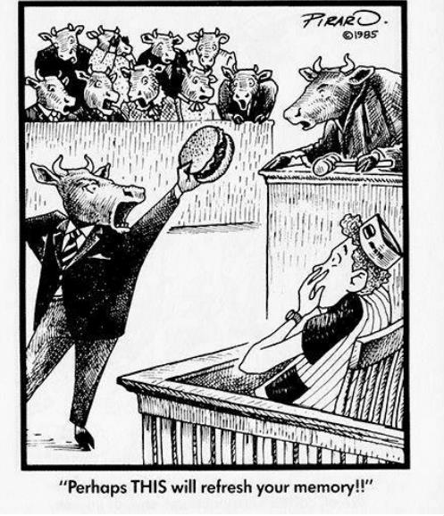
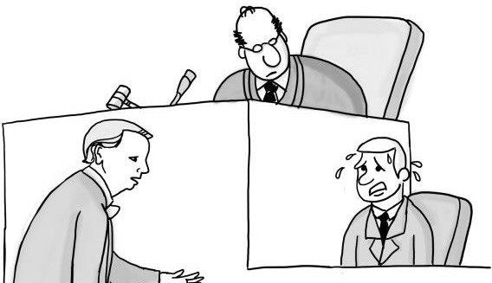
The Pause
What is “the pause”?
Break in the flow of the hearing, during which decision maker determines relevance of question
Happens after every question

Slide 25
New Regulations on Cross-Examination
Relevance
Relevance explanation does not have to be lengthy
Provides a pause in process; pace does not place undue pressure for immediate answer
Appeal of erroneous relevance determinations
permitted
DOE declined to revise regulations to require
submission of questions prior to hearing

Slide 26
Limitations on Cross-Examination
Prior Sexual History
Prior sexual history is only allowed in two narrow circumstances:
  Someone other than the Respondent committed
the sexual harassment
  The sexual behavior between the Complainant and the Respondent is offered to prove consent

Slide 27
Tips on How to Manage Cross-Examination
Encourage/require advisors to submit questions with the format of a “tree” of all possible questions
  If yes, then I will ask this follow-up question
  If no, then I will ask this
Encourage/require advisors to submit the kinds of evidence that they would use to test credibility on cross

Slide 28
Tips on How to Manage Cross-Examination
DOE recognizes schools can set forth rules of decorum to ensure respectful questioning
– School can require party to use a different advisor if advisor refuses to adhere to rules, i.e., even if question is relevant but manner of asking is abusive, school can enforce rules

Slide 29
Adjudication & Hearing
Management Training
Who Needs to be Trained
Advisors
  School-provided advisors
  Flexibility to provide trauma-informed training
Panels
Decision Makers
  Relevancy, weighing evidence
Title IX Office

Slide 30

Solution Models
Develop 100% in-house advisors and panel/decision makers
Outsource advisors
Outsource hearing/decision-maker roles
Outsource hearing management services

Slide 31
100% In-House
Training for staff, faculty, and students
Develop pool of potential advisors and panel members

Slide 32

Outsource Advisors
Develop pool of available attorneys
Retain law firm to serve as advisors
Caution: Beware of conflicts of interest

Slide 33

Outsource Hearing
A La Carte Approach: Retired judge, professional mediator
Law firm with arbitration experience

Slide 34
Hearing Management Services
Develop hybrids of above models tailored to institutional needs and resources
Vet and develop local networks of decision makers
and advisors
Provide advisor services for hearings
Supplement in-house general counsel or function as limited outside general counsel

Slide 35
Title IX: SURVIVING THE NEW TITLE IX REGULATIONS
Contact Info:
Alan Nahs
Civil Rights Coordinator
alan.nahs@Careertech.ok.gov
Office: 405-743-5578
Cell: 405-880-9457

