Slide 1
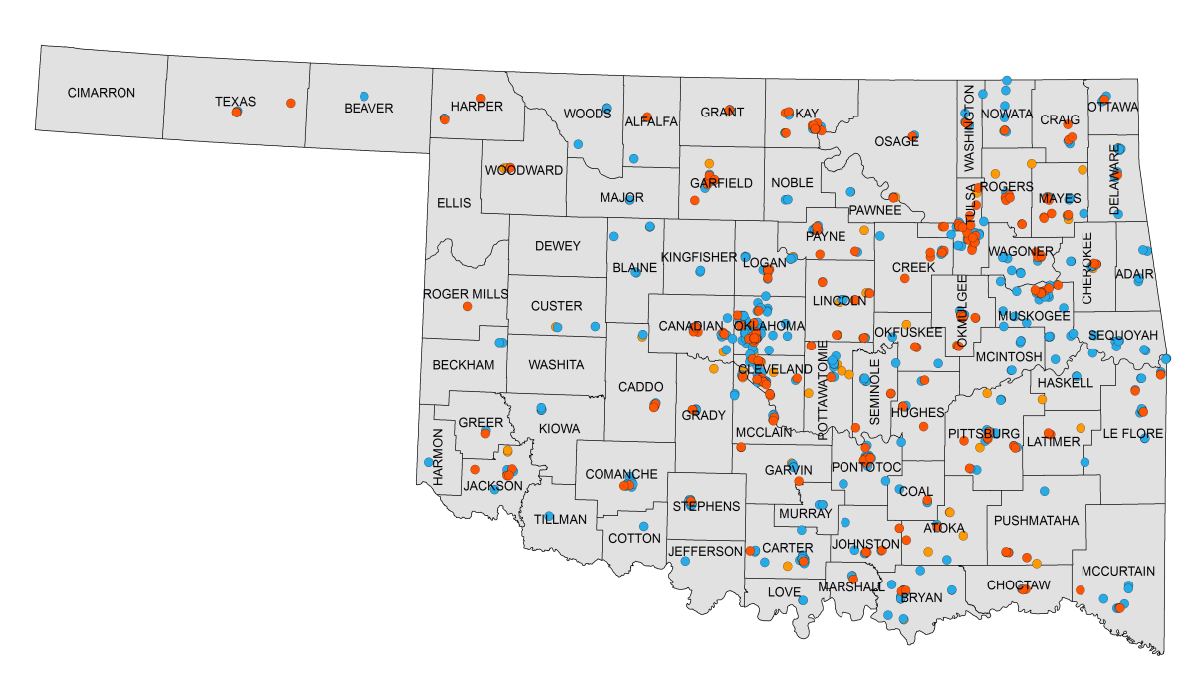
2017 Certified Healthy Business
23 applications
23 certifications
956
applications
864
certifications
137,232
people reached
121
Basic
243
Merit
500
Excellence
Criteria highlights
Actively enforce a written policy banning smoking and/or tobacco use
Provide free or subsidized blood pressure screening (beyond self-report) onsite or through partners
Provide environmental supports for recreation or physical activity
Have a written policy or formal communication which makes healthier food and beverage choices available during meetings when food is served

Slide 2
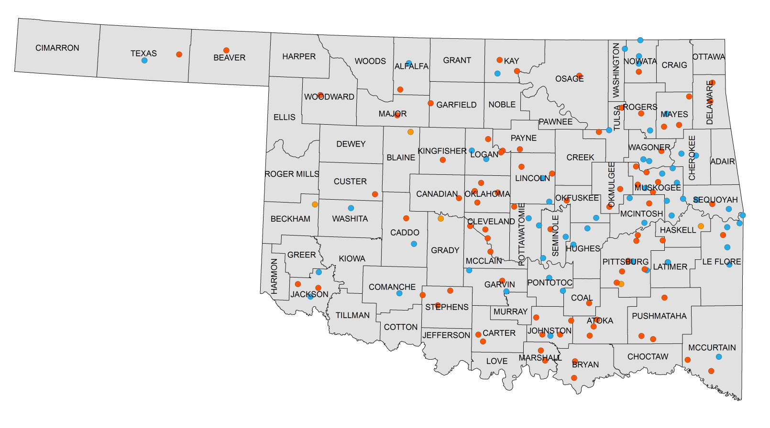
2017 Certified Healthy Community
55 applications
43 certifications
158
applications
143
certifications
1,988,172
people reached
5
Basic
82
Merit
56
Excellence
Criteria highlights
Affordable fresh fruits and vegetable (i.e. grocery stores, farmer's markets, corner stores, or community gardens) are available within the community
Primary and secondary educational institutions have adopted policies ensuring “24/7” tobacco, vapor products, alcohol and drug free properties that cover students, staff, and visitors
Local community gym (community center, church, school, etc.) is available for before/after school physical activity through a shared use agreement
Community based health screenings and referrals offered to identify health conditions such as obesity, diabetes, heart disease, mental health and substance misuse and abuse

Slide 3
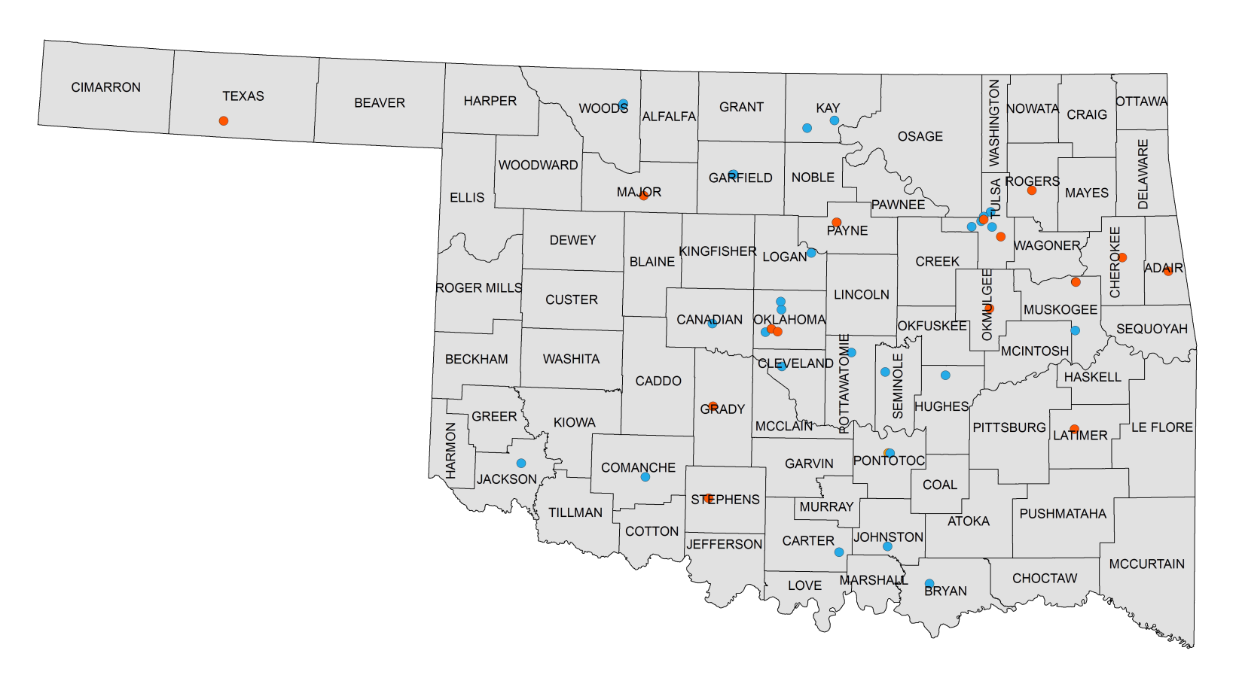
2017 Certified Healthy Campus
24 applications
20 certifications
54
applications
45
certifications
111,546
people reached
1
Basic
15
Merit
29
Excellence
Criteria highlights
Campus provides tobacco cessation assistance to faculty, staff, and students, including promotion of the Helpline: 1-800-QUIT-NOW
On campus dining displays nutritional information on menus
Campus provides a fitness facility for all faculty, staff, and students at free or reduced cost OR free or reduced membership to a local fitness facility
Campus has designated walking trails either indoor, outdoor, or both

Slide 4
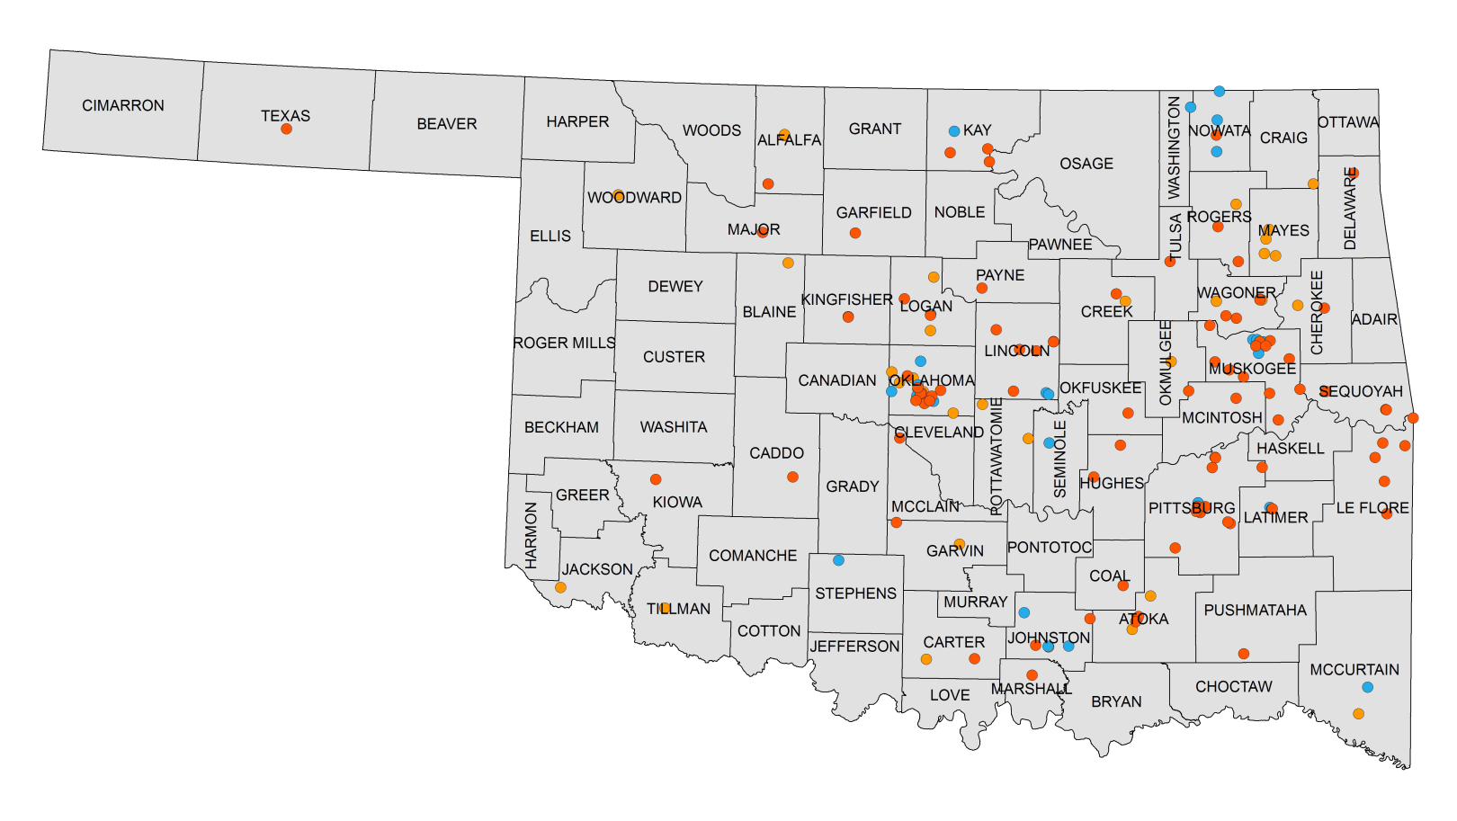
2017 Certified Healthy Congregation
169
applications
153
certifications
37 applications
34 certifications
51,827
people reached
38
Basic
87
Merit
28
Excellence
Criteria highlights
Active promotion of the Oklahoma Tobacco Helpline (1-800-QUIT-NOW, 1-800-DÉJEO-YA)
Opportunities for physical activity – indoors or outdoors (walking, aerobics classes, exercise videos, stretching, etc.)
Healthy snacks at meetings and fellowship gatherings (beverages – 100% fruit juice, low fat milk, water; snacks low in – calories, fat, sugar & sodium)
Blood pressure
screenings

Slide 5
2017 Certified Healthy Early Childhood
212 applications
205 certifications
228
applications
219
certifications
16,413
people reached
34
Basic
118
Merit
67
Excellence
Criteria highlights
Exceed the current USDA Child and Adult Care Food Program beverage, meal, and snack patterns by following recommended best practices; ensuring a healthy variety of beverages and foods are available for meals and snacks that meet the nutritional needs of the children in the age group served
Develop written policies and enforcement of tobacco-free (including vapor products) facilities and worksite vehicles for all staff, volunteers, and parents/guardians AT ALL TIMES including tobacco-free signage.
Physical activity is provided throughout the day via the following for all children birth to 6: at least two to three occasions of indoor or outdoor play, two or more adult-led physical activity-focused structured activities and/or games, and opportunities throughout the day for gross motor and movement skill development.

Slide 6
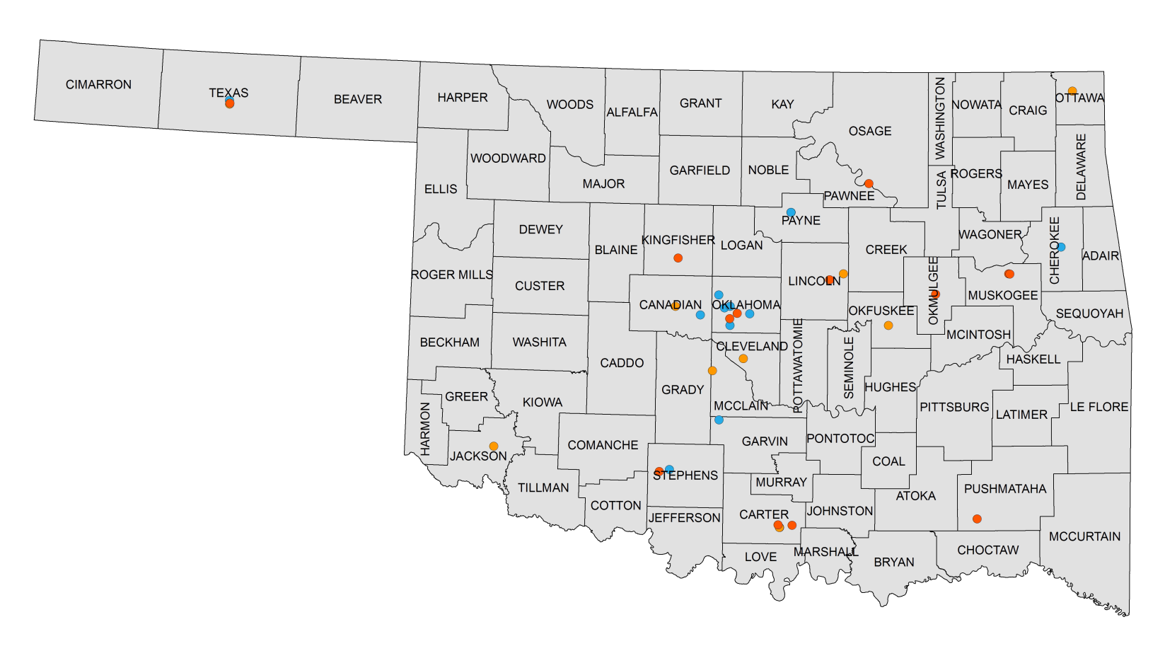
2017 Certified Healthy Restaurant
40
applications
39
certifications
8 applications
5 certifications
486,982
people reached
10
Basic
13
Merit
16
Excellence
Criteria highlights
This venue is tobacco-free (including vapor products).
The regular menu offers optional standard meals that have a maximum of 750 calories.
These side options contain no more than 230 mg of sodium.
This venue features healthy menu items in print marketing (such as flyers or brochures) or in other marketing media (such as radio, television, etc.) at least monthly.

Slide 7
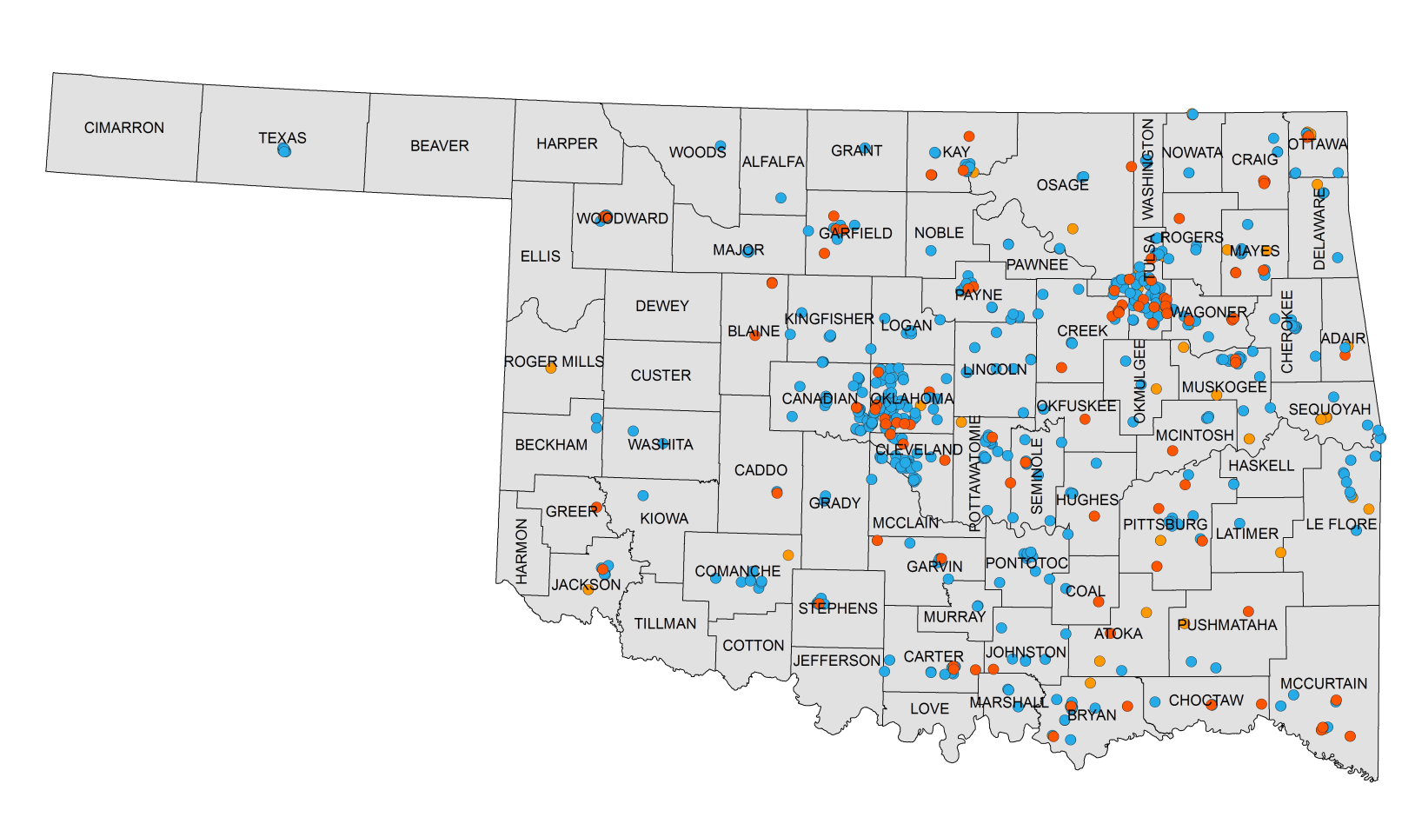
2017 Certified Healthy School
207 applications
155 certifications
895
applications
842
certifications
369,167
people reached
73
Basic
115
Merit
654
Excellence
Criteria highlights
Provides weekly physical activity during the school day
Provide annual health screening for students (with permission), then give results to parents along with the appropriate referrals
Written alcohol, tobacco, and drug free campus policies. Tobacco policy must be 24/7 including e-cigarettes and vapor products.
Display healthy menu items attractively, conveniently and well promoted using Smarter Lunchroom techniques

