Slide 1
State Plan Community Survey
06.09.2023
Family Support and Prevention Service

Slide 2
Initial Data Analysis of the State Plan Community Survey
06.09.2023
M. Dannielle Ayers, PhD, CHES® | MIECHV Program Evaluator III

Slide 3
Background
According to 63 O.S. §1-227.3, the Family Support and Prevention Services (FSPS), Office of Child Abuse Prevention (OCAP) is responsible for the creation and execution of the Oklahoma State Plan for the Prevention of Child Abuse and Neglect. The FSPS promotes the health, safety and wellness of Oklahoma's children and families by:
providing funding, training, technical assistance and oversight to local organizations/agencies that serve families with young children;
providing training to professionals that work in the area of child maltreatment prevention and intervention;
providing information and educational materials upon request; and
providing infrastructure to family support/child maltreatment prevention efforts.

Slide 4
Collaborators and Purpose
Collaboration
  FSPS Office of Child Abuse Prevention
  Oklahoma Commission on Children and Youth (OCCY)
  Oklahoma Human Services (OKDHS)
  Oklahoma Partnership for School Readiness (OPSR)
Purpose
  To create a state plan that includes the needs of all communities in Oklahoma.
  5- year state plan, executed in 2024
  Reviewed annually by OCCY
Data Collection Plan
  Surveys
  Community Cafes

Slide 5
Survey Fundamentals
Survey Methods
  Qualtrics online survey
  Open from 3.28 to 5.18
Survey Distribution
  QR code
    Facebook
    Collaborative convening
    Flyers
    TV interviews
    Telemundo
Total Responses
  Professional (n= 707)
  Parent (n=307)
User Language
  English
  Spanish (n= 46)
    Professional
    Parent (n= 35)
Survey Design
    Anonymous
    Demographics
    9 main domains
    Unique questions (professional; parent)
  Survey Length
    Parent, up to 60 questions
    Professional, up to 48 questions

Slide 6
Example of Text
Many areas of high need do not have any services and reply on in home care which may not meet health, safety and education standards. These programs and homes need much more support and are not considered as the great support they are. Visiting nurses, library book mobile, food trucks and toys and games, community recreation spaces, parks and pools are not in place to take kids to and they are inside with the TV and nobody to play with. This makes for problems instead of opportunities and was not solved with the pandemic. Some churches would be available to open doors to kids, but often don't have security clearance and health and safety code response in place, but want this. It's too bad this can't be thrown open to help get the right stuff in place. Also the day care review meets twice yearly to look at child abuse cases and this is not staffed by any systemic process for church and day camp or summer camp by a roundtable of professional people from teachers certification, forensics, psychology, language, ethnicity, religion, culture and health dept . This has been stuck for over 20 years and the way it is managed let's groups with money keep their program open and never address that they hired one or more child abusers, actively have pedophiles or violent offenders on the property as core child workers or who are on auxiliary staff as same or even administration who has these problems at home or responders hired by OKDHS, OKHCA and fire, police, teacher or certifiers. More groups should have incentive for early childhood education and support for parents who work and don't just need to go for coffee and a place to drop the kids during yoga. I am concerned these things are unchanged for 20 years, and parents can't find people with college degrees to care for kids using vetted strategies and in that be available for 9 hours of childcare without the parents being threatened with leaving their kids there too long and threatened with fines or CPS reports for any reason including being late due to unforeseeable reasons. These things aren't on your list, and then you aren't thinking about them at all. I paid $25 or more per childcare application in advance for each facility which was non refundable and had to be resubmitted each year to secure spots. Some years my dtr had to attend more than one program due to hours of availability and more than once I had to move my dtr from an abusive care situation which was reported to the state licensure and was found to be true on all counts and no prosecuted nor published as true. These things are annoying but leave children of astute parents open to criticism and the child open to being abused again because of this type of practice errors by OKDHS staff who are not required to have professional degrees with an accompanying license any ethics or accountability

Slide 7
Professionals

Slide 8
Professionals Specific Questions
Training in last five years
Child abuse and neglect training offered by their organization
Confidence to identify, report, and refer victims or perpetrators of expected abuse or neglect
Knowledge of ACES, PACES, Protective Factors
Characteristics of services they provide
Open-ended questions for beliefs about the biggest strengths for child abuse and neglect resources in their community.

Slide 9
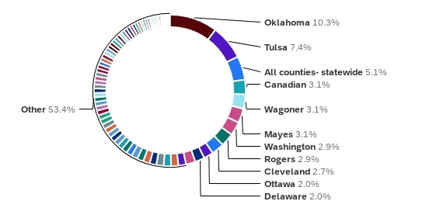
Response by County

Slide 10
Professionals Organizations and Roles
Type of Organization
  Education- 15%
  Faith based- 1%
  Government- 35%
  Non profit- 35%
  Other- 14%
Role within Organization
  Administration- 34%
  Child advocate- 5%
  Direct client services- 30%
  Other- 32%

Slide 11
Other Types of Organizations
Tribal and Government
  Tribal Government
  Child welfare
  Mother-based
  CASA (Court Appointed Special Advocate)
  Foster care agency
Education and Higher Education
  Education - Social enterprise
Legal and Law
Private Agency and For-Profit
  Private agency
  For-profit
  For profit healthcare
Community and Advocacy
Childcare and Daycare
Retired and Former
  Former CWS (Child Welfare Services)
  Retired school psychologist
Miscellaneous
  Work Ready Oklahoma
  OHS (Office of Head Start)
  Children First (C1)
  RMRS (Residential Mental Retardation Services)
  Self employed private practice

Slide 12
Other Types of Roles in Organization
Education and Teaching: 33.5%
  Teacher
  Teacher's Assistant
  School Counselor/Homeless Liaison
  School Nurse
Healthcare and Nursing: 18.5%
  Nursing Educator
  Home Visiting Nurse
  RN Case Manager
  Public Health Nurse in a School Setting
Volunteer and Advocacy: 4.5%
Social Work and Counseling: 11%
  Therapist
  School Social Worker
  Licensed Counselor
  Prevention and Education
Administration and Management: 7%
  Program Coordinator
  Program Manager
  Supervisor/Direct Client Services
Research and Data: 4.5%
  Research Project Coordinator
Other Professions: 21.5%

Slide 13
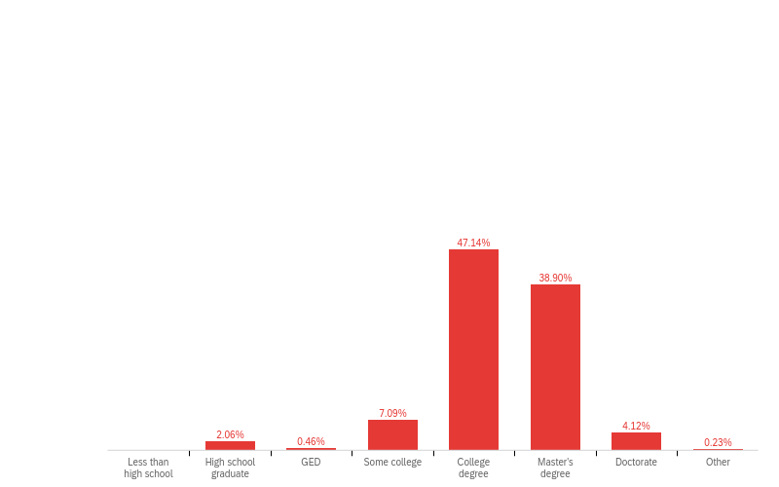
Professional Demographics
Gender
  Female (89%)
  Male (9%)
  Non-binary (1%)
  Other (1%)
Race
  White (72%)
  American Indian or Alaska Native (15%)
  Other (7%)
  Black or African American (5%)
  Asian (1%)
Ethnicity
  Non-hispanic/Latino (87%)
  Hispanic/Latino (11%)
  Not sure (3%)
Education

Slide 14

Professional: How confident are you in your ability to do the following?

Slide 15
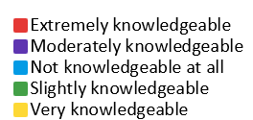
Professional: How knowledgeable are you of the following?

Slide 16
Professional: What is the biggest strength or resource in your community to help prevent child abuse and neglect?

Slide 17

Professional: What is the biggest strength or resource in your community to help prevent child abuse and neglect? (Other Text)
Support services such as local parenting groups, domestic violence/emergency shelters, tribal services, and family oriented support programs.
Government agencies, particularly the Department of Human Services.
Interconnected communities where neighbors, friends, family provide a mutual support system to one another.
Education centered programs that focus on educating the community about healthy parenting and child advocacy.

Slide 18
Parents

Slide 19
Parent Specific Questions
Relationship
  To child(ren)
  Personal
Age of child(ren)
Employment status
Military status
History of giving feedback to organizations or services.

Slide 20
Parent Demographics
Most had children that were between 6 and 18 years (86%)
Most were married (68%) and employed full time (56%)
Race
  White (68%)
  American Indian or Alaska Native (16%)
  Black or African American (4%)
  Asian (1%)
  Native Hawaiian or Pacific Islander (1%)
  Other (10%)
  Ethnicity
    Non-Hispanic/Latino (79%)
    Hispanic/Latino (16%)
    Not sure (4%)

Slide 21
Parent: Most parents agreed with the following statements.

Slide 22
Parent: Most parents disagreed with the following statements:

Slide 23
Parents: Please indicate how often you experience the following.

Slide 24
Parents: Please indicate how often you experience the following.

Slide 25
Parent: History of giving feedback to organizations/services they have engaged with.
“I give feedback that goes to the local coalition director and she gives it to the agencies. I like this because then I don’t think they are targeting me when I tell them what they could do better. They give me gift cards and that’s helped with going to the grocery. They invited me to join their Learning Community, I’ve gone a few times and they always ask for my input. It’s nice because it’s not run by government people, just normal people who’ve got kids too. “
45% of the parents had given feedback to organizations/services that they had engaged with.
Most feedback was given through surveys.

Slide 26
Experiences with Home-based Programs

Slide 27
Professionals: Please indicate if you have REFERRED families to the following home-based programs within the last three years:
Parents: Please indicate if you are AWARE of or have USED any of the following home-based programs:

Slide 28
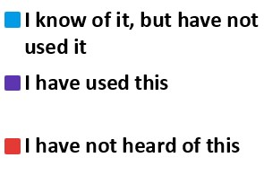
Professional Parent

Slide 29
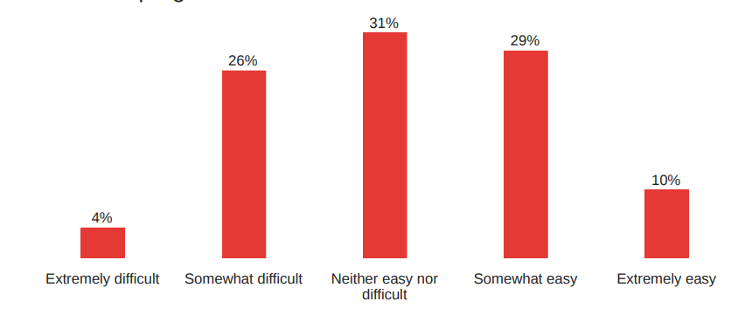
Professional
How would you describe your clients' experience accessing the home-based programs?

Slide 30
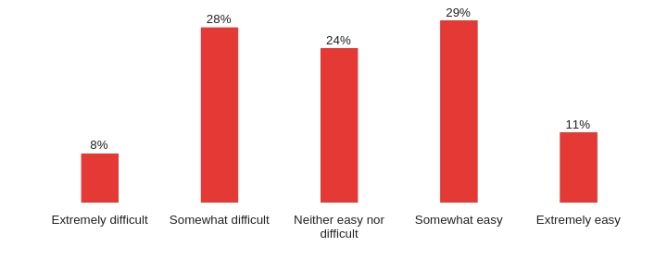
Parent
How would you describe your experience accessing the home-based programs for yourself or your child?

Slide 31
Response Options for Home-based Program Barriers
Clients are unaware of what is available
Cost
Finding facilities or providers that speak their language or understand their culture
Finding facilities or providers who are responsive to disabilities and accommodating to special needs
Lack of available facilities or providers in the community
Location
Transportation
Wait lists
Work schedule
Other

Slide 32
Professional: What do you think are the most significant barriers to accessing home-based programs?
Notes:
The top 3 out of ten.

Slide 33
Parent: What do you think are the most significant barriers to accessing home-based programs?

Slide 34
Parent: Do you know where to find home-based programs?

Slide 35
Interesting Take Aways for Home-based Programs
The top three were the same for professionals and parents- (1) Unaware of what is available (2) Lack of available facilities or providers in the community (3) Wait lists.
42% of professionals believed transportation was a barrier to accessing home-based programs, while only 10% of parents felt it was a barrier.
Professionals selected 4 barriers on average, while parents selected 3.
7% of parents thought there were other barriers.
12% of professionals thought there were other barriers not listed.
    Traumatic environments in homes
    Distrust of community agencies
    Challenging application processes
    Cultural understanding and representation
    Limited access to internet 7% of parents felt other things were a barrier.

Slide 36
Experiences with Parent-Support Programs

Slide 37
Professionals: Please indicate if you have REFERRED families to the following parent-support programs within the last three years:
Parents: Please indicate if you are AWARE of or have USED any of the following parent-support programs:

Slide 38
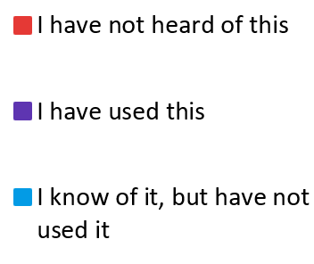
Professional Parent

Slide 39
Professional
How would you describe your clients' experience accessing the parent-support programs?

Slide 40
Parent
How would you describe your experience accessing the parent-resource programs for yourself or your child?

Slide 41
Response Options for to Parent-support Program Barriers
Clients are unaware of what is available
Cost
Finding facilities or providers that speak their language or understand their culture
Finding facilities or providers who are responsive to disabilities and accommodating to special needs
Lack of available facilities or providers in the community
Location
Transportation
Wait lists
Work schedule
Other

Slide 42
Professional: What do you think are the most significant barriers to accessing parent-support programs?

Slide 43
Parent: What do you think are the biggest challenges that prevented you from being able to use parent-support programs?

Slide 44
Parent: Do you know where to find parent-support programs?

Slide 45
Interesting Take Aways for Parent-Resource Programs
Transportation is noticed as a top 3 barrier for Professionals.
  6/9 domains

Slide 46
Experiences with Mental Health and Substance Treatment Programs

Slide 47
Professionals: Please indicate if you have REFERRED families to the following mental health and substance abuse treatment programs within the last three years:
Parents: Please indicate if you are AWARE of or have USED any of the following mental health and substance abuse treatment programs:

Slide 48
Professional Parent

Slide 49
Professional
How would you describe your clients' experience accessing the mental-health and substance abuse treatment programs?

Slide 50
Parent
How would you describe your experience accessing the mental-health and substance abuse treatment programs for yourself or your child?
Notes:
If professionals or parents answered that accessing a program was difficult or neutral, they were asked about barriers

Slide 51
Response Options for Mental-health and Substance Abuse Treatment Program Barriers
Clients are unaware of what is available
Cost
Finding facilities or providers that speak their language or understand their culture
Finding facilities or providers who are responsive to disabilities and accommodating to special needs
Lack of available facilities or providers in the community
Location
Transportation
Wait lists
Work schedule
Other

Slide 52
Professional: What do you think are the most significant barriers to accessing mental-health and substance abuse treatment programs?

Slide 53
Parent: What do you think are the biggest challenges that prevented you from being able to use mental-health and substance abuse treatment programs?

Slide 54
Parent: Do you know where to find mental-health and substance abuse treatment programs?

Slide 55
Experiences with Resource Programs

Slide 56
Professionals: Please indicate if you have REFERRED families to the following resource programs within the last three years:
Parents: Please indicate if you are AWARE of or have USED any of the following resource programs:

Slide 57
Professional Parent

Slide 58
Professional
How would you describe your clients' experience accessing the resource programs?

Slide 59
Parent
How would you describe your experience accessing the resource programs for yourself or your child?

Slide 60
Response Options for Resource Barriers
Clients are unaware of what is available
Cost
Finding facilities or providers that speak their language or understand their culture
Finding facilities or providers who are responsive to disabilities and accommodating to special needs
Lack of available facilities or providers in the community
Location
Transportation
Wait lists
Work schedule
Other

Slide 61
Professional: What do you think are the most significant barriers to accessing resource programs?

Slide 62
Professional: What do you think are the most significant barriers to accessing resource programs? (Other Text)
Some felt that the process to receive help from a resource program was too burdensome.
  Eligibility
  Length of application
  Issues with computer literacy
Many described inadequate customer service as a barrier to accessing resource programs.
  Lack of personal interaction
  Poor communication from staff
“Specific programs seem to change frequently and the only way we know about things to spend a lot of time looking them up and finding out all of the details. Our parents are not going to look online and try to find things.”- Burdensome
Notes:
12% of professionals thought there were Other Barriers as reported by Providers.

Slide 63
Parent: What do you think are the biggest challenges that prevented you from being able to use resource programs?

Slide 64
Parent: What do you think are the biggest challenges that prevented you from being able to use resource programs? (Other Text)
Income Gap
  Financial struggle, but too much income to qualify.
Many described inadequate customer service as a barrier to accessing resource programs.
  Feeling unwelcomed by staff
  Poor communication from staff
“I had a full time job and couldn’t make ends meet, but yet was told that the year of my vehicle was keeping from obtaining benefits”. –Income Gap

Slide 65
Parent: Do you know where to find resource programs?

Slide 66
Interesting Take Aways for Resource Programs
26% of parents thought transportation was a barrier, 79% of professionals thought it was a barrier
50% of professionals though work schedule was a barrier, 45% of parents thought it was a barrier.

Slide 67
Experiences with Child-Care Resource Programs

Slide 68
Professionals: Please indicate if you have REFERRED families to the following child-care resource programs within the last three years:
Parents: Please indicate if you are AWARE of or have USED any of the following child-care resource programs:

Slide 69
Professional Parent

Slide 70
Professional
How would you describe your clients' experience accessing the child-care resource programs?

Slide 71
Parent
How would you describe your experience accessing the child-care resource programs?

Slide 72
Response Options for Child-care Resource Barriers
Clients are unaware of what is available
Cost
Finding facilities or providers that speak their language or understand their culture
Finding facilities or providers who are responsive to disabilities and accommodating to special needs
Lack of available facilities or providers in the community
Location
Transportation
Wait lists
Work schedule
Other

Slide 73
Professional: What do you think are the most significant barriers to accessing child-care resource programs?

Slide 74
Professional: What do you think are the most significant barriers to accessing child-care programs? (Other Text)
“Many areas of high need do not have any services and reply on in home care which may not meet health, safety and education standards. These programs and homes need much more support and are not considered as the great support they are.”-
Many professionals felt child-care programs were unobtainable to parents.
  Affordability
  Lack of facilities
  Closed during evening hours
  Income guidelines for help are too low, therefore, unobtainable by many.

Slide 75
Parent: What do you think are the biggest challenges that prevented you from being able to use child-care resource programs?

Slide 76
Parent: Do you know where to find child-care resource programs?

Slide 77
Interesting Take Aways for Child-Care Resource Programs
41% of parents said they knew how to locate child-care resource programs.
The response options listed for barriers seems to comprehensively cover all reasons for not accessing child-care programs.

Slide 78
Experiences with Employment Programs

Slide 79
Professionals: Please indicate if you have REFERRED families to the following employment programs within the last three years:
Parents: Please indicate if you are AWARE of or have USED any of the following employment programs:

Slide 80
Professional Parent

Slide 81
Professional
How would you describe your clients' experience accessing the employment programs?

Slide 82
Parent
How would you describe your experience accessing the employment programs for yourself or for your child?

Slide 83
Response Options for Employment Barriers
Clients are unaware of what is available
Cost
Finding facilities or providers that speak their language or understand their culture
Finding facilities or providers who are responsive to disabilities and accommodating to special needs
Lack of available facilities or providers in the community
Location
Transportation
Wait lists
Work schedule
Other

Slide 84
Professional: What do you think are the most significant barriers to accessing employment programs?
Notes:
The top 3 out of ten.

Slide 85
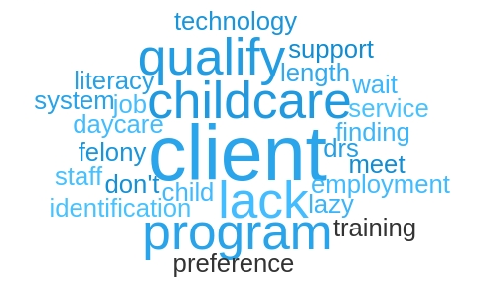
Professional: What do you think are the most significant barriers to accessing employee programs? (Other Text)
Many professionals thought that issues with childcare was the most significant barrier to accessing employee programs.
Lack of technical competency.
  Poor computer literacy
  Lack of training
“

Slide 86
Parent: What do you think are the biggest challenges that prevented you from being able to use employment programs?

Slide 87
Employment; and Parent: What resources and services in your community are most effective at meeting you or child’s needs? (an example of across data analysis)
“I haven’t made use of many social services. So I don’t really know. We have both had to access unemployment services recently. The people there have been very helpful. But it was very difficult to get the money and we both were rejected because we didn’t jump through the right hoops (registering properly for the job hunting website).”
"I feel like I am living in extreme poverty, but have hardly any resources as someone who doesn't fall within the guidelines. It makes me not want to keep my job that pays decent. I want to improve my daughter's and I's life so that I do not have to rely on the government, but it is nearly impossible. I am not living a life, I am busting my tail end to just survive painfully and somewhat miserably, but I have to put on a good face to be a mother.”
“We have both had to access unemployment services recently. The people there have been very helpful. But it was very difficult to get the money and we both were rejected because we didn’t jump through the right hoops (registering properly for the job hunting website).”

Slide 88
Parent: Do you know where to find employment programs?

Slide 89
Interesting Take Aways for Employment Programs
46% of parents felt that they knew how to locate employment programs

Slide 90
Experiences with Education Programs

Slide 91
Professionals: Please indicate if you have REFERRED families to the following education programs within the last three years:
Parents: Please indicate if you are AWARE of or have USED any of the following education programs:

Slide 92
Professional Parent

Slide 93
Professional
How would you describe your clients' experience accessing the education programs?

Slide 94
Parent
How would you describe your experience accessing the education programs?

Slide 95
Response Options for Education Barriers
Clients are unaware of what is available
Cost
Finding facilities or providers that speak their language or understand their culture
Finding facilities or providers who are responsive to disabilities and accommodating to special needs
Lack of available facilities or providers in the community
Location
Transportation
Wait lists
Work schedule
Other

Slide 96
Professional: What do you think are the most significant barriers to accessing education programs?

Slide 97
Professional: What do you think are the most significant barriers to accessing education programs? (Other Text)
Some felt that there were systematic barriers that prevented parents from accessing education programs.
  Poor Internet connectivity
  Proof of residential requirements
  Changing back to in person classes
Many said that childcare was the most significant barrier to accessing education programs.
  Lack of childcare
Some also felt that there were intrapersonal barriers.
  Learning disabilities
  Low self-efficacy
“Often in cycles of crisis [sic] make the stability required for education almost impossible”-Systematic Barriers
“Believing they can do it.”- Intrapersonal Barrier

Slide 98
Parent: What do you think are the biggest challenges that prevented you from being able to use education programs?

Slide 99
Parent: What do you think are the biggest challenges that prevented you from being able to use education programs? (Other Text)
While few comments were made by parents, the few that were indicated feeling confused or that the process was too burdensome.
Overwhelming
Complicated
Confusing
Burdensome
“Too complicated-too much paperwork.” Process
“Figuring out how to fill out the forms.”- Process

Slide 100
Parent: Do you know where to find education programs?

Slide 101
Interesting Take Aways for Education Programs
54% of parents felt that they knew how to locate education programs.

Slide 102
Experiences with Insurance and Healthcare Programs

Slide 103
Professionals: Please indicate if you have REFERRED families to the following insurance/healthcare programs within the last three years:
Parents: Please indicate if you are AWARE of or have USED any of the following insurance/healthcare programs:

Slide 104
Professional Parent

Slide 105
Professional
How would you describe your clients' experience accessing the insurance/healthcare programs?

Slide 106
Parent
How would you describe your experience accessing the insurance/healthcare programs?

Slide 107
Response Options for Insurance/Healthcare Barriers
Clients are unaware of what is available
Cost
Finding facilities or providers that speak their language or understand their culture
Finding facilities or providers who are responsive to disabilities and accommodating to special needs
Lack of available facilities or providers in the community
Location
Transportation
Wait lists
Work schedule
Other

Slide 108
Professional: What do you think are the most significant barriers to accessing insurance/healthcare programs?

Slide 109
Parent: What do you think are the biggest challenges that prevented you from being able to use insurance/healthcare programs?

Slide 110
Parent: Do you know where to find insurance/healthcare programs?

Slide 111
Interesting Take Aways for Insurance/Healthcare Programs
Only 31% of parents felt sure that they could find insurance/healthcare programs

Slide 112
Experiences with Disability Programs

Slide 113
Professionals: Please indicate if you have REFERRED families to the following disability programs within the last three years:
Parents: Please indicate if you are AWARE of or have USED any of the following disability programs:

Slide 114
Professional Parent

Slide 115
Professional
How would you describe your clients' experience accessing the disability programs?

Slide 116
Parent
How would you describe your experience accessing the disability programs for yourself or for your child?

Slide 117
Response Options for Disability Program Barriers
Clients are unaware of what is available
Cost
Finding facilities or providers that speak their language or understand their culture
Finding facilities or providers who are responsive to disabilities and accommodating to special needs
Lack of available facilities or providers in the community
Location
Transportation
Wait lists
Work schedule
Other

Slide 118
Professional: What do you think are the most significant barriers to accessing disability programs?
Notes:
The top 3 out of ten.

Slide 119
Professional: What do you think are the most significant barriers to accessing disability programs? (Other Text)
“Family advocacy is often too little too late and historically successful methods to network are crashed by systems of service focused on billing criteria or other points of exclusion”-Bottlenecking
Some felt that there the disability programs were not efficient and that this caused people to miss out on receiving help.
  Slow responses
  Lack of communication between providers and agencies
  Bottle necking during approval process
Some professionals also thought that the parents lacked necessary knowledge or ability to navigate the system.
  Low computer/technology literacy
“The applications are very long-hard for someone with disabilities to complete without someone helping them.”- Navigation Challenges

Slide 120
Parent: What do you think are the biggest challenges that prevented you from being able to use disability programs?

Slide 121
Parent: Do you know where to find disability programs?

Slide 122
Interesting Take Aways for Disability Programs
Overall professionals thought it was more difficult for parents to access disability programs.
  Professionals, 16%- Easy
  Parents, 32%- Easy
  Only 26% of parents felt sure they would know how to locate disability programs.

Slide 123
Additional Shared Questions

Slide 124
Professional: What resources and services in your community are the most effective in meeting your community’s needs?
“Government funded programs. Non profit organizations are struggling majorly for funding and ability to hire enough people to meet the need.”
“The warmline, child care resource and referrals, child care locator, family builders, parents as teachers, resources from various entities regarding child health and safety.”
“Having a one-stop center where families can access many different services in one location. Having bicultural and bilingual staff.”

Slide 125
Parent: What resources and services in your community are the most effective in meeting your community’s needs?
“Right now - public schools, DDS, DHS, SoonerCare. I have a teen in public schools and an adult disabled son living at home.”
“Education is most effective, however we have needs that are unmet in our community, specifically mental health.”
“With my sons, OKSA was such an incredibly valuable lifeline, and so was my foster agency.”

Slide 126
Professional: What resources and services in your community are the least effective in meeting your community’s needs?
“High barrier emergency homeless shelters. rental and utility assistance - hard to access and does not cover deposits and other key bills.”
“There are very few services available in our area. In rural NWOK we have many services "available", however, when referring clients, co-workers, or peers - many of those services are understaffed and too thinly stretched to be able to service our area.”
“Lack of resources/agencies/programs that are in ALL native languages spoken in the area.”

Slide 127
Parent: What resources and services in your community are the least effective in meeting your community’s needs?
“Lack of funding mostly and apparent miss appropriation of existing funding and the people of the community needs to step up and clean up our community it looks like a pig sty “
“The way the DHS daycare assistance just cuts people off. I think we also need to take into account of inflation. I think yall leaving out the people who make more than what yall consider to be under the poverty line is not effective.”
“Those that are based only on income and do not include middle class families who want to learn more and be the best parent for their children”

Slide 128


