Slide 1
Preventive Health and Health Services (PHHS) Block Grant
Advisory Committee Meeting
Public Hearing
2:00 pm, December 14, 2022

Slide 2
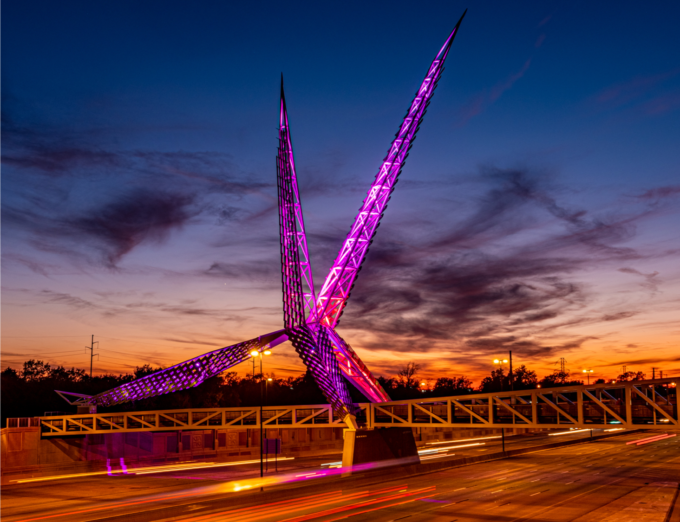
Meeting Agenda
Welcome and Introductions
Review and Approve of Minutes
FY21 PHHSBG Updates
FY22 PHHSBG Updates
FY23 PHHSBG Updates
2023 Committee Meeting Dates
Closing Remarks and Adjournment
Oklahoma State Department of Health | Preventive Health and Health Services Block Grant | 2022

Slide 3
Review and Approval of Meeting Minutes

Slide 4
FY 2021 PHHS Block Grant Final APR Updates
Success Stories
“The OMHHE Interpretation and Translation team provides outstanding translation and interpretation services in Spanish. This group goes above and beyond to ensure that language is not a barrier to receiving quality healthcare services and resources. The Spanish interpretations improved the completion time from 7-21 business days to a 24-72 hr turnaround time (depending on the complexity of the translation, but for most, it’s 24-72 hrs). The OMHHE Interpreter/Translation team spent many hours supporting “back to school” events, and car seat installations and providing interpretations for clients participating in the maternity clinics in rural Oklahoma to include questions around routine vaccines, birth control, postpartum planning while attending listening sessions for different communities.”
“This Block Grant program has provided opportunity to increase Certified Healthy Oklahoma Certification for programs. One success to highlight is the work OSDH staff did with the City of Edmond, Oklahoma to update their tobacco policy. This town has a population of over 94,000 in 2020 per the U.S. Census Bureau. OSDH staff worked with a city council member from the City of Edmond to update their City Owned and Operated Property Tobacco Ordinance to cover more properties of the city and include all types of tobacco products, not just smoking. This Tobacco Ordinance will impact the over 94,000 residents and the numerous visitors to the city. Along with the Tobacco Ordinance change, OSDH staff connected them to more tobacco cessation resources to provide to city employees and residents interested in quitting tobacco. OSDH staff began working with Edmond July of 2021, but the Tobacco Ordinance was approved with no opposition on October 10, 2021.”

Slide 5
FY 2021 PHHS Block Grant Final APR Updates
Success Stories Cont.
“Using the Preventive Health and Health Services Block funding we were able to provide access to the Association of Diabetes Care and Education Specialists (ADCES) Career Path certificate program entitled “Diabetes Community Care Coordinators” at no cost. OSDH staff (CHWs, WIC staff, Health Educators, Nursing Service staff, and others) as well as Diabetes partners across the state were invited to complete the certification program. At the end of the Block Grant budget period 80 individuals had completed certification training.”
“The condoms distribution program has been one that continues to grow from year to year. The rates of sexually transmitted infections (STIs) continue to rise in Oklahoma. Persons from ages 15 to 29 are the impacted with these infections. The reason why young adults seem to have to highest rates of STIs in Oklahoma could be attributed to so many different factors. The truth is that more innovative ways have to be employed by the Sexual Health and Harm Reduction Services (SHHRS) to prevent this age group from getting and transmitting such infections. One of the ways that SHHRS is through the Oklahoma HIV and Hepatitis Planning Council (OHHPC). Through the OHHPC, a website was launched; www.endinghivoklahoma.org. This website makes it very easy for young people who are more technologically driven to order condoms online and in the convenience of their homes to be very discretely mailed to them. This program increased the number of condoms distributed by the condom distribution program. In 2020, this program began amidst the COVID-19 pandemic, and we distributed a total of 1,420 condoms to individuals across Oklahoma. In 2021 this number increased to 2,360 condoms and by only the third quarter of 2022, we are already at 24,500 condoms distributed to individuals across the state of Oklahoma. This has well surpassed the amount distributed in 2020 and 2021 put together. Organizations can also use this site to order condoms, dispensers and lubricants. In 2019, a total of 123,680 condoms were distributed. In 2020, a total of 120,120 condoms were distributed. In 2021, a total of 342,266 condoms were distributed to organizations across Oklahoma. Data collected in the third quarter of 2022 show that the total amount of condoms distributed thus far in 2022 total 471,368 and counting. During the reporting period of 10/1/2021 to 9/31/2022, the program distributed a total of 563,768 condoms and 261,772 lubricants to both individuals and organizations in Oklahoma.”

Slide 6
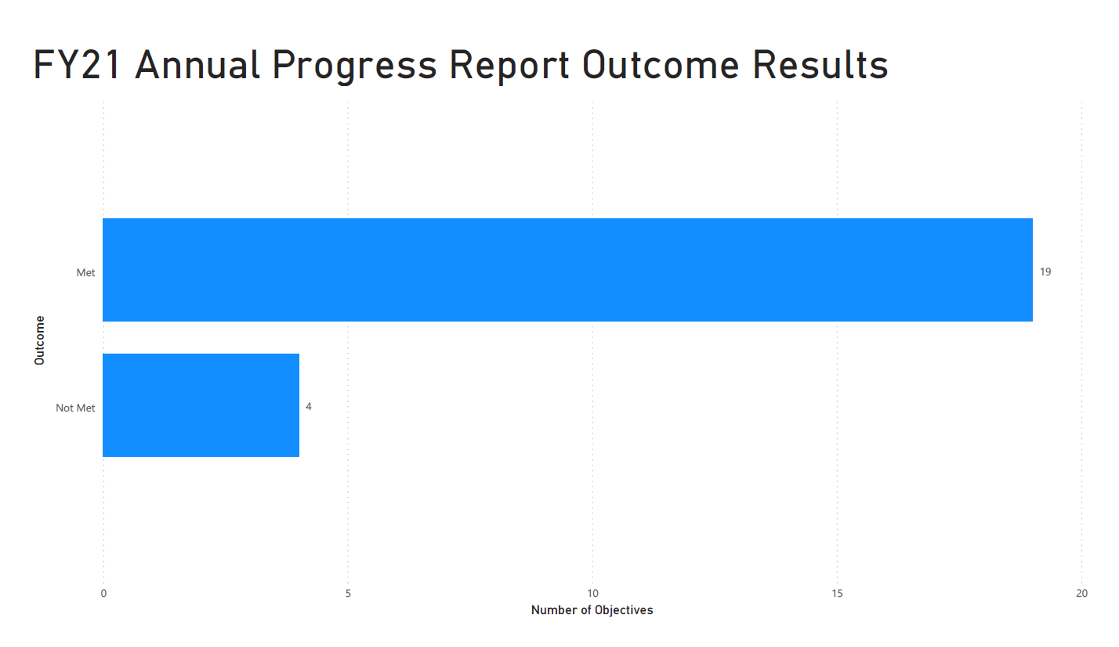
FY 2021 PHHS Block Grant Final APR Updates

Slide 7
FY 2022 PHHS Block Grant Work Plan Updates
Work Plan Updates
Successes and Challenges
Funding Map
Dashboard
Budget Revisions and Work Plan Changes
Project CHAT
Expanded CATCH program
Fluoride Varnish Outreach
Certified Healthy
Nursing Services
IECHMH

Slide 8
FY 2022 Successes and Challenges
Successes
New partnerships across several programs
254 Booster Seats have been distributed to date
Expanding evidence-based programs in rural areas
Distribution of equipment to schools in NE Oklahoma
Challenges
Staff/Volunteer capacity
Filling vacancies

Slide 9
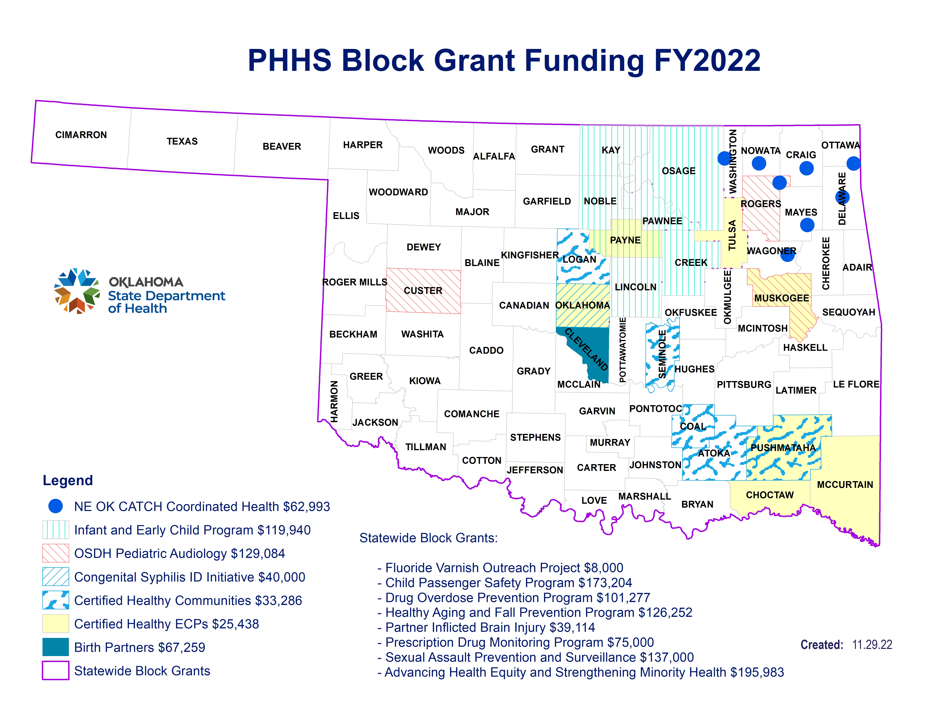

Slide 10
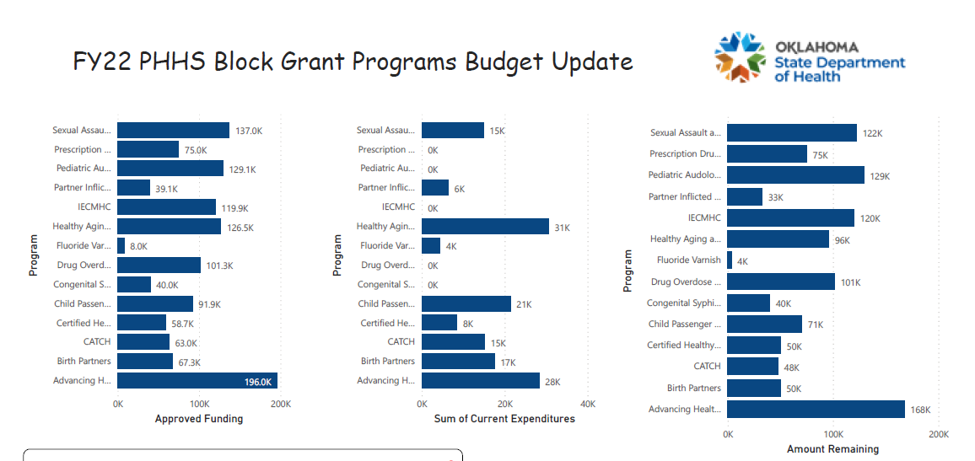
Ac meeting dashboard - Power BI (powerbigov.us)

Slide 11
FY 2022 Budget Revisions and Work Plan Changes
IECHMH
Funding Returned ~ $119,900
CATCH
Expanding program into District 7 ~$40,000
Project CHAT
Services completed in November for approved revision in May ~$67,000

Slide 12
FY 2022 Budget Revisions and Work Plan Changes
Fluoride Varnish
Spent 2/3 of funding, will re-evaluate in new year, but could request ~$3,000
Nursing Services
Vacancies and/or delay in hiring
Potential funding may be identified in the Spring

Slide 13
FY 2023 PHHS Block Grant Program Updates
January 2023 – FY23 Applications Open
February 2023 – FY23 Applications Due
March 2023 – Recommendations Made for FY23 Programs
May 2023 – Public Hearing to Present Approved FY23 Programs
July 2023 – FY23 Programs Project Period Begins

Slide 14
2023 PHHS Block Grant Advisory Committee Dates
March 8, 2023
FY23 Proposal Request Recommendations
FY22 Program and Budget Spend Down Update
May 10, 2023
Public Hearing of FY23 Work Plan
FY22 Program and Budget Spend Down Update
December 13, 2023
FY24 Update
Final APR FY22 Update

Slide 15
Closing Remarks and Adjournment
Thank you!

