Slide 1
Preventive Health and Health Services (PHHS) Block Grant
Special Advisory Committee Meeting
Public Hearing
2:00 pm, June 15, 2022

Slide 2
PHHSBG Advisory Committee
COMMITTEE MEMBERS
Chair – Danielle Durkee, Deputy Chief Financial Officer, OSDH
Member - Michael Peercy, MPH, MT(ASCP)H, Epidemiologist and IRB Administrator, Chickasaw Nation Department of Health
Member – Cara Gluck, MPH, Chief Public Health Strategist – Community Health Administration, OCCHD
Member - Melissa Blanton, JD, Assistant Attorney General; Chief, Victim Services Unit Chief, Office of the Attorney General
Member - Dr. David Gahn, MD, MPH, FACOG, Medical Director, Cherokee Nation Public Health
Member – Floritta Pope, MSM, Director of Offices of Minority Health and Health Equity, OSDH
Member – Halley Reeves, MPH, MCP, Lecturer, Hudson College of Public Health, OUHSC
Member – Raffaella Espinoza, MPH, Analytics and Dissemination Administrative Program Manager, OSDH
Member – Theodore Noel, President/CEO of Guiding Right, Inc.
Member – Dr. Tracy Wendling, DrPH, Director of Injury Prevention Service, OSDH

Slide 3
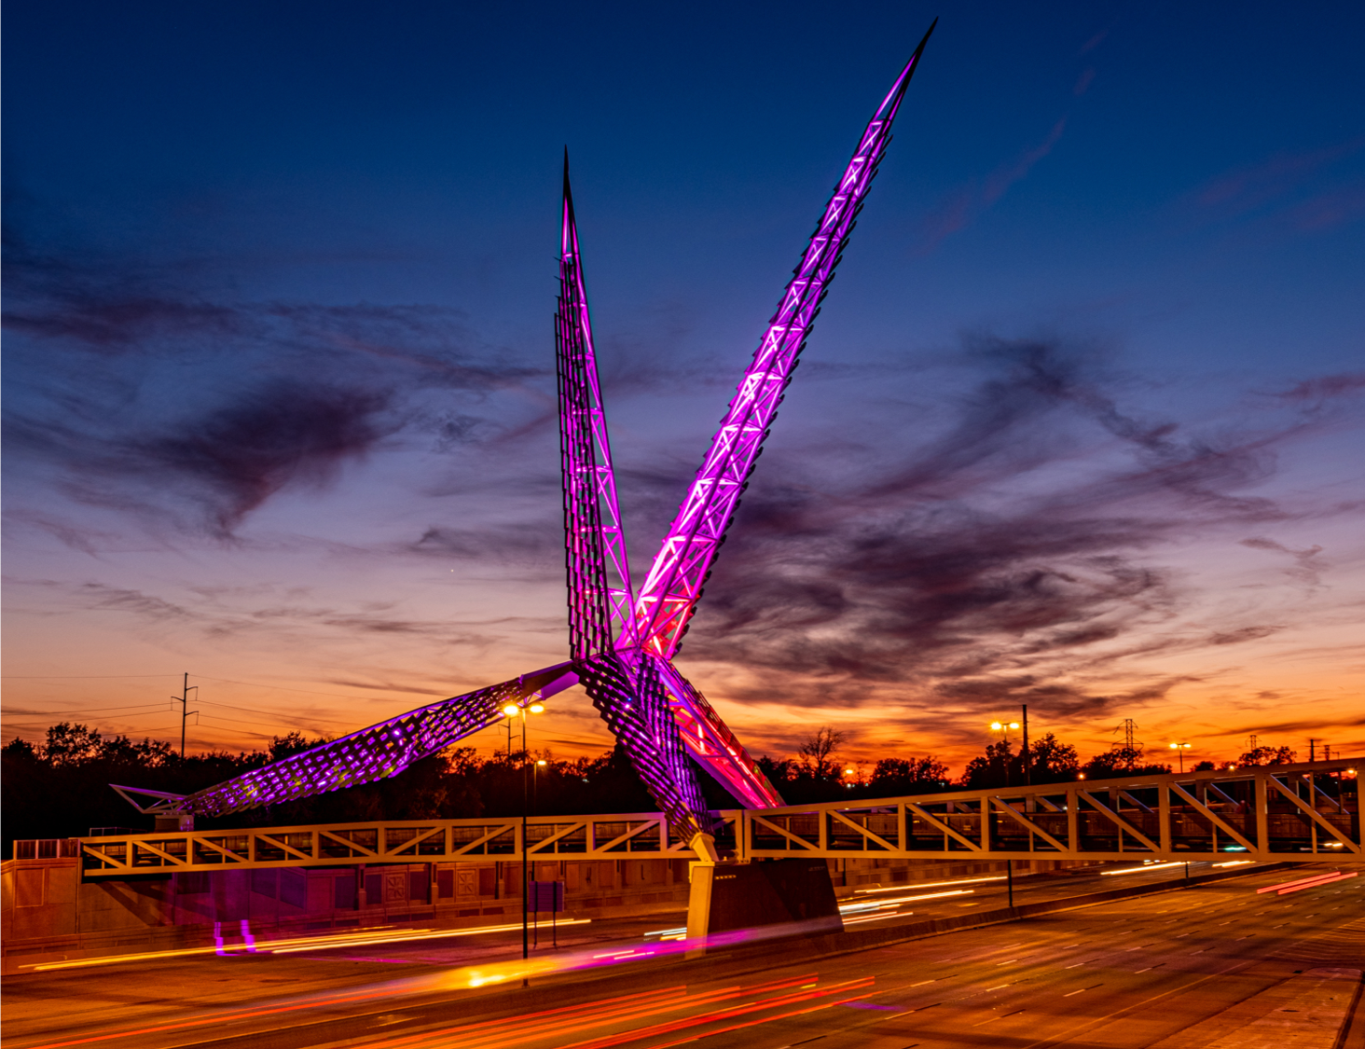
Meeting Agenda
Welcome and Introductions
Review and Approval of Minutes
PHHSBG Updates
Public Hearing –State Work Plan
Closing Remarks and Adjournment
Oklahoma State Department of Health | Preventive Health and Health Services Block Grant | June 2022

Slide 4
FFY 2021 PHHS Block Grant Updates
Budget and Funding transitioning to new financial system; still finalizing figures
All programs have money to spend based on figures available
Will meet with FFY 2021 programs over the next month to discuss budget spend down and ensure funds are spent by end of FFY 2021 funding cycle
FFY 2021 funding cycle ends September 30, 2022

Slide 5
Public Hearing – Oklahoma State Work Plan
Preventive Health and Health Services Block Grant Fiscal Year 2022 Approved Proposals
Fiscal Year 2022 Total Funding Allocation for Oklahoma - $1,445,519
The Preventive Health and Health Services (PHHS) Block Grant Program (Notice of Funding Opportunity OT19-1902) provides federal funds to 61 recipients across all 50 states, the District of Columbia, 2 American Indian tribes, 5 US territories, and 2 freely associated states. This program gives recipients the ability to address prioritized public health need within their jurisdiction. Recipients set their own goals and program objectives and implement local strategies to address national health priorities. CDC - Home Page - Preventive Health and Health Services Block Grant (PHHSBG) The Oklahoma State Department of Health is the recipient for Oklahoma. For the FFY 2022 PHHS Block Grant State Work Plan, 14 proposals have been approved based on recommendations from the PHHS Block Grant Advisory Committee and OSDH leadership.
Notes:
Refer to Approved Proposals document

Slide 6
Closing Remarks and Adjournment
Thank you!

