Slide 1
Call To Order
March 9, 2022

Slide 2
Roll Call

Slide 3
Preventive Health and Health Services
March 9, 2022
Advisory Committee Meeting

Slide 4
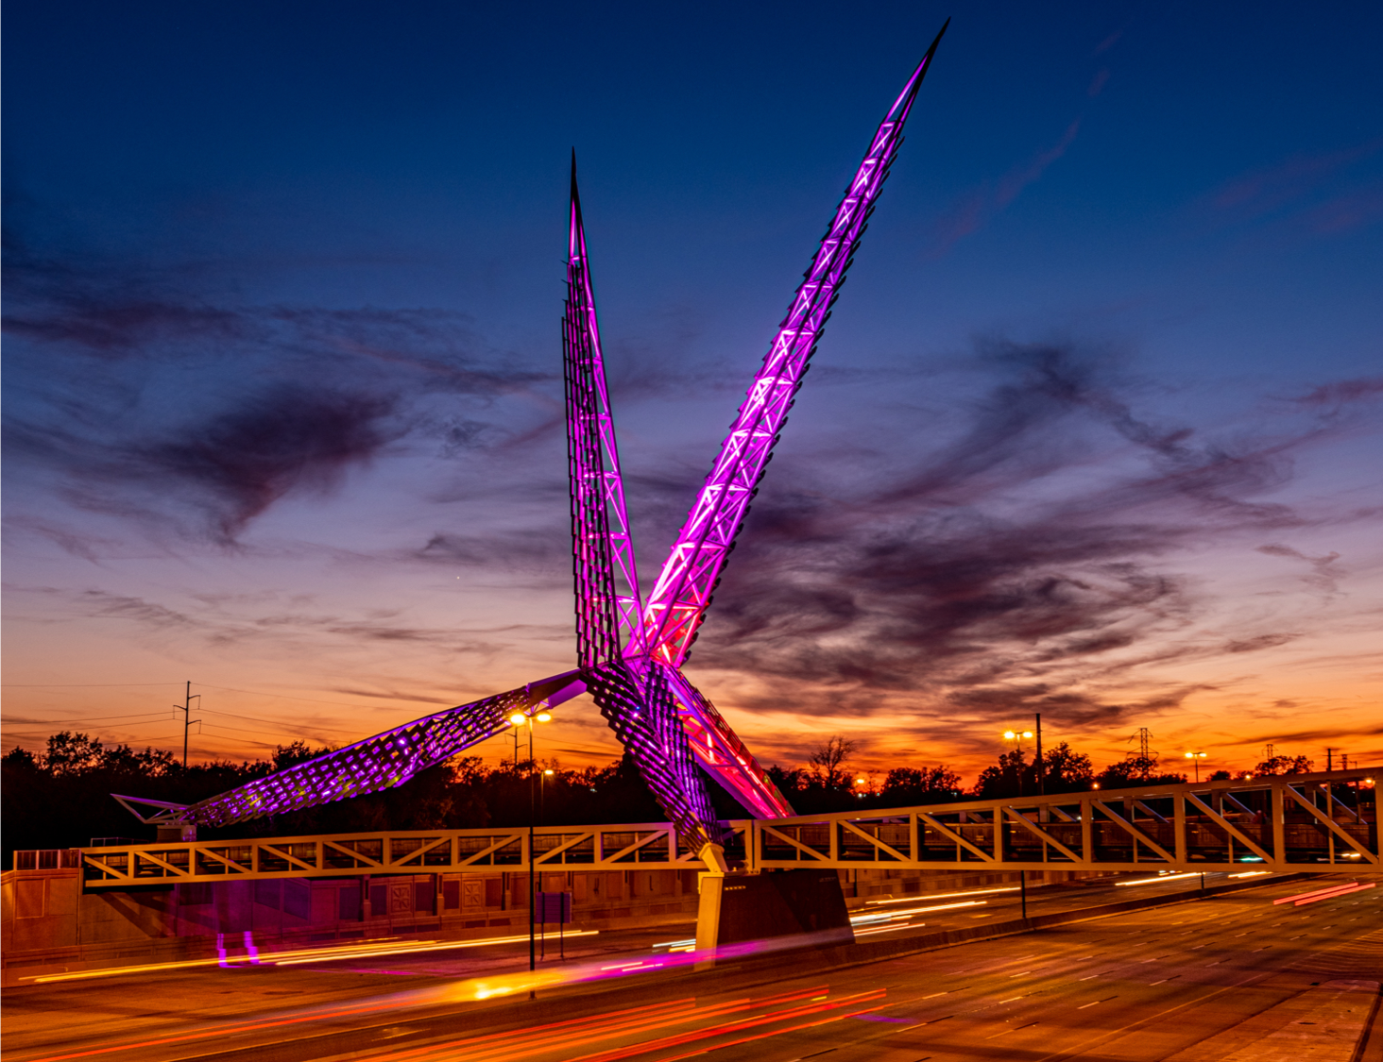
Meeting Agenda
Call to Order
Roll Call
Review and Approval of the June 2021 Meeting Minutes
Advisory Committee Updates
PHHSBG Updates
Program Presentations
Public Comment
Closing Remarks, Questions, and Adjournment
Oklahoma State Department of Health | Preventive Health and Health Services | March 9, 2022

Slide 5
Review and Approval of Minutes
June 08, 2021 Meeting Minutes

Slide 6
Advisory Committee Updates

Slide 7
PHHSBG Advisory Committee
COMMITTEE MEMBERS
Interim Chair - Mendy Spohn, MPH, Deputy Commissioner for Community Health Promotion and Protection, OSDH
Member - Michael Peercy, MPH, MT(ASCP)H, Epidemiologist and IRB Administrator, Chickasaw Nation Department of Health
Member - Kelly Baker, MPH, State Registrar of Vital Records, OSDH
Member - Melissa Blanton, JD, Assistant Attorney General; Chief, Victim Services Unit Chief, Office of the Attorney General
Member - Dr. David Gahn, MD, MPH, FACOG, Medical Director, Cherokee Nation Public Health
Member - Jan Fox, RN, MPH, Deputy Commissioner Health Preparedness, OSHD
Member - Cara Gluck, MPH, Chief, Community Health Services, OCCHD

Slide 8
Advisory Committee Updates
Nominations and/or appointments for a New Chair
Discussion for New Advisory Committee Members
Oklahoma State Department of Health | Preventive Health and Health Services | March 9, 2022

Slide 9
PHHSBG Updates

Slide 10
PHHSBG Updates
Budget Revision Request
Proposal for Salary Change for the QI position
Vote on Proposed Budget Revision
Review and Approval of FY22 Application
Key Dates to Remember
May 11, 2022
June 15, 2022
December 14, 2022
Process Timeline
Oklahoma State Department of Health | Preventive Health and Health Services | March 9, 2022
Notes:
Diane - The first update is regarding a proposal to revise a program budget.
Please welcome Buffy Heater. - Call Buffy on the phone
She is here to provide information on the proposal for the Budget Revision Request.
(MENDY) Once Buffy is finished, AC members to Vote on Proposal
Diane - Let’s change gears and talk about the FY22 Block Grant Application.
Review Application - The link for the application will open once it has been approved by the Advisory Committee; programs will receive notification with their application details once they submit. When the AC approves in May, I’ll go in and approve/deny the applications and they will receive another email notifying them they were either approved or denied.
(MENDY) Approve Application
Diane - Key dates to remember. These are the upcoming Advisory Committee meeting dates.
Calendar holds have been sent for the May and June meetings. A calendar invite for December will be sent later this summer.
The next slide is an overview of the process timeline that we will tentatively follow regarding the submission of the FY22 PHHS Block Grant Work Plan.

Slide 11
PHHSBG Process Timeline
BG Coordinator sends out Notice of Funding Opportunity
& Proposal Questionnaire through Communications and share link on Health Hub.
March 10th
Advisory Committee enters executive session
at May meeting to reach consensus on funding recommendations
May 11th
FY22 Work Plan Submission to CDC Deadline July 1st, 2022
FY 2022 Work
Plan reviewed at
Public Hearing of Advisory Committee / Discuss FY21 remaining funds
June 15th
BG Coordinator performs initial review and completes Scorecard Cover Sheet for Advisory Members
April 7th – April 8th
Notify Programs Approved for Funding
May 13th
BG Coordinator prepares FY 2022 Work Plan, Budget Justification, and other administrative forms
May 30th – June 3rd
Potential Applicants complete & submit Proposal Questionnaire March 10th – April 7th
Advisory Committee Reviews Applications
April 11th – May 6th
Meet with Budget Staff and F/U with Programs, if necessary to finalize FY22 Work Plan
June 16th – June 22nd
Programs selected for funding initiate drafts of FY 2022 Work Plans
May 13th - May 27th
Meet with Budget Staff and FY21 Programs to discuss money remaining for FY21
June 6th – June 7th
Meet with Budget Staff to discuss FY22 Allocation and FY22 Requested Amounts
May 12th
PHHSBG Advisory Committee
Approves FY22 Application
March 9th
Oklahoma State Department of Health | Preventive Health and Health Services | March 9, 2022

Slide 12
FY21 PHHSBG Program Presentations

Slide 13
FY21 PHHSBG Program Presentations
Today’s Program Presentations
Sexual Violence Prevention – Michelle Stansel
Falls Prevention – Madelyn Maxwell
Future Program Presentations
May 2022
Statewide Condom Distribution
Advancing Health Equity and Strengthening Minority Health
June 2022
Health Communications in Oklahoma
Oklahoma State Department of Health | Preventive Health and Health Services | March 9, 2022

Slide 14
Public Comment
Oklahoma State Department of Health | Preventive Health and Health Services | March 9, 2022

Slide 15
Closing Remarks, Questions, and Adjournment
Thank you!

