Slide 1
Prevention Work in Rural Oklahoma: Two Block Grant Stories
Michelle Stansel, MEd.
Rape Prevention Coordinator
Injury Prevention Services

Slide 2
Objectives:
At the end of this presentation participants will be able to:
Recognize CDC changes to Rape Prevention Education and how those changes affect the scope of the work the grantees do
Describe challenges and successes that the grantees have experienced
Demonstrate opportunities the grantees have had to implement community level work
Discuss the overall impact of how the block grant contributes to rape prevention education efforts

Slide 3
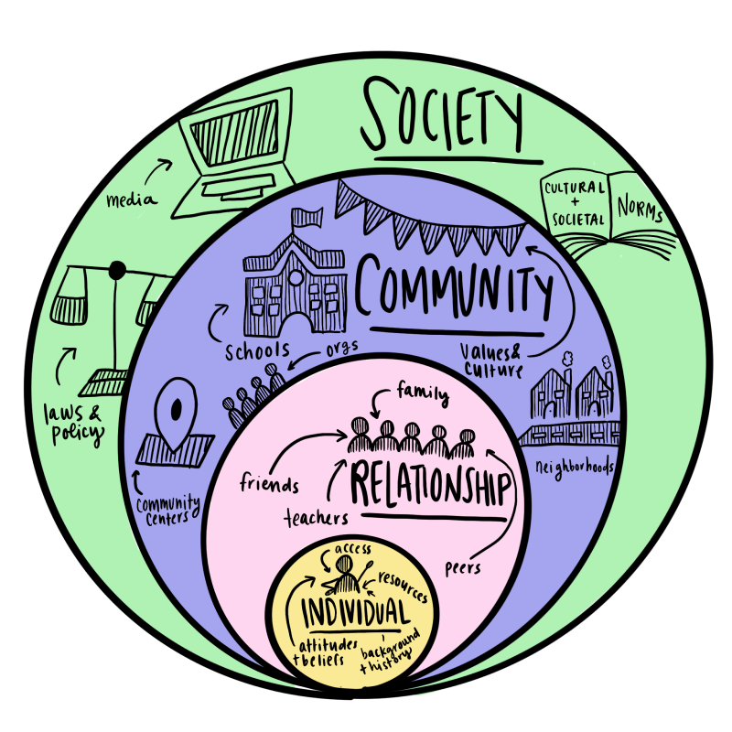
CDC Changes to RPE:
Focus is on the deeper level root causes of sexual violence in society, which include:
Oppression- Racism, sexism, classism, heterosexism, ageism, ableism
Who it impacts:
Everyone, but especially marginalized communities.
People of color, people living in poverty, those is the LBGTQIA+ community, elders, people with disabilities and other diverse persons are affected by sexual violence in unique and devastating ways.
What does this change mean for the scope of work?
Moving from in class presentations about consent, bodily autonomy, healthy relationships etc. to more active engagement with the community.
(Ex) Climate surveys, needs assessments, community readiness, developing task forces, creating youth leadership opportunities
Notes:
Shift from individual level work to community level work
Oppression in all of its forms is among the root causes of sexual violence. Sexual violence is preventable through collaborations of community members at multiple levels of society—in our homes, neighborhoods, schools, faith settings, workplaces, and other settings. We all play a role in preventing sexual violence and establishing norms of respect, safety, equality, and helping others.
Sexual violence does not occur in isolation. Victims of sexual violence are affected by many forms of oppression
Oppression is both a cause and effect of sexual violence.
Sexual violence is tied to inequality. People who commit sexual violence may target people who may have less power in the world. This can make it hard for a person to report sexual assault or get help.

Slide 4
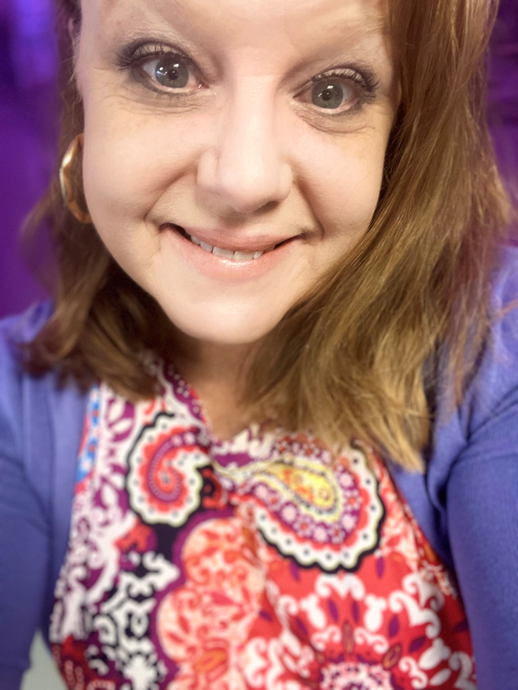
Community Crisis Center (CCC):
(Areas served: Mayes, Delaware, Rogers Counties in Miami- NE Oklahoma)
Beth Anderson, RPE
Pronouns (She, her)
Sexual Violence Prevention Coordinator
office: (918) 540-2275
email: Beth@getmeout.org
"Whether its empowering individuals and families, collaborating with community partners, or providing public awareness on Sexual Violence, our collective efforts can lead to a safer, healthier and more equitable future. Together we can end violence."
Notes:
Beth Anderson came to the Community Crisis Center as RPE April of 2018. She has a background in education, office administration and independent business.
Beth is a longtime resident of Miami, OK and raised her family in rural Miami. She knows firsthand of the need for meaningful SVP through her personal lived experiences.

Slide 5

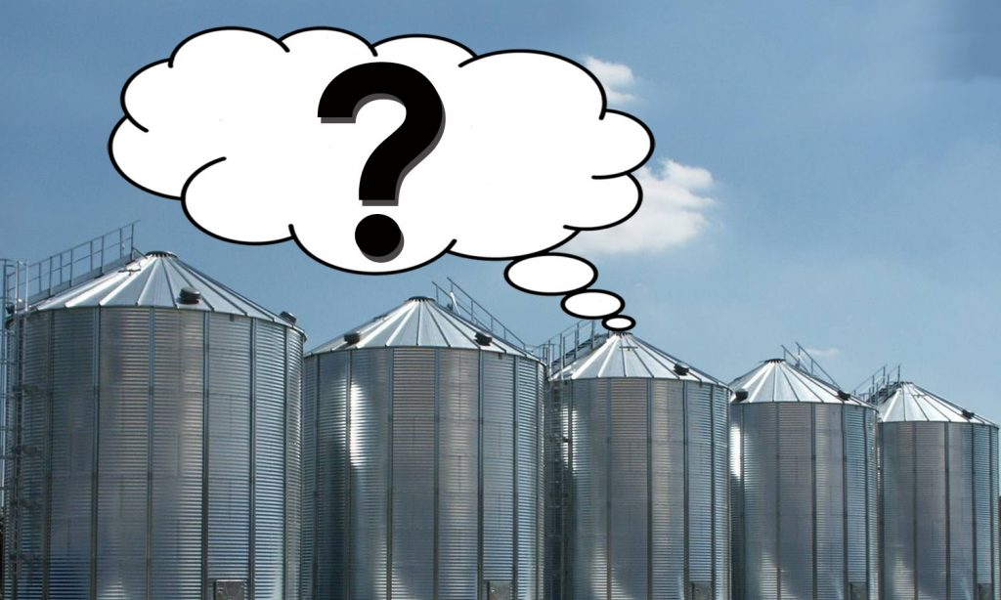
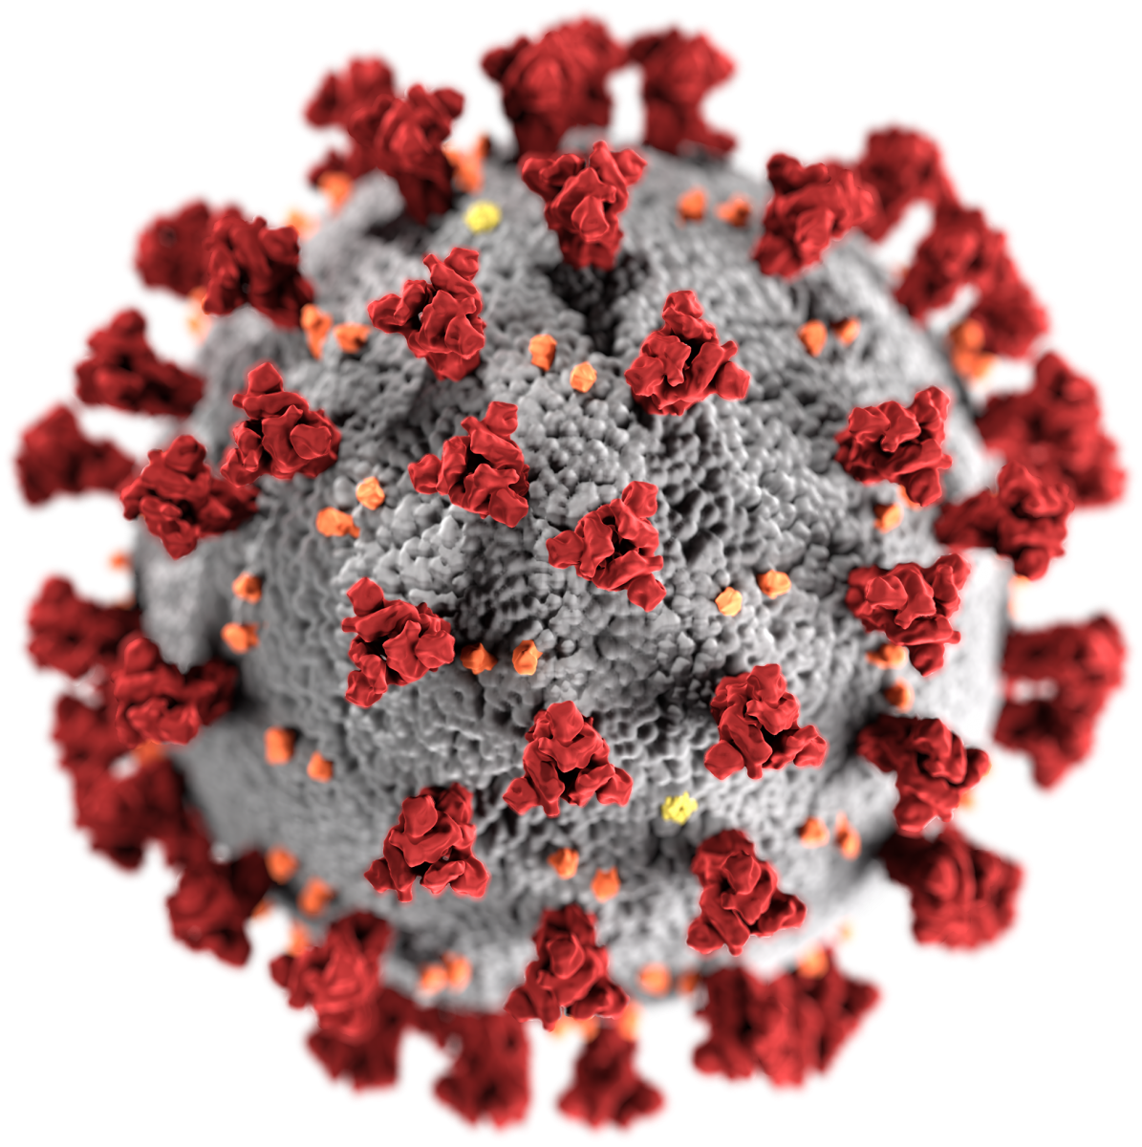

Challenges:
Notes:
Rural silos
Relationship building during COVID
Turnover with partners and within agency
Spread out
Very closed off rural areas (not wanting to have these conversations)
Recent well known sexual assault case involving a teen – In fact, her agency had a protest happening outside her office involving this case. We might be seeing more people reach out to Beth, b/c unfortunately it takes something really bad to happen, before people are ready and wanting to make change.

Slide 6




Successes:
Notes:
Increasing agency capacity and internal understanding of community level prevention – CDC has changed what they want us to focus on, a lot of unpacking for CCC and the rest of the RPE Team
Increased communication between agency and state RPE Team
Policy review internally – opportunity came up
Length of program continuity – 5+ years
RPE subcontractor needs to be cooperative, collaborative and creative in order to do community level work

Slide 7

Opportunities for Community Level Work:
Notes:
NEO and CCC are partnering more than they ever have before. They will now have a CCC Advocate on campus 1x/month
RA Training to start and goal is to do prevention work more campus wide (faculty, staff, PD)
Next steps- Campus Climate Survey, creating and implementing a successful committee/taskforce, creating a youth advisory

Slide 8
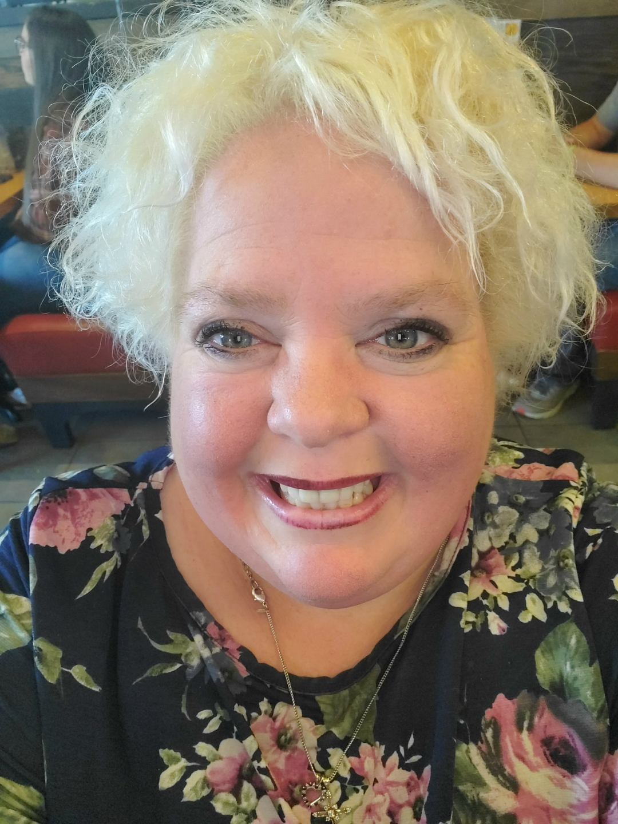
Leflore Crisis County Services (LCCS):
(Areas served: Leflore, Poteau and Talihina- Poteau, OK. Borders Arkansas)
Crissy D Keeton M.A.
Community Educator & Coordinator
Rape Prevention & Education Specialist
Leflore County Crisis Services | 918-658-5665
“Prevention work is important to me personally, because I come from a place where prevention knowledge would have been helpful, now that I have the opportunity to be an educator and help the community know and understand how we all can be the change, and use our voices to help prevent rape. I want to be a change agent in perspective and openness in my communities and pave a path as a pioneer to prevention.”
Notes:
t is about 12 miles (19 km) west of the Oklahoma-Arkansas border.[9]

Slide 9



Successes:
Notes:
She is a pastor in her community- strong faith-based ties
Built connections to the faith based community (Covenant- Recovery & Church of Nazarene- Upward Sports & First Baptist) – Drug recovery, court ordered (drug & alcohol) open to the public, losing a spouse, depression
Upward- 4 years old through 12 years old, coaches are caregivers/parents, 180 kids (Wants to get in and talk to the coaches) CBIM supplemented w/additional programming
Built relationship with Chamber of Commerce- Was asked to speak with the board in January (Empower Project in Poteau- faith community & school system) – (Previously, Project SAFE in Talihina) – Empower Project is still being developed.

Slide 10
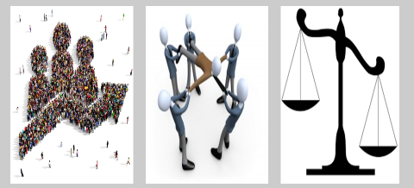
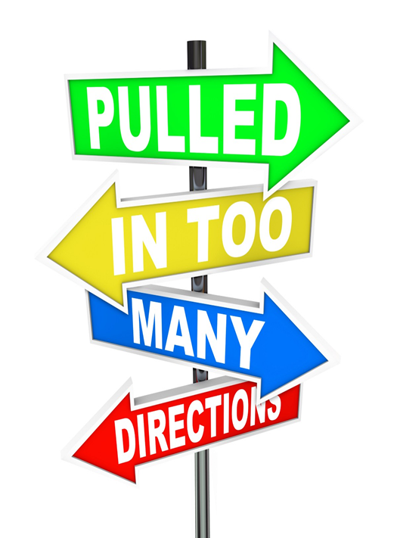
Challenges:
Notes:
Prevention in a rural area
Relationships
Good ole boy system
Don’t want to talk about things
Strong family ties and privacy *(huge issue: keep it within the family) – Easy to do, b/c it is so rural and very few if any opportunities to seek help or talk to someone else – This can lead to gaslighting/feelings of anger
Additional Challenges
Can take an hour drive to get to any major resources like groceries, healthcare etc.
It’s a food desert
Internet access is sparse – That poses challenges for virtual Zoom meetings
Understanding what Prevention is both internally within the agencies and externally in the communities (Intervention/direct services is what a lot of people know and what people know as prevention is not actually prevention it’s awareness)
Picture 1- is being stretched too thin and just one person. The Prevention Specialist (not just w/LCCS) but they often want to do all the things asked of them, but they can’t push themselves to burnout
Picture 2 -Unequal services and funding. A lot of money and resources go to Intervention and direct services, which is absolutely needed AND it can also be true that Prevention is a massive part of the solution to preventing the issues from happening in the first place.

Slide 11

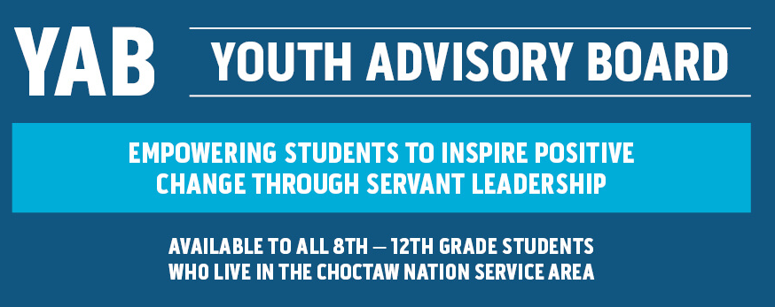
Opportunities for community level work:
Notes:
New contractor in position (October 2021)- attempting to build her capacity to do work in community
Choctaw Nation- YAB
Faith based communities- Possibly created a coalition b/n 3 major churches to then work with their congregation. Plans to administer a needs assessment the caregivers/parents and kids on healthy relationship. Will be working evaluator. Next steps could be to develop a Healthy Relationship Youth Leadership Group. (Strong faith ties = connectedness, which can be a huge protective factors, sadly in the church it can be a risk factor if there isn’t education, awareness and prevention efforts discussed w/n the church.)
Work in progress- Choctaw Nation- DV prevention- That advocate has invited the Prevention Educator to come to local colleges and tech schools – Forming coalitions with those college student (youth leadership development) evaluation/assessment and having them look at policy
YAB- Get to know them and go from there. Possibly, pick their brains to help her shape a youth advisory for her agency

Slide 12
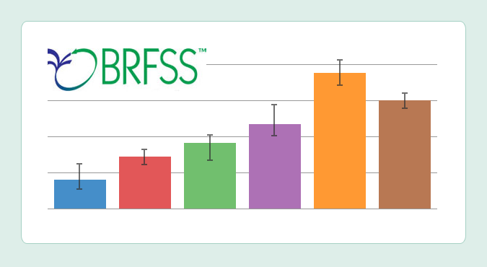
Impact of how the Block Grant Contributes to RPE efforts:
RPE is a formula grant, which means funds are limited
The Block grant allows us to expand work into rural communities
If we did not have the Block Grant, we would not be able to do the work that is very needed in these areas
The Block grant also helps use know the depth of the problems here in Oklahoma through the Behavioral Risk Factor Surveillance System (BRFSS) Data.
Notes:
BRFSS includes intervention and prevention

Slide 13





Questions?
Michelle Stansel, MEd.
Oklahoma State Department of Health
Injury Prevention Service
(405) 426-8440
michellexs@health.ok.gov
www.osdh.gov

