Slide 1
Preventive Health and Health Services Block Grant (PHHSBG)
Special Advisory Committee Meeting
2:00 pm, May 25, 2022

Slide 2
PHHSBG Advisory Committee
COMMITTEE MEMBERS
Chair – Danielle Durkee, Deputy Chief Financial Officer, OSDH
Member - Michael Peercy, MPH, MT(ASCP)H, Epidemiologist and IRB Administrator, Chickasaw Nation Department of Health
Member – Cara Gluck, MPH, Chief Public Health Strategist – Community Health Administration, OCCHD
Member - Melissa Blanton, JD, Assistant Attorney General; Chief, Victim Services Unit Chief, Office of the Attorney General
Member - Dr. David Gahn, MD, MPH, FACOG, Medical Director, Cherokee Nation Public Health
Member – Floritta Pope, MSM, Director of Offices of Minority Health and Health Equity, OSDH
Member – Halley Reeves, MPH, MCP, Lecturer, Hudson College of Public Health, OUHSC
Member – Raffaella Espinoza, MPH, Analytics and Dissemination Administrative Program Manager, OSDH
Member – Theodore Noel, President/CEO of Guiding Right, Inc.
Member – Dr. Tracy Wendling, DrPH, Director of Injury Prevention Service, OSDH

Slide 3
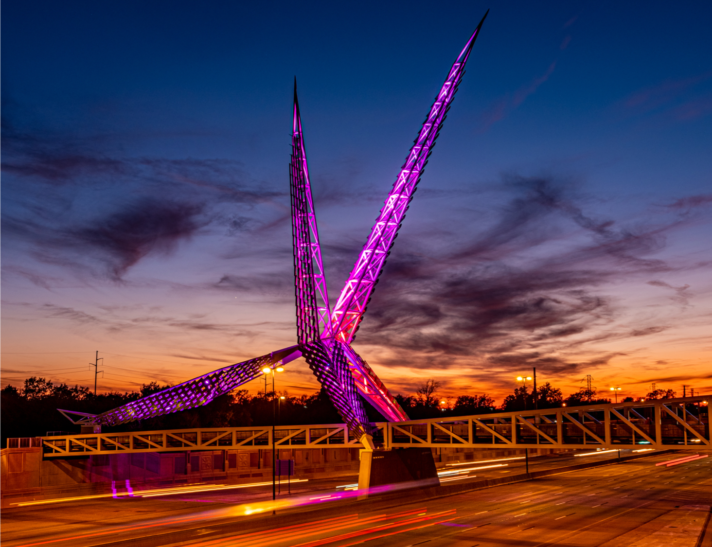
Meeting Agenda
Call to Order, Welcome, and Introductions
Review and Approval of Minutes
PHHSBG Update – Work Plan Revision Request
PHHSBG Update – FFY 2022 Funding Allocation
FFY 2022 PHHSBG Funding
Adjournment
Oklahoma State Department of Health | Preventive Health and Health Services Block Grant | May 2022

Slide 4
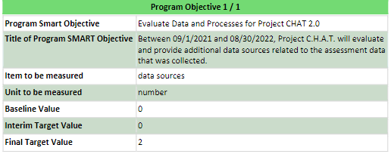
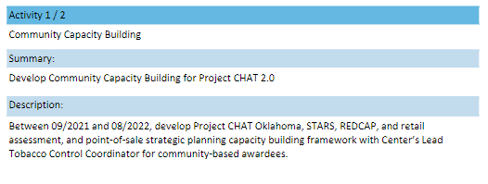
FFY 2021 PHHSBG Work Plan Revision Request
Sub-recipient, Project CHAT, would like to use funds available ($67,353) to work with Saxum
Support and enhance the launch of the OSDH validate website by promoting it to key target audiences (retailers)
Goal is to raise awareness that a new website exists and drive traffic to it.
Current activity description for community capacity building is complete so this proposal will add an additional activity within this Program SMART Objective

Slide 5
FFY 2021 PHHSBG Work Plan Revision Request
Paid Media Services*
● Media Strategy & Planning
○ Research
○ Media mix strategy and recommendations
○ Audience and targeting strategy and recommendations
○ Channel and platform strategy and recommendations
○ Media measurement, tracking, media KPIs
○ Reporting cadence
○ Final gross media budget recommendations
○ Timeline, milestones and Flowcharts
○ Walkthrough and finalization
● Campaign Management - Delivery Fee Subscription Terms TBD (Client will be assigned a Media Delivery
Fee Tier based on the projected average monthly gross media spend at the start of the contract period or
the total length of the contract period (whichever tier is lowest).
○ Flowchart Maintenance
○ Buying (RFPs, Avails, I/Os)
○ Trafficking
○ Ad operations
○ Monitoring
○ Optimization
○ Working media delivery (gross)
● Media Performance
○ Reconciliation
○ Reporting
○ Insights

Slide 6
PHHSBG FFY 2022 Funding Allocation
FFY 2021 Allocation Breakdown
FFY 2022 Allocation Breakdown
Budget Detail for Oklahoma – Federal Fiscal Year 2021
A. FFY 2021 Award | $1,437,401
Annual Basic Allocation | $1,353,524
Sex Offense Allocation | $83,877
Budget Detail for Oklahoma – Federal Fiscal Year 2022
A. FFY 2022 Award | $1,445,519
Annual Basic Allocation | $1,362,863
Sex Offense Allocation | $82,656

Slide 7
FFY 2022 PHHSBG Funding
26 proposal requests submitted for FFY 2022
Previously Funded: 12
New Requests: 14
$4,510,567.85 in Total Requests
Proposal Title | Past Recipient
Sexual Assault Prevention & Surveillance | Yes
Drug Overdose Prevention Program | Yes
Prescription Drug Monitoring Program Training and Education | Yes
Healthy Aging and Falls Prevention Program | Yes
Child Passenger Safety Program | Yes
Partner Inflicted Brain Injury | No
Congenital Syphilis Identification Initiative – Clinical Services | No
Fluoride Varnish Outreach Project | No
Statewide Condom Distribution Program | Yes
Navigating Pregnancy | No
Northeastern Oklahoma CATCH Coordinated School Health | No
Oklahoma Youth Sports Coalition | No
OSDH LiveWell: Employee Wellness | No
Certified Healthy Communities and Early Childhood Programs Consultation | Yes
Certified Healthy Business Outcome Evaluation Project | No
State BMI Registry | No
Obesity in the State of Oklahoma | No
OSDH Pediatric Audiology Program | No
Birth Partners | Yes
Infant and Early Childhood Mental Health Consultation (1-ECMHC) Program Expansion | No
Advancing Health Equity and Strengthening Minority Health | Yes
Diabetes and Heart Disease (Pharmacy Focused Practice Transformation) | No
Region 5 Mobile Clinics and SWOSU MTM Program (Community Pharmacist Targeted Medication Review for Patients with Chronic Conditions) | No
Comprehensive Quality Improvement Initiative | Yes
Prevent Block (Human Resources) | Yes
Personnel, partial - Community Relations Manager (Office of Communications) | Yes

Slide 8
FFY 2022 PHHSBG Funding
Things to remember when reviewing the proposal requests:
Evaluate based on criteria including Population Reach, Address Health Disparities, SMART Objective, Budget, Evaluation, application answered completely and correctly
SMART Objective Example: Between 10/2019 and 06/2020, (time-bound), program staff will provide reading curriculum and resources to 5 schools in the central region (measurable & achievable) in order to increase jurisdiction-level health literacy levels by 10%. (specific & relevant).
Does the request address at least one of the following areas?
Address emerging health issues and gaps in Oklahoma
Decrease premature death and disabilities by focusing on the leading preventable risk factors
Work to achieve health equity and eliminate health disparities by addressing the social determinants of health
Support local programs to achieve healthy communities
Establish data and surveillance systems to monitor the health status of targeted populations
Mandatory - Does it Align with a Healthy People 2030 objective?
Example: Increase the proportion of adult heart attack survivors who are referred to a rehabilitation program — HDS‑D03

Slide 9
FFY 2022 PHHSBG Funding
Things to remember when reviewing budget requests:
(b) Prohibited uses of PHHSBG Funding
A State may not use amounts paid to it under section 300w-2 of this title to –
provide inpatient services,
make cash payments to intended recipients of health services,
purchase or improve land, purchase, construct, or permanently improve (other than minor remodeling) any building or other facility, or purchase major medical equipment,
satisfy any requirement for the expenditure of non-Federal funds as a condition for the receipt of Federal funds, or
provide financial assistance to any entity other than a public or nonprofit private entity.
(d) Limitation on administrative costs Of the amount paid to any State under section 300w-2 of this title, not more than 10 percent paid from each of its allotments under subsections (a) and (b) of section 300w-1 of this title may be used for administering the funds made available under section 300w-2 of this title. The State will pay from non-Federal sources the remaining costs of administering such funds.
Q: If subrecipients are awarded PHHS Block Grant funds and they use a portion of the funds for personnel, is the IDC from the funded personnel included in the ‘no more than 10% of administrative costs’?
A: Regulations flow down from the prime to the sub, yes, the 10% applies.

Slide 10
Dates to Remember
June 15, 2022
PHHSBG Advisory Committee Meeting/Public Hearing to present approved State Work Plan
July 1, 2022
State Work Plan due to CDC
December 14, 2022
PHHSBG Advisory Committee Meeting

Slide 11
Adjournment
Thank You!

