Slide 1
Preventive Health and Health Services (PHHS) Block Grant
Advisory Committee Meeting
Public Hearing
2:00 pm, March 8, 2023

Slide 2
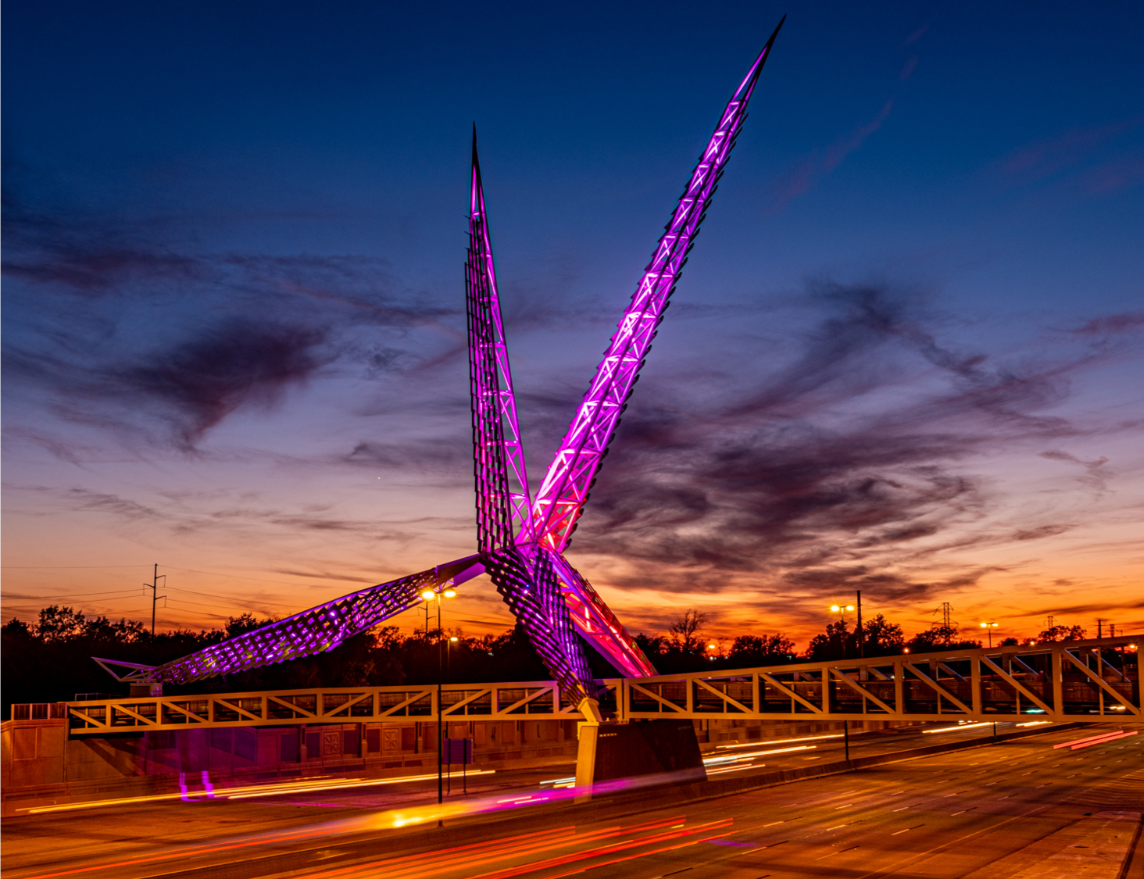
Meeting Agenda
Call to Order, Welcome and Introductions
Review and Approve of Minutes
FY22 PHHSBG Updates
FY23 Proposal Request Discussion and Recommendations
2023 Advisory Committee Dates
Closing Remarks and Adjournment
Oklahoma State Department of Health | Preventive Health and Health Services Block Grant | 2023

Slide 3
Review and Approval of Meeting Minutes

Slide 4
FY 2022 Work Plan Updates
Successes, Revisions and Spend Down

Slide 5
FY 2022 PHHS Block Grant Work Plan Updates
Work Plan Updates
  Successes
  Revision Requests
  Spend Down

Slide 6
FY 2022 Successes
  Successes
    Child Passenger Safety Program - A total of 134 car seats were distributed last month
    Healthy Aging and Falls Prevention - Setting a training date for new Matter of Balance (MOB) trainers. A MOB class also started in Lincoln County with good participation from the older adults in the community.
    Fluoride Outreach - They helped OKMOM – a free dental clinic held annually. Thousands of Oklahomans received free dental care, including hundreds of children. 10 boxes of Fluoride Varnish were distributed

Slide 7
FY 2022 Successes
  Successes
    Pediatric Audiology Program obtained two new partners – Able Tech and School for the Blind
    Birth Partners continues to see an increase in attendance at childbirth education classes and 4 new doula enrollees
    CATCH trained all PE teachers in district 4 on CATCH
    New Programs - Nurse Education Training and Expanded CATCH Program in District 7

Slide 8
FY 2022 Work Plan and Budget Revision Requests
  Program Name: District 4 Community Health Promotion and Education Awareness
Healthy People 2030 Objective: Increase the number of state health departments that use social marketing in health promotion programs — HC/HIT‑D01
Activities to be conducted:
  Purchasing of Educational materials (brochures, flyers, banners)
  Materials will be utilized at health fairs, coalition meetings, job fairs, within the health department, at schools, and at community centers.
  Program staff, health educators, and community health workers will ensure that materials are disseminated appropriately to community members.
  Areas of target include rural schools (teen health brochures, audiology brochures, child guidance brochures), universities (teen health brochures), daycares (audiology and child guidance brochures), and churches (all)
  Distribution will be tracked via Smartsheet, and number of individuals calculated

Slide 9
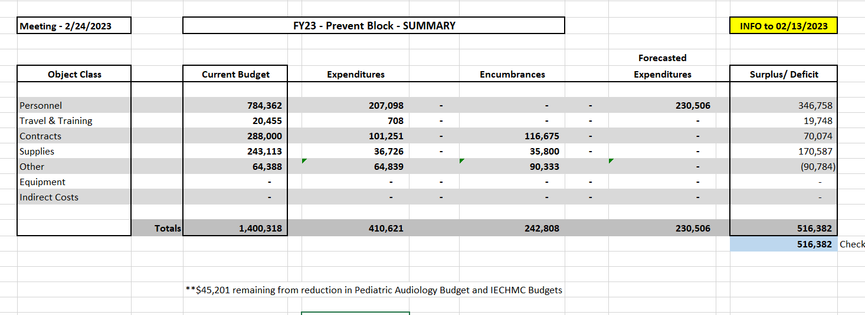
FY 2022 Budget Summary

Slide 10
FY23 Proposal Requests

Slide 11
State and Tribal Public Health Learning Collaborative
Funding Amount Requested: $37,662.70
New Program
HP2030 Goal: Community, Public Health Infrastructure - Explore the impact of community health assessment and improvement planning efforts
Establish a tribal/state platform for collaboration around public health priorities to identify common priorities. This will help align and allocate resources, plan strategic interventions, avoid duplicative efforts in tribal jurisdictions, and bring tribal partners to the table in implementing statewide strategies.
  Recruit four tribes and one tribal-serving entity. The recruitment process will be flexible (first come, first serve, or competitive) until all opportunities are filled
  complete five (5) tribal listening sessions to establish shared priorities, identify potential collaborative projects and present a road map for further collaboration
  The program will use surveys to gather collaboration ideas and will be used to identify priority needs among the collaborative.
  Findings from surveys and listening sessions will be presented at the Tribal Public Health Conference and used to develop a future roadmap of priorities and strategies.

Slide 12
Advancing Health Equity and Strengthening Minority Health 1 & 2
Funding Amount Requested: $196,504.42
Role of Funding; To enhance or expand the program
HP2030 Goal: Reduce the proportion of people who can’t get medical care when they need it.
2 Main Objectives
  Capacity Building services via training and staff development on minority health and health equity to improve access to healthcare for minority or underserved populations
    Mini Grants: Mobilize community members, outreach, promotional materials, community events, media campaign, translation services, etc.
  Interpretation and document translation
    Provide training for culturally and linguistically appropriate policies and practices

Slide 13
Addressing Chronic Disease Prevalence Using a Multidisciplinary Team
Funding Amount Requested: $5,690
Role of Funding; Start up of a new program
HP2030 Goal: Increase control of high blood pressure in adults
District 5 - Greer and Kiowa County are piloting this project with the mobile unit as the patient access point into the project. The protocol received IRB approval.
  Both these areas are primarily rural areas and are designated health professional shortage areas.
Provide additional resources to patients affected by these conditions through provision of education, development of goals and referrals to community programs, will assist them in learning skills necessary to better manage their health status.
This program relates to the agency mission of protecting and promoting health, preventing disease and injury, and cultivating conditions by which Oklahomans can thrive. It also relates to the agency vision of leading Oklahomans to prosperity through health.

Slide 14
STI At-Home Testing Program Pilot
Funding Amount Requested: $199,909.00
Role of Funding; Start up of a new program
HP2030 Goal: Increase knowledge of HIV status, Increase the proportion of sexually active female adolescents and young women who get screened for chlamydia
Promotes health by ensuring individuals know their STI status, Prevents disease by actively following up on positive tests results, treating, and intervening in the spread of infection, and Cultivates conditions by which Oklahomans can thrive by educating and empowering individuals to know their status.
Six-month pilot which would include three county health departments, one tribal facility, two SHHRS contracted community-based organizations, and Sexual Health and Harm Reduction Service (SHHRS) prevention program to increase access to STI testing in Oklahoma residents.

Slide 15
Health Literacy for ESL
Funding Amount Requested: $5,000.00
Role of Funding; Start up of a new program
HP2030 Goal: Increase the proportion of adults with limited English proficiency who say their providers explain things clearly
Program will bridge the gap of those who have English as a second language providing them with a fair opportunity to be able to communicate with their health care providers which is teaching them medical and health terminology.
By June 30, 2024, two contract employees will provide and promote four sessions of Health Literacy for ESL classes that consist of 15 lessons to those who speak Spanish and Marshallese. Both Spanish and Marshallese classes to be offered by the Fall of 2023 and Spring of 2024. Classes will improve the capability to interact in different health-related environments.

Slide 16
Obesity in the state of Oklahoma Community Analysis and Linkages
Funding Amount Requested: $90,000
Role of Funding; Start up of a new program
HP2030 Goal: Reduce overweight and obesity by helping people eat healthily and get physically active.
The goal of the state obesity plan is the statewide reduction of obesity rates in adults by 1% and the reduction in statewide obesity rates in children by 3% by 2026. This will be done by targeting disparate populations and communities that are marginalized. Specifically, the development and execution of a communication plan will increase awareness of statewide efforts undertaken by stakeholders, increase enrollment in SoonerCare in the aforementioned populations and increase utilization of resources in the treatment and prevention of obesity.
This project aligns with the mission to protect and promote health, prevent disease and injury, and cultivate conditions by which Oklahomans can thrive. By addressing inequity hotspots this program will address obesity and weight stigma to improve the health of all Oklahomans. By utilizing respectful messaging in collaboration with the Communications team we lean into the values of the Oklahoma State Department of Health.

Slide 17
Go NAPSACC Statewide Implementation
Funding Amount Requested: $79,260.00
Role of Funding; Enhance or expand the program
HP2030 Goal: Reduce the proportion of children and adolescents with obesity
The Oklahoma State Department of Health (OSDH) has adopted the Go Nutrition and Physical Activity Self-Assessment for Child Care (Go NAPSACC) online toolkit in efforts to enhance nutrition and physical activity practices in early care and education (ECE) programs in Oklahoma. The platform will provide assistance to childcare providers to improve the health of young children through education, practices, policies, and environments that support healthy eating, physical activity, and oral health.
OSDH will recruit other stakeholders to become GO NAPSACC consultants to increase the reach of in-depth consultation to early childcare providers to implement evidence-based strategies to increase physical activity and nutrition in their environments.

Slide 18
Creating Healthy Environments in Schools
Amount Requested: $157,975.00
Role of Funding; Enhance or expand the program
  Project funded by the CDC for the last 10 years - agency no long has that funding to carry on the work.
HP2030 Goal: Reduce the proportion of children and adolescents with obesity
By 2028 at least 25 schools (5 per year) will receive technical assistance and consultation to implement healthy policy, systems and environments based on results from the School Health Index and Wellness Policy in Action Tool.
  1) Continue state-level health and education partner co-action to support dissemination of best practices, professional development standards, and inclusion of health and wellness as a priority for state and local programs and grants such as Title IV;
  2) Continue to increase access to evidence-based school health services, which have been found to give students care when they need it, keeping them in school and out of more costly care settings;
  3) Integrate school health practices, programs, and policies into education accountability measures (for example, using health data to inform School Improvement Plans and updating the school accountability measures for health and wellness) while specifically addressing chronic health conditions;
  4) Continue to enhance the collection of health and wellness data in schools through health assessments and measures;
  5) Ongoing evaluation for monitoring progress made towards promoting and reinforcing healthy behaviors among students and staff.

Slide 19
District 3 Communication and Health Literacy Project
Funding Amount Requested: $199,959.13
Role of Funding; Enhance or expand the program
  staffing allocations will be negatively impacted and cannot be sustained
HP2030 Goal: Increase the health literacy of the population.
Develop a 3-5 year strategic plan with a central theme and focus on resilience, trauma informed practices, and enhancing equitable access for all to our health care services.
Develop and disseminate health and safety information that is accurate, accessible, and suited appropriately to various audience needs across the district.
Support and expand local efforts to provide adult health education including culturally and linguistically appropriate health information services in the community.
Mobilize partners and collaborators to advance health equity and address social determinants of health as they relate to health literacy among populations at higher risk and that are underserved
Develop a training program for District 3 staff focused on being a trauma informed, health literate workplace aware of the health disparities and factors impacting health equity in the communities and populations served.

Slide 20
Office of Primary Care, Health Workforce Development
Funding Amount Requested: $161,480.00
Role of Funding; Enhance or expand the program
HP2030 Goal: Health Care Access and Quality, Reduce the proportion of people who can't get medical care when they need it
Increase the number of primary care clinicians accessible to underserved populations,
  Perform process improvement interventions to enhance the procedures for the J1 Visa Program to maximize automation and communication with applicants by December 31, 2023.
  Perform process improvement interventions to enhance the process and procedures for J1 Visa Program to maximize automation and communication with applicants by December 31, 2023.
The proposed project targets access to primary care providers and primary and prevention services. The program will enhance current contracting efforts that provide Tort coverage to volunteer providers in Oklahoma’s free clinics, place physicians on J1 Visa Waivers in health professional shortage areas, manage and monitor contracts for state appropriations for community health centers, and improve statewide health workforce data collection and analysis.

Slide 21
Healthy Aging and Injury Prevention
Funding Amount Requested: $187,209.90
Role of Funding; Enhance or expand the program
  If not approved/funded, the IPS would have no funding for healthy aging or fall prevention efforts
HP2030 Goal: Reduce fall-related deaths among older adults
IPS will work with community partners, including county health departments, senior centers, health care facilities, nonprofits, coalitions, and other local organizations, to identify opportunities to increase understanding and application of prevention strategies to reduce fall and MVC-related injury and death, and improve quality of life for older adults in Oklahoma..

Slide 22
Child Passenger Safety Program
Funding Amount Requested: $199,981.53**
Role of Funding; Enhance or expand the program
HP2030 Goal: Reduce the proportion of deaths of car passengers who weren’t buckled in
To increase child safety seat usage rates in Oklahoma and reduce crash-related injuries and deaths to child occupants, the Injury Prevention Service (IPS) will administer a comprehensive child safety seat installation and education program, including the following components:
Free car seat/booster seat checks and education to the general public by appointment,
Distribution and installation of free car seats/booster seats and education to eligible low-income families by appointment, Certified technician training classes,
Education and basic training courses for professional partners (e.g., home visiting nurses, child welfare workers, law enforcement, perinatal nurses, childbirth instructors),
Public education on child passenger safety (CPS) best practices and Oklahoma's law,
Sharing best practices and education to inform legislative and organizational decision-making, and (7) coordination of county health department installation sites, including the provision of seats and technical assistance, and maintaining statewide capacity for CPS.

Slide 23
Certified Healthy Oklahoma Consultation
Funding Amount Requested: $100,359.93
Role of Funding; Enhance or expand the program
  If not approved consultation and technical assistance would be limited
HP2030 Goal: Reduce the proportion of adults with obesity
The primary health concern being targeted is adult obesity. This program focuses on providing targeted technical assistance and in-depth consultation to Certified Healthy Oklahoma Community and Congregation applicants. The CHO application will serve as a baseline to the organization. Based on the identified gaps in the organization’s application, a customized consultation plan will be created in partnership with the organizations to grow to the next Certified Healthy Oklahoma certification level. Through this deeper consultation the organizations we are working with will implement policy, environmental and systems change that will create healthier environments that will lead to adopting behaviors that will prevent and reduce adult obesity.

Slide 24
Fluoride Outreach Project
Funding Amount Requested: $15,000
Role of Funding; Enhance or expand the program
HP2030 Goal: Reduce the proportion of children and adolescents with lifetime tooth decay
OSDH/Dental Health plans to purchase 7,500 single-use 5% sodium fluoride varnish packets. We will distribute the fluoride varnish to partners who will apply the product to the teeth of children. Fluoride varnish prevents or reduces caries on primary and permanent teeth. The frequency of applications is not firmly established, however two or more applications per year is recommended by the CDC, depending on the risk of dental decay.
Specific outcomes:
Distributing the fluoride product to partners with access to children, ability to apply the product.
We will track the number of children served and the number of applications.
Partners will relay oral health education to parents/caregivers.
The primary health concern is dental caries in children. Dental decay in children may cause pain and infections that lead to problems with eating, speaking, playing, and learning. Poor oral health can affect school readiness and performance.

Slide 25
Northeastern Oklahoma CATCH Coordinated School Health Initiative
Funding Amount Requested: $119,240
Role of Funding; Enhance or expand the program
HP2030 Goal: Increase the proportion of children who do enough aerobic physical activity
The goal of the Northeastern Oklahoma CATCH Coordinated School Health Initiative, is to increase the amount of rural and low-income middle school and elementary school aged students in District 4 participating in an evidence based physical activity and exercise CATCH program.
If award the grant, we will have the opportunity to expand the program into middle schools within the same school districts, encouraging students to continue following the CATCH philosophy, cementing those healthy habits in place, and encouraging lifelong participation in physical activity.
purpose of funding is to purchase CATCH curriculum, equipment supplies, provide training, and technical assistance to implement whole child wellness programs across District 4.

Slide 26
Marijuana and Injury Prevention
Funding Amount Requested: $88,032.19
Role of Funding; Start up of a new program
HP2030 Goal: Reduce the proportion of adults who used drugs in the past month
As marijuana access and use increases in Oklahoma, there is a need to identify the public health impacts and assess what role marijuana use plays as a risk factor for various types of injuries.
To increase understanding of these impacts and reduce potential negative health outcomes related to marijuana. Injury Prevention Service (IPS) will begin with some foundational activities that build on the findings throughout the project period, which include:
To review current literature on marijuana, including its effectiveness as a medical treatment, safety concerns, risks for other types of injuries, and relationship to other forms of substance use.
Examine available data to explore magnitude and trends. The IPS has access to a variety of rich data sources that can be used to inform this project, including emergency department and inpatient hospitalization data, death certificates and medical examiner reports, prescription monitoring program data, and a variety of representative surveys.
Identify, convene, and collaborate with experts and partners to synthesize ongoing work in the state and incorporate differing perspectives and information.
Utilize the information learned to develop materials, resources, and public messaging to increase the knowledge of injury prevention partners and the general public and awareness of marijuana-related impacts.
Assess existing gaps and how needs can be met with defined next steps, which may include coalition building around the issue, dissemination and awareness strategies, additional data and evaluation, or other things.

Slide 27
Partner Inflicted Brain Injury
Funding Amount Requested: $51,434.69
Role of Funding; Enhance or expand the program
HP2030 Goal: Reduce intimate partner violence
The program is designed to build the capacity of domestic violence service (DVS) agencies and allied service areas to serve clients who have experienced partner-inflicted brain injury (PIBI). By providing:
Training,
Program support,
Resources,
Increase awareness, and
Use of appropriate accommodations for clients with this disability.
Additionally, staff will conduct focus groups/listening sessions with identified populations experiencing health disparities to determine if materials and/or training should be adapted to better serve the identified population.

Slide 28
Suicide Prevention
Funding Amount Requested: $130,781.48
Role of Funding; Start up of a new program
HP2030 Goal: Reduce the suicide rate
The Injury Prevention Service (IPS) has collected, analyzed, and disseminated suicide data as part of the Oklahoma Violent Death Reporting System for nearly 20 years and has partnered closely with the Oklahoma Department of Mental Health and Substance Abuse Services (ODMHSAS) Suicide Prevention area during that time. Over the years, there have been numerous discussions regarding the development of a suicide prevention program within the IPS to complement the work of ODMHSAS and to better support the county health departments (CHDs) and other public interfacing programs at OSDH in this area. This proposal will provide dedicated staff time for building a suicide prevention program tailored to OSDH and the CHDs.
The IPS will use the project period to:
Develop infrastructure in suicide prevention,
Determine modalities that are best suited to the CHDs,
Build capacity among the CHDs and other public interfacing OSDH programs to implement suicide prevention strategies and best serve our clients.

Slide 29
Sexual Assault Prevention & Surveillance
Funding Amount Requested: $109,000
Role of Funding; Maintain existing program
HP2030 Goal: Reduce contact sexual violence
The program is designed to reduce the first-time occurrence of sexual violence perpetration and reduce risk factors and enhance protective factors linked to sexual violence perpetration and victimization. To do this, the Injury Prevention Service (IPS) will:
Provide two contracts to support two community-based sexual violence prevention educators,
Conduct surveillance of sexual violence through the Behavioral Risk Factor Surveillance System (BRFSS).
The community-based sexual violence prevention educators will implement prevention strategies across the social-ecological model based on the Centers for Disease Control and Prevention’s STOP SV: A Technical Package to Prevent Sexual Violence. The technical package identifies five strategies to help communities prevent sexual violence:
Promote social norms that protect against violence
Teach skills to prevent sexual violence
Provide opportunities to empower and support girls and women;
Create protective environments; and
Support victims/survivors to lessen harms.

Slide 30
Healthy Lifestyles Program
Funding Amount Requested: $10,567.36
Role of Funding;
HP2030 Goal: Heart Disease and Stoke – Improve Cardiovascular Health in Adults – HDS-01
Program Strategy Summary:
    Week 1: Introduction to program
    Week 2: Participants will learn about healthy nutrition, how to read food labels, and how to identify differences between fresh foods and processed foods.
    Week 3: Participants will learn about physical activity and exercise, target heart rate, frequency and duration.
    Week 4: Participants will learn about mental health, services available, and reducing mental health stigma.
    Week 5: Participants will learn about pre-diabetes and how it relates to nutrition and exercise.
    Week 6: Participants will learn about basic pain management, rest and recovery and daily living.
All interventions provided through the classes are evidence based to improve health outcomes and improve quality of life while lowering prevalence of heart disease and stroke.

Slide 31
Parents as Teachers (PAT)
Funding Amount Requested:
Central Office $48,753.75
District 1 $199,059.24
District 3 $199,164.64
Role of Funding; Enhance or expand the program
HP2030 Goal: Increase the proportion of children who are developmentally on track and ready for school
Program Strategy Summary: The PAT model focuses on the early years of a child’s life for optimal development and provides the foundation for success in school and life, not only for the enrolled child but the whole family. The PEs are equipped with the training and knowledge to not only screen for developmental delays, but focus on the family as a whole to provide support to the parents as they are their children’s first and most influential teacher.
Parents as Teachers is an evidence-based intervention backed by nearly 40 years of independent research including many evidence recognitions in the U.S. and Internationally. The PAT model offers a cohesive package of services for families with young children and is framed around four dynamic components: Personal Visits, Group Connections, Child Screenings, and Resource Network. These components are guided by explicit fidelity and quality standards that guide program service delivery and successful replication of the program.

Slide 32
Birth Partners
Funding Amount Requested: $137,902.16
Role of Funding; Enhance or expand the program
HP2030 Goal: Reduce cesarean births among low-risk women with no prior births
The program aims to decrease maternal stressors and increase social support among expectant people during the pregnancy and postpartum. Educational classes will be available to the public at no cost. Doula services will be provided at no cost to eligible pregnant people who may be at risk for suffering adverse pregnancy and birth outcomes.
Results from previous funding include a statistically significant knowledge increase from childbirth education, doula clients who were less likely to experience stress from doctors, nurses, or the “normal stress of childbirth,” a control group of participants who were more likely to get an epidural, and doula clients who were less likely to deliver by cesarean than the group without doula care.
Proposed additions during this funding cycle include:
To enhanced prenatal support in the form of group classes focusing on breastfeeding and social connections,
Postpartum depression counseling, and another doula.
Current doula staffing does not provide a backup for births and leaves little time for ongoing support in the postpartum period. With the addition of another doula on staff, the program could provide a higher level of prenatal and postpartum support and increase outreach efforts.

Slide 33
Department of Communications
Funding Amount Requested: $20,000.00
Role of Funding; Start up of a new program
HP2030 Goal: Health Behaviors and Social Determinates of Health
Awarded funds will be used to host a strategic communications training with OSDH staff throughout the state.
Provide high quality communications training by engaging key staff across the agency to provide them with critical communications tools and tactics to effectively communicate their actives related to HP2030.
Committed to leading Oklahomans to prosperity through health. In order to do so, we must focus our messaging on health concerns that affect all Oklahomans. We do this by collaborating with program areas who deliver services at the local level. The Office of Communications will conduct the training and will include presentations from program areas who address some of our most pressing health concerns, including infant mortalities, access to services, chronic disease and STI prevention.
By working with these program areas, the Office of Communications, and after the training, attendees will be able to more appropriately message around these areas to help the programs reach their goals.

Slide 34
2023 PHHS Block Grant Advisory Committee Dates
May 10, 2023
  Public Hearing of FY23 Work Plan
  FY22 Program and Budget Spend Down Update
December 13, 2023
  FY24 Update
  Final APR FY22 Update

Slide 35
Closing Remarks and Adjournment
Thank you!

