Slide 1
Preventive Health and Health Services (PHHS) Block Grant
Advisory Committee Meeting
Public Hearing
2:00 pm, May 10, 2023
Notes:
AC members and quest must sign in per the attendance sheet
Andy - call to order the meeting; note time of start time
Let Andy know the meeting can start. If less than 4 board members are there, won't have a quorum. Can still have meeting if they want, but cannot vote on anything.

Slide 2
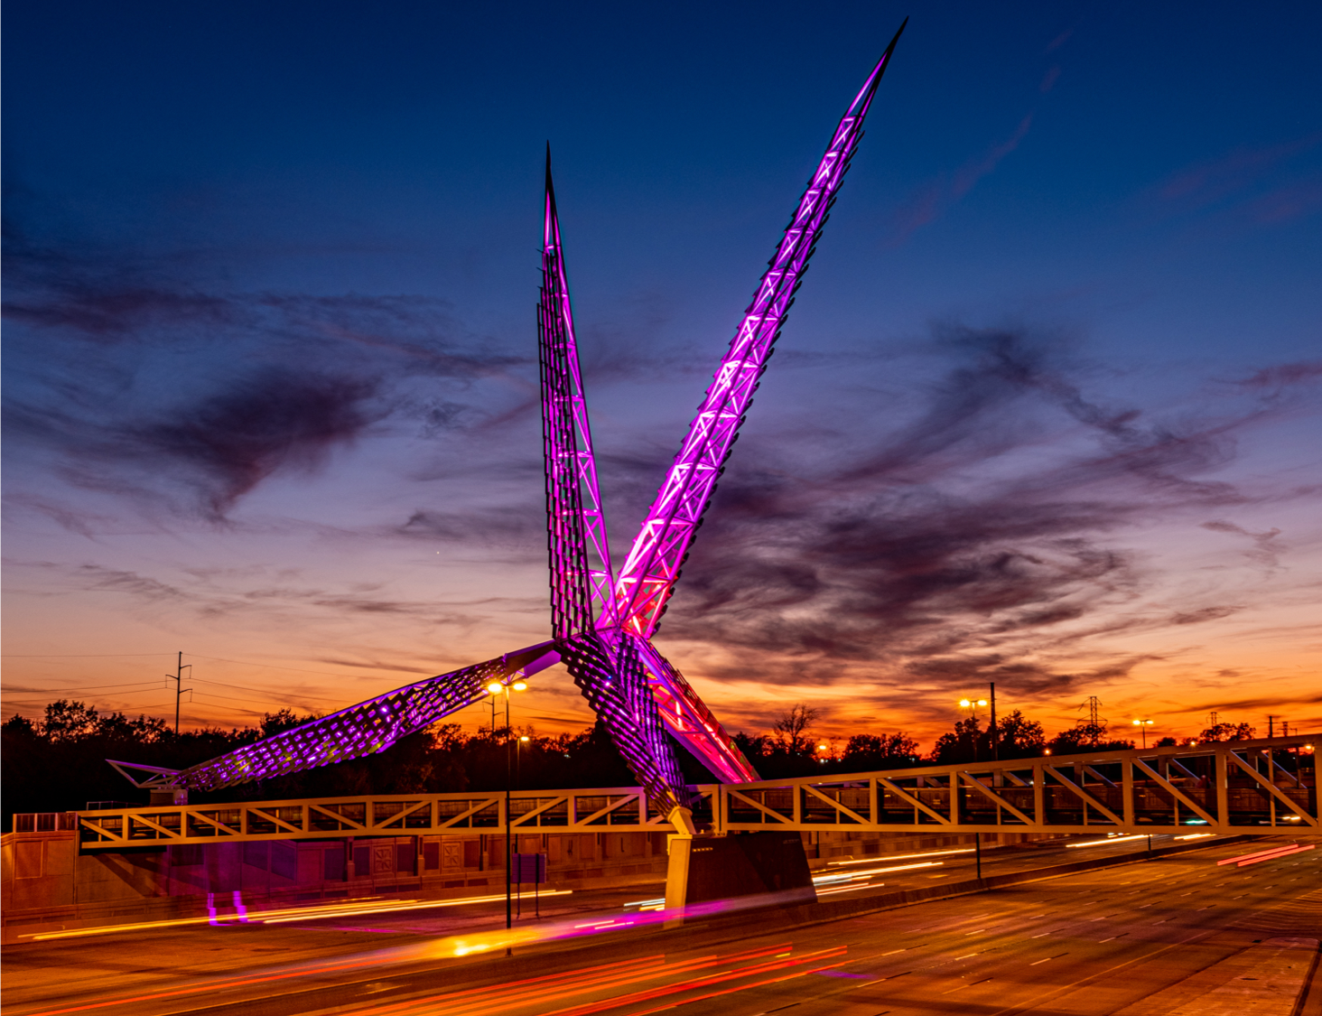
Meeting Agenda
Call to Order, Welcome and Introductions
Review and Approve of Minutes
FY22 Program and Budget Spend-down Updates
FY23 Work Plans
FY 2023 Advisory Committee Dates
Closing Remarks and Adjournment
Oklahoma State Department of Health | Preventive Health and Health Services Block Grant | 2023
Notes:
Have all guests and AC members make introductions

Slide 3
Review and Approval of Meeting Minutes
Notes:
Chair will ask if there is discussion on the minutes. If not, chair will ask if there is a motion to approve minutes. Note who motions and who seconds approval. Go around the AC members and ensure each one either say 'yay' or 'nae' and note that. If there is a discussion and minutes not approved, will table to approve at next meeting and just note it. Or can motion to approve with changes. March’s Regular meeting and April’s Special meeting

Slide 4
FY22 Program and Budget Spend down Update
Notes:
Final allocation table not available until after May (see note on last slide)

Slide 5
FY 2022 PHHS Block Grant Work Plan Updates
Work Plan Updates
Budget Spend down
Notes:
No FY 22 updates work plan,

Slide 6
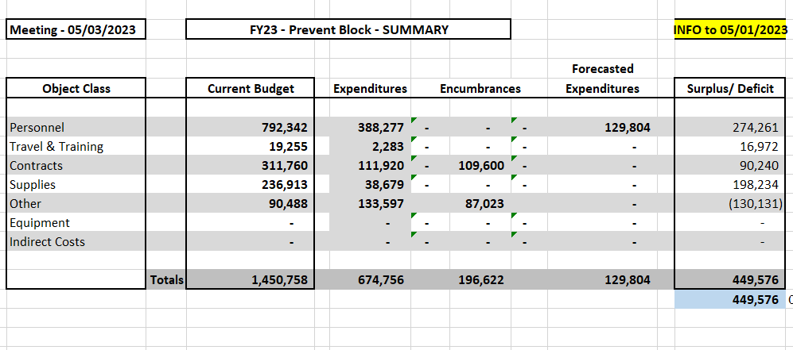
FY 2022 Budget Summary as of May 2023
Notes:
Steve to update the current budget to reflect the correct about of the award. The surplus/deficit is just an estimation. More funds have been spent. IDC and travel are not currently included within the expenditures. Steve can explain further.

Slide 7
FY2023 Work Plan Drafts
FY 2023 Awardees

Slide 8
Advancing Health Equity and Strengthening Minority Health 1 & 2
Funding Amount: $151,392 - Enhance or expand program
| FTEs, IT support, Supplies, Travel, Contractual agreement |
HP2030 Goal: Reduce the proportion of people who can’t get medical care when they need it.
Capacity Building services via training and staff development on minority health and health equity to improve access to healthcare for minority or underserved populations
Mini Grants: Mobilize community members, outreach, promotional materials, community events, media campaign, translation services, etc.
Interpretation and document translation
Provide training for culturally and linguistically appropriate policies and practices
Notes:
Requested $196,504.42
FTEs- translator/interpreter and planning coordinator
Travel – motor pool
Contractual – language line

Slide 9
Addressing Chronic Disease Prevalence Using a Multidisciplinary Team
Funding Amount: $5,690 - Start up of a new program
| Supplies, Other |
HP2030 Goal: Increase control of high blood pressure in adults
District 5 - Greer and Kiowa County are piloting this project with the mobile unit as the patient access point into the project. The protocol received IRB approval.
Both these areas are primarily rural areas and are designated health professional shortage areas.
Provide additional resources to patients affected by these conditions through provision of education, development of goals and referrals to community programs, will assist them in learning skills necessary to better manage their health status.
This program relates to the agency mission of protecting and promoting health, preventing disease and injury, and cultivating conditions by which Oklahomans can thrive. It also relates to the agency vision of leading Oklahomans to prosperity through health.
Notes:
Requested $5690.
Other – quarterly aggregate reporting stipends

Slide 10
Birth Partners
Funding Amount: $110,111 - Enhance or expand program
|FTEs, Travel, Supplies |
HP2030 Goal: Reduce cesarean births among low-risk women with no prior births
The program aims to decrease maternal stressors and increase social support among expectant people during the pregnancy and postpartum. Educational classes will be available to the public at no cost. Doula services will be provided at no cost to eligible pregnant people who may be at risk for suffering adverse pregnancy and birth outcomes.
Results from previous funding include a statistically significant knowledge increase from childbirth education, doula clients who were less likely to experience stress from doctors, nurses, or the “normal stress of childbirth,” a control group of participants who were more likely to get an epidural, and doula clients who were less likely to deliver by cesarean than the group without doula care.
Proposed additions during this funding cycle include: To enhanced prenatal support in the form of group classes focusing on breastfeeding and social connections, Postpartum depression counseling, and another doula.
Current doula staffing does not provide a backup for births and leaves little time for ongoing support in the postpartum period. With the addition of another doula on staff, the program could provide a higher level of prenatal and postpartum support and increase outreach efforts.
Notes:
Requested 137,902
FTEs-
Travel – $1500 need justification

Slide 11
Creating Healthy Environments in Schools
Funding Amount: $50,813 - Enhance or expand the program
| Contractual agreement |
HP2030 Goal: Reduce the proportion of children and adolescents with obesity
By 2028 at least 25 schools (5 per year) will receive technical assistance and consultation to implement healthy policy, systems and environments based on results from the School Health Index and Wellness Policy in Action Tool.
1) Continue state-level health and education partner co-action to support dissemination of best practices, professional development standards, and inclusion of health and wellness as a priority for state and local programs and grants such as Title IV;
2) Continue to increase access to evidence-based school health services, which have been found to give students care when they need it, keeping them in school and out of more costly care settings;
3) Integrate school health practices, programs, and policies into education accountability measures (for example, using health data to inform School Improvement Plans and updating the school accountability measures for health and wellness) while specifically addressing chronic health conditions;
4) Continue to enhance the collection of health and wellness data in schools through health assessments and measures;
5) Ongoing evaluation for monitoring progress made towards promoting and reinforcing healthy behaviors among students and staff.
Notes:
Requested-$157,975.00
FTEs-
Travel –
Contractual – Nursing Corp Manager
Other

Slide 12
Health Literacy for ESL
Funding Amount: $5,000.00 - Start up of a new program
| Contractual agreement |
HP2030 Goal: Increase the proportion of adults with limited English proficiency who say their providers explain things clearly
Program will bridge the gap of those who have English as a second language providing them with a fair opportunity to be able to communicate with their health care providers which is teaching them medical and health terminology.
By June 30, 2024, two contract employees will provide and promote four sessions of Health Literacy for ESL classes that consist of 15 lessons to those who speak Spanish and Marshallese. Both Spanish and Marshallese classes to be offered by the Fall of 2023 and Spring of 2024. Classes will improve the capability to interact in different health-related environments.
Notes:
Requested 5,000.
FTEs-
Travel –
Contractual – Basic Health Literacy terminology, Spanish to English and Marshallese to English
Other

Slide 13
Go NAPSACC Statewide Implementation
Funding Amount: $69,260 - Enhance or expand the program
| FTE, Supplies, IT support, Travel |
HP2030 Goal: Reduce the proportion of children and adolescents with obesity
The Oklahoma State Department of Health (OSDH) has adopted the Go Nutrition and Physical Activity Self-Assessment for Child Care (Go NAPSACC) online toolkit in efforts to enhance nutrition and physical activity practices in early care and education (ECE) programs in Oklahoma. The platform will provide assistance to childcare providers to improve the health of young children through education, practices, policies, and environments that support healthy eating, physical activity, and oral health.
OSDH will recruit other stakeholders to become GO NAPSACC consultants to increase the reach of in-depth consultation to early childcare providers to implement evidence-based strategies to increase physical activity and nutrition in their environments.
Notes:
Requested 79,260.
FTEs- Certified Healthy consultant
Travel – motor pool
Supplies – basic and God NAPSACC portal renewals and environmental supplies
Contractual –
Other

Slide 14
D-3 Communication & Health Literacy Project
Funding Amount: $20,000 - Enhance or expand the program
| Supplies, Other|
HP2030 Goal: Increase the health literacy of the population.
Develop a 3-5 year strategic plan with a central theme and focus on resilience, trauma informed practices, and enhancing equitable access for all to our health care services.
Develop and disseminate health and safety information that is accurate, accessible, and suited appropriately to various audience needs across the district.
Support and expand local efforts to provide adult health education including culturally and linguistically appropriate health information services in the community.
Mobilize partners and collaborators to advance health equity and address social determinants of health as they relate to health literacy among populations at higher risk and that are underserved
Develop a training program for District 3 staff focused on being a trauma informed, health literate workplace aware of the health disparities and factors impacting health equity in the communities and populations served.
Notes:
Requested 199,959.13
FTEs-
Travel –
Contractual –
Supplies – Bridges out of Poverty supplies for workshop and participants
Other – OMES Data Cost

Slide 15
Healthy Aging and Injury Prevention
Funding Amount: $158,065 - Enhance or expand the program
| FTEs, Travel, Supplies, Other |
If not approved/funded, the IPS would have no funding for healthy aging or fall prevention efforts
HP2030 Goal: Reduce fall-related deaths among older adults
IPS will work with community partners, including county health departments, senior centers, health care facilities, nonprofits, coalitions, and other local organizations, to identify opportunities to increase understanding and application of prevention strategies to reduce fall and MVC-related injury and death, and improve quality of life for older adults in Oklahoma..
Notes:
Requested 187,209.09
FTEs- Project Coordinators, Program manager
Travel – in state mileages and out state Annual conference to Denver
Contractual –
Supplies - printing for training material, post cards and educational information
Other – Data Cost

Slide 16
Child Passenger Safety Program
Funding Amount Requested: $202,373.70 - Enhance or expand the program |Supplies |
HP2030 Goal: Reduce the proportion of deaths of car passengers who weren’t buckled in
To increase child safety seat usage rates in Oklahoma and reduce crash-related injuries and deaths to child occupants, the Injury Prevention Service (IPS) will administer a comprehensive child safety seat installation and education program, including the following components:
Free car seat/booster seat checks and education to the general public by appointment,
Distribution and installation of free car seats/booster seats and education to eligible low-income families by appointment, Certified technician training classes,
Education and basic training courses for professional partners (e.g., home visiting nurses, child welfare workers, law enforcement, perinatal nurses, childbirth instructors),
Public education on child passenger safety (CPS) best practices and Oklahoma's law,
Sharing best practices and education to inform legislative and organizational decision-making, and (7) coordination of county health department installation sites, including the provision of seats and technical assistance, and maintaining statewide capacity for CPS.
Notes:
Requested 199981.53
FTEs-
Travel –
Contractual –
Supplies – child safety seats
Other

Slide 17
Certified Healthy Oklahoma Consultation
Funding Amount Requested: $70,370 - Enhance or expand the program
If not approved consultation and technical assistance would be limited
| FTEs, Travel, Supplies |
HP2030 Goal: Reduce the proportion of adults with obesity
The primary health concern being targeted is adult obesity. This program focuses on providing targeted technical assistance and in-depth consultation to Certified Healthy Oklahoma Community and Congregation applicants. The CHO application will serve as a baseline to the organization. Based on the identified gaps in the organization’s application, a customized consultation plan will be created in partnership with the organizations to grow to the next Certified Healthy Oklahoma certification level. Through this deeper consultation the organizations we are working with will implement policy, environmental and systems change that will create healthier environments that will lead to adopting behaviors that will prevent and reduce adult obesity.
Notes:
Requested 100,369.93FTEs-
Travel – motor pool
Contractual –
Supplies- congregational environmental support
Other

Slide 18
Fluoride Outreach Project
Funding Amount: $15,000 - Enhance or expand program
| Supplies|
HP2030 Goal: Reduce the proportion of children and adolescents with lifetime tooth decay
OSDH/Dental Health plans to purchase 7,500 single-use 5% sodium fluoride varnish packets. We will distribute the fluoride varnish to partners who will apply the product to the teeth of children. Fluoride varnish prevents or reduces caries on primary and permanent teeth. The frequency of applications is not firmly established, however two or more applications per year is recommended by the CDC, depending on the risk of dental decay. Specific outcomes:
Distributing the fluoride product to partners with access to children, ability to apply the product.
We will track the number of children served and the number of applications.
Partners will relay oral health education to parents/caregivers.
The primary health concern is dental caries in children. Dental decay in children may cause pain and infections that lead to problems with eating, speaking, playing, and learning. Poor oral health can affect school readiness and performance.
Notes:
Requested 15,000

Slide 19
Northeastern Oklahoma CATCH Coordinated School Health Initiative
Funding Amount: $95,990 - Enhance or expand the program
|FTE, Travel, Supplies |
HP2030 Goal: Increase the proportion of children who do enough aerobic physical activity
The goal of the Northeastern Oklahoma CATCH Coordinated School Health Initiative, is to increase the amount of rural and low-income middle school and elementary school aged students in District 4 participating in an evidence based physical activity and exercise CATCH program.
If award the grant, we will have the opportunity to expand the program into middle schools within the same school districts, encouraging students to continue following the CATCH philosophy, cementing those healthy habits in place, and encouraging lifelong participation in physical activity.
Purpose of funding is to purchase CATCH curriculum, equipment supplies, provide training, and technical assistance to implement whole child wellness programs across D4.
Notes:
Requested $119,240
FTEs- Health Equity Specialist
Travel – motor pool
Contractual –
Supplies- material
Other -

Slide 20
Healthy Lifestyles Program
Funding Amount: $10,567 - Enhance or expanded program
| Travel, Supplies |
HP2030 Goal: Heart Disease and Stoke – Improve Cardiovascular Health in Adults – HDS-01
Program Strategy Summary:
Week 1: Introduction to program Week 2: Participants will learn about healthy nutrition, how to read food labels, and how to identify differences between fresh foods and processed foods. Week 3: Participants will learn about physical activity and exercise, target heart rate, frequency and duration. Week 4: Participants will learn about mental health, services available, and reducing mental health stigma. Week 5: Participants will learn about pre-diabetes and how it relates to nutrition and exercise. Week 6: Participants will learn about basic pain management, rest and recovery and daily living.
All interventions provided through the classes are evidence based to improve health outcomes and improve quality of life while lowering prevalence of heart disease and stroke.
Notes:
Requested 10,567
FTEs-
Travel – motor pool
Supplies – program material
Contractual –
Other

Slide 21
Partner Inflicted Brain Injury
Funding Amount $51,435 - Enhance or expand the program
|FTE, Travel, Supplies, Contractual agreement, Other |
HP2030 Goal: Reduce intimate partner violence
The program is designed to build the capacity of domestic violence service (DVS) agencies and allied service areas to serve clients who have experienced partner-inflicted brain injury (PIBI). By providing:
Training, Program support, Resources, Increase awareness, and
Use of appropriate accommodations for clients with this disability.
Additionally, staff will conduct focus groups/listening sessions with identified populations experiencing health disparities to determine if materials and/or training should be adapted to better serve the identified population.
Notes:
Requested $51,434.69
FTEs- Coordinator
Travel – overnight motor pool
Contractual – Ohio Domestic Violence Network
Supplies – participant incentives, overnight
Other – Data Cost

Slide 22
Suicide Prevention
Funding Amount: $101,427.50 - Start up of a new program
| FTEs, Travel, Supplies, Other |
HP2030 Goal: Reduce the suicide rate
The Injury Prevention Service (IPS) has collected, analyzed, and disseminated suicide data as part of the Oklahoma Violent Death Reporting System for nearly 20 years and has partnered closely with the Oklahoma Department of Mental Health and Substance Abuse Services (ODMHSAS) Suicide Prevention area during that time. The numerous discussions regarding the development of a suicide prevention program within the IPS to complement the work of ODMHSAS, to better support the CHDs and other public interfacing programs at OSDH in this area. This proposal will provide dedicated staff time for building a suicide prevention program tailored to OSDH and the CHDs.
The IPS will use the project period to:
Develop infrastructure in suicide prevention,
Determine modalities that are best suited to the CHDs,
Build capacity among the CHDs and other public interfacing OSDH programs to implement suicide prevention strategies and best serve our clients.
Notes:
Requested 130,781.48
FTEs- Program manager and Coordinator
Travel – motor pool, out of state conference
Contractual –
Supplies - can gun locks
Other - data cost

Slide 23
Sexual Assault Prevention & Surveillance
Funding Amount: $109,000 - Maintain existing program
| Contractual agreement, Other |
HP2030 Goal: Reduce contact sexual violence
The program is designed to reduce the first-time occurrence of sexual violence perpetration and reduce risk factors and enhance protective factors linked to sexual violence perpetration and victimization. To do this, the Injury Prevention Service (IPS) will:
Provide two contracts to support two community-based sexual violence prevention educators,
Conduct surveillance of sexual violence through the Behavioral Risk Factor Surveillance System (BRFSS).
The community-based sexual violence prevention educators will implement prevention strategies across the social-ecological model based on the Centers for Disease Control and Prevention’s STOP SV: A Technical Package to Prevent Sexual Violence. The technical package identifies five strategies to help communities prevent sexual violence:
Promote social norms that protect against violence, teach skills to prevent sexual violence
Provide opportunities to empower and support girls and women; Create protective environments; and Support victims/survivors to lessen harms.
Notes:
Requested 109,000 but mandated allocation is 82,000
FTEs-
Travel –
Contractual – Prevention Educator
Other – Behavioral Risk Factor Surveillance system – added 3 questions

Slide 24
Parents as Teachers (PAT)
Funding Amount: $35,000 - Enhance or expand the program (Declined)
HP2030 Goal: Increase the proportion of children who are developmentally on track and ready for school
Program Strategy Summary: The PAT model focuses on the early years of a child’s life for optimal development and provides the foundation for success in school and life, not only for the enrolled child but the whole family. The PEs are equipped with the training and knowledge to not only screen for developmental delays, but focus on the family as a whole to provide support to the parents as they are their children’s first and most influential teacher.
Parents as Teachers is an evidence-based intervention backed by nearly 40 years of independent research including many evidence recognitions in the U.S. and Internationally. The PAT model offers a cohesive package of services for families with young children and is framed around four dynamic components: Personal Visits, Group Connections, Child Screenings, and Resource Network. These components are guided by explicit fidelity and quality standards that guide program service delivery and successful replication of the program.
Notes:
Total is $446,977.63 for 3 districts.
This funding was allocated to increase car seat for the Child Passenger Safety Program and SVP to their requested funding total.

Slide 25
2023 PHHS Block Grant Advisory Committee Dates
December 13, 2023
FY23 Update
Final APR FY22 Update

Slide 26
Closing Remarks and Adjournment
Thank you!
Notes:
Chair to call the meeting to end. and note time.
Closing remarks – also say at beginning of proposal request section – drafts based on the current allocations. Won't know the official amount until May. Once we receive that will finalize the budget.

