Slide 1
Oklahoma State Innovation Model
Health WORKFORCE
Health System Transformation

Slide 2
OSIM
Project will design a value-based analytics tool which will use multi-payer claims information, Health Information Exchange, Electronic Health Records and other data sets to be used to accelerate and support health system transformation in Oklahoma.

Slide 3
OSIM Updates
February 1 is the official start date for the grant
Final amount to be awarded 2 million:
195,000 in personnel costs
87, 844 in supplies, travel and other
1, 667, 860 in contracts
The interview process for OSIM Director and Coordinator positions is complete.
Tentative offers were made and accepted
New CHIE staff has been hired
2 out of 6 Health Planning Coordinators
2 Data Analysts
1 out of 2 Administrative Assistants

Slide 4
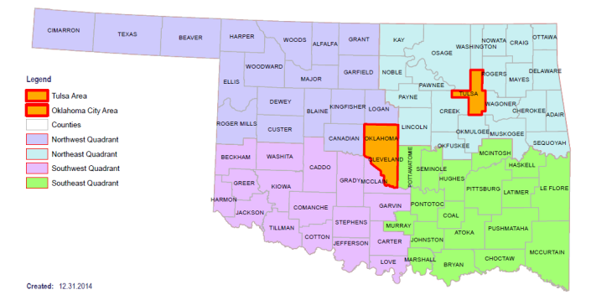
2015 OSIM Proposed Timeline
OSIM Deliverables
HIT - EHR Adoption Analysis - HIE Environmental Scan - VBA tool adoption proposal HF and HEE - Actuarial Analysis Market effects on health care transformation Analysis of care delivery models in Oklahoma High-cost delivery services Financial forecast of new delivery models HW - Workforce assessment - Program Evaluation
Select contractors
Develop Scope of Work (SWO)
Facilitate planning activities for OSIM
Jan 2015
Notify stakeholders of OSIM award
Jan – Apr
CMS
Mar 30
Stakeholder Engagement Plan
By Jan 20, 2016
TA team
incorporates final feedback
By Jan 16
Hire OSIM Staff &
Develop initial SOW
Nov – Dec
TGA Public Comment
CMS
Jan 31 2016
grant end date
TGA Submission
Feb 1
Grant start date
Due dates between Mar – Oct
October
CMS
May 30
1 Qtr. Rep
CMS
Aug 30
2 Qtr. Rep
TA team works with contractors and OSIM staff to finalize TGA draft
CMS
Nov 30
3 Qtr. Rep
Feb 20
Implementation of Tribal Advisory Board
CMS
Apr 30 2016
Final report
OSIM ongoing assessment by CMS
Mar – Nov
OSIM Deliverable
Technical Assistance team (TA) develops TGA
Feb – May Initial OSIM Project & Goals Presentation
Tribal Advisory Meeting
Jun – Sep Feedback Collection
Tribal Advisory Meeting
Oct – Dec Presentation of Final Report
Formal Tribal Consultation
Jan – Dec
TA team
Stakeholder Engagement and follow-up meetings
Health Information Technology: HIT
Health Finance: HF
Health Efficiency & Effectiveness : HEE
Health Workforce: HW
Test Grant Application: TGA
Geographic area breakdown for advisory meetings

Slide 5
Stakeholder Roles
Active consultants for OSIM activities
Subject Matter Experts involved in the analysis and recount of specific topics of interest for the actuarial analysis
Participating in reviewing and endorsing different OSIM deliverables

Slide 6
OSIM Contracts
Stakeholder Engagement: recruitment, coordination, and organization of stakeholder meetings
Technical Assistance: prepare documents for CMS throughout OSIM planning year 1
Actuarial Analysis: analyze impacts of health innovation
Health Care Data Research: evaluate EHR, HIE, and create roadmap for VBA tool
Health Workforce Assessment: examine current health workforce environment, issues, and influences
Program Evaluation Design & Quality Measurements: roadmap for evaluation and implementation of proposed activities/projects

Slide 7
OHIP/OSIM Alignment
OHIP Health Workforce Goals
Coordinated statewide efforts including data collection and analysis
Identify critical health occupations and supply/demand gaps
Recommend policy and programs that support and retain an optimized health workforce
OHIP/OSIM Strategies
Define roles, functions and parameters for stakeholders
Explore/Assess best practices in health workforce data collection and analysis
Assess and evaluate current state recruitment and incentive strategies
Assess barriers to health workforce flexibility and optimization
Conduct stakeholder engagement process to determine appropriate, feasible models of care for a range of Oklahoma communities
Notes:
*Contractors will assess the Electronic Health Records (EHR) adoption rate in Oklahoma; perform gap analysis and advise on strengthening and expanding the use of Health Information Technology (HIT) and Health Information Exchange (HIE) to support population health, health care delivery, and new value-based payment models. The contractor(s) will also serve as information technology and data utilization consultant(s) to OSIM leadership.

Slide 8
OSIM Contract Deliverables
Comprehensive assessment(s) of health workforce in Oklahoma (Due July 1, 2015)
Assessment of scope of practice, prescriptive authority, and competencies and continuing education requirements for all licensed and certified health professionals with a comparison of Oklahoma to other states
Identification of gaps between scope of practice and competencies for health professions including at a minimum, pharmacists, physician assistants, registered nurses, advance practice registered nurses, dental hygienists, and dental assistants
Assessment of existing telemedicine competencies and identification of gaps between existing and needed competencies
Identification, mapping and assessment of service delivery models for primary care physicians, dentists, and behavioral health providers
Assessment of policies, rules, reimbursement and regulations affecting health care services with a comparison of Oklahoma to other states
Assessment of telemedicine reimbursement, rules and regulations including identification of barriers to implementation
Assessment of state capacity and strategies for addressing identified workforce issues (Due July 1, 2015)
Assessment of state’s capacity for data collection and analysis and health workforce program planning and development. (What is the state’s capacity to monitor health workforce, make informed decisions, and respond to identified needs in the health system? Are boards, commissions, task forces, and data sources in place and functioning? How does Oklahoma compare to other states?)

Slide 9
OHIP/NGA Policy Academy
Center for Health Innovation and Effectiveness & OHIP Partners
Assessment of salaries by region and cost of practice (liability and training)
Assessment and analysis of health professional training programs including residency slots, clinical rotation capacity, and faculty
Assessment of loan repayment programs, scholarships, and other financial incentives to practice in rural and underserved areas or in professional shortages (primary care physicians, dentists); also assessment of programs aimed at recruiting disadvantaged or rural students

Slide 10
Questions?

