Slide 1
Oklahoma State Department of Health
Health Finance Meeting
December 17, 2015

Slide 2

Health Finance Workgroup Meeting Agenda
December 17 2015, 9:00-11:00am
Oklahoma State Department of Health
1000 NE 10th St, OKC, OK 73117
Section
Presenter
Meeting Overview & Objectives | 10 min | 9:00
OSIM Status Update Progress Timeline | 10 min | 9:10 |  | A. Miley
OSIM Proposed CCO Model | 25 min | 9:20 |  | A. Miley
Comments, Questions, and Discussion on CCO Model | 20 min | 9:45
OSIM Proposed Quality Metrics | 15 min | 10:00 |  | A. Miley
Comments, Questions, and Discussion on Quality Metrics | 15 min | 10:15
OSIM Proposed Episodes of Care | 25 min | 10:30 |  | I. Lutz
Wrap-Up & Next Steps | 5 min | 10:55

Slide 3
Meeting Objectives
Update on overall OSIM initiative status
Progress to date
Model Discussion
Next Steps
1
3

Slide 4
Health Finance Workgroup Meeting Agenda
December 17 2015, 9:00-11:00am
Oklahoma State Department of Health
1000 NE 10th St, OKC, OK 73117
Section
Presenter
Meeting Overview & Objectives | 10 min | 9:00
OSIM Status Update Progress Timeline | 10 min | 9:10 |  | A. Miley
OSIM Proposed CCO Model | 25 min | 9:20 |  | A. Miley
Comments, Questions, and Discussion on CCO Model | 20 min | 9:45
OSIM Proposed Quality Metrics | 15 min | 10:00 |  | A. Miley
Comments, Questions, and Discussion on Quality Metrics | 15 min | 10:15
OSIM Proposed Episodes of Care | 25 min | 10:30 |  | I. Lutz
Wrap-Up & Next Steps | 5 min | 10:55

Slide 5
OSIM Progress Update
The OSIM initiative has made substantial progress in the intervening months since the previous workgroup meeting
Milestone Updates
Major OSIM accomplishments
  Model proposal
  Quality measures
  Episodes of care
  Writing of SHSIP sections
    HIT Plan
    Workforce Redesign
    Environmental Scan
CMS has granted Oklahoma a two month extension for the OSIM initiative
  Allows for a thorough public engagement and comment period
  Will result in a more robust State Health System Innovation Plan (SHSIP) to guide health transformation efforts in Oklahoma
5

Slide 6
SIM Initiative Timeline
The final four months of the OSIM design phase will incorporate substantial stakeholder involvement
- | December | January | February | March
Model Development
SHSIP Development
Payer Alignment
Public Comment Period
OHIP Workgroups
Milestone
6

Slide 7
Health Finance Workgroup Meeting Agenda
December 17 2015, 9:00-11:00am
Oklahoma State Department of Health
1000 NE 10th St, OKC, OK 73117
Section
Presenter
Meeting Overview & Objectives | 10 min | 9:00
OSIM Status Update Progress Timeline | 10 min | 9:10 |  | A. Miley
OSIM Proposed CCO Model | 25 min | 9:20 |  | A. Miley
Comments, Questions, and Discussion on CCO Model | 20 min | 9:45
OSIM Proposed Quality Metrics | 15 min | 10:00 |  | A. Miley
Comments, Questions, and Discussion on Quality Metrics | 15 min | 10:15
OSIM Proposed Episodes of Care | 25 min | 10:30 |  | I. Lutz
Wrap-Up & Next Steps | 5 min | 10:55

Slide 8
Oklahoma Department Spending Share 2005-15
Oklahoma’s health spending has increased its share of the total state budget by 5.6 percentage points, from 13.6% to 19.2%, since 2005
Percentage Department Spending (%), 2005
Percentage Department Spending (%), 2015
Source: Oklahoma Comprehensive Annual Financial Reports, CHIE Analysis
8
Notes:
Good news/bad news slide – This administration has been a strong supporter of health and human services and that has led to increased spending in these areas BUT
1 – could be more efficient and
2 – could be more effective

Slide 9
Oklahoma Health Spending Average Annual Increase 2005-15
Oklahoma’s health spending has increased twice as fast as the state budget and one and a half times as fast as US total healthcare expenditures
Health Spending Average Annual Percentage Increase (%), 2005-15
Percentage Growth (%)
Source: Oklahoma Comprehensive Annual Financial Reports, CMS National Health Expenditure Data, CHIE Analysis
9
Notes:
Oklahoma health expenditures track closely with expenses for the Oklahoma Healthcare Authority (OHCA)
Between OHCA (65%) & DMHSAS (25%) – 91% of the expense
OSDH & other health nearly evenly split the rest
Still waiting on EGID data
Total OK state spend increases have slightly outpaced the CPI
Average CPI: 1.80%
Health spend increases, both overall and for OHCA, have are nearly three times as high
Significant increase in the real costs of healthcare, relative to other goods and services

Slide 10
Oklahoma Healthcare Costs
State of Oklahoma High-Cost Condition Relative Cost
 | % Increase | Average Annual Cost
Entire Population | 100% | $4,993
Diabetes | 349% | $17,426
Obesity | 343% | $17,126
Tobacco Usage | 345% | $17,226
Behavioral Health | 313% | $15,628
Hypertension | 283% | $14,130
10

Slide 11
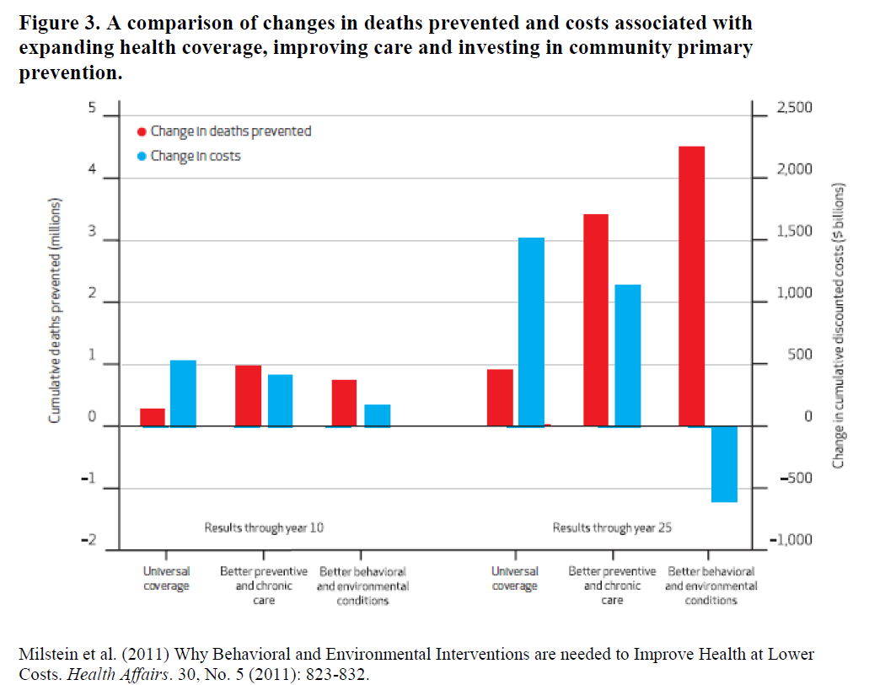
Primary Prevention Strategies Needed
11

Slide 12
The Case for Change
The fee-for-service system incentivizes volume, making it difficult to contain costs
Fee-for-service payments do not incentivize investment in innovative delivery methods or systems
Patients too often viewed by system as diagnoses instead of whole persons with need for coordinated care
Providers ability to deliver person-centered care inhibited by ever-expanding mandates
Current system does not emphasize primary prevention efforts that can lead to better population health and reduced costs
12

Slide 13
SIM Model Goal
To move the purchasing of health care services from a fee-for-service system to a population-based payment structure that incentives quality and value while emphasizing primary prevention strategies.
By moving to value-based care coordination model and focusing on the SIM flagship issues, we will improve population health, increase the quality of care, and contain costs.
Tobacco Use
Hypertension
Behavioral Health
Diabetes
Obesity
13

Slide 14
Where Are We Going?
Health Care Payment Learning & Action Network
Alternate Payment Methodology Framework
Category 4
Population-Based Payment
Category 3
APMs Built on Fee-for-Service Architecture
Category 2
Fee-for-Service Link to Quality
Category 1
Fee-for-Service No Link to Quality
Payments are based on volume of services and not linked to quality or efficiency
At least a portion of payments vary based on the quality of efficiency of health care delivery
Some payment is linked to the effective management of a segment of the population or an episode of care. Payments still triggered by delivery of services but opportunities for shared savings or 2-sided risk
Payment is not directly triggered by service delivery so volume is not linked to payment. Clinicians and organizations are paid and responsible for the care of a beneficiary for a long period (e.g.≥1 year)
14

Slide 15
How Did We Get Here?
The Oklahoma SIM project began in February 2015 and has used the expertise of our OHIP/OSIM workgroups, the SIM All Payer and Executive Committees, technical assistance contractors, and dozens of stakeholders from our communities and health systems.
OHIP/OSIM Workgroups
Executive Steering Committee
  After reviewing stakeholder feedback, the Executive Steering Commitee directed the SIM team to proceed with the development of a model concept similar to a Care Coordination Organization.
Technical Assistance
  Deloitte Consulting
  Milliman Healthcare Consulting
  SIM and Non-SIM States
  Centers for Medicare and Medicaid Innovation
    SHADAC
    ONC
Other Oklahoma Stakeholders
  Turning Point, Rural Health Association, OKPCA, OHA, et al
15

Slide 16
OSIM Model Proposals – Conceptual Design Tenets
Through this process the OSIM team identified several key tenets to build the OSIM model
Incorporate What Drives Health Outcomes
Expand from an integrated clinical view of patients to include social determinants of health and associated health enabling elements
  Address behavioral health needs
  Develop stronger relationships with social services and community resources
Integrate The Delivery Of Care
Ensure that various aspects of patient care are integrated and managed collectively, rather than in an isolated fashion
  Leverage Care Coordination practices already in place
  Enhance and expand use of health information technology
  Fully integrate primary care and behavioral health
Drive Alignment To Reduce Provider Burden
Engage with external stakeholders to align quality metrics from OSIM
  Foster buy-in from private payers
  Work with Medicare to synchronize evaluative metrics
Move Toward VBP With Realistic Goals
Understand that value-based purchasing will need a transition period
This is a large commitment that needs to be collaborative to allow for transformation to occur at the practice level
16
Notes:
Align quality measures
Emphasize the expansion of practicing at the top of the clinical license
Integrate community support and social services to address social determinants of health
Integrate behavioral health and substance abuse
Utilize care coordination
Do not add to the provider burden

Slide 17
SIM Goal:
To move payments to providers from a fee-for-service system to a value-based payment structure
Communities of
Care Organizations
Multi-Payer
Quality Measures
Multi-Payer Episodes of Care
17

Slide 18
Table of Contents
Communities of Care Overview
Payment Methodology
Integration of Social Determinants
Delivery Model
Health Information Technology Integration
Governance
18

Slide 19
I. Communities of Care Organizations: Overview
What are Communities of Care Organizations?
CCOs are local, risk-bearing care delivery entities that are accountable for the total cost of care for patients within a particular region of the state
Governed by a partnership of health care providers, community members, and other stakeholders in the health systems to create shared responsibility for health
CCOs focus on primary care and prevention strategies, using care coordination and the integration of social services and community resources into the delivery of care
Utilize global, capitated payments with strict quality measure accountability to pay for outcomes and health
Reimburse non-traditional health care workers and services, such as community health workers, peer wellness specialists, housing, et al
Initially, this model is proposed for all state purchased health care, which comprises a quarter of the state’s population
  Medicaid (SoonerCare): 805,757 members
  Public Employees: 225,861 members
19

Slide 20
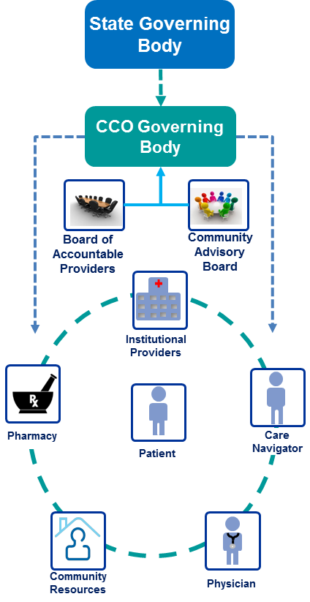
I. Communities of Care Organization
Geographically distinct, provider and community-led care delivery entities that are each accountable for the total cost of care for patients within their geography
Receive a capitated payment from the State Governing Body to cover total cost of member services
CCOs create a network of providers and community resources that will deliver care to the attributed members
  CCOs will have to show they have assembled an adequate network of providers to deliver patient-centered care
CCOs will organize a governance structure that incorporates the providers and community they serve
CCO
20

Slide 21
I. CCO Overview- Who could be a CCO?
There are many different organizations already operating within the healthcare system that could be a CCO or join together to be a CCO.
Example CCOs:
  Integrated System partnership with Health Plan – Example is Hypothetical
    Plan administered by system providers and health plan leadership
    Ownership: Those within integrated system, key community partners, and health plan
  Provider and System Partnerships – Example: Eastern Oregon Care Organization
    Plan administered by: Greater Oregon Behavioral Health, Inc. (GOBHI) and Moda Health
    Ownership: GOBHI, Moda Health, Good Shepard Health Care System (NFP Hospital), Grand Ronde Hospital, Inc., Saint Alphonsus Health System Inc., St. Anthony Hospital, Pendleton IPA Inc., Yakima Valley Farm Workers Clinic (FQHC)
    Joined through LLC
  Independent Physician Association – Example: AllCare CCO
    Governance: AllCare is actively governed by a 21-member board composed of eleven practicing physicians and 10 stakeholders including: one representative from each of our three Community Advisory Councils, a public member at large, two local hospital representatives, a representative of a Federally Qualified Health Center, a local pediatric dentist, a representative of a local Addictions Recovery program, and a representative of a local mental health provider. The ten stakeholders have no financial interest in the company. Each person on the board has an equal vote.

Slide 22
II. Payment Methodology – CCO
CCOs will receive a fully capitated, risk-adjusted per member per month payment
Incentives paid through a Community Quality Incentive Pool
  X% of capitated rate will be withheld for a community quality incentive pool that pay bonus payments for meeting performance and quality benchmarks
  The percent of withhold will increase over time to accelerate move toward outcome-based payments
If savings are accrued, a portion must be reinvested in the community to serve human needs affecting health (e.g., transportation, housing, mold remediation, food access).
A percentage of the capitated rate will be paid to a Health Information Network for interoperability and data infrastructure (see Health Information Technology Plan)
22

Slide 23
II. Payment Methodology – CCO to Network Providers
The CCO will implement an Alternate Payment Arrangement (APA) with the providers in their networks
  Allowing CCOs to choose the payment arrangements gives the model flexibility to meet providers and regions where they are in their practice transformation
  Strict interpretation of what constitutes an APA is needed
The CCOs will work to meet the following targets:
  80% of payments made to providers will be value-based by 2020 to align with Medicare;
  Participation with the Multi-Payer Episodes of Care;
  At least one additional Alternative Payment Arrangement must be utilized; and
  APAs must include mechanisms to encourage both cost savings and high quality care
Alternate payment arrangements include, but are not limited to:
  Pay for Performance
  Payment Penalties
  Shared Savings
  Shared Savings and Shared Risk
  Full Capitation
  CPCI
23

Slide 24
III. Integration of Social Determinants
A Community Advisory Board will serve as the mechanism for formal integration of the social determinants of health within the proposed model.
  Their guidance will address population needs outside of the normal scope of healthcare to help the CCO create better care and cost savings
Oklahoma will negotiates with CMS to pursue the use of flexible spending arrangements to assist in addressing social determinants.
  Purpose is to give providers and patients access to non-medical services that can have a direct, positive impact on their health
At enrollment members will complete a human needs survey which analyzes patient social needs
  Used in risk stratification of member
  Proactively identify needs before seeking care
Quality metrics include a social determinant aspect
All CCOs will create and maintain a regional asset database of community resources for easy referral
24
Notes:
The idea has not been widely utilized in places that have negotiated this kind of spending because of the auditing fears and unclear documentation requirements.
Requirements of Oregon’s Flexible Services
The services must:
Be “health related”
Be “consistent with a member’s treatment plan as developed by the member’s primary care team and documented in the member’s medical record”
Be “likely to be cost-effective alternatives to covered benefits and likely to generate savings”
Be “likely to improve health outcomes, prevent or delay health deterioration”
Not be “covered benefits under Oregon’s State Plan”
Not be covered by an existing billing and encounter code
Examples: Mold remediation, shoes, refrigerator, housing

Slide 25
IV. Delivery Model
The CCO will be required to articulate back to the governing body the mechanisms by which they will deliver patient-centered care (e.g., care coordination strategies, primary care provider role, creation of care teams, etc.)
Delivery model designs should show how the CCO will:
  Focus on comprehensive primary care and prevention
  Integrate behavioral health and primary care
  Integrate Federally Qualified Health Centers, County Health Depts., and other existing entities
  Use non-traditional healthcare workers
  Role of a centralized (among providers) multi-specialty care coordinator
  Integrate telemedicine
The best practices of the current Medicaid PCMH and HAN model will be part of the CCO quality metrics
  24 hour availability, expanded clinic hours
  Co-Management and integrated health plans among healthcare disciplines
  Use of EHR and e-Prescribing, supporting patient with educational materials and patient reminders for tests/screenings
Other best practices and quality metrics will be set out so that each CCO must show how they achieve a high degree of patient-centered team-based care.
25

Slide 26
V. Health Information Technology Integration
All CCOs must establish connection to an interoperable Health Information Exchange
  An interoperable Health Information Exchange (HIE) is an HIE that is interoperable with any other HIE exchanging the health data of Oklahoma residents
  Due to the necessity of interoperability for model success a percentage of the capitated rate will be paid to the HIN for maintenance and upkeep of interoperability
HIE views will be required to be established for the care team
CCOs must demonstrate how providers will be supported in actively managing the patient’s care with patient- and panel-level data analysis
Data analytics for payment will be done with a VBA tool using data that will be available within the HIN
Ensure access to a consumer-friendly patient portal
26

Slide 27
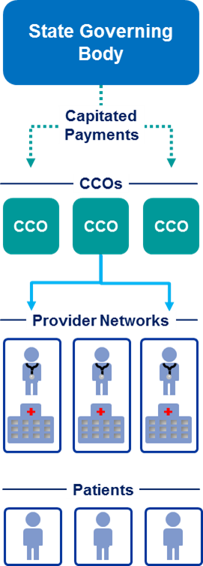
VI. Oklahoma Communities of Care Organization: Governance
State CCO Governing Body
Governing body consisting of members of health and human service agencies, paying institutions, and providers
Sets and monitors contracting requirements
Uses data-driven methods to evaluate CCOs performance
Sustains key activities for plan maintenance
Communities of Care Organization
Must show they have network adequacy and population size to support model
Must meet Oklahoma Insurance Department requirements to be a risk bearing entity and sell insurance products in Oklahoma or contract with a partner to provide these services
27
Notes:
State CCO Governing Body
Governing body consisting of members of health and social services organizations and payers
Owns data-driven aspects of care
Part of HIT VBA governance
Quality metrics determination
Analysis and reporting
Best practices
Manages contracting requirements and RFP process for regional care associations
This is a government agency with representation from separate agencies
activities of note that will be needed:
Eligibility and Enrollment Systems
Benefits/Covered Services policy
Fiscal Operations/Rate Setting
Compliance Monitoring – Network Adequacy, Appeals/Grievances, Marketing, etc
Program Integrity – Member/Provider Fraud
Performance Improvement Plans
Information Technology – (e.g., claims processing, encounter record processing, federal reporting, member and provider portals, etc)

Slide 28
VI. State Governing Body – Example Advisory Boards and Committees
The State Governing Body will form committees to guide the operations and standards of the CCO
State Governing Body
Health Care Workforce Committee
Episodes of Care Alignment
Health Information Technology
Behavioral Health Promotion
CCO Model Alignment
Quality Measure Committee

Slide 29


VI. CCO Governing Body
CCO Governing Body
A Board of Accountable Providers and a Community Advisory Board will be established by the CCO. If the CCO operates in multiple regions, they will set up a separate board in each region
Each CCO must establish a governance structure that reflects the coordination of care delivery and community services and resources in a single integrated model
To ensure the organizations decision-making is consistent with community members’ values, the CCO governing board must include relevant stakeholders who will be impacted by the CCO, including community members and providers
Board of
Accountable
Providers
Community
Advisory
Board
29
Notes:
Governance structure of the CCO will be approved by the State Governing Body

Slide 30
VI. Board of Accountable Providers (BAP) and Community Advisory Board (CAB)
Members
Duties
BAP: Will represent all service areas of the CCO in the region and CCO members. Set numbers and types of providers should be dictated to the CCO
CAB: Broad representation from the region including but not limited to: 501c3 entities, County Health Departments, tribal nations, consumer advocates, local churches, businesses, patient advocates and community action agencies. Specific numbers and types of community partners will need to be established through contracting, as determined by the state
Assure culturally aware use of clinical best practices and innovative approaches to delivering care
Suggest interventions to address issues with cost and quality attainment
Help guide the CCO to provide regionally-specific care and guide interventions that help address the social determinants of health
Maintain a database of community resources to facilitate linking the CCO to resources that support whole-person care
Assist the CCO with 3 functions:
  Community Health Needs Assessment
  Community Health Improvement Plan
  Recommendations for reinvesting savings
30

Slide 31
Health Finance Workgroup Meeting Agenda
December 17 2015, 9:00-11:00am
Oklahoma State Department of Health
1000 NE 10th St, OKC, OK 73117
Section
Presenter
Meeting Overview & Objectives | 10 min | 9:00
OSIM Status Update Progress Timeline | 10 min | 9:10 |  | A. Miley
OSIM Proposed CCO Model | 25 min | 9:20 |  | A. Miley
Comments, Questions, and Discussion on CCO Model | 20 min | 9:45
OSIM Proposed Quality Metrics | 15 min | 10:00 |  | A. Miley
Comments, Questions, and Discussion on Quality Metrics | 15 min | 10:15
OSIM Proposed Episodes of Care | 25 min | 10:30 |  | I. Lutz
Wrap-Up & Next Steps | 5 min | 10:55

Slide 32
Model Discussion

Slide 33
Health Finance Workgroup Meeting Agenda
December 17 2015, 9:00-11:00am
Oklahoma State Department of Health
1000 NE 10th St, OKC, OK 73117
Section
Presenter
Meeting Overview & Objectives | 10 min | 9:00
OSIM Status Update Progress Timeline | 10 min | 9:10 |  | A. Miley
OSIM Proposed CCO Model | 25 min | 9:20 |  | A. Miley
Comments, Questions, and Discussion on CCO Model | 20 min | 9:45
OSIM Proposed Quality Metrics | 15 min | 10:00 |  | A. Miley
Comments, Questions, and Discussion on Quality Metrics | 15 min | 10:15
OSIM Proposed Episodes of Care | 25 min | 10:30 |  | I. Lutz
Wrap-Up & Next Steps | 5 min | 10:55

Slide 34
SIM Goal:
To move payments to providers from a fee-for-service system to a value-based payment structure
Communities of Care Organizations
Multi- Payer Quality Measures
Multi-Payer Episodes of Care
34

Slide 35
Multi-Payer Quality Measures
Why Are These Important?
How Are They Incorporated?
Quality measures allow healthcare payers and providers to gauge the quality of care being delivered
These can help assure cost-effectiveness is not achieved at the expense of quality care
Multi-payer quality measures will reduce provider burden and create synergy around achieving a high level of performance on selected measures
Participating payers will be asked to make the measures a requirement to report from all applicable providers they contract with
Participating payers will be asked to form APM strategies around measures with as much alignment among plans as possible
These measures will be among those asked to be reported by the CCOs
35

Slide 36
Proposed Quality Metrics: Multi-Payer and CCO Required
The following quality metrics were determined based on the following criteria:
  Utilized and endorsed by a national authority on healthcare quality metrics
  Relation to the core OHIP 2020 goals
  OHIP 2020 and OSIM specifically targets obesity, diabetes, hypertension, tobacco use, and behavioral health as areas for improvement
  Links to clinical outcomes
  Alignment with State and National initiatives
  Initiatives such as : CPCI, SoonerVerse, PQRS, Healthy Hearts for Oklahoma, Meaningful Use, eCQMs, FFM QRS, ACO measures, FQHCs, GPRA
36

Slide 37
Quality Metric Data Sources
Clinical Measures:
  Clinical Data
  Claims Data
Quality Assurance:
  Independently Reported Via CCO
Population Measures:
  Clinical Data
  BRFSS
  Death Data
37

Slide 38
Quality Metric Workgroup/Committee
The measure set today is a proposed measure set. To ensure we are meeting our goals, it is anticipated that a diverse workgroup will be assembled to evaluate and recommend quality metrics that effectively incentivize high quality, high value care is delivered.
Examples:
Alabama Regional Care Organization Quality Assurance Committee
  Established to identify outcome and quality measures for ambulatory care, inpatient care, chemical dependency and mental health treatment, oral health care, and all other health services provided.
  Membership: 60% physicians who provide care to Medicaid Beneficiaries served by Regional Care Organization; 40% other.
Oregon Metrics and Scoring Committee
  Established for the purpose of recommending outcome and quality measures for Coordinated Care Organizations (CCOs). The nine members are appointed by the Director of the Oregon Health Authority and serve two-year terms.
  Membership: Three members at large; three individuals with expertise in health outcomes measures; and three representatives of coordinated care organizations.

Slide 39
Communities of Care Organization – Required Clinical Measures
CCO – Clinical Measures
NQF 0028: Tobacco Use Screening & Cessation Intervention | NQF 0059: Comprehensive Diabetes Management/Diabetes Poor Control
USPTF: Abnormal Blood Glucose and Type 2 Diabetes: Screening - Adults Aged 40 to 70 Years who are Overweight or Obese | NQF 1932: Diabetes Screening for People with Schizophrenia or Bipolar Disorder who are Using Antipsychotic Medications
NQF 0018: Controlling High Blood Pressure | NQF 0421: Body Mass Index Screening & Follow-Up
NQF 0024: Weight Assessment and Counseling for nutrition and physical activity | NQF 105: Anti – Depressant Medication Management
NQF 0418: Depression Screening | NQF 0004: Initiation and Engagement of Alcohol and Other Drug Dependence Treatment
NQF 0576: Follow-Up after Hospitalization (within 30 days) (BH primary diagnosis) | HEDIS: Ambulatory Care: Emergency Department Utilization
39

Slide 40
Communities of Care Organization – Required Clinical Measures
CCO – Clinical Measures Continued
NQF: 0275 PQI 05: Chronic Obstructive Pulmonary Disease Admission Rate | NQF: 0277 PQI 08: Congestive Heart Failure Admission Rate
NQF: 0272 PQI 01: Diabetes, Short Term Complication Admission Rate | NQF: 0283 PQI 15: Adult Asthma Admission Rate
CAHPS Composite: Satisfaction With Care | NQF: 1448 Developmental Screening In The First 36 Months Of Life
NQF: 1517 Prenatal And Postpartum Care: Timeliness Of Prenatal Care
40

Slide 41
Communities of Care Organization – Required Quality Metrics
CCO – Quality Assurance
% Of population with co-located behavioral health care provider | % Of primary care practices in network with expanded hours (after 5pm/weekends)
% Of primary care practices in network with 24-hour availability | % Of population with an assigned risk score/stratification
% Of population assigned to a care coordinator with an elevated risk score | % Of network with HIE access
Electronic resource guide available to care coordinator/staff | Provider Satisfaction Survey
41

Slide 42
Communities of Care Organization – Required Quality Metrics
CCO – Population Measures
% Of population who screened yes to being a current tobacco user under 18 years of age | % Of population who screened yes to being a current tobacco user 18 years of age and older
% Of population with a current BMI over 25 who are under 18 years of age | % Of population with current BMI over 25 who are 18 years of age and older
% Of population diagnosed with diabetes (type I and II) under 18 years of age | % Of population diagnosed with diabetes (type I and II) 18 years of age and older
% Of population diagnosed with hypertension under 18 years of age | % Of population diagnosed with hypertension 18 years of age and older
% Of population with a positive screening for depression under 18 years of age | % Of population with a positive screening for depression 18 years of age and older
Infant Mortality Rate | Deaths Due to Heart Disease
Suicide Deaths | Diabetes Deaths
42

Slide 43
Communities of Care Organization – Optional Bonus Measures
CCO – Optional Bonus Measures
NQF 0032- Cervical Cancer Screening | NQF 0034- Colorectal Cancer Screening | NQF 0041- Influenza Immunization (6 months and older)
NQF 0039- Influenza Immunization (50 years and older) | NQF 0031- Breast Cancer Screening | NQF 0038- Childhood Immunization Status
NQF 1516- Well Child Visits | NQF 1768: Plan All-Cause Readmission | Dental Sealants for Children
Effective Contraceptive Use | NQF 0074: Chronic Stable Coronary Artery Disease – Lipid Control | NQF 0569: Adherence to Statins
NQF 0541: Portion of Days Covered | Screening, Brief Intervention, and Referral to Treatment | USPTF: Cholesterol Abnormalities Screening

Slide 44
Health Finance Workgroup Meeting Agenda
December 17 2015, 9:00-11:00am
Oklahoma State Department of Health
1000 NE 10th St, OKC, OK 73117
Section
Presenter
Meeting Overview & Objectives | 10 min | 9:00
OSIM Status Update Progress Timeline | 10 min | 9:10 |  | A. Miley
OSIM Proposed CCO Model | 25 min | 9:20 |  | A. Miley
Comments, Questions, and Discussion on CCO Model | 20 min | 9:45
OSIM Proposed Quality Metrics | 15 min | 10:00 |  | A. Miley
Comments, Questions, and Discussion on Quality Metrics | 15 min | 10:15
OSIM Proposed Episodes of Care | 25 min | 10:30 |  | I. Lutz
Wrap-Up & Next Steps | 5 min | 10:55

Slide 45
Quality Metrics Discussion

Slide 46
Health Finance Workgroup Meeting Agenda
December 17 2015, 9:00-11:00am
Oklahoma State Department of Health
1000 NE 10th St, OKC, OK 73117
Section
Presenter
Meeting Overview & Objectives | 10 min | 9:00
OSIM Status Update Progress Timeline | 10 min | 9:10 |  | A. Miley
OSIM Proposed CCO Model | 25 min | 9:20 |  | A. Miley
Comments, Questions, and Discussion on CCO Model | 20 min | 9:45
OSIM Proposed Quality Metrics | 15 min | 10:00 |  | A. Miley
Comments, Questions, and Discussion on Quality Metrics | 15 min | 10:15
OSIM Proposed Episodes of Care | 25 min | 10:30 |  | I. Lutz
Wrap-Up & Next Steps | 5 min | 10:55

Slide 47
Goal:
To move payments to providers from a fee-for-service system to a value-based payment structure
Communities of
Care Organizations
Multi-Payer Quality Measures
Multi-Payer Episodes of Care
47

Slide 48
Multi-Payer Episodes of Care
Why is this important?
How is this part of the Model?
Episodes have been shown to be effective tools to contain cost and improve quality and outcomes
These episodes can help providers become accustomed to bearing risk within the delivery of healthcare
Multi-payer episodes reduce provider burden by focusing the attention of the provider on the patient instead of who the patient’s carrier might be
Participating payers will be asked to make the episodes a requirement to report from all applicable providers they contract with
48

Slide 49
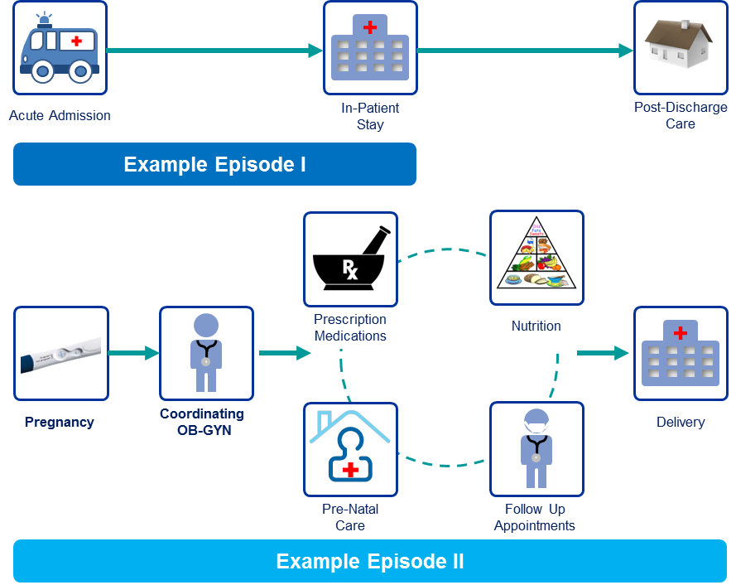
Episodes of Care
Overview
Payment model in which services related to a condition or procedure are grouped into “episodes” that provide benchmarks for both costs and quality of care
Example Episodes of Care
Scope
Principle Accountable Provider (PAP) is assigned and is responsible for the episode's outcome
Episodes may include acute, chronic, or behavioral health conditions
Care
Model
Encourage provider efficiency and care coordination to avoid the need for further intervention or complications
Payment
Model
PAPs are assigned by the carrier and initially paid on a fee-for-service basis. They are retroactively evaluated against a set of benchmarks for the average cost of care delivered over the episode’s performance period
PAPs are rewarded with a percentage of savings or charged a portion of costs in excess of the benchmarks
Results & Considerations
Episodes can be difficult to define, and changes in best practices or technology can render even well designed episodes obsolete
Pricing episodes correctly can require significant data
Costs can vary based on inherent risk within patient population
  Patient volume considerations to ensure appropriate distribution of risk
Attribution
Patient has a triggering event or certain number of claims related to an episode with a participating provider
49

Slide 50




Episodes of Care – Payment Model Design
Episodes begin with a triggering event
  E.g. Acute admission to a hospital
  E.g. Confirmation of pregnancy
Episode lasts until a pre-determined duration elapses
  E.g. 60-day postpartum upon completion or termination of pregnancy
Episodes define which related services and patients will be considered within the episode’s performance year
  E.g. Certain patients with complex conditions may be excluded and non-related services would also be excluded for episode
PAPs are initially paid on a fee for service basis and then retroactively evaluated against a set benchmark for the average cost of the care delivered per episode
Acute Admission
In-Patient
Stay
Post-Discharge
Care
Example Episode I
Prescription
Medications
Nutrition
Pregnancy
Coordinating
OB-GYN
Delivery
Pre-Natal
Care
Follow Up
Appointments
Example Episode II
50

Slide 51
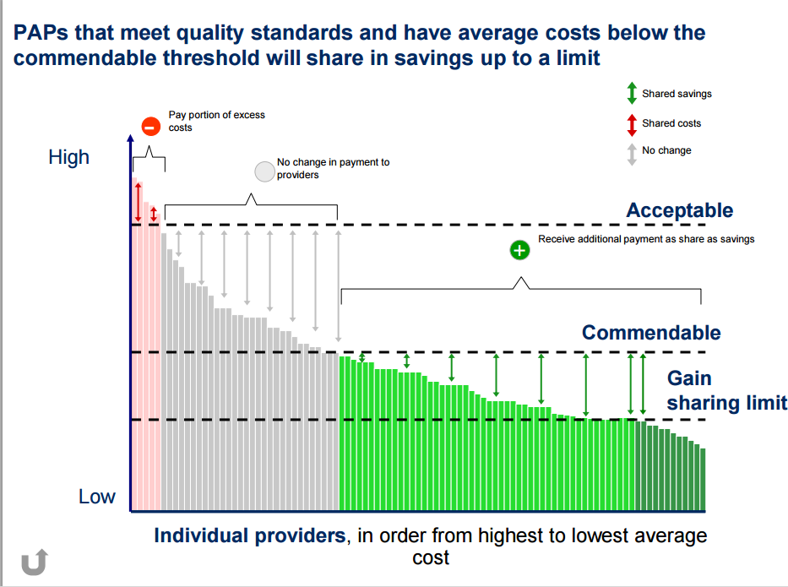
Episodes of Care – Payment Model Design (continued)
Each episode for a particular condition has an overall performance year in which all patient episodes for that condition are aggregated and evaluated against benchmarks for cost and/or quality of care
PAPs that come in under the cost benchmarks receive a percentage of the savings as a bonus, provided they also meet quality benchmarks
PAPs that exceed the acceptable level of costs may have to pay a portion of the overrun as a penalty
  Penalties are capped to ensure provider viability
Source: http://www.paymentinitiative.org/
Illustrative
51

Slide 52
Proposed Episodes of Care
Asthma (acute exacerbation)
  Overview: Covers care for 30 days following an asthma related trigger (typically an asthma diagnosis on an emergency department or inpatient facility claim). This episode typically covers physician visits, medication, care coordination, and can include hospital readmissions and post-acute care.
Perinatal
  Overview: The aim of the perinatal episode is ensuring a healthy pregnancy and follow-up care for mother and baby. Perinatal episodes include all pregnancy-related care including: prenatal care, labs, medications, ultrasounds, labor and delivery, and postpartum care. The triggering event for this episode is a live birth and delivery diagnosis code and the episode covers 40 weeks of care prior to the delivery and up to 60 days after delivery.

Slide 53
Proposed Episodes of Care
3. COPD (acute exacerbation)
Overview: Covers care for 30 days following a COPD related trigger (typically a COPD diagnosis on an emergency department or inpatient facility claim). This episode typically covers physician visits, medication, care coordination, and can Include hospital readmissions and post-acute care.
4. Total Joint Replacement
Overview: The purpose of a joint replacement (TJR) episode of care is to reduce duplication of services and increased costs through better care coordination. This episode covers 30 days prior to triggering event – total joint replacement – and 90 days postoperatively. This episode typically covers all orthopedic related costs during the episode.
5. Congestive Heart Failure
Overview: Episodic care for congestive heart failure (CHF) is aimed at reducing preventable hospitalizations and improving care coordination. The triggering event for this episode is a hospitalization for congestive heart failure; the episode typically covers the admission day and 30 days after. Episodes include facility services, inpatient services, emergency department visits, observation, and post-acute care; can also cover outpatient services: labs, diagnostics, and medications.

Slide 54
Health Finance Workgroup Meeting Agenda
December 17 2015, 9:00-11:00am
Oklahoma State Department of Health
1000 NE 10th St, OKC, OK 73117
Section
Presenter
Meeting Overview & Objectives | 10 min | 9:00
OSIM Status Update Progress Timeline | 10 min | 9:10 |  | A. Miley
OSIM Proposed CCO Model | 25 min | 9:20 |  | A. Miley
Comments, Questions, and Discussion on CCO Model | 20 min | 9:45
OSIM Proposed Quality Metrics | 15 min | 10:00 |  | A. Miley
Comments, Questions, and Discussion on Quality Metrics | 15 min | 10:15
OSIM Proposed Episodes of Care | 25 min | 10:30 |  | I. Lutz
Wrap-Up & Next Steps | 5 min | 10:55

Slide 55
Next Steps
1. Plan Presentations
2. Plan Review
Tribal Public Health Advisory Committee meeting
  December 4, 2015
Health Finance Workgroup Meeting
  Today
  HIT - 12/11
  Health E&E – 12/14
  Health Workforce – 12/16
OSIM Steering Committee Meeting
  TBD, January 2016
Individual meetings
Next Finance Meeting
  TBD, January
Submitting to CMS for Feedback
  12/18/15
Email questions and comments
Deloitte and Milliman Review
  12/18/15
  Milliman will be hosting an “Assumptions Review” meeting in early January for the financial analysis
55

Slide 56
SIM Initiative Timeline
The final four months of the OSIM design phase will incorporate substantial stakeholder involvement
- | December | January | February | March
Model Development
SHSIP Development
Payer Alignment
Public Comment Period
OHIP Workgroups
Milestone
56

