Slide 1
Taking a Step Forward
21st Century Strategies for Learner-Centered Instruction
Series Director
Jayme Adelson -Goldstein

Slide 2
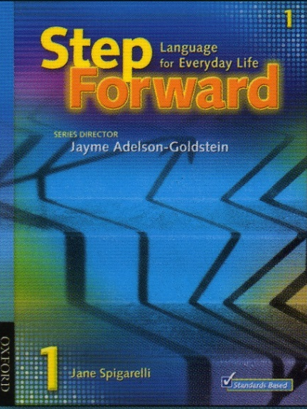
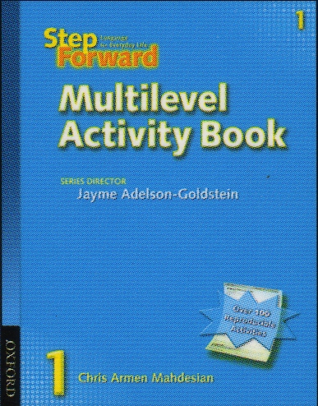
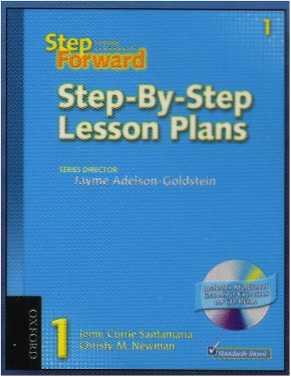
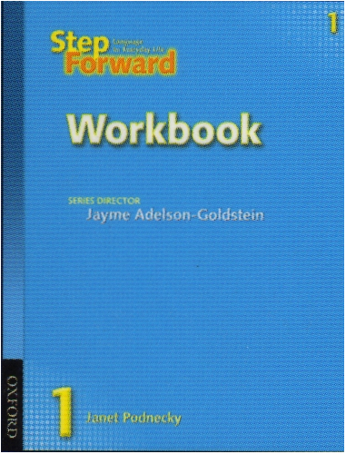
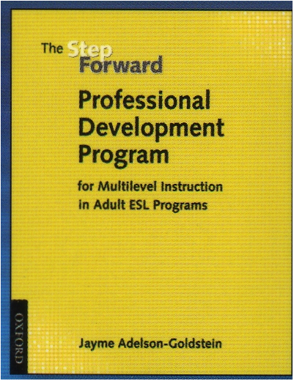
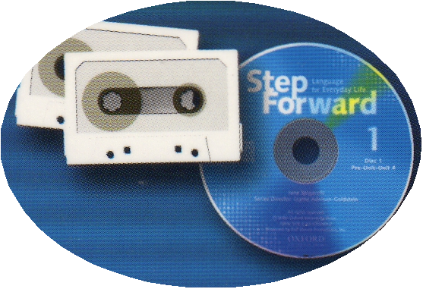
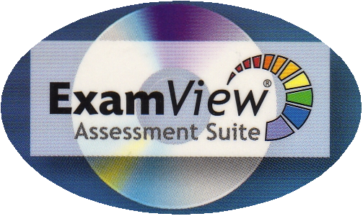

Slide 3
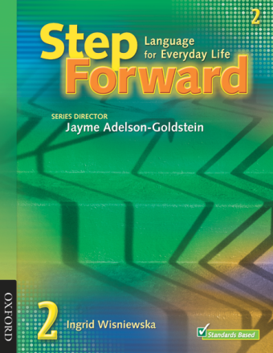
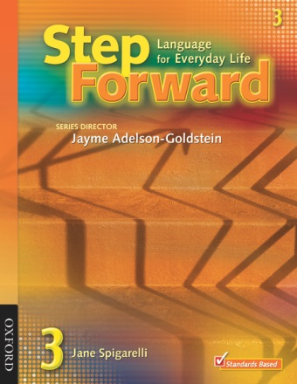
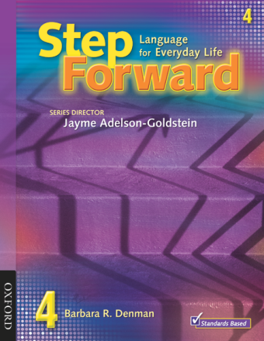
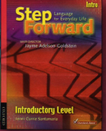
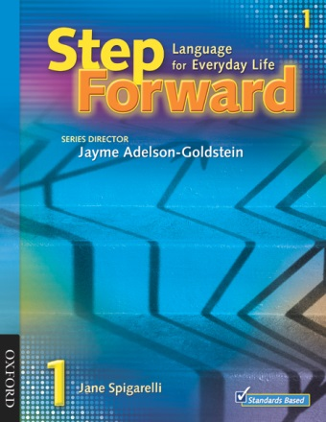
5 levels including
Introductory—Literacy
Level 1—low beginning
Level 2—high beginning
Level 3—low intermediate
Level 4—intermediate
How Many Levels in the Series?
Notes:
NRS Levels— https://www.dllr.state.md.us/gedmd/cs/eslcslevel.pdf
The levels are correlated with the National Reporting System.

Slide 4
Quick Overview
Each level contains 12 thematic units including
(workplace, goal setting, housing, civics & community themes)
5 lessons in each unit
Each unit contains Vocabulary, Life Stories/Real Life Writing, Grammar, Everyday Conversation, Real-Life Reading, Review & Expand (Problem Solving)
Multilevel strategies help tutors meet the varying needs of all learners
Step-By-Step Lesson Plans provide tutors all the information you need to be successful.
b) 4 levels
c) 5 levels
d) 6 levels
Step
Forward
Notes:
Each level
contains 12 thematic units including (workplace, goal setting, housing, civics & community themes)
6 lessons in each unit
Each unit contains Vocabulary, Life Stories/Real Life Writing, Grammar, Everyday Conversation, Real-Life Reading, Review & Expand (Problem Solving)
In each lesson, multilevel strategies help meet the varying needs of all learners.
As tutors you can use SF Step-By-Step Lesson Plans to provide all the information you need to be successful.

Slide 5
Overview of a Unit
1
1
Vocabulary
LESSON
Vocabulary
LESSON
2
Life Stories
2
Life Stories
Life Stories
Life Stories
LESSON
LESSON
3
Grammar
3
Grammar
LESSON
LESSON
4
Everyday Conversation
4
Everyday Conversation
LESSON
LESSON
5
5
Real-life reading
Real-life Reading
LESSON
LESSON
Review and Expand
Notes:
Each level contains 12 thematic units including
(workplace, goal setting, housing, civics & community themes)
6 lessons in each unit
Each unit contains Vocabulary, Life Stories/Real Life Writing, Grammar, Everyday Conversation, Real-Life Reading, Review & Expand (Problem Solving)
Multilevel strategies help tutors meet the varying needs of all learners
Step-By-Step Lesson Plans provide tutors all the information you need to be successful.
Strands contextualized within the themes, lots of opp for active learning within each lesson. With this consistent structure, you see the developmental curriculum principle of expansion and building on prior learning.

Slide 6
WIPPEA
Stages of a Lesson
Sequence the stages of the lesson with your partner.
Warm Up / Review
Communicative Practice
Introduction
Evaluation
Presentation
Introduction
Guided Practice
• Warm Up / Review
• Communicative Practice
• Presentation
• Evaluation
Guided Practice
• Application
• Application
Notes:
2:15 – 2:20
1. Pairs sequence the stages
Look at a lesson plan- read the steps in the warm up and first presentation. Share with your group the suggestions. Decide if you would use it, adapt it, or do something else.

Slide 7
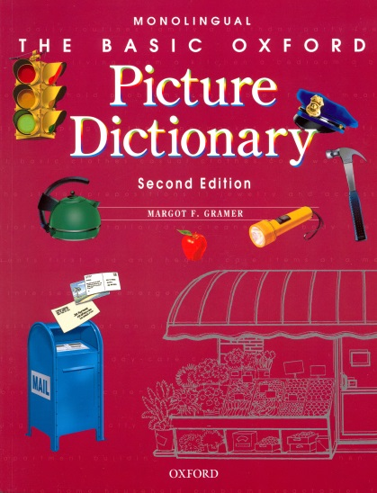
Introductory Book and
Basic Oxford Picture Dictionary) 20 in each book
a) 12 units in each book
b) 10 units in each book
c) 15 units in each book
Step
Forward
Notes:
Introductory book for pre-literate learners.
Correlates to The Oxford Picture Dictionary. OPD Literacy Program provides a needs based approach to instruction. Learners will develop literacy skills and be able to transition into Step Forward Student Book 1.
Turn to page XX

Slide 8
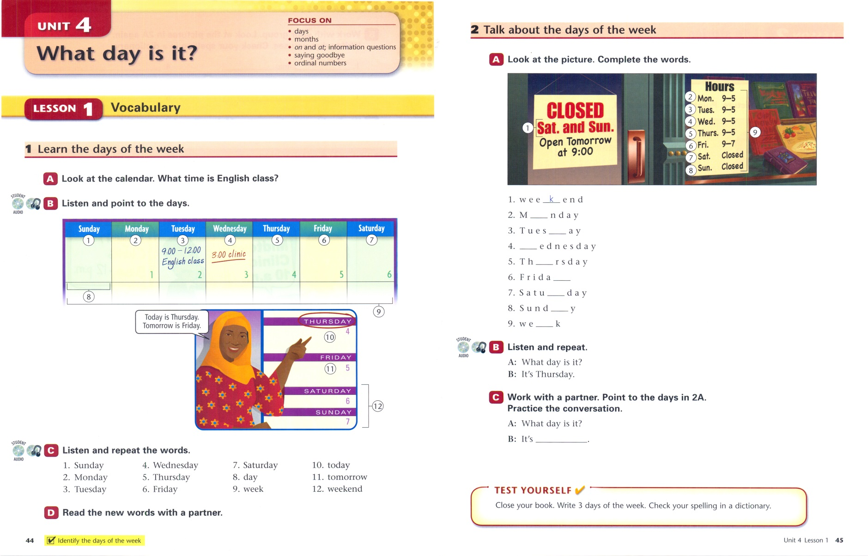
Unit 4—Lesson 1
Vocabulary

Slide 9
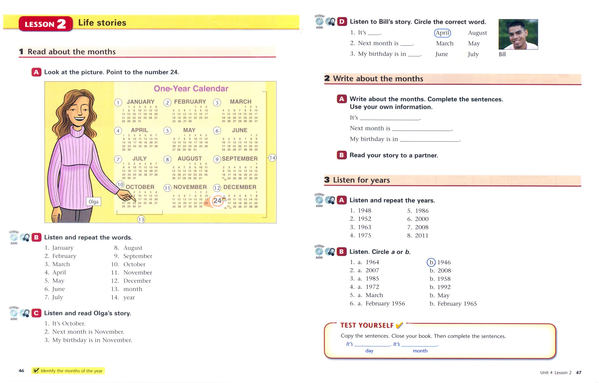
Unit 4—Lesson 2
Life Stories

Slide 10
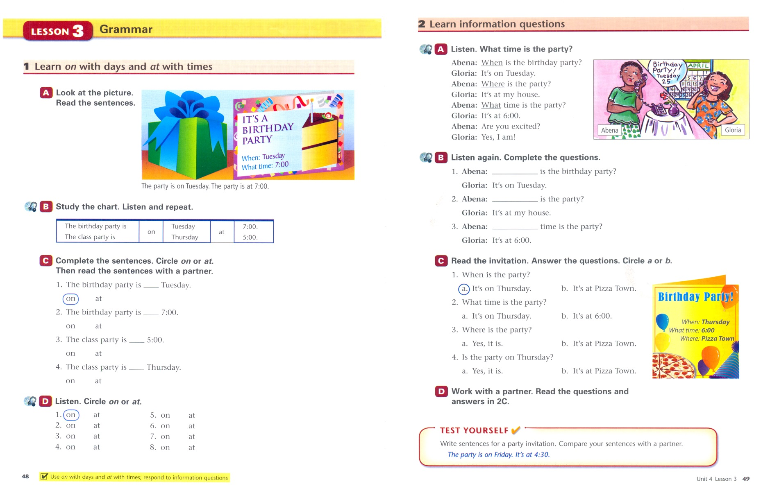
Unit 4—Lesson 3
Grammar

Slide 11
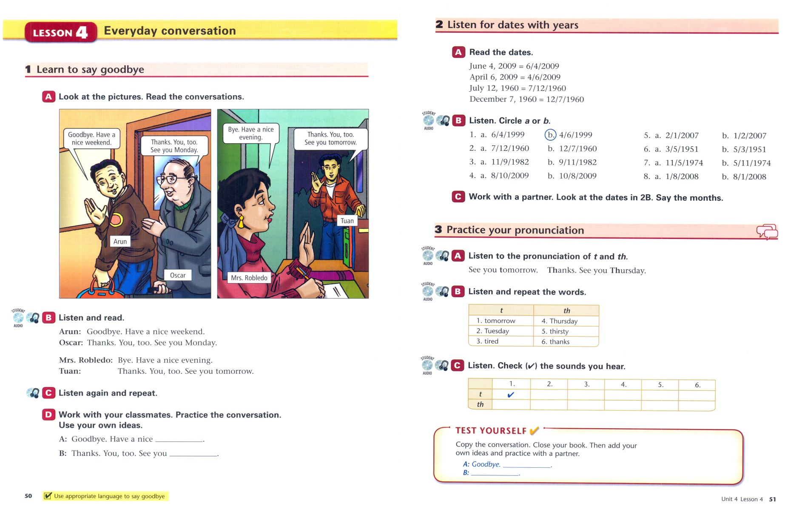
Unit 4—Lesson 4
Everyday Conversation

Slide 12
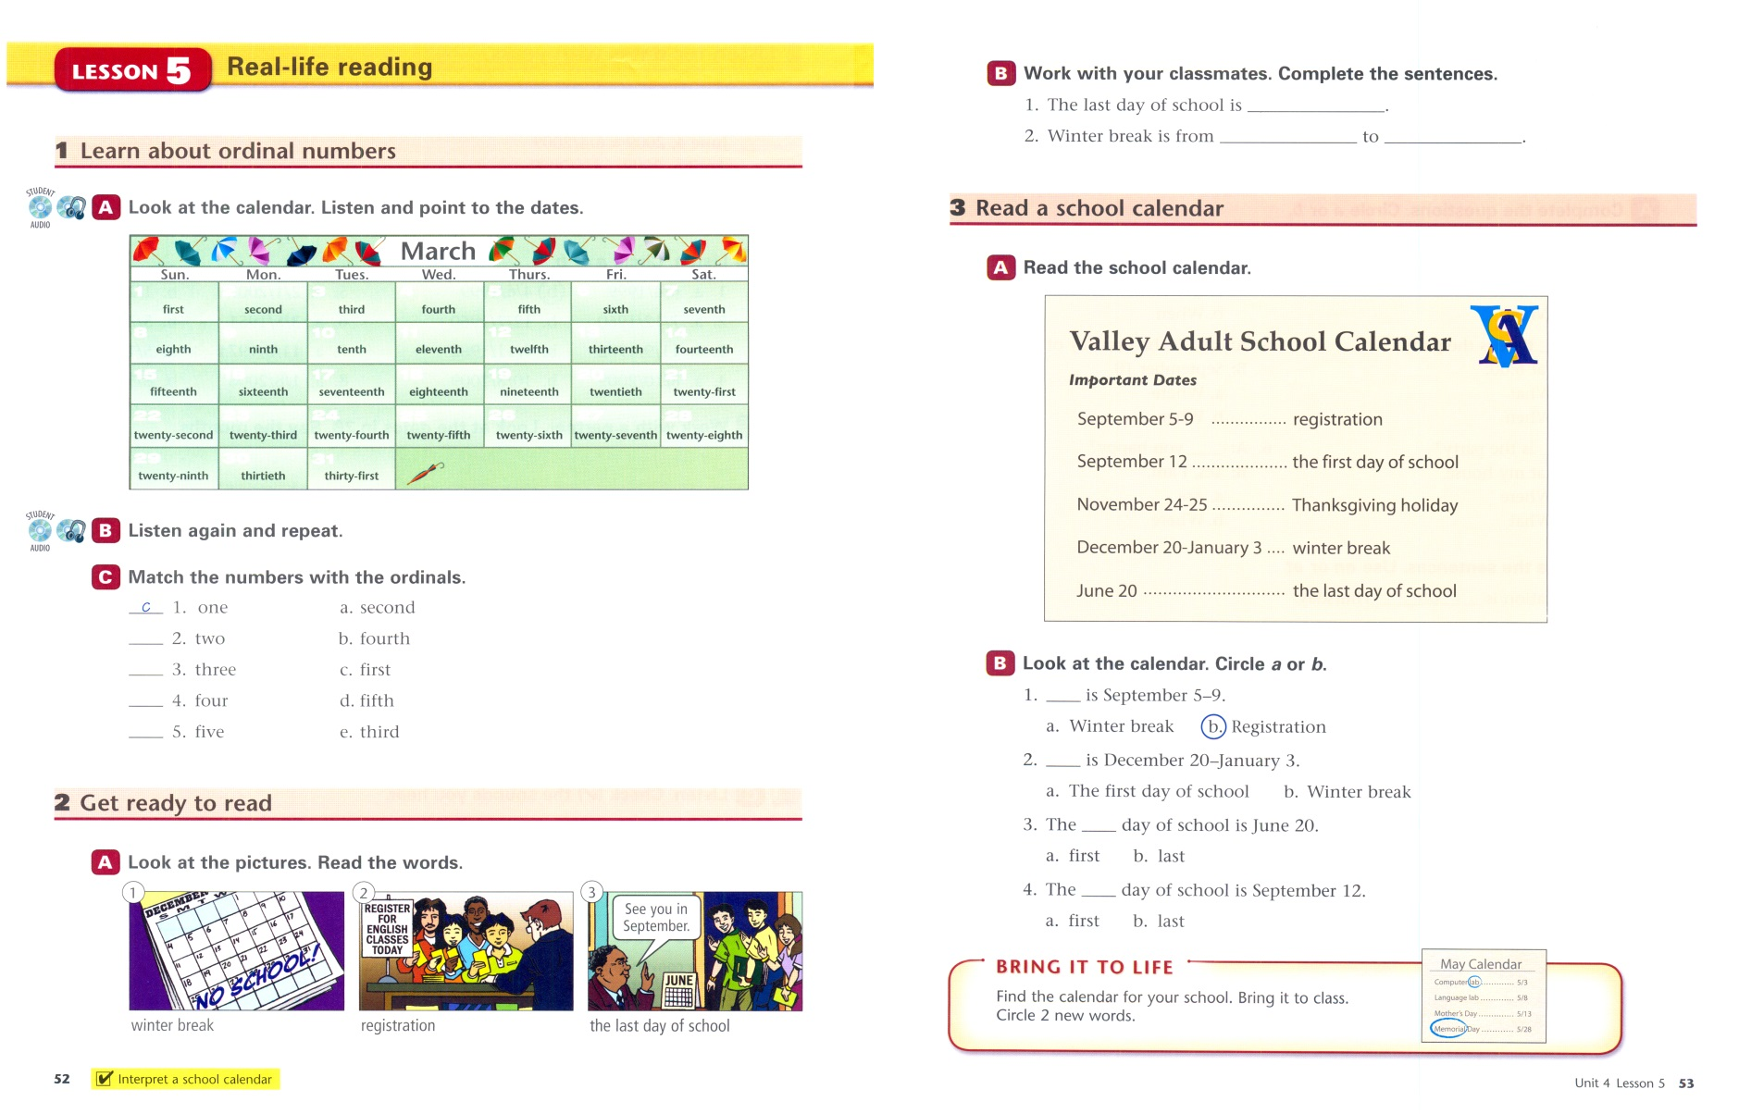
Unit 4—Lesson 5
Real-life Reading

Slide 13
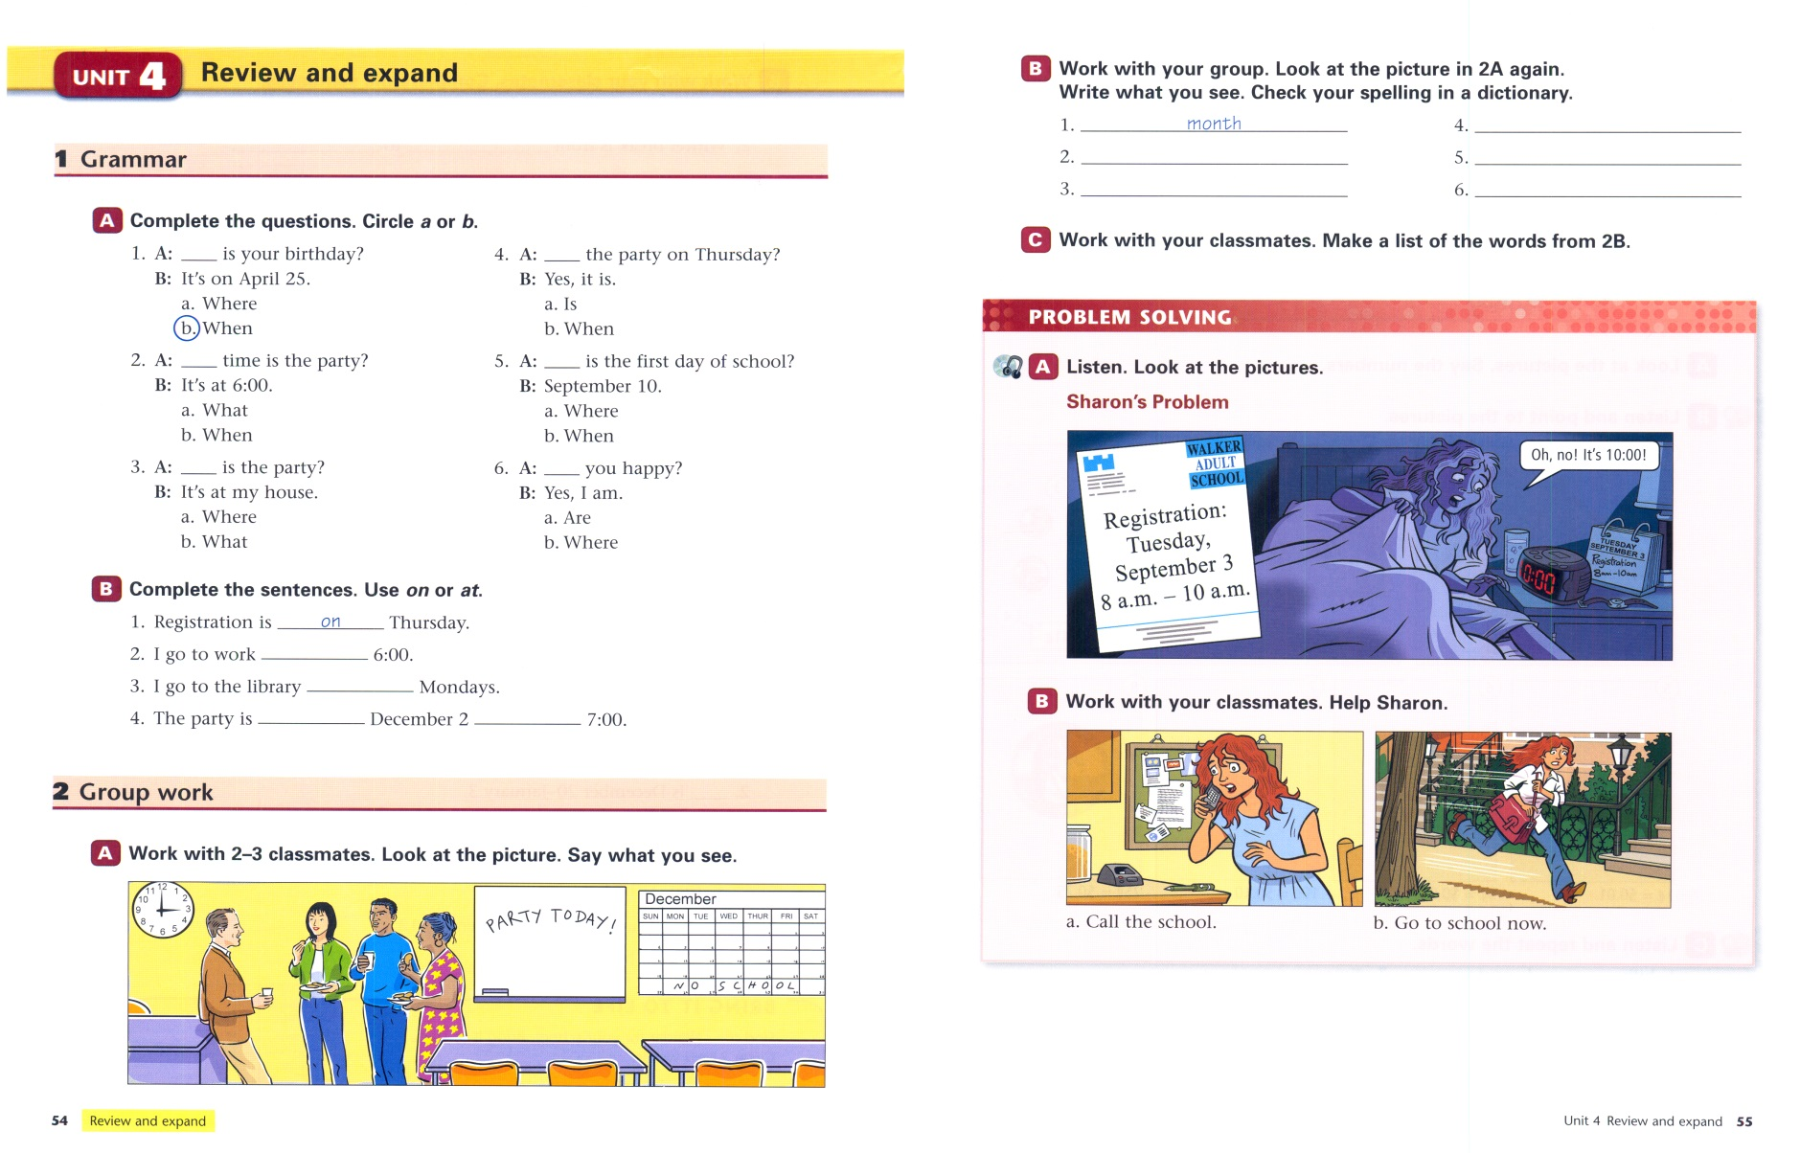
Unit 4—Lesson 6
Review and Expand

Slide 14
Planning Lessons with
Step Forward
Reflect on the Unit
Preview the Lesson
Gather Any Additional Materials
Calculate!
And Go!

Slide 15
Planning Lessons with Step Forward
Activity
Work with your colleague.
Select a lesson.
What is the general objective?
How does this lesson relate to your learners’ needs?
What would you teach from this lesson?
What would you cut, adapt or expand upon?

Slide 16
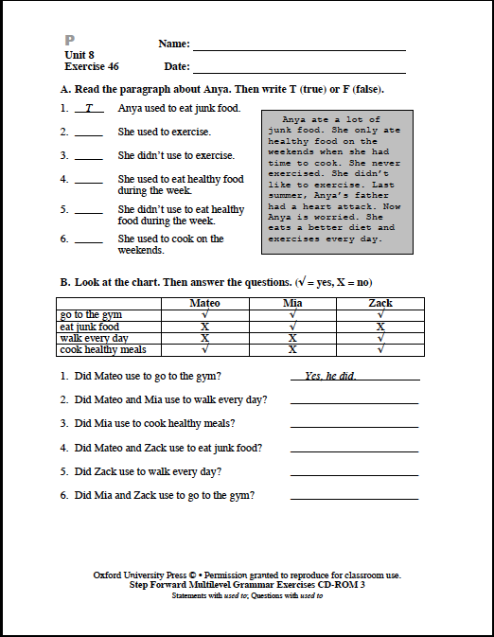
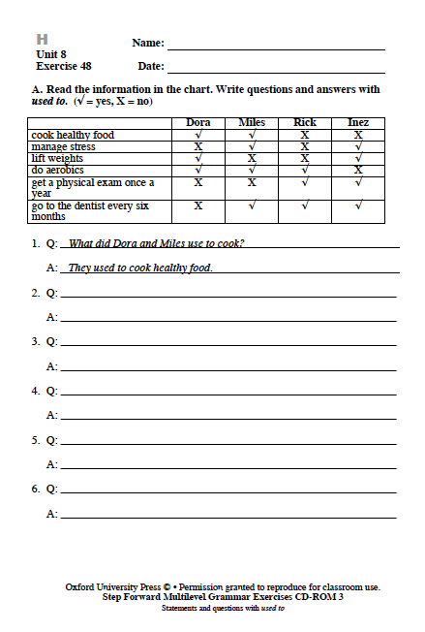
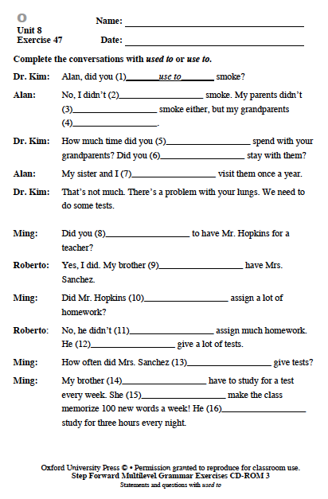
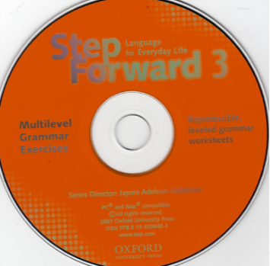


P
H
O
Notes:
We know that students need lots of guided practice with grammar structures—and that not all learners in a class have the same proficiency levels. The Lesson Plans include a CD rom with ML grammar worksheets for learners who are “on level,” below or Pre-level and above or Higher level.

Slide 17
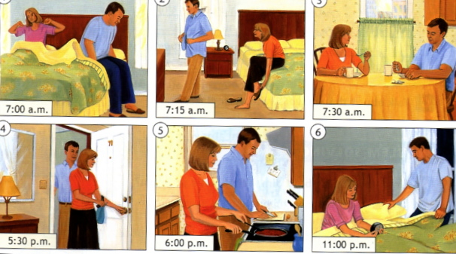
Using Pictures
Ask Questions
Tell a Story
Act out a Sequence
Notes:
3:05 – 3:08ish, my questions
3:08-3:13 they generate questions and ask each other

Slide 18
Questions We Might Ask
WH—
Early Production Questions
What is it?
Who is it?
Where is it?
What is he doing?
What do you think?
Why?
What happened to you today?
Show me the…
Point to the…
Is it a …
Is this a _____ or a _____?

Slide 19
More
Step Forward & Step Toward Workplace & Skills Development
goo.gl/Flnsfk
Stepping Forward to Learner Success
goo.gl/llRSzN
Picturing Success in the Multilevel Classroom with the OPD: goo.gl/hokBPy
Vocabulary Learning Strategies with OPD
goo.gl/aZR2jx
Three Lesson demonstrations
goo.gl/UgF8LY

