Slide 1


2022
Davis Bacon Principles
Federal Labor Standards for Government Construction Contracts

Slide 2

Disclaimer
This presentation is intended as general information only and does not carry the force of legal opinion.
The Department of Labor is providing this information as a public service. This information and related materials are presented to give the public access to information on Department of Labor programs. You should be aware that, while we try to keep the information timely and accurate, there will often be a delay between official publications of the materials and the modification of these pages. Therefore, we make no express or implied guarantees. The Federal Register and the Code of Federal Regulations remain the official source for regulatory information published by the Department of Labor. We will make every effort to keep this information current and to correct errors brought to our attention.

Slide 3
DBA Coverage
Applies to contracts in excess of $2,000 to
which the Federal Government or the District
of Columbia is a party for construction,
alteration, and/or repair, including painting
and decorating, of public buildings or public
works.

Slide 4
Davis Bacon Related Acts (DBRA)
Davis-Bacon (DB) requirements extend to numerous “related Acts” that provide federal assistance by
  Grants
  Loans
  Loan guarantees
  Insurance

Slide 5
Distinguishing DBA and DBRA
DBA
  VA hospital
  Federal office building (GSA)
  Military base housing (DOD)
  National Park road (Dept. of Interior)

Slide 6
Distinguishing DBA and DBRA
DBRA
HUD - assisted housing construction project
EPA - assisted water treatment plant construction project
The Federal Highway Administration provides grants to states for reconstruction of roads and bridges on Federal-aid highways

Slide 7
Compliance Principles
Basics

Slide 8
DBA/DBRA
Compliance Principles
Laborers & Mechanics
Site of the work
Truck drivers
Wages & Fringe Benefits
Apprentices & Trainees
Computing overtime pay
Certified Payroll
Copeland “Anti-kickback” Act
DOL Investigative Procedures
Conformances

Slide 9
Laborers and Mechanics
  Workers whose duties are manual or physical in nature;
  Includes apprentices, trainees and helpers; and
  For CWHSSA, includes guards and watchmen.

Slide 10
Laborers and Mechanics
Does not include:
  Timekeepers, inspectors, architects, engineers; or
  Bona fide executive, administrative, and professional employees as defined under FLSA.
Working foremen are generally non-exempt:
  must be paid the Davis Bacon (DB) rate for the classification of work performed if not 541 exempt.

Slide 11
Site of the Work
Davis-Bacon applies only to laborers and mechanics employed “directly on the site of the work.”
A three-part definition applies to determine the scope of the term “site of the work.”

Slide 12
Site of the Work Definition #1
DBA applies only to workers “directly on the site of the work:”
  The physical place or places where the construction called for in the contract will remain after work has been completed; and
  Any other site where a significant portion of the building or work is constructed, provided that such site is established specifically for the contract.

Slide 13
Site of the Work Definition #2
“Site of the work” also includes job headquarters, tool yards, batch plants, borrow pits, etc., provided they are:
  Located adjacent or virtually adjacent to the
  “site of the work” described in paragraph 1; and
  Dedicated exclusively or nearly so to the performance of the contract or project.
  Except if they are excluded – see next slide

Slide 14
Site of the Work Definition #3
“Site of the work” does not include a contractor’s
or subcontractor’s:
  permanent home office, branch locations, fabrication plants, tool yards, etc.;
  whose location and continuance in operation are determined without regard to a particular covered project.

Slide 15
Truck Drivers
Truck drivers of the contractor or subcontractor are covered by Davis-Bacon for time:
  Spent working on the “site of the work;” and/or
  Spent loading or unloading materials and supplies on the “site of the work,” if such time is more than de minimis.

Slide 16
Truck Drivers
Owner-Operators
DOL has an enforcement position with respect to bona fide owner-operators of trucks who are independent contractors (an owner-operator is a person who owns and drives a truck). Certified payrolls including the names of such owner-operators do not need to show the hours worked or the rates paid, only the notation “owner-operator.”
This position does not apply to owner-operators of other equipment such as bulldozers, cranes, etc.

Slide 17
Material Suppliers
The manufacture and delivery to the work site of supply items such as sand, gravel, and ready-mixed concrete by bona fide material suppliers, are activities not covered by DBA/DBRA requirements (even though the materials are delivered directly into a contractor’s work site mixing facilities).
Bona fide material suppliers (including truck drivers) whose only contractual obligations for on-site work are to deliver materials and/or pick up materials are not considered contractors under the DBA/DBRA. Thus, their employees are not subject to the Davis-Bacon labor standards.

Slide 18
Material Suppliers (cont’d.)
However, laborers and mechanics employed at the site of the work by a material supplier, manufacturer, or carrier that undertakes to perform a part of a construction contract as a subcontractor:
  Would be subject to Davis-Bacon labor standards in the same manner as those employed by any other contractor or subcontractor.
  For enforcement purposes, if such a worker spends more than an incidental amount (20%) of his/her time in a workweek engaged in construction work on the site, he/she is covered for all time spent on the site during workweek.

Slide 19
Compliance Principles
Wage Determinations & Conformances

Slide 20
Wage Determinations
Davis-Bacon WDs specify the prevailing wages, including fringe benefits, which are determined to be prevailing for the described classes of laborers and mechanics employed on construction projects of a similar character in the localities specified therein.

Slide 21
“General” WDs
Issued for most counties for each major type of construction (building, heavy, highway and residential) nationwide.
Official site for General Wage Determinations – https://beta.sam.gov
May be used by Federal agencies without notifying the WHD.

Slide 22
Selecting the Correct Wage Determination
Selecting and incorporating the appropriate general wage determination for the project type
  Building
  Residential
  Highway, and/or
  Heavy
Application of Multiple Wage Schedules
Separate constructions types and:
  At least 20% of the total project is a different type of construction; and/or
  The different type of construction is at least $1 million in cost
  Guidance found in AAM 130 and 131

Slide 23
Interpreting General Wage Determinations
Decision Number
State and county
Type of construction with description
Record of modifications
List of classifications and rates
Basis for rates – Identifiers
  Union Identifiers
  Union Weighted Average Identifiers
  SU Identifiers

Slide 24
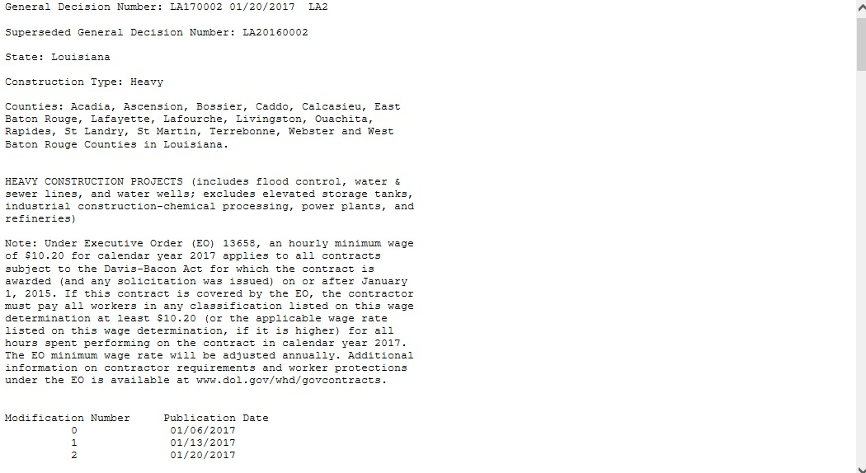
Interpreting “General” WDs
Cover Sheet

Slide 25
Interpreting “General” WDs
Body of WD
Union Identifiers
ELEV0101-001 10/01/2017
ELEVator Constructors: International Union
Local 101: Local union Number
001: Internal Processing Number
10/01/2017: Date the rate became effective on the CBA

Slide 26
Interpreting “General” WDs
Body of WD
CARP0055-001 11/01/2016
Rates Fringes
CARPENTER (Acoustical Ceiling $26.25 $8.64
Installation and Drywall Hanging Only)
---------------------------------------------------
CBA rates are updated when CBA rates are changed

Slide 27
Interpreting “General” WDs
Body of WD
SU (Non-Union) Identifiers
SUCO2015-015 07/31/2015
SU: SUrvey – Basis of Rate(s)
CO: Colorado
2013: Date of Survey
015: Internal numbering
7/31/2015: Date submitted for publication
* SU rates remain unchanged until new survey

Slide 28
Interpreting “General” WDs
Body of WD
SUCO2015-05 07/31/2015
Rates Fringes
Bricklayer...................................$ 21.96 0.00
Carpenter...................................$ 18.22 0.00

Slide 29
Compliance Principles
Apprentices, Trainees, & Helpers

Slide 30
Apprentices and Trainees
Are laborers and mechanics; not listed on WDs.
Permitted to work on covered projects and be paid less than the journey level WD rate when:
  Individually registered in an approved apprenticeship or training program;
  Paid the percentage of hourly rate required by the apprenticeship or training program;

Slide 31
Apprentices
Persons individually registered in a bona fide apprenticeship program registered with DOL’s Employment Training Administration (ETA) Office of Apprenticeship (OA) or a State Apprenticeship Agency recognized by OA.
Individuals in their first 90 days of probationary employment as an apprentice in such a program.
Regulations: 29 C.F.R. §§ 5.2(n)(1) and 5.5(a)(4)(i).

Slide 32
Trainees
Persons registered and receiving on-the-job training in a construction occupation under a program approved in advance by DOL’s Employment Training Administration (ETA).
Regulations: 29 C.F.R. §§ 5.2(n)(2) and 5.5(a)(4)(ii).

Slide 33
Employment Training Administration Office of Apprenticeship
www.doleta.gov
Robert “Bob” Couse
U.S. Department of Labor
Office of Apprenticeship
(405) 231-4338
Couse.robert@dol.gov

Slide 34
Helpers
May be employed if:
  Duties are clearly defined and distinct from other classifications on the WD;
  An established prevailing practice in the area; and
  Not employed in an informal training program.
May be added to WD if all above conditions are met; and no WD class performs the work.

Slide 35
Compliance Principles
Prevailing Wage & Fringe Benefits

Slide 36
Wages & Fringe Benefits
DBA: the terms “wages” and “prevailing wages” include:
  The basic hourly rate (BHR);
  Contractor contributions irrevocably made to a trustee or third party pursuant to a bona fide fringe benefit (FB) fund, plan, or program; and/or
  The rate of costs the contractor reasonably anticipates in providing bona fide FB’s where certain conditions are met.

Slide 37
Wage & Fringe Benefits
Under DBA, FB’s are a component of the DBA
“prevailing wage.”
The prevailing wage obligation may be satisfied by:
  Paying the BHR and FB in cash (including negotiable instruments payable on demand);
  Contributing payments to a bona fide plan; or
  Any combination of the two.

Slide 38
Wages & Fringe Benefits
Must be paid weekly for all hours worked:
  Unless the fringe benefits are paid into a bona fide FB plan and then contributions must be paid no less often then quarterly.
Cash wages paid in excess of BHR may count to offset or satisfy the FB obligation (unlike under SCA).

Slide 39
Prevailing Wage Example
BHR $14.00
FB $ 1.00
Total prevailing wage $15.00
The contractor may comply by paying:
  $15.00 in cash wages
  $14.00 in cash wages plus $1.00 for FB
  $12.00 in cash wages plus $3.00 for FB

Slide 40
Prevailing Wage Example
An employee spent 32 hours working as an electrician, with a BHR of $22.00 and an FBR of $3.00, and 8 hours working as a laborer, with a BHR of $14.00 and a FBR of $1.00.
The employee is due $800.00 for his electrician work (32 hours X ($22.00 + $3.00)) and $120.00 for his laborer work (8 hours X ($14.00 +$1.00)), for a total of $920.00.
The $920.00 can be paid in any combination of cash wages and fringe benefit contributions.

Slide 41
Examples of Fringe Benefits
Life Insurance;
Health Insurance;
Pension;
Vacation;
Holiday; and
Sick Leave (only what exceeds Executive order 13706).

Slide 42
Computing the Hourly Equivalent Fringe Benefit Credit – Medical Insurance
Employer provides medical insurance at $200 per
month to an electrician on a Davis-Bacon project.
The WD requires $16.00 plus $2.50 in FB’s, or $18.50 an hour. Employee works 160 hours a month
  $200/160 hours = $1.25 credit per hour for the FB
  No other benefit provided
  Electrician is due: $17.25 in cash wages per hour
  ($18.50 - $1.25 = $17.25)

Slide 43
Compliance Principles
Overtime

Slide 44
Overtime
Neither DBA nor SCA provide premium rates for overtime hours of work, but both recognize other Federal laws that do:
  Contract Work Hours and Safety Standards Act (CWHSSA) (40 U.S.C. §§ 327-332) applies to contracts in excess of $100,000 ($150,000 for contracts procured under the Federal Acquisition Regulations) that employ laborers, mechanics, guards, and watchmen.
  Fair Labor Standards Act (FLSA) (29 U.S.C. § 201, et seq.)applies more broadly, with over 130 million workers subject to coverage.

Slide 45
Requirements of CWHSSA
Requires overtime pay for laborers, mechanics, guards, and watchmen at a rate of one and a half times the basic rate of pay for hours worked in excess of 40 in a workweek on covered contracts.
Liquidated damages can be assessed per day for each laborer, mechanic, guard, or watchman not paid proper overtime

Slide 46
Coverage of CWHSSA
Covers contracts over $100,000 ($150,000 for contracts procured under the Federal Acquisition Regulations) that require or involve the employment of laborers, mechanics, watchmen or guards on
  DBA covered construction contracts
  DBRA covered construction contracts; and
  SCA covered service contracts
Is self-executing (even if not stated in contract)
Has no “site of the work” limitation

Slide 47
Application of CWHSSA
CWHSSA applies to laborers, mechanics, guards and watchmen for the time spent on covered contract work only.
  Total up all the time each employee spent working on covered contracts – off-site as well as on-site on DBA/DBRA projects;
  Exclude all commercial, non-government, non-covered work.

Slide 48
Overtime Pay is for Hours Worked
CWHSSA and FLSA requirements apply only to hours worked.
  Non-work hours such as paid holidays and paid leave are not counted in computing overtime pay. Rules concerning “Hours Worked” are at 29 C.F.R. Part 785.

Slide 49
Overtime Pay Computations
Example 1
If the employer paid $22.00 in cash wages and paid $5.00 in fringe benefits, the electrician would receive:
44 hours x $22.00 = $ 968.00 for cash wages
44 hours x $ 5.00 = $ 220.00 in fringe benefits
4 hours x ½ x $22.00 = $ 44.00 for CWHSSA earnings
$1232.00

Slide 50
Overtime Pay Computations
Example 2
If the employer paid $20.00 in cash wages and $7.00 in fringe benefits:
44 hours x $20.00 = $ 880.00 for cash wages
44 hours x $ 7.00 = $ 308.00 in fringe benefits
4 hours x ½ x $22.00 = $ 44.00 in CWHSSA earnings
$1232.00

Slide 51
Overtime Pay Computations
Example 3
If the employer paid $24.00 in cash wages and $3.00 in fringe benefits:
44 hours x $22.00 = $ 968.00 for cash wages
44 hours x $ 2.00 = $ 88.00 cash in lieu of fringes
44 hours x $ 3.00 = $ 132.00 in fringe benefits
4 hours x ½ x $22.00 = $ 44.00 in CWHSSA earnings
$ 1232.00

Slide 52
Overtime Computations
Employee Employed at Different Rates
During a workweek, an employee works 20 hours as an Electrician at $22.00 an hour and 24 hours as a Painter at $20.00 an hour.
Electrician $22.00 X 20 hours = $440.00
Painter $20.00 X 24 hours = $480.00
Total Straight time wages $920.00
$920/44 hours = $20.91 (regular rate)
Overtime due: $20.91 X 1/2 x 4 hours = $41.82

Slide 53
Liquidated Damages
CWHSSA
  Liquidated damages shall be computed in the sum of $29 per calendar day on which an individual did not receive the required overtime compensation
  Liquidated damages are assessed by the contracting agency, but the contracting agency must seek the concurrence of the Administrator to reduce or entirely relieve the contractor of liquidated damages liability, per 29 CFR 5.8
FLSA
  The statute provides that liquidated damages shall be assessed in an amount equal to the unpaid overtime compensation
  Liquidated damages are assessed by WHD

Slide 54
Computing Liquidated Damages under CWHSSA
Are computed at $29 per day per violation:
S M T W T F S Total
Regular Time 0 10 12 13 9 8 3 55
15 weekly hours of overtime were worked on 3 calendar days (Thursday, Friday, Saturday) without payment of overtime. Liquidated damages computed at $81. ( Due to increase in January 2023)

Slide 55
Compliance Principles
Copeland Act

Slide 56
Copeland Act
Purpose and Requirements
Prohibits “kickback” of wages and back wages
Requires contractors on DBA/DBRA covered projects to submit weekly a “statement of compliance” (Certified Payroll)
Regulates payroll deductions

Slide 57
18 USC 874 - Kickbacks
Requiring kickbacks is a felony, and under current federal crime provisions can entail a fine of up to $250,000 for a person and $500,000 for a corporation, as well as up to five years in jail.
Depending upon the circumstances, requiring kickbacks can also potentially involve the commission of other felonies, such as false statements, mail or wire fraud, or obstruction of justice.

Slide 58
40 USC 3145 – Certified Payrolls
The properly signed “Statement of Compliance” submitted or transmitted to the appropriate federal agency certifies that:
  The payroll for the payroll period contains the information required to be provided;
  The appropriate information is being maintained;
  Such information is correct and complete;
  Each laborer or mechanic has been paid the full weekly wages earned; and
  Each laborer or mechanic has been paid not less than the applicable wages, as specified in the applicable wage determination incorporated into the contract.

Slide 59
40 USC 3145 – Certified Payrolls
Falsification of a certified payroll is a criminal violation that can result in a fine, up to 5 years in prison, or both. 18 U.S.C. § 874 & 1001.
It can also be grounds for a lawsuit under the False Claims Act. 31 U.S.C. § 3730.

Slide 60
Compliance Principles
Certified Payrolls

Slide 61
Certified Payrolls
Two separate contract clause requirements apply to “certified payrolls” for a project:
  The contractor shall submit weekly for any week in which any contract work is performed a copy of all payrolls. 29 C.F.R. § 5.5(a)(3)(ii)(A).
  Each weekly payroll submitted must be accompanied by a “Statement of Compliance.”
  29 C.F.R. § 5.5(a)(3)(ii)(B).

Slide 62
Certified Payrolls
Weekly, the contractor must submit “a copy of
all payrolls” to:
  The federal agency; or
  If the federal agency is a not a party to the contract, to the applicant, sponsor, or owner for transmission to the federal agency).
  29 C.F.R. § 5.5(a)(3)(ii)(A).

Slide 63
Certified Payrolls
Weekly payrolls must include specific information as required by 29 C.F.R. § 5.5(a)(3).
Weekly payroll information may be submitted in any form desired.
  Optional Form WH-347 is available for this purpose
  The WH-347 form, with instructions, is at:
    http://www.dol.gov/whd/forms/wh347instr.htm

Slide 64
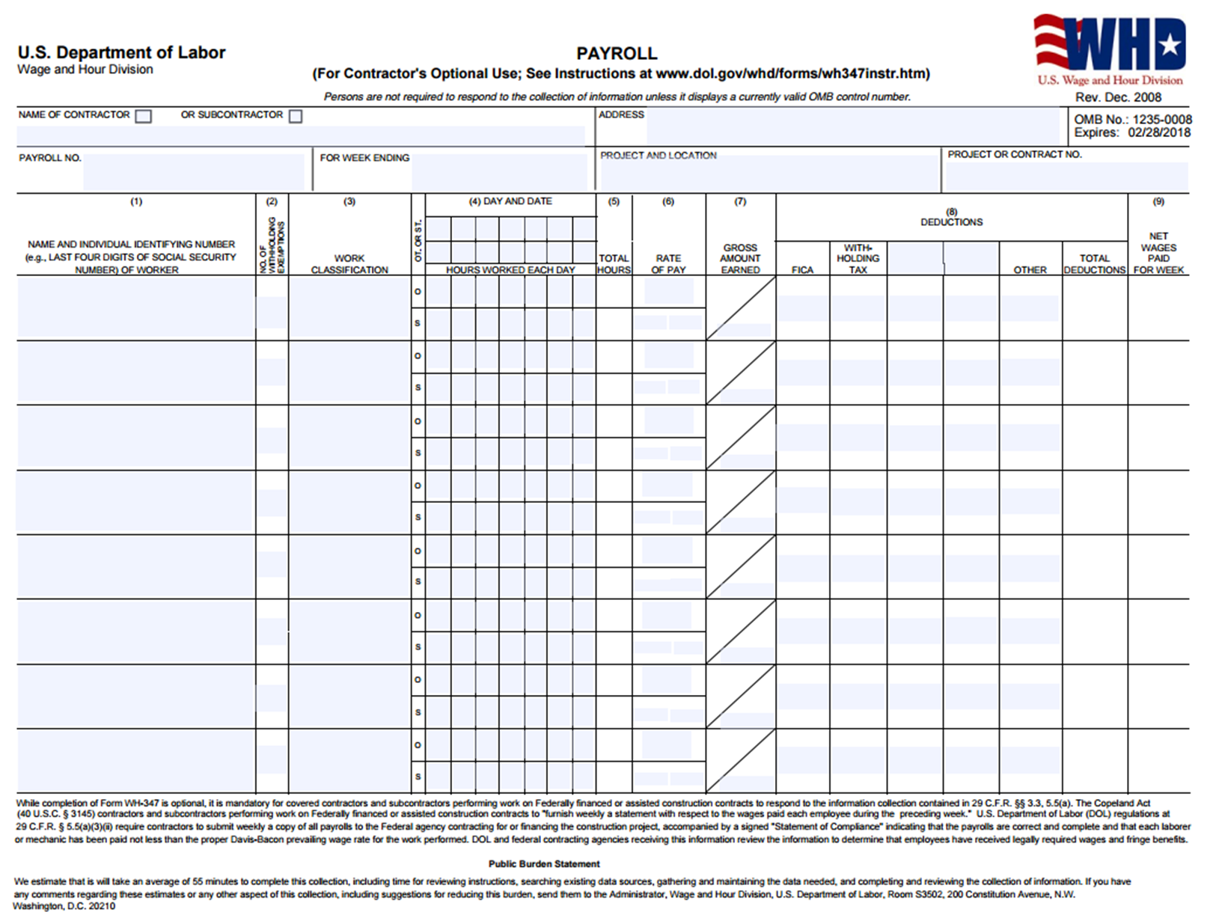

Slide 65
“Statement of Compliance”
The certification “Statement of Compliance” attached to each weekly payroll must be:
  On page 2 of the WH-347 Form “Payroll (For Contractors Optional Use)”; or
  On any form with identical wording.

Slide 66
“Statement of Compliance” Certification for weekly payrolls
The properly signed “Statement of Compliance” submitted or transmitted to the appropriate federal agency certifies that:
  The payroll for the payroll period contains the information required to be provided;
  The appropriate information is being maintained;
  Such information is correct and complete;
  Each laborer or mechanic has been paid the full weekly wages earned; and
  Each laborer or mechanic has been paid not less than the applicable wages, as specified in the applicable wage determination incorporated into the contract.

Slide 67
“Statement of Compliance”
Must be executed by the contractor or subcontractor or by an authorized officer or employee of the contractor or subcontractor who supervises the payment of wages. 29 C.F.R. § 3.3(b).
Each weekly statement must be delivered or mailed by the contractor or subcontractor, within seven days after the regular payment date of the payroll period, to a representative of a Federal or State agency contracting for or financing the building or work. 29 C.F.R. § 3.4(a).

Slide 68
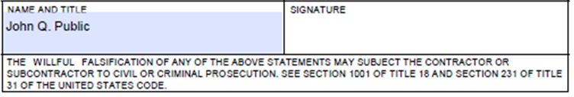
THIS IS IMPORTANT!

Slide 69
Deductions
Regulations enacted under the authority of 40 USC 3145(a) also regulate the circumstances in which contractors may take deductions from payroll.
29 CFR 3.5 describes when deductions may be made without prior approval from the Secretary, while 29 CFR 3.6 describes the circumstances in which the Secretary may grant approval for other types of deductions

Slide 70
Compliance Principles
Investigative Procedures

Slide 71
Investigative Responsibilities
Contracting agencies have day to day enforcement responsibility for:
  Contract Stipulations;
  Wage Determinations;
  WH-1321 Poster;
  Reviewing certified payrolls;
  Employee interviews and investigations;
  Forwarding refusal-to-pay and/or debarment consideration cases to WHD for appropriate action; and
  Enforcement reports.

Slide 72
Investigative Responsibilities
DOL Functions/Responsibilities:
  Determining “prevailing wages”;
  Issuing regulations and standards to be observed by contracting agencies; and
  Perform oversight function and has independent authority to conduct investigations.

Slide 73
Why Are Employers Investigated?
WHD conducts investigations for a variety of reasons, and generally does not disclose the reason during the investigation.
Many investigations are the result of complaints, but all complaints are confidential, and investigators may not even disclose whether one has been received.
WHD also conducts investigations of business or industries for a variety of other reasons, such as high violation rates, employment of vulnerable workers, or rapid changes in the industry.

Slide 74
The Investigation Process
Investigators will obtain the following information:
  Copy of labor standards clauses in contract;
  Copy of Davis-Bacon WD in contract, including any instructions for multiple schedules;
  Copies of certified payrolls; and
  Employer identification number.
Notes:
74

Slide 75
The Investigation Process
Initial conference with employer.
Examine certified payrolls.
Examine basic payroll records.
Check for compliance with apprenticeship and/or trainee requirements.
Interview employees
Determine if a conformance is necessary.
Evaluate compliance with prevailing wages and FBs
Apply CWHSSA if applicable
Compute back wages and liquidated damages, if any
Final conference with employer to discuss results of the investigation
Notes:
75

Slide 76
Conclusion of Investigation
Final Conference Procedure:
  Inform contractor of investigation findings;
  Detail steps to eliminate violations;
  Consider additional evidence that may impact on findings (e.g., conformance); and
  Request payment of back wages and any liquidated damages under CWHSSA.
Notes:
76

Slide 77
Compliance Principles
Withholding & Debarment

Slide 78
Withholding
DBA and CWHSSA provide for withholding of contract funds to satisfy alleged wage underpayments pending resolution of a wage dispute.
  40 U.S.C. § 3142(c)(3); 40 U.S.C. § 3702(d).
Withholding of contract funds is an effective enforcement tool in DBA/DBRA/CWHSSA cases.
  It protects the rights of covered workers to wages due them.

Slide 79
Withholding
Withholding from another federal contract with the same prime contractor is called “cross-withholding.”
The contracting agency may withhold funds:
  on its own initiative; or
  at the direction of DOL.

Slide 80
Debarment
Occurs when a contractor is declared ineligible for future contracts due to:
  Violations of the DBA in disregard of its obligations to employees or subcontractors.
  Aggravated or willful violations under the labor standards provisions of related Acts.
Period of ineligibility is 3 years for DBA and up to 3 years for DBRA.

Slide 81
Debarment Criteria
Debarment is considered when a contractor has:
  Submitted falsified certified payrolls;
  Required “kickbacks” of wages or back wages;
  Committed repeat violations;
  Committed serious violations;
  Misclassified covered workers in clear disregard of proper classification norms; and/or
  As a prime contractor, failed to ensure compliance by subcontractors.

Slide 82
Debarment List
The name(s) of the contractor and any responsible parties, along with the name of any firms in which they are known to have an interest, are placed on the list of ineligible persons or firms, which is distributed to federal agencies.
This list is searchable online at the System Awards Management website

Slide 83
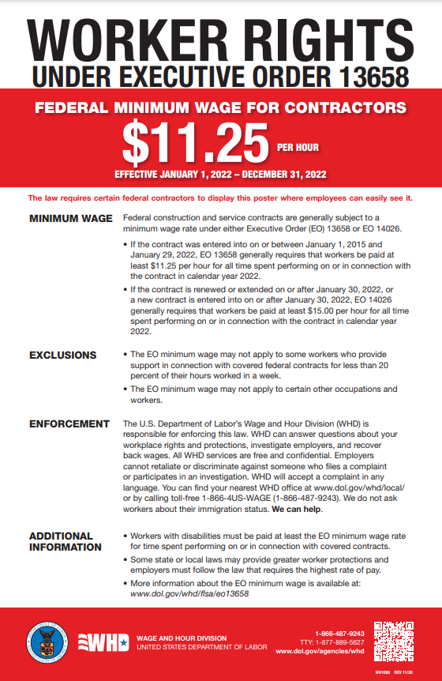
Federal Minimum Wage

Slide 84

Paid Sick Leave

Slide 85
Overview of Executive Order 13706:
Paid Sick Leave for Federal Contract Workers
EO 13706 was signed on September 7, 2015.
  It requires covered contractors to allow employees to accrue 1 hour of paid sick leave for every 30 hours worked on or in connection with a covered contract, up to 56 hours (7 days) per year, and to use accrued leave for certain purposes.
Regulations for the EO were published on September 30, 2016
(29 CFR Part 13).
  The regulations provide details about coverage, exclusions, the accrual and use of paid sick leave, requirements for contractors and contracting agencies, and enforcement.

Slide 86

Overview of Executive Order 13706:
Paid Sick Leave for Federal Contract Workers
Requirements are effective as of January 1, 2017.
  The requirements of the EO and regulations are effective as of January 1, 2017, though they only apply to “new contracts” on or after that date.

Slide 87
Coverage:
Which contracts are covered by EO 13706?
EO 13706 applies to four types of contracts entered into by the federal government (29 CFR 13.3(a)(1):
Procurement contracts for construction covered by the Davis-Bacon Act (DBA).
  This includes prime contracts at the $2,000 threshold and DBA-covered lower-tier contracts of any monetary value.
Service contracts covered by the Service Contract Act (SCA).
  This includes prime contracts at the $2,500 threshold and SCA-covered lower-tier contracts of any monetary value.

Slide 88
The Job Classifications I need are Missing???

Slide 89
Conformances
Unlisted classifications needed for work not included within the scope of the classifications listed may be added after award only as provided in the labor standards contract clauses (29CFR 5.5 (a) (1) (ii)).
Conformance requirements:
  The work to be performed by the proposed classification is not performed by a classification already in the wage determination (WD);
  The proposed wage rate must bear a reasonable relationship to WD rates; and
  The proposed classification is utilized in the area by the construction industry.

Slide 90
Unnecessary Conformance Actions
Conformance requests are not
needed for bona fide:
    Apprentices;
    Trainees; or
    Welders

Slide 91
Conformance Process
Pre-Bid/Pre-Award
Both the Contracting Agency & Contractor should:
Review the WD;
Compare the WD with the project work;
Anticipate needed classifications; and
Apply key criteria.

Slide 92
Conformance Process
After-Award
Contractor should:
Identify needed classes;
  At the pre-construction conference.
  From certified payrolls.
Advise agency of the needed classification;
Complete Contractor Part of SF-Form 1444.
  Apply Conformance Key Criteria.
Forward SF-Form 1444 to agency for review, signature, and submission to DOL.

Slide 93
Conformance Process:
Submitting the SF-1444
https://www.dol.gov/whd/govcontracts/dbra-forms.htm
https://www.dol.gov/whd/govcontracts/dbra-guidance.htm

Slide 94
Compliance Principles
Surveys

Slide 95
Area Practice Surveys
There are no nationwide standard classification definitions under the DBA.
To determine proper classifications for workers employed on a Davis-Bacon covered project, it may be necessary to examine local area practice.

Slide 96
Impact of Survey Participation
Accuracy and completeness of wage determinations is dependent upon:
Survey participation by contractors, unions, contractor associations, federal agencies and other interested parties; and
The level of construction activity.

Slide 97
Wage Survey Process
Notification of contractors and interested parties;
Non-respondent follow-up; and
Data collection, analysis and clarification.
  If insufficient data is received for a classification, no rate will be recommended.

Slide 98
Compliance Assistance

Slide 99
Online Resources
Wage Determinations – https://beta.sam.gov/
Wage and Hour Division - http://www.dol.gov/whd
Resource Book - https://www.dol.gov/whd/govcontracts/pwrb/toc.htm
Office of the Administrative Law Judges Law Library - http://www.oalj.dol.gov
Administrative Review Board - http://www.dol.gov/arb

Slide 100
Local Resources
Oklahoma City District Office
  405-231-4158
Tulsa Area Office
  918-581-6303
Lawton Field Office
  580-357-3796

Slide 101
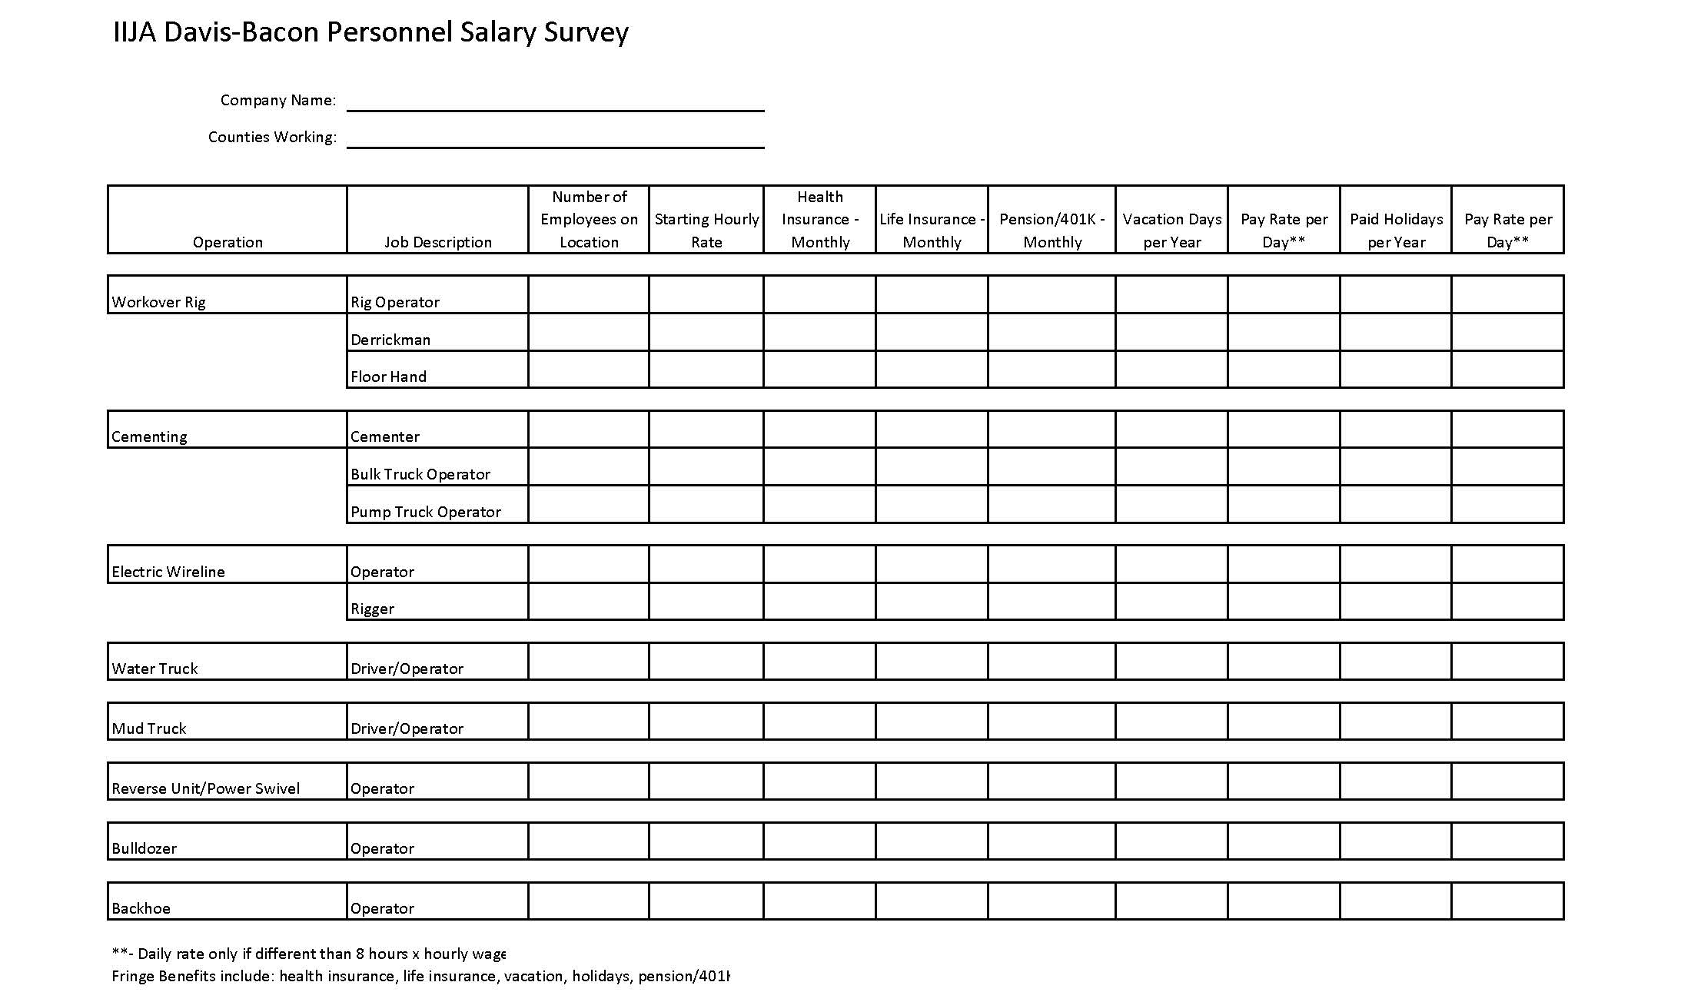
Area Practice Survey

