Slide 1

Prevention Division
Strategic Prevention Enhancement Planning
March 2012

Slide 2
Prevention Division
Mission – To implement and sustain comprehensive, statewide prevention efforts that are evidence-based and accountable to the state’s citizens, encourage the collaboration of multiple agencies and organizations, and enhance the capacity of communities to provide an effective and comprehensive system of prevention services reflective of community needs and resources.
Vision – A future for Oklahoma in which every citizen is provided the opportunity to achieve a state of health and well-being free from the scourge of mental, emotional, and behavioral disorders.

Slide 3
What the Data Say
Notes:
“Data” is technically plural

Slide 4
Underage Drinking
In 2009, among 9th to 12th grade Oklahoma public high school students
71% had at least one drink during their life.
19% had their first drink of alcohol before the age of 13.
39% had at least one drink during the last 30 days.
11% drove a vehicle while drinking during the past 30 days.
24% of students had 5 or more drinks of alcohol in a row, that is, within a couple of hours, one or more of the past 30 days.

Slide 5
Alcohol Consequences
Oklahoma is consistently above the national average in crimes related to alcohol. Since 2003, there has been an 18.1% increase in aggravated assaults, sexual assaults, and robberies. (UCR)
Oklahoma is consistently above the national average in alcohol-related mortality.
In 2009, 11% of Oklahoma’s adolescents drove while drinking, 13% higher than the national average (YRBS).

Slide 6
Drug Consumption
Oklahoma ranks number one for the non-medical use of pain relievers in the past year in all age categories: 12+, 12-17, 18-25 and 26+. (NSDUH, 2009)
Adolescent use of inhalants is on a steady ascent. In 2009, 12.7 percent of Oklahoma adolescents reported inhalant use, surpassing the national average of 11.7 percent. (YRBS)
Oklahoma has been consistently above the national average among persons aged 12 and older reporting the use of any illicit drug other than marijuana. (NSDUH)
Oklahoma exceeds the national average in adolescent methamphetamine, cocaine, ecstasy, steroid, and inhalant use. (YRBS, 2009)
Since 2003, the percentage of youth methamphetamine users in grades 9-12 has dropped by half. (YRBS)
Notes:
*2010 Partnership Attitude Tracking Study (PATS) contradicts this.

Slide 7
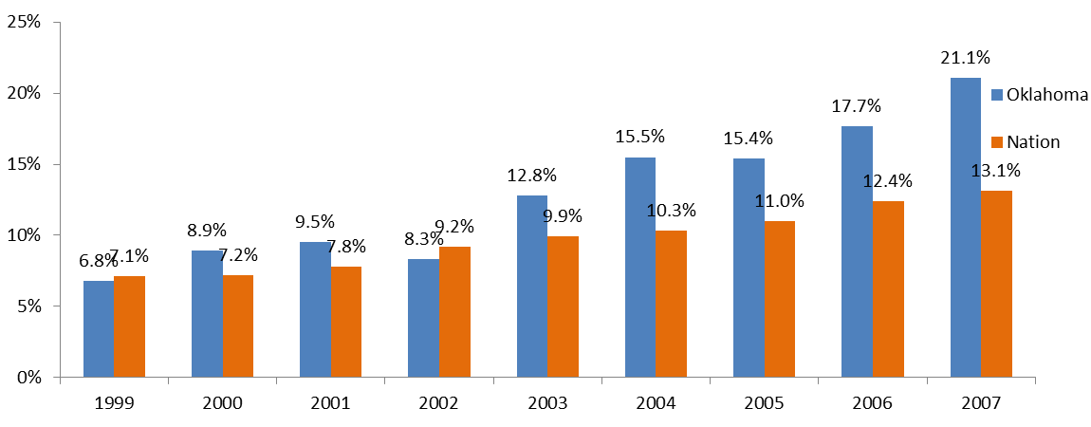
Drug Consequences
In 2007, the rate per 100,000 of deaths due to drug poisonings was 19.1 for Oklahoma and 11.9 for the Nation as a whole. (NVSS)
In 2009, Oklahoma reported 3573.8 per 100,000 property crimes compared to the national rate of 3036.1 per 100,000. (UCR)
There has been a 210 percent increase in opiate-related deaths in Oklahoma since 1999. (NVSS) Oklahoma ranked 4th in the Nation for opiate overdoes deaths, exceeding the national average by 123 percent. (NCHS)
NVSS 1999-2007 Opioid Overdose Deaths Per 100,000 Population

Slide 8
Where to Get Data
Oklahoma Data Query System
To provide communities and agencies with easy access to available alcohol, tobacco, and other drug consumption and consequence data.
http://indicators.bachharrison.com/okdataquerysystem

Slide 9
What Needs to Happen

Slide 10
What is Prevention?
Prevention is viewed as a proactive process by which conditions that promote wellbeing are created; empower individuals and communities to meet the challenges of life events and transitions by creating conditions and reinforcing individual and collective behaviors that lead to healthy communities and lifestyles.

Slide 11
What is the Environmental Approach to Prevention?
Strategies that aim to decrease social and health consequences of substance abuse by limiting access to substances and changing social norms that are accepting and permissive of substance abuse.
How? By changing public laws, policies and practices to create environments that decrease the probability of substance abuse.

Slide 12
Environmental Prevention Focuses on Community Risk
Why focus on the environment?
Has not traditionally been addressed
Costs less – inexpensive
Changes the culture/what’s acceptable and normal
Impacts more people for the long term

Slide 13

Causal/Contributing Factors
Factors that have been identified as being strongly related to and influence the occurrence and magnitude of substance use and its consequences.
SUBSTANCE USE and RELATED CONSEQUENCES
Causal Variables
SCIENTIFIC KNOWLEDGE ABOUT PREVENTION STRATEGIES

Slide 14
Variables
Availability
  Economic Availability - Price
  Retail Availability - ATOD accessibility from retail sources (money is exchanged).
  Social Availability – ATOD accessibility from non-retail sources (money rarely exchanged -- family and friends).
Promotion- Attempts to increase the attractiveness of drinking, smoking or using illicit drugs and/or the substances themselves

Slide 15
Variables
Norms - Informal standards or values regarding the acceptability or unacceptability of certain behaviors, including substance use.
Enforcement - Of laws and regulations beyond the passage of the law.
Individual characteristics - Values, attitudes, and social associations that influence individual decisions to use

Slide 16
Economic Availability (Price)
ALCOHOL:
  Higher alcohol prices are associated both with less alcohol consumption and fewer associated problems
  Studies have found increased price leads to decreased alcohol-related problems
TOBACCO:
  Higher tobacco prices are associated both with less consumption and fewer associated problems
  Studies have found that increased price leads to decreased tobacco use (cigarettes and smokeless)
ILLICIT DRUGS:
  Higher illicit drug prices are associated with reduced consumption
  Studies have found that an increase in price yields decreased use of marijuana, cocaine, and heroin

Slide 17
Retail Availability
ALCOHOL:
  Specific efforts to reduce retail availability have found reduced retail availability results in lower alcohol consumption and associated problems (all ages)
TOBACCO:
  Local efforts have demonstrated that efforts to enact and enforce underage tobacco laws can reduce the retail sales rate of tobacco (studies focus on youth)
ILLICIT DRUGS:
  Few studies have examined relationship between efforts to change the retail availability of illicit drugs and use or associated problems. Evidence suggests can at minimum move retail markets.

Slide 18
Social Availability
ALCOHOL:
  Majority of alcohol consumed by youth is obtained through social sources
  Worldwide, 1/3-2/3 of drunk driving offenders had last drink in unlicensed premise (e.g., home, party)
  Little intervention data are available
TOBACCO:
  Most common sources of cigarettes by youth are gifts, borrowing, or stealing from family members and peers
  Little intervention research available
ILLICIT DRUGS:
  Large percentage of users report obtaining drugs as gift
  No intervention research

Slide 19
Promotion
ALCOHOL:
  Advertising is almost universal in Western countries.
  High recall of advertising among youth and increased exposure to alcohol ads associated with increased consumption and hazardous drinking
  Partial bans appear not to impact consumption; total bans show some effects on consumption and related problems
TOBACCO:
  Advertising is almost universal in Western countries.
  High recall of advertising among youth increased exposure to tobacco ads associated with increased consumption
  Mixed findings on effects of advertising bans or restrictions
ILLICIT DRUGS:
  Limited promotion through legal channels
  No studies that have examined the relationship between promotion and illicit drug use and associated problems

Slide 20
Community Norms
ALCOHOL:
  Countries where drinking and/or excess drinking not sanctioned drink less than countries where use is widely sanctioned
  Surveys find increasing support over time for restrictions on alcohol access and use indicating a temporal change in norms as consumption declines.
TOBACCO:
  Gender difference in smoking likely reflect social norms
  Surveys show increasing support over time for restrictions on tobacco access and use indicating a temporal change in norms as consumption declines.
ILLICIT DRUGS:
  Little research exploring the influence of social norms on illicit drug use was found.

Slide 21
Enforcement
ALCOHOL:
  Studies of efforts to enforce youth access and specific types of use policies find increased enforcement related to changes in use and related problems.
TOBACCO:
  Studies of enforcement of youth access and clean air laws provide strong evidence that increases in enforcement can reduce tobacco use and problems associated with use.
ILLICIT DRUGS:
  Marginal increases in enforcement efforts appear not to change use patterns or problems. Increased enforcement may at times produce increased use and/or problems

Slide 22
Why Prevention?
Prevention saves money.
Research indicates that for every $1 invested in prevention up to $18 can be saved.
Prevention preserves public health, safety, and wellbeing.
Prevention saves lives.

Slide 23
Oklahoma Prevention Initiatives
What we do
Who to contact
Prevention Block Grant
Strategic Prevention Framework State Incentive Grant
State Epidemiology Outcomes Workgroup
Too Much To Lose
Youth Suicide Prevention
Synar Compliance
Oklahoma Prevention Needs Assessment
Oklahoma Partnership Initiative
Mental Health First Aid
State Prevention Enhancement Grant
Stephanie U’Ren
Young Onuorah
Jamie Piatt
Adrienne Rollins
David Harris
Lenae Clement
Jamie Piatt
Elicia Berryhill
Dane Libart
Deborah Smith
http://ok.gov/odmhsas/Prevention_/Prevention_Initiatives/index.html

Slide 24

Prevention Takes Careful Planning
Strategic Prevention Framework

Slide 25
State Prevention Enhancement Grant
One-year cooperative agreement
To strengthen and enhance current prevention infrastructure
For community-oriented, evidence-based prevention services.

Slide 26
Regional Prevention Coordinators

Slide 27
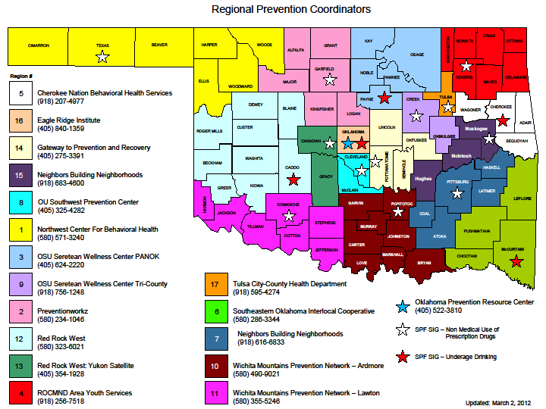

Slide 28

Populations of Focus
Asian American
African American
Elderly
Latino
LGBTQ2
Low Income
Military Families
Native American
Rural

Slide 29
Why We Need Your Help
To help us determine:
whether our substance abuse prevention services are meeting focus population’s needs
what data are available to help us assess, plan, support and/or deliver services that are inclusive of the focus populations
what data/gaps exist
what barriers exist
ways to address unmet needs
what additional partnerships should be developed

Slide 30
The Process
Workgroup Meetings
Outcome
Facilitator (keep discussions lively and ongoing)
Group leader (recruit/retain members/organize meetings)
4-5 active participating members
Note taker (record discussions)
3-4 meetings
Mileage covered (if necessary)
Prepared agenda
Compile report of recommendations
focused on substance
abuse prevention
By June 30, 2012

Slide 31
Will You Continue Meeting?
The group should decide whether it is beneficial to the focus population and to the ODMHSAS to continue meeting and in what capacity (advisory, independent, etc.)

Slide 32

Questions
Jessica Hawkins
Director of Prevention Division
405-522-5952
jhawkins@odmhsas.org

