Slide 1
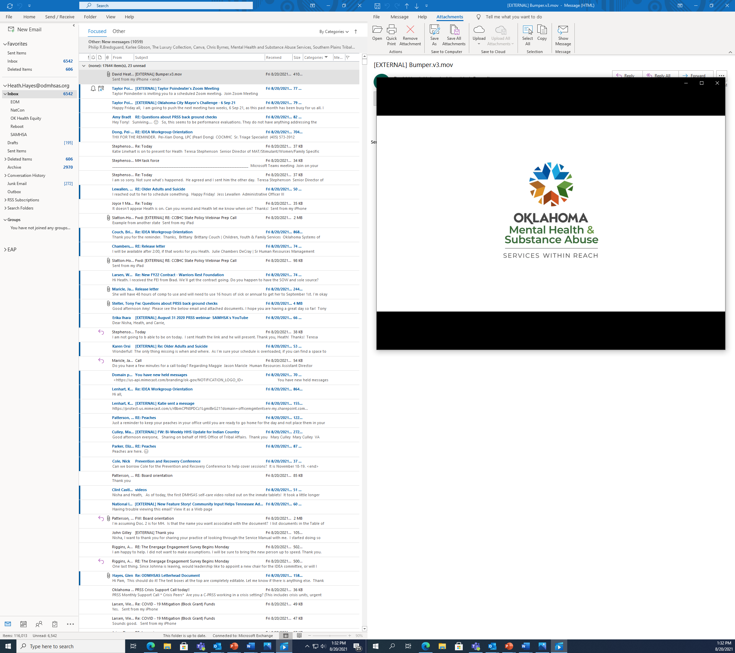
Methamphetamine in Oklahoma:
Finding Solutions
Commissioner
Carrie Slatton-Hodges

Slide 2
Stimulant Use in Oklahoma
Methamphetamine is the number one drug of choice in Oklahoma.
  33.6% as number one drug of choice
  50.8% report meth being a top 3 drug of choice
Number of people entering ODMHSAS funded treatment for meth increased by 200% since 2019.
Approximately 80% of crisis center admissions test positive for stimulant use.

Slide 3

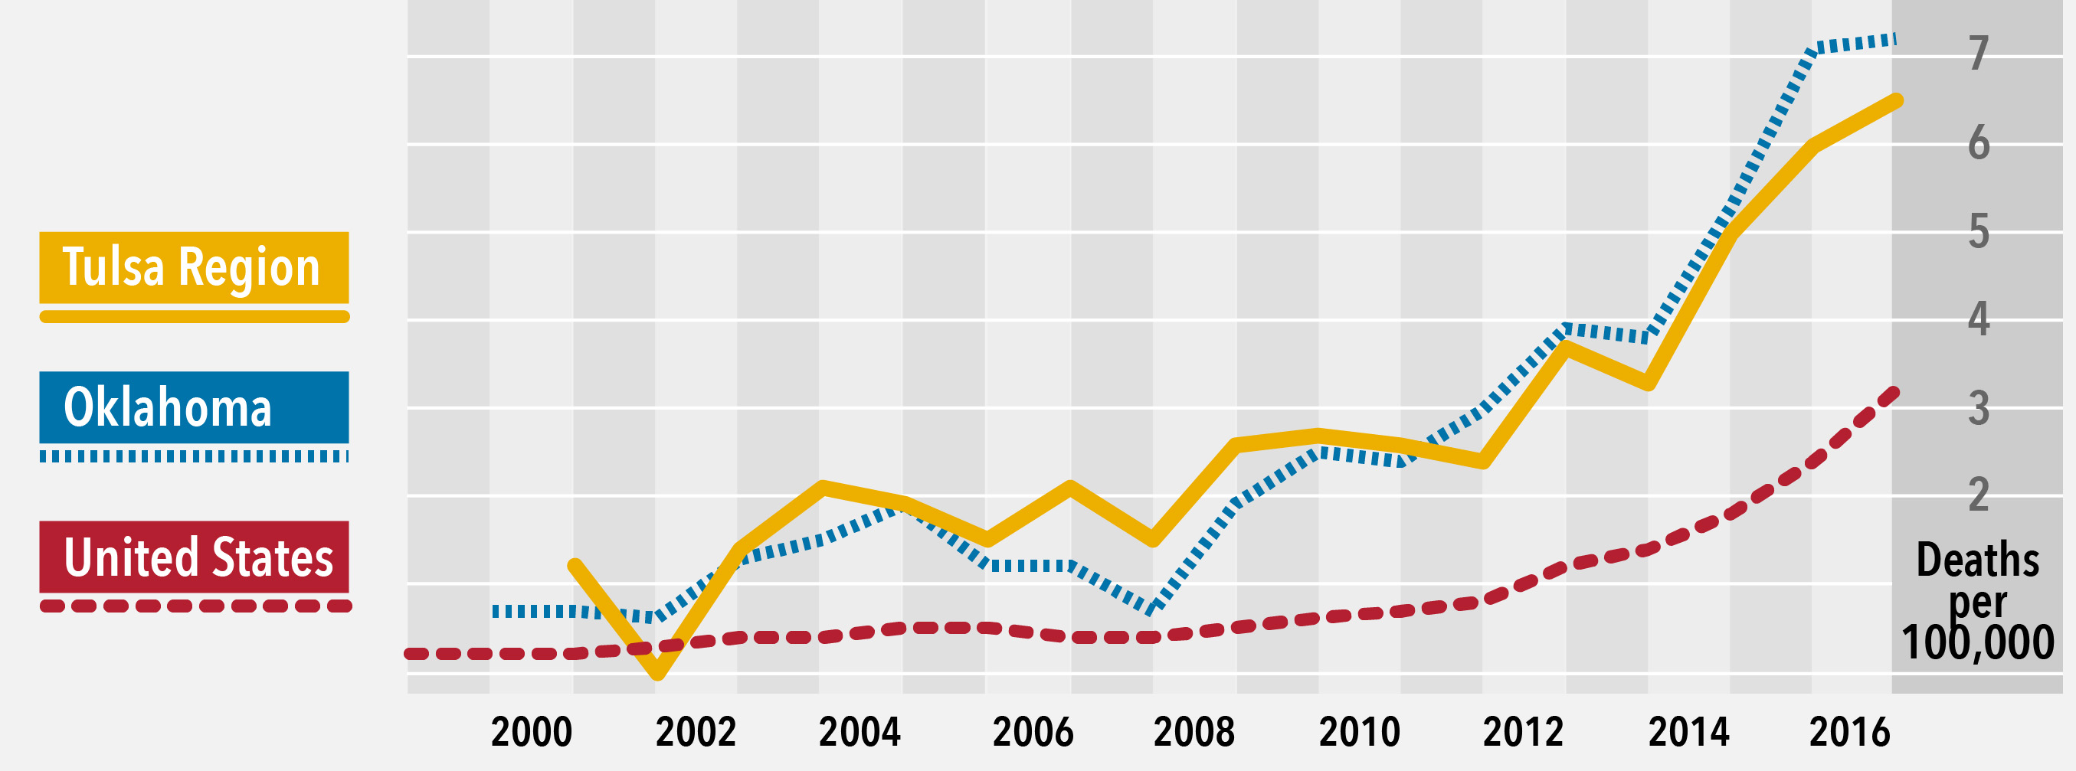
Drug Overdose Deaths
Drug Overdose Deaths Involving Psychostimulants with Abuse Potential (Methamphetamine) (1997–2017)

Slide 4
Tulsa Meth Treatment Plan: The Model
Psych ER (Police-Friendly Drop Off)
Assessment and Triage
Acute Meth Intoxication
Focus on Crisis as a Result of Mental Illness, other SUD (CCC, Crisis Stabilization)
Dual Diagnosis- Capable Inpatient Beds at TCBH
Intensive Meth-Capable Chairs at CCC (Psych ER)
Meth Detox Beds at 12&12
Services in the “Bubble”
Residential Treatment Services/Supports
Medical services
Substance abuse counseling
Services/Supports in the Residential-IOP Transition
Case management component of Assertive Continuing Care
Housing: Transitional, permanent, sober living
Comprehensive IOP Services/Supports
Evidence-based Matrix Model
Recovery coaching/support
Family and social network assessment, intervention, and support
Peer Recovery Coaching/Support
Vocational/activity services
Assessment of social determinants
Discharge planning & coordination
Transportation
Supported Employment/IPS
Parent training and support
Case management component of Assertive Continuing Care
Women In Recovery partnership
The “Bubble”
Residential Treatment
(up to 90 Days)
Transition to IOP
Comprehensive Intensive Outpatient
(90+ Days)

Slide 5
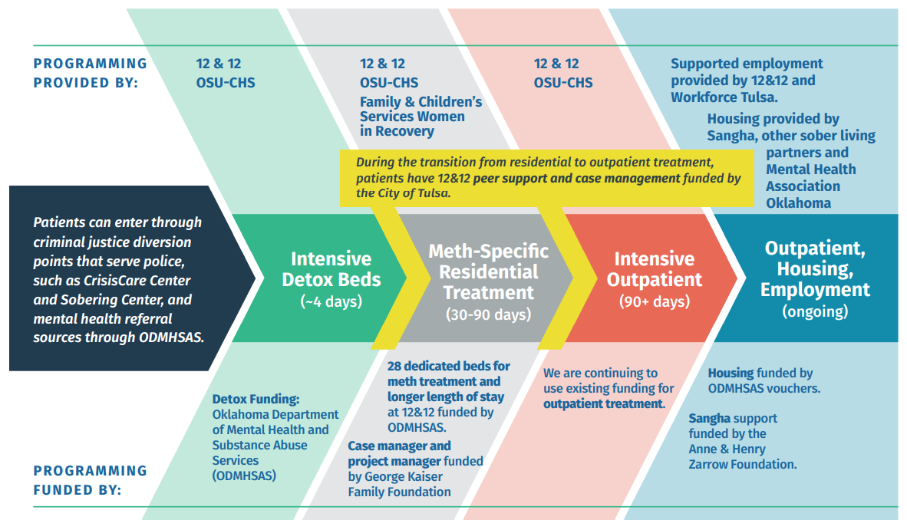
Partners and Roles

Slide 6
Additional Treatment Service Expansion
Understanding the challenges we’re faced with in Oklahoma
Dispelling Myths
Raise Awareness
Google Analytics
Recovery Support Services
Peer Outreach
Supported Housing and Employment
Evidenced Based Treatment and Training Programs
Contingency Management
Community Reinforcement Approach
Cognitive Behavioral Therapy

Slide 7

Outcomes
62% of consumers using stimulants ceased using after treatment
84.5% of consumers using intravenous simulants ceased IV use after treatment
44% of homeless stimulant users become homed during treatment saving $7.7 million annually
$2 million in new wages were earned annually by reducing unemployment

Slide 8
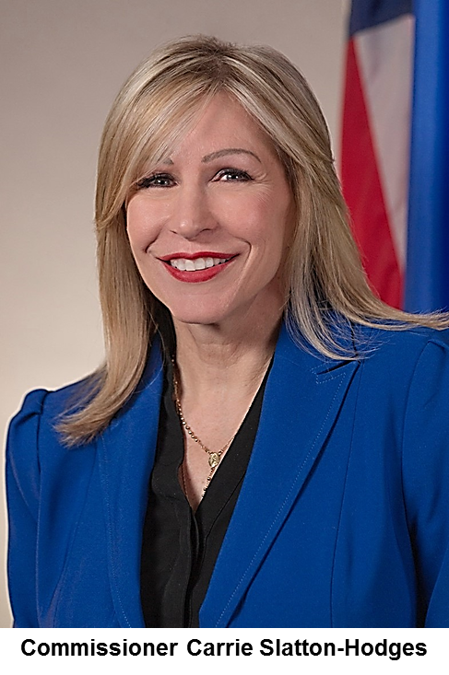




For More Information go to:
odmhsas.org
@odmhsas
@csh_ok
@odmhsasinfo
Carrie Slatton-Hodges
ODMHSAS Commissioner

