Slide 1

APPLYING FOR DISADVANTAGED BUSINESS ENTERPRISE CERTIFICATION
Oklahoma Department of Transportation

Slide 2

ABOUT US
The Oklahoma Department of Transportation (ODOT) ensures that no person or groups of persons shall, on the grounds of race, color, sex, religion, national origin, age, disability, retaliation or genetic information, be excluded from participation in, be denied the benefits of, or be otherwise subjected to discrimination under any and all programs, services, or activities administered by ODOT, its recipients, sub-recipients, and contractors. To request an accommodation please contact the ADA Coordinator at 405-521-4140 or the Oklahoma Relay Service at 1-800-722-0353. If you have any ADA or Title VI questions email ODOT-ada-titlevi@odot.org.

Slide 3


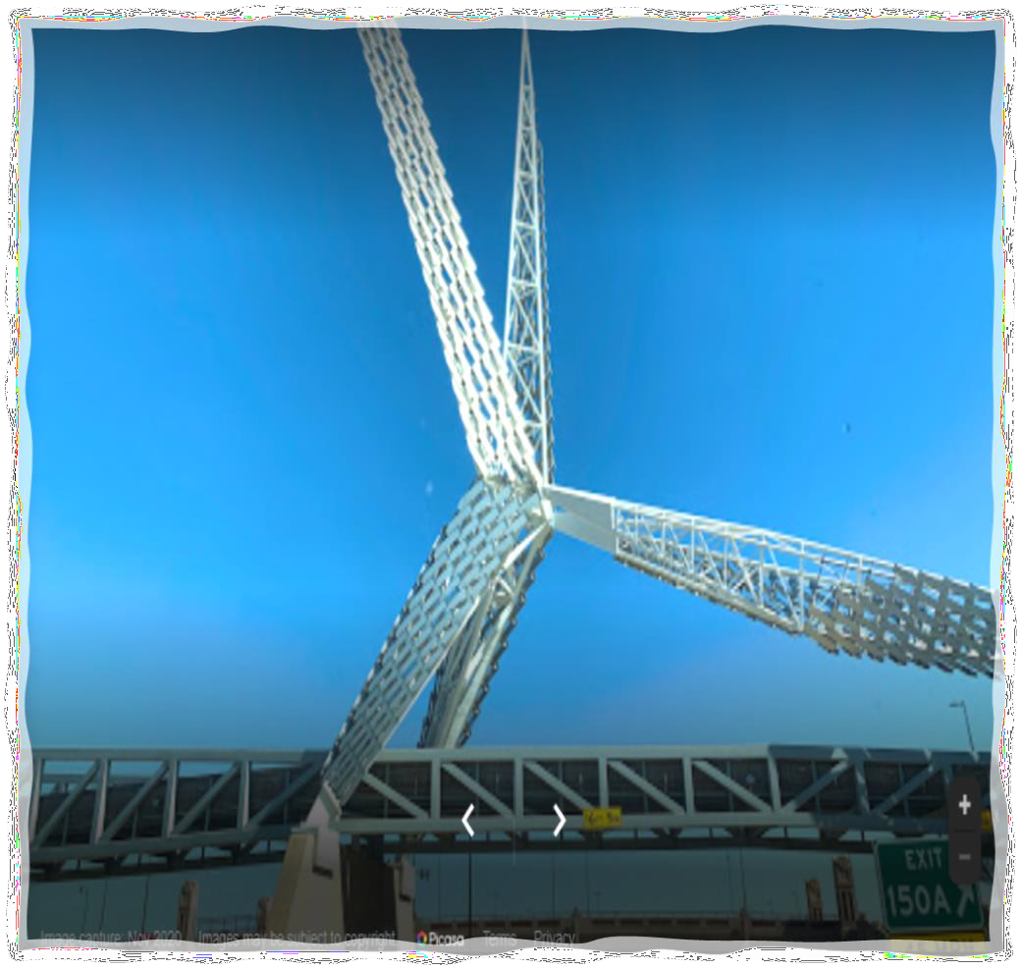
Eligibility Requirements
51% ownership
U.S Citizen
Meets SBA size standard does not exceed
26.29 million in gross annual receipts
Firm is for profit
Personal Net Worth does not exceed $1.32 million

Slide 4
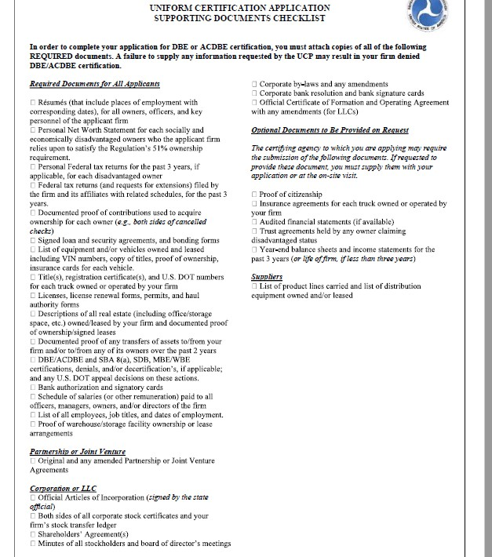


Gathering Documents
Five most recent tax year returns (Both business and personal)
Submit all documents that are related to the firm's business structure
A notary will be required regarding the Affidavit of Certification and Personal Net Worth

Slide 5

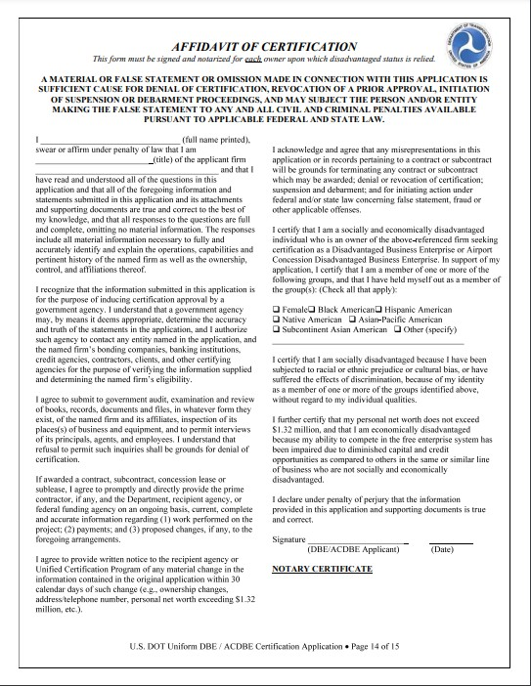
Mandatory Documents
Complete All Sections
Notarize

Slide 6
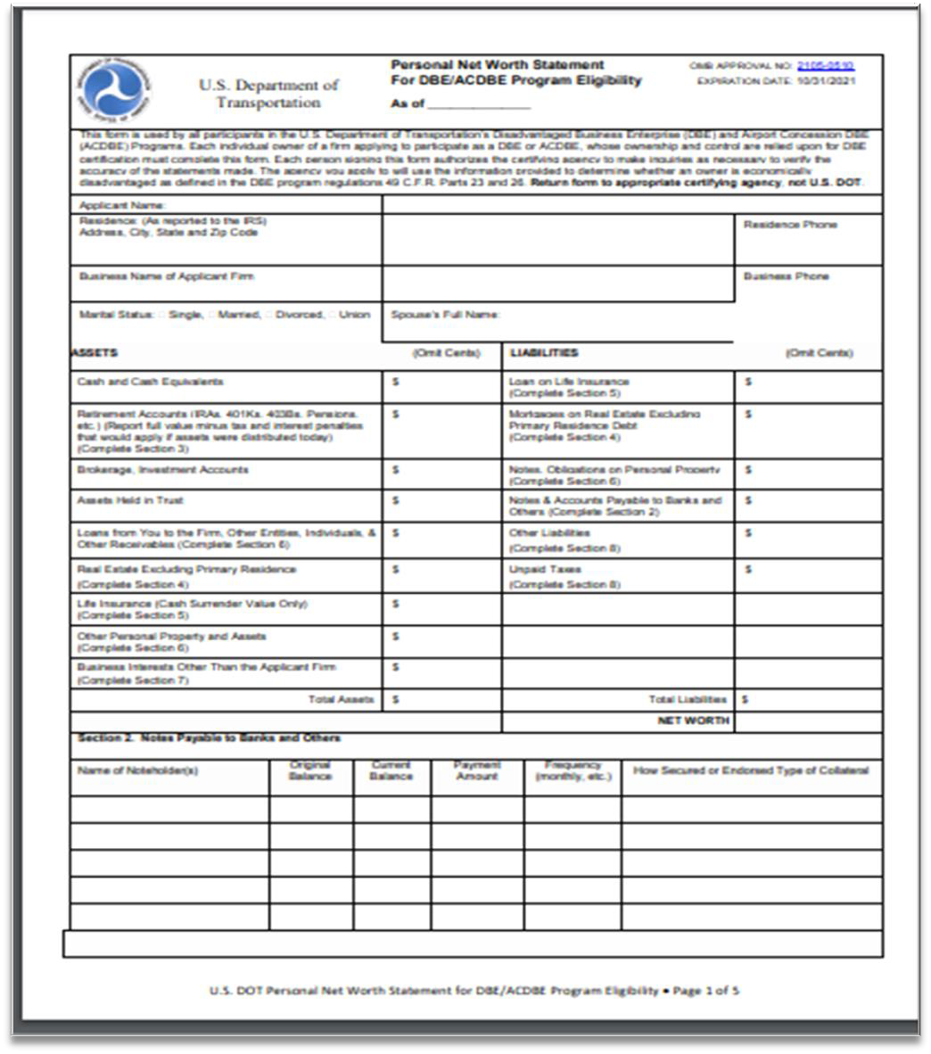
Personal Net Worth Statement
ENSURE THIS DOCUMENT IS FILLED OUT. ( DO NOT LEAVE BLANKS.)
WRITE N/A
WHERE APPLICABLE.
STATEMENT MUST BE NOTARIZED.
MANDATORY
DOCUMENT

Slide 7
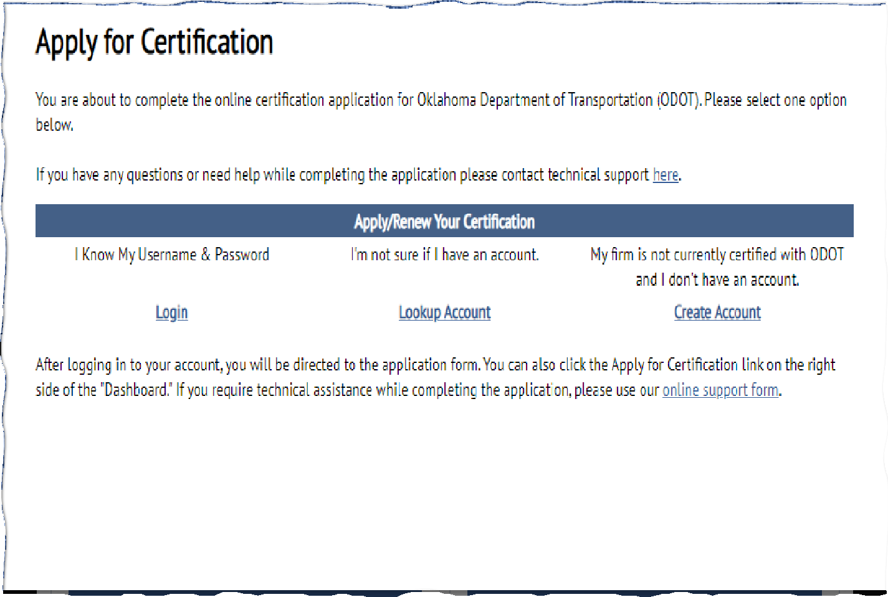
Select an option
Look up account first to ensure that the firm does not have an existing account.
Login if firm already has an existing account with another UCP entity.
Online Support is available

Slide 8

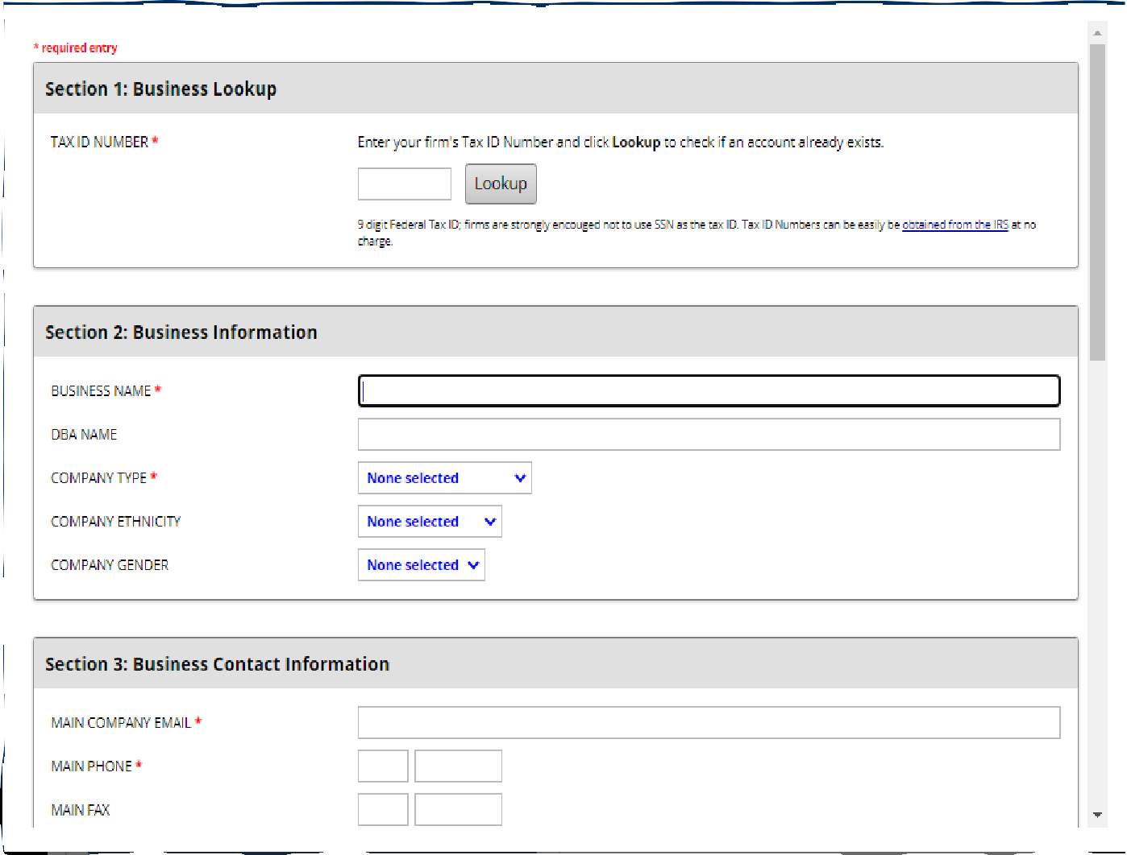
Business Contact information
Ensure provided information is correct. The information entered on this page is the point of contact regarding the firm.

Slide 9
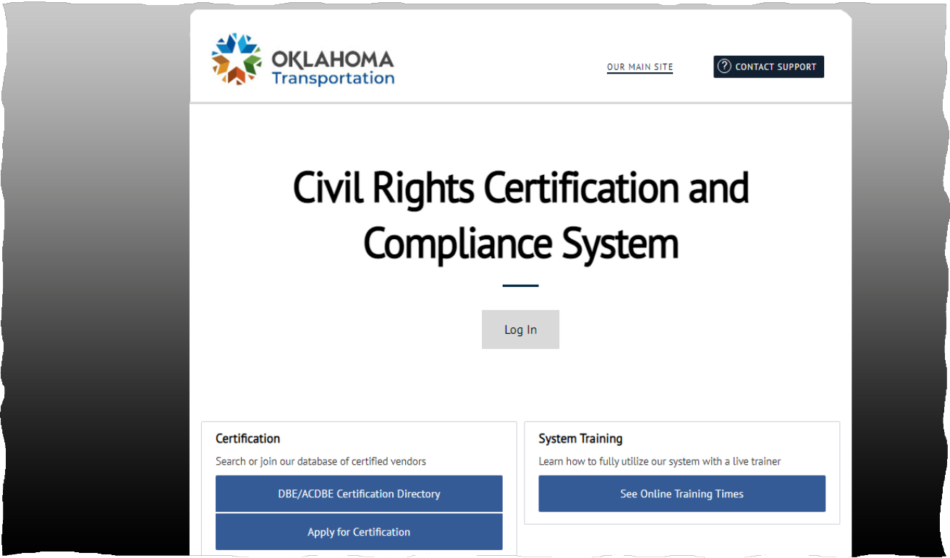

ODOT Website
Login to okdot.gob2g.com
Click on Apply for certification

Slide 10
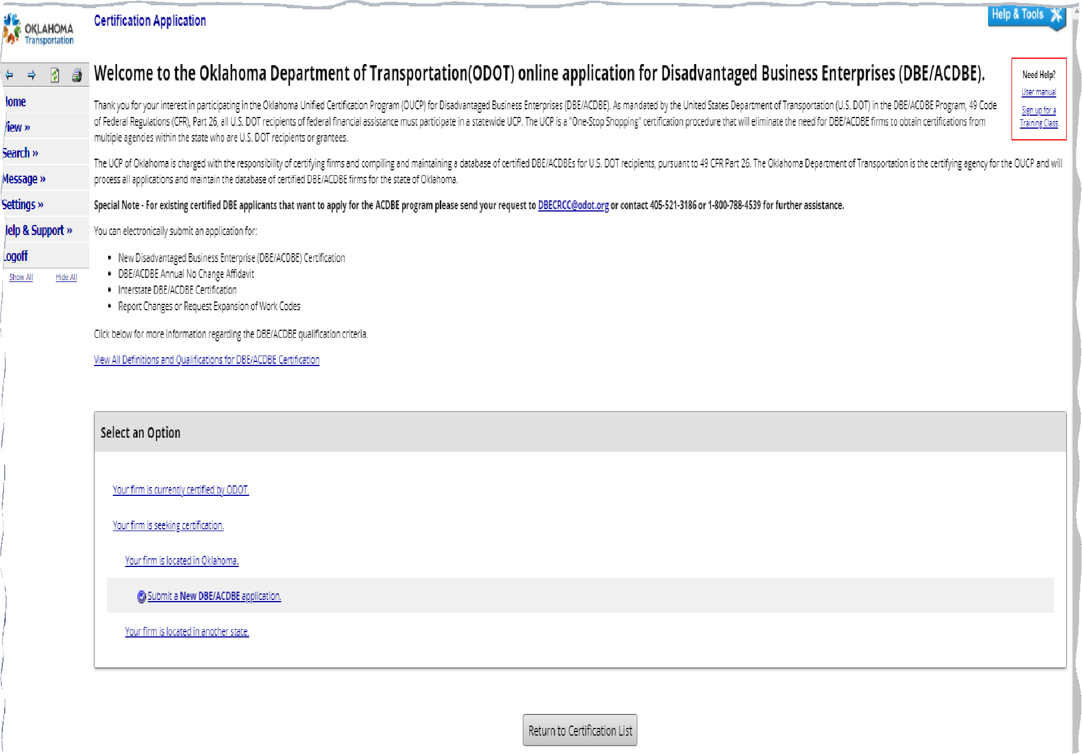
Applying for New DBE Certification
First Click “ Your Firm is seeking certification”
Next “ Click firm is located in Oklahoma”
Click “ Submit a New DBE/ACDBE application”

Slide 11
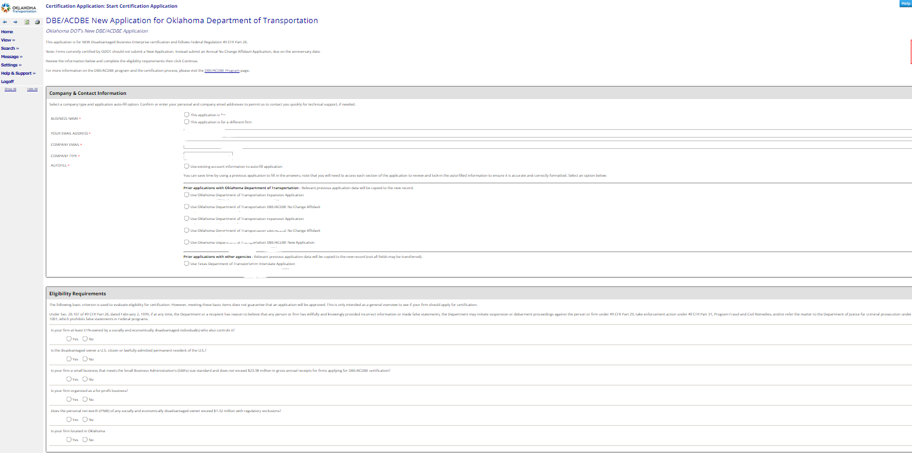
New DBE application Contact Information
Please complete all red asterisks
Complete eligibility requirement questions

Slide 12
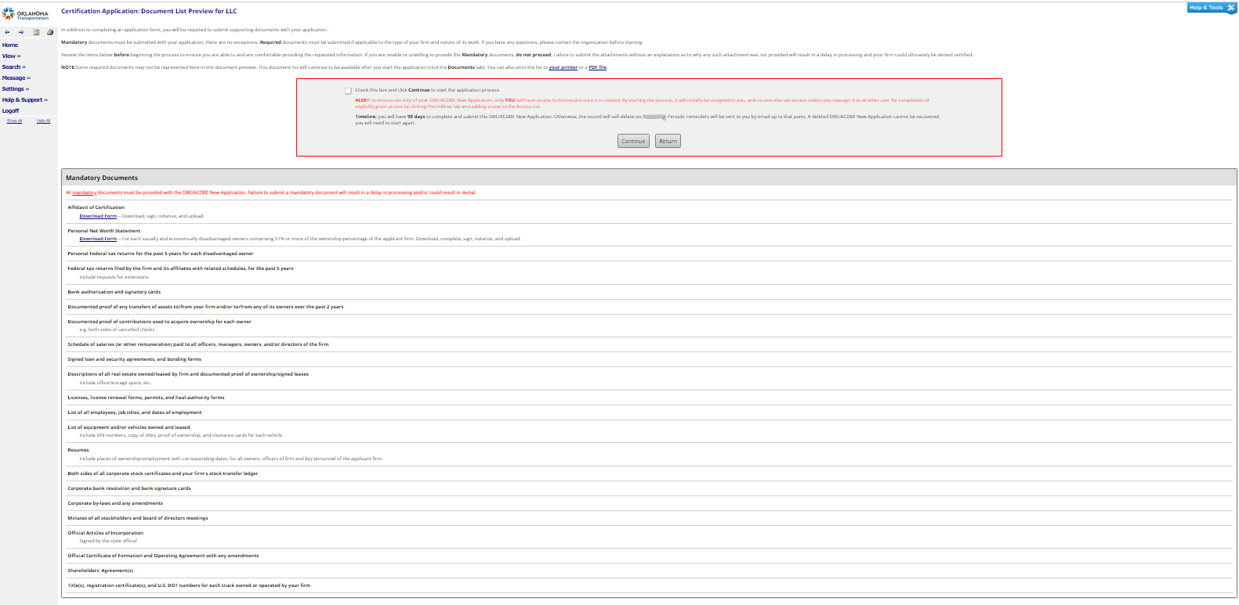

Mandatory Documents / Applicable Documents
Access Mandatory documents
Checks and balances from supportive check list

Slide 13
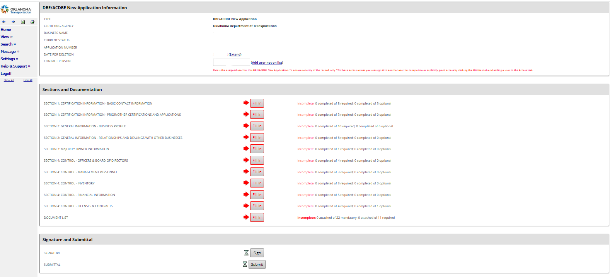
Applying For DBE Certification
Complete all Sections
Electronically Sign and Submit

Slide 14


Civil Rights DBE Application

Slide 15
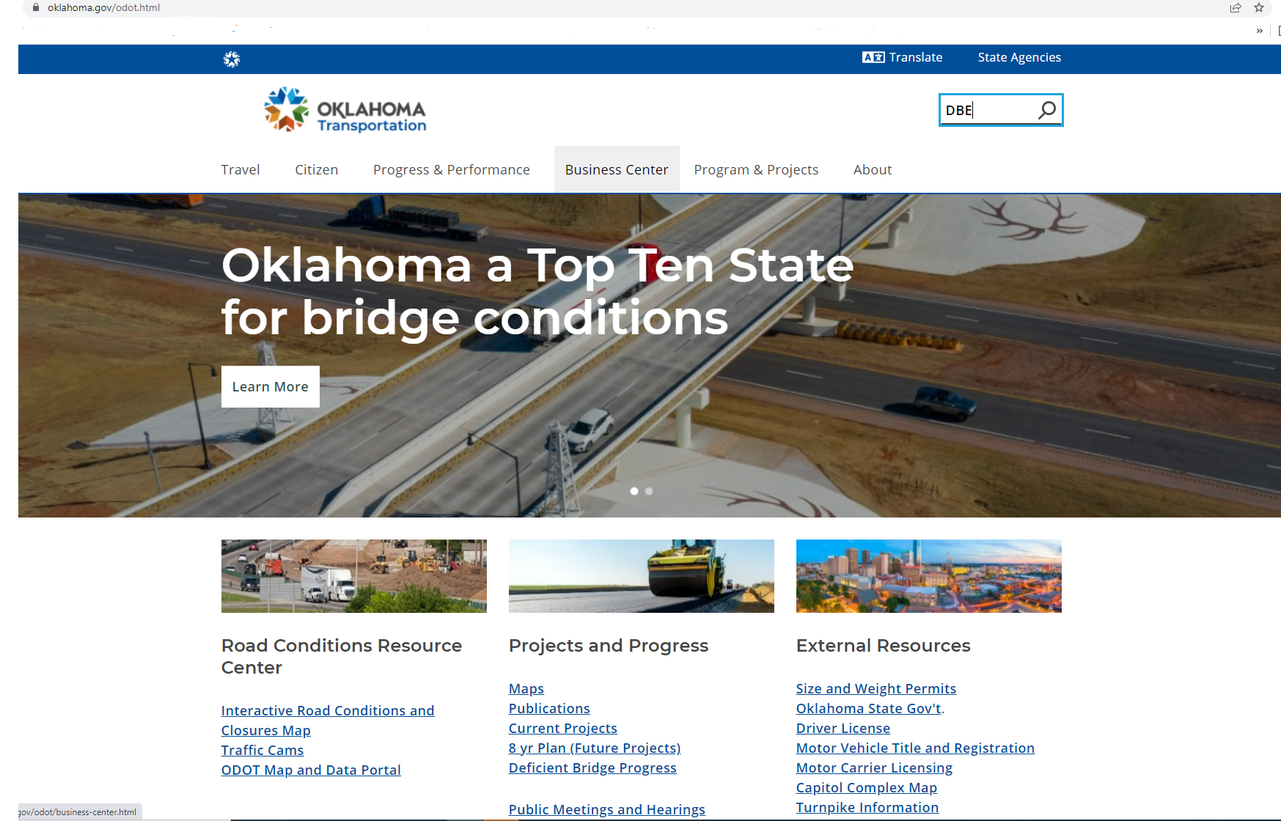

How to Access Onboarding Information
Login into https://oklahoma.gov/odot.html
. Use Oklahoma Department of Transportation search engine box

Slide 16
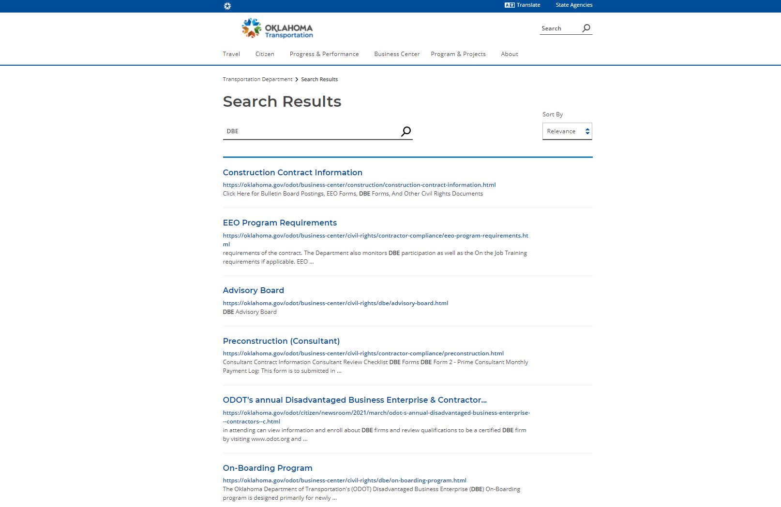

How to Access Onboarding Information ( continued)
“Scroll Down”
Click “ Onboarding
Program “

Slide 17
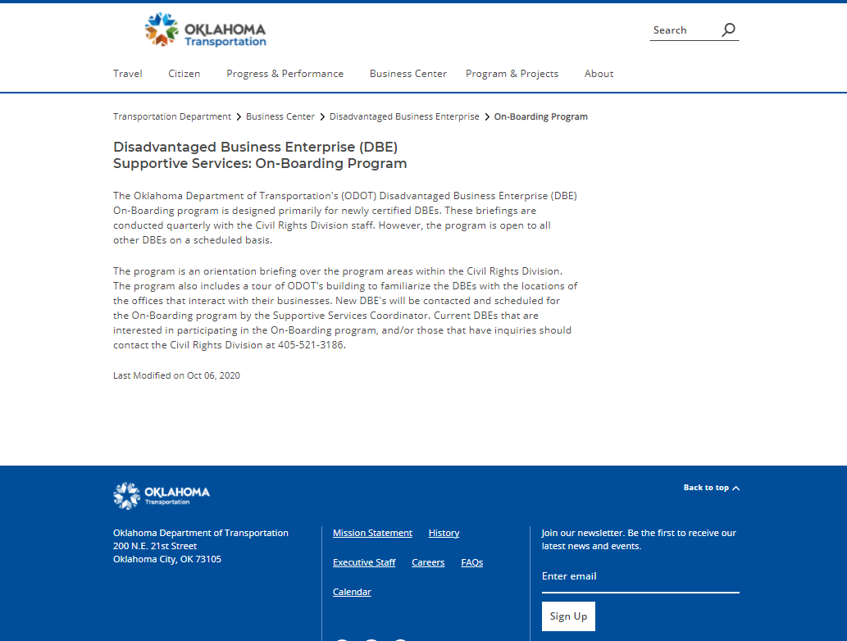
Onboarding Program
New DBE’s Orientation
Tour of Oklahoma Department of Transportation facility

Slide 18

What to Expect after submitting A DBE Application
Time Frame of Decision
Final decision will be posted in the Civil Rights Certification and Compliance System.
Approved DBE Certification
Not Approved DBE Certification

Slide 19


Civil Rights Division
QUESTIONS & ANSWERS
Jessica Patterson, MPA DBE Reviewer jpatterson@odot.org (405)-521-3174 :phone
(405)-318-1425 : Cell

