Slide 1
Oklahoma PTAC
Statewide Procurement Technical Assistance Center

Slide 2
Personal Coach to Government Contracting
At its core, the PTAC is your guide to government contracting
Guide you through registrations and applications
Help you plan your approach and pitch to agencies
Help you find opportunities
Help you tackle new language and rules
Encourage you to persist and persevere

Slide 3
Who is the Oklahoma PTAC?
Program of the Oklahoma CareerTech system
Operates out of ten Oklahoma Technology Centers
Funding from federal, state, and local tax funds
  U.S. Dept. of Defense
  Oklahoma Dept. of Career and Technology Education
  Each participating technology center
www.okbid.org (click on OkPTAC Coordinators)

Slide 4
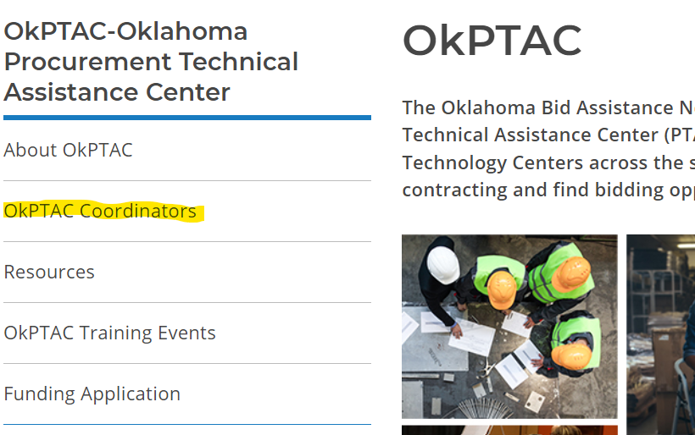
OkPTAC Contact List
At www.okbid.org, click on OkPTAC Coordinators for current list of offices and personnel.

Slide 5
OkPTAC Ideas and Success Stories
Stories from the Counselors

Slide 6
OkPTAC Office
Main Office is at the Oklahoma Dept of CareerTech
1500 W 7th Ave, Stillwater
To contact the program office you can call:
405-743-5571 or 405-612-7386
www.okbid.org

