Slide 1



Oklahoma department of
transportation
US-70 & East Main Street
Durant Oklahoma
Notes:
Welcome to the Oklahoma Department of Transportation Virtual Open House. ODOT is proposing to improve the intersection of US-70 and East Main Street in the City of Durant, Bryan County Oklahoma.

Slide 2
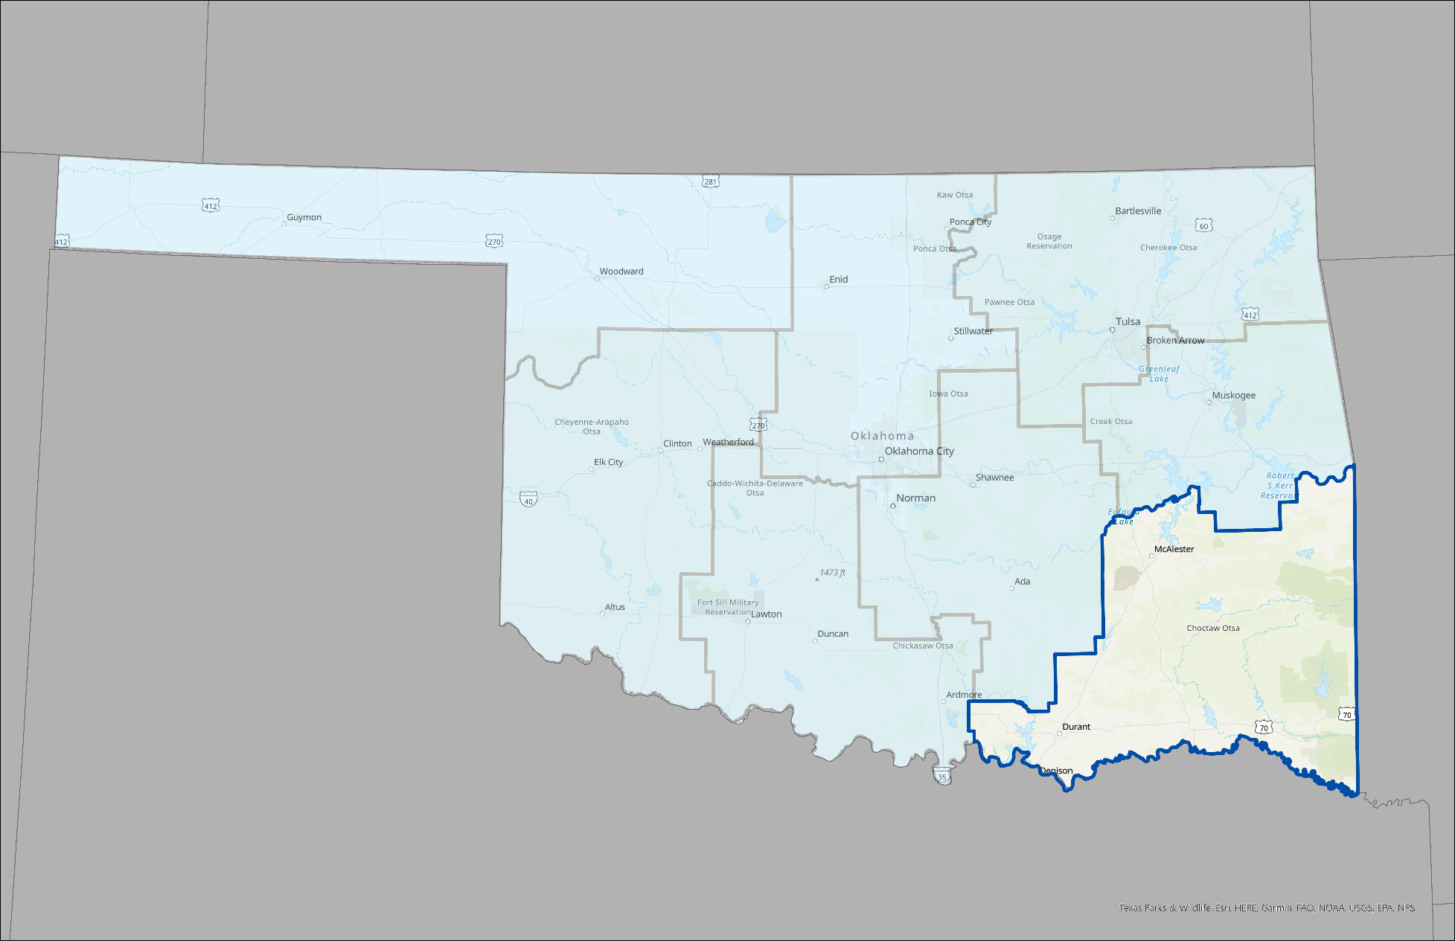
Project Location History
US-70
Notes:
The proposed project is located on the Durant Bypass at US-70 and East Main Street in the City of Durant, Bryan County Oklahoma.
The Oklahoma Department of Transportation (ODOT) has long been considering the need to provide safer and more direct access to and from US-70 and East Main Street. US-70 at East Main Street currently does not provide direct access from southbound US-70 to East Main Street and from East Main Street to northbound US-70. To access East Main Street to and from US-70, an access road known as Sawmill Road (N3750 RD) just north of the grade separation is provided.

Slide 3
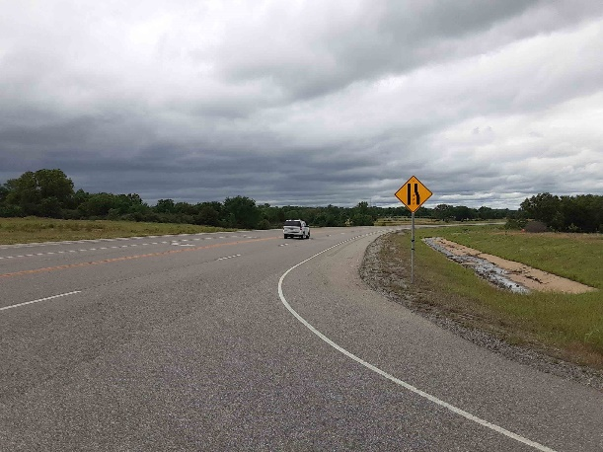
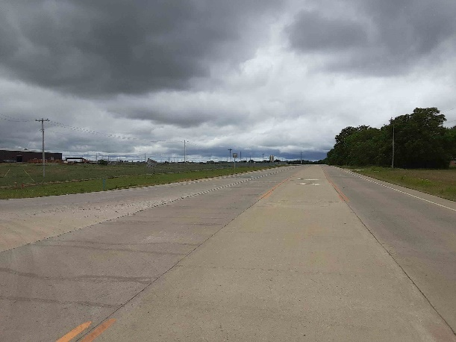
Existing Conditions
US-70
  US-70 over East Main Street
  Speed Limit: 65 mph
  Two-lane Open Typical Section; 12’ Driving Lanes, 8’ Shoulders
  Southbound Exit and Northbound Entrance Ramps
  3400 Average Daily Traffic
East Main Street
  2-lane Open Typical Section; 12’ Driving Lanes, 4’ Shoulders
Notes:
This existing section of US-70 consists of two 12' driving lanes with 8' shoulders. The speed limit along this corridor is 65 mph. On average this section of US-70 experiences approximately 3400 vehicles a day. East Main Street is a two-lane roadway with 12' driving lanes and 4' shoulders. To access East Main Street to and from US-70, an access road known as Sawmill Road (N3750 RD) just north and east of the intersection is provided.

Slide 4
Environmental Re-evaluation
A re-evaluation of the original Environmental Assessment is being conducted for the continued improvements to the US-70 Corridor. The proposed project is consistent with the original Environmental Assessment. ODOT is performing additional studies to update the original environmental document. Issues that will be analyzed include the project’s effects to noise, water quality, cultural and natural resources and other effects to the environment.
Notes:
A re-evaluation of the original EA is being conducted for the continued improvements to the US-70 Corridor. The proposed project is consistent with the original EA. ODOT is performing additional studies to update the original environmental document. Issues that will be analyzed include the project’s effects to noise, water quality, cultural and natural resources and other effects to the environment.

Slide 5
Environmental Study
Environmental Studies are Underway
ODOT - is Performing Studies of:
  Waters and Wetlands
  Threatened and Endangered Species
  Cultural Resources (Historic and Archeological)
  Neighborhoods and Businesses
  Noise
  Hazardous Materials
  No Significant Impacts are Anticipated
Studies will be compiled in Environmental Assessment re-evaluation
Notes:
ODOT is in the process of completing detailed environmental studies of the proposed project. Studies of waters and wetlands, threatened and endangered species, cultural resources, neighborhoods and businesses, and hazardous materials are not completed yet. No Significant impacts to any of these resources is expected. Additional commitments to avoid and/or minimize impacts to the environment will be added to the project.

Slide 6
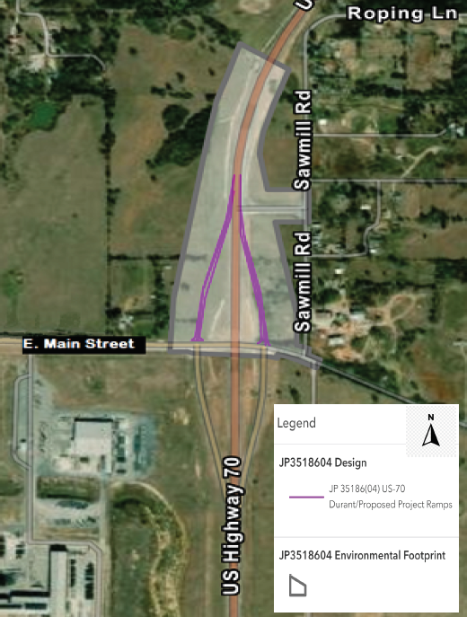
Environmental Study Area
Notes:
This slide shows the Environmental Study area and the addition of two proposed ramps to and from US-70 at East Main Street. The light grey shaded area does not depict the right of way for the proposed project.

Slide 7
Prioritized Improvements
Add additional ramps to provide direct northbound access to US-70 from East Main Street and direct southbound access from US-70 to East Main Street
Remove access road to US-70 from Sawmill Road (N3750 RD)
Ramp connection configuration at East Main Street to and from US-70 to be determined by traffic analysis and coordination with District 2
No improvements or modifications to East Main Street are anticipated at this time
Notes:
ODOT is proposing to add additional ramps to provide direct northbound access to US-70 from East Main Street and direct southbound access from US-70 to East Main Street. Once the ramps have been constructed ODOT will remove the connector from US-70 known as Sawmill Road (N3750 RD). The construction of a northbound US-70 entrance ramp from East Main Street and a southbound US-70 exit ramp to East Main Street is warranted based on current traffic data. No improvements or modifications to East Main Street are anticipated at this time. The addition of these ramps will complete the full diamond interchange and provide a safer, more direct access to and from US-70 and East Main Street.

Slide 8
Project Schedule
ROW/Utility Plan Submittal Summer 2023
Environmental Assessment Document Re-evaluation Fall 2023
Final Design Plan Submittal Spring 2025
Project Letting FFY 2025
This schedule is contingent on funding and subject to change.
Notes:
The current programmed schedule for this project is as follows. The right of way and utility plans are to be submitted in the summer of 2023. The Environmental Assessment re-evaluation will be finalized in the fall 2023. The final design plans are to be submitted in the spring 2025. The project letting is currently scheduled for Federal Fiscal Year 2025
*Please note that this schedule is contingent on funding and subject to change.

Slide 9
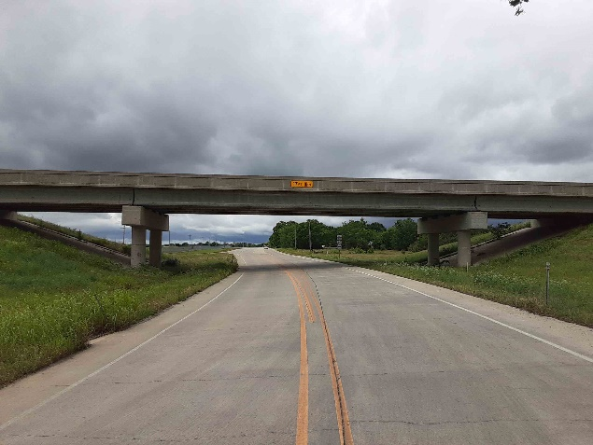
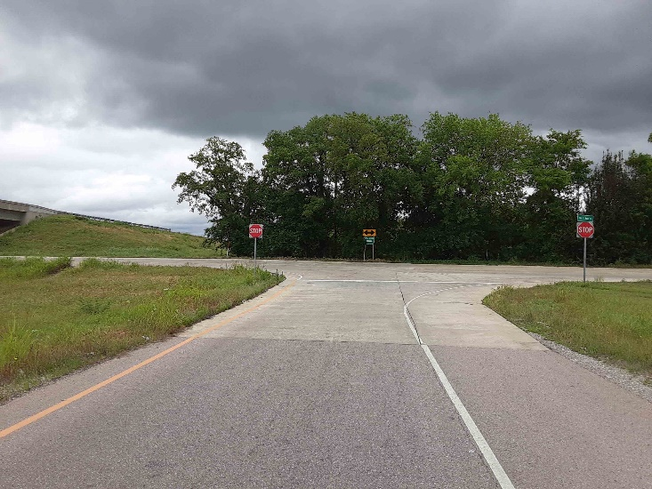
Please submit your Comments by May 2, 2023
www.odot.org/US70Durant
Notes:
Thank you for participating in this virtual open house for the proposed project to improve US-70 and East Main Street in the City of Durant, Bryan County. Please submit your comments to ODOT by May 2, 2023.

