Slide 1
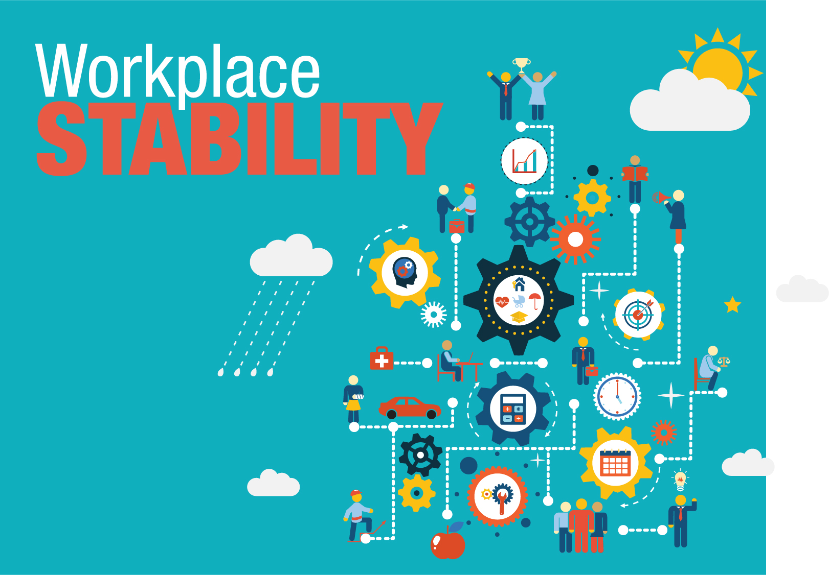
Creating conditions that lead to retention, productivity, and engagement in entry-level workers
Ruth K. Weirich
Notes:
The behaviors habits and patterns of low wage and entry level employees often leave business owners and managers scratching their heads. Have you had employees who were fired from a position returned three days later asking when you would "stop being mad" and hire them back? Perhaps an employee suddenly stopped coming to work or started arriving late every day. Maybe you promoted an employee from within but were confused by that person's behavior after the promotion. Or maybe an employee surprised you by turning down a promotion. Do you think your low-wage workers are lazy, "takers," and unreliable? This workshop is for business people who would like to improve on the turnover treadmill, absenteeism, lack of productivity, motivation issues, language barriers, and disciplinary problems that sometimes occur with entry-level, lower-wage employees.

Slide 2
The Stability Paradigm
Stability
Environment
and Resources
Hidden Rules Language
Engagement
Motivation
Opportunity
Retention, Performance,
and Profits
Notes:
We have found that a person’s environment and resources determine the level of stability they are experiencing. The same goes for an organization. There’s personal stability, and there’s organizational stability. If an organization is experiencing degrees of instability, that can make it harder to “tune in” to employees who are experiencing personal instability.
And, it turns out, the level of stability you experience to a large degree determines how you operate in life and even the language you speak.
In fact, isn’t it true that our employees’ level of stability affects us at work all the time? If they have stability, our organization often does too. If they are dealing with instability, especially daily instability on an ongoing basis, we often feel the impact.
This arrow is actually a two-way arrow. We hadn’t realized it before, but we can greatly influence the level of stability of our employees.
We already do it now! What benefits do we already offer that help to further the stability of people in daily stability? (Wait for responses)
Medical plans and 401(k) plans are examples.
401(k) plans help to create that future story of retirement. Am I thinking about that if I live in daily instability? (Wait for responses) Why not? (Wait for responses) Because I’m busy solving today’s problems. Tomorrow? Retirement? Forget about that; not real for me.
We, as employers, have developed benefits programs and management practices that help people we understand, people who are already stable, to stabilize their lives further. For the most part, we have not developed benefits programs and management practices to help people we haven’t understood so well, people who are living with instability. But we could.

Slide 3
Get to Know Your Employees
Employee Stability Assessment
Employee lives without a checking account and credit cards.
Employee regularly uses a credit card, checking account, and savings account and knows how to check and improve own credit score.
Employee has a financial advisor, lawyer, interior designer, gardener, and uses a domestic employment service.
Employee has arranged schedule to get to two jobs without the use of a car.
Employee knows how to complete work in ways that meet both the organization’s needs and the employee’s personal goals.
Employee knows how to present the organization’s financials so the organization is seen in the best possible light.
Notes:
(Training Supplement Workbook Handouts – pages 6-8)
We will be looking at skills necessary to survive in daily instability, daily stability, and long-term stability.
I have handouts for you to fill out. Do this activity with a partner and then be prepared to discuss with the group. As you do this activity think about how these pieces are different or similar to your own experience and which of these pieces, if any, affect stability, productivity, and business strategies in the workplace. Discuss whether you could operate in these different environments.
Let's look at some specific items from the assessments and determine if they are indicative of daily instability, daily stability, or long-term stability:
#1 – Employee lives without a checking account and credit cards. This would be characteristic of daily instability. Some of us really prefer dealing with cash and only cash. The way our society works, though, we can pay for more things we need more easily if we have a credit card or checking account. For example: paying for the electric bill without having to go somewhere to hand over cash. A checking account or credit card might save time.
#2 – Employee regularly uses a credit card, checking account, and savings account and knows how to check and improve own credit score. This person can pay for things they need and want easily; they can keep things stable and raise their ability to borrow money if needed.
#3 – Employee has a financial advisor, lawyer, interior designer, gardener, and uses a domestic employment service. This would be long-term stability because this person is delegating their stability—using large sums of money to have other people handle things for them. They are using their financial and relationship resources to get things done so they don’t have to do them.
#4 – Employee has arranged schedule to get to two jobs without the use of a car. Daily instability. Two jobs, no independent transportation option. A very busy life that can involve ongoing problem solving (e.g., what if the bus is late, what if my employer needs me to stay longer when I’m supposed to be at another job, what if what I learn in one job confuses me about what I’m supposed to do in the other?).
#5 – Employee knows how to complete work in ways that meet both the organization’s needs and the employee’s personal goals. This would be a characteristic of daily stability. I can get my needs met while also working for the company.
#6 – Employee knows how to present the organization’s financials so the organization is seen in the best possible light. This is long-term stability. I know how to make presentations to the executives and owners of the company, I know how to create that presentation, and I know what numbers to use and how to present a report about money and earnings. This can be a difficult concept for some folks on the front line who don’t even know these kinds of meetings take place.
What kind of thoughts came up as you and your partner completed the assessments? (discuss)
It's not easy to survive in any of these environments if you don't have the skills equipped for it. Because business norms are built on hidden rules and the required skills of daily and long-term stability, helping employees build stability in their own lives also helps further stabilize and optimize the business.
Next, we will look at what instability costs a business.

Slide 4
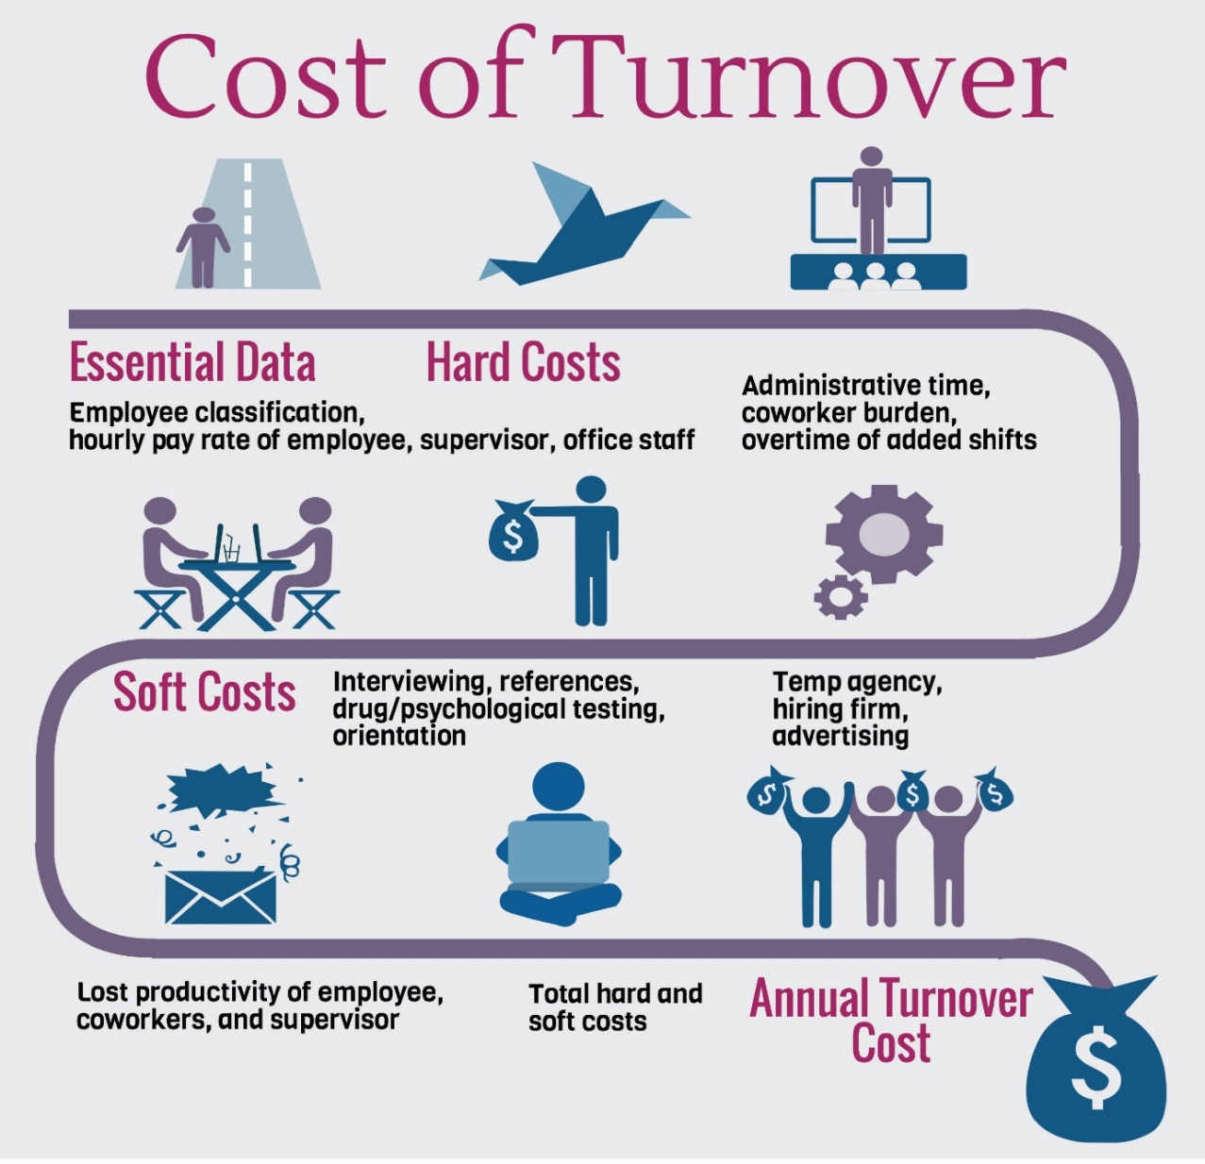
Notes:
Many times we think of entry-level workers as "expendable" and when that employee quits, there is a good chance that the company will hire another employee with the same work patterns as the employee who just walked off the job. This is sometimes termed as the "turnover treadmill". So, what does the turnover treadmill cost a business? Turnover is one of the biggest drains on productivity and profits, but if your company hasn't taken the time to review the hard and soft costs of turnover, then you may not realize how much money that your company is losing with each turnover.
SHRM reported that on average it costs a company 6 to 9 months of an employee’s salary to replace them. So for an employee making $60,000 per year, that’s about $30-45,000 in recruiting and training costs. For an employee making $31,200 per year, that’s about $15,600-$23,4000 in recruiting and training costs.

Slide 5
Declining Birth Rates
Notes:
Why else would we want to talk about retaining our employees? There has been a rapid decline in birth rates around the world, just looking at the United States, the birth rates declined by 52% from 1950 to 2021. With the population aging and declining birth rates, that can lead to labor shortages, wage pressures, and high turnover, so the need to retain employees is greater now than it ever has been.

Slide 6
“Knowledge is a key form of privilege, as are social access, race, and money. How you spend your time determines your knowledge base to a large extent.”
–Ruby K. Payne, Ph.D.
Notes:
Knowledge is a key form of privilege, as are social access, race, and money. How you spend your time determines your knowledge to a large extent.
We will be exploring mental models, which are tools that help the mind store abstract information.
The mental models on the next few slides show how people’s environments shape how they spend their time and thereby influence their knowledge bases.

Slide 7
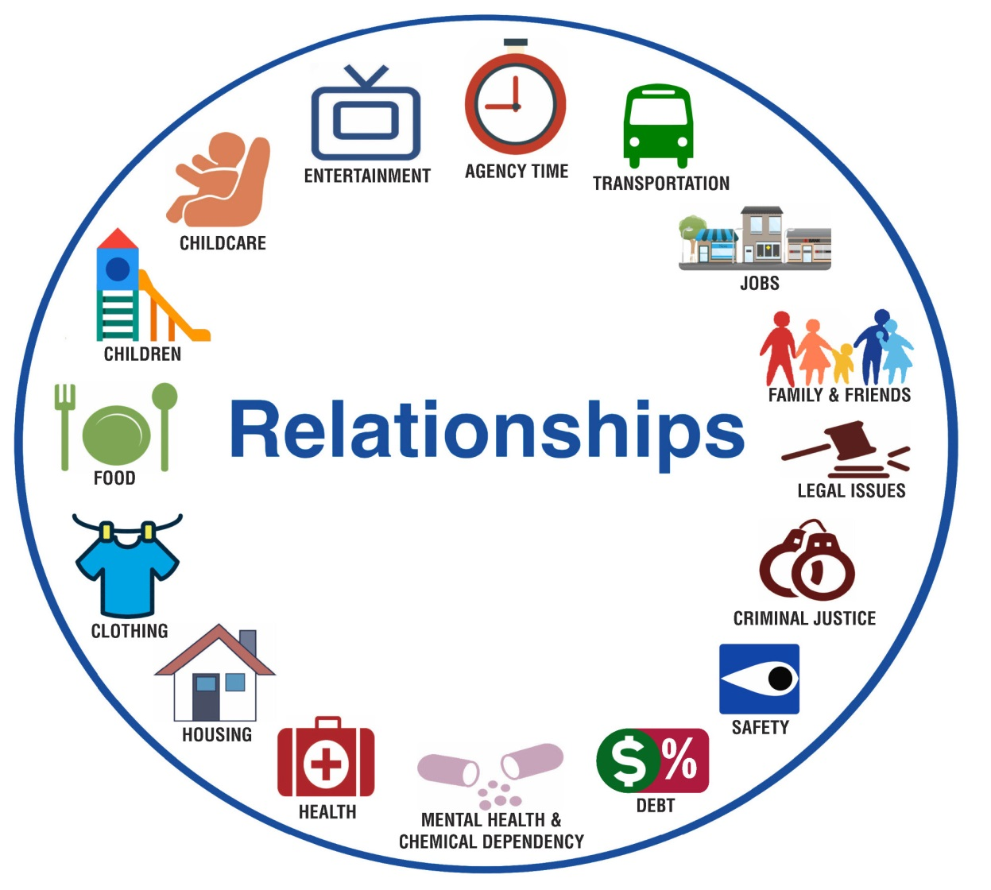
Mental Model for Instability:
What It’s Like Now
How do individuals spend their time when living in daily instability?
Developed by Phil DeVol
Notes:
How do individuals spend their time when living in daily instability? What do you commonly see in low-income areas? (click for mental model)
This mental model was created off of the experiences of approximately 50 individuals in Ohio who lived in daily instability.
Relationships are the driving force for those in daily instability. They are living in the tyranny of the moment. There is no future story because they are focused on today. And because they are focused on today, they are constantly solving problems. (discuss the categories in the mental model)

Slide 8
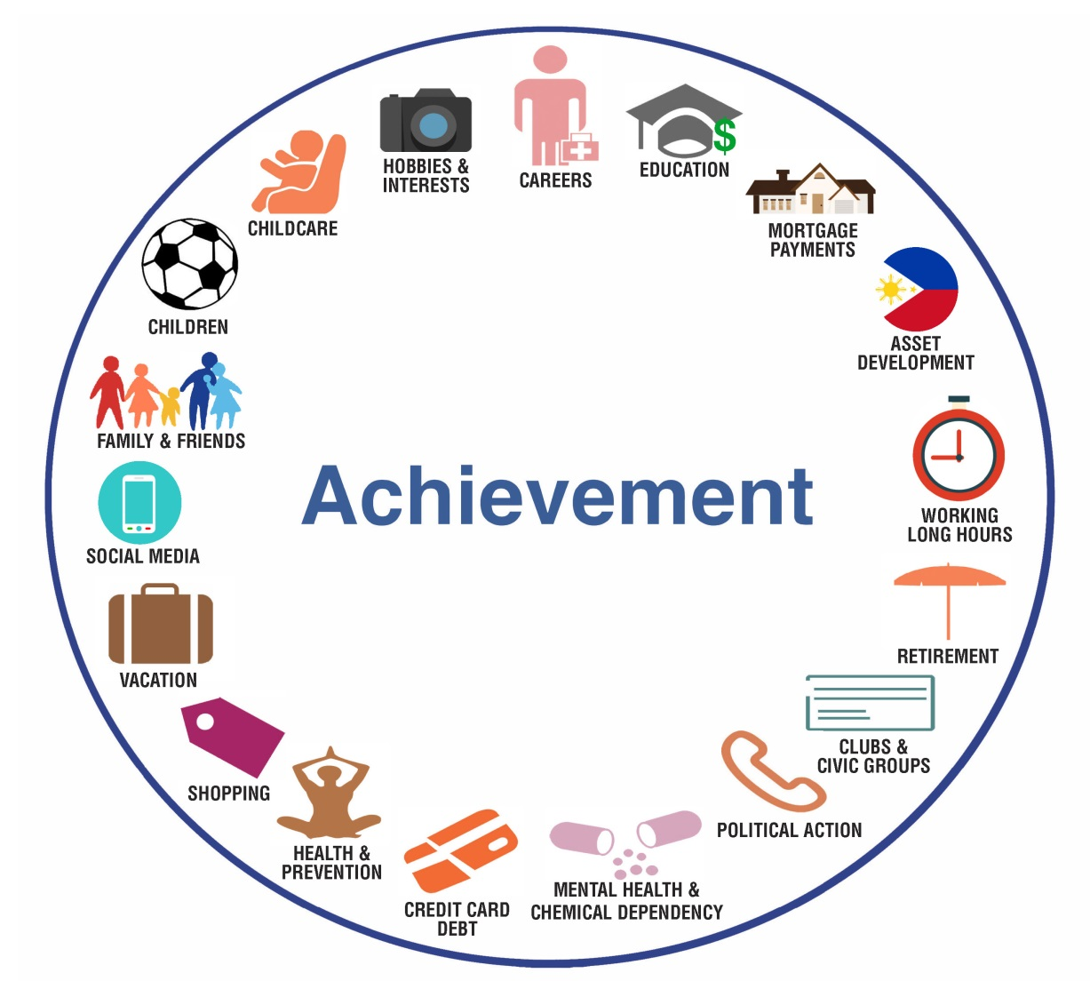
Mental Model for Stability
How do individuals spend their time when living in daily stability?
Developed by Phil DeVol
Notes:
How do individuals spend their time when living in daily stability? What do you typically see in more middle-class neighborhoods? (click for mental model)
When you live in a stable environment, the circle looks different.
Achievement is the driving force for those in daily stability. Can you see some similarities and differences between the mental models? (discuss the categories in the mental model) What do these two mental models look like in the workplace?

Slide 9
Business and Employee Pain
Based on Daily Instability
Notes:
Let's revisit the mental model for daily instability. Using this mental model, we will discuss how this environment causes pain for employers and employees alike. It creates barriers that cause both businesses and employees to achieve limited success. Because of this environment, businesses face loss of productivity, turnover, communication barriers, employee conflict, and more. So, let's look at a couple of these and see how it may be impacting not just the employee but also the business.
How is the employee impacted by….?
How is the business impacted by….?
Agency Time: People in poverty typically go to 3-9 agencies in the course of a year to get needs met. Each agency demands behavioral changes, a plan of action, and time for the activities in the plan.
Employee: Life/work balance to make ends meet, services based on middle class environment
Business: Absenteeism, life/work balance
Transportation: Vehicles are often not dependable and require constant repair; breakdowns result in lost jobs, missed appointments, and stress. Insufficient public transportation also often limits mobility.
Employee: Price of gas, walk to bus stop, bus lines don’t run at the correct time or to the best destinations for the job, multiple buses needed, lack of reliable transportation, upkeep of cars
Business: Turnover, tardiness, absenteeism
Jobs: Jobs don't pay enough, temp work doesn't provide enough hours or benefits, many work two jobs to make ends meet, no vacation. Money is a constant worry. People are vulnerable to the prices of gas and milk going up by the gallon.
Employee: Low wages, inconsistent hours, multiple jobs, part-time work, temp jobs, no maternity leave, no paid vacation, boring work
Business: Turnover grind – employee continues to seek better-paying jobs with benefits and steady and consistent hours
Family/Friends: Relationships are important period they are a resource needed for survival.
Employee: Relationships needed for survival, take precedence over work
Business: Relationships take precedence over work; friends help solve problems
Legal Issues
Criminal Justice
Safety: Protecting your people and yourself is a constant concern. The criminal justice system is part of life; Members of the family are in jail, on parole, or on probation. The drug culture is threatening.
Employee: Victims of predatory lending, street crime, drug trade, sex trade; relationships take precedence over work
Business: Relationships take precedence over work
Debt
Mental Health & Chemical Dependency
Health: Being sick, caring for others who are sick, and trying to get health care are time consuming and exhausting.
Employee: No health insurance, poor quality of food, sleep deprivation, hard physical labor, unreliable transportation to get to health services, lack of support system for sick children and care for elders, lack of money
Business: Lack of time off for self and children, lack of motivation and productivity, exhausted
Housing: Houses are often in isolated rural areas or unsafe urban and suburban neighborhoods. Houses are crowded, people come and go, there is no private place for children to do their homework, rooms are used for many purposes, people sleep on the couch, repairs can't be made, landlord can be difficult, people have to move frequently.
Employee: Unstable housing options, multiple families in house, inability to pay rent, dollars spent on rent, predatory mortgage lenders
Business: Sleep deprivation may affect productivity, human resource issues
Clothing
Food: There are concerns about not having enough. Grocery stores have moved out of the neighborhood. Local grocery stores that have stayed overcharge, and the quality of the produce is poor. Many must buy from convenience stores. Fast food outlets provide relatively cheap but unhealthy food options.
Employee: Food insecurity, poor quality food, fast food, highly processed food – leads to illness, diabetes, and other health problems
Business: Turnover, tardiness, absenteeism
Children: It's hard to get kids through the day; People have concerns about school, health, clothing, and safety. Child care arrangements are unreliable, while good child care is either unavailable or too expensive.
Employee: Poor quality of food, fewer after-school activities, no time to help with homework, unreliable childcare, lack of money
Business: Absenteeism due to unreliable childcare, illness, agency time
Childcare
Entertainment: Entertainment takes many forms, including cable television, video games, drugs, alcohol, music, and spending time with friends.
Employee: Preferred forms foster little bridging social capital, humor may offend
Business: Decreased networking capacity, strained social events, harassment complaints

Slide 10
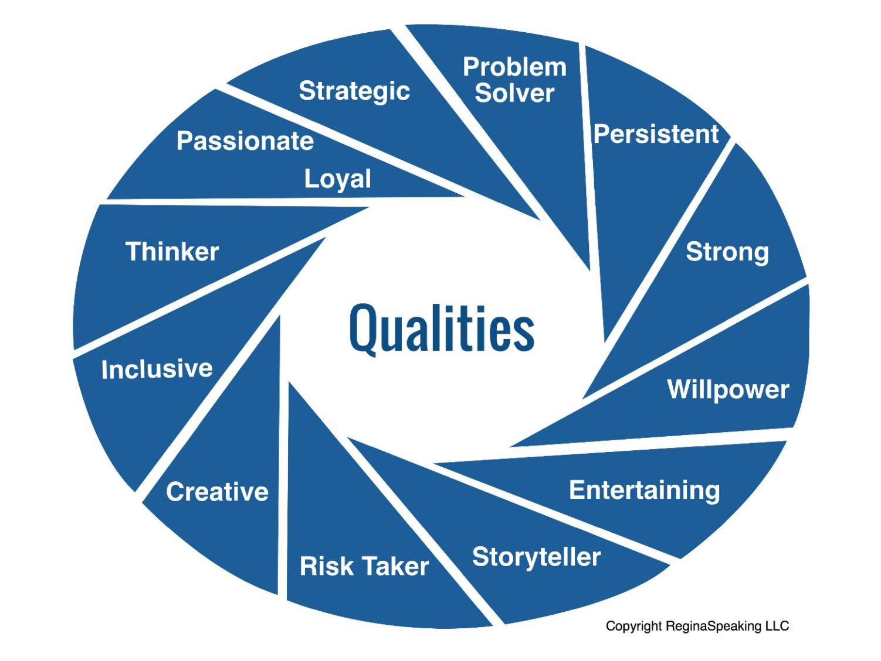
Qualities of Daily Instability
Notes:
Employees in poverty have lots of barriers, but that does not mean that these same employees don’t have amazing qualities and can be great assets when translated effectively to the workplace. What could some of these qualities be of someone who is living in poverty or daily instability? (discuss. Click for infographic.) If we treat these employees with mutual respect, in turn we will see employees who have many of these qualities.

Slide 11
Resources
Daily instability is the extent to which an individual does without resources.
Notes:
People living in daily instability are affected by more than just financial resources, and people from daily stability and long term stability alike have differing access to resources.
Resources are interlocking and affect each other.
They are passed along from parents, family, friends, and connections.
Community is also responsible for growing the resources of individuals in the community.
The resources of the employee base play directly into the stability of a business.
The resources of a business link directly to the stability of the employees.
We will review resources as they fit in with the environments and driving forces we discussed earlier and how the resources employees bring to work with them have an impact on the success of a business.

Slide 12
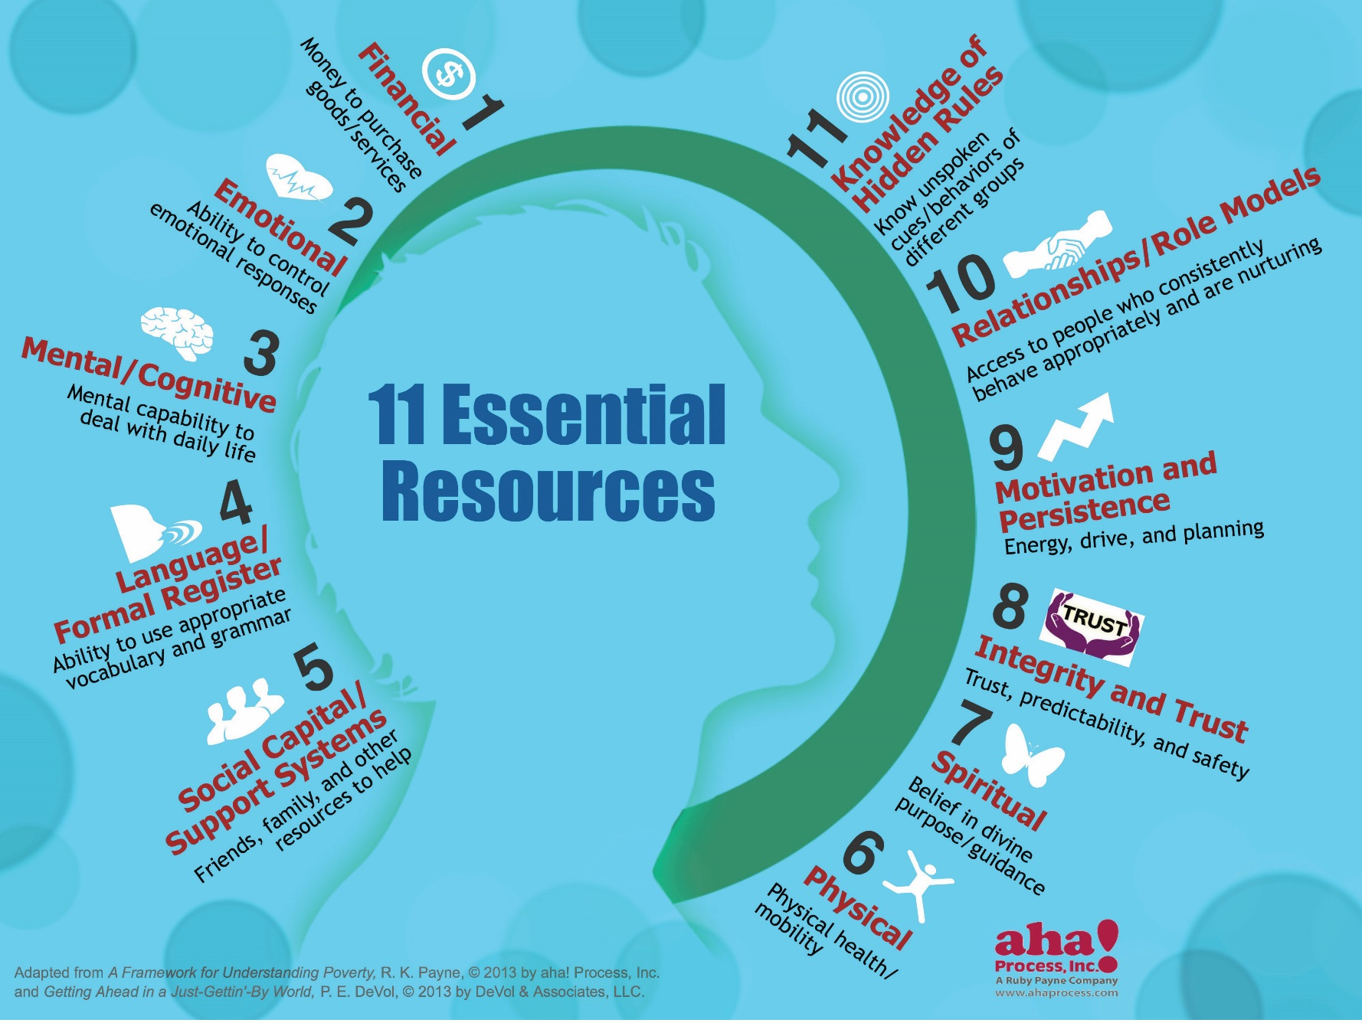
Notes:
(Training Supplement Workbook Handout – page 47)
If we go back to our definition of daily instability—the ability to do without resources—you will see that our definition of resources is more than just financial. The more resources an individual has, the more successful they can potentially be in life. A person can be financially stable but have low emotional and physical resources. The quality of life would tend to be lower.
In this infographic, and in your handouts, you can see 11 different resources:
Financial—Having the money to purchase goods and services.
Emotional—Being able to choose and control emotional responses, particularly to negative situations, without engaging in self-destructive behavior. This is an internal resources and shows itself through stamina, perseverance, and choices.
Mental/Cognitive—Having the mental abilities and acquired skills (reading, writing, computing) to deal with daily life.
Language/Formal Register—Having the vocabulary, language ability, and negotiation skills necessary to succeed in school and/or work settings.
Social Capital/Support Systems—Having friends, family, and backup resources available to access in times of need. These are external resources.
Physical—Having physical health and mobility.
Spiritual—Believing in divine purpose and guidance. Having hope or a future story.
Integrity/Trust—Trust, predictability, and safety.
Motivation/Persistence—Energy, drive, and planning.
Relationships/Role Models—Having frequent access to adult(s) who are appropriate, who are nurturing, and who do not engage in self-destructive behavior.
Knowledge of Hidden Rules—Knowing the unspoken cues and habits of a group.

Slide 13
Activity
What resources did your grandparents have, grow, and pass along to your parents?
What resources did your parents grow and pass along to you?
Notes:
We are going to break up into groups of 3 or 4 and discuss what types of resources were passed down in your family. What resources did your grandparents have, grow, and pass along to your parents? Discuss what resources your parents grow and pass along to you.
We see through this exercise that we didn’t grow all of our resources on our own, but through the supports of others around us. Does “If they would just pull themselves up by their bootstraps…” really work that way? For some, then “They were born on third base and think they hit a triple.”

Slide 14
Ready to Hear the Whole Presentation?
Dana Campbell
Business Services & Communications Program Manager
DanaClark@cowib.org
(405) 633-3785
https://cowib.org/services/business-services-2/
Notes:
Viewing and diverse workforce through the lens of economic class allows a company to create more stability for team members and for the business, which results in higher retention, higher productivity, more engagement, and increased profits. While we didn’t get to solutions, we hope that it encourages you to attend our full presentation. Your company could reap huge rewards not only financially, but with improved retention, productivity, and other great results you never even expected.
Be sure to change it to your name and information when you present.

