Slide 1
Soonercare I/t/u Provider training
Vickie Sams March 2023

Slide 2
Disclaimer
This presentation was compiled by OHCA tribal government relations and provider engagement.
The information contained within this presentation is intended as a reference only and is current as of March 2023. Content is subject to change.
Stay current with up-to-date information on the OHCA website: www.okhca.org.

Slide 3
OHCA SOONERCARE I/T/U PROVIDER TRAINING Agenda
Welcome & Introduction
SoonerCare Programs
I/T/U Rules & Policies
I/T/U Prior Authorization
10 Minute Break
I/T/U SoonerCare Referrals
I/T/U Dental
I/T/U Reminders & Questions

Slide 4
Welcome and Introductions Johnney Johnson, Director of pathways to community living

Slide 5
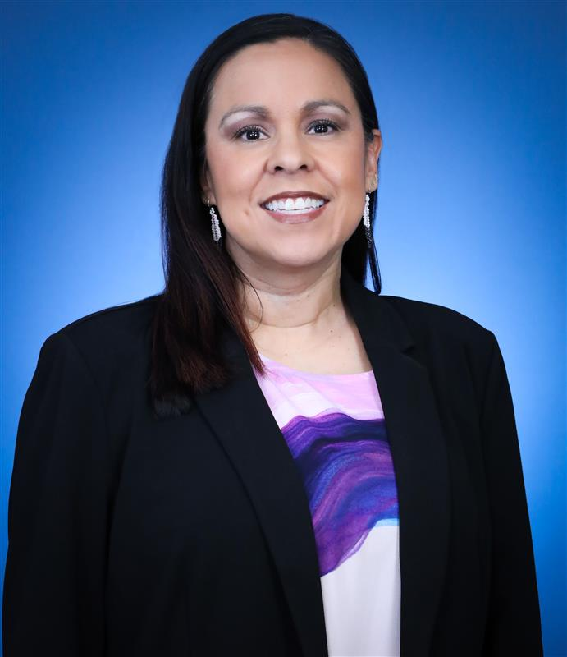
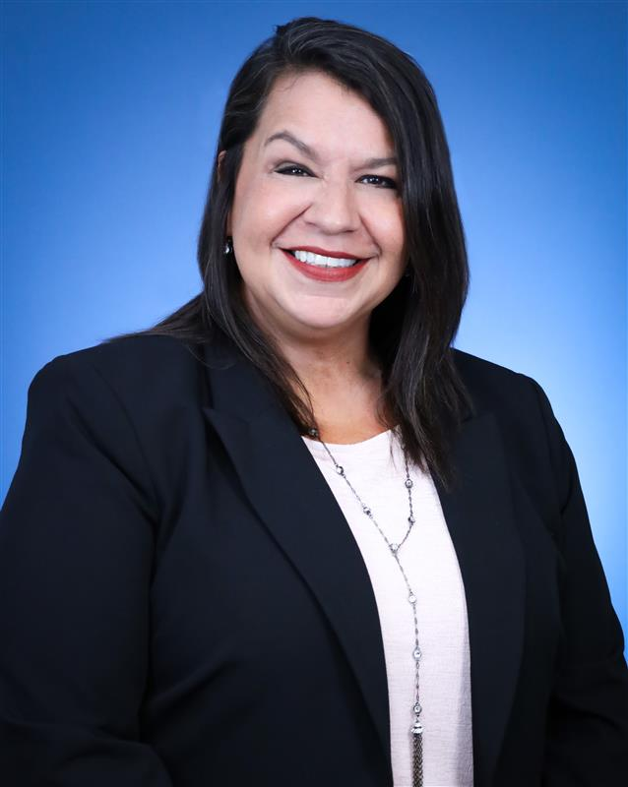
Tribal Government Relations Department
In addition to SoonerCare and tribal
health care collaboration, the TGR team has a wide range of experience in Indian Country including:
I/T/U provider education
I/T/U administration
Legislative affairs
Nonprofit/advocacy
Indian Health education
Elder care
Behavioral health
Partner collaboration
Kathrine McCoy
TGR Senior Coordinator
Vickie Sams
TGR Outreach & Provider Engagement Coordinator

Slide 6
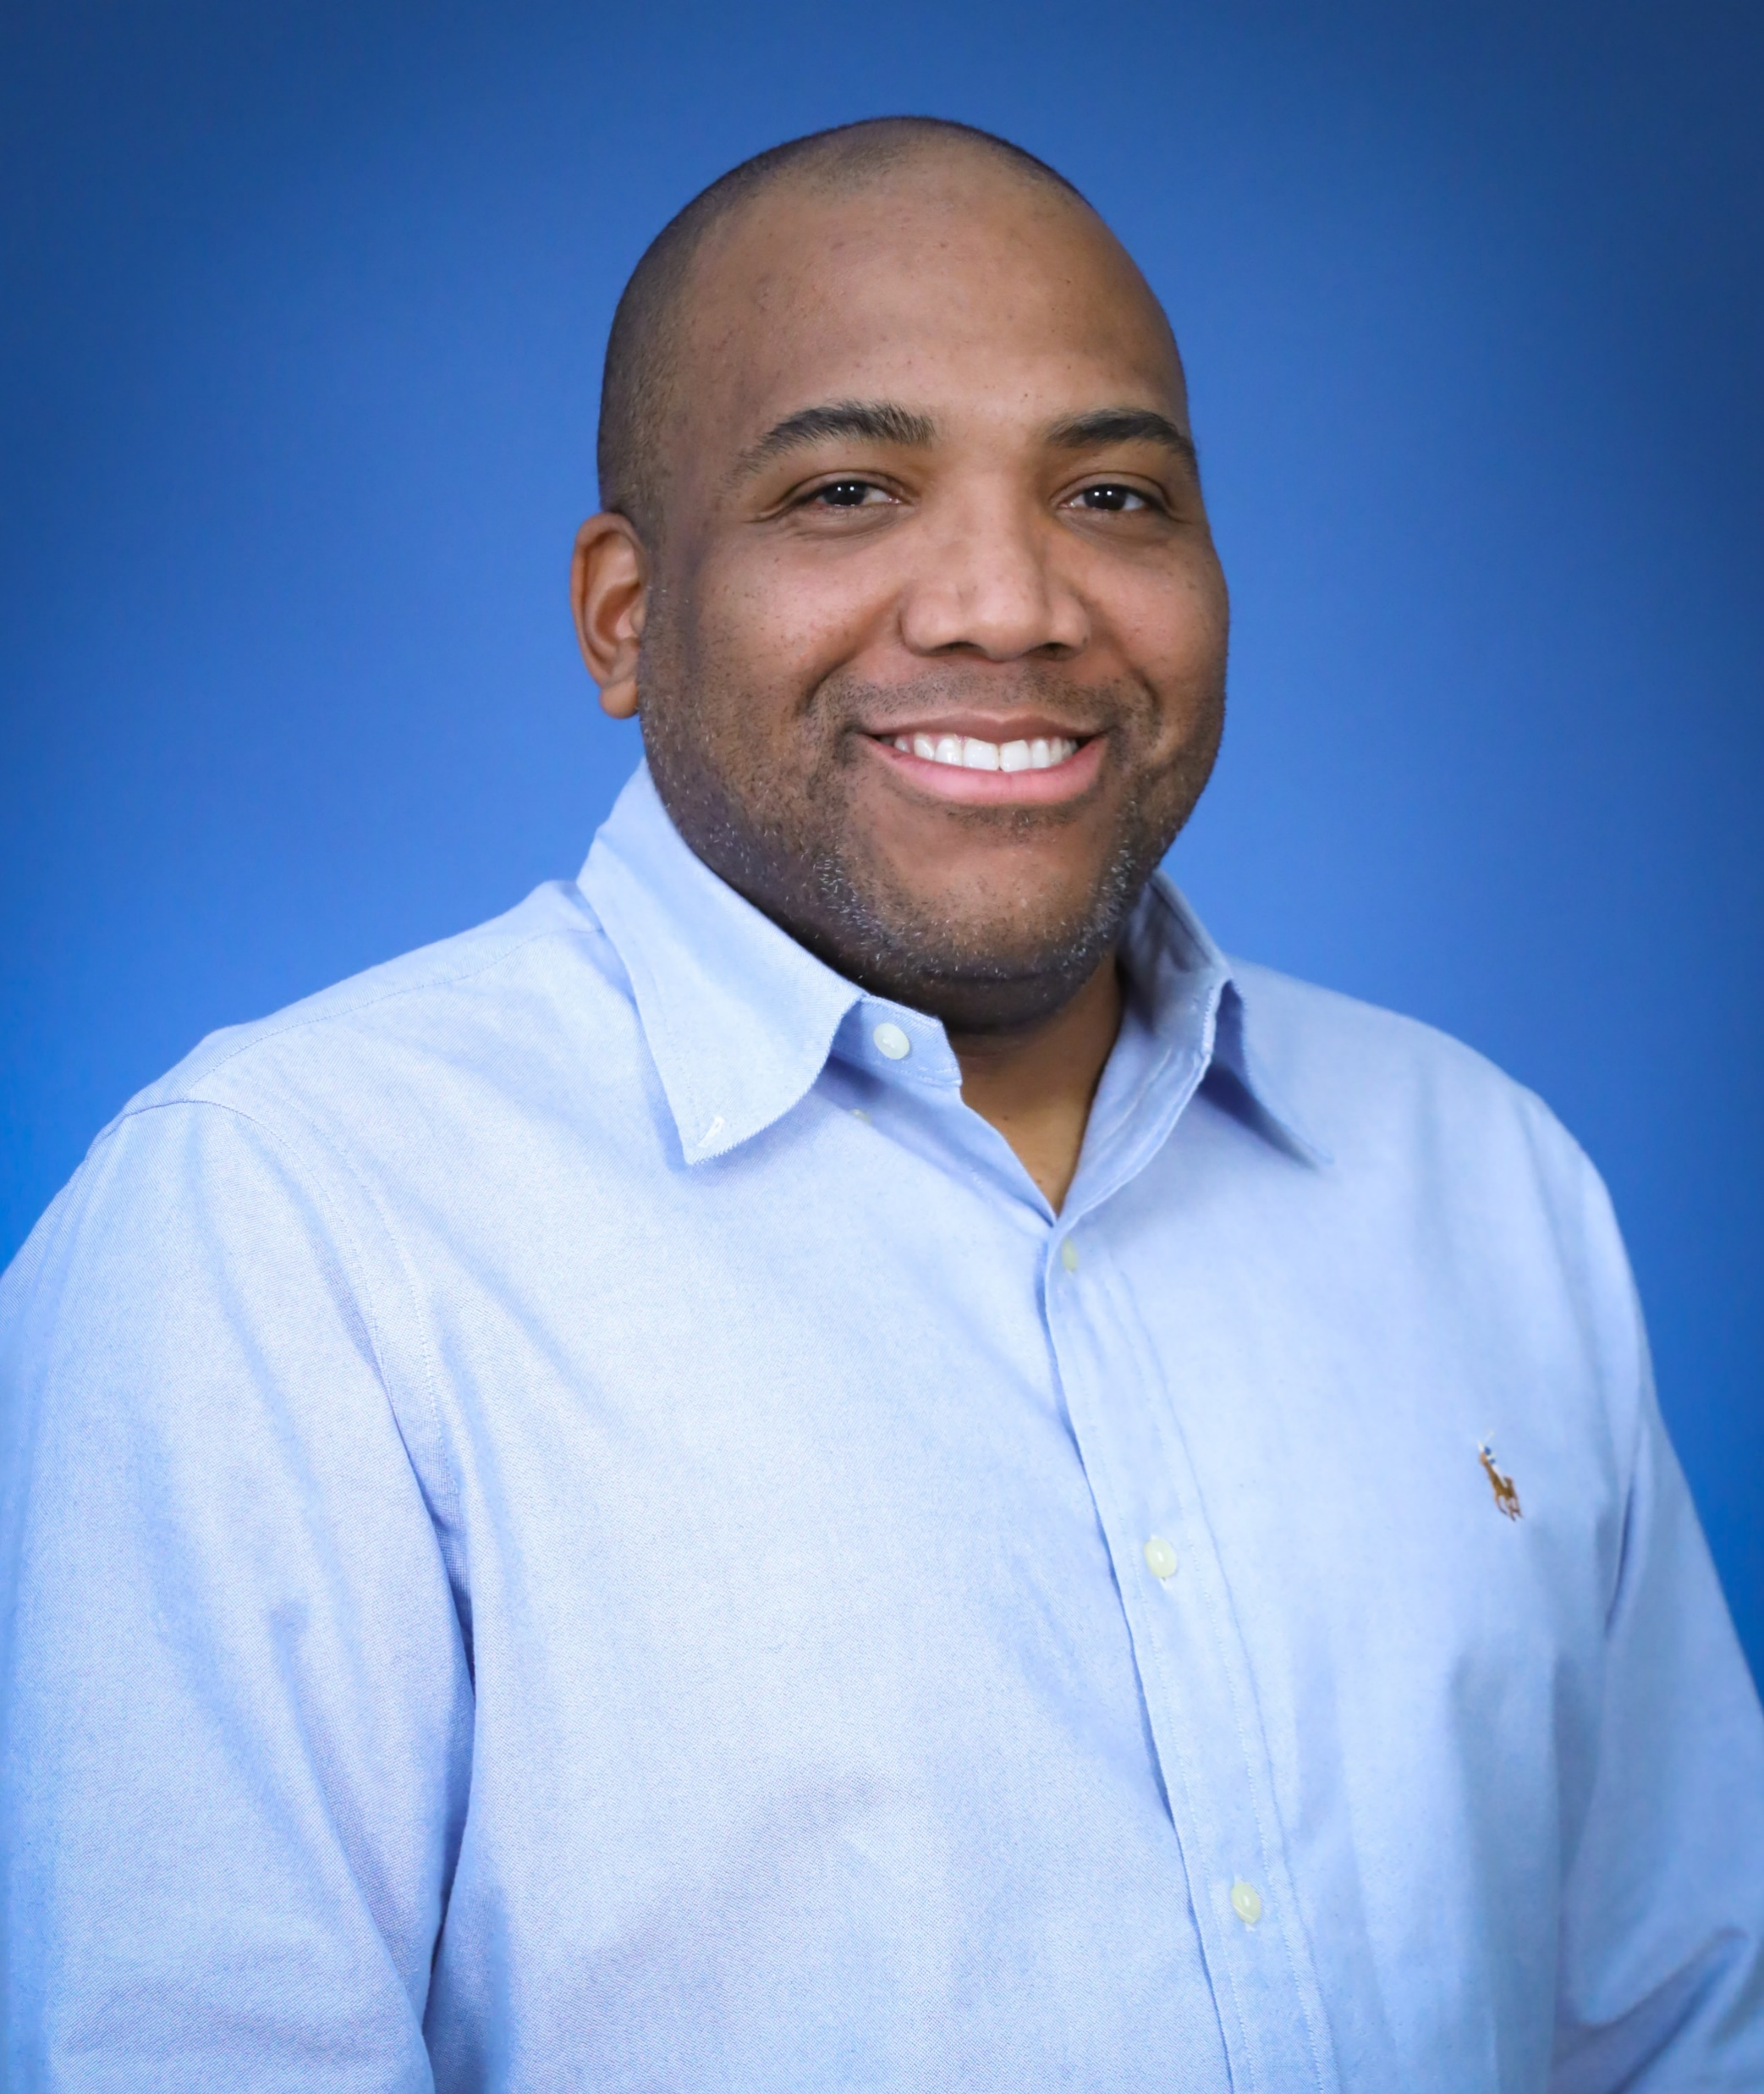
Pathways to community living
Johnney Johnson
Director of Pathways to Community Living
About Pathways
Money Follows the Person (MFP) transitions qualified
Oklahomans from a nursing home back into the community of their choice. The MFP tribal initiative (Pathways) was modified to work more independently with tribes to give funds more specific to their needs.
Outreach
Our team has one Community Outreach Coordinator who will:
• Engage tribal partners
• Attend/present at tribal events across the state
• Maintain relationships
Carley Fryrear
Community Outreach Coordinator

Slide 7
Soonercare Programs Vickie Sams, TrG Outreach and provider engagement coordinator

Slide 8
What is Medicaid?
Medicaid is a federal assistance program, administered by the states, that provides basic health and long-term care services for low-income citizens.
Notes:
.

Slide 9
SoonerCare enrollment

Slide 10
SoonerCare
Children
Birth through age 20
Adults
Ages 21 and up

Slide 11
SoonerCare Traditional
SoonerCare Traditional (Title XIX) is a statewide network of providers that includes but is not limited to I/T/U facilities, hospitals, family practice doctors, pharmacies and medical suppliers.
Other names SoonerCare Traditional goes by:
Title 19
Medicaid
SoonerCare

Slide 12
Soonercare traditional coverage
Behavioral health
Certain prosthetic devices
Dental and orthodontic services
Diabetic testing supplies
Durable medical equipment
Early and Periodic Screening, Diagnosis and Treatment (EPSDT) exams and services

Slide 13
SoonerCare Traditional Coverage
Home health care services
Inpatient hospital services
Laboratory and X-ray
Long-term care
Outpatient hospital and surgery services
Pregnancy services
Over-the-counter contraceptives

Slide 14
SoonerCare traditional coverage
Prescription drugs
School-based services
Smoking and tobacco services cessation counseling products
Therapy services – physical, speech and occupational
Transplant services
Transportation related to medical emergency
Vision services

Slide 15
SoonerCare Traditional: Provider portal

Slide 16
SoonerCare Choice
SoonerCare Choice is a managed care model where a member is linked to a primary care provider (PCP) who serves as the “medical home.”
PCPs manage all of the basic health care needs of members, including specialty referrals.
SoonerCare Choice
SoonerCare IHS/ASO

Slide 17
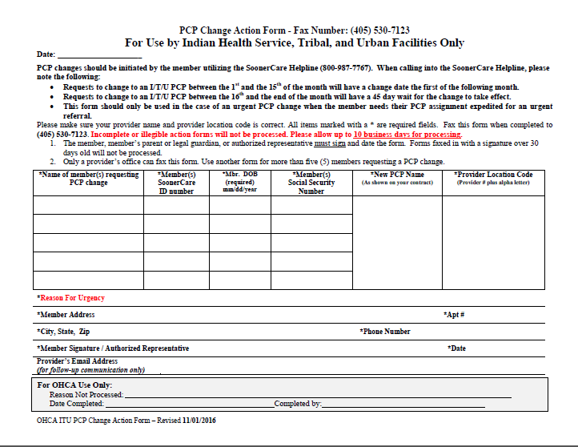
PCP Changes
OHCA has discontinued the use of the
I/T/U-specific PCP Change Form.

Slide 18
PCP Changes , cont.
Effective July 26, 2018, OHCA implemented system changes to include I/T/U PCPs in the PCP selection module in Home View and Agency View.
Real-time PCP changes are also available to members requesting an I/T/U as their PCP; they will have the ability to make same-day changes with a phone call to the SoonerCare Helpline at 800-987-7767.

Slide 19
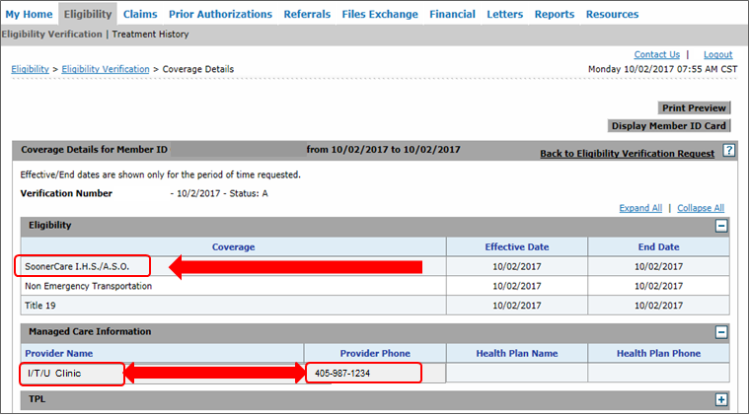
SoonerCare Choice: Provider Portal

Slide 20
Healthy Adult Expansion (HAP)
On June 30, 2020, the Oklahoma Medicaid Expansion Initiative, State Question 802, passed by a majority vote to expand Medicaid eligibility to adults ages 19-64 whose income is 138% (133% with a 5% disregard) of the federal poverty level or lower. This equates to an estimated annual income of $17,796 for an individual or $36,588 for a family of four.

Slide 21
Healthy adult expansion (Hap)
Behavioral health and substance abuse treatment services
Diabetic supplies
Dental services
Durable medical equipment
Inpatient hospital services
Immunizations
Mammograms
Prescription drugs
Notes:
.

Slide 22
ADULT EXPANSION population also known as Healthy adult Program (HAP)
SOONERCARE TRADITIONAL EXPANSION AND SOONERCARE CHOICE EXPANSION
Individuals who can enroll in expansion:
Oklahoma residents
Non-pregnant adults
Adults ages 19-64
Eligibility requirements:
Income at or below 138% of federal poverty level (FPL)
Citizenship or alienage
Cooperation with child support (AI/AN exceptions apply)
Not otherwise eligible as parent/caretaker relative (NCT) or former foster care (FFC)
For an adult who is the parent of a dependent child, the child must also be on Medicaid, CHIP, or have other minimum essential coverage

Slide 23
ADULT EXPANSION population also known as Healthy adult Program (HAP)
BENEFITS AND SERVICES COVERED UNDER TRADITIONAL AND CHOICE EXPANSION

Slide 24
Expansion Healthy adult program: provider portal

Slide 25
Soon-to-Be-Sooners
Soon-to-be-Sooners (STBS) services are provided to qualified unborn children to support healthy pregnancy and birth. Citizenship or immigration status requirements that ordinarily apply to all members do not apply to the pregnant mother who applies for STBS services on behalf of her unborn child.
Women ages 19-65
Must meet financial standards
Must provide proof of pregnancy

Slide 26
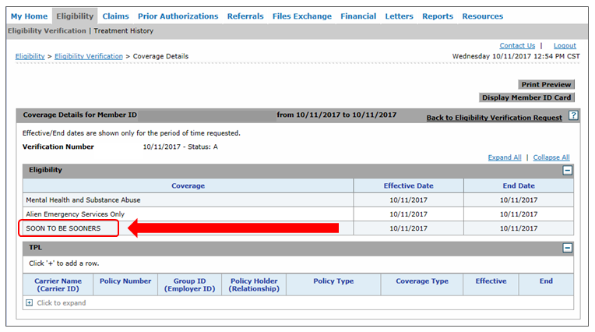
STBS: Provider Portal

Slide 27
Mental Health and Substance Abuse Services
Mental Health and Substance Abuse Services (MHSAS) is behavioral health coverage for Oklahoma Department of Mental Health and Substance Abuse Service (ODMHSAS) contracted providers only.
This is not medical coverage.
Qualifications for this program are different than SoonerCare.
Some may qualify for this program and not SoonerCare.

Slide 28
SoonerRide
SoonerRide is Oklahoma’s non-emergency transportation (NET) program providing curb-to-curb service for eligible SoonerCare members.
Broker is Modivcare
SoonerRide Reservations: 877-404-4500

Slide 29
SoonerRide
Requesting transportation to a scheduled appointment:
To make a reservation, a member must call 877-404-4500 or 711 (TDD) at least three business days before their medical appointment.
Reservations can be made by phone from 7 a.m. to 6 p.m. Monday through Friday.
Online reservations can be made at: https://tripcare.logisticare.com/login
EDI form must be completed by facility-
You can request form by calling 1-800-435-1276

Slide 30
SoonerPlan
SoonerPlan is Oklahoma’s family planning program for eligible men and women who are not enrolled in regular SoonerCare services.
To be eligible, an individual must:
Be age 19 or older
Be an Oklahoma resident
Be a U.S. citizen or qualified alien
Have income at or below 133% of the FPL

Slide 31
SoonerPlan Coverage
Coverage includes:
Birth control information and supplies
Office visits and physical exams related to family planning
Laboratory tests related to family planning services, including pregnancy tests, pap smears
and screening for some sexually
transmitted infections

Slide 32
SoonerPlan Coverage, cont.
Tubal ligations for women ages 21 and older
Vasectomies for men ages 21 and older
Gardasil for males and females through age 26
These services will be paid for as long as the member is seeking a birth control method.

Slide 33
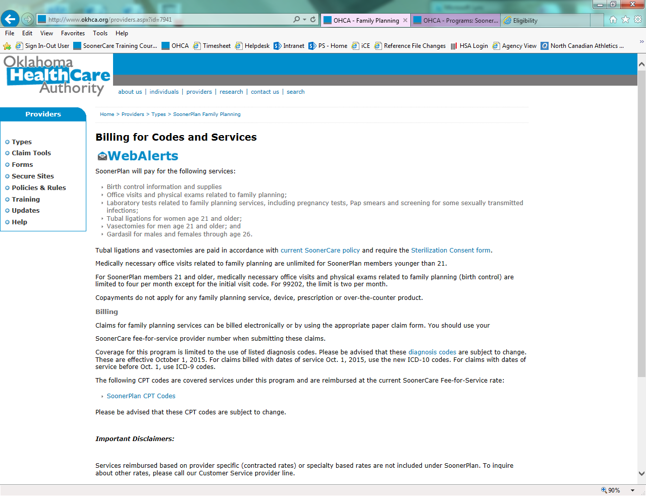
SoonerPlan: Billing

Slide 34
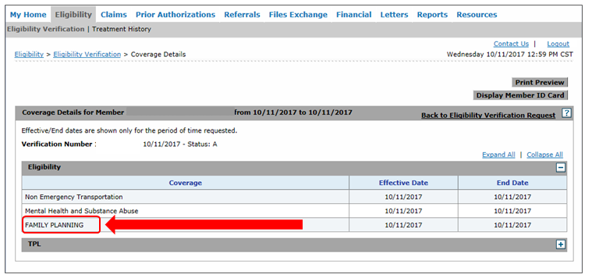
SoonerPlan: Provider Portal

Slide 35
Oklahoma Cares
Eligibility Requirements:
Be screened under NBCCEDP and have an abnormal screen, requiring further diagnosis and/or treatment services.
To find a NBCCEDP screener, please call:
OSDH: 866-550-5585
Cherokee Nation: 877-458-4491
Kaw Nation: 580-362-1039 ext. 228
NBCCEDP: National Breast and Cervical Cancer Early Detection Program

Slide 36
Oklahoma Cares, cont.
Covered services include:
Breast and cervical cancer and pre-cancer diagnosis and treatment
SoonerCare coverage that includes the full range of services
Eligibility will show Title 19

Slide 37
I/T/U Rules and PolicIes

Slide 38
AI/AN Health
Indian Health refers to health services that are available to American Indians through the Indian Health Service (IHS) tribal clinics and hospitals, and urban Indian health facilities (I/T/U). AI/AN members may select an Indian Health Service, tribal or urban Indian (I/T/U) health clinic as a medical home/primary care provider.
Enrollment as a medical home/PCP is not required for Indian Health services.
No cost sharing, copays and/or premium payments for SoonerCare services.
Services at any Indian Health facility without a referral.

Slide 39
Itu outpatient encounters
What is an I/T/U encounter?
It is a face-to-face or telehealth contact between a health care professional and an HIS-eligible SoonerCare member for the provision of medically necessary Title XIX or Title XXI covered services through an IHS or Tribal 638 facility or an urban Indian clinic within a 24-hour period ending at midnight, as documented in the patients record.
More than one outpatient visit with a medical professional within a 24-hour period for distinctly different diagnoses may be reported as two encounters.
I/T/U outpatient encounters for IHS-eligible SoonerCare members, whether medical, dental or behavioral health, are not subject to prior authorization.

Slide 40
Outpatient encounter
Examples include but are not limited to:
Medical and diagnostic services
Behavioral health services
Dental services
Vision services
Physical, occupational and speech therapy
Podiatry
Visiting nurse services
Smoking and tobacco use cessation counseling

Slide 41
Outpatient Encounters, cont.
More than one outpatient visit with a medical professional within a 24-hour period for distinctly different diagnoses may be reported as two encounters.
I/T/U outpatient encounters for HIS-eligible SoonerCare members, whether medical, dental or behavioral health, are not subject to prior authorization.
317:30-5-1098 I/T/U outpatient encounters

Slide 42
Services Outside of the Encounter Rate
317:30-5-1090 Provision of other health services outside of the I/T/U encounter
[Revised 09-01-17]
Medically necessary SoonerCare covered services that are not included in the I/T/U outpatient encounter rate may be billed outside the encounter rate within the scope of the SoonerCare fee-for-service contract. The services will be reimbursed at the fee-for-service rate, and will be subject to any limitations, restrictions or prior authorization requirements.

Slide 43
Services outside of the encounter rate
Examples include but are not limited to:
Durable medical equipment
Glasses
Ambulance
Home health
Inpatient practitioner services
Non-emergency transportation
Behavioral health case management
Psychosocial rehabilitative services
Psychiatric residential treatment facility services
Applied behavior analysis
Diabetes self-management training

Slide 44
Encounter Rate
Calendar Year | Outpatient Rate (per encounter) | Inpatient Rate (per covered day)
2020 | $479 | $3,675
2021 | $519 | $3,631
2022 | $640 | $4,239
2023 | $654 | $4,333
The annual OMB rate for covered encounters paid to contracted I/T/U providers is established by the Office of Management and Budget (OMB) and is published in the Federal Register.

Slide 45
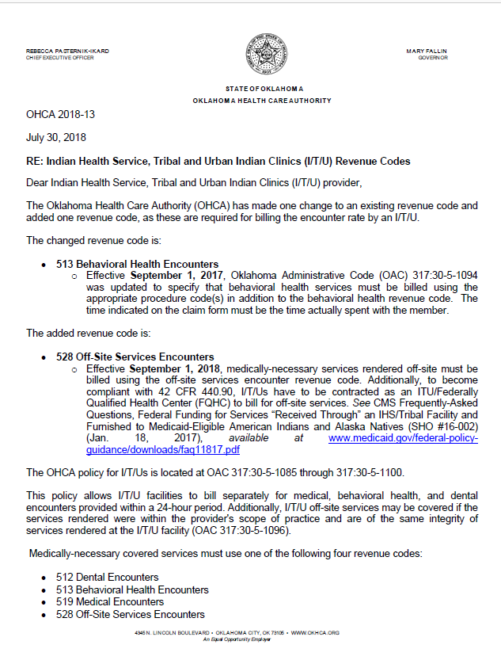
I/t/u Revenue Codes
Contracted I/T/U providers bill with revenue codes for compensable services:
512: Dental
513: Behavioral Health
519: Medical
528: Off-Site Services
OHCA 2018-13

Slide 46
Third Party Liability
317:30-3-24 Third party resources
As the Medicaid agency, OHCA is the payer of last resort, with few exceptions. When other resources are available, those resources must first be utilized.
Exceptions to this policy are those receiving medical treatment through Indian Health Services and those eligible for the Crime Victims Compensation Act.
Notes:
.

Slide 47
Billing Question
Do I/T/U providers bill the global delivery fee for pregnancy-related services?
An I/T/U facility should not be billing the global delivery fee.
Because I/T/U providers are paid an encounter rate, the facility should be billing for each visit a patient has at the clinic during her antepartum and/or postpartum care.
Upon delivery of the child, the appropriate delivery-only CPT should be billed.

Slide 48
Timely Filing
317:30-3-11 Timely filing limitation
Providers must submit all claims no later than 12 months from the date of service. Federal regulations provide no exceptions to this requirement.
In the event that a problem exists (such as a pending eligibility determination), the provider must still file the claim within timely guidelines.
For dates of service provided on or after July 1, 2015, the timely filing limit, for SoonerCare reimbursement, is six months (183 days) from the date of service.

Slide 49
I/t/u Prior authorization
Notes:
Before we get started: Quick Note for you all: Please make sure you are using Google Chrome when using the provider portal and interqual. Our systems work at there best when using this application.
And like I just stated the first part will be over in the provider portal.
And we will take a look at verification.

Slide 50
Presentation Description
This class covers the prior authorization (PA) submission for InterQual®-related procedures and provides resolutions to common errors within the InterQual review. PAs related to behavioral health, dental, durable medical equipment (DME), therapy (OT/PT/ST), pharmacy and waiver are not included.
Note: This webinar will not include managed care organization (MCO) changes or Medicaid expansion. For more information, click on the banner from the home page.
Recommended audience: Providers who submit PAs related to surgeries, procedures and high-tech imaging.

Slide 51
disclaimer
SoonerCare policy is subject to change.
The information included in this presentation is current as of March 2023.
Current information can be found on the OHCA public website: www.Oklahoma.gov/ohca.

Slide 52
Eligibility verification
Select Eligibility Verification to verify member eligibility.

Slide 53
Eligibility verification
Enter the SoonerCare Member ID.
Enter the From Date and To Date of Service.

Slide 54
Eligibility verification
Eligibility must show Title 19 for active benefits.

Slide 55
Treatment history
Select Treatment History under the Eligibility tab.

Slide 56
Treatment history
Member ID – Enter the SoonerCare member ID.
Service From and To Date – Enter the dates of service.
Procedure Code Type – Select CPT/HCPCS or Revenue
Procedure Code – Enter the procedure code.

Slide 57
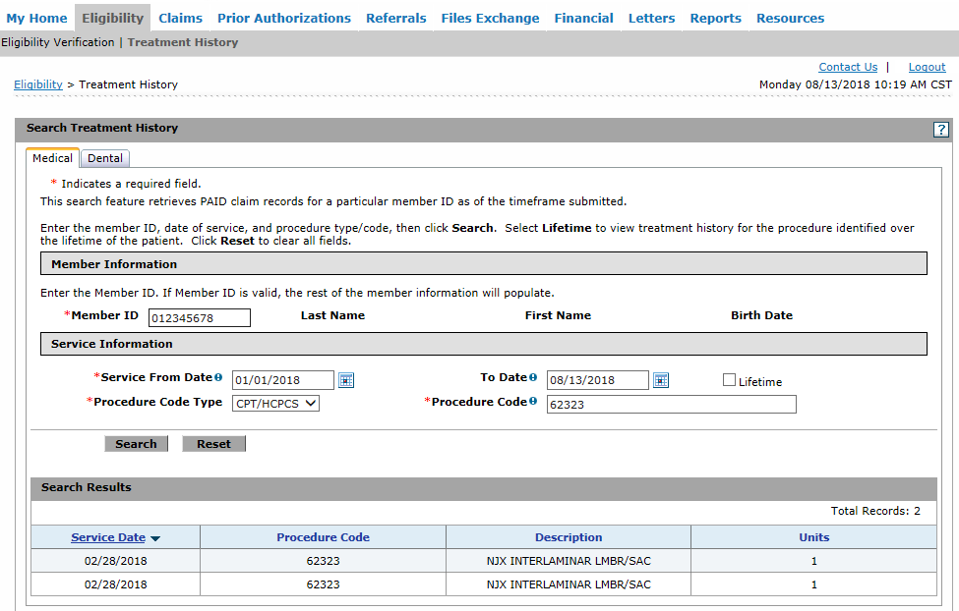
Treatment history
Search Results will reflect the date when services were rendered and how many units were billed.

Slide 58
Fee schedule
Select Search Fee Schedule under the Resources tab.

Slide 59
Fee schedule
Search Results will show if a PA is required.

Slide 60
Pa submission
Select Create Authorization under the Prior Authorizations tab.

Slide 61
Pa submission
Requesting Provider Information – This will automatically populate the provider logged in.
Member Information – Enter the SoonerCare Member ID.

Slide 62
Pa submission
Service Provider Information is only required for durable medical supplies/equipment/appliances, prosthetics, orthotics, home health, hospice, specialized nursing and vision care services. All other types leave this blank.

Slide 63
Pa submission
Transmission Method: EL = Electronic Only
Accepted file types: JPG, PDF, TIF, XPS.
Up to 10 MB.
Only the first line item requires attached documents.

Slide 64
Pa submission
Upload File – Select Browse to locate the attachments.
Description – Enter a brief description of the documentation. Click Add.

Slide 65
Pa submission
The transmission method, file and control number will reflect if the documentation is successfully attached to the PA line item.
The system will populate another blank section if additional documents need to be added.

Slide 66
Pa submission
Assignment Code – Select the appropriate assignment code.
Managed Care, Fund, Letter – Leave blank.

Slide 67
Pa submission
Diagnosis Code – Enter the primary diagnosis code without the decimal point, then click Add.

Slide 68
Pa submission
Remarks (optional) – Enter a contact name and telephone number of the person submitting the PA request. For items listed as miscellaneous, enter the line item and description in the remark field. Select Add.

Slide 69
Pa submission
From Date and To Date – Enter the date range.
Therapy – No retro.
Imaging – MRA, MRI, CT, PET 3-day retro.**
All others – 6-month retro.**
**From the initial date of service.

Slide 70
PA SUBMISSION
Code Type – Select Procedure Code or Revenue.
Code – Enter the procedure code.
Thru Code – Currently only allowed for certain medical supplies/equipment/appliances. Do not use thru codes therapy, imaging, surgery or other medical procedures.

Slide 71
PA SUBMISSION
Modifiers – Use appropriate modifiers, if applicable. Up to four modifiers can be entered.

Slide 72
PA SUBMISSION
Modifiers TC and 26 entered on the same line of the PA will cause claims to deny.

Slide 73
Pa submission
Units – Enter the number of units.
Click Add Service to save the PA line item.

Slide 74
Interqual® review
InterQual evidence-based questions and answers are currently implemented in the SoonerCare provider portal PA function.
OHCA currently has high-tech imaging, some surgeries and some procedures impacted by the InterQual medical review guidelines.
OHCA will continue to add additional services throughout the remainder of the year.

Slide 75
InterQual® Review
The page will redirect to the InterQual website if the code entered requires InterQual review.

Slide 76
InterQual® Review
Select one code on the recommendation screen. Another line item will need to be entered on the PA if more than one code is required. Click OK to continue.
Notes:
.

Slide 77
InterQual® Review
Select the appropriate Subset from the results list for the related procedure entered.
Notes:
once you’ve located the procedure you want to authorize click, the appropriate subset.

Slide 78
InterQual® Review
Click the Smartsheets tab to download the medical review questions related to the procedure entered.
Notes:
So on this page you will click on the smartsheets tab to download the medical review questions related to the procedure entered.
Smartsheets were incorporated to help non-clinical and clinical staff answer the medical review questions appropriately.
We encourage providers to use the InterQual SmartSheets to submit prior authorization requests for certain procedures.
Also, again it is very important to have the members chart notes in front of you at this time, this way you will be able to answer the questions that the smart sheets are going to ask you.
Let me show you really quick on how to use them. These are very helpful when you get a denied PA.
So go ahead and Click the smartsheets tab to download the medical review questions related to the procedure entered.

Slide 79
InterQual® Review
Select the Requested Service, Age and Indication.

Slide 80
InterQual® Review
The Smartsheets are designed with step-by-step instructions, based on the answer selected.

Slide 81
InterQual® Review
Click the Begin Medical Review button to answer the medical scenario questions.

Slide 82
InterQual® Review
Select the correct age for the member.

Slide 83
InterQual® Review
Comments must be added if Other clinical information is selected or if applicable.
Notes:
So on this screen the questions asks Prior successful injection for same specific condition, it tells you to choose one, so a little note here: Providers have the ability to add additional comments.
But if you select other clinical information, you will most likely not receive an automatic approval. It will be sent over for manual review and can take up to several days. As you can see this one was selected then it says no remaining questions. Click view recommendations to continue. So if you are looking for an automatic approval, select the answer that best applies to the patients criteria, go ahead and review the smartsheets again and may have to reconsider if the request is medical necessary, but if you do select the comment button it will lead you to the next screen where you can add the information. (go to next slide)

Slide 84
InterQual® Review
Enter the Reviewer Comments then click ADD COMMENT.

Slide 85
InterQual® Review
Click View Recommendations if no questions remain.

Slide 86
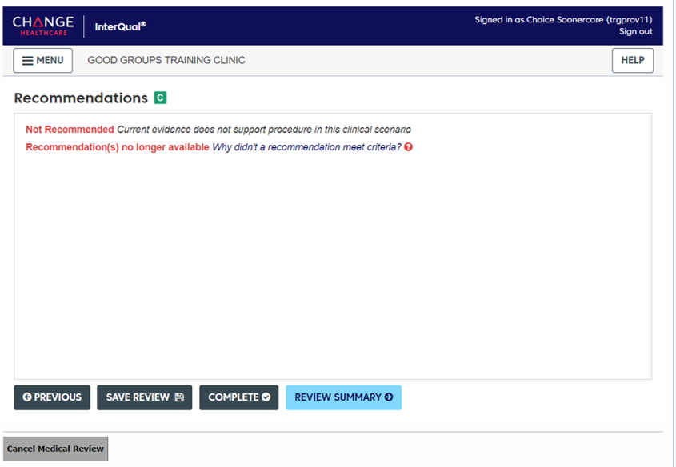
InterQual® Review
Select Why didn’t a recommendation meet criteria if recommendations are not available.

Slide 87
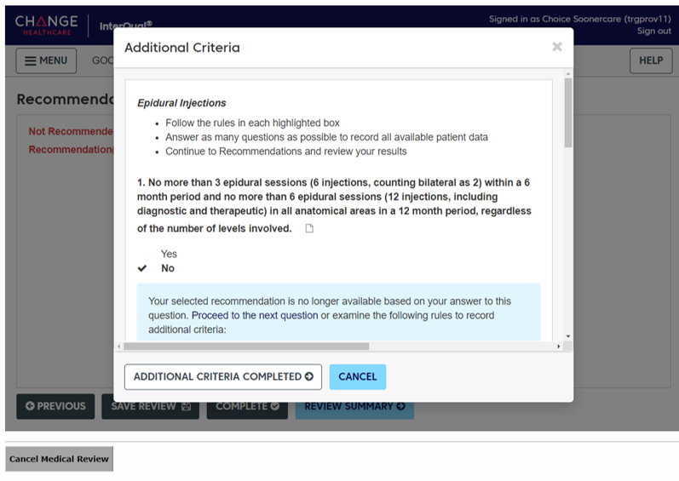
InterQual® Review
Follow the rules in each highlighted box and answer the medical scenario questions.
Click Additional Criteria Completed.

Slide 88
InterQual® Review
Select the Recommended procedure if the procedure is listed within the Recommendations screen.

Slide 89
InterQual® Review
Select the appropriate Code under the CPT® tab and click Complete.
Notes:
.

Slide 90
InterQual® Review
Completing the medical review will be locked and no further edits can be made. Click Yes to continue.

Slide 91
InterQual® Review
The following is only a recommendation result, final determination is to follow. Click OK.

Slide 92
InterQual® Review
Click the Save PA Line Item button to save the review.

Slide 93
Pa submission
The page is redirected to the provider portal and the information entered is saved on the PA request.

Slide 94
Pa submission
If no additional codes need to be added, click Submit.

Slide 95
Pa submission
Click Confirm to submit the request.

Slide 96
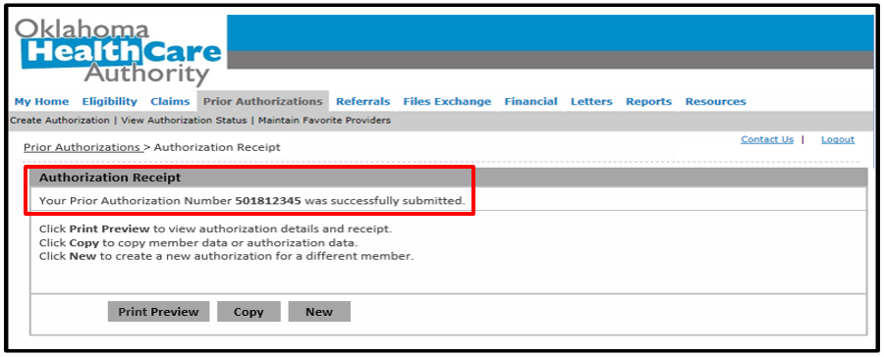
Pa submission
Prior Authorizations > Authorization Receipt
Authorization Receipt
Your Prior Authorization Number 501812345 was successfully submitted.
Click Print Preview to view authorization details and receipt.
Click Copy to copy member data or authorization data.
Click New to create a new authorization for a different member.
Print Preview
Copy
New
Authorization Receipt – The portal will generate a PA number to confirm the request submitted successfully. This does not mean the PA is approved.

Slide 97
I/T/U referral

Slide 98
Soonercare referral guidelines
Referrals are to be initiated for medically necessary services as determined by the PCP.
The PCP and specialty provider are responsible for maintaining appropriate documentation of each referral to support the claims for medically necessary services.
Services authorized by the PCP must be within the scope of coverage of the SoonerCare Choice program.
A PCP referral is not a guarantee of payment.

Slide 99
Soonercare referral guidelines
Referrals can be issued for up to a period of 12 months.
Referrals from the PCP are required prior to rendering services, except for retrospective referrals that are deemed appropriate by the PCP.
PCPs can backdate referrals up to six months.
PCPs do not have to see a member before a referral is approved, but they may require this.

Slide 100
Soonercare referral guidelines
Referrals may be written to an individual provider or group.
Referrals may be forwarded to other specialists with the approval of the PCP.
Specialists must report findings directly to the provider issuing the referral.

Slide 101
administrative referrals
Administrative referrals may be provided by OHCA under special and extenuating circumstances and should not be requested as a standard business practice. Administrative referrals may be requested using the SC-14 form. OHCA will not process retrospective administrative referrals unless one of the following exceptions applies:
The specialty services are referred from an I/T/U facility.
The specialty services are referred as the result of an emergency room visit or emergency room follow-up visit.

Slide 102
Administrative referral, cont.
The specialty services are referred for pre-operative facility services prior to a dental procedure.
The retrospective administrative referral request for specialty services is requested from OHCA within 30 calendar days of the specialty care date of service. The request must include appropriate documentation for OHCA to approve the request.

Slide 103
Administrative referral, cont.
Appropriate documentation must include:
Proof the specialist has attempted to collect a PCP referral from the member’s assigned PCP.
Medical documentation to substantiate the specialty services are medically necessary.

Slide 104
I/t/u soonercare referrals
I/T/U PCPs are the only provider type to retain the ability to submit a new electronic referral after Sept. 1, 2017.
The attestation box on an electronic referral should only be check marked by I/T/Us actively participating in the 100% FMAP initiative.
Requires a signed Care Coordination Agreement (CCA) between the I/T/U provider and the specialist.
FMAP: Federal Medical Assistance Percentage

Slide 105
I/t/u soonercare Referrals, cont.

Slide 106
I/t/u soonercare Referrals, cont.

Slide 107
Soonercare Dental 101 Wendy pAYNE

Slide 108
Disclaimer
SoonerCare policy is subject to change.
The information included in this presentation is current as of March 2023.
Stay informed with current information found on the OHCA public website by visiting www.oklahoma.gov/ohca.

Slide 109
Presentation Description
A current look at covered dental services, services requiring a prior authorization, and the documents required for each submission.
Target audience – Dentists, Orthodontists and Administrative Staff.

Slide 110
Agenda
Covered populations
Covered services
Resources
Questions

Slide 111
Covered populations

Slide 112
dental coverage
SoonerCare (Oklahoma Medicaid) Title XIX pays for preventive, diagnostic and restorative services for eligible members under the age of 21.
Dental care for adults residing in private intermediate care facilities for individuals with intellectual disabilities (ICF/IID) is similar to the scope of services available to individuals under 21.

Slide 113
Covered populations
Healthy Adult Program (HAP) expansion members ages 19-20 fall under EPSDT guidelines and will have the same dental benefits as those available to Title XIX members ages 0-20.
Healthy Adult Program (HAP) expansion members ages 21 and older, and current Title XIX adults ages 21 and older, have an expanded limited dental benefit that began July 1, 2021.

Slide 114
Covered services

Slide 115
Adult limited dental benefits ages 21+
Comprehensive oral evaluation
Periodic oral evaluation
Limited oral evaluation
Complete series of radiographs
Dental prophylaxis, including fluoride
X-rays
Periodontal maintenance
Restoration/fillings
Scaling and root planning*
Scaling in the presence of generalized moderate or severe gingival inflammation*
Full and partial dentures*
Adjustments 3 per 12 months
Relines one per 3 years*
Alveoloplasty in conjunction w/extractions 4 or more teeth per quadrant*
Removal of lateral extosis*
Removal of tori*

Slide 116
dental benefits ages 0-20
Analgesia
Pulp cap
Protective restorations
Diagnostic cast and oral/facial Images
Silver diamine Fluoride
Smoking and tobacco use cessation counseling
Medically necessary extractions
Comprehensive oral evaluation
Periodic oral evaluation
Limited oral evaluation
Dental prophylaxis, including fluoride
Stainless steel crowns for primary and permanent teeth
Pulpotomies and pulpectomies
Space maintainers

Slide 117
Services Requiring a Prior Authorization (PA) Ages 0-20
Endodontics
More than 2/12 months
Crowns for permanent teeth
Partials, dentures and related services
Occlusal guards
Bridges
Periodontal scaling and root planing
Scaling in the presence of generalized moderate or severe gingival inflammation
Periodontal maintenance
Orthodontics

Slide 118
Required documents

Slide 119
Required Documents
Minimum required records to be submitted with each dental Prior Authorization Request (PAR):
Comprehensive treatment plan.
Right and left-mounted bitewing X-rays or panoramic X-ray.
Periapical film of tooth/teeth involved or the edentulous areas if not visible in the bitewings.
Six-point periodontal charting.
Records on member’s oral hygiene and flossing ability or Carries Risk Assessment.

Slide 120
Document requirements
X-rays or images must be identified by the tooth number and include date of exposure, member name, member ID, provider name and provider ID.
All X-rays or images, regardless of the media, must be submitted together with a completed and signed comprehensive treatment plan that details all needed treatment at the time of examination.
The film or print must also clearly identify the requested service.
PA films must show 3 mm below apex.

Slide 121
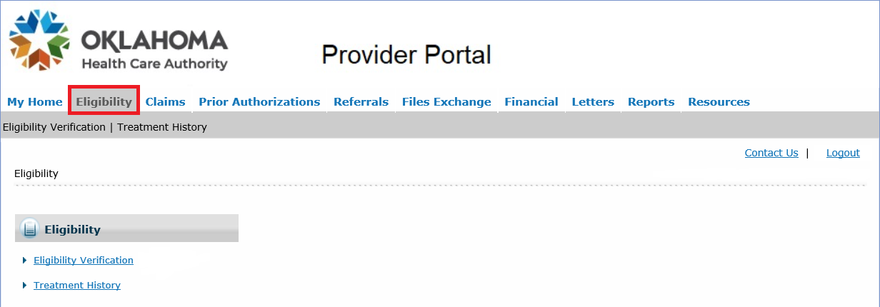
Treatment history
Treatment history of SoonerCare members can be found through the secure provider portal.
Select Treatment History under the Eligibility tab.

Slide 122
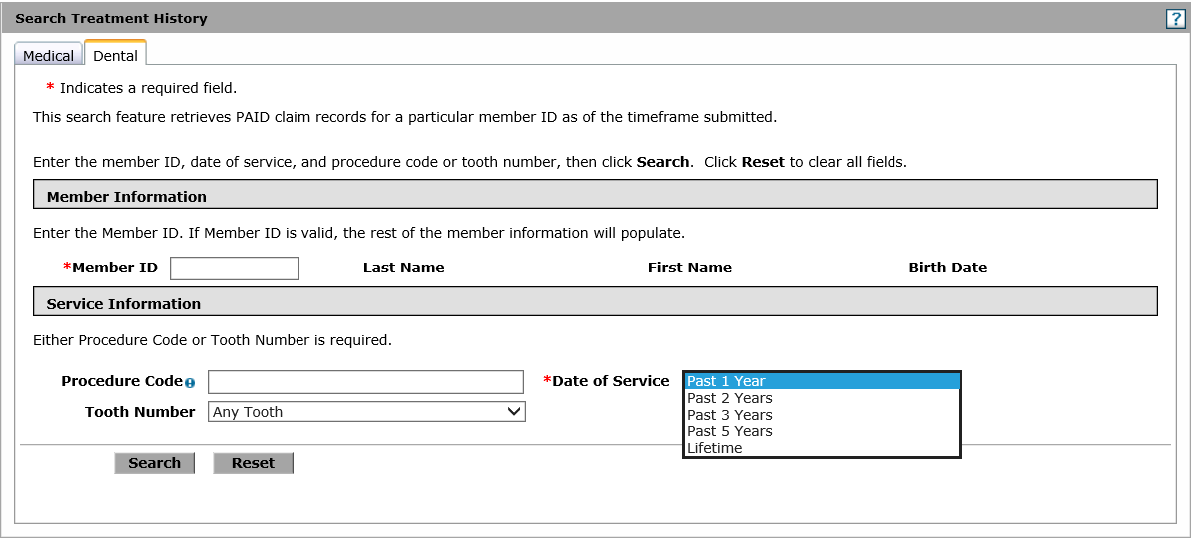
Search Treatment history
Select the Dental tab, enter the Member ID and the Date of Service.

Slide 123
Lifetime disclaimer
Selecting Lifetime Date of Service will return services that are only compensable once in a member’s lifetime.

Slide 124
resources

Slide 125
Helpful telephone numbers
Dental Prior Authorization
405-522-7401
Dentalservices@okhca.org
OHCA Provider Helpline
800-522-0114, option 1
Internet Help Desk
800-522-0114, option 2,1

Slide 126
Helpful links
Dental Provider Page
https://oklahoma.gov/ohca/providers/types/dental/dental.html
Dental Newsletter
https://oklahoma.gov/ohca/providers/types/dental/dental-newsletter.html
OHCA Public Website
https://oklahoma.gov/ohca.html

Slide 127
I/t/u Reminders & updates

Slide 128
Training resources
I/T/U Provider Engagement Coordinator:
Engagement Coordinator provide education and training as needed for providers either virtually or by phone.
Requests for assistance should be emailed to: Vickie.Sams@okhca.org. (Requests should include the provider name and ID, contact information and a brief description of what assistance is being sought.)
For immediate claims or policy assistance, please contact the OHCA provider helpline at 800-522-0114.

Slide 129
questions

Slide 130
Tribal Government Relations
Kathrine McCoy, Sr. Coordinator Kathrine.McCoy@okhca.org
Vickie Sams, TGR Outreach/Provider Coordinator Vickie.Sams@okhca.org
Johnney Johnson, Director Pathways to Community Living Johnney.Johnson@okhca.org
Carley Fryrear, Community Outreach Coordinator Carley.Fryrear@okhca.org
GET IN TOUCH
4345 N. Lincoln Blvd.
Oklahoma City, OK 73145
okhca.org
MySoonerCare.org
Agency: 405-522-7300
Helpline: 800-987-7767

