Slide 1
SOONERCARE
PAIN MANAGEMENT
PROGRAM

Slide 2
SOONERCARE PAIN MANAGEMENT PROGRAM
The SoonerCare Pain Management Program is designed to equip SoonerCare providers with the knowledge and skills to appropriately treat members with chronic pain. To accomplish this, the Oklahoma Health Care Authority (OHCA) has developed a proper prescribing toolkit.

Slide 3
SOONERCARE PAIN MANAGEMENT PROGRAM
Two practice facilitators assist with implementing the components of the toolkit within selected SoonerCare practices.
30 CME credits
Additionally, two substance use resource specialists are dedicated to assist providers with linking members with substance use disorder, or other behavioral health needs, to the appropriate treatment.

Slide 4
SOONERCARE PAIN MANAGEMENT PROGRAM
Launched January 2016
Electronic version
www.okhca.org/pain-management

Slide 5
OKLAHOMA STATE BOARD OF MEDICAL LICENSURE AND SUPERVISION
Rule 435:10-7-11 Use of controlled substances for the management of chronic pain:
Evaluation of the patient
Treatment plan
Informed consent and agreement for treatment
Periodic review
Consultation
Medical records
Compliance with controlled substance laws and regulations

Slide 6
OKLAHOMA STATE BOARD OF OSTEOPATHIC EXAMINERS
Rule 510:5-9-1,2,3 Prescribing for intractable pain:
Benefits vs. risks
Complete medical history and physical exam
Treatment plan
Review course of treatment
History of substance abuse
Informed consent

Slide 7
A look at the problem

Slide 8
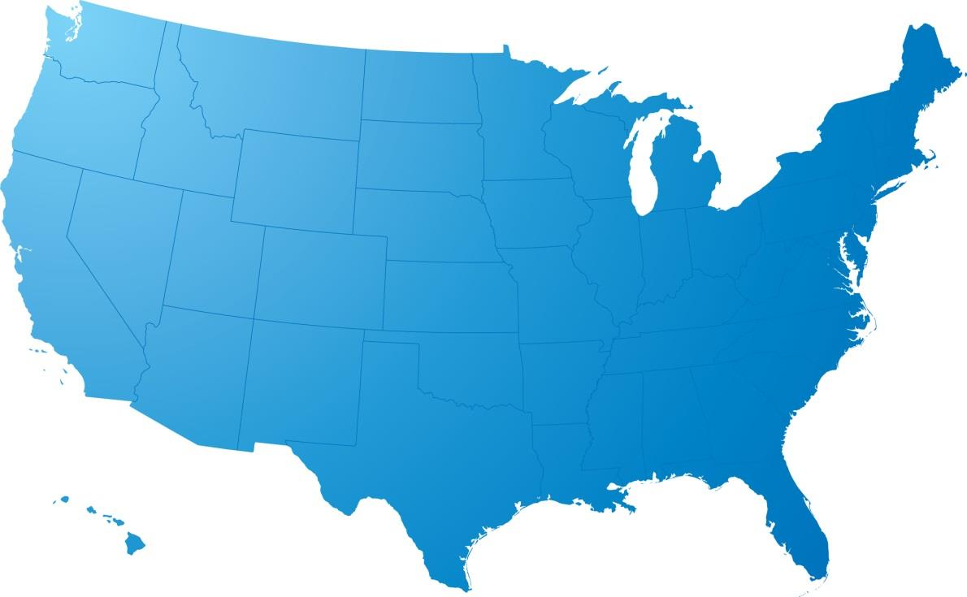
A look at our state
Oklahoma’s national ranking
for accidental overdose deaths:
5th

Slide 9
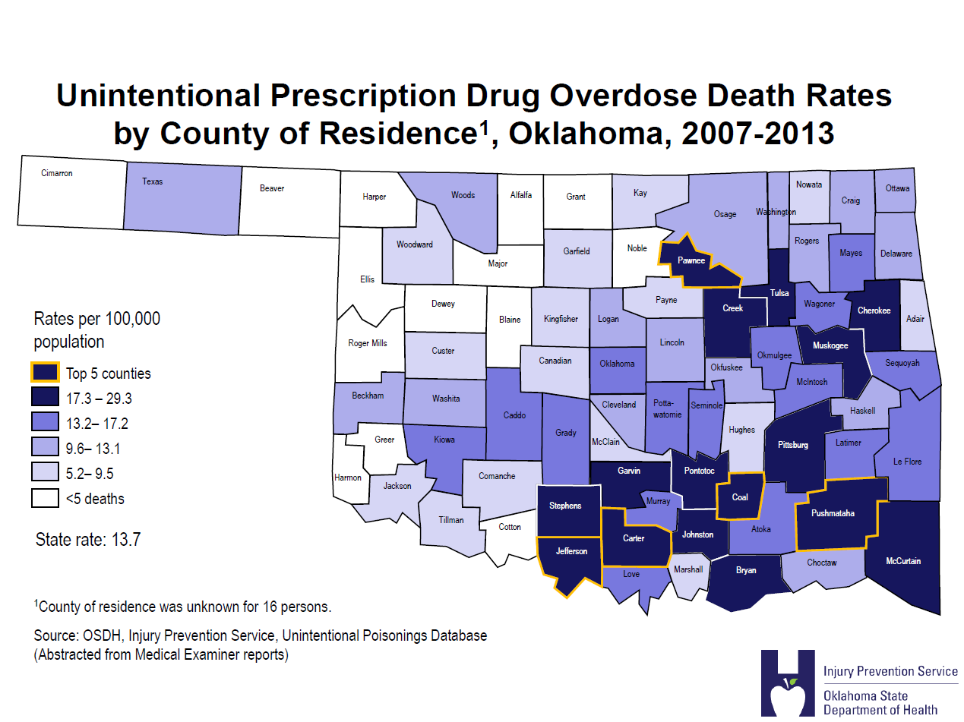

Slide 11
CONTACT INFORMATION
Jaclyn Mullen, R.N., BSN
Pain Management Program Sr. Nurse Analyst
405-522-7052
Jaclyn.Mullen@okhca.org

