Slide 1

SOONERCARE CHOICE PROGRAM
INDEPENDENT EVALUATION
THE PACIFIC HEALTH POLICY GROUP
SEPTEMBER 2014

Slide 2
INTRODUCTION
This presentation is an update to a PHPG analysis of SoonerCare Choice performance conducted last year
The update includes utilization/expenditure results for 2009 through 2013 (based on paid claims)
The update also includes the most recent available data on enrollment, provider participation, quality of care and member satisfaction
Most findings are presented by state fiscal year; calendar year data is noted where used

Slide 3
INTRODUCTION cont’d
PHPG specializes in design, implementation and evaluation of health reform initiatives for publicly-funded populations
PHPG has assisted over 30 state Medicaid programs since 1994
In recent years PHPG has worked on Medicaid managed care engagements for public or managed care organization clients in:
Arizona | California | Florida | Georgia
Hawaii | Kansas | Kentucky | Michigan
Missouri | New Jersey | New Mexico | New York
Ohio | Tennessee | Texas | Vermont

Slide 4
INTRODUCTION cont’d
PHPG was retained to evaluate SoonerCare Choice and address the following:
Trends - How is SoonerCare Choice performing on the critical measures of Access to Care, Quality and Cost Effectiveness?
New Initiatives – What has been the impact to-date of the SoonerCare Health Management Program, Patient Centered Medical Homes and Health Access Networks?
National Perspective - How does SoonerCare Choice compare to managed care programs elsewhere in the country?

Slide 5
INTRODUCTION cont’d
Overview of SoonerCare Choice Enrollment
The SoonerCare Program serves over 800,000 Oklahomans
SoonerCare Choice is the managed care portion of the larger SoonerCare program
About 70 percent of SoonerCare members are enrolled in SoonerCare Choice
About 80 percent of SoonerCare Choice members are children
As part of their enrollment in managed care, SoonerCare Choice members are aligned with Patient Centered Medical Homes (PCMH model)

Slide 6
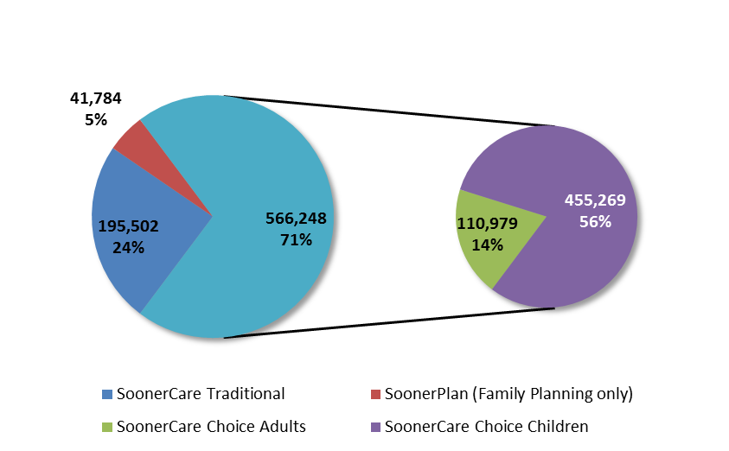
INTRODUCTION cont’d
SoonerCare – May 2014
Total Enrollment – 803,534
SoonerCare
SoonerCare Choice
(70% of total)
Source: OHCA Fast Facts

Slide 7
INTRODUCTION cont’d
Overview of Patient Centered Medical Homes
PCMH model was created at the recommendation of a 2007 OHCA Medical Advisory Task Force
Oklahoma’s PCMH initiative is part of a broader national movement to improve primary care for Medicaid members
PCMH seeks to transform the delivery of primary care through:
  Interdisciplinary team approach to care coordination
  Standardization of care in accordance with evidence-based guidelines
  Tracking of tests and consultations and follow-up after ER visits/hospitalizations
  Active measurement of quality and adoption of Quality Improvement strategies

Slide 8
INTRODUCTION cont’d
Overview of Patient Centered Medical Homes
There is early evidence from state-level and national studies that patient centered medical homes can improve access and quality, while helping to control costs
A three-year study by Independence Blue Cross of Pennsylvania found that high risk members enrolled in a PCMH experienced fewer hospital admissions and lower total costs than members in a control group (American Journal of Managed Care, March 2014)
A national study of patients with access to weekend and extended office hours (component of many PCMH programs) found they experienced lower total health care expenditures and equal health outcomes than patients without such access (Annuals of Family Medicine, 2012)

Slide 9
INTRODUCTION cont’d
SoonerCare Choice PCMH Tiers – SFY 2013
PCMH includes three tiers with escalating responsibilities and associated per member per month care coordination fees
Providers also can earn “SoonerExcel” quality incentives for meeting performance targets, such as for preventive care, member use of the ER and prescribing of generic drugs
Tier 3
Entry Level
Advanced
Optimal
12 requirements
$3.46 - $4.85 per month
Practice with average caseload receives up to $14,783 per year in care coordination fees
Includes 24/7 telephone coverage by medical professional
19 requirements, including all Tier 1 requirements
Includes offering at least 30 hours of office time to see patients
$4.50 - $6.32 per month
Practice with average caseload receives up to $19,263 per year in care coordination fees
23 requirements, including all Tier 1 and Tier 2 requirements
Includes using health assessment tools to characterize patient needs/risks
$5.99 - $8.41 per month
Practice with average caseload receives up to $25,634 per year in care coordination fees
Tier 2
Tier 1

Slide 10
INTRODUCTION cont’d
PCMH Practice Participation
The total number of participating practices increased significantly from 2009 to 2014
Since 2009, Tier 3 practices, as a percent of total, have increased four-fold, from under five percent to 19 percent
Nearly 60 percent of SoonerCare Choice members are now enrolled with a Tier 2 or Tier 3 practice
PCMH providers earned over $3.5 million in SoonerExcel incentive payments in SFY 2013 for meeting quality targets

Slide 11
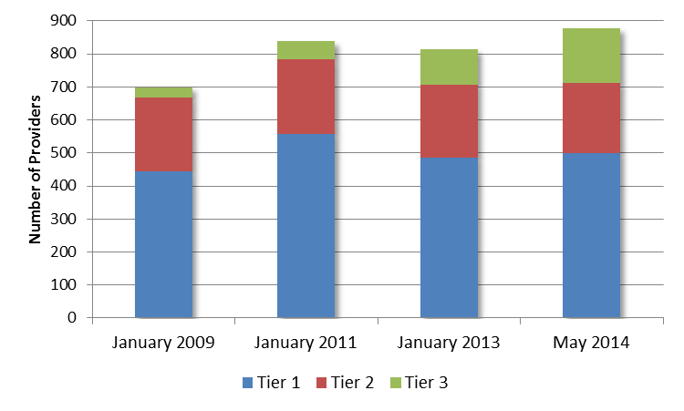
INTRODUCTION cont’d
Participating Practices by Tier Level*
879
838
814
699
*Note – Practices can include multiple providers
Source: OHCA Provider Fast Facts

Slide 12
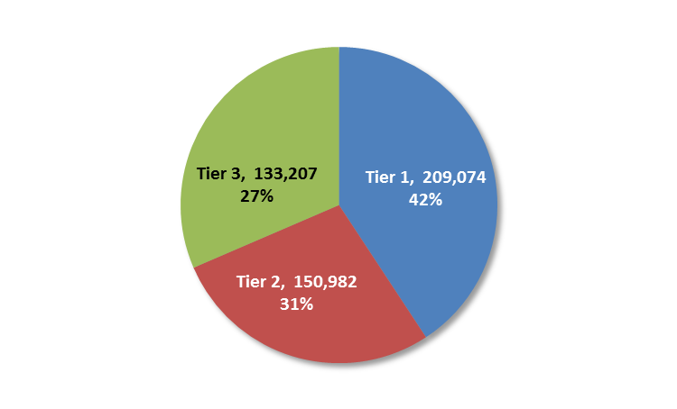
INTRODUCTION cont’d
Enrollment by Tier Level – May 2014
Source: OHCA May 2014 PCMH Provider Tiers and Panel Capacity Report

Slide 13
INTRODUCTION cont’d
Sooner Excel Quality Incentive Payments
Quality Measure | Benchmark | Incentive (subject to available funds) | SFY 2012 Payments | SFY 2013 Payments
4th DTaP | Immunization prior to age 2 | $3.00 per child | In EPSDT Total | In EPSDT Total
EPSDT Screen | Meet or exceed appropriate compliance rate | Up to 25 percent bonus on standard FFS rate for procedure | $985,000 | $984,000
Breast/ Cervical Cancer Screens | Payment made for each screen | Amount based on comparison to peers and available funds | $358,000 | $358,000
ED Utilization | Expected ED/office visit rate (risk adjusted) | Additional PMPM payment for outperforming benchmark | $496,000 | $483,000
Generic Prescribing | Payment made for each Rx, after application of adjustment formula | Provider-specific portion out of quarterly pool of $250,000 | $967,000 | $967,000
Physician Hospital Visits | Making inpatient visits | 25 percent bonus per procedure + additional $20 per visit if above average of participating providers | $614,000 | $760,000
Total |  |  | $3,420,000 | $3,552,000
Source: OHCA

Slide 14
SoonerCare Choice Evaluation - TRENDS
Access
Quality
Cost

Slide 15
TRENDS – ACCESS TO CARE
Evaluation Questions
Is it easy or difficult for SoonerCare Choice members to enroll or renew coverage?
Once enrolled:
  Is there an adequate selection of primary care providers?
  Are services (primary care and specialty) accessible?
Are members with complex or chronic conditions helped to navigate the system?

Slide 16
TRENDS – ACCESS TO CARE cont’d
Online Enrollment
Over 30,000 applications for SoonerCare are processed each month
Online enrollment objectives:
  Provide 24/7 access to enrollment and “real time” determination of eligibility
  Facilitate selection of a medical home
  Reduce staff hours required for processing applications
Online enrollment was launched in September 2010
Impact was immediate – paper applications have nearly ended

Slide 17
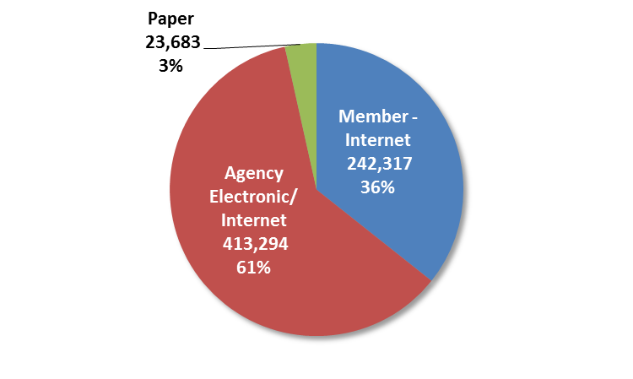
TRENDS – ACCESS TO CARE cont’d
Enrollment Method – SFY 2013
Source: OHCA Enrollment Automation and Data Integrity, Business Enterprises

Slide 18
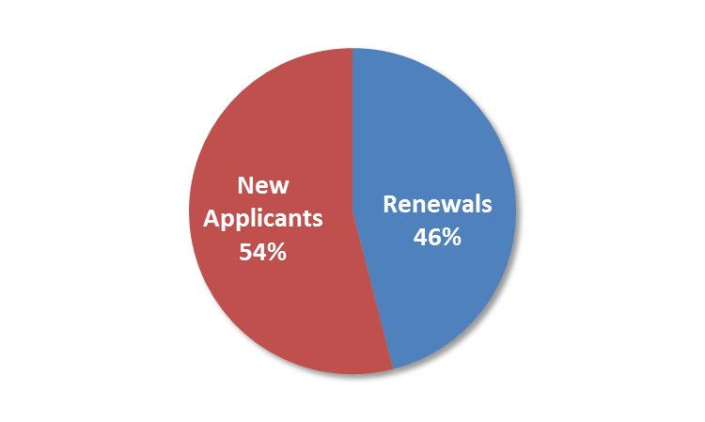
TRENDS – ACCESS TO CARE cont’d
Online Enrollment by Member Status – SFY 2013
Source: OHCA Enrollment Automation and Data Integrity, Business Enterprises

Slide 19
TRENDS – ACCESS TO CARE cont’d
Online Enrollment Savings
PHPG evaluated the “return on investment” for online enrollment by comparing state share of operational costs over the first five years to potential for reallocating caseworker resources
A separate study was conducted by Mathematica Policy Research of “Express Lane Eligibility” in multiple states, with Oklahoma included as a comparison state
Both firms estimated annual savings in the initial post go-live period of about $1.5 million
The “savings” represent case worker resources freed-up for other activities, such as assisting individuals applying to DHS for cash assistance or Supplemental Security Income benefits

Slide 20
TRENDS – ACCESS TO CARE cont’d
Online Enrollment Savings
For SFY 2013, online enrollment saved an estimated $6 million in state funds, versus what would have been spent in a paper application environment
Online Enrollment – Estimated SFY 2013 Savings (State Dollars)*
Online applications – SFY 2013 | 655,611
Estimated net savings per application, versus paper* | $9.27
Total savings (state dollars) | $6,074,272
*Note: Savings based on estimated average caseworker time per paper application x estimated wage/benefit for entry level application worker x 50% (to represent state portion of costs, which are shared 50/50 with the federal government)
Sources: Online enrollment statistics provided by the OHCA: caseworker productivity estimate taken from PHPG 2011 evaluation of online enrollment implementation; caseworker salary data taken from OKDHS website

Slide 21
TRENDS – ACCESS TO CARE cont’d
Provider Recruitment Strategies
Primary Care Providers (PCP) are essential to the SoonerCare Choice program and its objective of person-centered care
In 2009, the OHCA transitioned to the PCMH model, which introduced new PCP accessibility and accountability standards and performance incentives
PHPG examined trends in PCP participation and the impact on SoonerCare Choice member caseloads per provider
The number of participating practices has increased faster than enrollment, resulting in smaller average caseloads in both urban and rural counties

Slide 22
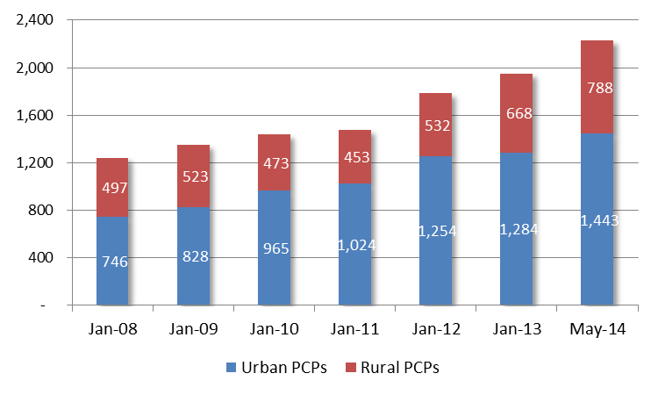
TRENDS – ACCESS TO CARE cont’d
Unduplicated PCP (now PCMH) Count by Year*
2,192
1,952
1,786
1,438
1,477
1,243
1,351
*Note: Urban includes former SoonerCare Plus counties. A portion of the increase may be attributable to more precise taxonomy in 2012 - 2013; Cotton and Ellis Counties had no PCPs in May 2014 (members were served by PCPs in adjacent counties)
Sources: OHCA Provider Fast Facts Report

Slide 23
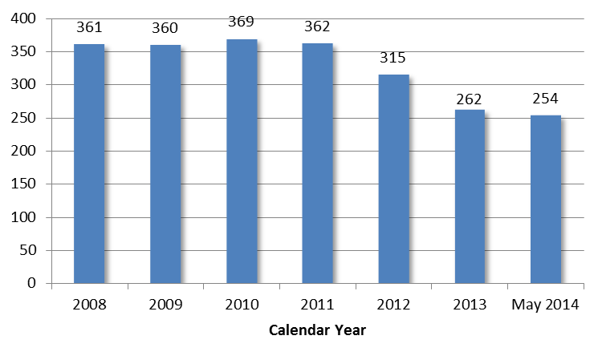
TRENDS – ACCESS TO CARE cont’d
Average SoonerCare Choice Members per PCP (PCMH)
Sources: OHCA Provider and Member Fast Facts Report; Waiver Enrollment Reports

Slide 24
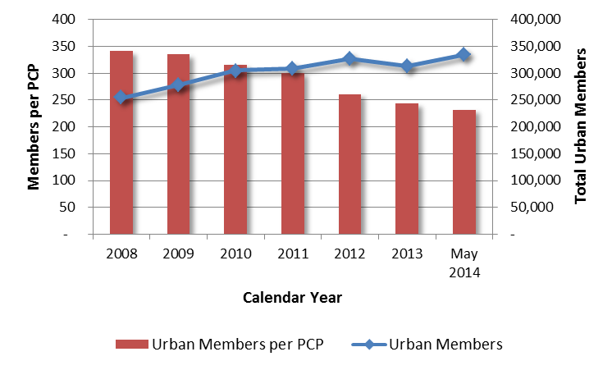
TRENDS – ACCESS TO CARE cont’d
Average SoonerCare Choice Members per PCP (PCMH)
Urban Counties
Note: 2008 – 203 enrollment represents monthly average
Sources: OHCA Provider and Member Fast Facts Report; Waiver Enrollment Reports

Slide 25
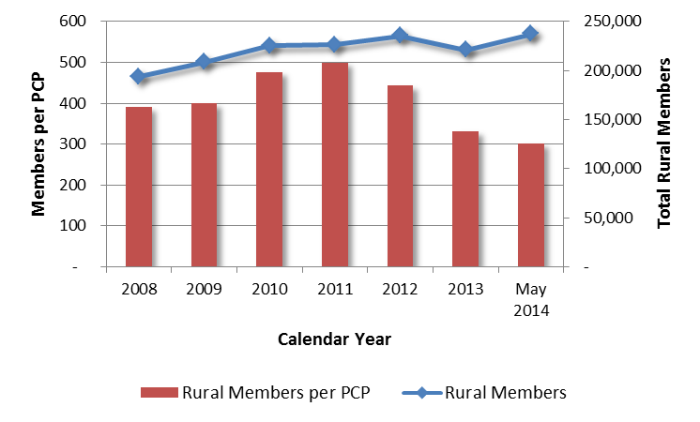
TRENDS – ACCESS TO CARE cont’d
Average SoonerCare Choice Members per PCP (PCMH)
Rural Counties
Note: 2008 – 203 enrollment represents monthly average
Sources: OHCA Provider and Member Fast Facts Report; Waiver Enrollment Reports

Slide 26
TRENDS – ACCESS TO CARE cont’d
Appointment Availability
PCP (and specialist) capacity must translate into appointment availability or members will bypass in favor of the emergency room
SoonerCare Choice members are routinely surveyed on their ability to see their personal doctor and specialists
PHPG evaluated appointment availability through
  Review and trending of published survey data
  Analysis and trending of total SoonerCare Choice emergency room utilization

Slide 27
TRENDS – ACCESS TO CARE cont’d
Member Satisfaction
Consumer Assessment of Healthcare Providers and Systems survey (CAHPS) is used to measure member satisfaction
Satisfaction with adult services has increased since 2008, though it dipped slightly in the most recent survey
Satisfaction with services for children has shown an uninterrupted rise

Slide 28
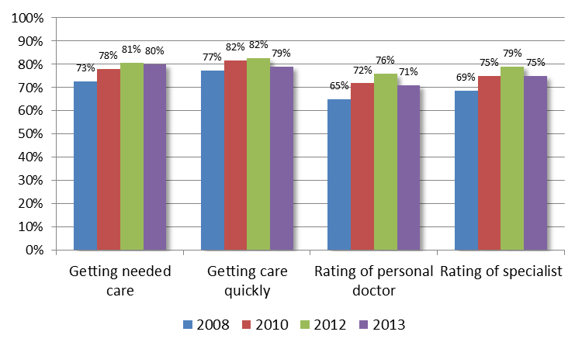
TRENDS – ACCESS TO CARE cont’d
Satisfaction with Care for Adults*
*Note: Percent rating 8, 9 or 10 on a 10-point satisfaction scale; “Getting care quickly” is a composite measure based on questions regarding satisfaction with obtaining needed care, both urgent and non-urgent
Sources: CAHPS Health Plan Survey Adult Version – Telligen through 2012; Morpace for 2013 (surveys are conducted from July to December of year preceding reporting year)

Slide 29
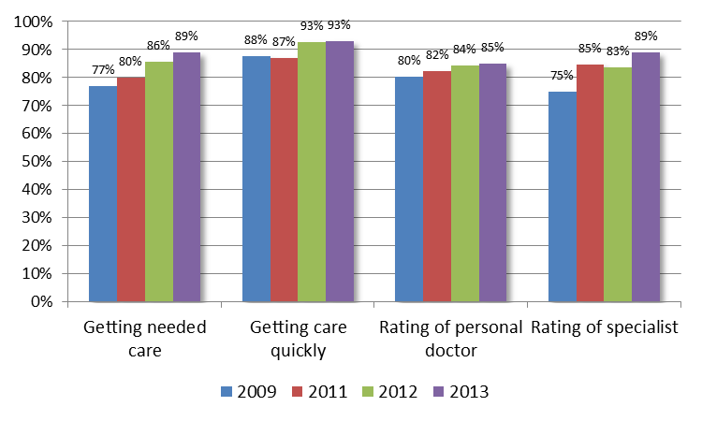
TRENDS – ACCESS TO CARE cont’d
Satisfaction with Care for Children*
*Note: Percent rating 8, 9 or 10 on a 10-point satisfaction scale
Sources: CAHPS Health Plan Survey Child Version – Telligen through 2012; Morpace for 2013 (surveys are conducted from July to December of year preceding reporting year)

Slide 30
TRENDS – ACCESS TO CARE cont’d
Emergency Room Utilization
Oklahoma has historically experienced high ER use
A Lewin/GDIT study of 2008 Medicaid ER utilization rates in 39 states ranked Oklahoma second highest
OHCA and provider partners have launched multiple initiatives since 2008 to reduce ER visits:
  Enrollment of members into patient centered medical homes
  Requirement for all medical home providers to offer 24-hour/7-day telephone coverage by a medical professional
  Requirement for “Tier 3” medical home providers to offer extended office hours
  Targeted intervention with members who visit the ER two or more times in a three-month period by the OHCA and Health Access Networks
  Physical and behavioral health case management of members with complex/chronic conditions associated with ER use

Slide 31
TRENDS – ACCESS TO CARE cont’d
Emergency Room Utilization
The combined initiatives have had a positive impact on ER use
ER visits, on a per member basis, declined by over 13 percent from 2008 to 2013
The portion of members with at least one visit fell during the same period, as did the average number of visits per utilizer
The decline from 2009 to 2013 equated to 61,000 avoided ER visits in 2013, i.e., visits that did not occur, but would have if the 2008 utilization rate had remained unchanged

Slide 32
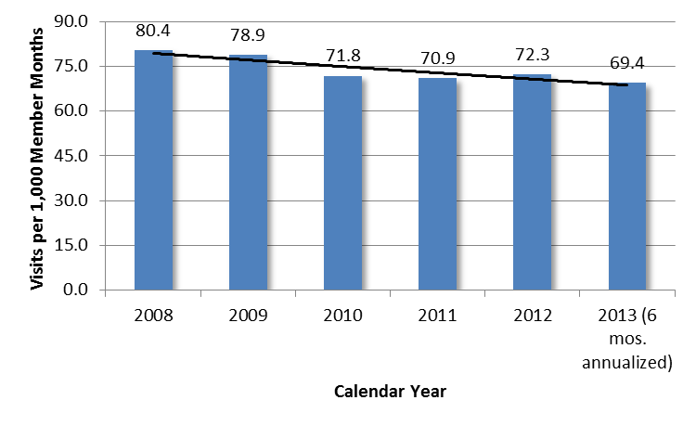
TRENDS – ACCESS TO CARE cont’d
Emergency Room Utilization per 1,000 Member Months
Source: OHCA paid claims data. ER results include claims with paid amounts for ER services as well as claims with zero pay amounts for ER services as long as at least one other service on the claim was paid

Slide 33


TRENDS – ACCESS TO CARE cont’d
Illustration of ER Utilization per 1,000 Member Months
In a typical month in 2008, for every 1,000 SoonerCare Choice members:
There were 80 emergency room visits

Slide 34
TRENDS – ACCESS TO CARE cont’d
Illustration of ER Utilization per 1,000 Member Months
In a typical month in 2013, for every 1,000 SoonerCare Choice members:
There were 69 emergency room visits

Slide 35
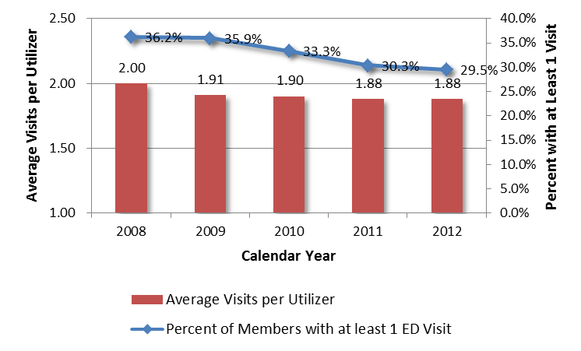
TRENDS – ACCESS TO CARE cont’d
Portion of Members with 1+ ER Visit & Average Visits per Utilizer
*Note: CY 2013 not included, as only six months of data was available
Source: OHCA paid claims
PHPG - SoonerCare Choice Evaluation

Slide 36
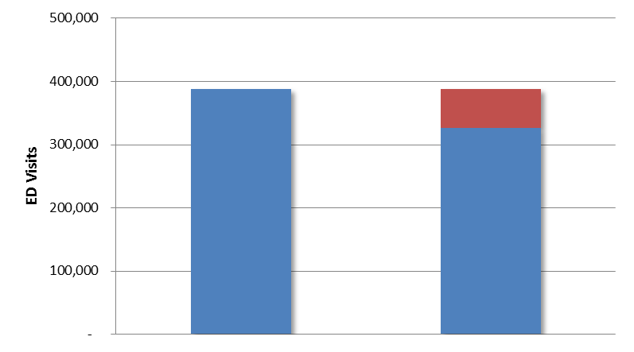
TRENDS – ACCESS TO CARE cont’d
Emergency Room Utilization – Avoided Visits
Avoided
visits
Expected visits at 2008 rate
Actual 2013 visits*
*Note: Annualized based on first six months

Slide 37
TRENDS – ACCESS TO CARE cont’d
The average bill for a SoonerCare Choice member seen in the ER in 2013, but not admitted to the hospital, included:
The avoided ER visits x average bill = financial impact of ER diversion strategy on ER claim costs
Component | Average Bill*
Facility | $180.19
Professional | $116.06
Ancillary | $ 53.36
TOTAL | $349.61
*Note: Ancillary is average for all SoonerCare and includes ambulance, pharmacy, DME, lab/radiology, other professional. Average cost figure provided by OHCA Finance Division. Amount may overstate actual cost of avoided ER visits to the extent these visits were lower than average in acuity.

Slide 38
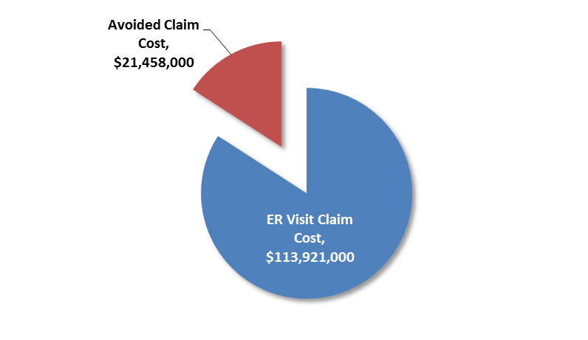
TRENDS – ACCESS TO CARE cont’d
The ER diversion strategy helped the State to avoid an estimated $21 million in ER payments in 2013

Slide 39
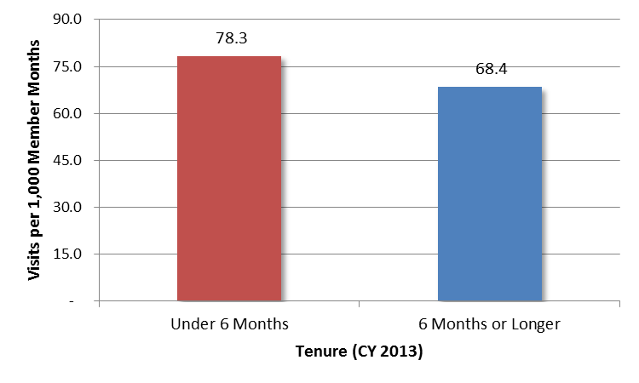
TRENDS – ACCESS TO CARE cont’d
Emergency Room Utilization – Impact of Enrollment in a PCMH
Members enrolled at least 6 months have lower ER utilization, suggesting that the impact of PCMH care management increases over time
Source: OHCA paid claims data

Slide 40
TRENDS – ACCESS TO CARE cont’d
ER use is not uniform across SoonerCare Choice members
Utilization rates for children, adolescents and young adults have fallen since 2008 while rates for older adults have remained relatively flat or increased
Utilization among SoonerCare Choice members with disabilities (primarily adults) also has risen since 2008, while utilization for other members has fallen
The primary reasons members visit the ER are for treatment of injuries and behavioral health conditions, although the top five diagnoses vary by age

Slide 41
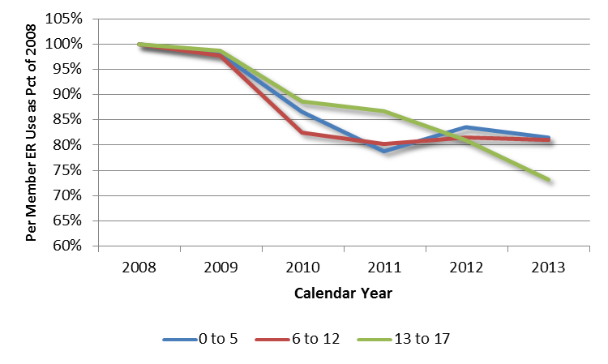
TRENDS – ACCESS TO CARE cont’d
Per Member Emergency Room Utilization Trend
Ages 0 to 17 (2008 = 100%)
Avoided
visits
Expected visits at 2009 rate
Actual 2013 visits*
Source: OHCA paid claims data

Slide 42
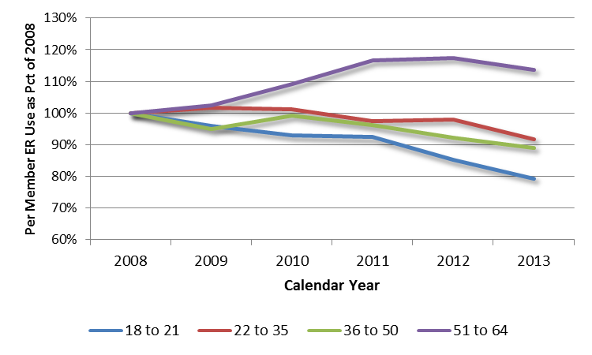
TRENDS – ACCESS TO CARE cont’d
Per Member Emergency Room Utilization Trend
Ages 18 to 64 (2008 = 100%)
Avoided
visits
Expected visits at 2009 rate
Actual 2013 visits*
Source: OHCA paid claims data

Slide 43
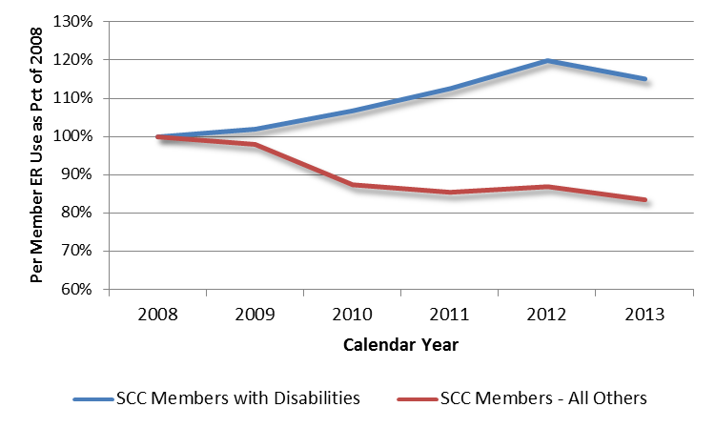
TRENDS – ACCESS TO CARE cont’d
Per Member Emergency Room Utilization Trend
Disability Status (2008 = 100%)
Avoided
visits
Expected visits at 2009 rate
Actual 2013 visits*
Source: OHCA paid claims data

Slide 44
TRENDS – ACCESS TO CARE cont’d
Top 5 Primary ER Diagnoses – Children
January 2012 – June 2013
 | 0 – 5 | 6 – 12 | 13 - 17
1 | Respiratory disease (15%) | Injury (22%) | Injury (21%)
2 | Injury (13%) | Respiratory disease (9%) | Neurotic, personality, and other non-psychotic mental disorders (7%)
3 | Disease of the ear (9%) | Disease of musculoskeletal system (5%) | Disease of musculoskeletal system (6%)
4 | Disease of skin (4%) | Disease of the ear (4%) | COPD, including Asthma (6%)
5 | Other viral disease (4%) | COPD, including Asthma (4%) | Disease of skin (3%)
Top 5 | 45% of visits | 44% of visits | 43% of visits
Source: OHCA paid claims data

Slide 45
TRENDS – ACCESS TO CARE cont’d
Top 5 Primary ER Diagnoses – Adults
January 2012 – June 2013
 | 18 – 21 | 22 – 35 | 36 – 50 | 51 - 64
1 | Neurotic, personality, and other non-psychotic mental disorders (11%) | Neurotic, personality, and other non-psychotic mental disorders (15%) | Neurotic, personality, and other non-psychotic mental disorders (15%) | Neurotic, personality, and other non-psychotic mental disorders (13%)
2 | Injury (10%) | Injury (8%) | Injury (14%) | Disease of musculoskeletal system (13%)
3 | Complications of pregnancy (8%) | Disease of musculoskeletal system (6%) | Disease of musculoskeletal system (7%) | Hypertension (7%)
4 | Respiratory disease (5%) | Complications of pregnancy (5%) | Hypertension (7%) | Injury (7%)
5 | Disease of genital organs (4%) | Respiratory disease (3%) | Nervous system disease (5%) | Heart disease (6%)
Top 5 | 38% of visits | 37% of visits | 48% of visits | 46% of visits
Source: OHCA paid claims data

Slide 46
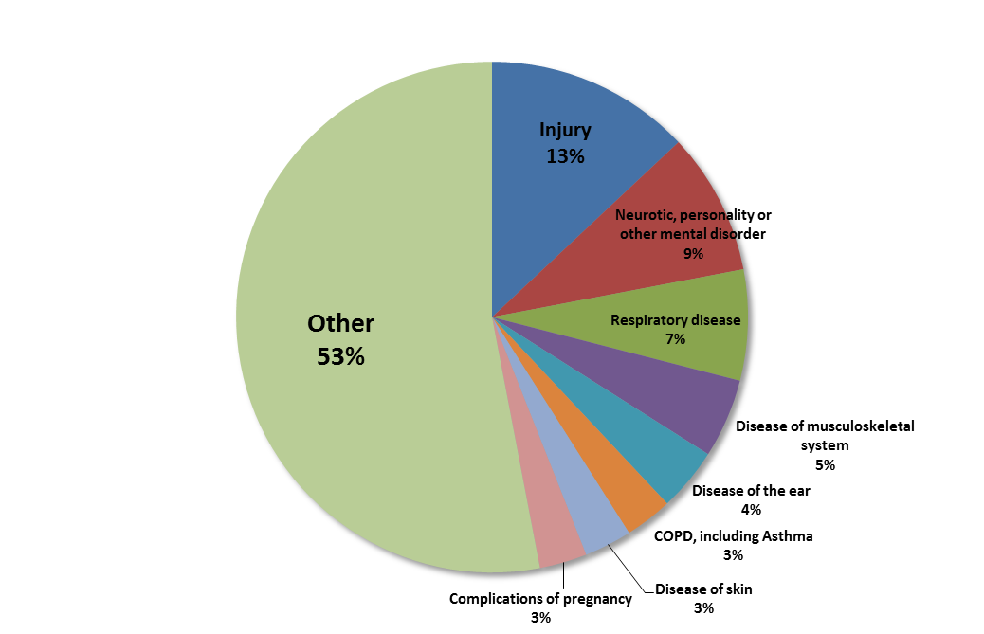
TRENDS – ACCESS TO CARE cont’d
Top Primary ER Diagnoses – All Ages
January 2012 – June 2013
Source: OHCA paid claims data

Slide 47
TRENDS – ACCESS TO CARE cont’d
The OHCA’s strategy has reduced ER utilization overall since 2009, although Oklahoma’s rate remains relatively high
Adults and persons with disabilities (often the same people) represent the best opportunity for further reduction on a per member basis
The OHCA’s most recent initiatives targeting persons with chronic/complex medical and behavioral health conditions should have a positive effect on ER use among adults
Because of the prevalence of children in the program, parents also should continue to be a focus for education on proper use of the ER

Slide 48
TRENDS – ACCESS TO CARE cont’d
Assistance to Members with Complex/Chronic Needs
The OHCA Population Care Management and BH Departments oversee an integrated, and needs-based (multi-tier) care management structure
The OHCA also contracts with Oklahoma University Health Sciences Center to operate a care management program for children and adolescents with diabetes
PHPG is conducting a targeted evaluation of OHCA’s Population Care Management Department and recently completed a five-year evaluation of the SoonerCare HMP (summary HMP findings presented on later slides)
At Risk/ High Risk Medical
Case Management Unit
Chronic Conditions
SoonerCare HMP
Behavioral Health Needs
Behavioral Health
Chronic Care Unit

Slide 49
SoonerCare Choice Evaluation - TRENDS
Access
Quality
Cost

Slide 50
TRENDS – QUALITY OF CARE
Evaluation Questions
Does the program have mechanisms to measure and reward quality?
Are members receiving appropriate preventive and diagnostic services?
Are health outcomes improving?

Slide 51
TRENDS – QUALITY OF CARE cont’d
Preventive and Diagnostic Services
The OHCA tracks preventive and diagnostic service delivery for SoonerCare Choice through “Healthcare Effectiveness Data and Information Set” (HEDIS®) measures
PHPG evaluated HEDIS results over time and in comparison to national HEDIS Medicaid MCO rates, where available (see listing on next slide).
PHPG also reviewed the impact of the OHCA’s campaign to reduce tobacco use among SoonerCare Choice members

Slide 52
TRENDS – QUALITY OF CARE cont’d
HEDIS Measures
Children/Adolescents | Adults
Access to PCP | Access to preventive/ambulatory health services
Annual dental visit | Breast cancer screening (ages 40 – 69)
Lead screening rate by two years of age | Cervical cancer screening (ages 21 – 64)
Appropriate treatment for urinary tract infection (ages 3 months to 1 year) | Cholesterol management for patients w/cardiovascular conditions (ages 18 – 75)
Appropriate testing for children with pharyngitis (ages 2 – 18) | Comprehensive diabetes care
Appropriate medications for treatment of asthma (children) | Appropriate medications for treatment of asthma (adults)

Slide 53
TRENDS – QUALITY OF CARE cont’d
HEDIS Trends – Children/Adolescent Access to PCP
SoonerCare Choice has achieved improvement in child/adolescent access to PCPs since 2008
The SoonerCare Choice access rate is higher than the national rate for all groups
HEDIS Measure | 2008 | 2009 | 2010 | 2011 | 2012 | 2013 | Change 2008 -13 | National Rate
Child access to PCP, 12 -24 months | 94.1% | 96.2.% | 97.8% | 97.2% | 96.6% | 97.0% | h2.9% | 96.0%
Child access to PCP, 25 months - 6 years | 83.1% | 86.9% | 89.1% | 88.4% | 90.1% | 90.6% | h7.5% | 88.3%
Child access to PCP, 7 - 11 years | 82.7% | 87.6% | 89.9% | 90.9% | 91.7% | 92.4% | h9.7% | 89.9%
Adolescent access to PCP, 12 - 19 years | 81.4% | 85.8% | 88.8% | 89.9% | 91.6% | 92.8% | h11.4% | 88.4%
Source: Oklahoma Health Care Authority (OHCA) for Oklahoma HEDIS® results and National Committee for Quality Assurance (NQCA) for national Medicaid HMO rates. Reporting years represent results for activity in the prior year

Slide 54
TRENDS – QUALITY OF CARE cont’d
HEDIS Trends – Children/Adolescents (Multiple)
Dental visit, lead screening, URI treatment and pharyngitis testing rates also have improved
Lead screening and urinary tract infection treatment rates are still below the national average
HEDIS Measure | 2008 | 2009 | 2010 | 2011 | 2012 | 2013 | Change 2008-13* | National Rate
Annual dental visit under 21 years | 59.7% | 62.1% | 60.2% | 62.0% | 64.0% | 64.1% | h4.4% | 49.2%
Lead screening rate |  |  | 43.5% | 44.5% | 44.7% | 48.2% | h4.7% | 67.5%
Appropriate treatment for urinary tract infection |  |  | 67.7% | 69.5% | 66.8% | 73.1% | h5.4% | 85.1%
Appropriate testing for children with pharyngitis |  |  | 38.8% | 44.8% | 49.1% | 53.2% | h14.4% | --
*Note: 2010 – 2013 for lead rate
Source: Oklahoma Health Care Authority (OHCA) for Oklahoma HEDIS® results and National Committee for Quality Assurance (NQCA) for national Medicaid HMO rates. Reporting years represent results for activity in the prior year

Slide 55
TRENDS – QUALITY OF CARE cont’d
HEDIS Trends – Adult Access to Preventive Services
Adult access to preventive/ambulatory services has improved and is over 80 percent for members 20 – 44 and over 90 percent for members 45 – 64
Both rates exceed the national benchmarks
HEDIS Measure | 2008 | 2009 | 2010 | 2011 | 2012 | 2013 | Change 2008 -13 | National Rate
Adult access to preventive/ ambulatory services, 20 – 44 years | 78.4% | 83.3% | 83.6% | 84.2% | 83.1% | 82.8% | h4.4% | 80.0%
Adult access to preventive/ ambulatory services, 45 – 64 years | 86.8% | 89.7% | 90.9% | 91.1% | 91.0% | 90.8% | h4.0% | 86.1%
Source: Oklahoma Health Care Authority (OHCA) for Oklahoma HEDIS® results and National Committee for Quality Assurance (NQCA) for national Medicaid HMO rates. Reporting years represent results for activity in the prior year

Slide 56
TRENDS – QUALITY OF CARE cont’d
HEDIS Trends – Adults (Multiple)
Breast/cervical cancer screening rates and cholesterol management rate for patients with cardiovascular conditions have declined slightly since 2008
All three rates also are below the national rate
These represent opportunities for targeted education and incentives to improve provider adherence to care guidelines
HEDIS Measure | 2008 | 2009 | 2010 | 2011 | 2012 | 2013 | Change 2008-13* | National Rate
Breast cancer screening rate | 38.3% | 43.0% | 41.1% | 41.3% | 36.9% | 36.5% | i1.8% | 51.9%
Cervical cancer screening rate | 44.4% | 46.6% | 44.2% | 47.2% | 42.5% | 41.0% | i3.4% | 64.5%
Cholesterol management for patients with cardiovascular conditions |  |  | 69.5% | 69.9% | 68.6% | 68.2% | i1.3% | 81.5%
*Note: 2010 – 2013 for cholesterol rate
Source: Oklahoma Health Care Authority (OHCA) for Oklahoma HEDIS® results and National Committee for Quality Assurance (NQCA) for national Medicaid HMO rates. Reporting years represent results for activity in the prior year

Slide 57
TRENDS – QUALITY OF CARE cont’d
HEDIS Trends – Adult Comprehensive Diabetes Care
Trends for comprehensive diabetes care measures are mixed but SoonerCare Choice rates are consistently below the national rate
This represents another opportunity for targeted improvement
HEDIS Measure | 2010 | 2011 | 2012 | 2013 | Change 2010-13 | National Rate
Hemoglobin A1C testing | 71.0% | 71.1% | 70.5% | 71.5% | h0.5% | 83.0%
Eye exam (retinal) | 32.8% | 31.8% | 31.8% | 32.0% | i0.8% | 53.2%
LDL-C screening | 63.6% | 62.9% | 62.0% | 63.1% | i0.5% | 75.5%
Medical attention for nephropathy | 54.4% | 55.9% | 56.8% | 58.7% | h4.3% | 78.4%
*Note: 2010 – 2013 for lead rate
Source: Oklahoma Health Care Authority (OHCA) for Oklahoma HEDIS® results and National Committee for Quality Assurance (NQCA) for national Medicaid HMO rates. Reporting years represent results for activity in the prior year

Slide 58
TRENDS – QUALITY OF CARE cont’d
HEDIS Trends – Asthma (Children/Adolescents & Adults)
SoonerCare Choice rate for appropriate medications for the treatment of asthma exceeds the national rate among children and older adults
Rate is slightly below the national average for younger adults but increased from 2012 to 2013
HEDIS Measure | 2010 | 2011 | 2012 | 2013 | Change 2010-13* | National Rate
Appropriate medications for treatment of asthma, ages 5- 11 | 90.9% | 90.6% | 90.3% | 94.0% | h3.1% | 89.6%
Appropriate medications for treatment of asthma, ages 12 - 18 |  |  | 85.2% | 95.2% | h10.0% | 85.6%
Appropriate medications for treatment of asthma, ages 19 - 50 |  |  | 60.4% | 68.9% | h8.5% | 73.9%
Appropriate medications for treatment of asthma, ages 51- 64 |  |  | 56.9% | 74.1% | h17.2% | 71.4%
*Note: 201-2013 for three older age groups. Age bands for persons 12 and older revised in 2012. Prior to 2012 persons 12 – 50 were grouped together; rate for persons 51 – 64 was not reported
Source: Oklahoma Health Care Authority (OHCA) for Oklahoma HEDIS® results and National Committee for Quality Assurance (NQCA) for national Medicaid HMO rates. Reporting years represent results for activity in the prior year

Slide 59
TRENDS – QUALITY OF CARE cont’d
SoonerQuit Tobacco Cessation Activities
Tobacco use is the single most preventable cause of death in the U.S.
Oklahoma historically has had one of the nation’s highest tobacco use rates and tobacco use among SoonerCare members has exceeded the State average
  In 2008, 48 percent of SoonerCare Choice adults in the CAHPS survey reported using tobacco products
  Twenty-five percent of pregnant SoonerCare Choice members report using tobacco products
The OHCA’s SoonerQuit initiative was launched with the goal of reducing tobacco use among SoonerCare Choice members through:
  Tobacco cessation counseling and products (e.g., educational materials and prescription/OTC aids)
  Assistance to prenatal care providers in performing the “5 A’s” of tobacco cessation (ask, advise, assess, assist arrange) through practice facilitation
The OHCA continues to work in coordination with other initiatives, including the Oklahoma Tobacco Helpline

Slide 60
TRENDS – QUALITY OF CARE cont’d
SoonerQuit Tobacco Cessation Activities
Members and providers have responded to the SoonerQuit and related initiatives and tobacco use rates are on the decline
Tobacco Helpline call volume increased 82 percent from 2009 to 2012
Among SoonerCare Choice prenatal care providers who participated in practice facilitation, the portion offering onsite tobacco cessation counseling increased from 29 percent to 68 percent
The tobacco use rate among SoonerCare Choice adults, as reported in CAHPS survey data, declined from 48 percent in 2008 to 43 percent in 2013
The potential health benefits of this decline are substantial. For every dollar spent on tobacco cessation activities, there is an estimated $3.12 saved in the form of reduced cardiovascular-related hospital admissions
Sources: Oklahoma use rate data provided by the OHCA; provider activity data taken from independent evaluation of SoonerQuit initiative conducted by PHPG; hospitalization data provided by OU Health Sciences Center

Slide 61
TRENDS – QUALITY OF CARE cont’d
Avoidable (Ambulatory Care Sensitive) Hospitalizations
Avoidable (ambulatory care sensitive) conditions are those for which appropriate ambulatory care prevents or reduces the need for admission to the hospital. The hospitalization rate for these conditions is an effective indicator of the quality of ambulatory health care
PCMH and SoonerCare Choice care management activities are both directed in part to ensuring access to the right care in the right setting
PHPG used paid claims data to evaluate the ambulatory sensitive condition hospitalization rate among SoonerCare Choice members with asthma, CHF, COPD and pneumonia (based on admitting diagnosis)
The rate fell for three of four conditions from 2009 to 2013
The rate for asthma fell from its peak in 2011 but remained slightly above the 2009 rate in 2013

Slide 62
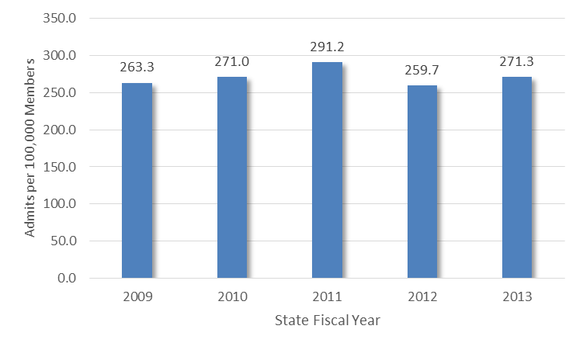
TRENDS – QUALITY OF CARE cont’d
Ambulatory Care Sensitive Hospitalization Rate – Asthma
Source: OHCA paid claims

Slide 63
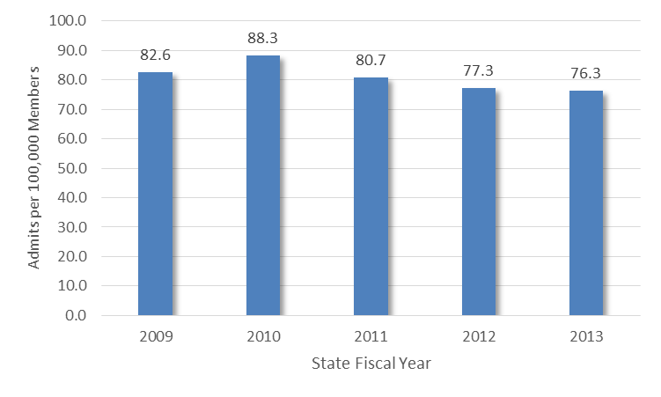
TRENDS – QUALITY OF CARE cont’d
Ambulatory Care Sensitive Hospitalization Rate – CHF
Source: OHCA paid claims

Slide 64
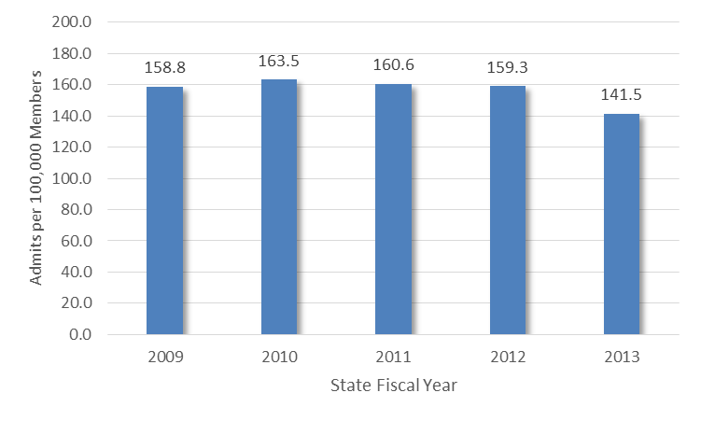
TRENDS – QUALITY OF CARE cont’d
Ambulatory Care Sensitive Hospitalization Rate – COPD
Source: OHCA paid claims

Slide 65
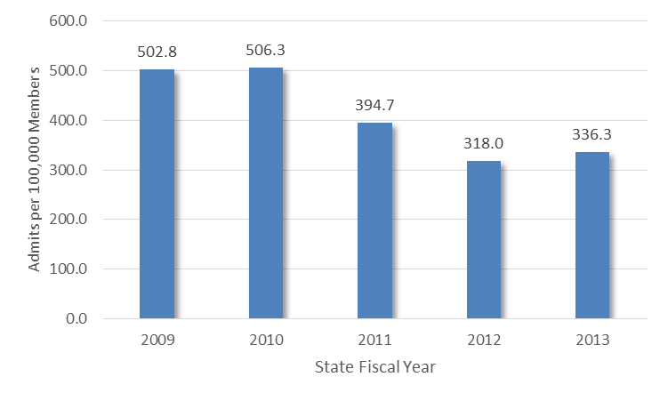
TRENDS – QUALITY OF CARE cont’d
Ambulatory Care Sensitive Hospitalization Rate – Pneumonia
Source: OHCA paid claims

Slide 66
TRENDS – QUALITY OF CARE cont’d
Hospital Readmissions
The hospital 30-day readmission rate is an effective indicator of discharge planning activities, PCP post-discharge care and SoonerCare Choice case management
PHPG used paid claims data to evaluate the 30-day readmission rate for 2009 – 2013
The rate remained relatively low over the evaluation period and has declined from its (modest) peak in 2011
Members who are readmitted return to the hospital an average of 2 – 3 times after their initial admission

Slide 67
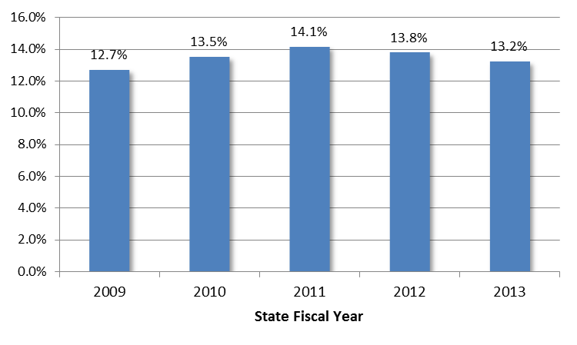
TRENDS – QUALITY OF CARE cont’d
Hospital 30-Day Readmission Rate*
*Note: SoonerCare Choice members enrolled in a Patient Centered Medical Home
Source: OHCA paid claims

Slide 68
TRENDS – QUALITY OF CARE cont’d
Post-Discharge Visit to PCMH
The post-discharge visit rate to the PCMH is an indicator of PCMH care management activity
PHPG used paid claims data to evaluate the 14- and 30-day visit rates for all inpatient stays and for the four ambulatory sensitive conditions
The post discharge PCMH visit rate was consistently at or slightly above 50 percent
The rate for ambulatory sensitive conditions was consistently above 60 percent
Most follow-up occurs in the first 14 days

Slide 69
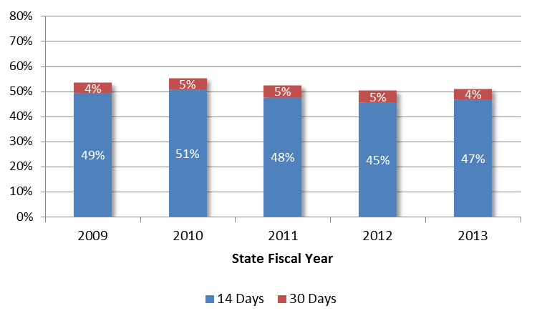
TRENDS – QUALITY OF CARE cont’d
Visit to PCMH Post-Discharge – All Admits*
53%
56%
53%
51%
50%
*Note: SoonerCare Choice members enrolled in a Patient Centered Medical Home
Source: OHCA paid claims

Slide 70
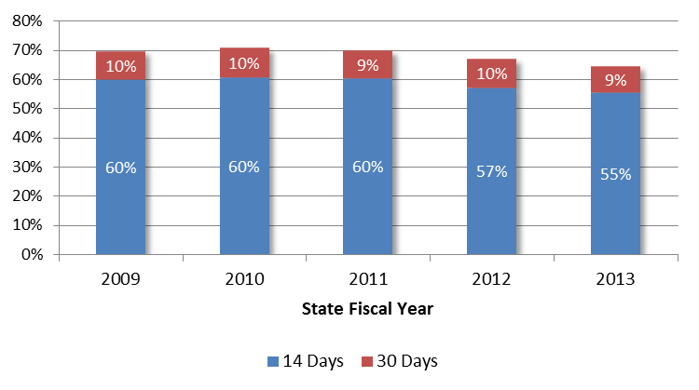
TRENDS – QUALITY OF CARE cont’d
Visit to PCMH Post-Discharge – Ambulatory Sensitive*
70%
70%
69%
67%
64%
*Note: SoonerCare Choice members enrolled in a Patient Centered Medical Home; conditions are Asthma, CHF, COPD and Pneumonia
Source: OHCA paid claims

Slide 71
TRENDS – QUALITY OF CARE cont’d
Post-Discharge Visit to BH Provider
PHPG also evaluated the post-discharge visit rate to an outpatient behavioral health provider, following a behavioral health inpatient stay
The post-discharge visit rate was lower than the PCMH rate but increased significantly from 2009 to 2013
Again, most follow-up occurs in the first 14 days

Slide 72
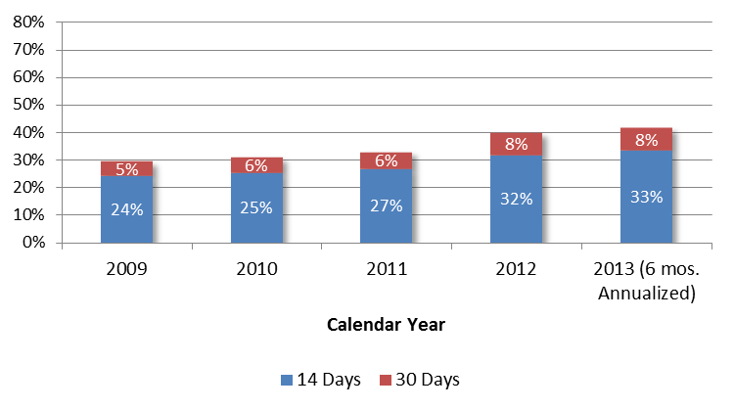
TRENDS – QUALITY OF CARE cont’d
Visit to BH Provider Post-Discharge*
40%
41%
29%
31%
33%
*Note: For admissions with a BH primary diagnosis. Equated to 12,000 – 14,000 visits per year
Source: OHCA paid claims

Slide 73
SoonerCare Choice Evaluation - TRENDS
Access
Quality
Cost

Slide 74
TRENDS – COST EFFECTIVENESS
Evaluation Questions
Is the SoonerCare program cost effective in terms of health care expenditures?
Is the SoonerCare program cost effective in terms of administrative expenses?

Slide 75
TRENDS – COST EFFECTIVENESS cont’d
Health Expenditures
Improved program performance must be cost effective to be sustainable
PHPG used paid claims data to calculate per member per month expenditures for SoonerCare Choice members for SFY 2009 through SFY 2013
PHPG also evaluated SoonerCare Choice expenditures against the national health care inflation rate

Slide 76
TRENDS – COST EFFECTIVENESS cont’d
Health Expenditures
PMPM health expenditures for SoonerCare Choice members* rose modestly from SFY 2009 – SFY 2013, increasing an average of 1.5 percent per year
During the period 2009 - 2012, per capita national health expenditures increased by an average of 3.0 percent per year**
SoonerCare Choice Member PMPM Expenditures (SFY)
Admitting Diagnosis | 2009 | 2010 | 2011 | 2012 | 2013 | Avg. Annual Change
ABD (non-duals) | $779 | $815 | $806 | $806 | $836 | h1.8%
TANF/Other | $216 | $215 | $217 | $228 | $236 | h2.3%
TOTAL | $274 | $275 | $276 | $280 | $291 | h1.5%
*Note 1 – Data is for members assigned to a PCMH. Total SCC trend is lower than ABD and TANF/Other rates due to changes in member mix.
**Note 2 – 2013 national data not yet available
Sources: OHCA paid claims data; Henry J Kaiser Foundation (national per capita)

Slide 77
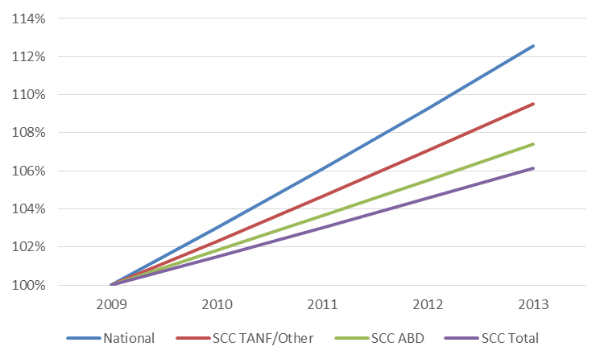
TRENDS – COST EFFECTIVENESS cont’d
PMPM Expenditure Growth - SFY 2009 – 2013 (Based on Average Annual)*
*Note 1 – Data is for members assigned to a PCMH. Total SCC trend is lower than ABD and TANF/Other rates due to changes in member mix.
**Note 2 – National rate is actual for 2009 – 2012; 2013 is projected based on average annual growth rate for 2009 – 2012 period
Sources: OHCA paid claims data; Henry J Kaiser Foundation (national per capita)

Slide 78
TRENDS – COST EFFECTIVENESS cont’d
Administrative Expenditures
The OHCA contracts for some care management activities (e.g., SoonerCare HMP) but otherwise operates as a state managed care plan
This structure enables the agency to devote a larger share of expenditures to the delivery of care
States with MCO contracts can have slightly lower agency costs
However, the difference is typically offset by administrative costs incurred by the managed care organizations, each of which must replicate the administrative functions otherwise performed by the state, as well as MCO funding requirements for risk reserves and profits

Slide 79
TRENDS – COST EFFECTIVENESS cont’d
Both Models Provide the Same Services
Component | SoonerCare OHCA MCO | Private MCO Model
Member Eligibility Standards | Same for both models
Covered Benefits | Same for both models
Contracted Network/Medical Homes | Yes | Yes
Member Education | Yes | Yes
Medical/Case Management | Yes | Yes
Chronic Care/Health Management | Yes | Yes
Quality Improvement Initiatives | Yes | Yes
Program Oversight/Administration | State | State + MCO (shared)

Slide 80
TRENDS – COST EFFECTIVENESS cont’d
Public (OHCA) Managed Care Model
Under the public model, the OHCA contracts directly with providers and Health Access Networks
OHCA as MCO
Partner agencies
Facilities
Professionals
Health Access Networks
Ancillary

Slide 81
TRENDS – COST EFFECTIVENESS cont’d
Private Managed Care Model
Under the private model, the OHCA contracts with MCOs, which in turn construct provider networks
OHCA as oversight agency
Partner agencies
MCO 1
MCO 2
MCO 3
Facilities
Professionals
Ancillary
Facilities
Professionals
Ancillary
Facilities
Professionals
Ancillary
Networks typically contain overlap across MCOs

Slide 82
TRENDS – COST EFFECTIVENESS cont’d
MCO Administrative Resource Needs
Under both models, OHCA resources must be devoted to oversight functions
Under the private model, funds also must be allocated for MCO risk and profit
Public MCO Model
Private MCO Model
OHCA MCO operations
Private MCO operations
Reserve for risk
OHCA oversight of providers
OHCA oversight of MCOs
Profit

Slide 83
TRENDS – COST EFFECTIVENESS cont’d
Private MCO Administrative Cost
PHPG analyzed administrative costs, as a percentage of total costs, in AZ, CO, FL, KS, LA, NM & TX
KS and TX are especially useful benchmarks, as they border OK and enroll the populations covered under SoonerCare Choice (TANF and ABD)
Private MCO administrative costs in the comparison states vary by eligibility type, but average just under 10.9 percent

Slide 84
TRENDS – COST EFFECTIVENESS cont’d
Private MCO Administrative Costs
Private MCO administrative costs average 10.9 percent of total spending in Medicaid programs examined by PHPG
This includes dollars for operations, risk reserves and profits
STATE | YEAR | ALL | TANF | ABD | LTC-HCBS | LTC-FACILITY
Arizona | 2014 | 8.00% | n/a | n/a | n/a | n/a
Colorado | 2011 | 9.00% | n/a | n/a | n/a | n/a
Florida | 2012 | 12.00% | n/a | n/a | n/a | n/a
Kansas | 2013 | n/a | 10.00% | 7.50% | 9.00% | 6.00%
Louisiana | 2012 | 11.50% | n/a | n/a | n/a | n/a
New Mexico | 2012 | 12.00% | n/a | n/a | n/a | n/a
Texas | 2012 | n/a | 13.75% | 9.70% | 9.00% | n/a
Average (unweighted) |  | 10.50% | 11.88% | 8.60% | 9.00% | 6.00%
Average (weighted) |  | 10.87%

Slide 85
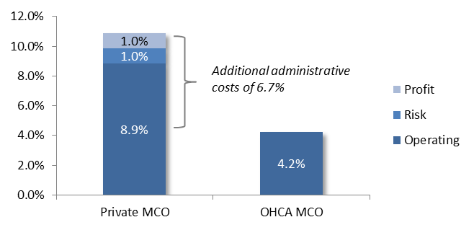
TRENDS – COST EFFECTIVENESS cont’d
MCO Administrative Cost Comparison
OHCA MCO administrative cost is approximately 4.2 percent of total program expenditures (includes relevant partner agency activities)
Private MCO administrative cost is approximately 10.9 percent
Private MCO model also would require resources for OHCA oversight (not reflected in chart)

Slide 86
SoonerCare Choice Evaluation – NEW
HMP
PCMH
HAN

Slide 87
TARGETED EVALUATION - HMP
Overview
The SoonerCare Health Management Program (HMP) was mandated by the Oklahoma Medicaid Reform Act of 2006 and implemented in 2008 to:
  Better manage the needs of members with complex/chronic conditions through a holistic model of care (focus on the person, not the disease)
  Prepare members to self-manage their conditions (and transition out of program)
  Enhance the ability of primary care providers to manage the needs of patients with complex/chronic conditions
Common conditions include: Asthma, Congestive Heart Failure, COPD, Coronary Artery Disease, Diabetes and Hypertension
Many participants have multiple physical conditions, as well as behavioral health needs

Slide 88
TARGETED EVALUATION - HMP
Overview
The OHCA uses predictive modeling software as a tool to identify members for the program and contracts with an outside vendor (Telligen) to administer program components
The program, under its original design, had two components:
  Nurse Care Management - 5,000 members at any given time, selected based on projected risk of adverse health outcomes and high healthcare expenditures using MEDai predictive modeler – originally in two tiers: Tier 1 (face-to-face) and Tier 2 (telephonic)
  Practice Facilitation (96 practices since 2008; 50 active practices in SFY 2013)

Slide 89
TARGETED EVALUATION – HMP cont’d
Overview cont’d
The OHCA is seeking to further strengthen the program by undertaking two significant changes, effective in SFY 2014
  Introduction of Health Coaches in provider offices, to replace field- and telephonic nurse care management (chronic care unit will absorb some of this activity)
  Integration of Health Coaching and Practice Facilitation through placement of Health Coaches in Practice Facilitation offices
PHPG has served as an independent evaluator of the HMP over its first five years
  The program was evaluated with respect to member/provider satisfaction, quality of care and impact on utilization and health expenditures
  The program’s impact intensified over time as care management practices took hold
  Although the program’s effect on member health status was ambiguous, the results in other evaluation areas were uniformly positive

Slide 90
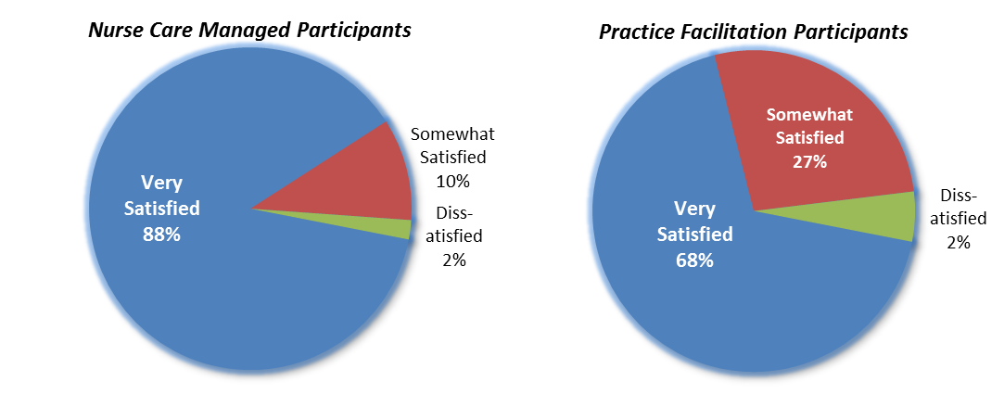
TARGETED EVALUATION – HMP cont’d
Satisfaction
Both members and providers have expressed high levels of satisfaction with the program
Source: SoonerCare HMP Fifth Annual Evaluation Report

Slide 91
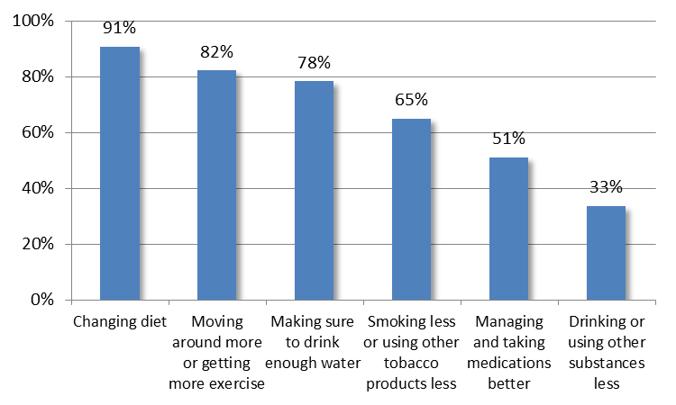
TARGETED EVALUATION – HMP cont’d
Lifestyle Changes
Participants enrolled for at least six months have reported making important lifestyle changes to improve their health
Lifestyle Changes – Percent that Reported Making Changes*
*Note: Respondents enrolled six months or longer who were counseled to make a change and reported continuing to do so
Source: SoonerCare HMP Fifth Annual Evaluation Report

Slide 92
TARGETED EVALUATION – HMP cont’d
SoonerCare HMP Participant Interviews
“Well, I mean, health-wise, I feel like I’m better. I lost, like, 92 pounds. I started that prior to my hip surgery because I’d recover faster. But after my hip surgery, I had to go on the ADvantage program. I’m exercising three times a week...and when it’s warm I try to walk as much as I can outside. When it’s cold I walk inside my apartment building in the hall. There’s other things going on too, but my nurse also helped me to come up with a plan to lose weight.”
“She keeps my health and my mind together. Exercising and eating right and taking my medication, my blood sugar and my blood pressure.”
“I love it that someone’s checking up on me and making sure that I’m OK every month. I can’t say that anybody I’ve given birth to would do that!”
Source: 2013 SoonerCare HMP Satisfaction & Self-Management Impact Report

Slide 93
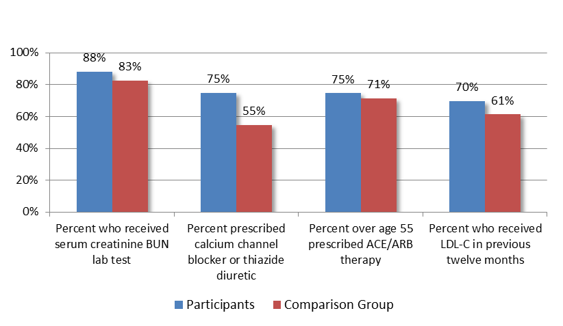
TARGETED EVALUATION – HMP cont’d
Quality of Care
Quality of care, as measured by member and provider adherence to HEDIS® standards, was tracked by disease state and has improved for all conditions over time
SoonerCare HMP participants also have demonstrated greater adherence to recommended care guidelines than a “comparison group” of persons eligible for, but not enrolled in the HMP
Quality of Care Evaluation Example – Coronary Artery Disease
Source: SoonerCare HMP Fifth Annual Evaluation Report

Slide 94
TARGETED EVALUATION – HMP cont’d
Utilization and Expenditures
Service utilization and PMPM medical expenditures were evaluated against what would have occurred absent participation in the program:
  For members – against projected expenditures as calculated by MEDai predictive modeler
  For providers in Practice Facilitation – expenditures for their patients against patients of providers not participating in the HMP
The impact on utilization (e.g., inpatient days and ER visits) has improved significantly over time, as member and provider behaviors have changed

Slide 95
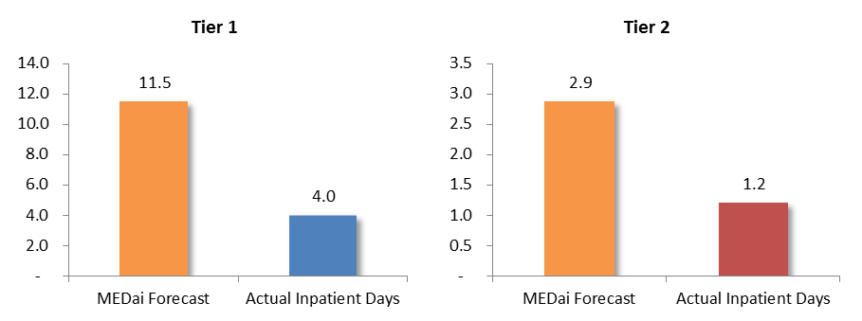
TARGETED EVALUATION – HMP cont’d
Utilization
Inpatient days are significantly below MEDai projections for both Tier 1 and Tier 2 participants
Inpatient Utilization Impact - Inpatient Days per Member
Source: SoonerCare HMP Fifth Annual Evaluation Report

Slide 96
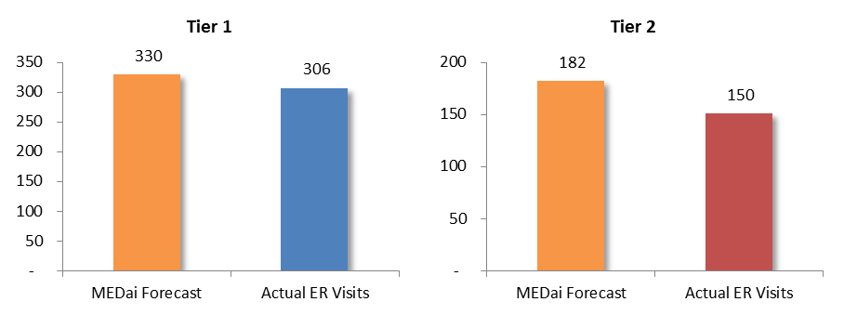
TARGETED EVALUATION – HMP cont’d
Utilization
ER visits are similarly well below MEDai projections
ER Utilization Impact - Visits per 1,000 Member Months
Source: SoonerCare HMP Fifth Annual Evaluation Report

Slide 97
TARGETED EVALUATION – HMP cont’d
Utilization and Expenditures
Overall cost effectiveness was measured taking into consideration program administrative costs (OHCA and Telligen)
The program’s net cost effectiveness (accounting for administrative expenses), and associated return-on-investment have increased each year, with total savings through SFY 2013 exceeding $180 million (state and federal dollars)
From a return-on-investment perspective, the program has generated over six dollars in medical savings for every dollar in administrative expenditures

Slide 98
TARGETED EVALUATION – HMP cont’d
Cost Effectiveness
SoonerCare HMP – Net Savings (Deficit) by State Fiscal Year (in millions)*
Program Component | 2009 | 2010 | 2011 | 2012 | 2013 | Total
Total NCM | $5.6 | $14.9 | $27.9 | $38.1 | $37.4 | $123.9
Practice Facilitation | ($0.6) | $4.3 | $15.4 | $19.6 | $19.2 | $58.0
Total Program | $5.0 | $19.2 | $43.3 | $57.7 | $56.6 | $181.9
*Note: Savings are net of HMP administrative expenses (OHCA staff and vendor payments). Administrative expenses totaled $32 million through SFY 2012
Source: SoonerCare HMP Comprehensive Program Evaluation and Cost Savings Report

Slide 99
SoonerCare Choice Evaluation – NEW
HMP
PCMH
HAN

Slide 100
TARGETED EVALUATION - PCMH
PHPG Targeted Evaluation
As presented earlier, the PCMH initiative has contributed to positive trends with regard to service utilization and expenditures
The favorable results are in the aggregate, across all tier levels
When tiers are compared, Tier 1 and Tier 2 providers generally perform as well as their Tier 3 counterparts

Slide 101
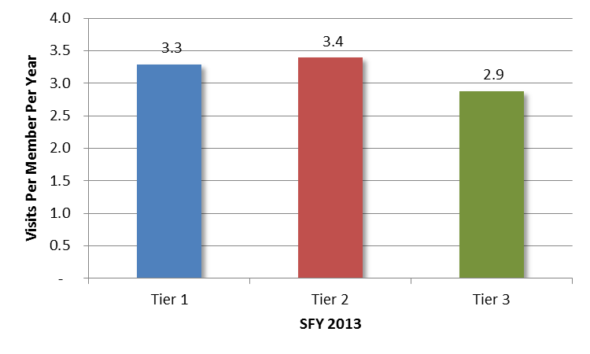
TARGETED EVALUATION - PCMH
PCMH Visit Rates (Per Member Per Year)
Members aligned with a Tier 1 or Tier 2 PCMH see their provider slightly more often over the course of a year than members aligned with a Tier 3 PCMH
Source: OHCA paid claims data

Slide 102
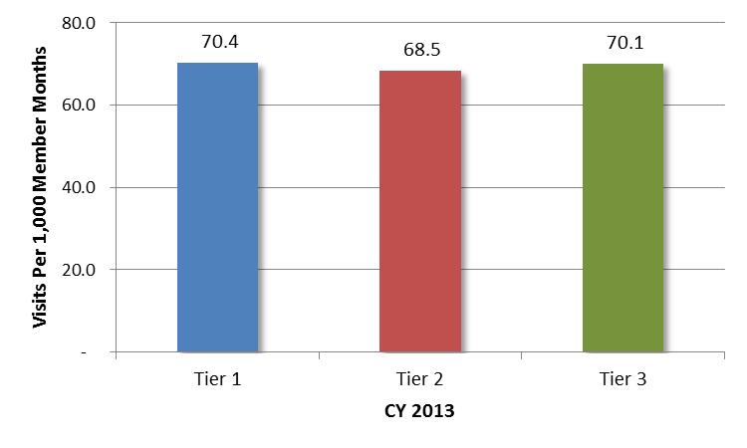
TARGETED EVALUATION - PCMH
Emergency Room Utilization (Per 1,000 Member Months)
The ER visit rate is nearly identical across tiers
Source: OHCA paid claims data

Slide 103
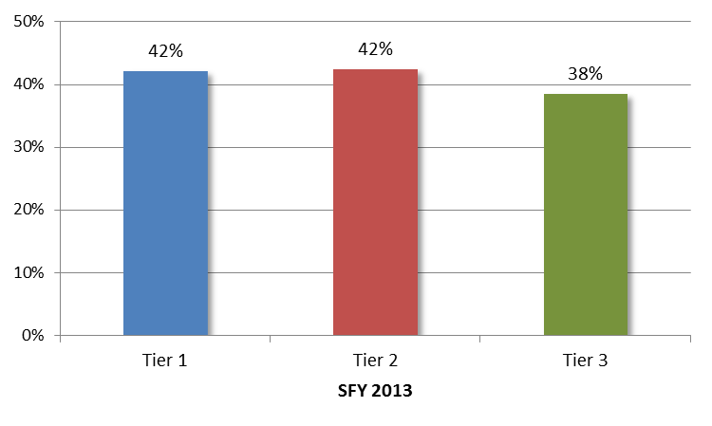
TARGETED EVALUATION - PCMH
Follow-up visit with PCMH within 30 days of ER encounter
Tier 1 and Tier 2 PCMH providers are slightly more likely to see their members within 30 days of an ER visit than Tier 3 providers
Source: OHCA paid claims data

Slide 104
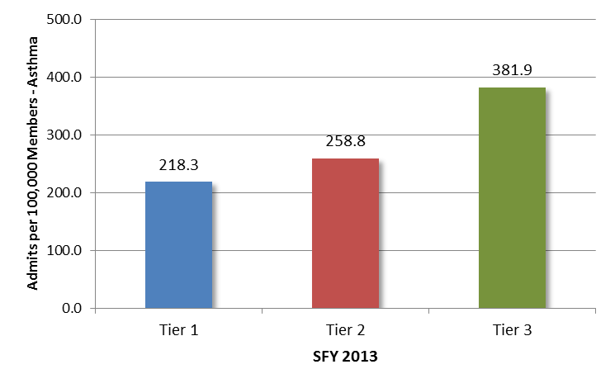
TARGETED EVALUATION - PCMH
Ambulatory Care Sensitive Hospitalization Rate - Asthma
Tier 1 PCMH providers have the lowest admit rate for asthma, while Tier 3 providers have the highest rate
Source: OHCA paid claims data

Slide 105
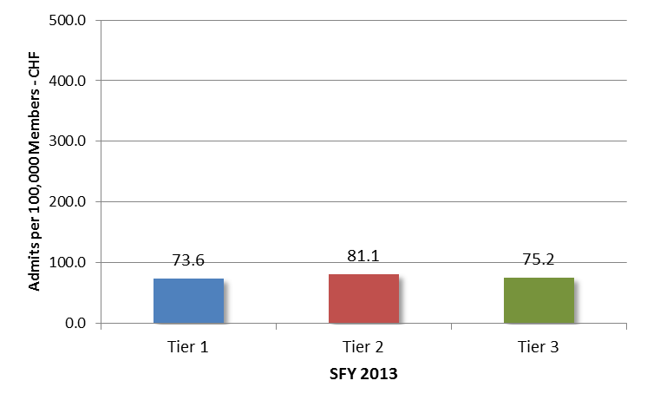
TARGETED EVALUATION - PCMH
Ambulatory Care Sensitive Hospitalization Rate - CHF
Tier 1 PCMH providers have the lowest admit rate for CHF, while Tier 2 providers have the highest rate
Source: OHCA paid claims data

Slide 106
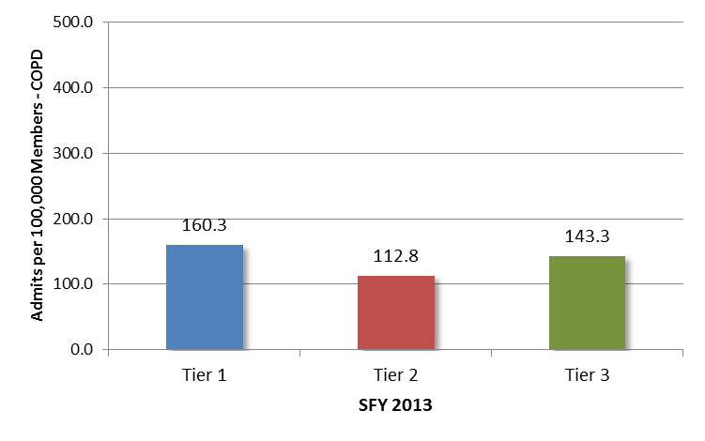
TARGETED EVALUATION - PCMH
Ambulatory Care Sensitive Hospitalization Rate - COPD
Tier 2 PCMH providers have the lowest admit rate for COPD, while Tier 1 providers have the highest rate
Source: OHCA paid claims data

Slide 107
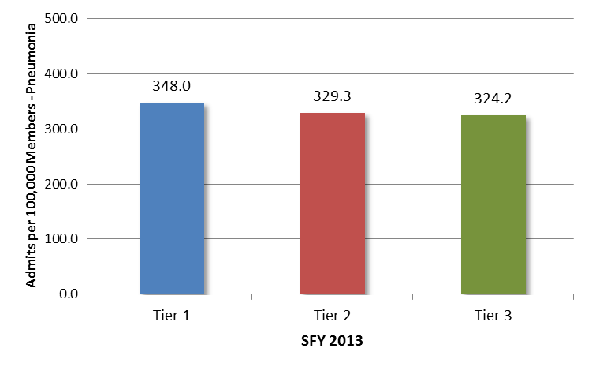
TARGETED EVALUATION - PCMH
Ambulatory Care Sensitive Hospitalization Rate - Pneumonia
Tier 3 PCMH providers have the lowest admit rate for pneumonia, while Tier 1 providers have the highest rate
Source: OHCA paid claims data

Slide 108
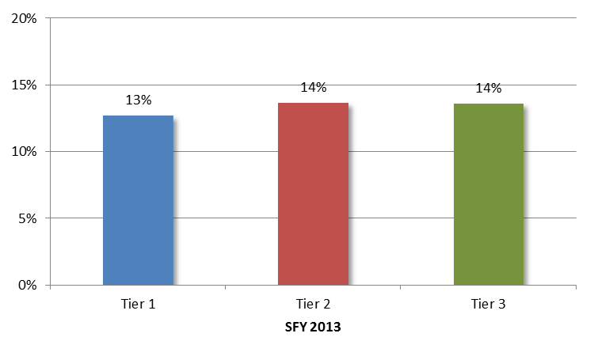
TARGETED EVALUATION - PCMH
Hospital Readmission Rate within 30 Days of Discharge
Readmission rates are nearly identical
Source: OHCA paid claims data

Slide 109
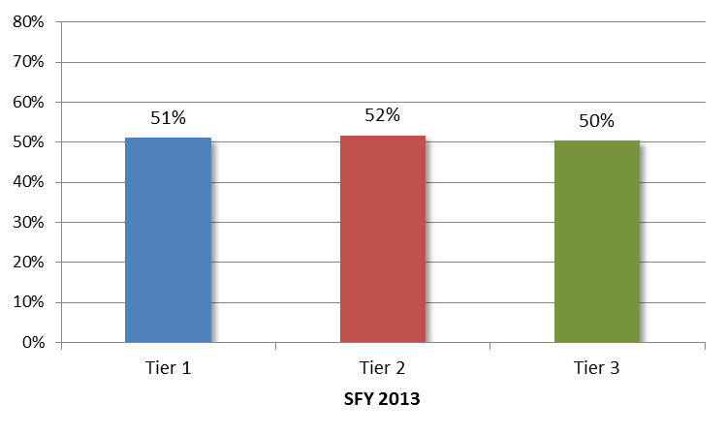
TARGETED EVALUATION - PCMH
Visit to PCMH Post Discharge (30 Days)
Post Discharge PCMH visit rates also are almost identical
Source: OHCA paid claims data

Slide 110
TARGETED EVALUATION - PCMH
PCMH Impact: Quantifying Return-on-Investment
The PCMH model appears to be contributing to positive trend lines for the SoonerCare Choice program as a whole
PCMH intentionally overlaps with, and amplifies that impact of other OHCA initiatives
For example, ER utilization is addressed through:
  Broad-based PCMH patient care requirements
  Targeted interventions with high ER utilizers by OHCA PCM Department
  Holistic care management of high risk members through SoonerCare HMP and
  Health Access Networks (discussed in next section)

Slide 111
TARGETED EVALUATION – PCMH
PCMH Impact: Provider Tiers
There is no evidence that provider activities or member outcomes differ significantly by tier assignment
Most program requirements apply across all three tiers
OHCA audit findings indicate that providers are striving to meet or exceed PCMH requirements
“I provide excellent care regardless of tier.” – respondent to 2012 OU PCMH provider survey

Slide 112
TARGETED EVALUATION – PCMH
Options for Provider Tiers
The OHCA could consolidate PCMH providers into two tiers, although this would require additional dollars if the two highest tiers were retained and Tier 1 eliminated
Standards for the highest tier could be more closely aligned with NCQA standards (or other accrediting body), although the current OHCA standards appropriately place a high priority on access
Tier 3 providers could be subject to a pre-certification audit to confirm adherence with standards (providers currently are subject to post-certification random audits)
A portion of Tier 3 case management fees could be tied to performance targets and paid only upon achievement of the targets (separate from SoonerExcel payments)

Slide 113
SoonerCare Choice Evaluation – NEW
HMP
PCMH
HAN

Slide 114
TARGETED EVALUATION - HAN
Overview
The Health Access Network model expands on the PCMH by creating community-based, integrated networks intended to:
  Increase access to health care services
  Enhance quality and coordination of care
  Reduce costs
Network
Community
Medical Home
Member

Slide 115
TARGETED EVALUATION - HAN
Overview
The HAN model was launched in 2010 and includes:
  Partnership for Healthy Central Communities (based in Canadian County))
  OSU Center for Health Sciences
  OU Sooner Health Access Network
The HANs receive an additional $5.00 PMPM in part for their care management duties, which focus on high-risk SoonerCare Choice members enrolled with HAN-affiliated PMCH providers

Slide 116
TARGETED EVALUATION - HAN
Overview
Care management target groups include:
  Breast and cervical cancer patients
  High Risk pregnancies
  Persons with hemophilia
  Frequent emergency room utilizers
The HANs also support network PCMH providers through facilitation of specialist referrals, expansion of telemedicine and assistance in achieving Tier 3 status
HAN enrollment has increased rapidly as the HANs have added PCMH providers to their networks

Slide 117
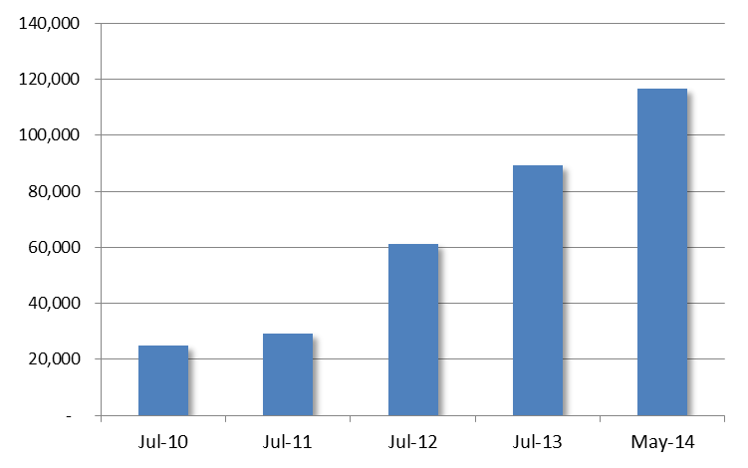
TARGETED EVALUATION - HAN
Overview - HAN Enrollment (all sites)
HAN enrollment grew from 25,000 in July 2010 to nearly 117,000 in May 2014
Source: OHCA HAN Total Summary Report – May 2014

Slide 118
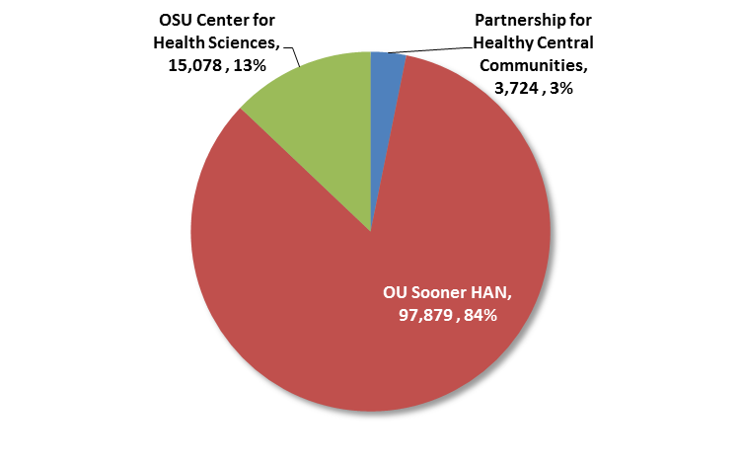
TARGETED EVALUATION - HAN
Overview - HAN Enrollment (by site)
In May 2014, OU Sooner HAN accounted for approximately 84 percent of enrollment; OSU for 13 percent and Central Communities for the remaining three percent
Source: OHCA HAN Total Summary Report – May 2014

Slide 119
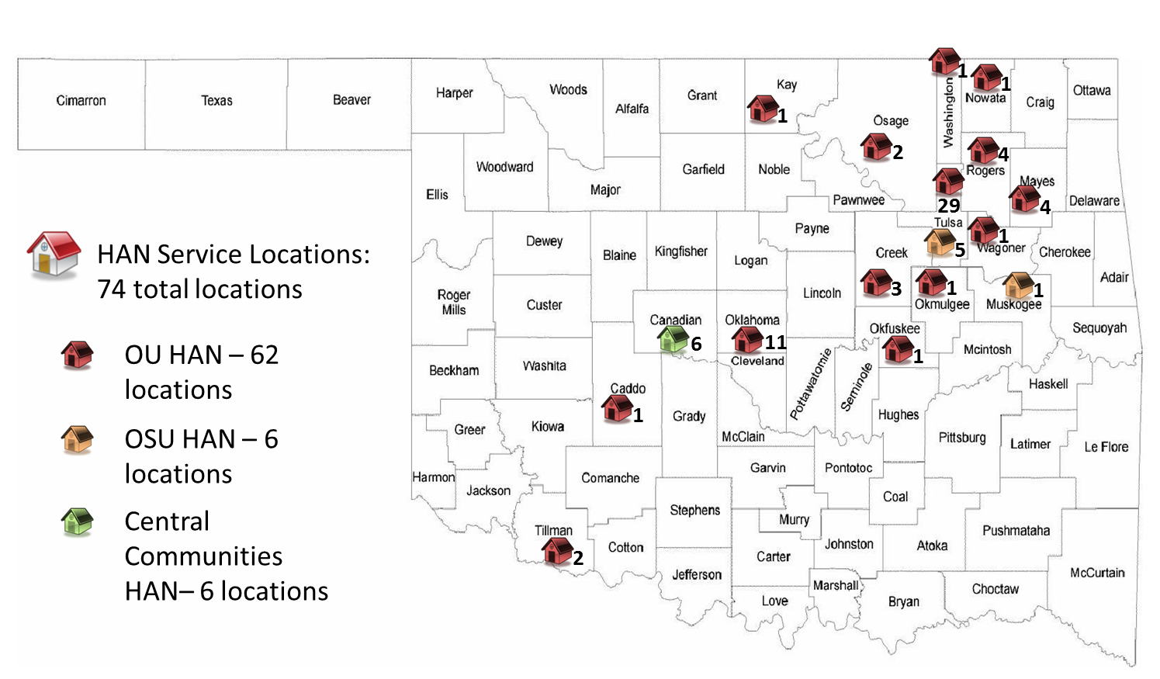
TARGETED EVALUATION - HAN
Overview - HAN Provider Sites (May 2014)
There are 600 HAN-affiliated PCMH providers at 74 locations throughout the State
Source: OHCA

Slide 120
TARGETED EVALUATION - HAN
Overview – Care Management
The care management strategies of the three HANs have been tailored to their relative sizes and locations
The contrast between Central Communities and OU demonstrates how the HAN principles can be advanced along different paths
Central Communities HAN
  Local focus consistent with founding organization’s (El Reno Clinic) service to the community
  Referral assistance to solo/small group practices through a central database
  Hands-on assistance to practices in documenting compliance with higher PCMH tiers
  Person-centered care management through a small staff (made feasible due to the organization’s small enrollment)
  Possible role model for other rural communities interested in establishing a HAN

Slide 121
TARGETED EVALUATION - HAN
Overview – Care Management
OU Sooner HAN
  Broad network encompassing OU clinics and affiliated providers
  Blend of RN, LCSW and support staff within care management
  July 2014 staffing: 12 care managers (7 RNs and 5 LCSWs)
  Formal care management structure process, including member assessment, education and care coordination
  Focused initiatives to improve primary care effectiveness, reduce ER use and raise provider productivity (e.g., Open Access Initiative)
  Emphasis on technology to support care initiatives (e.g., Doc2Doc referral system and MyHealth electronic records/assessment platform)
  Measurement of outcomes and incorporation of findings into quality improvement activities

Slide 122
TARGETED EVALUATION - HAN
Overview – Care Management
OSU Center for Health Sciences
  Has charted a middle course between the other two HAN’s, in terms of staffing and use of technology
  Blend of direct and telephonic contact between care management and individual members
  Recently increased care manager staff from one to two, which should enhance capacity to provide one-on-one assistance to members

Slide 123
TARGETED EVALUATION - HAN
PHPG Evaluation
PHPG evaluated HAN activities and performance through interviews with HAN managers, claims analysis and review of operational reports
PHPG compared HAN demographics to the general SoonerCare Choice population
PHPG also conducted an analysis of the two largest target care management populations: frequent ER utilizers and high-risk OB (other groups were too small in number to evaluate separately)

Slide 124
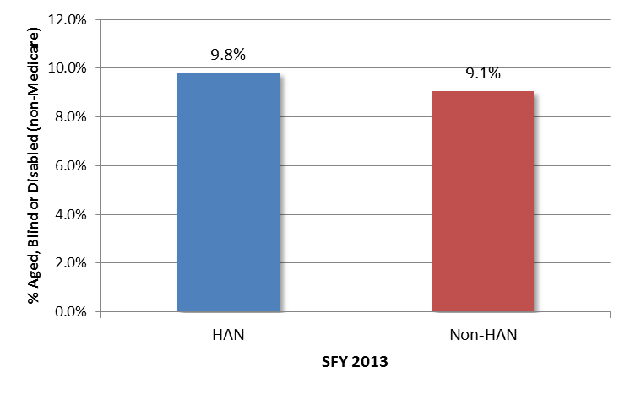
TARGETED EVALUATION - HAN
HAN and non-HAN Member Mix
The HAN network includes a higher percentage of costly Aged, Blind and Disabled (ABD) members than the non-HAN PCMH community
Source: OHCA paid claims data

Slide 125
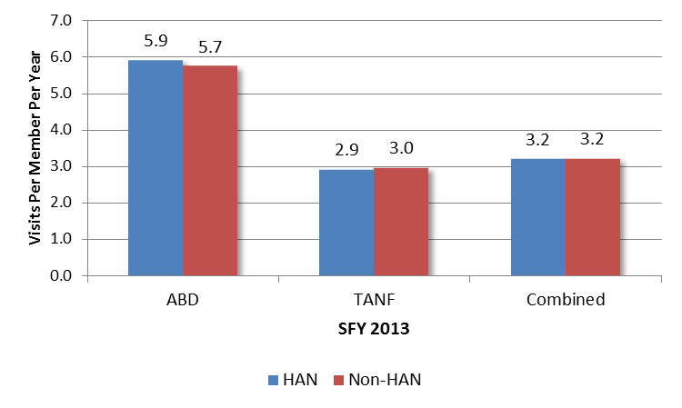
TARGETED EVALUATION - HAN
HAN and non-HAN PCMH Visits
Members affiliated with a HAN PCMH saw their provider at nearly the same rate as other members
Source: OHCA paid claims data

Slide 126
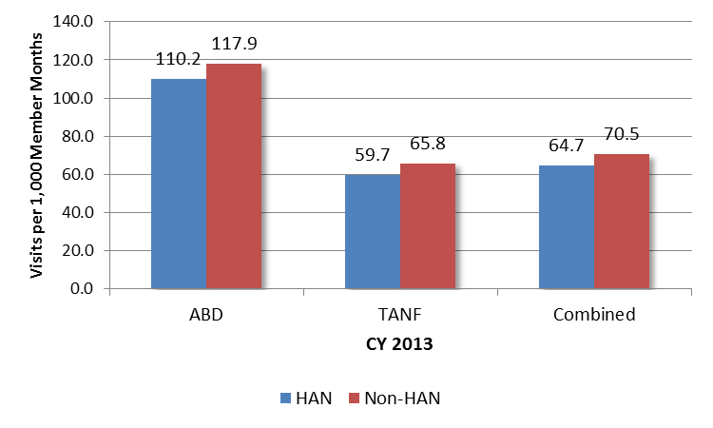
TARGETED EVALUATION - HAN
HAN and non-HAN ER Visits
HAN members – both ABD and TANF – used the emergency room at a moderately lower rate than other members
Source: OHCA paid claims data

Slide 127

TARGETED EVALUATION - HAN
HAN and non-HAN – Post-ER Visit to PCMH
HAN and non-HAN members were nearly equally likely to see their PCMH provider within 30 days of an ER visit
Source: OHCA paid claims data

Slide 128

TARGETED EVALUATION - HAN
HAN and non-HAN PMPM Claim Costs
HAN and non-HAN members have almost identical claim costs within eligibility groups; the HANs’ slightly higher overall PMPM costs are due to their larger relative share of ABD members
Source: OHCA paid claims data

Slide 129
TARGETED EVALUATION - HAN
HAN Care Management – ER Utilizers
PHPG evaluated ER usage among 218 frequent utilizers enrolled by the HANs into care management
HAN activities include:
  Member follow-up, after inappropriate ER use
  Ongoing member outreach and education
  Requiring the member to use a designated PCMH provider (“PCMH Lock-in”), as a means of fostering a relationship and encouraging the member to seek non-emergent care outside of the ER

Slide 130

TARGETED EVALUATION - HAN
CC HAN Educational Materials for Frequent ER Cases

Slide 131
TARGETED EVALUATION - HAN
HAN Care Management – ER Utilizers
PHPG compared the 12-month period prior to PCMH lock-in/care management to the subsequent 12 months
ER utilization, while still high, declined in the second 12-month period
Although members were not more likely to see their PCMH provider after a trip to the ER, the rate in both time periods significantly exceeded the 42 percent rate for the general HAN population
Measure | 12 Months prior to PCMH Lock-in/Care Management | 12 Months after PCMH Lock-in/Care Management
Average number of ER visits per member | 10.8 | 8.8
Members with 6 or more visits | 51.4% | 22.0%
Members with zero ER visits (post-lock in) | -- | 40.8%
Members seeing PCMH within 30 days of ER visit | 59.1% | 56.5%

Slide 132
TARGETED EVALUATION - HAN
HAN Care Management – High Risk OB
PHPG evaluated birth outcomes among 351 high risk OB members enrolled with a HAN-affiliated PCMH provider
  SFY 2011 – 5 cases
  SFY 2012 – 85 cases
  SFY 2013 – 261 cases
Because of the relatively small number of cases prior to SFY 2013, PHPG evaluated the three years together; the resulting baseline data can be tracked against over time
HAN activities for the high risk OB population include assisting expectant mothers to obtain appropriate prenatal services and prepare for the birth of the child, as well as linking newborns to a pediatrician
The HANs often face a significant challenge in reaching high risk OB members because many have a relationship with a prenatal care provider rather than their PCMH

Slide 133
TARGETED EVALUATION - HAN
HAN Care Management – High Risk OB Outcomes
PHPG examined outcomes by state fiscal year and overall for SFY 2011 – SFY 2013
Although data is presented by year, the three-year average should serve as a combined baseline
Measure (Premature Births) | SFY 2011 | SFY 2012 | SFY 2013 | Average (Baseline)
Total cases | 5 | 85 | 261 | 351
# premature births | 3 | 46 | 127 | 176
% premature births | 60.0% | 54.1% | 48.7% | 50.1%
% of premature births w/NICU stay | 66.7% | 30.4% | 43.3% | 40.3%
% readmission w/in 30 days of IP stay - premature | 66.7% | 28.3% | 20.5% | 23.3%
Average # of ER visits – premature birth | 5.3 | 2.2 | 2.2 | 2.3
Average cost per case – premature birth | $25,447 | $20,509 | $22,850 | $22,282

Slide 134
TARGETED EVALUATION - HAN
HAN Care Management – High Risk OB Outcomes
PHPG examined outcomes by state fiscal year and overall for SFY 2011 – SFY 2013
Although data is presented by year, the three-year average should serve as a combined baseline
Measure (Full-Term Births) | SFY 2011 | SFY 2012 | SFY 2013 | Average (Baseline)
Total cases | 5 | 85 | 261 | 351
# full-term births | 2 | 39 | 134 | 175
% full-term births | 40.0% | 45.9% | 52.3% | 49.9%
% of full-term births w/NICU stay | -- | -- | 1.5% | 1.1%
% readmission w/in 30 days of IP stay – full-term | -- | 15.4% | 14.2% | 14.3%
Average # of ER visits – full-term birth | 2.0 | 1.7 | 1.6 | 1.6
Average cost per case – full-term birth | $13,396 | $12,758 | $11,977 | $12,167

Slide 135
TARGETED EVALUATION - HAN
HAN Impact
The Health Access Networks serve a higher risk population than the general PCMH provider community
The HANs are obligated to perform more care management activities, while also offering support to their PCMH networks
To date, the HANs have performed these additional activities at no greater claim cost, and for a modest administrative fee
The experience of the SoonerCare HMP suggests it could be several years before the impact of the HANs is realized
In the interim, the OHCA is clarifying and enhancing the contractual standards for the HANs, which is appropriate
The OHCA also should re-evaluate the efficacy of including high-risk OB members in the HAN system, if no improvement to the baseline outcomes is observed

Slide 136
FINAL OBSERVATIONS
Managed Care Models
Summary Findings

Slide 137
FINAL OBSERVATIONS – MANAGED CARE MODELS
Managed Care Organization (MCO) Model
The majority of states introducing or expanding managed care have done so through MCO contracts
Among Oklahoma’s neighbors, Missouri, Kansas, New Mexico and Texas contract with MCOs, including for ABD members and long term care (Missouri is TANF only)
The industry is undergoing consolidation and a small number of commercial MCOs increasingly dominate
Seven large plans (Aetna, Anthem Blue Cross, Centene, Health Net, Molina, United, WellCare) have combined enrollment of more than six million lives
These MCOs can bring expertise from existing markets into states implementing or expanding managed care (e.g., Kansas)

Slide 138
FINAL OBSERVATIONS – MANAGED CARE MODELS
MCO Model cont’d
States considering adoption of an MCO model should address the following as part of implementation planning:
  Incorporation of state’s priorities for access, quality and cost effectiveness into MCO contract requirements, to ensure MCO’s focus on the areas of greatest need
  Development of an objective and defensible procurement process that can withstand challenges from losing offerors
  Inclusion of contract language that penalizes MCO’s from exiting the program before expiration of their contract term

Slide 139
FINAL OBSERVATIONS – MANAGED CARE MODELS
Community-Based Systems of Care
A smaller number of states, like Oklahoma, have developed programs that:
  Combine community-based systems of care with support at the state level in the form of chronic care/health management and quality initiatives (either directly administered or purchased)
  Use market-based incentives to drive and reward holistic, cost-effective care
Examples of programs similar in concept to SoonerCare Choice include:
  California – CalOptima Program (Orange County)
  North Carolina – Community Care of NC/ACCESS
  Oregon – PCMH/Coordinated Care Organizations
  Vermont – Global Commitment to Health

Slide 140
FINAL OBSERVATIONS - SUMMARY
Positives
The SoonerCare Choice program continued to demonstrate improved performance with respect to quality and access from 2009 – 2013
Health care inflation for SoonerCare Choice members has averaged less than two percent per year since 2009
Recent initiatives, including HMP, PCMH and HAN, are contributing to the overall success of the program
PCMH providers have demonstrated consistent positive outcomes across all three tiers
SoonerCare Choice has fostered innovation while exhibiting stability for both members and providers

Slide 141
FINAL OBSERVATIONS - SUMMARY
Opportunities for Improvement
ER utilization, while down, remains high by national standards, particularly for adults and persons with disabilities
Quality measures generally show improvement and exceed national benchmarks. Exceptions are breast/cervical cancer screening rates, cholesterol screening rates and diabetes care measures
PCMH model has demonstrated effectiveness in the aggregate but there is no evidence that higher payments to Tier 2 and 3 providers result in better outcomes, as compared to Tier 1
The OHCA is developing strategies to improve performance in each of these areas

