Slide 1
Advanced Planning Document Process
Adolph Maren
April 24, 2019

Slide 2
ACRONYM
HIE APD Phases
Concept development
Develop draft HIE APD and budget
Develop draft contracts, amendments and RFPs from all entities
Internal state reviews of HIE APD, budget and contracts, amendments and RFPs (OHCA, OSDH, MyHealth, OMES)
Submission of APD and all supporting documents to CMS
Approval of APD and draft supporting documents
Release of RFPs
Submit final supporting documents to CMS
Maintenance of APD

Slide 3
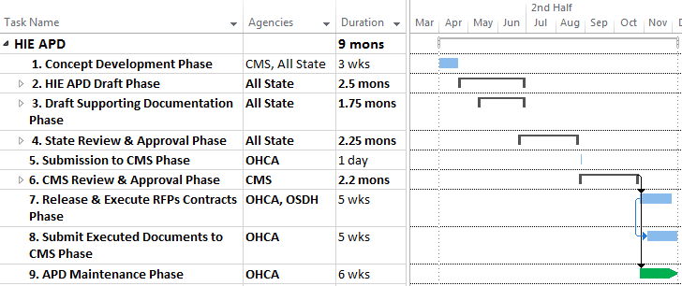
Sample Schedule
DETAILED
Note: All State = OHCA, OSDH, MyHealth

Slide 4
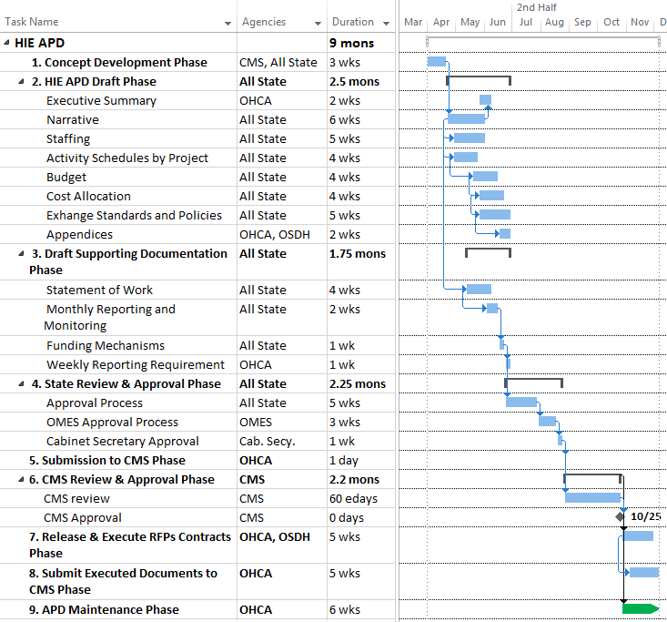
Note: All State = OHCA, OSDH, MyHealth

Slide 5
1. Concept Development
Obtain concept approval from CMS for HIE Plan
Contact CMS Lead ☑ 3/28/19
Provide brief HIE concept document ☑ 4/3/19
CMS sets up teleconference with appropriate participants
Participate in teleconference with CMS in order to provide any requested detail.
Modify HIE concept document and resubmit to CMS if requested

Slide 6
2. HIE APD Draft
HIE APD executive summary:
Requested amounts by FFYs
Date of CMS approval of previous APD with amounts by FFYs
Date of last State Medicaid HIT Plan (SMHP) approval and/or expected timing of next update
Notes:
HIE APD Guide from CMS available for email upon request

Slide 7
2. HIE APD Draft, cont.
HIE APD narrative to include:
HIE approach
Risks and risk mitigation
Impact on providers’ ability to meet Meaningful Use (MU) and it’s relevance to public health
Role of state government/governance
Exchange standards and policies
Summary of transition plans from design to ongoing operations
Sustainability plan
Key milestones

Slide 8
2. HIE APD Draft, cont.
Proposed activity schedule
Detailed list of activities/projects including:
Start date
Completion date
Current status
Proposed budget by FFY
Federal, state and total cost
Also budget each FFY by quarter
Notes:
Due to complexity, Proposed Activity Schedules could be 10-20 pages

Slide 9
2. HIE APD Draft, cont.
Cost allocation plan, if applicable
Method of calculating Medicaid percentage based on projected benefits to state’s Medicaid Program
Proportional investments by other payers
Cost allocation methodology and data sources by activity and funding stream
Assurances, security, interface requirements
Description of the exchange standards and policies
Required affirmations of state’s compliance with federal regulations

Slide 10
2. HIE APD Draft Phase, cont.
Appendix A – Medicaid Management Information System (MMIS) costs and allocation, if applicable
Appendix B – Provider Incentive Payments (N/A)
Appendix C – Grants (N/A)
Appendix D – HIE Checklist
Appendix E – Table of alignment with seven standards and conditions

Slide 11
3. Draft Supporting Documentation
Drafts of contracts, amendments and RFPs with entities such as OSDH, MyHealth, and other contractors to include:
Statement of work
System requirements
Regulations
Monthly reporting and monitoring
Funding/payment mechanism/cost allocation
Weekly reporting requirements
Auditing and IV and V requirements

Slide 12
4. State Reviews
State entities required to review and approve HIE APD, contracts, amendments and RFPs expected to include:
OHCA
Finance
Legal
Business Enterprises
Executive Staff
OSDH & MyHealth
OMES
Oklahoma Cabinet Secretary
STAFFING

Slide 13
4. State Review Details
OHCA and OMES positions to approve HIE APD, contracts, amendments and RFPs:
OHCA Finance
Contracts Development Coordinator
Contracts Development Manager
Purchasing & Contracts Development Director
Director of Financial Accountability & Compliance
Budget & Fiscal Planning Director
General Accounting Director
Sr. Director General Accounting/Budget & Fiscal Planning
Chief Financial Officer

Slide 14
4. State Review Details, cont.
OHCA Legal
Deputy General Counsel and others as assigned
OHCA Business Enterprises
Chief of Business Enterprises
Director of Electronic Health Operations
HIT Grant Program Manager
HIT Grant Resource Manager
OHCA Executive
Chief Executive Officer
Chief Operating Officer/Deputy State Medicaid Director
OSDH, MyHealth & OMES
Cabinet Secretary

Slide 15
Internal Process Development
Monitoring, control and invoicing process for contracts
Weekly activity reports provided to:
Director of Electronic Health Operations
HIT Grant Resource Manager
Annual auditing, as required
IV&V, as required
Monthly invoicing
Submitted to OHCA Finance as prescribed in contract
Approved by various OHCA staff levels
State share to be invoiced by OHCA to entity, if applicable
Reimbursement to be made by entity to OHCA

Slide 16
9. APD Maintenance
Monitoring, control and invoicing process for contracts
Weekly activity reports provided to:
Director of Electronic Health Operations
HIT Grant Resource Manager
Annual auditing, as required
IV&V, as required
Notes:
State share must be either state appropriations or certified public funds such as local taxes (42 CFR, Section 433.51)

Slide 17
9. APD Maintenance, cont.
Monthly invoicing
Submitted to OHCA Finance as prescribed in contract
Approved by various OHCA staff levels
State share to be invoiced by OHCA to entity, if applicable
Reimbursement to be made by entity to OHCA
HIE APD to be updated/resubmitted annually with all previous requirements
Notes:
State share must be either state appropriations or certified public funds such as local taxes (42 CFR, Section 433.51)

Slide 18
Acronyms
BACK @
APD Advanced Planning Document
CMS Centers for Medicare and Medicaid Services
HIE Health Information Exchange
HIT Health Information Technology
IV&V Independent Verification and Validation
OHCA Oklahoma Health Care Authority
OMES Oklahoma Management Enterprise Services
OSDH Oklahoma State Department of Health
MMIS Medicaid Management Information System
MU Meaningful Use
RFP Request for Proposal
SMHP State Medicaid HIT Plan

Slide 19
Questions?

Slide 20
Contact Information
Adolph Maren Jr.
Director of Electronic Health Operations
Oklahoma Health Care Authority
4345 N. Lincoln Blvd. | Oklahoma City, OK 73105
P: (405) 522-7915 | F: (405) 530-7298
adolph.maren@okhca.org

