Slide 1

Capitol-Medical Center
Improvement and Zoning
Commission
April 23, 2021
Virtual Special Meeting

Slide 2
Call to Order / Welcome

Slide 3
Item B.1.
Approval of Minutes

Slide 4

Item C.1.
BP-20-21-42
940 NE 30th Street
Applicant: Garry Adams, Extreme Builders
Owner: Extreme Homes LLC
Request for a building permit for construction of a single family dwelling in the RD-1 District

Slide 5
BP-20-21-42
940 NE 30th Street
Existing Vacant Lot – Looking South

Slide 6

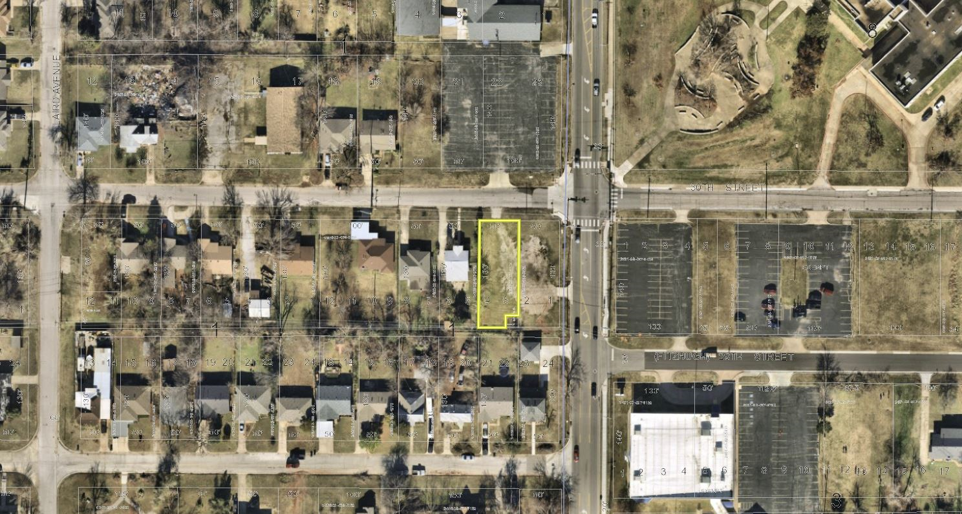
Aerial, December 2020
NE 30TH ST
NE 30TH ST
N LAIRD AVE
N KELLEY AVE
NE 29TH ST
NE 29TH ST
BP-20-21-42 940 NE 30th Street

Slide 7
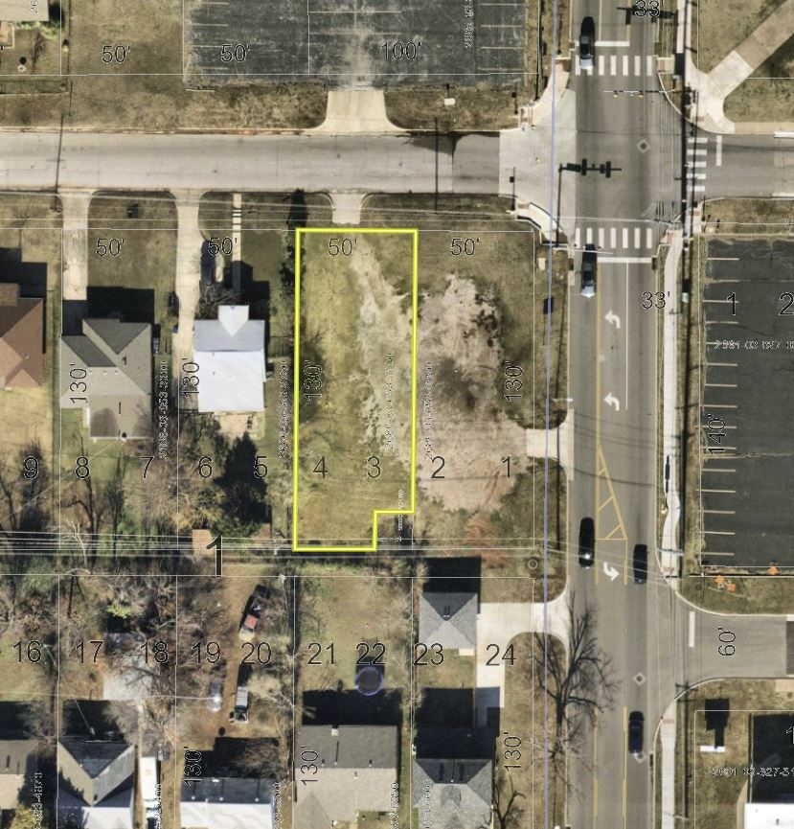
Aerial, December 2020
NE 30TH ST
N KELLEY AVE
BP-20-21-42 940 NE 30th Street

Slide 8
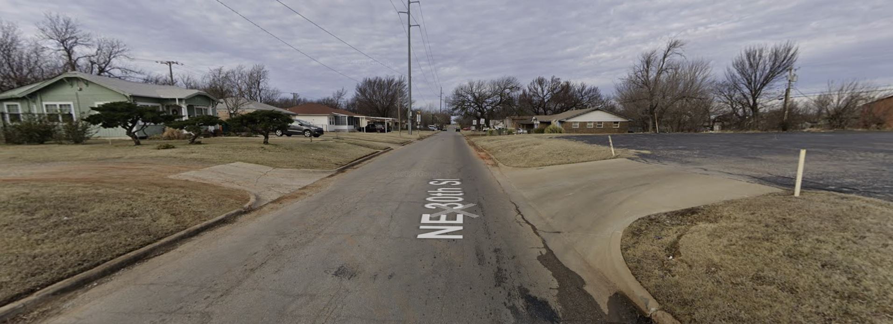
NE 30th Street, Looking West
BP-20-21-42 940 NE 30th Street

Slide 9
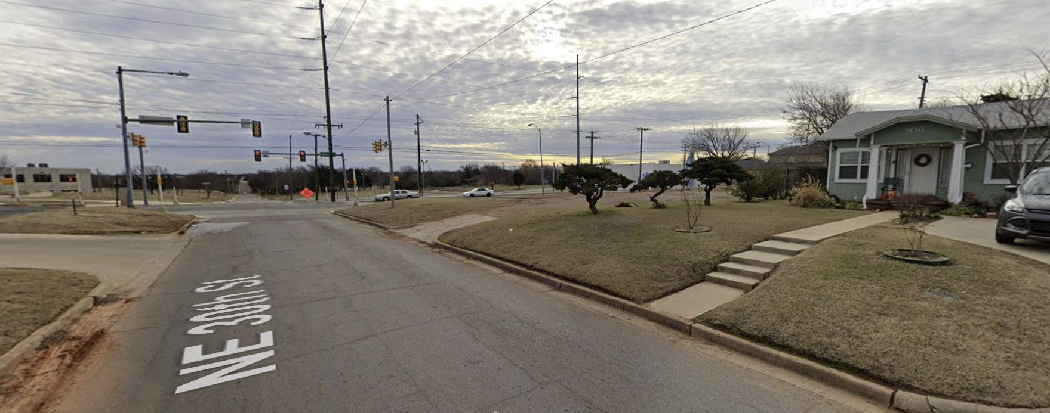
NE 30th Street, Looking East-Southeast
BP-20-21-42 940 NE 30th Street

Slide 10
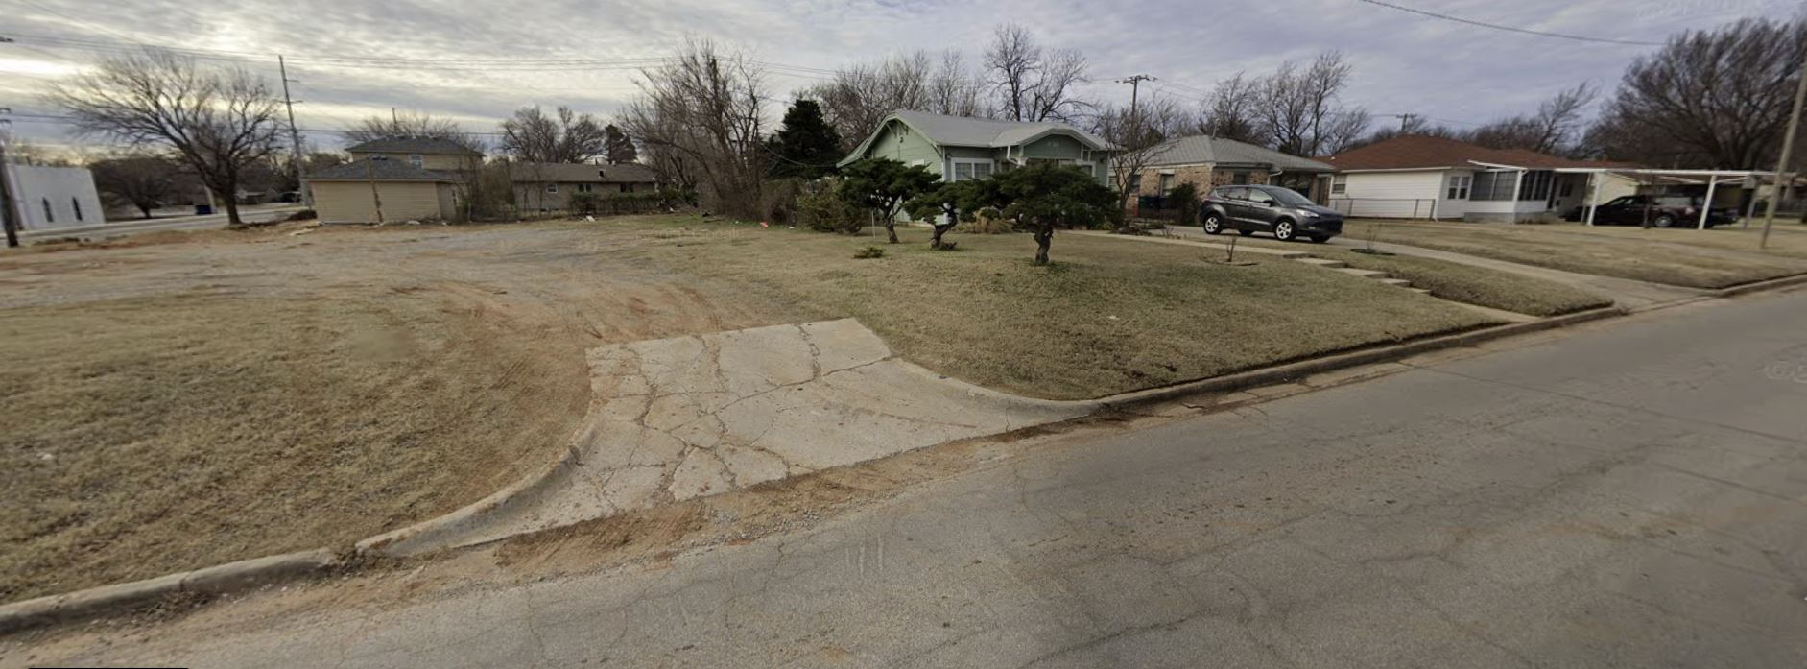
940 NE 30th Street and Adjacent Properties
Looking South-Southwest
BP-20-21-42 940 NE 30th Street

Slide 11
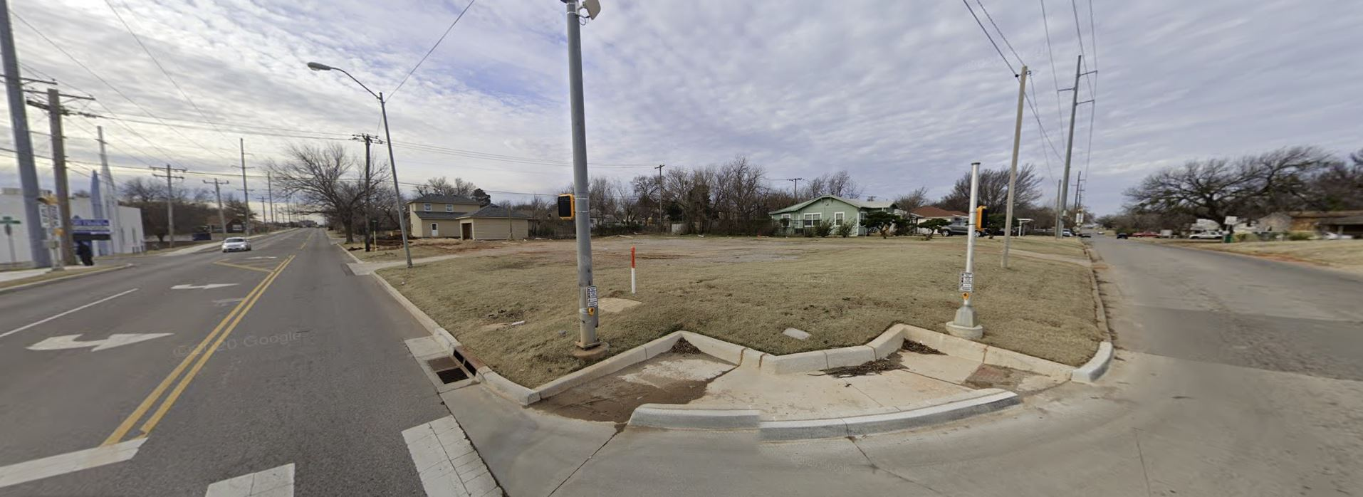
Looking Southwest from 30th & Kelley
BP-20-21-42 940 NE 30th Street

Slide 12
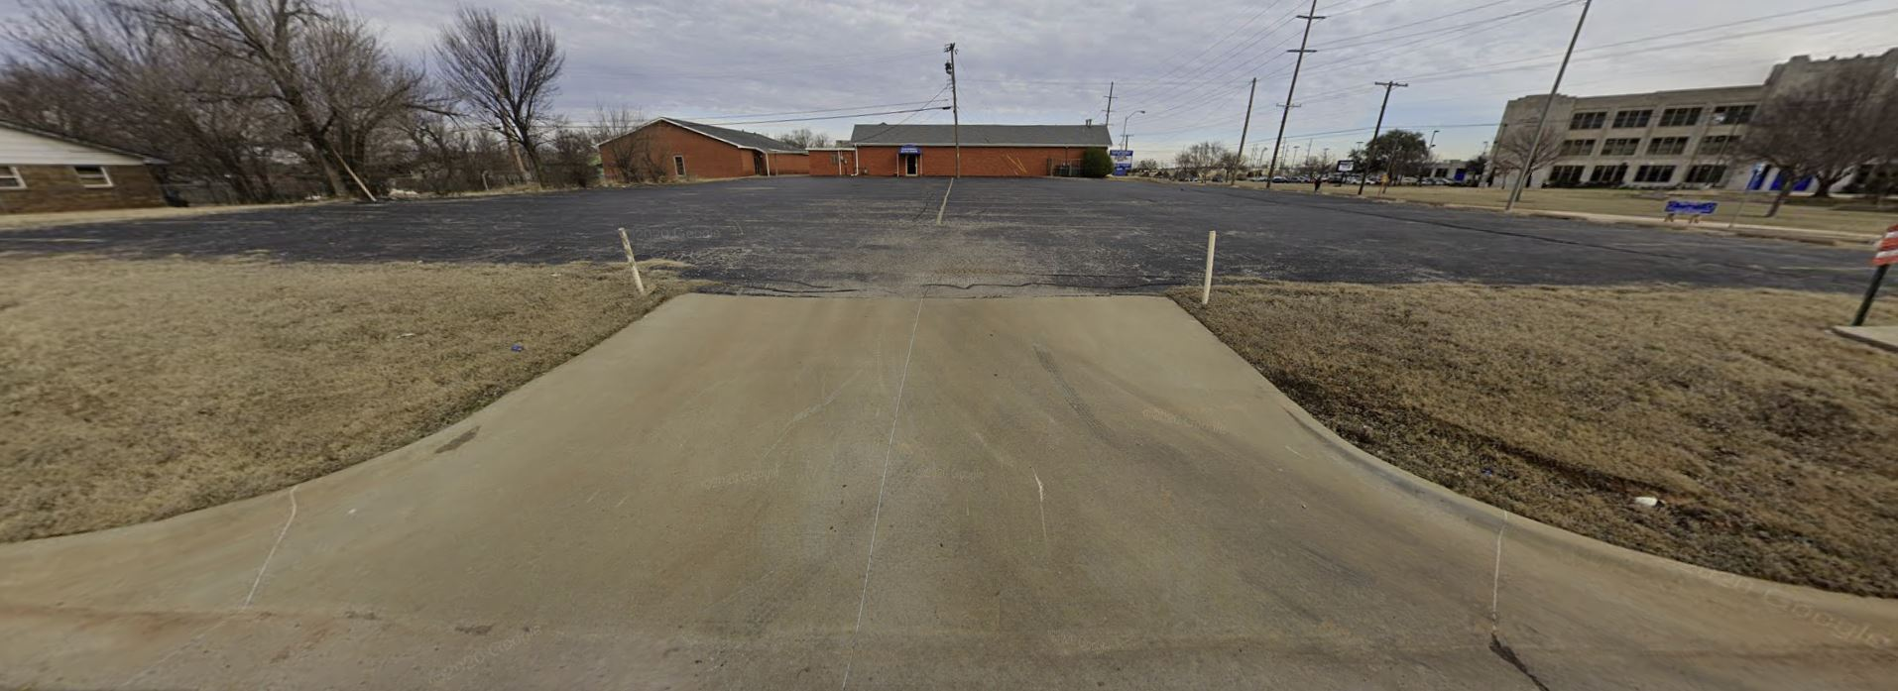
Existing Church to the North
BP-20-21-42 940 NE 30th Street

Slide 13
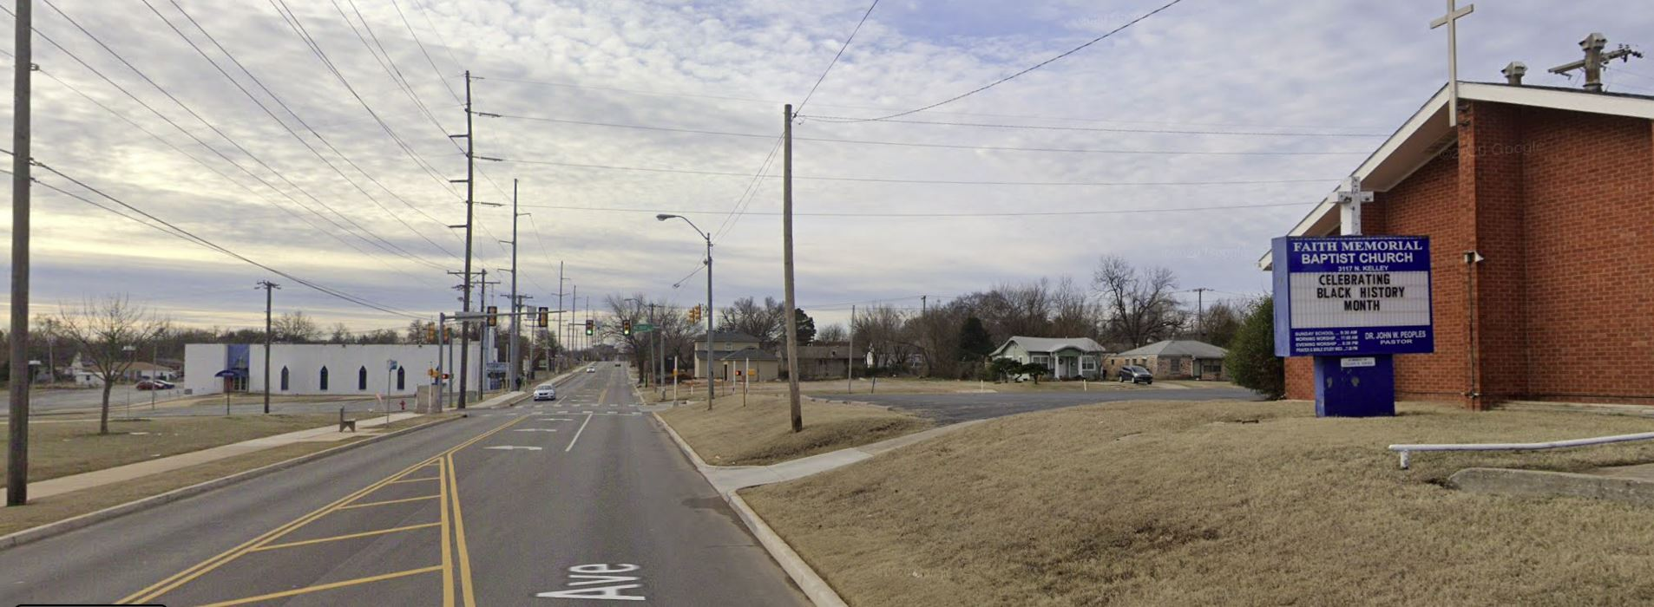
Looking South along Kelley Avenue
BP-20-21-42 940 NE 30th Street

Slide 14
Site Plan
BP-20-21-42
940 NE 30th St.
NORTH
PROPOSED
DWELLING

Slide 15
Floor Plan
1,100 s.f. living
400 s.f. garage
BP-20-21-42 940 NE 30th St.

Slide 16
Proposed Dwelling, North (Front) Elevation
BP-20-21-42 940 NE 30th Street

Slide 17
Proposed Dwelling, South (Rear) Elevation
BP-20-21-42 940 NE 30th Street

Slide 18
Proposed Dwelling, East (Side) Elevation
BP-20-21-42 940 NE 30th Street

Slide 19
Proposed Dwelling, West (Side) Elevation
BP-20-21-42 940 NE 30th Street

Slide 20
Roof Plan
BP-20-21-42
940 NE 30th St.

Slide 21
Zoning Standards for Residential Use, RD-1 District
Standard | Required | Provided | Met | Not Met
Front yard setback | 25 feet | 45 feet, 6 inches | ✓
Rear yard setback | 26 feet | 35 feet, 10 inches | ✓
Side yard setback | 5 feet | 5 feet | ✓
Lot coverage | 25 percent max. | 23.9 percent | ✓
Pervious open space | 25 percent min. | 65 percent | ✓
Driveway width | 12 feet max. | 12 feet | ✓
Parking spaces | 2 spaces | 2 spaces in garage | ✓
Building height | 35 feet max. | 19 feet | ✓
BP-20-21-42 940 NE 30th Street

Slide 22
940 NE 30th Street
CAC recommendation (April 8, 2021):
  Approval
Staff recommendation:
  Approval
BP-20-21-42 940 NE 30th Street

Slide 23
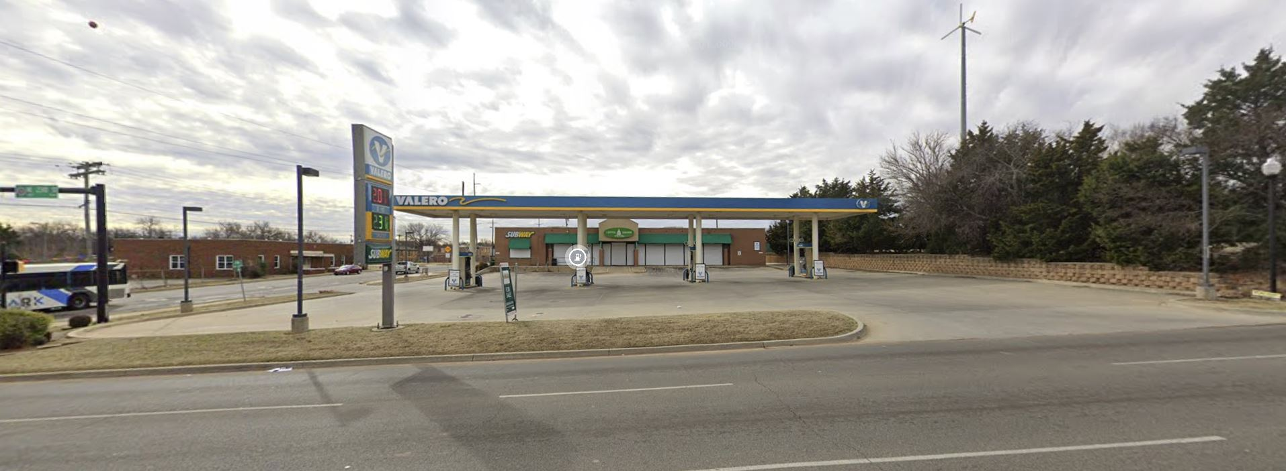
Items C.2. – C.5
950 NE 23rd Street
Building permit for demolition
Variances and building permit for redevelopment
Sign permit

Slide 24
950 NE 23rd Street
Zoning: CN, Neighborhood Commercial District
Existing Building: Built 2001
Owner of Record: Ester Thompson Revocable Living Trust and Eric Thompson
Applicant/Consulting Engineer: Mark Grubbs, Grubbs Consulting LLC

Slide 25
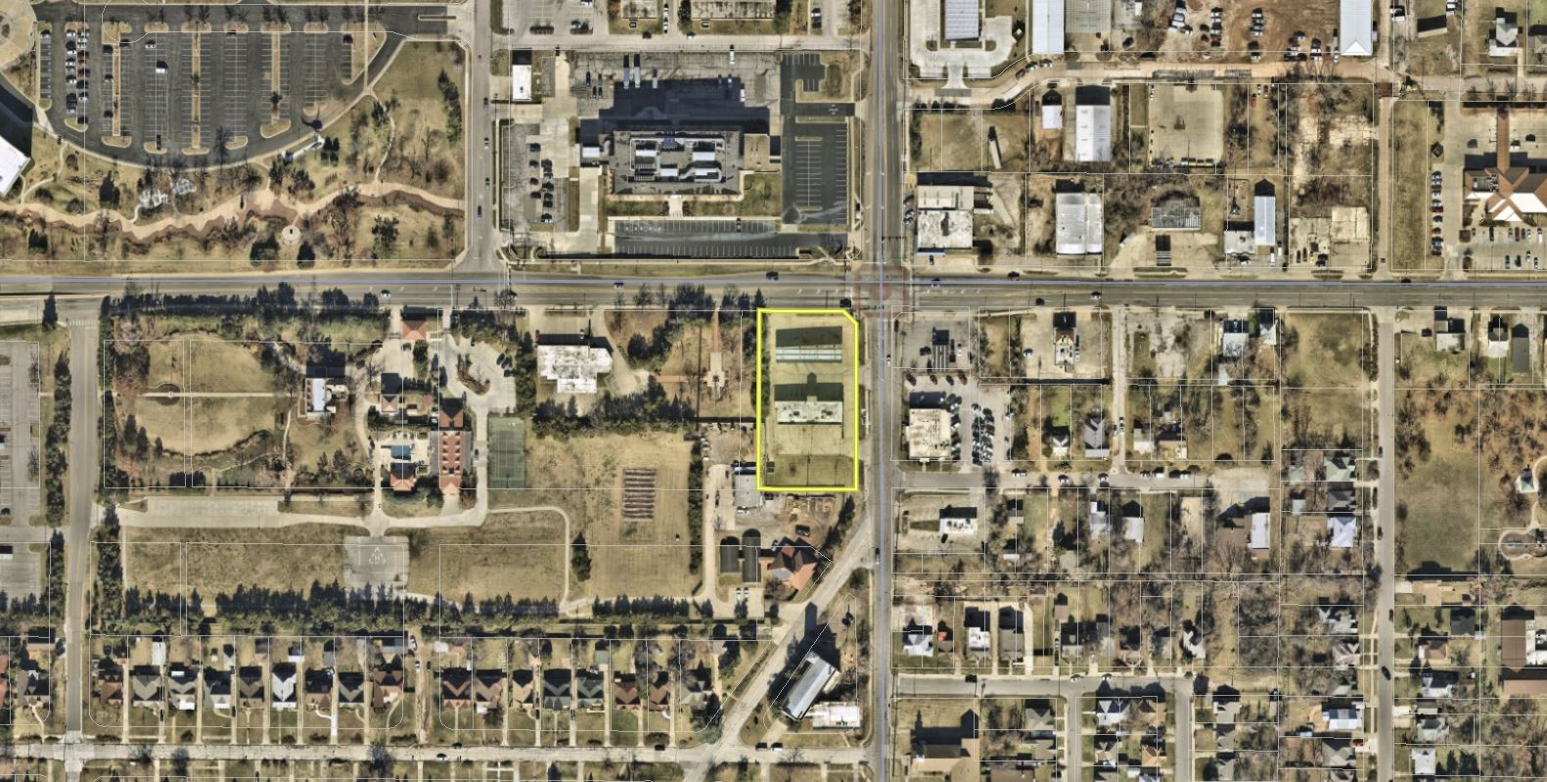
Aerial, December 2020
NE 23RD ST
N KELLEY AVE
950 NE 23rd Street

Slide 26
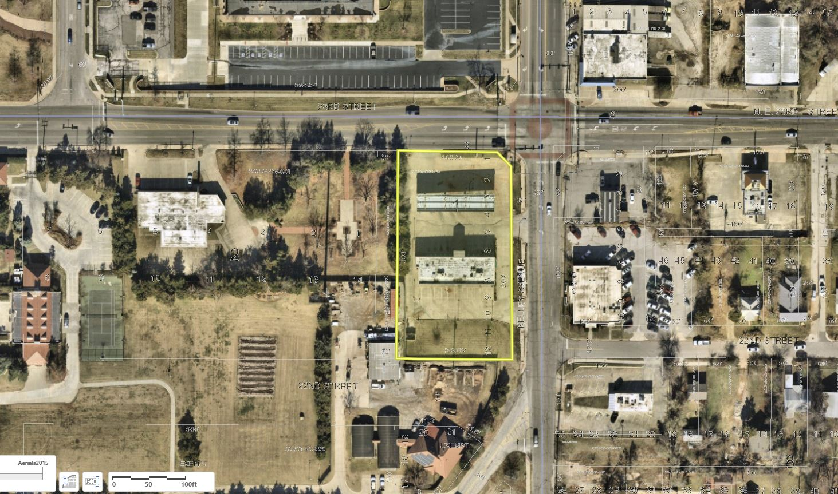
Aerial, December 2020
NE 23RD ST
N KELLEY AVE
950 NE 23rd Street

Slide 27
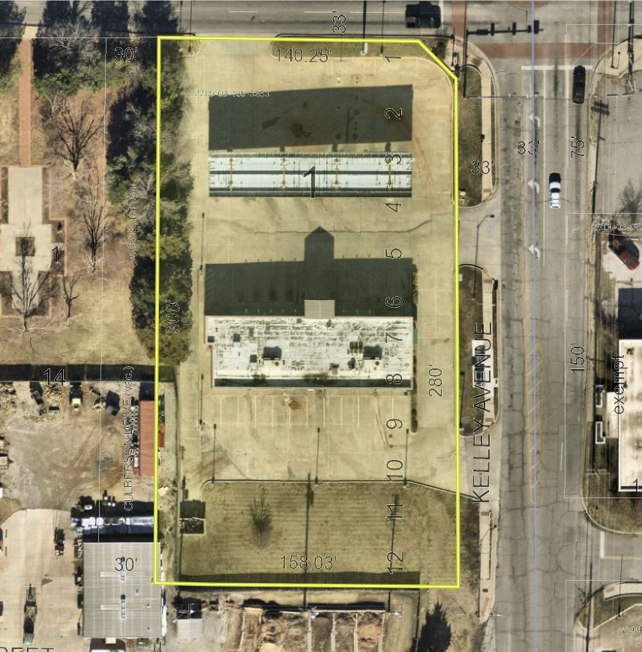
NE 23RD ST
Aerial,
Dec. 2020
950 NE 23rd St.
N KELLEY AVE

Slide 28
950 NE 23rd Street
North Elevation, Looking South

Slide 29
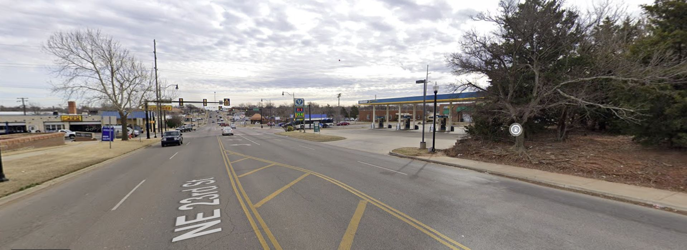
950 NE 23rd Street
Looking East along NE 23rd Street

Slide 30
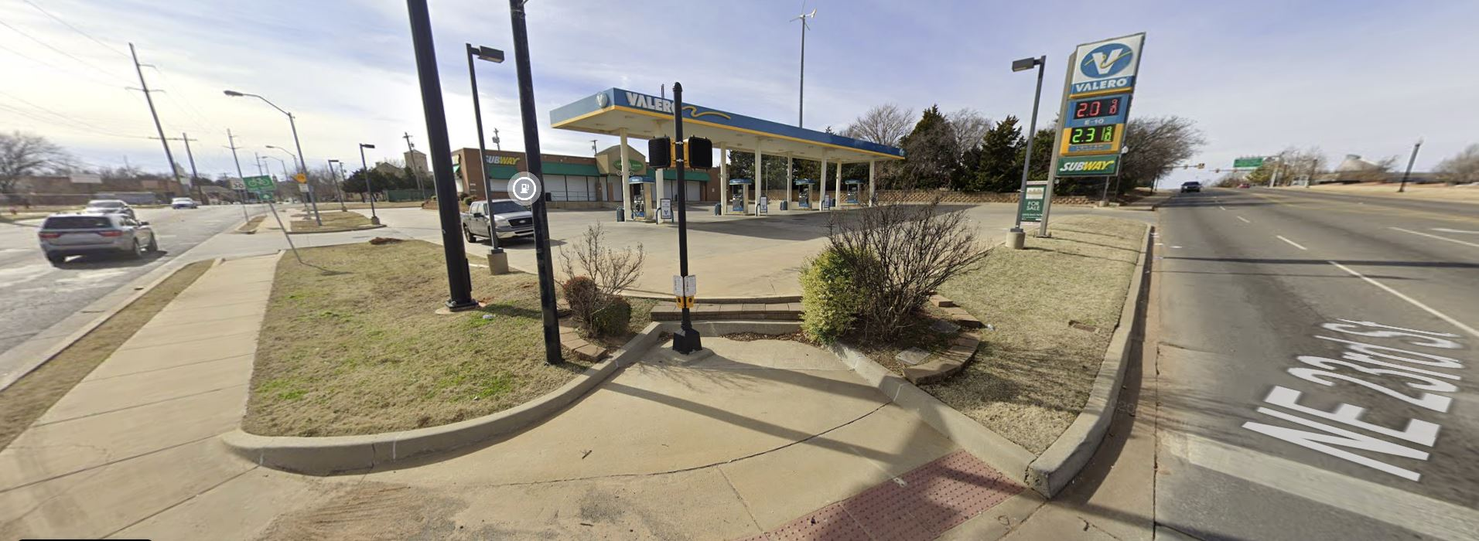
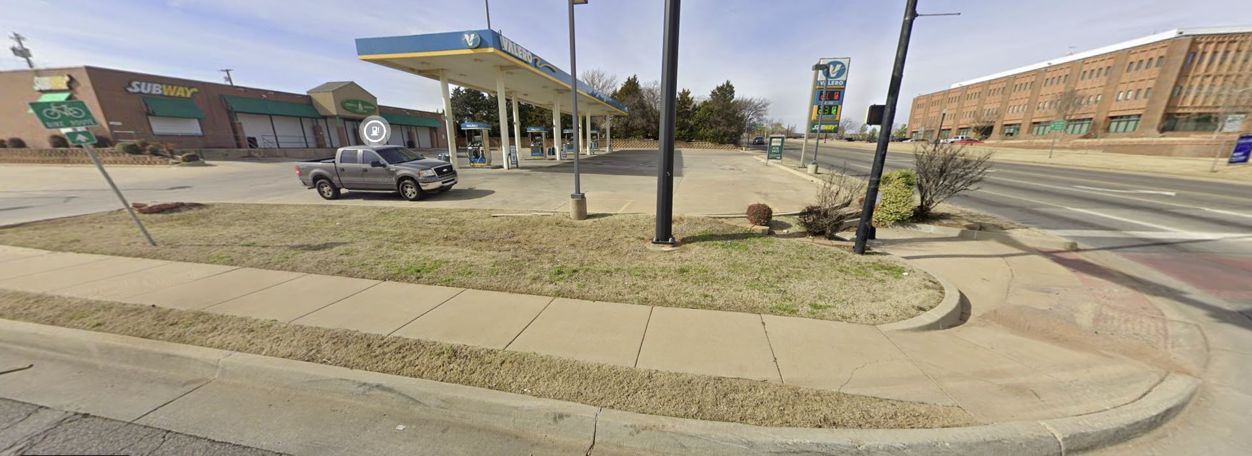
Looking Southwest from 23rd & Kelley
BP-20-21-42 940 NE 30th Street

Slide 31
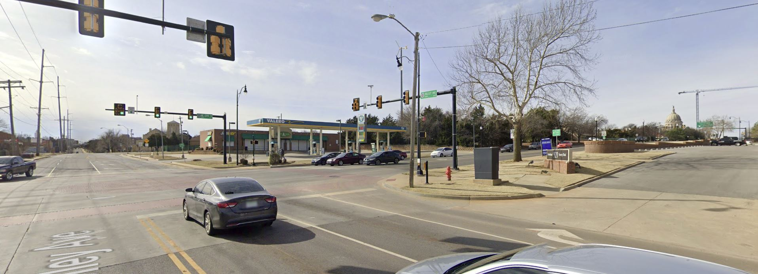
950 NE 23rd Street
Looking Southwest

Slide 32
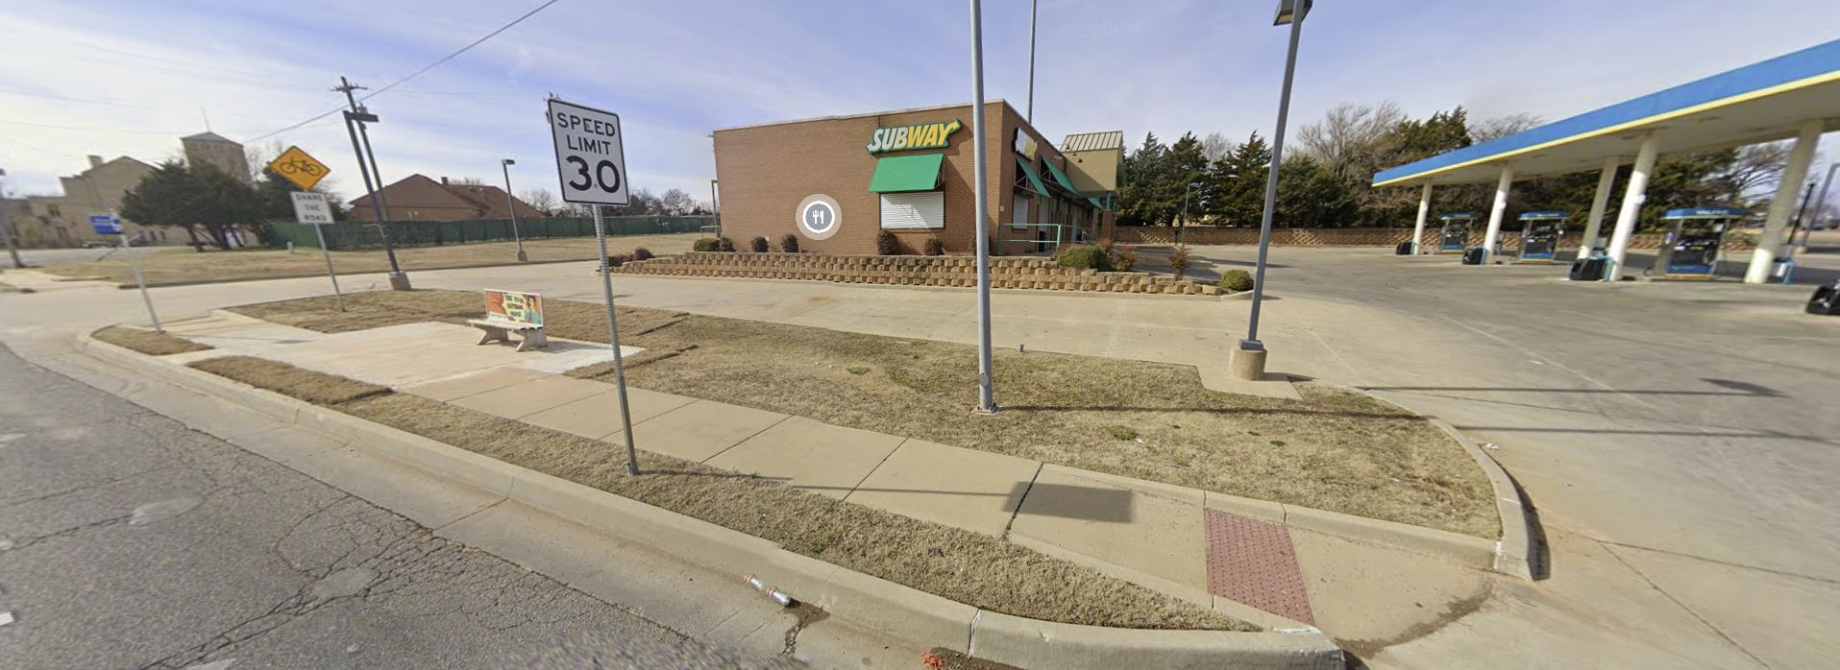
950 NE 23rd Street
East Elevation, Looking West-Southwest

Slide 33
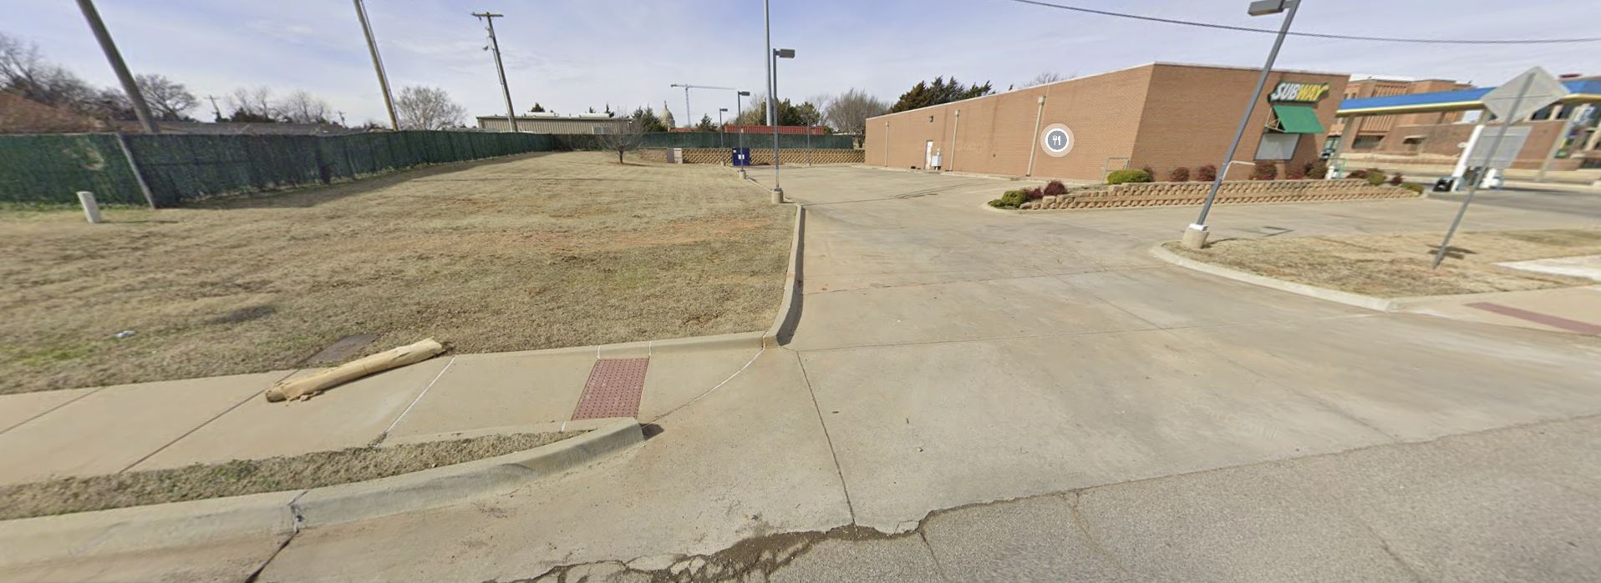
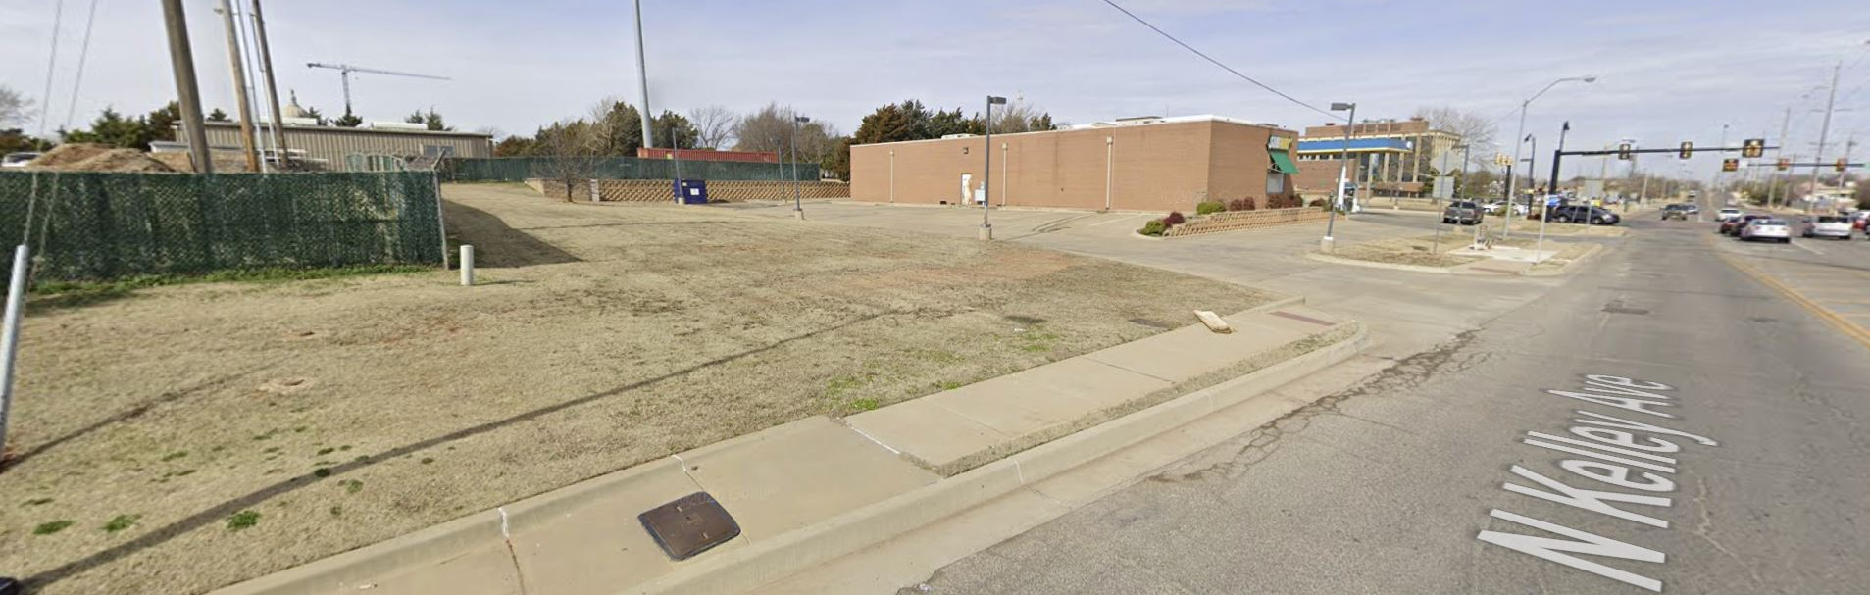
950 NE 23rd Street, Looking W-NW from Kelley Avenue

Slide 34
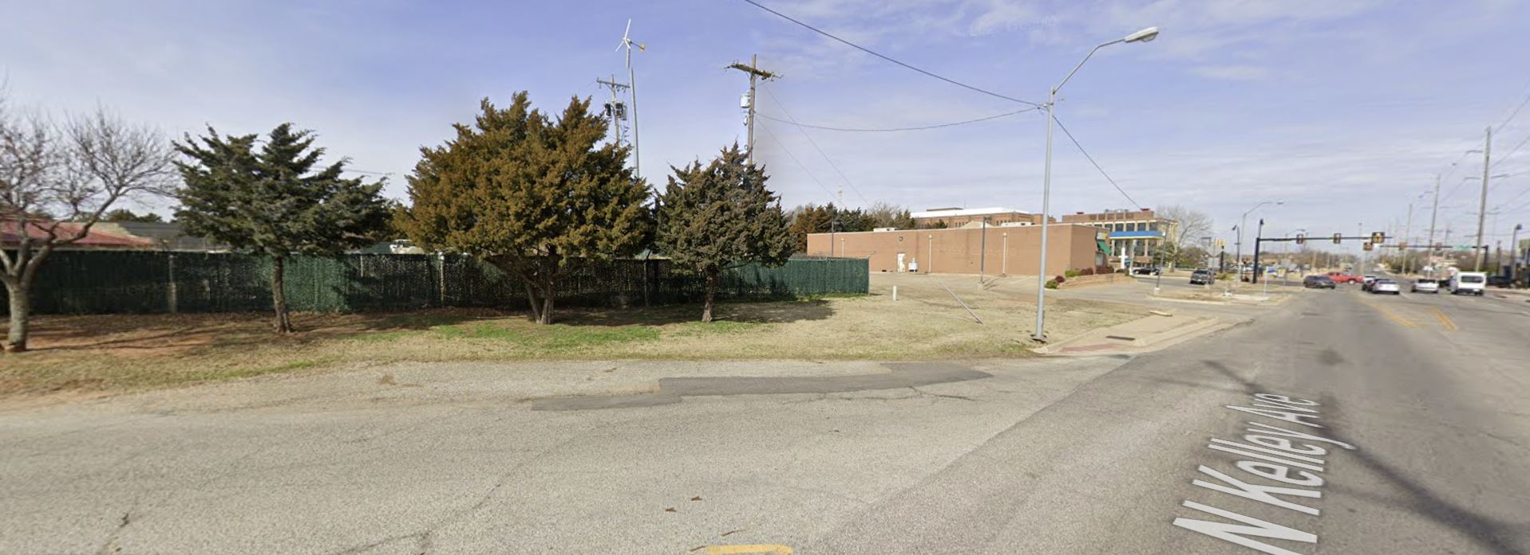
950 NE 23rd Street
Looking North along Kelley Avenue
From Culbertson Drive

Slide 35
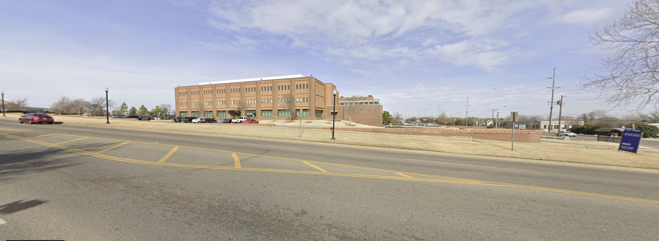
Property to North

Slide 36
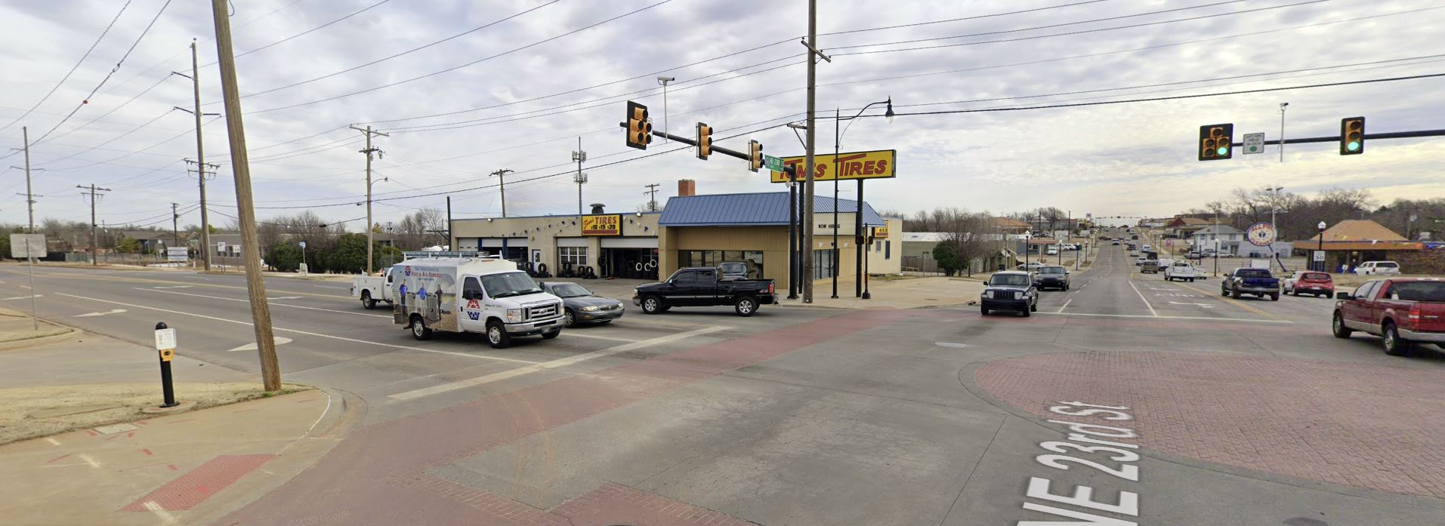
Property to Northeast

Slide 37
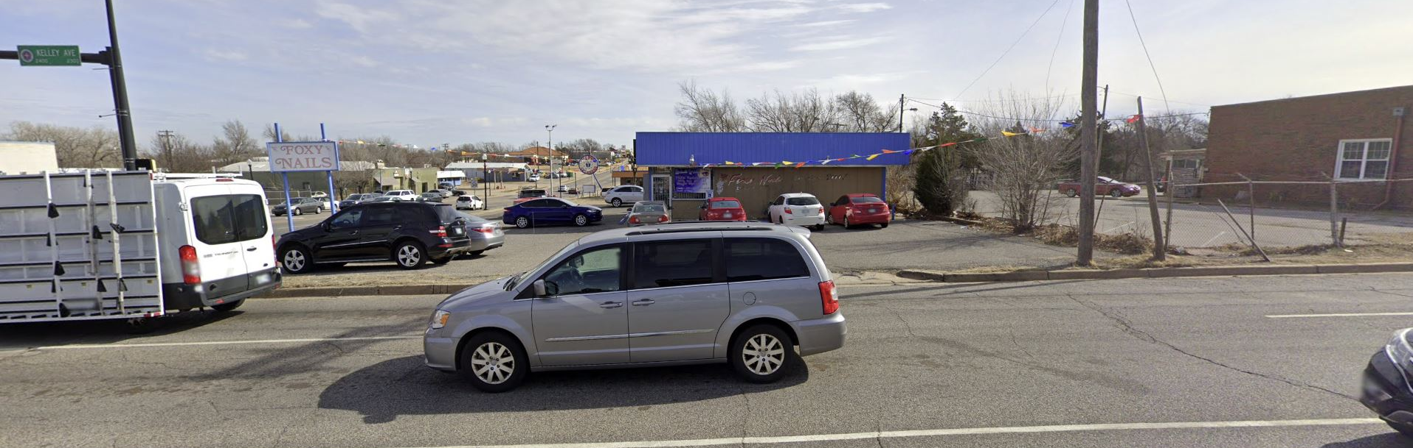
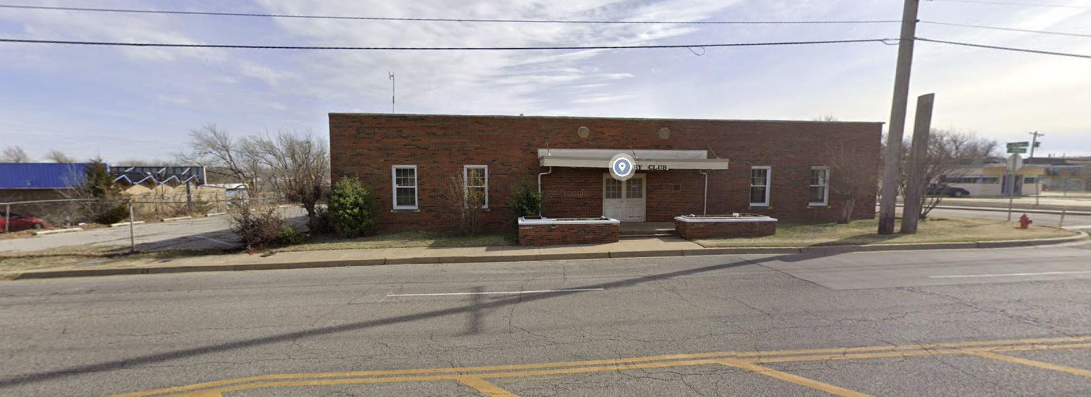
Properties to East

Slide 38
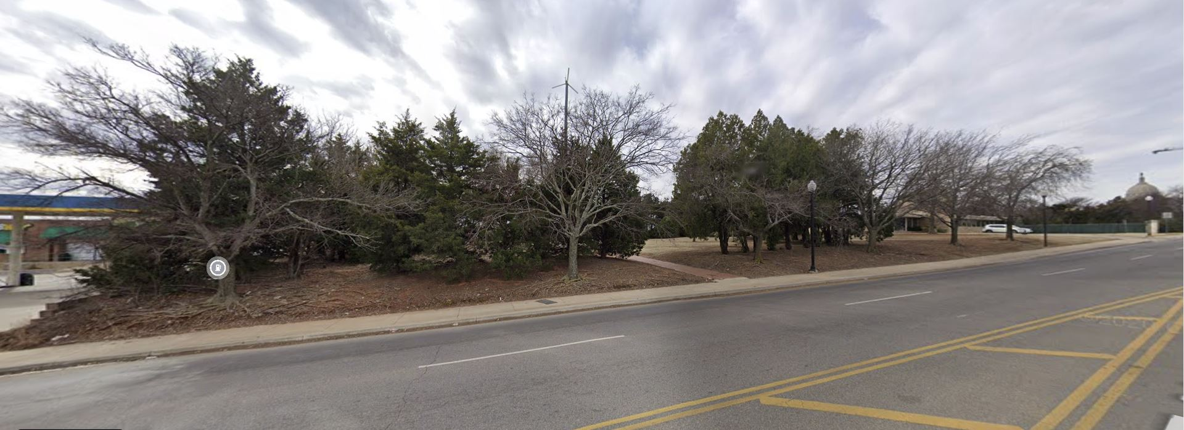
Adjacent Property to West,
Looking Southwest

Slide 39
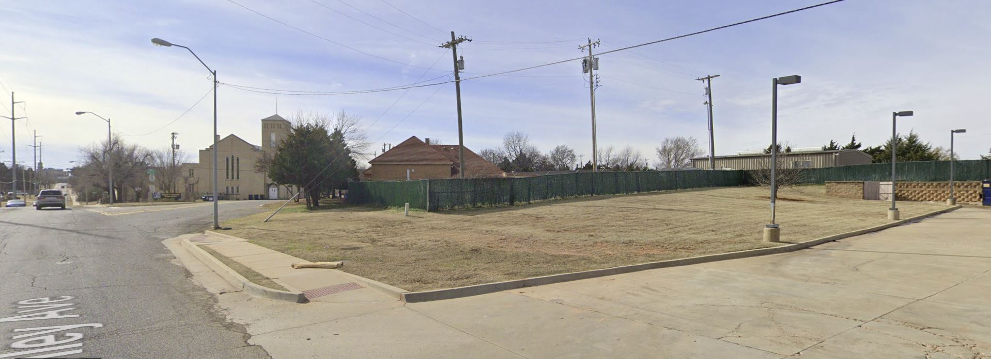
Property to South

Slide 40
Existing Improvements

Slide 41
Existing Improvements

Slide 42
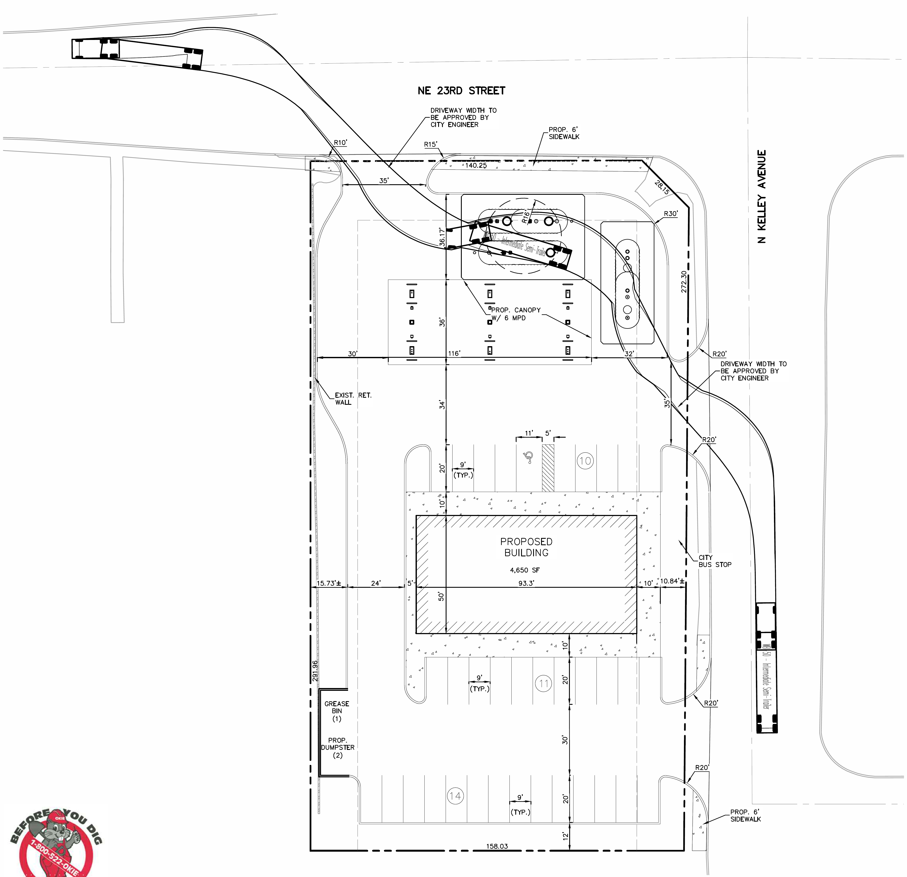
Site Plan, Proposed

Slide 43
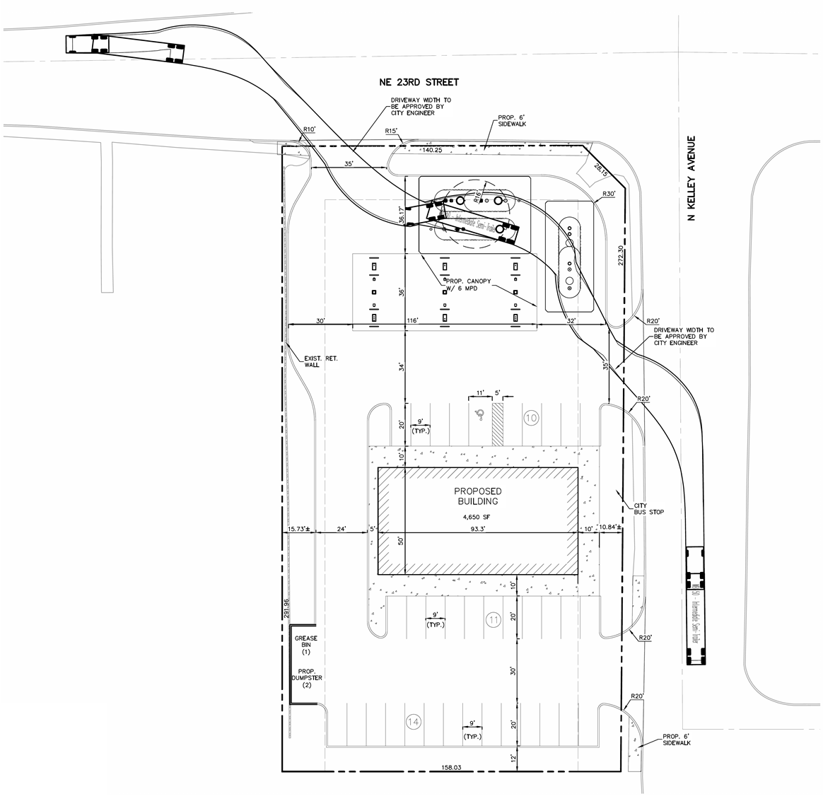
Site Plan, Proposed

Slide 44
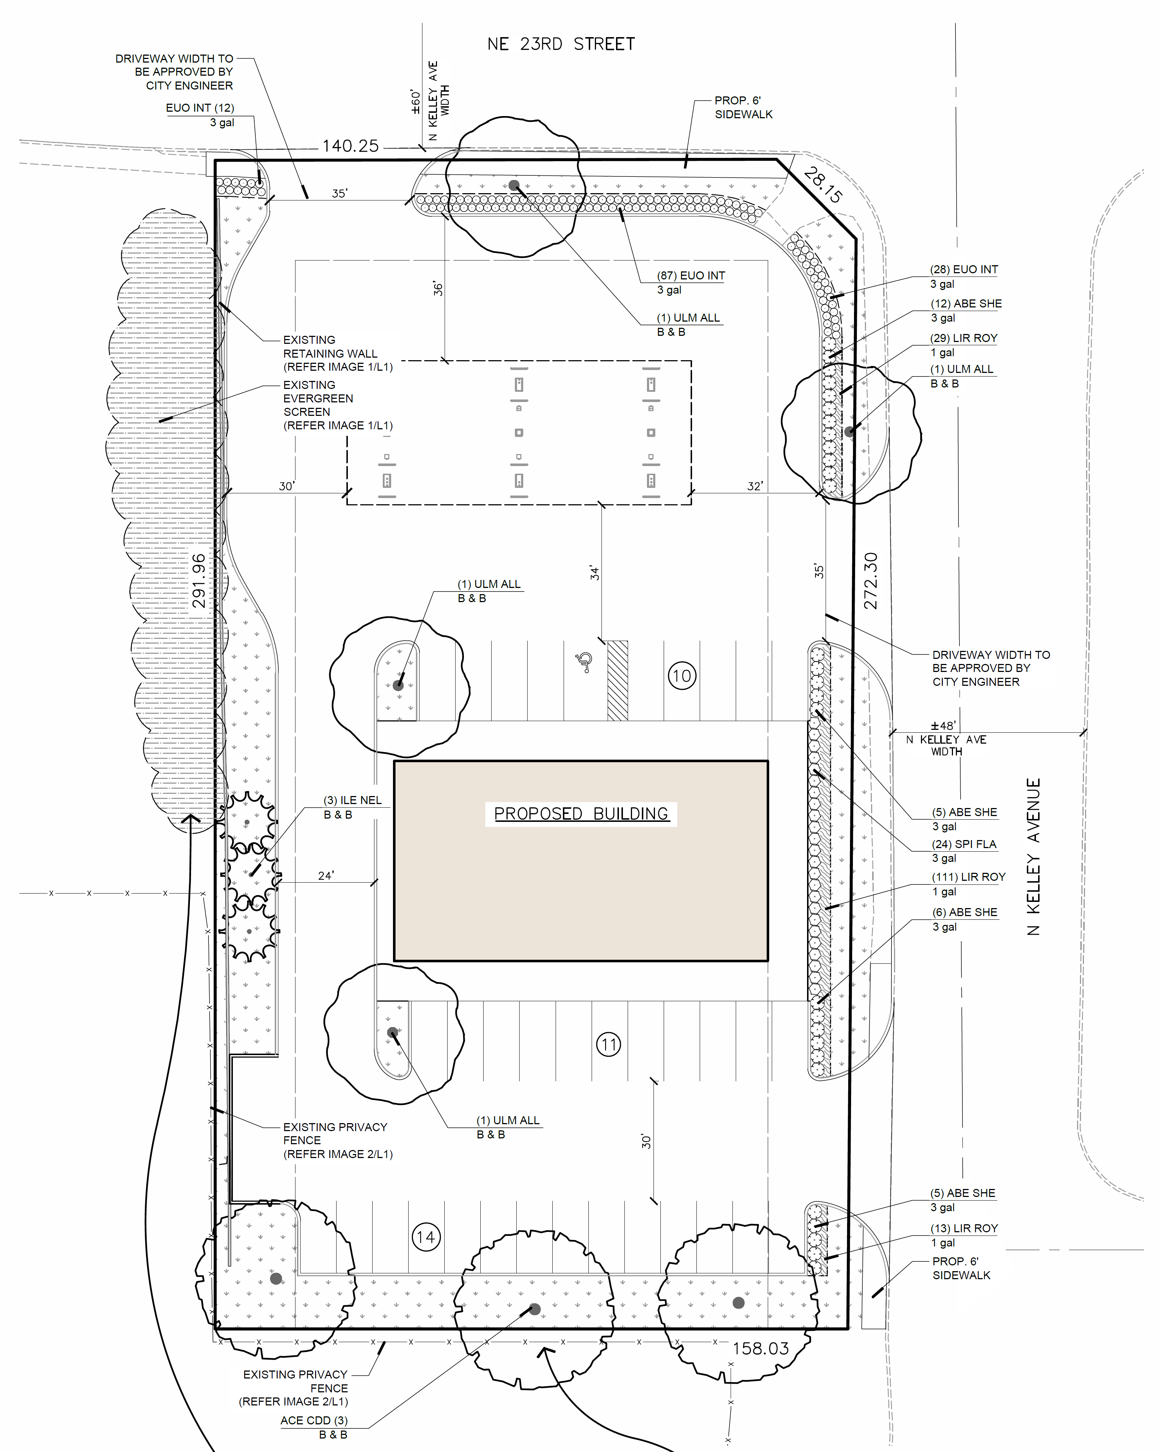
Landscape Plan

Slide 45
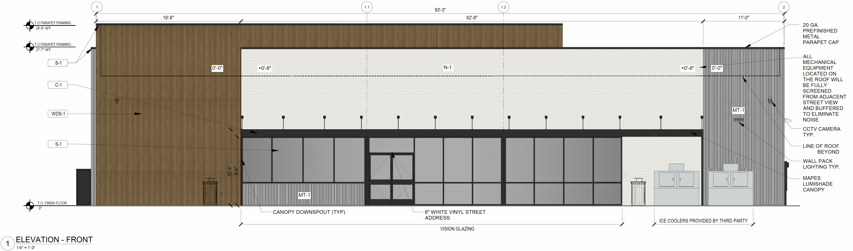
North Elevation (Front – Facing 23rd)
East Elevation (Street Side – Facing Kelley)

Slide 46
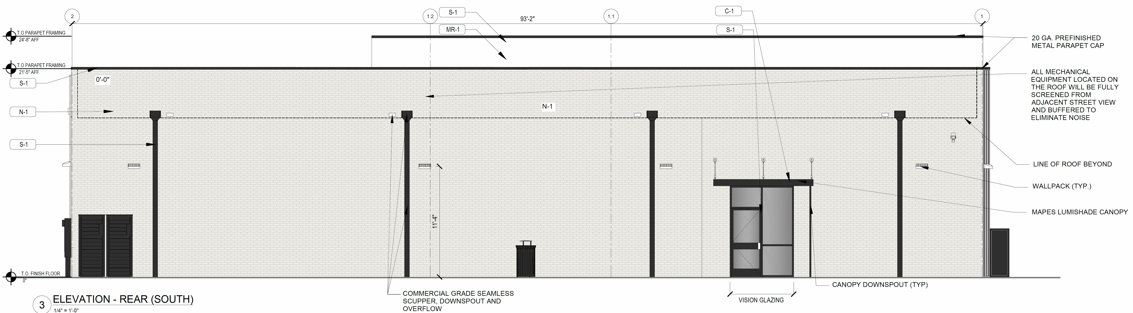
South Elevation (Rear)
West Elevation (Interior Side)

Slide 47
Floor Plan – Proposed Store

Slide 48
Trash Enclosure Plan

Slide 49
Trash Enclosure Plan

Slide 50
Signage
Site Plan

Slide 51
Sign Elevations

Slide 52
Sign Elevations
East Side
(Facing Kelley):
West Side
(Interior Side):

Slide 53
Fuel Canopy Fascia Sign Elevations

Slide 54
Pylon Sign Refacing

Slide 55
Item C.2. 950 NE 23rd Street
D-20-21-4
Request for a building permit for demolition of all existing structures (building, canopy, fuel pumps, parking lot, and driveways)

Slide 56
Item C.3. 950 NE 23rd Street
V-20-21-4 – Variance Request
a. Variance from OAC 120: 10-3-24(b)(4) to permit propane fuel and packaged ice to be stored and displayed for sale outside of the building.

Slide 57
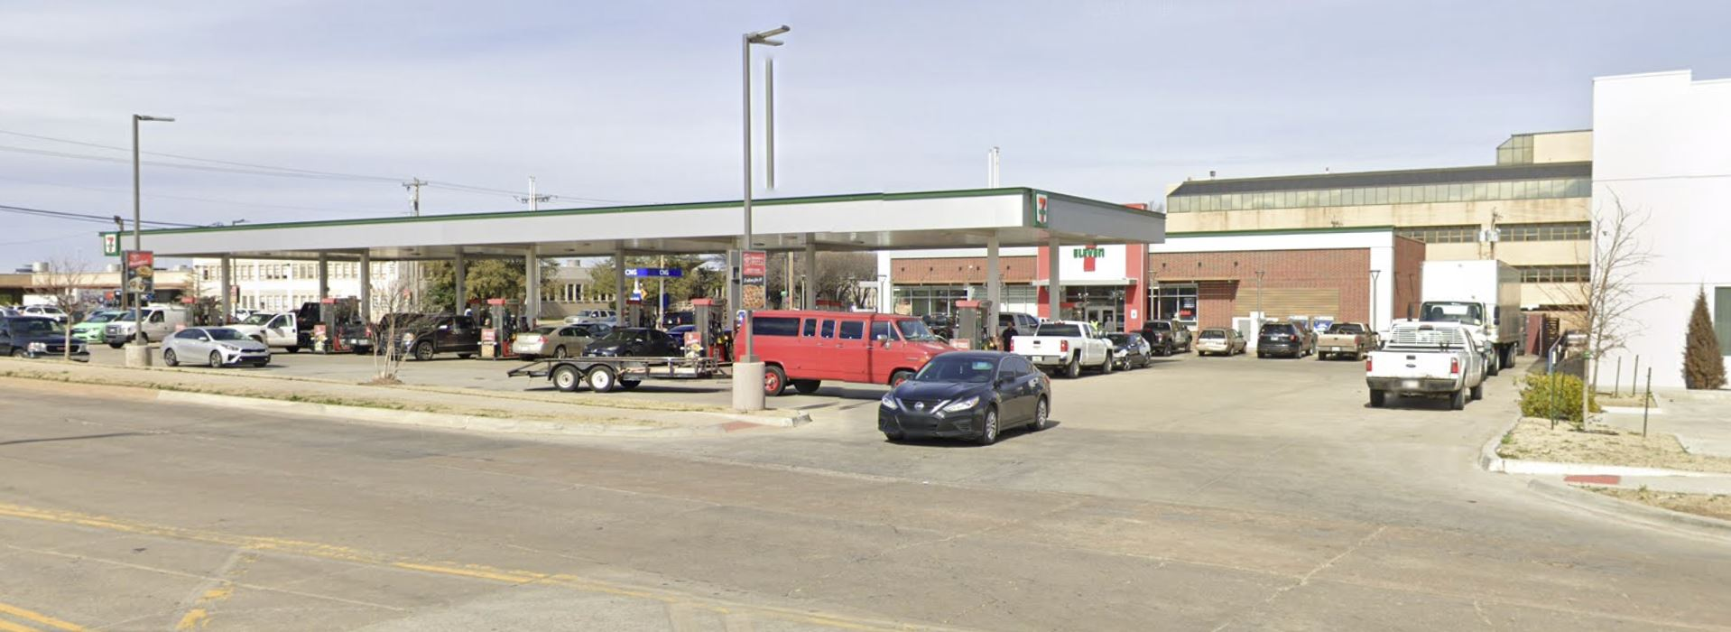
Example of Similar Development
1 NE 36th Street
Constructed in 2016

Slide 58
Item C.3. 950 NE 23rd Street
V-20-21-4 – Variance Request
b. Variance from OAC 120: 10-7-11(a)(32) to permit the minimum parking requirement for a “retail/commercial establishment” to be calculated at the rate of one parking space per 200 square feet of net floor area.
  Without variance, 46 spaces required
  With variance, 27 spaces required
  20 spaces on existing site
  35 spaces on proposed site

Slide 59
Item C.3. 950 NE 23rd Street
V-20-21-4 – Variance Request
c. Variance from OAC 120: 10-7-12(1) to permit driveway widths of 35 feet for the driveway on NE 23rd Street and for one of the two driveways on North Kelley Avenue.
Commission approval is required for driveways wider than 30 feet.
Two 35-foot driveways are proposed for safe truck maneuvering.

Slide 60
Item C.3. 950 NE 23rd Street
V-20-21-4 – Variance Request
d. Variance from OAC 120: 10-7-10(2) to permit parking spaces in the rear yard setback area.
A 15-foot rear yard is required.
The proposed parking spaces are set back 12 feet from the south property line.

Slide 61
Item C.3. 950 NE 23rd Street
V-20-21-4 – Variance Request
e. Variance from OAC 120: 10-5-4.1(8) to permit a trash enclosure in the side yard setback area.
Side yards must be “free of projections” and “open to the sky.”
The trash enclosure will be installed next to the existing retaining wall, away from the building and drive aisle.

Slide 62
Item C.4. 950 NE 23rd Street
BP-20-21-45
Building permit for redevelopment (construction of new convenience store, filling station, fuel canopy, and off-street parking)

Slide 63
Item C.5. 950 NE 23rd Street
BP-20-21-46
Building permit for signs
  Install new building wall signs
  Install new fuel canopy fascia signs
  Reface existing pylon sign

Slide 64
Notice of Public Hearing
Published in the Journal-Record
Mailed to owners of all properties within 300 feet

Slide 65
950 NE 23rd Street
CAC recommendation (April 8, 2021):
  Approval
Staff recommendation:
  Approval

Slide 66
Item D.1. - Appointment
  Discussion and possible action to appoint Guy Parkhurst, a resident of the Capitol-Lincoln Terrace Historic District, to fill a vacancy on the Citizens’ Advisory Committee

Slide 67
Item D.2. - Appointment
  Discussion and possible action to appoint Camal Pennington, a resident of the Lincoln Terrace East Historic District, to fill the unexpired term of Sharon Astrin on the Historical Preservation and Landmark Board of Review

Slide 68
Item D.3. - Appointment
  Discussion and possible action to appoint Carla Splaingard to a second term as a real estate agent on the Historical Preservation and Landmark Board of Review

Slide 69
Item D.4. – Agreement for Services
  Consideration and possible action to enter into an agreement with the City of Oklahoma City to provide zoning code enforcement on behalf of the Capitol-Medical Center Improvement and Zoning Commission for Fiscal Year (FY 22), July 1, 2021 through June 30, 2022, cost $12,000.

Slide 70
Item E.
Reports and Communications

Slide 71
Adjournment
Next Meeting:
8:15 a.m., May 28, 2021

Slide 74


