Slide 1
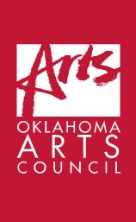

Slide 2
February 2021 State Capitol Preservation Commission
Projects for Consideration
Visitors Entrance and Ground Floor Lobby:
Pre-Statehood & Native American History
Greeting Video
Spiro Themed Mural
Traditional form Caddo pot
Bust of Chief Allen Wright
First Floor Rotunda: Oklahoma’s African-American History
Bust of Clara Luper
Second Supreme Court Hallway
Hall of Heroes
Original Supreme Court Justices
Fourth Floor Meeting Rooms
Pro Patria Drawings

Slide 3
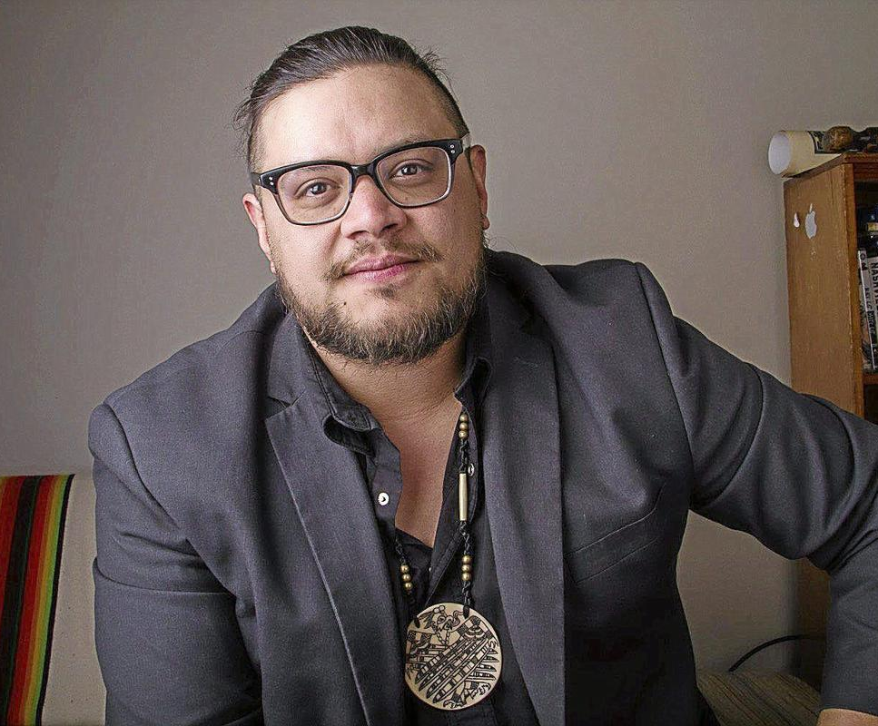
Visitors Entrance and Ground Floor Lobby Area: Pre-Statehood and Native American History
Selection of Producer / Editor for
Visitors Entrance Greeting Video
Artist: Sterlin Harjo (Seminole, Muscogee)
BFA Film and Video, University of Oklahoma
Member: Academy of Motion Picture Arts and Sciences
Director: FX Series Reservation Dogs
Films include:
Love and Fury (2020)
Mekko (2015)
This May Be the Last Time (2014)
Barking Water (2009)
Four Sheets to the Wind (2007)
Goodnight Irene (2005)

Slide 4
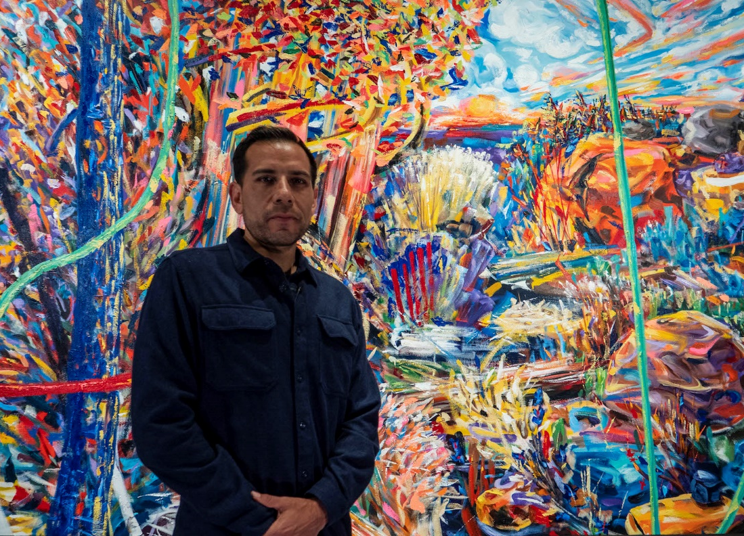
Visitors Entrance and Ground Floor Lobby Area: Pre-Statehood and Native American History
Celebrating Oklahoma as a center of Culture and Commerce
Spiro-themed mural – oil on linen 5’ x 12’
Artist: Yatika Starr Fields (Osage, Muscogee, Cherokee Nation)
Artwork 16,000
Gold leafed frame 6,000
Installation 1,000
Signage 400
Subtotal $23,400

Slide 5
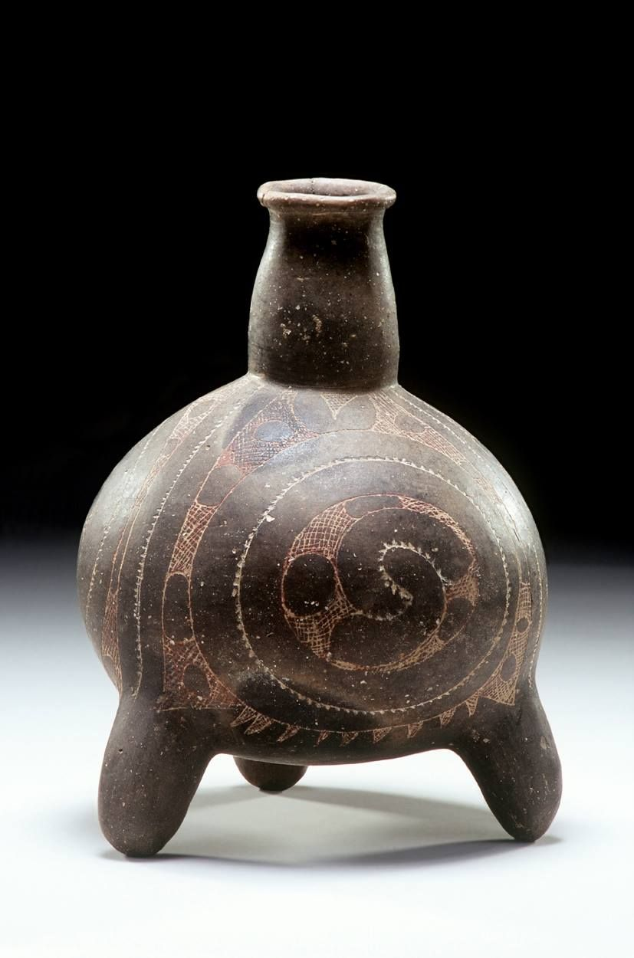
Visitors Entrance and Ground Floor Lobby Area: Pre-Statehood and Native American History
Traditional Caddo Tripod Pot
Artist: Chase Kahwinhut Earles (Caddo)
Artwork 8,500
Pedestal 2,000
Installation 200
Signage 400
Subtotal $11,100

Slide 6
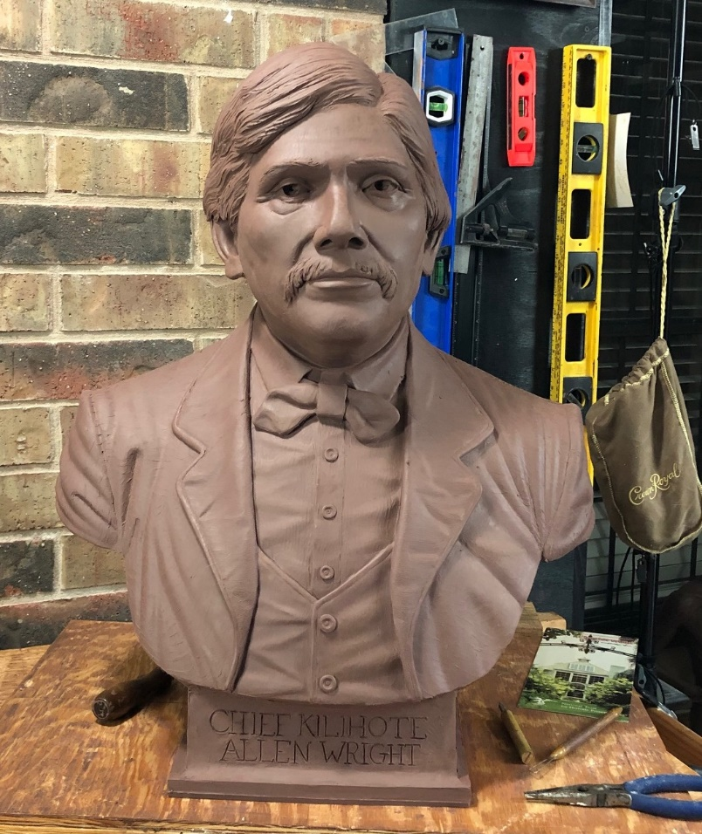
Visitors Entrance and Ground Floor Lobby Area: Pre-Statehood and Native American History
Bronze bust of Chief Allen Wright
Artist: LaQuincey Reed
Artist fee 9,500
Casting and finishing 8,500
Pedestal 1,800
Installation 300
Signage 400
Subtotal $20,500

Slide 7
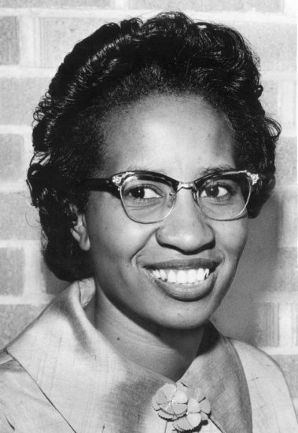
1st Floor Rotunda: African-American History
Bronze bust of Clara Luper
Artist: LaQuincey Reed
Artist fee 9,500
Casting and finishing 8,500
Pedestal 1,800
Installation 300
Signage 400
Subtotal $20,500

Slide 8
2nd Floor: Supreme Court Hallway
Proposed Location of the “Hall of Heroes”
Purpose:
To honor the contributions of Oklahomans who have served in the Armed Services of the United States of America.
To recognize the sacrifices that Oklahomans of all cultural backgrounds have made in service to the Nation.
Location on the Supreme Court Hallway recognizes:
Defense of the Constitution and laws of the United States a key part of the Oath of Service.
The unique status of the United States; a nation ruled by laws not men.
The balance between the Nation’s civil and military interests.

Slide 9
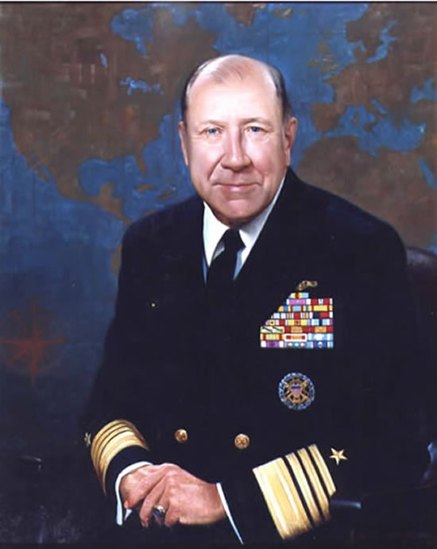
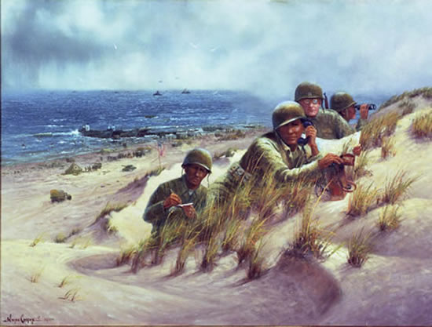
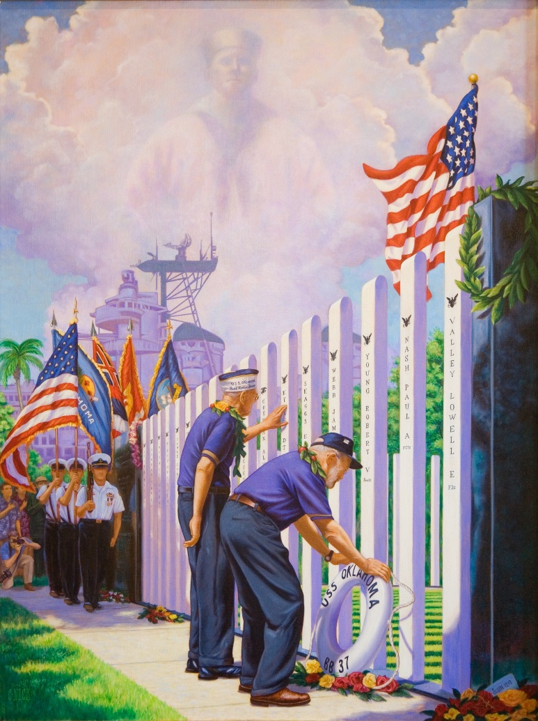
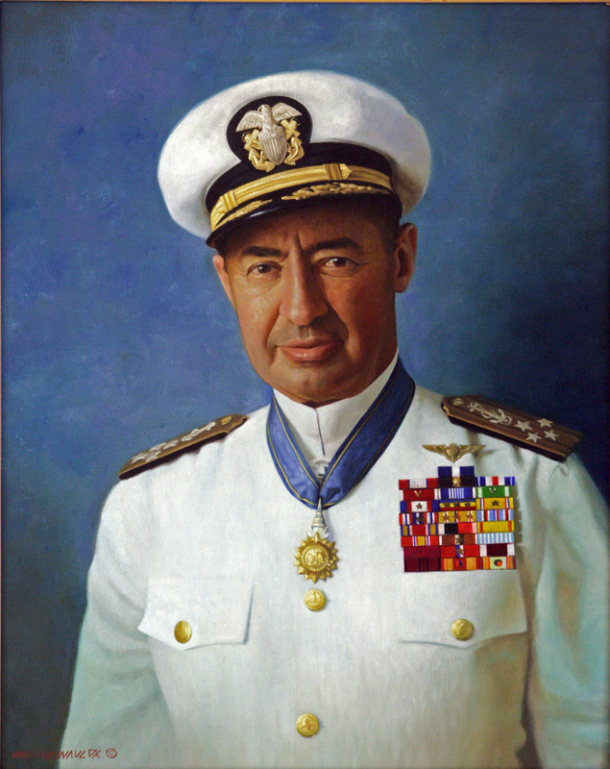
2nd Floor: Supreme Court Hallway
Potential artworks for the “Hall of Heroes”

Slide 10
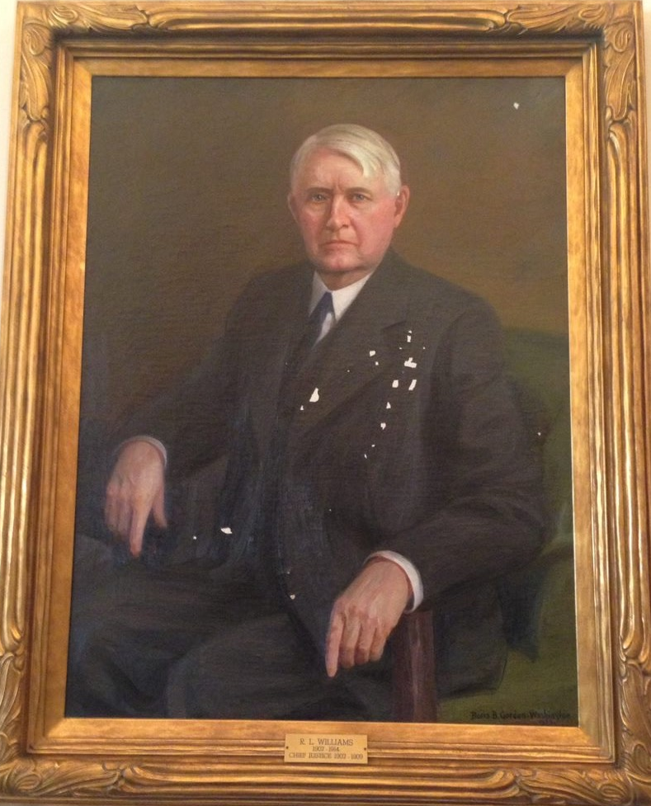
Oklahoma’s Original Supreme Court Justices
Locate at the west end of the Supreme Court Hallway.
Replacing photographs that do not meet CPC standards.
Four of the five portraits have been conserved and stabilized.
Portrait of Justice Williams suffers from “inherent vice” and can not be returned to display.
Will be replaced with a giclee in the original frame.
This requires an exception.

Slide 11
Oklahoma’s Original Supreme Court Justices
Care and Conservation Budget for portrait of Justice R.L. Williams
Scan and retouch original 400
Print and stretch canvas 300
Re-attach to historic frame 200
Signage (5 @ 300) 1,500
Subtotal $2,400

Slide 12
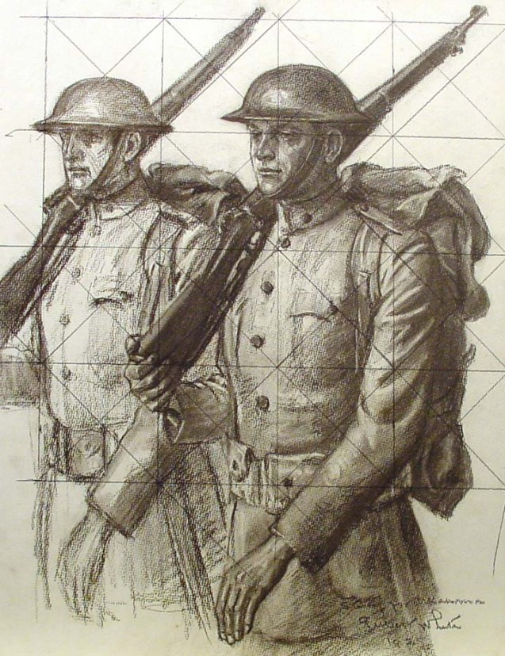
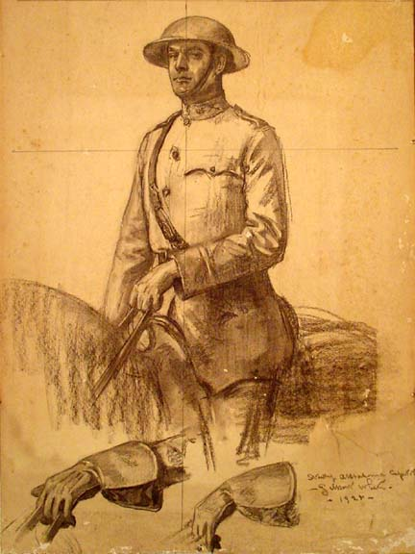
4th Floor Meeting Rooms Pro Patria Drawings
The Pro Patria mural by Gilbert Stuart White is the first work of Public Art in the Oklahoma State Capitol.
Dedicated to the memory of the Oklahomans who died in WWI.
The original studies and cartoons (preparatory drawings) in the Fred Jones Jr. Museum of art at OU.
Framed drawings on the walls of 4S.3.4.5 and 4S.7.8.9. will unify the spaces and re-focus attention on these magnificent historic murals.

Slide 13
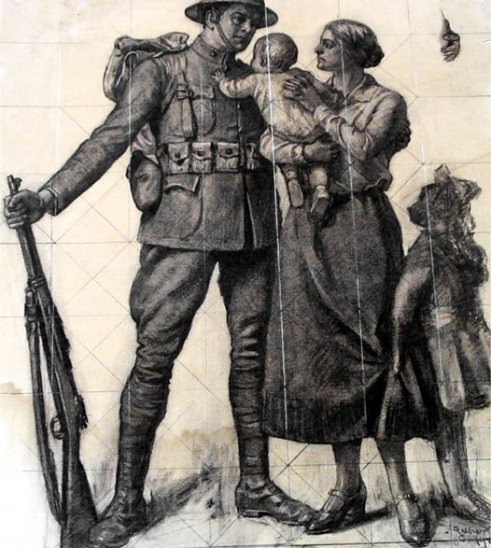
Pro Patria Drawings for 4th Floor Meeting Rooms
Budget for Pro Patria Drawing Giclee’s Photographer 2,000 6 @ 36” x 48”
Drawings and archival mats 2,900
Gold leafed frames 3,800
6 @ 30” x 40”
Drawings and archival mats 2,600
Gold leafed frames 3,100
Installation 1,000
Signage (2 @ 400) 800
Subtotal $16,200

Slide 14
Budget Total
Spiro Themed Mural $23,400
Traditional form Caddo pot $11,100
Bust of Chief Allen Wright $20,500
Bust of Clara Luper $20,500
Hall of Heroes
Original Supreme Court Justices $2,400
Pro Patria Drawings $16,200
_______
Total $94,100

Slide 15
Collections Manager’s Report
Update on damage to Love Actually on the Mansion grounds.
Report on loan request from the Cherokee Nation

Slide 16
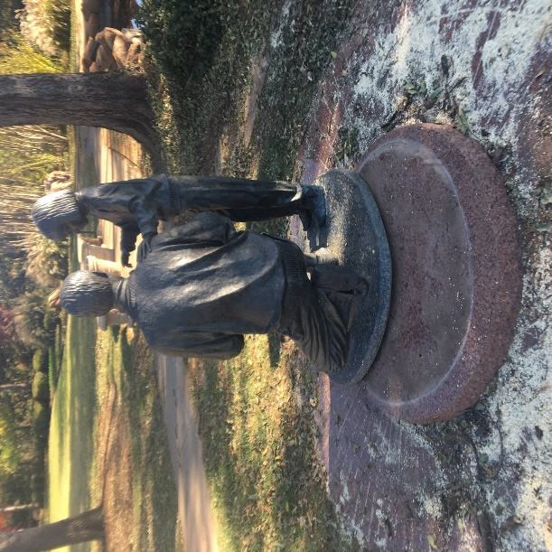
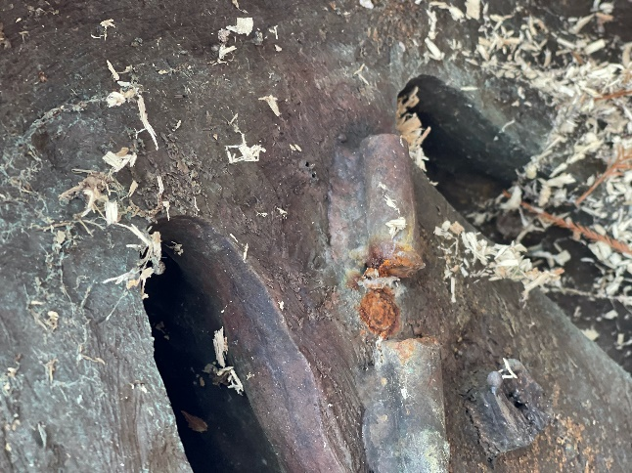
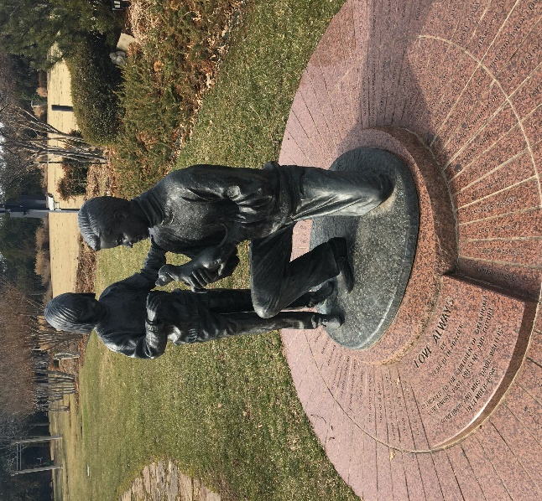
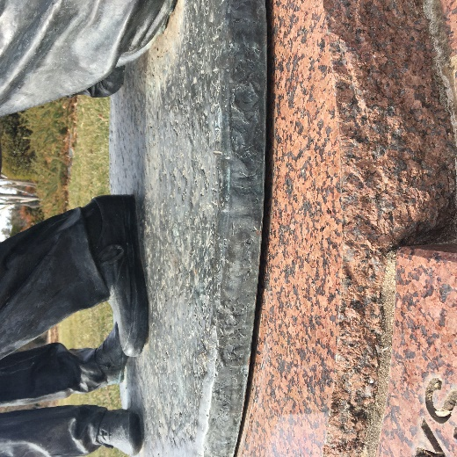
Love Actually by Lena Beth Frazier Mansion Grounds dedicated: 1994
Pushed off of base by falling trees during October 2020 Ice storm.
Trees and debris removed by grounds crew.
December CPC meeting approves Arts Council to take all necessary measures to to secure, stabilize, and if necessary, repair the sculpture.
1/8/21 Assessment by local sculptor David Phelps determines anchor bolts failed “quite some time ago” recommends return to base w/o further immediate action.
2/3/21 Grounds crew and Capitol Curator return sculpture to base.
Sculpture is stable. Apparent distortion of sculpture base requires further investigation.

Slide 17
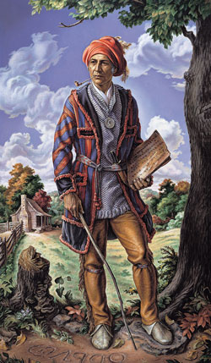
Loan request from the Cherokee Nation
Received a request to loan the Charles Banks Wilson portrait of Sequoyah from the Capitol Collection for an exhibition at the Cherokee National History Museum titled “Sequoyah: An American Icon” to run 3/21 – 12/21.
CPC Guidelines prohibit loans from the Capitol Collection.
The timeline is problematic.
Proposing a Memorandum of Understanding with the Cherokee National History Museum allowing them to produce a near-life sized print to be displayed during the exhibition.

Slide 18
Questions?

