Slide 1
Legislative Compensation Board
October 19, 2021

Slide 2
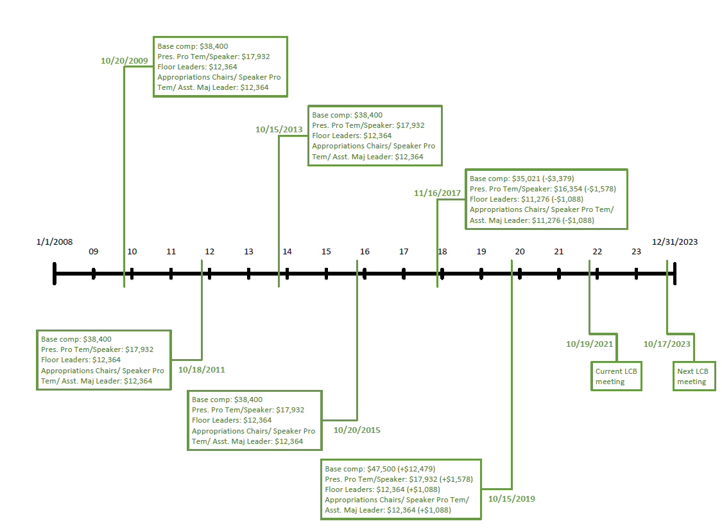
Historic Actions of Board: ’08-’23

Slide 3
Important Dates
Last day to change legislative compensation:
November 16, 2021
Effective date of a legislative compensation change:
November 23, 2022
Next biennial meeting:
October 17, 2023 at 9am

Slide 4
Annualized Compensation
$47,500 | Base Salary - No leadership position
$11,055 | Per diem - 67 days (2021 session)
$7,919 | Benefits Allowance ($659.89/month)
$3,325 | State Retirement Contribution (7%)
$69,799

Slide 5
2021 Oklahoma Legislative Compensation
Salary | Set by the Legislative Compensation Board | $47,500/year
Per Diem | Set in Statute: Title 74 Section 291.1 – Federal Allowable Rate | $165/day
Additional Salaries for leadership positions | Set by the Legislative Compensation Board | $17,932/year – President Pro Temp. and Speaker of the House
 |  | $12,364/year – Approp. Chairs; House Speaker Pro Temp.; Sen. Asst. Majority Leader; Floor Leaders
Mileage | Set in Statute: Title 74 Section 291.1b – Federal Allowable Rate (Sec. 500.4) | $0.56/mile
Health, Life, Dental and Disability Insurance | Benefits allowance set by the Legislative Compensation Board | $659.89/month (employee only)
Retirement Benefits | Set by Statute: Title 74 Section 935.2 | Legislators taking office after November 1, 2015 will be placed in the defined contribution plan, "Pathfinder". Members will choose a contribution rate of 4.5% or greater which will be matched up to 7% and have the freedom to select or change their investments.

Slide 6
Regional Compensation Packages
State | Salary | Per Diem | Additional Salaries for Leadership Positions | Mileage |  |  |  |  | Retirement
 |  |  |  |  | Heath | Dental | Disability | Life
Arkansas | $42,428/year | $151/day | $5,600/year - President Pro Tem | $0.56/mile | State Employee Plan | State Employee Plan | State Employee Plan | State Employee Plan | Mandatory; 5% of salary
 |  |  | Up to $3,600/year - Committee chairs, vice chairs, and standing subcommittee chairs
Colorado | $40,242/year | $219/day | $99/day - All leaders during interim when attendance is critical. | $0.53/mile | State pays portion, Legislator pays portion | State pays portion, Legislator pays portion | None | State pays in full for $50k policy; Legislators pay for additional | Mandatory; 10%
 |  |  | $99/day - All committee members during interim
Kansas | $5,586/year | $151/day | $14,039/year - Presiding Officer | $0.56/mile | State Employee Plan | State Employee Plan | State Employee Plan | State Employee Plan | Optional: 6% of annualized salary
 |  |  | $12,665/year - Majority Leader
 |  |  | $12,665/year - Minority Leader
 |  |  | $7,165/year - Vice President, assistant majority leaders, and assistant minority leaders
 |  |  | $11,290/year - Ways and Means Chair
Louisiana | $16,800/year | $160/day | $15,200/year - Presiding Officer | $0.56/mile | State pays portion, Legislator pays portion | Legislator pays 100% | Optional at legislator's expense | Optional at legislator's expense | None
 |  |  | $7,700/year - President Pro Tem
 |  |  | $15,200/year - Joint Budget Chair
Missouri | $35,915/year | $121/day | $1,500/year - Majority Leader | $0.37/mile | State Employee Plan | State Employee Plan | State Employee Plan | State Employee Plan | Mandatory: Non-contributory before 12/31/2010, 4% of salary after
 |  |  | $1,500/year - Minority Leader
 |  |  | $2,500/year - President Pro Tem
New Mexico | $0 | $165/day | None | $0.56/mile | State Employee Plan | State Employee Plan | None | State Employee Plan | Optional; $600/year
Texas | $7,200/year | $221/day | None | $0.50/mile | State Employee Plan | State Employee Plan | State Employee Plan | State Employee Plan | Optional: 9.5%

Slide 7
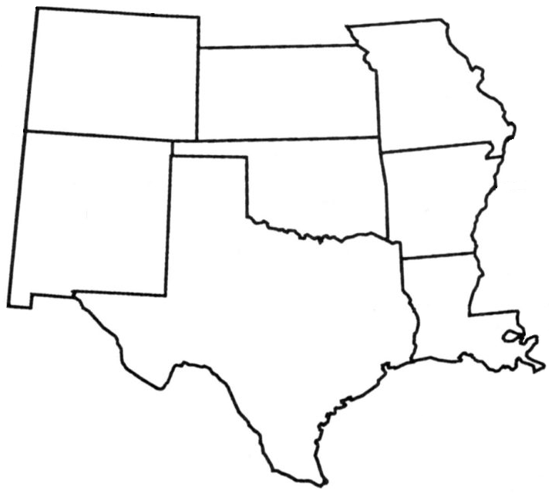
2021 Legislative Salaries and Per Diem Rates
$40,242 Salary $13,140 Per Diem
$53,382
$5,586 Salary $9,513 Per Diem
$15,099
$35,915 Salary $9,680 Per Diem
$45,592
$47,500 Salary $11,055 Per Diem
$58,555
$42,428 Salary $9,060 Per Diem
$51,488
$0 Salary $5,610 Per Diem
$5,610
$16,800 Salary $5,060 Per Diem
$21,860
$7,200 Salary $17,017 Per Diem
$24,217

Slide 8
2021 Regional Legislator Pay Assumptions
Most states provide legislators with an allowance for office supplies.
Salary does not include benefit allowances or retirement contributions.
Session lengths are calculated based on dates each state legislature convened and adjourned in 2021 and assumes a Monday through Thursday, four-day week excluding holidays and recesses; Session limits used when applicable; Special Sessions not included.

Slide 9
Recent Changes in the Region
Arkansas had a raise in 2020 from $41,394 to $42,428.
Colorado last salary raise was in 2019 to $40,242.
Kansas pays a salary $88.66 per session day.
Louisiana hasn’t raised the salary since before 2010.
Missouri last salary raise was in 2009 to $35,915.
Oklahoma had a raise in 2020 from $35,021 to $47,500.
Texas meets biennially for a maximum of 140 regular session days; Members are paid $600/month, or $7,200/year.

Slide 10
Ten Highest Paid State Legislators
Rank | State | Salary
1. | California | $114,877
2. | New York | $110,000
3. | Pennsylvania | $90,335
4. | Michigan | $71,685
5. | Massachusetts | $70,536
6. | Illinois | $69,464
7. | Ohio | $67,492
8. | Hawaii | $62,604
9. | Washington | $56,881
10. | Wisconsin | $55,141
15. | Oklahoma | $47,500

Slide 11
How are salaries determined statewide?
State of Oklahoma Position | How is salary established?
Legislative
Legislators | Legislative Compensation Board
Executive
Governor | Set in Statute
Lt. Governor | Set in Statute
Corporate Commissioners | Set in Statute
Treasurer | Set in Statute
Auditor | Set in Statute
Insurance Commissioner | Set in Statute
Attorney General | Set in Statute
State Superintendent of Public Instruction | Set in Statute
Commissioner of Labor | Set in Statute
Judicial
Chief Justice of the Supreme Court | Board on Judicial Compensation
Associate Justice of the Supreme Court | Board on Judicial Compensation
District Court Judge | Board on Judicial Compensation

Slide 12
Statewide survey of salaries: 2021 and 1999
State of Oklahoma Position | 2021 Salary |  | 1999 Salary |  | Change in Salary
Legislative
Legislators | $47,500 |  | $38,400 |  | 23.7%
Executive
Governor | $147,000 | ¹ | $101,140 | ¹ | 45.3%
Lt. Governor | $114,713 | ¹ | $75,530 | ¹ | 51.9%
Corporate Commissioners | $114,713 | ¹ | $82,004 | ¹ | 39.9%
Treasurer | $114,713 | ¹ | $82,004 | ¹ | 39.9%
Auditor | $114,713 | ¹ | $82,004 | ¹ | 39.9%
Insurance Commissioner | $114,713 | ¹ | $82,004 | ¹ | 39.9%
Attorney General | $132,825 | ¹ | $94,349 | ¹ | 40.8%
State Superintendent of Public Instruction | $124,373 | ¹ | $88,511 | ¹ | 40.5%
Commissioner of Labor | $105,053 | ¹ | $69,056 | ¹ | 52.1%
Judicial
Chief Justice of the Supreme Court | $172,049 | ² | $101,140 | ² | 70.1%
Associate Justice of the Supreme Court | $161,112 | ² | $97,807 | ² | 64.7%
District Court Judge | $145,567 | ³ | $88,511 | ³ | 64.5%
Additional State Employment Information
State Employee Benchmark Average | $50,051 | ⁴ | $26,961 | ⁵ | 85.6%
Oklahoma Median Household Income, Calendar Year 2019 | $54,449 | ⁶ | $33,400 | ⁷ | 63.0%

Slide 13
Questions?

Slide 14
2021 Oklahoma Judicial Compensation
Judicial salaries are set in statute (20 O.S.)
Uniform Retirement System for Justices and Judges (URSJJ)
URSJJ plan provisions effective July 1, 2020.
Membership in URSJJ begins immediately upon appointment or election to the bench.
Current contribution rates are 8% for the member and 22% for the employer with a computation factor of 4%.
Eligibility for normal retirement benefits:
If appointed before January 1, 2012, members can retire at age 60 with 10 years of service, at age 65 with 8 years of service, or with 80 points.
If appointed on or after January 1, 2012, members can retire at age 62 with 10 years of service or at age 67 with 8 years of service.

Slide 15
OPERS - Elected Officials
First elected prior to 11/01/2011:
Member chooses a contribution rate with a corresponding computation factor.
Can retire after 6 years of service at age 60 or with 80 points.
Vested after 6 years.
First elected on or after 11/01/2011:
Contribute 3.5% with a 2% computation factor.
Can retire after at age 62 with 10 years of service or at age 65 with 8 years of service.
May participate in Step-Up.
Vested after 8 years.
RATE | COMPUTATION FACTOR
4.5% | 1.9%
6.0% | 2.5%
7.5% | 3.0%
8.5% | 3.4%
9.0% | 3.6%
10.0% | 4.0%

Slide 16
Pathfinder Contributions
*Employee contributions are pre-tax.

Slide 17
Constitutional Reference
Article 5 Section 21 of the Constitution
“…Board shall each two years review the compensation paid to the members of the Legislature and shall be empowered to change such compensation.”
“such change to become effective on the fifteenth day following the succeeding general election”
Appointing authority
Governor – 5 members
President Pro Tempore – 2 members
Speaker of the House – 2 members

Slide 18
Statutory Reference
Title 74 Section 291.2 sets the meeting date and time and establishes the term limits for the Board members.
“third Tuesday of October in every odd-numbered year at nine o'clock a.m.”
“the Board shall review the compensation paid to members of the State Legislature and, if necessary, change the compensation”
May “hold such additional meetings as are necessary”
“Any change in legislative compensation shall be made by the Board no later than the third Tuesday of November in said odd-numbered year”

Slide 19
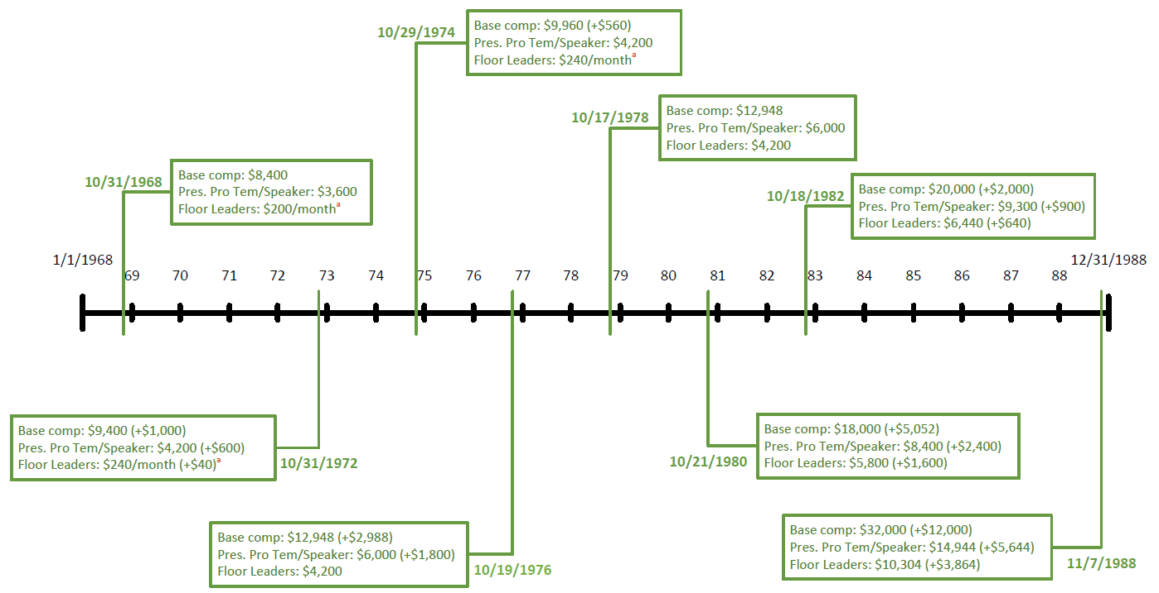
Historic Actions of Board: ‘69-’88

Slide 20
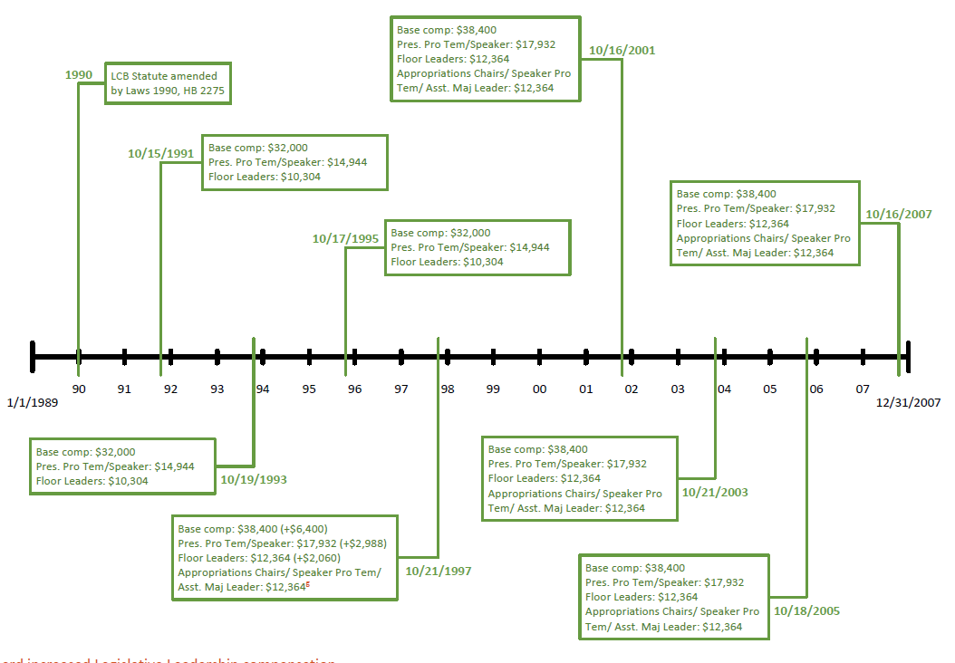
Historic Actions of Board: ‘89-’07

