Slide 1

Request for Approval for Transfer of
State-owned Real Property
Long Range Capital Planning Commission
Real Estate and Leasing Services
Melissa Milburn
April 22, 2021

Slide 2

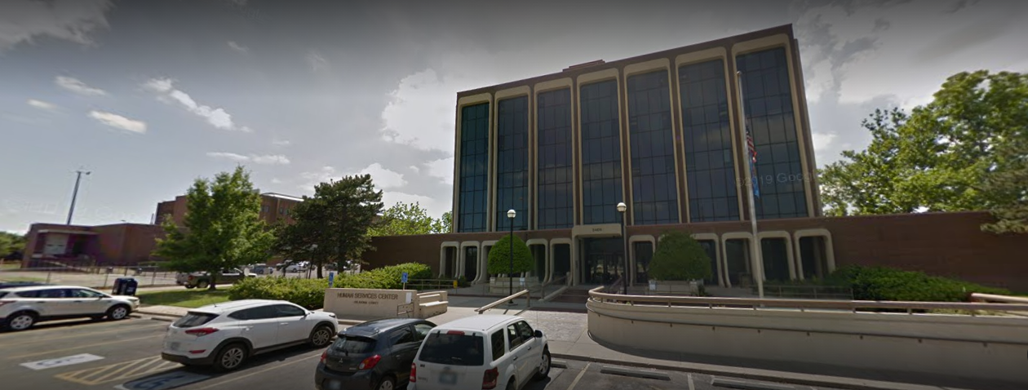
2409 N. Kelley, Oklahoma City, Oklahoma County, Oklahoma

Slide 3
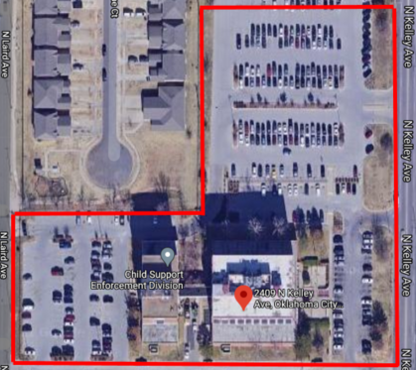
2409 N. Kelley, Oklahoma City, Oklahoma County, Oklahoma
The property is owned by the Oklahoma Department of Human Services (DHS).
The property consists of an office building with a detached annex consisting of approximately 87,741 square feet, MOL. It is located on 2.20 acres, mol.
The property will be sold through Interlocal Agreement or auctioned through a request for sealed bids.
Proceeds will be deposited to the Maintenance of State Building Revolving Fund and the funds utilized to offset the costs of the DHS Service First Initiative.

Slide 4
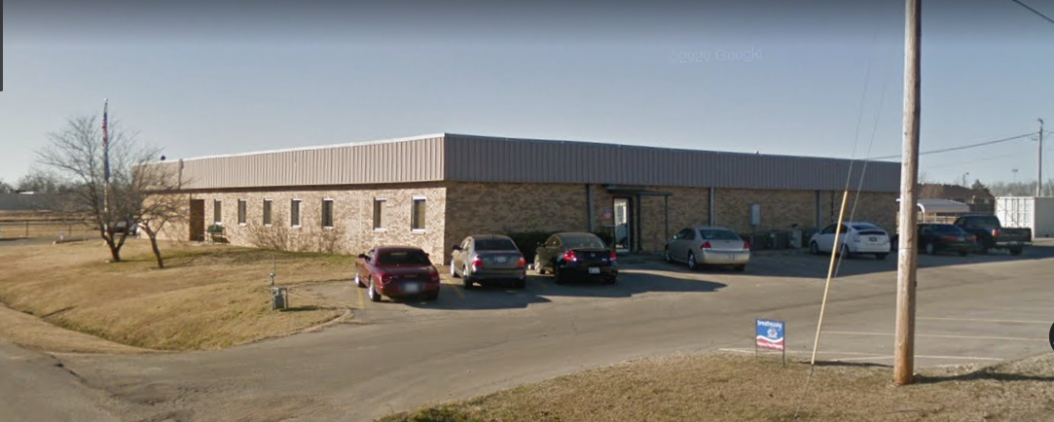
1603 East Kirk, Hugo, Choctaw
County, Oklahoma

Slide 5
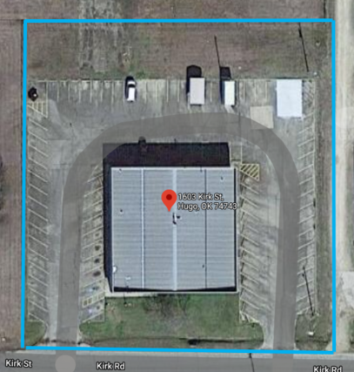
1603 East Kirk, Hugo, Choctaw
County, Oklahoma
The property is owned DHS.
The property consists of an office building consisting of approximately 10,000 square feet, mol. It is located on 1.58 acres, MOL.
The property will be sold through Interlocal Agreement or auctioned through a request for sealed bids.
Proceeds will be deposited to the Maintenance of State Building Revolving Fund and the funds utilized to offset the costs of the DHS Service First Initiative.
54.74 Acres

Slide 6

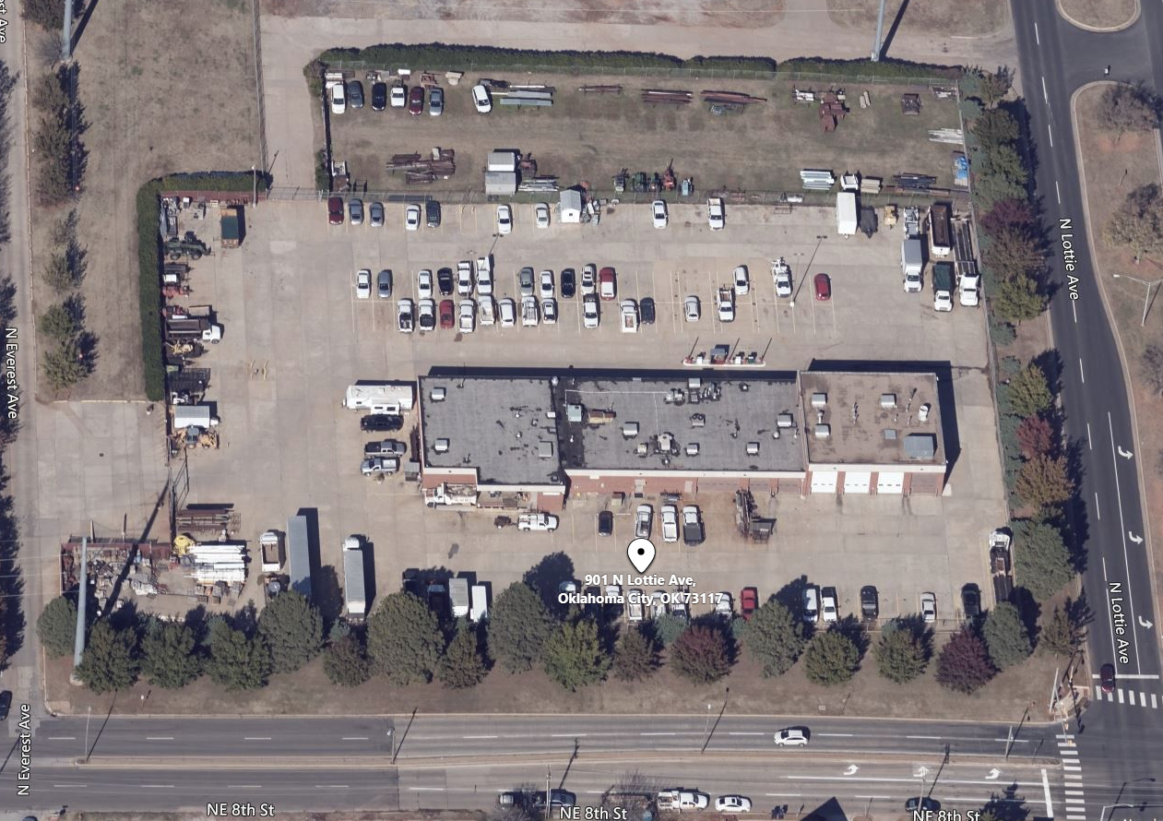
901 N. Lottie, Oklahoma City, Oklahoma County, Oklahoma

Slide 7
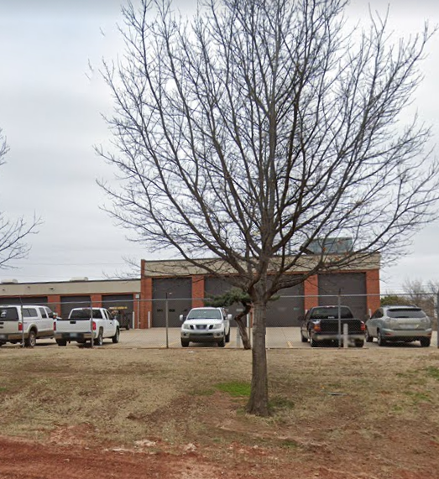
901 N. Lottie, Oklahoma City, Oklahoma County, Oklahoma
The property is owned by DHS.
The property consists of an office building consisting of approximately 14,556 square feet, mol. It is located on 5.03 acres, MOL.
The property will be sold through Interlocal Agreement or auctioned through a request for sealed bids.
Proceeds will be deposited to the Maintenance of State Building Revolving Fund and the funds utilized to offset the costs of the DHS Service First Initiative.

Slide 8
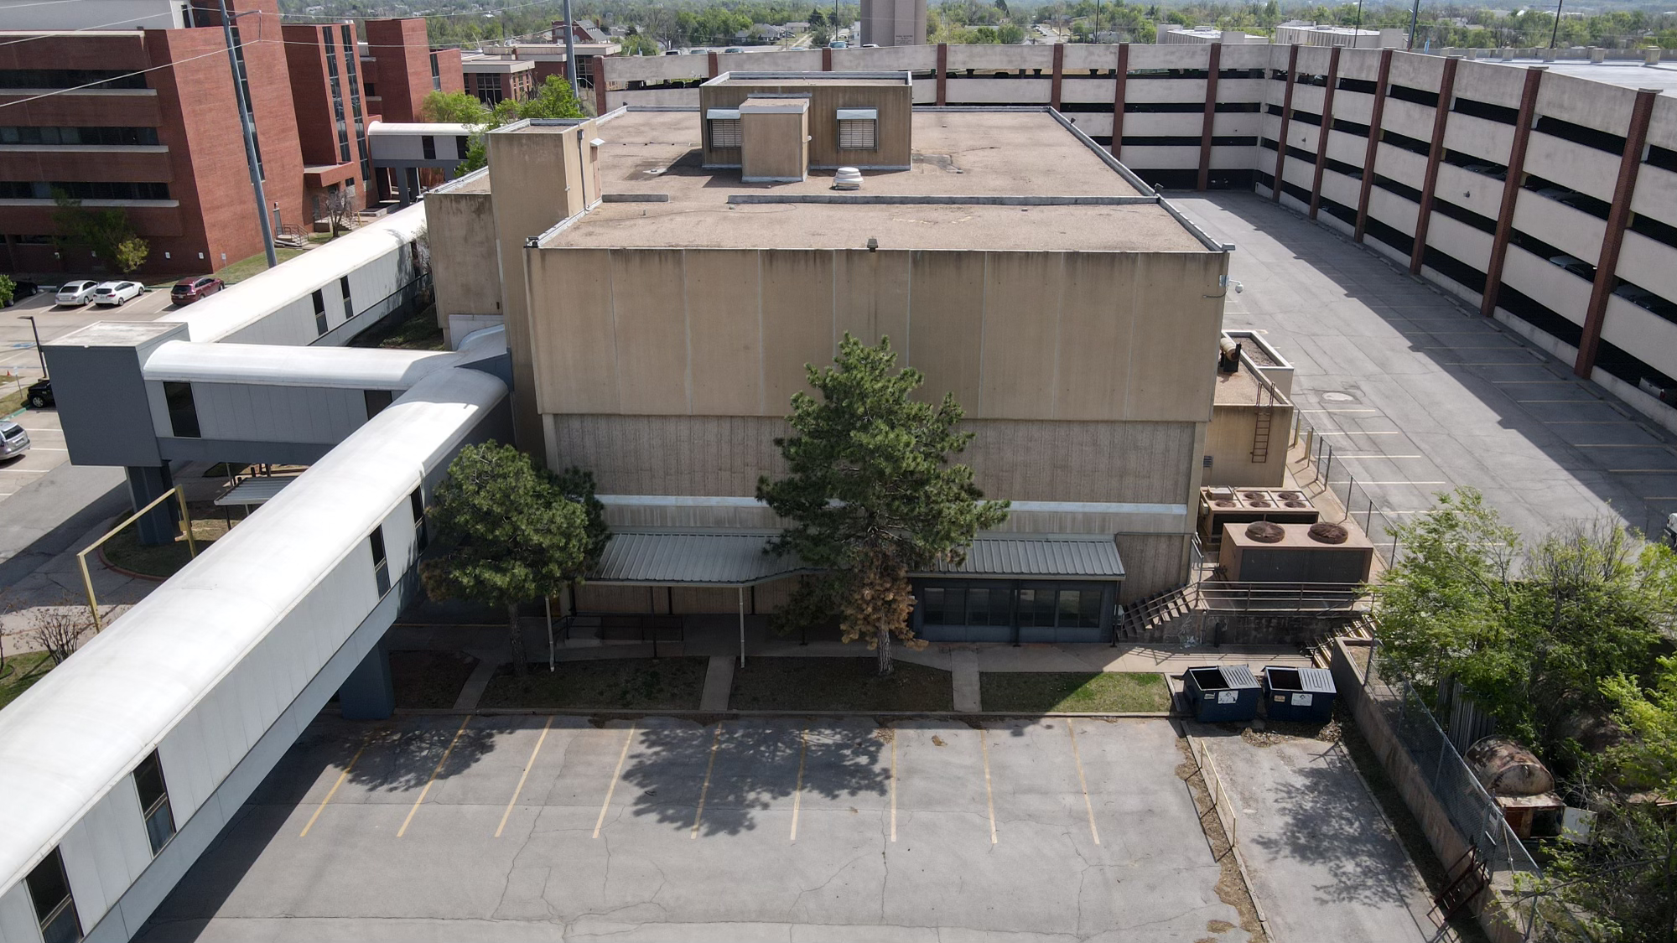
1110 N.E. 12th Street, Oklahoma City, Oklahoma County, Oklahoma

Slide 9
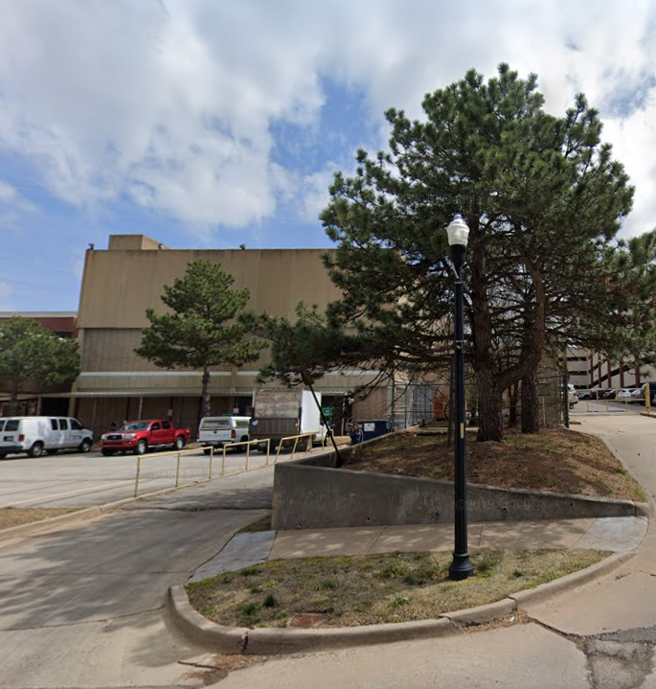
1110 N.E. 12th Street, Oklahoma City, Oklahoma County, Oklahoma
The property is owned by DHS.
The property consists of an office building consisting of approximately 47,428 square feet, mol. It is located on 2.03 acres, MOL.
The property will be sold through Interlocal Agreement or auctioned through a request for sealed bids.
Proceeds will be deposited to the Maintenance of State Building Revolving Fund and the funds utilized to offset the costs of the DHS Service First Initiative.

Slide 10
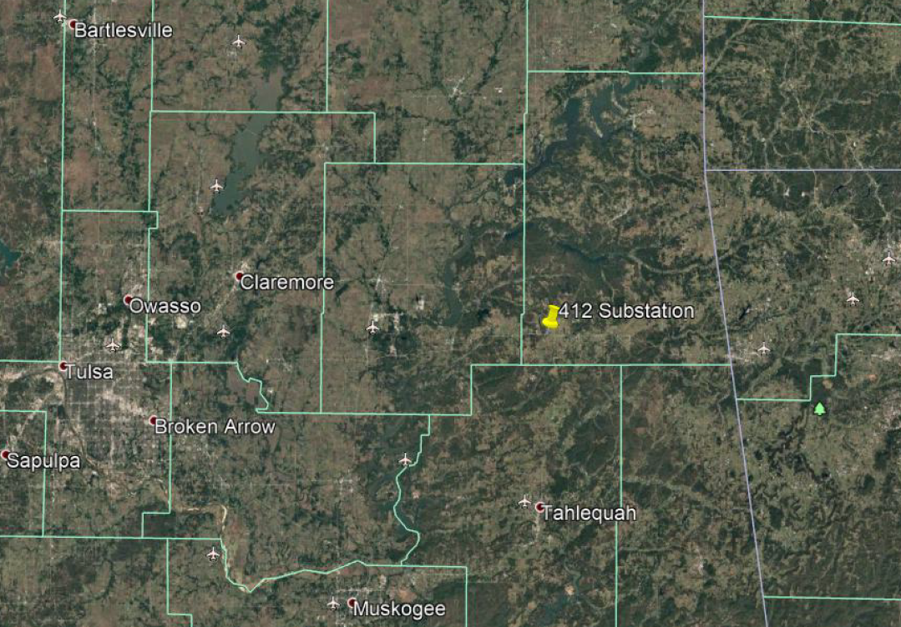
GRDA Property Exchange, Delaware County, Oklahoma
Property to be Exchanged

Slide 11
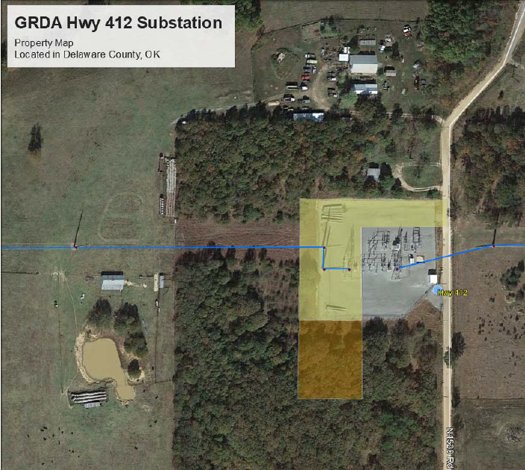
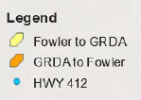
GRDA Property Exchange, Delaware County, Oklahoma
The property to be exchanged is owned by the Grand River Dam Authority and Mr. Jerry Fowler.
The properties are currently vacant.
GRDA would like to exchange property with Mr. Jerry Fowler by quitclaim deed as needed for their substation. Mr. Fowler’s property is adjacent to the GRDA Highway 412 Substation.
The transfer will not generate any proceeds.

