Slide 1





State of Oklahoma
Real Estate Portfolio Strategy
EXECUTIVE SUMMARY
December 2020

Slide 2

Project Objectives
  Develop a comprehensive strategic real estate plan for the State of Oklahoma’s office portfolio in Oklahoma City and Tulsa. The plan includes:
        Key findings and recommendations,
        Detailed implementation plans and strategies,
        A cost benefit analysis, and
        Impediments and success factors to consider for implementation.
  Identify “quick wins” that would reduce the cost and/or increase the efficiency of the State’s management of its real estate
  Review and benchmark State’s current practices related to the management of its real estate and provide recommendations for improvement.

Slide 3
Scope and Process
To develop a real estate portfolio strategy, JL employed both qualitative and quantitative methods consisting of the three main phases outlined below and discussed in more detail in the following pages.
Discovery + Current State
Scenario Development
Analysis and Assessment
Recommendations
Interviews and Site Tours
Private Sector Best Practices
Portfolio Assessment (Building Scorecard)
Peer Benchmarking
Policy Recommendations
Current State Summary
Workplace Occupancy Scenarios
Occupancy/SF Impact Analysis
Facilities Mgmt Recommendations
Portfolio Review
FM and Tech Review
Technology Recommendations
Financial Analysis (Business Case)
Policy and Legislative Review
Telework and Portfolio Recommendations
State Agency Efforts To-Date (DHS)
Surplus Property Identification
Preferred Scenario(s)

Slide 4
Methodology
JLL’s Process evaluated the following:
JLL conducted leadership interviews with state agencies to understand their use of real estate and expectations of the study:
Legislation / Policy
Review of the State’s current real estate-related legislation and policies
Technology
Telework
Facilities Management
Evaluation of the technology the State uses to manage and operate its real estate portfolio
Evaluation of current and planned telework practices / initiatives
Analysis of facilities management (FM) costs, practices, and general approach
Capital Planning
Review of the State’s capital planning strategy and process
Real Estate Portfolio
Assessment of current conditions of the State’s real estate operations and portfolio
Agencies Interviewed | Agency Leads Interviewed | FM Specific Discussion
Department of Human Services | X | X
Department of Transportation | X
Commissioners of the Land Office | X
State Bureau of Investigation | X | X
Department of Health | X
Department of Mental Health and Substance Abuse Services | X
Office of Management and Enterprise Services | X | X
Department of Environmental Quality |  | X

Slide 5
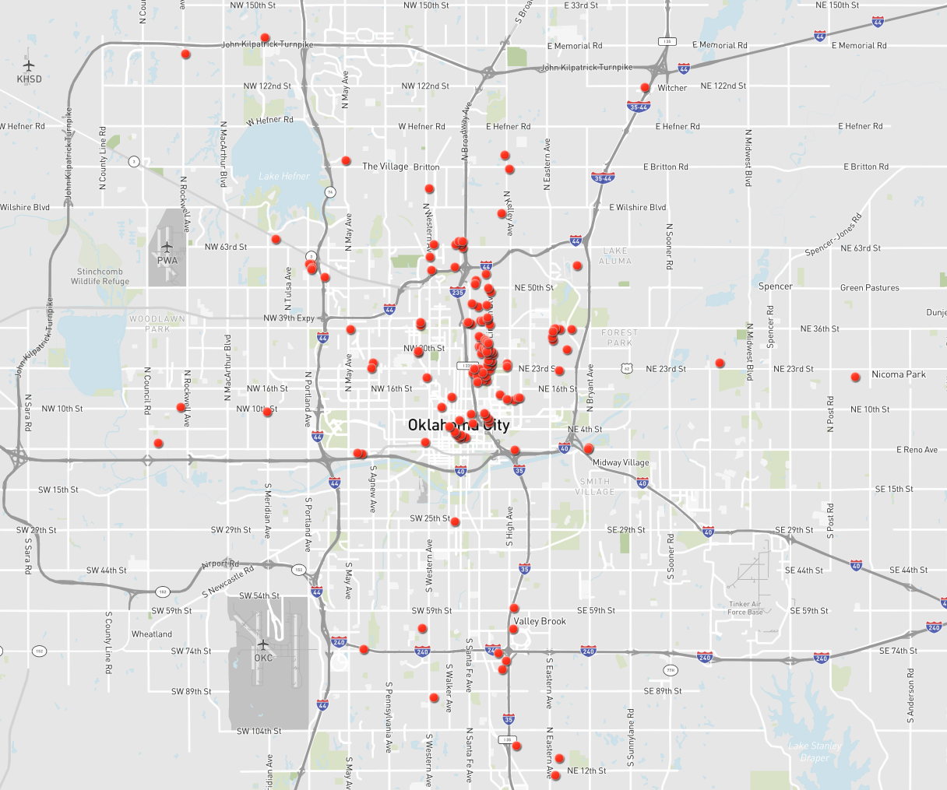
Portfolio Overview
JLL’s Reviewed the State’s Office Space Portfolio in Oklahoma City and Tulsa
73
State Owned Buildings
3.5m
Square Feet of Office Space
1.7m
Square Feet Managed by OMES
$5.07*
Per Square Foot OpEx in State Owned Buildings
64
Leased Buildings
1.1m
Square Feet of Leased Office Space
$16.41
Average Rent
Per Square Foot
16%
Avg. Rate State Pays Below Market Rate
Oklahoma City Properties
*Excludes utilities

Slide 6

Summary of Recommendations
JLL believes that the State can save over a hundred million dollars in real estate expenditures in the years following the adoption of the recommendations described in this report.
These savings are illustrated by JLL’s analysis of the Oklahoma City portfolio which resulted in savings of $76 million and the ability to exit most leased spaces and consolidate into the Capital Complex.
To achieve the savings requires the integrated implementation of several of the recommendations contained in this report. The key recommendations in this report address:
Adoption of comprehensive telework program
Portfolio reduction through telework adoption
Selection and implementation of technology solutions
Adoption of chargeback system for funding deferred maintenance
Consolidation of private sector facilities maintenance contracts
Enforcement of State-wide adherence to real estate policies

Slide 7
Telework Finding and Recommendations
FINDING
The State does not have a comprehensive all-agency telework policy.
Senior management believes remote work has been very effective, with little loss of productivity and for some jobs, productivity has increased.
IMPLICATIONS
The State would greatly benefit by thoughtfully developing a state-wide telework program to ensure the implementation of a comprehensive telework strategy that incorporates best practices and ensures continuity within and between state agencies.
CONSIDERATIONS
Learn from pilots currently underway (DHS/OMES), and other states adopting telework.
Retain outside consultant support as needed.
RECOMMENDATIONS
Establish a multi-agency task force to develop a statewide telework program and supporting policies.
Involve HR, IT, and real estate to develop the program taking an integrated and holistic approach.
Pilot the comprehensive program for proof of concept.
BENEFITS
A comprehensive telework policy will support attraction and retention of employees, significantly reduce real estate costs, improve access to talent in rural areas, improve overall productivity, and reduce stress on infrastructure.

Slide 8
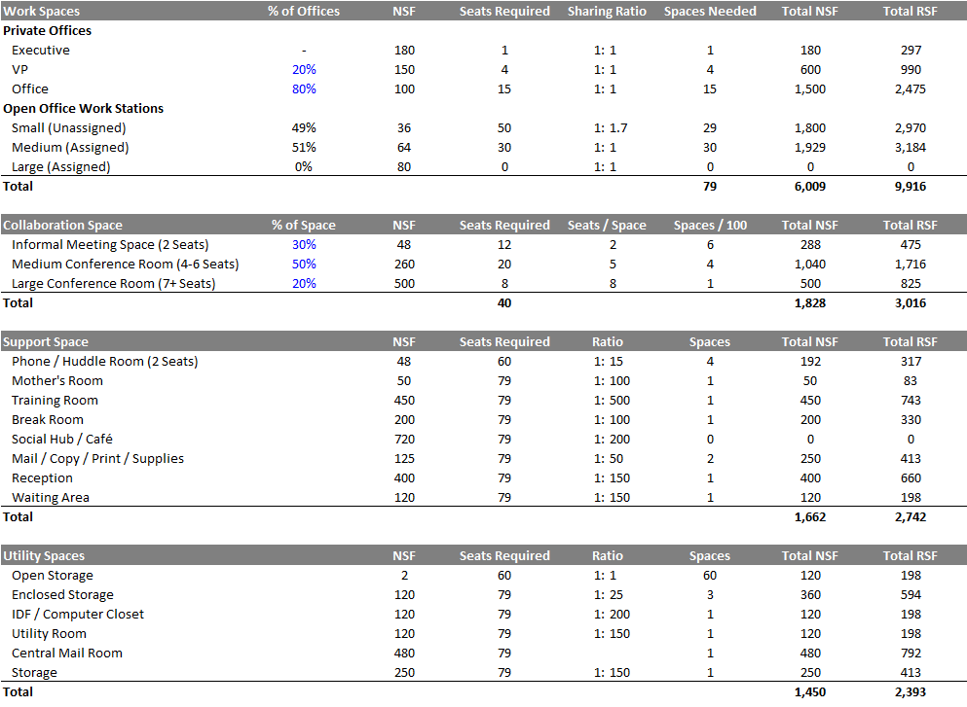
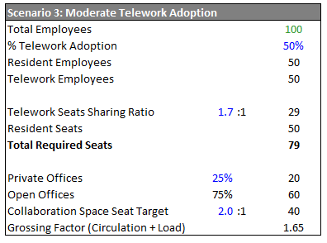


Illustrative Scenario
    To illustrate how the sample program can be utilized, a scenario for a 100-employee agency with 50% telework adoption is shown.
    The sample program forms the basis of the scenario shown in the following section.
Illustrative Scenario at 50% Telework Adoption
Scenario 3
50% Telework
8 workstations for every 10 people
79 Seats
181 RSF / FTE
18,067 RSF

Slide 9
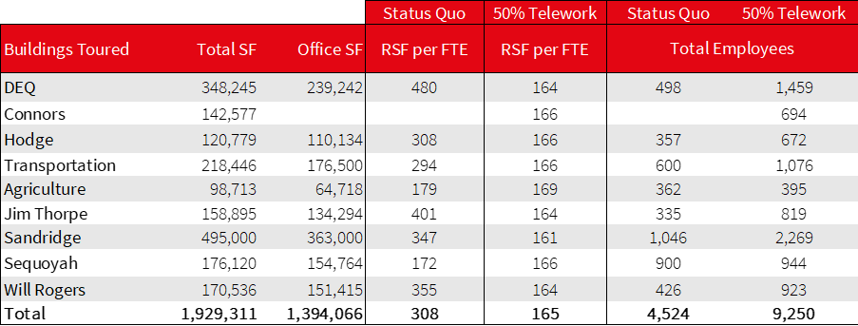
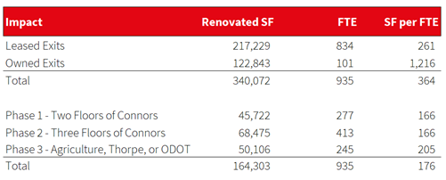
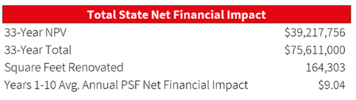
Impact of 50% Telework Adoption Scenario
To illustrate the physical and financial impact of telework, JLL modeled a scenario where the State exits out of leases and adopts 50% telework. Findings include:
31
Total leases exited
217,000
Total SF of exited leases
5
Total owned buildings exited
123,000
SF exited out of owned buildings
308→165
RSF/FTE reduction with 50% telework adoption
$39.2m
33-year NPV
$75.6m
Net financial impact

Slide 10

Technology Finding and Recommendations
    JLL assessed several technology categories and has found that there is a lack of integration and redundancies across programs. Several tools acquired by the State are capable of doing the same tasks but are not necessarily being used in coordination with each other.

Slide 11
Technology Finding and Recommendations
FINDING
The State does not have a cohesive strategy in the selection and deployment of real estate technology tools. This has resulted in agencies selecting and maintaining their own systems and datasets.
IMPLICATIONS
There is no single, state-wide source of record for real estate data. Improving the State's real estate portfolio will be extremely difficult without enabling technology. State employees do not have the technology required to implement a robust telework policy (e.g. space reservation tool).
CONSIDERATIONS
Retain consultant support as needed and ensure there is support for agencies who need assistance with change management.
This could require an executive mandate.
RECOMMENDATIONS
Establish Real Estate Information Technology Leadership Group to evaluate that will recommend technologies to enable a best-in-class real estate operation state-wide.
Select and implement technology solutions for space management, FM, and portfolio data across all State agencies.
BENEFITS
Enabling technology allows the State to understand portfolio-wide real estate data and measure performance improvements.
Space management / reservation technology will enable a robust telework implementation.

Slide 12
Capital Planning Finding and Recommendations
FINDING
There is a consensus between state facility managers and OMES that State assets have significant deferred maintenance which is currently underfunded. Information on this issue is dispersed among State facility professionals.
IMPLICATIONS
Uncured deferred maintenance degrades the quality of the work environment for state employees and reduces the useful life of state-owned assets.
Inconsistent deferred maintenance reduces the ability to understand facilities management costs across the portfolio.
CONSIDERATIONS
Consider beginning with small rent increase of 75 cents/SF and slowly increase amount to $1.50/SF.
Could require support from Governor’s office and will require funding.
RECOMMENDATIONS
As telework policies reduce real estate costs, increase rent charges from OMES to support a deferred maintenance fund.
Conduct a facilities condition assessment of all major state-owned buildings.
Consider an equitable split of proceeds with agencies that dispose of under-utilized State assets.
BENEFITS
Fully funding deferred maintenance reduces further degradation of owned facilities. Phasing additional space costs as agencies decrease space footprint could reduce political pushback.
Centralized information will enable the State to prioritize deferred maintenance needs.

Slide 13
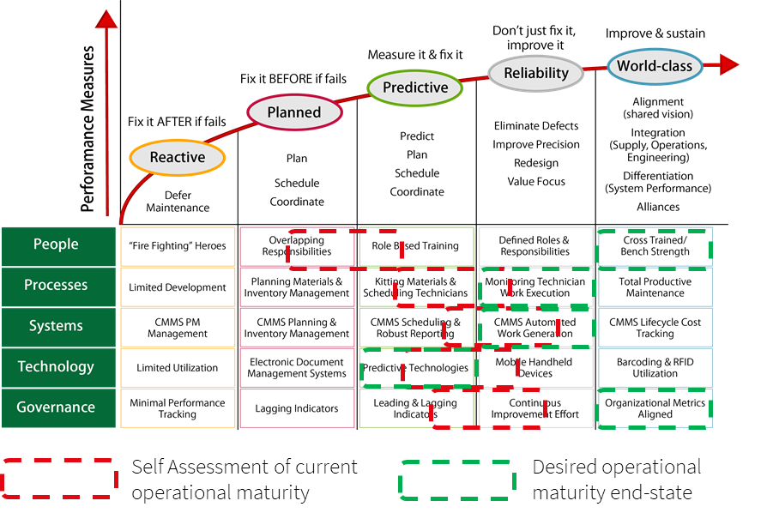
Facilities Management Findings
    The Maintenance Maturity Model addresses an agency’s operational maturity.
    JLL interviewed FM leads with OMES, DHS, and OSBI to discuss the agency’s current state and desired end-state. In this case, OMES self-rated as an organization overall in the “Predictive” category with a strong desire to progress to a “Reliability” position.
    JLL assessed that OMES is closer aligned currently in the “Planned” category. OMES is successfully fixing problems before they fail but could improve processes around predicting and planning repairs.
    A significant reason for this is that OMES and facilities management organizations in other state agencies are operating independently and are not managed uniformly by employing maintenance management best practices.
Facilities Management Health Check (OMES Self Assessment)

Slide 14
Facilities Management Finding and Recommendations
FINDING
Although the State operates within benchmark operating and maintenance costs for State run facilities operations, the State’s cost is at the higher end of the benchmark range partially due to the State’s ad hoc and fragmented vendor contracting. Operation and maintenance costs are higher than would be expected through an outsourcing.
IMPLICATIONS
There is a lack of consolidated information on building operating costs outside of OMES-managed buildings.
Fragmented data results in an inability to track KPIs and assess the efficiency and efficacy of facilities management assignments resulting in a higher State spend on facilities.
CONSIDERATIONS
Will requires support from Governor’s office and political pushback may slow or prevent outsourcing.
RECOMMENDATIONS
Consolidate all private sector facilities contracts into a single IFM contract.
Pilot an outsource facilities management program at an OMES-managed building.
Integrate FM technology into the Real Estate Information Technology Leadership Group to ensure statewide adoption of a CMMS system.
BENEFITS
Consolidation will likely yield cost savings and efficiencies. Outsourcing will provide the State with the ability to track KPIs for facilities management assignments.
A single CMMS system will consolidate FM data enabling leadership to analyze facility performance.

Slide 15
Policy Finding and Recommendations
FINDING
The State, through OMES, has several sound policies governing real estate operations elements. However, the State does not centrally enforce these policies, and agencies do not consistently adhere to them.
IMPLICATIONS
A lack of policy enforcement has created inefficiencies in the portfolio resulting in dispersed decision-making that creates an uneven workplace experience for state workers.
Decentralized decision-making then results in dispersed data preventing the ability to systematically control costs.
CONSIDERATIONS
This will require the Governor to mandate agency adherence to policy and could require business case for deviations from policy.
RECOMMENDATIONS
Enforce current real estate policies and authorities vested in OMES.
BENEFITS
These policies are designed to enable a more consistent and equitable use of space between agencies, and a more efficient overall use of space.
Adherence to these policies will allow the State to better measure and manage State spend on real estate.

Slide 16
Bob Hunt
Managing Director, Public Institutions
Phone: 206-354-1397
Email: bob.hunt@am.jll.com
Brian Carroll
Senior Vice President, Public Institutions
Phone: 312-228-3312
Email: brian.carroll@am.jll.com

